Slide 1
Computer [CPU] Organization

Slide 2
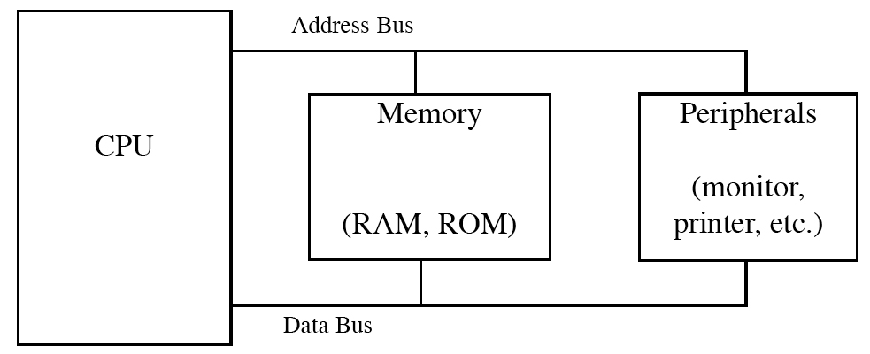
Basic Computer Organization

Slide 3
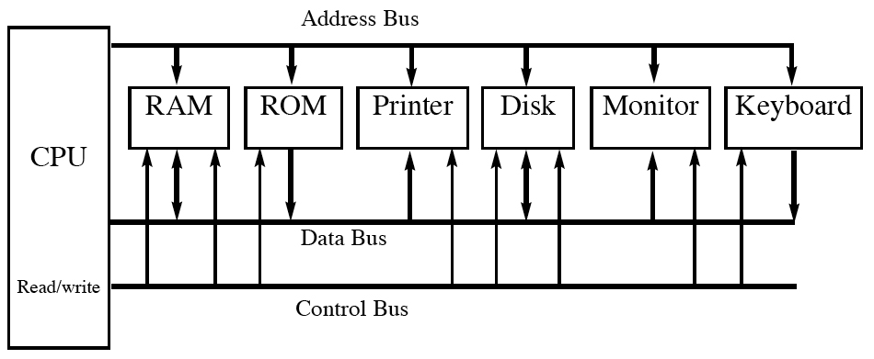
Internal Organization of Computers with Peripherals

Slide 4
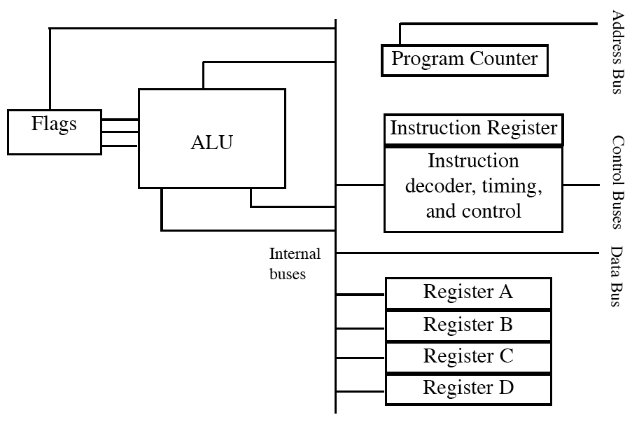
Internal Block Diagram of a CPU

Slide 5
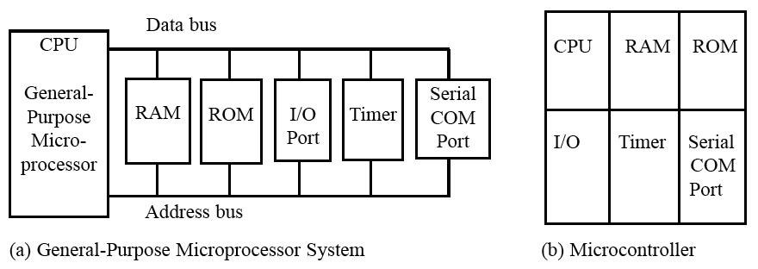
Microprocessor Vs Microcontroller

Slide 6
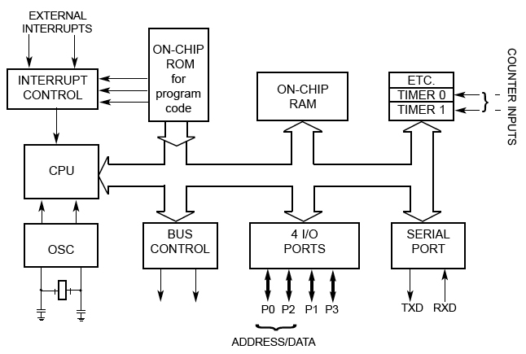
Inside the 8051 Microcontroller Block Diagram

Slide 7
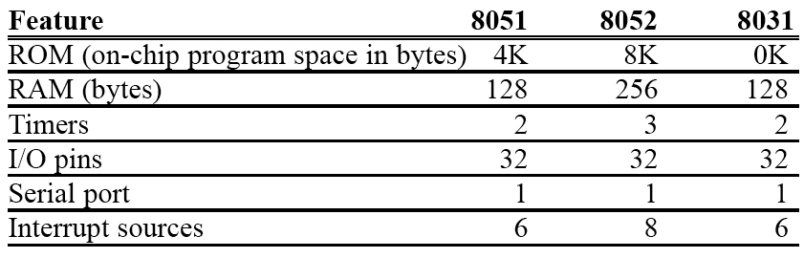
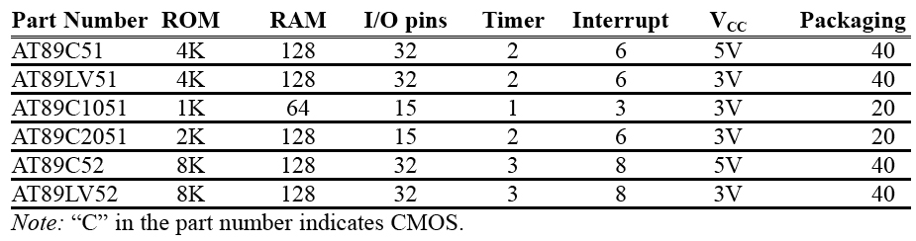
Examples

Slide 8
Memory Organisation

Slide 9
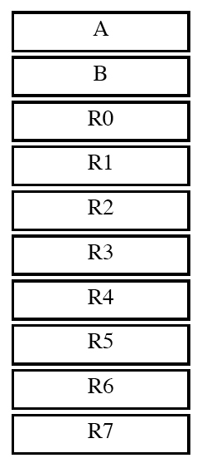
Registers As a Memory

Slide 10
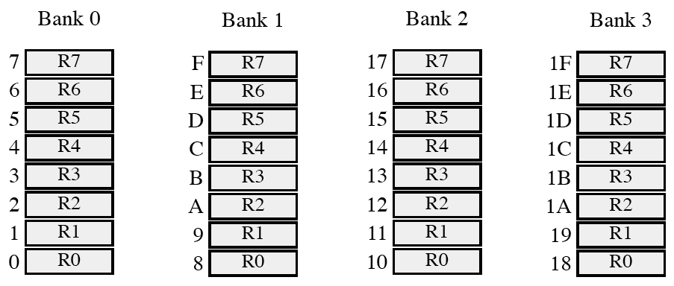
Register Banks and their RAM Addresses

Slide 11
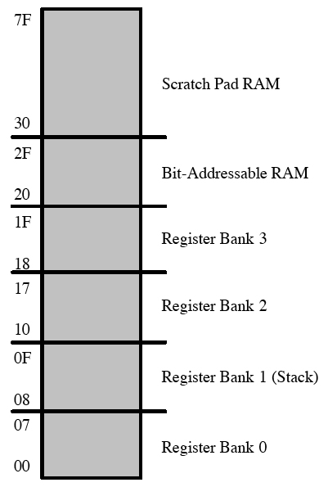
RAM Organization

Slide 12
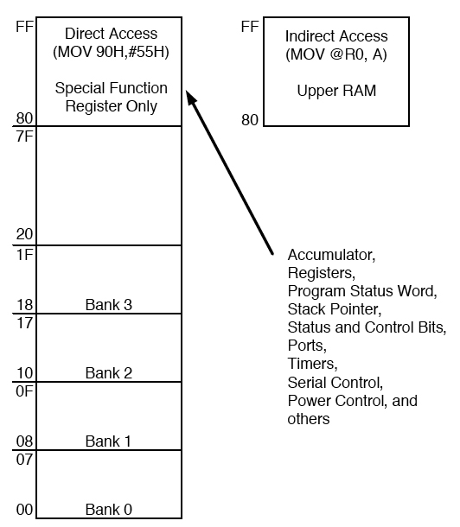
8052 On-Chip RAM Address Space

Slide 13
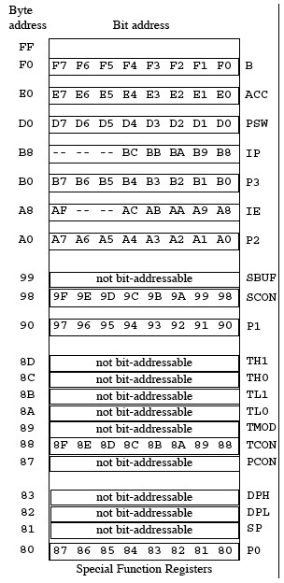
SFR RAM Address (Byte and Bit)

Slide 14
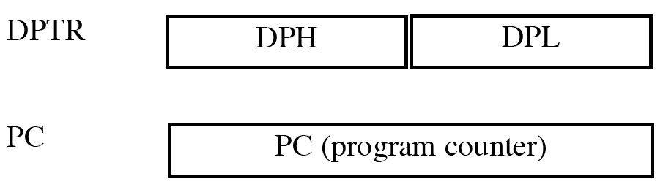
16-bit Registers

Slide 15
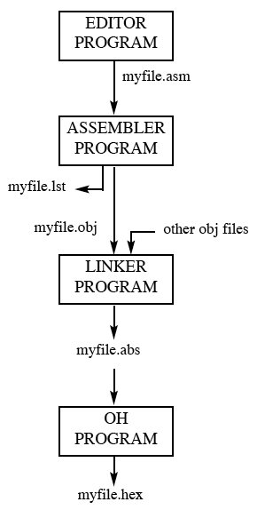
Steps to Create a Program

Slide 16
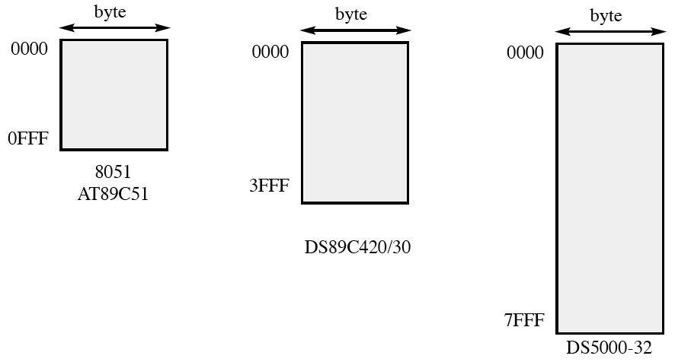
Address Range -ROM

Slide 17
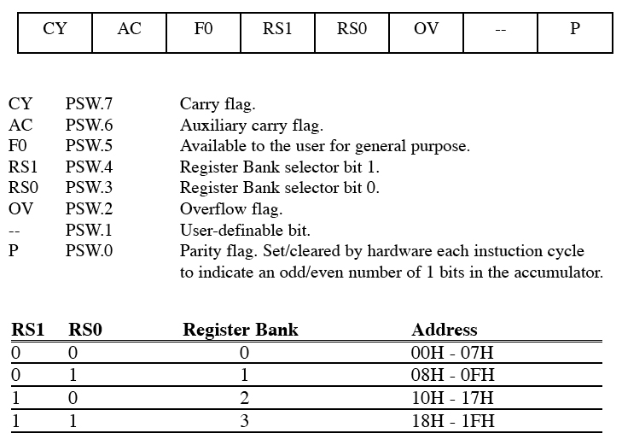
PSW -Program Status Register

Slide 18
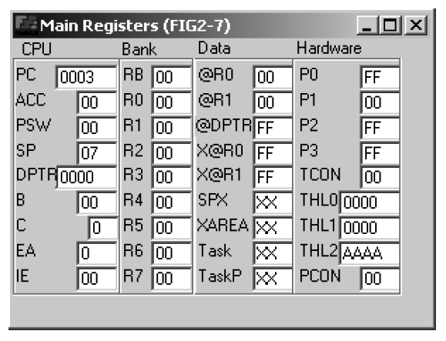
Figure 2–7 Register’s Screen from ProView 32 Simulator

Slide 19
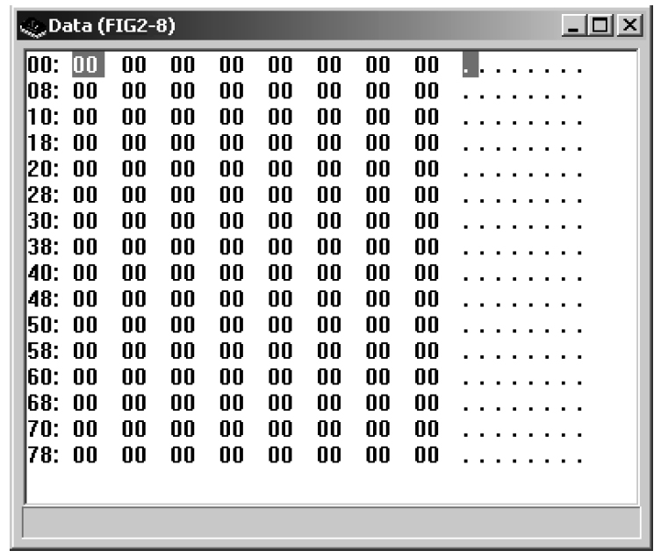
Figure 2–8 128-Byte Memory Space from ProView 32 Simulator

Slide 20
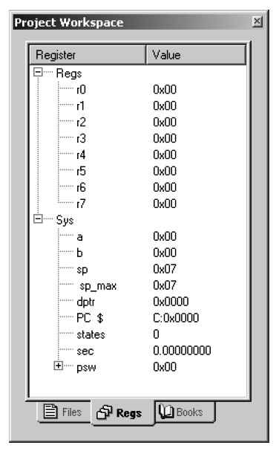
Figure 2–9 Register’s Screen from Keil Simulator

Slide 21
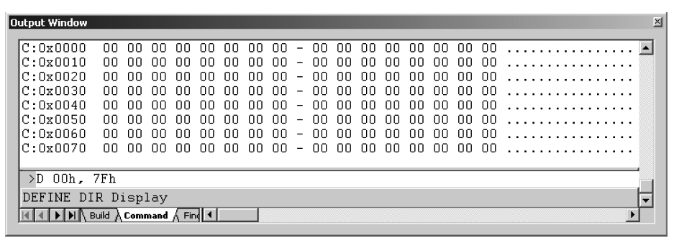
Figure 2–10 128-Byte Memory Space from Keil Simulator

Slide 22
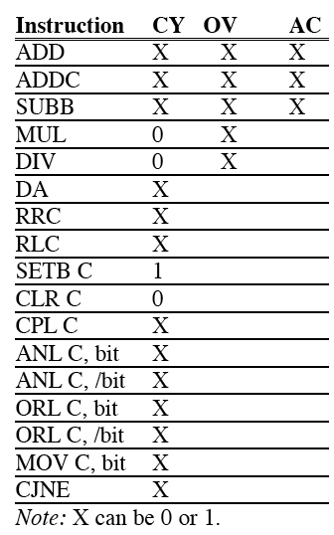
Instructions That Affect Flag Bits

Slide 23
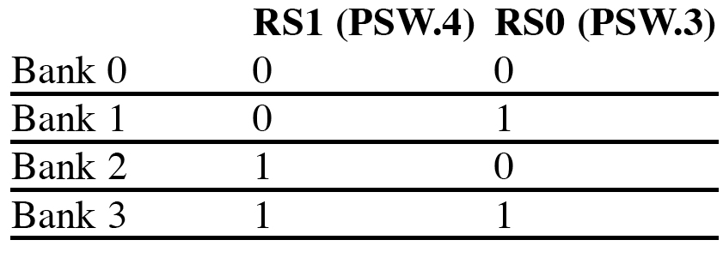
PSW Bits Bank Selection

Slide 24
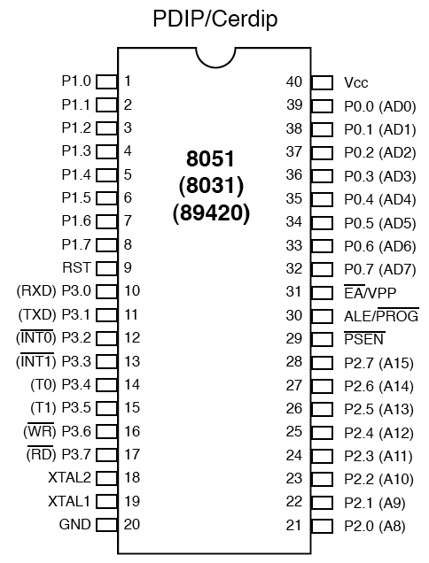
8051 Pin Diagram

Slide 25
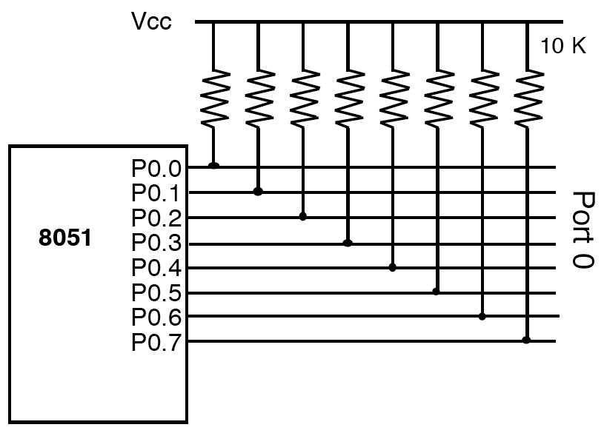
Port 0 with Pull-Up Resistors

Slide 26
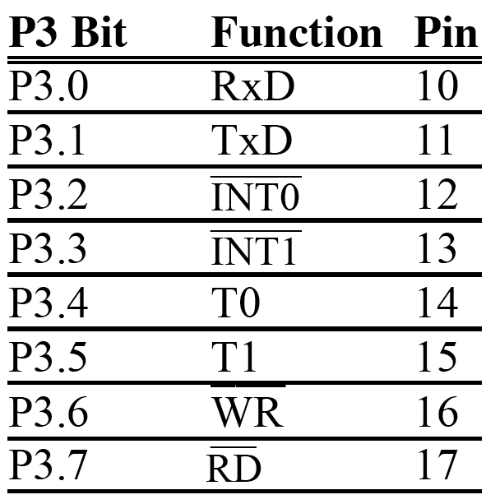
Port 3 Alternate Functions

Slide 27
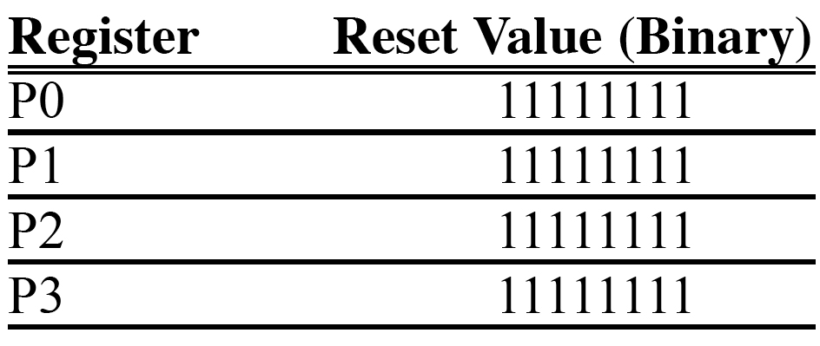
Table 4–2 Reset Value of Some 8051 Ports

Slide 28
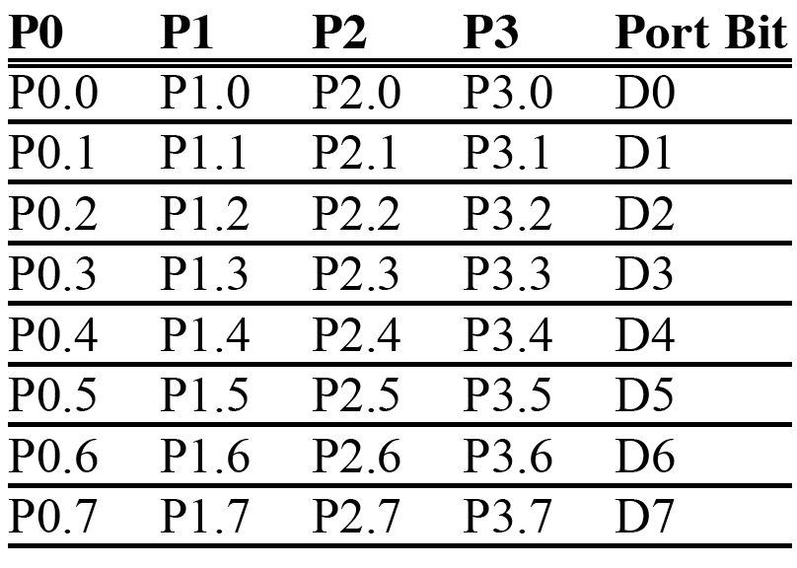
Bit Addressability of Ports

Slide 29
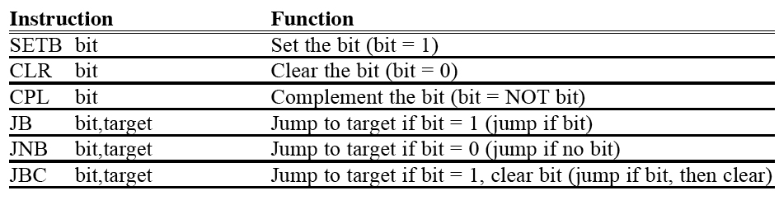
Single-Bit Instructions

Slide 30
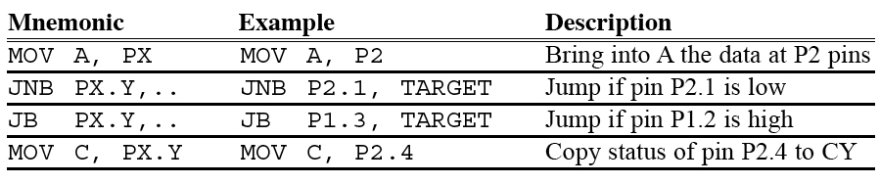
Instructions For Reading an Input Port

Slide 31
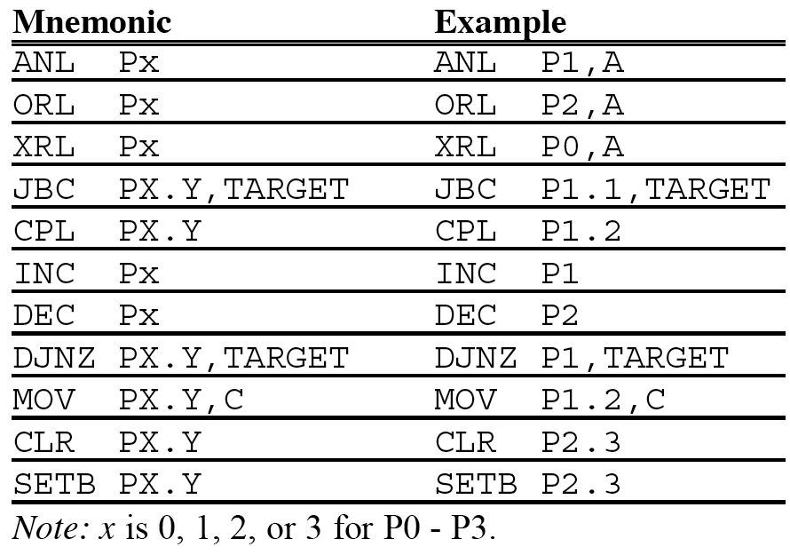
Instructions

