Slide 1
ARM Architecture
  ARM: Advanced RISC Machines

Slide 2
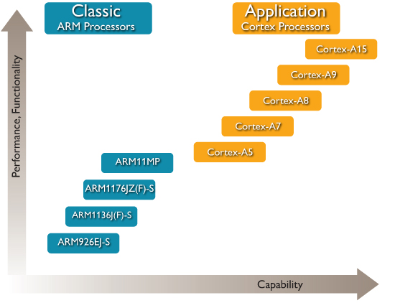
Application Processors

Slide 3
Variants of ARM
Architecture variants
  T: 16-bit Thumb instruction
  D: On-chip Debug support
  M: Hardware long Multiplier
  I: Embedded ICE
  E: DSP extension
  S: Synthesizable core
  J: Jazelle Java accelerator
  ~20: with cache and MMU
  ~40: with cache, protection unit rather than MMU
  ~22: smaller cache than ~20

Slide 4
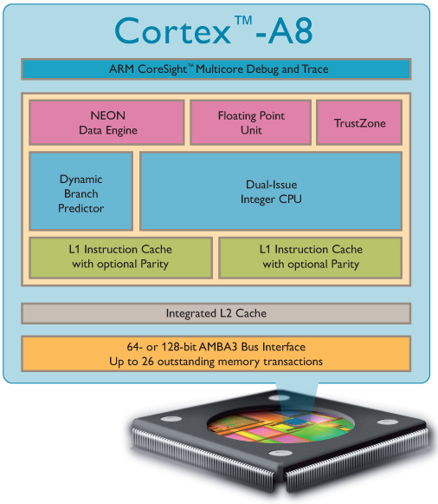
Architecture of ARM Cortex-A8
ARMv7-A Architecture
  Thumb-2
  Thumb-2EE (Jazelle-RCT)
  TrustZone extensions
Custom or synthesized design
MMU
L1 caches
  16 or 32KB each
Unified L2 cache
  0-2MB in size
  8-way set-associative
Optional features
  VFPv3 Vector Floating-Point
  NEON media processing engine
Dual-issue, super-scalar 13-stage pipeline
  Branch Prediction & Return Stack
  NEON and VFP implemented at end of pipeline

Slide 5
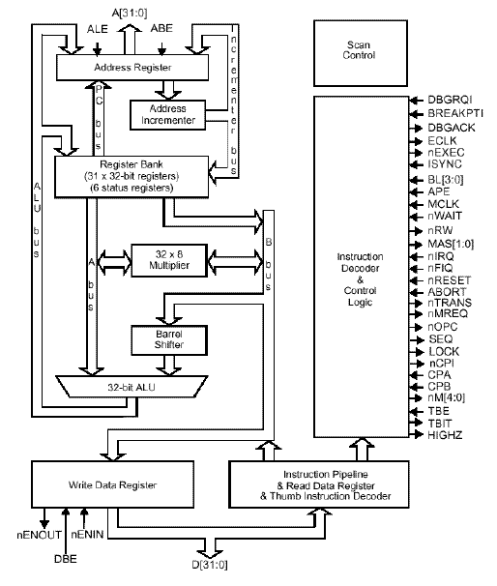
Architecture of ARM7TDMI

Slide 6
Data Sizes and Instruction Sets
The ARM is a 32-bit architecture.
When used in relation to the ARM:
  Byte means 8 bits
  Halfword means 16 bits (two bytes)
  Word means 32 bits (four bytes)
Most ARM’s implement two instruction sets
  32-bit ARM Instruction Set
  16-bit Thumb Instruction Set
Jazelle cores can also execute Java bytecode
Notes:
The cause of confusion here is the term “word” which will mean 16-bits to people with a 16-bit background.
In the ARM world 16-bits is a “halfword” as the architecture is a 32-bit one, whereas “word” means 32-bits.
There are actually three instruction sets in modern ARM cores (such as the version 7 cores – A8, M3, and R4, and even the M1): you have Thumb, Thumb2 and ARM. One core in particular, the M3, executes only Thumb2 code, not ARM. All the instructions are 16 bits.
Java bytecodes are 8-bit instructions designed to be architecture independent. Jazelle transparently executes most bytecodes in hardware and some in highly optimized ARM code. This is due to a tradeoff between hardware complexity (power consumption & silicon area) and speed.

Slide 7
Processor Modes
The ARM has seven basic operating modes:
  User : unprivileged mode under which most tasks run
  FIQ : entered when a high priority (fast) interrupt is raised
  IRQ : entered when a low priority (normal) interrupt is raised
  Supervisor : entered on reset and when a Software Interrupt
  instruction is executed
  Abort : used to handle memory access violations
  Undef : used to handle undefined instructions
  System : privileged mode using the same registers as user mode

Slide 8
Program Status Registers
31
28
27
24
23
16
15
8
7
6
5
4
0
N Z C V Q
U n d e f i n e d
I F T mode
J
f
s
x
c
Condition code flags
  N = Negative result from ALU
  Z = Zero result from ALU
  C = ALU operation Carried out
  V = ALU operation oVerflowed
Sticky Overflow flag - Q flag
  Architecture 5TE/J only
  Indicates if saturation has occurred
J bit
  Architecture 5TEJ only
  J = 1: Processor in Jazelle state
Interrupt Disable bits.
  I = 1: Disables the IRQ.
  F = 1: Disables the FIQ.
T Bit
  Architecture xT only
  T = 0: Processor in ARM state
  T = 1: Processor in Thumb state
Mode bits
  Specify the processor mode
Notes:
Green psr bits are only in certain versions of the ARM architecture
ALU status flags (set if "S" bit set, implied in Thumb state).
Sticky overflow flag (Q flag) is set either when
saturation occurs during QADD, QDADD, QSUB or QDSUB, or
the result of SMLAxy or SMLAWx overflows 32-bits
Once flag has been set can not be modified by one of the above instructions and must write to CPSR using MSR instruction to cleared
PSRs split into four 8-bit fields that can be individually written:
Control (c) bits 0-7
Extension (x) bits 8-15 Reserved for future use
Status (s) bits 16-23 Reserved for future use
Flags (f) bits 24-31
Bits that are reserved for future use should not be modified by current software. Typically, a read-modify-write strategy should be used to update the value of a status register to ensure future compatibility. Note that the T/J bits in the CPSR should never be changed directly by writing to the PSR (use the BX/BXJ instruction to change state instead).
However, in cases where the processor state is known in advance (e.g. on reset, following an interrupt, or some other exception), an immediate value may be written directly into the status registers, to change only specific bits (e.g. to change mode).
New ARM V6 bits now shown.

Slide 9
Switching of Modes
Mode | reg. | CPSR[4:0] | Use
User | usr | 10000 | Normal program execution mode with restricted system resources
FIQ | fiq | 10001 | Processing fast interrupts
IRQ | irq | 10010 | Processing general-purpose interrupts
Supervisor | svc | 10011 | Processing software interrupts
Abort | abt | 10111 | Processing memory faults
Undefined | und | 11011 | Handling undefined instruction traps
System | sys =usr | 11111 | Running privileged OS tasks (ARM architecture v4 and above)

Slide 10
ARM Register Set
Current Visible Registers
Current Visible Registers
Current Visible Registers
Current Visible Registers
Current Visible Registers
Current Visible Registers
r0
r0
r0
r0
r0
r0
Abort Mode
r0
SVC Mode
Undef Mode
FIQ Mode
User Mode
IRQ Mode
r1
r1
r1
r1
r1
r1
r1
r2
r2
r2
r2
r2
r2
r2
Banked out Registers
Banked out Registers
Banked out Registers
Banked out Registers
Banked out Registers
r3
Banked out Registers
r3
r3
r3
r3
r3
r3
r4
r4
r4
r4
r4
r4
r4
r5
r5
r5
r5
r5
r5
r5
User
User
User
User
User
FIQ
FIQ
FIQ
FIQ
FIQ
FIQ
IRQ
IRQ
IRQ
IRQ
IRQ
IRQ
SVC
SVC
SVC
SVC
SVC
SVC
Undef
Undef
Undef
Undef
Undef
Undef
Abort
Abort
Abort
Abort
Abort
r6
Abort
r6
r6
r6
r6
r6
r6
r7
r7
r7
r7
r7
r7
r7
r8
r8
r8
r8
r8
r8
r8
r8
r8
r8
r8
r8
r8
r8
r9
r9
r9
r9
r9
r9
r9
r9
r9
r9
r9
r9
r9
r9
r10
r10
r10
r10
r10
r10
r10
r10
r10
r10
r10
r10
r10
r10
r11
r11
r11
r11
r11
r11
r11
r11
r11
r11
r11
r11
r11
r11
r12
r12
r12
r12
r12
r12
r12
r12
r12
r12
r12
r12
r12
r12
r13 (sp)
r13 (sp)
r13 (sp)
r13 (sp)
r13 (sp)
r13 (sp)
r13 (sp)
r13 (sp)
r13 (sp)
r13 (sp)
r13 (sp)
r13 (sp)
r13 (sp)
r13 (sp)
r13 (sp)
r13 (sp)
r13 (sp)
r13 (sp)
r13 (sp)
r13 (sp)
r13 (sp)
r13 (sp)
r13 (sp)
r13 (sp)
r13 (sp)
r13 (sp)
r13 (sp)
r13 (sp)
r13 (sp)
r13 (sp)
r13 (sp)
r13 (sp)
r13 (sp)
r13 (sp)
r13 (sp)
r13 (sp)
r13 (sp)
r13 (sp)
r13 (sp)
r13 (sp)
r13 (sp)
r13 (sp)
r14 (lr)
r14 (lr)
r14 (lr)
r14 (lr)
r14 (lr)
r14 (lr)
r14 (lr)
r14 (lr)
r14 (lr)
r14 (lr)
r14 (lr)
r14 (lr)
r14 (lr)
r14 (lr)
r14 (lr)
r14 (lr)
r14 (lr)
r14 (lr)
r14 (lr)
r14 (lr)
r14 (lr)
r14 (lr)
r14 (lr)
r14 (lr)
r14 (lr)
r14 (lr)
r14 (lr)
r14 (lr)
r14 (lr)
r14 (lr)
r14 (lr)
r14 (lr)
r14 (lr)
r14 (lr)
r14 (lr)
r14 (lr)
r14 (lr)
r14 (lr)
r14 (lr)
r14 (lr)
r14 (lr)
r14 (lr)
r15 (pc)
r15 (pc)
r15 (pc)
r15 (pc)
r15 (pc)
r15 (pc)
r15 (pc)
cpsr
cpsr
cpsr
cpsr
cpsr
cpsr
cpsr
spsr
spsr
spsr
spsr
spsr
spsr
spsr
spsr
spsr
spsr
spsr
spsr
spsr
spsr
spsr
spsr
spsr
spsr
spsr
spsr
spsr
spsr
spsr
spsr
spsr
spsr
spsr
spsr
spsr
spsr
spsr
spsr
spsr
spsr
spsr
Notes:
This animated slide shows the way that the banking of registers works. On the left the currently visible set of registers are shown for a particular mode.
On the right are the registers that are banked out whilst in that mode.
Each key press will switch mode:
user -> FIQ ->user -> IRQ -> user ->SVC -> User -> Undef -> User -> Abort and then back to user.
The following slide then shows this in a more static way that is more useful for reference

Slide 11
Visibility of Registers
Visible registers
  31 general-purpose registers, 6 program status registers
  At any time, 16 general-purpose registers and one or two status registers are visible according to processor mode
General-purpose registers (GPR)
  Unbanked registers, R0-R7, R15
    The same physical registers in all processor modes
  Banked registers, R8-R14
    The physical register referred to by each of them depends on the current processor mode
  Special function of R13-15
    Stack pointer (R13)
    Link register (R14): save the return address
    Program counter (R15): point to address of instruction to be fetched

Slide 12
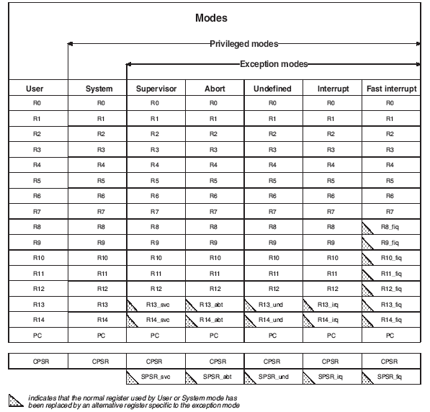
Registers Vs Modes

Slide 13
Program Counter (r15)
When the processor is executing in ARM state:
  All instructions are 32 bits wide
  All instructions must be word aligned
  Therefore the pc value is stored in bits [31:2] with bits [1:0] undefined (as instruction cannot be halfword or byte aligned)
When the processor is executing in Thumb state:
  All instructions are 16 bits wide
  All instructions must be halfword aligned
  Therefore the pc value is stored in bits [31:1] with bit [0] undefined (as instruction cannot be byte aligned)
When the processor is executing in Jazelle state:
  All instructions are 8 bits wide
  Processor performs a word access to read 4 instructions at once

Slide 14
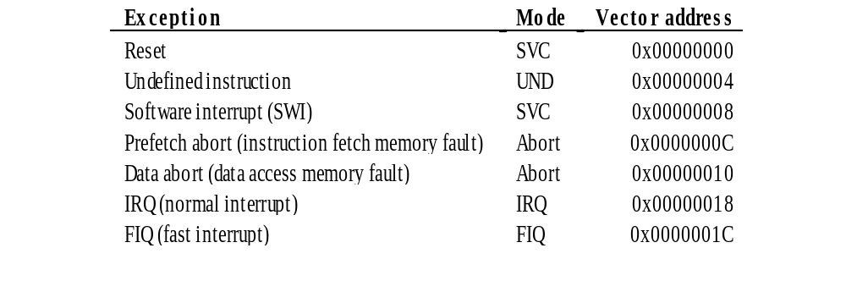
Vector Table

Slide 15
Data processing instructions
31
28
27
26
25
24
21
20
19
16
15
12
1
1
0
cond
0 0
#
opcode
S
Rn
Rd
operand 2
destination register
first operand register
set condition codes
arithmetic/logic function
25
1
1
8
7
0
1
#rot
8-bit immediate
immediate alignment
1
1
7
6
5
4
3
0
#shift
Sh
0
Rm
25
immediate shift length
0
shift type
second operand register
1
1
8
7
6
5
4
3
0
Rs
0
Sh
1
Rm
register shift length

Slide 16

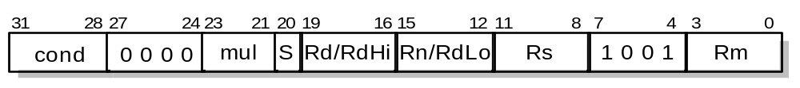
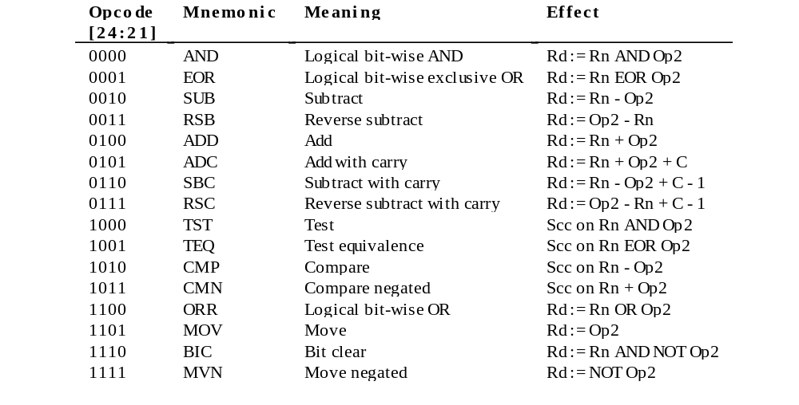
Data Processing

Slide 17
Conditional Execution and Flags
ARM instructions can be made to execute conditionally by postfixing them with the appropriate condition code field.
  This improves code density and performance by reducing the number of forward branch instructions.
  CMP r3,#0 CMP r3,#0
  BEQ skip1 ADDNE r0,r1,r2
  ADD r0,r1,r2
  skip1
By default, data processing instructions do not affect the condition code flags but the flags can be optionally set by using “S”. CMP does not need “S”.
  loop
  …
  SUBS r1,r1,#1
  BNE loop
decrement r1 and set flags
if Z flag clear then branch
Notes:
Unusual but powerful feature of the ARM instruction set. Other architectures normally only have conditional branches.
Some recently-added ARM instructions (in v5T and v5TE) are not conditional (e.g. v5T BLX offset)
Core compares condition field in instruction against NZCV flags to determine if instruction should be executed.

Slide 18
Condition Codes
The possible condition codes are listed below
  Note AL-Always Execute is the default and does not need to be specified
Suffix
Description
Flags tested
EQ
Equal
Z=1
NE
Not equal
Z=0
CS/HS
Unsigned higher or same
C=1
CC/LO
Unsigned lower
C=0
MI
Minus
N=1
PL
Positive or Zero
N=0
VS
Overflow
V=1
VC
No overflow
V=0
HI
Unsigned higher
C=1 & Z=0
LS
Unsigned lower or same
C=0 or Z=1
GE
Greater or equal
N=V
LT
Less than
N!=V
GT
Greater than
Z=0 & N=V
LE
Less than or equal
Z=1 or N=!V
AL
Always
Notes:
Condition codes are simply a way of testing the ALU status flags.
This slide is for reference only.

Slide 19
Conditional execution examples
C source code
ARM instructions
unconditional
conditional
if (r0 == 0)
{
r1 = r1 + 1;
}
else
{
r2 = r2 + 1;
}
CMP r0, #0
BNE else
ADD r1, r1, #1
B end
else
ADD r2, r2, #1
end
...
CMP r0, #0
ADDEQ r1, r1, #1
ADDNE r2, r2, #1
...
5 instructions
5 words
5 or 6 cycles
3 instructions
3 words
3 cycles

Slide 20
Data Processing Instructions
Consist of :
  Arithmetic: ADD ADC SUB SBC RSB RSC
  Logical: AND ORR EOR BIC
  Comparisons: CMP CMN TST TEQ
  Data movement: MOV MVN
These instructions only work on registers, NOT memory.
Syntax:
  <Operation>{<cond>}{S} Rd, Rn, Operand2
    Comparisons set flags only - they do not specify Rd
    Data movement does not specify Rn
Second operand is sent to the ALU via barrel shifter.
Notes:
BIC bit clear
ORR bit set
AND bit mask
EOR bit invert
Comparisons produce no results - just set condition codes.
CMP like SUB
CMN like ADD (subtract of a negative number is the same as add)
TST like AND
TEQ like EOR (eor of identical numbers gives result of zero)
Generally single-cycle execution (except write to PC and register-controlled shift). Mention ARM NOP & Thumb NOP.
Explain RSB and RSC which do subtract in other order (e.g. y-x not x-y)
Does not include multiply (separate instr format). No divide - compiler uses run-time library or barrel shifter to perform division.
Can combine “S” bit with conditional execution, e.g.
ADDEQS r0, r1, r2

Slide 21
Data Processing Exercise
1. How would you load the two’s complement representation of -1 into Register 3 using one instruction?
2. Implement an ABS (absolute value) function for a registered value using only two instructions.
3. Multiply a number by 35, guaranteeing that it executes in 2 core clock cycles.

Slide 22
Data Processing
1. MOVN r6, #0
2. MOVS r7,r7 ; set the flags
RSBMI r7,r7,#0 ; if neg, r7=0-r7
3. ADD r9,r8,r8,LSL #2 ; r9=r8*5
RSB r10,r9,r9,LSL #3 ; r10=r9*7

Slide 23
Immediate constants
No ARM instruction can contain a 32 bit immediate constant
  All ARM instructions are fixed as 32 bits long
The data processing instruction format has 12 bits available for operand2
4 bit rotate value (0-15) is multiplied by two to give range 0-30 in steps of 2
Rule to remember is
“8-bits rotated right by an even number of bit positions”
11
8
7
0
rot
immed_8
Quick Quiz: 0xe3a004ff
MOV r0, #???
x2
Shifter
ROR

Slide 24
Loading 32 bit constants
To allow larger constants to be loaded, the assembler offers a pseudo-instruction:
  LDR rd, =const
This will either:
  Produce a MOV or MVN instruction to generate the value (if possible).
or
  Generate a LDR instruction with a PC-relative address to read the constant from a literal pool (Constant data area embedded in the code).
For example
  LDR r0,=0xFF => MOV r0,#0xFF
  LDR r0,=0x55555555 => LDR r0,[PC,#Imm12]
  …
  …
  DCD 0x55555555
This is the recommended way of loading constants into a register
Notes:
26
Literal pools
These are constant data areas embedded in the code at the end of assembler modules, and at other locations if specified by the user using LTORG. Data value must not be executed (will probably be an undefined instruction), assembly programmer must ensure this by placing LTORG at an appropriate location. ARM C compilers will handle placement of literal pools automatically.

Slide 25
Single register data transfer
  LDR STR Word
  LDRB STRB Byte
  LDRH STRH Halfword
  LDRSB Signed byte load
  LDRSH Signed halfword load
Memory system must support all access sizes
Syntax:
  LDR{<cond>}{<size>} Rd, <address>
  STR{<cond>}{<size>} Rd, <address>
  e.g. LDREQB
Notes:
Instruction cycle timing:
STR LDR
7TDMI 2 cycles 3 cycles
9TDMI 1 cycle 1 cycle - interlock if used in next cycle
StrongARM1 1 cycle 1 cycle - interlock if used in next cycle
Xscale 1 cycle 1 cycle - interlock if used in next 2 cycles
Note size specifier comes after condition code.
Link: <address> explained on next slide.
Note that load/store instructions never set condition codes.

Slide 26
Address accessed
Address accessed by LDR/STR is specified by a base register with an offset
For word and unsigned byte accesses, offset can be:
  An unsigned 12-bit immediate value (i.e. 0 - 4095 bytes)
  LDR r0, [r1, #8]
  A register, optionally shifted by an immediate value
  LDR r0, [r1, r2]
  LDR r0, [r1, r2, LSL#2]
This can be either added or subtracted from the base register:
LDR r0, [r1, #-8]
LDR r0, [r1, -r2, LSL#2]
For halfword and signed halfword / byte, offset can be:
  An unsigned 8 bit immediate value (i.e. 0 - 255 bytes)
  A register (unshifted)
Choice of pre-indexed or post-indexed addressing
Choice of whether to update the base pointer (pre-indexed only)
  LDR r0, [r1, #-8]!
Notes:
Halfword access and signed halfword/byte accesses were added to the architecture in v4T, this is the reason the offset field is not as flexible as the normal word/byte load/store - not a problem because these accesses are less common.
Link: diagram on next slide
No “!” for post-indexed because post-increment of base register always happens (otherwise the offset field would not be used at all).

Slide 27
Load/Store Exercise
Assume an array of 25 words. A compiler associates y with r1. Assume that the base address for the array is located in r2. Translate this C statement/assignment using just three instructions:
array[10] = array[5] + y;

Slide 28
Load/Store Exercise Solution
array[10] = array[5] + y;
LDR r3, [r2, #5] ; r3 = array[5]
ADD r3, r3, r1 ; r3 = array[5] + y
STR r3, [r2, #10] ; array[5] + y = array[10]

Slide 29
Load and Store Multiples
Syntax:
  <LDM|STM>{<cond>}<addressing_mode> Rb{!}, <register list>
4 addressing modes:
  LDMIA / STMIA increment after
  LDMIB / STMIB increment before
  LDMDA / STMDA decrement after
  LDMDB / STMDB decrement before
IA
IB
DA
DB
LDMxx r10, {r0,r1,r4}
STMxx r10, {r0,r1,r4}
r4
r4
r1
r1
r0
Increasing
Address
Base Register (Rb)
r10
r0
r4
r1
r4
r0
r1
r0
Notes:
Several aliases for stack usage are allowed for instance:
LDMFD -> LDMIA
STDFD -> STMDB

Slide 30
Multiply and Divide
There are 2 classes of multiply - producing 32-bit and 64-bit results
32-bit versions on an ARM7TDMI will execute in 2 - 5 cycles
  MUL r0, r1, r2 ; r0 = r1 * r2
  MLA r0, r1, r2, r3 ; r0 = (r1 * r2) + r3
64-bit multiply instructions offer both signed and unsigned versions
  For these instruction there are 2 destination registers
  [U|S]MULL r4, r5, r2, r3 ; r5:r4 = r2 * r3
  [U|S]MLAL r4, r5, r2, r3 ; r5:r4 = (r2 * r3) + r5:r4
Most ARM cores do not offer integer divide instructions
  Division operations will be performed by C library routines or inline shifts
Notes:
We have two basic types of multiply instructions; those that produce a 32 bit result based on the bottom 32 bits of a 64-bit result, and those that produce the full 64 bit result. Now, for each of those, we can do accumulation or not. We do have signed and unsigned versions of the MUL long instructions. And if we are only using the bottom 32 bits of a 64 bit result for the standard MULS, then there is no reason to have signed versions.
ARM7TDMI and ARM9TDMI use 8-bit Booth’s algorithm, which takes 1 cycle for each byte in Rs and terminates when rest of Rs is all zeros or all ones. Most of the cores have early termination based on contents of operand 2. Therefore smaller value if known should be placed in operand 2 if possible. And as you can see from the examples, there is not support for the use of immediates.
Cycle information is general and specific cores. You should refer to a core’s particular TRM for timing information.
The Cortex-M3 does have hardware divide.

Slide 31
Branch instructions
Branch : B{<cond>} label
Branch with Link : BL{<cond>} subroutine_label
The processor core shifts the offset field left by 2 positions, sign-extends it and adds it to the PC
  ± 32 Mbyte range
  How to perform longer branches?
31
28
27
25
24
23
0
Cond 1 0 1 L Offset
Link bit 0 = Branch
1 = Branch with link
Condition field
Notes:
PC-relative to allow position independent code, and allows restricted branch range to jump to nearby addresses.
How to access full 32-bit address space? Can set up LR manually if needed, then load into PC
MOV lr, pc
LDR pc, =dest
ADS linker will automatically generate long branch veneers for branches beyond 32Mb range.

Slide 32
Register Usage
Register
The compiler has a set of rules known as a Procedure Call Standard that determine how to pass parameters to a function (see AAPCS)
CPSR flags may be corrupted by function call.
Assembler code which links with compiled code must follow the AAPCS at external interfaces
The AAPCS is part of the new ABI for the ARM Architecture
Arguments into function
Result(s) from function
otherwise corruptible
(Additional parameters
passed on stack)
r0
r1
r2
r3
r4
r5
r6
Register variables
Must be preserved
r7
r8
r9/sb
- Stack base
r10/sl
- Stack limit if software stack checking selected
r11
Scratch register
(corruptible)
r12
Stack Pointer
Link Register
Program Counter
r13/sp
- SP should always be 8-byte (2 word) aligned
r14/lr
- R14 can be used as a temporary once value stacked
r15/pc
Notes:
The compiler has a set of rules that determines a standard for passing parameters between functions. This is know as the ARM Architecture Procedure Call Standard. The AAPCS defines how functions behave from the processors point of view, defining things such as which registers can be corrupted by a function call (r0-r3, and r12), and which registers are non-corruptible over function calls (in other words, registers that must be preserved over function calls). Those would be registers r4 – r11.
If we are using software stack checking, the compiler would use r9 as a stack base and r10 as a stack limit. Stacks grow unchecked by default. With SWSC, either the C library checks that the stack does not override the heap, or the stack is checked against the stack limit. This just depends on the image memory model. And of course as we’ve seen, r13, 14, and 15 are used as the sp, lr, an pc, respectively.
The Application Binary Interface (ABI) for the ARM® Architecture is a collection of all of the standards used in the ARM architecture, some open and some specific to the ARM, anything from the executable image file standards produced by development tools to exception handling standards, to the AMBA spec. You can view the full ARM ABI on our webpages.

Slide 33
ARM Branches and Subroutines
B <label>
  PC relative. ±32 Mbyte range.
BL <subroutine>
  Stores return address in LR
  Returning implemented by restoring the PC from LR
  For non-leaf functions, LR will have to be stacked
func1
func2
:
:
BL func1
:
:
STMFD sp!,{regs,lr}
:
BL func2
:
LDMFD sp!,{regs,pc}
:
:
:
:
:
MOV pc, lr
Notes:
This slide shows the way that ARM branch instructions work
It also shows the need to stack the LR (using STM/LDM instructions) when making subroutine calls within subroutines.

Slide 34
PSR access
MRS and MSR allow contents of CPSR / SPSR to be transferred to / from a general purpose register or take an immediate value
  MSR allows the whole status register, or just parts of it to be updated
Interrupts can be enable/disabled and modes changed, by writing to the CPSR
  Typically a read/modify/write strategy should be used:
  MRS r0,CPSR ; read CPSR into r0
  BIC r0,r0,#0x80 ; clear bit 7 to enable IRQ
  MSR CPSR_c,r0 ; write modified value to ‘c’ byte only
In User Mode, all bits can be read but only the condition flags (_f) can be modified
31
28
27
24
23
19
16
15
10
9
8
7
6
5
4
0
de
GE[3:0]
IT cond_abc
E A
N Z C V Q
I F T mode
J
f
s
x
c
Notes:
GE: SIMD status bits
E: Controls LD/ST Endianess
A: disable special type of data abort
IT: controls special conditional execution of THUMB2
For MSR operations, we recommend that only the minimum number of fields are written, because future ARM implementations may need to take extra cycles to write specific fields that have recently been allocated and may cause unwanted results; not writing fields you don't want to change reduces any such extra cycles or unwanted results to a minimum.

Slide 35
Pipeline changes for ARM9TDMI
ARM7TDMI
Instruction
Fetch
ARM decode
Reg
Read
Reg
Write
Thumb→ARM
decompress
Shift
ALU
Reg Select
FETCH
DECODE
EXECUTE
ARM9TDMI
ARM or Thumb
Inst Decode
Instruction
Fetch
Shift + ALU
Memory
Access
Reg
Write
Reg
Decode
Reg
Read
FETCH
DECODE
EXECUTE
MEMORY
WRITE
Notes:
Pipeline Comparison
The point of this foil is to show that with the ARM7TDMI a lot of work was carried out in the execute stage of the pipeline. Now with ARM9TDMI the execute stage has been split out into three stages to allow greater throughput.
This then means the CPI is about 1.5 compared against 1.9 for ARM7TDMI, and the operating frequency is approximately double for ARM9TDMI over ARM7TDMI on the same fabrication process. Therefore, at least double the processing power is available.
It is possible for the pipeline to interlock. Forwarding paths have been provided to minimise this as much as possible, but they can still occur. By using a bit of consideration when writing code they can almost be eliminated.

Slide 36
ARM10 vs. ARM11 Pipelines
ARM10
Branch
Prediction
ARM or
Thumb
Instruction
Decode
Reg Read
Shift + ALU
Memory
Access
Reg
Write
Instruction
Fetch
Multiply
Multiply Add
FETCH
ISSUE
DECODE
EXECUTE
MEMORY
WRITE
ARM11
Shift
ALU
Saturate
Write
back
Fetch
1
Fetch
2
Decode
Issue
MAC
1
MAC
2
MAC
3
Address
Data
Cache
1
Data
Cache
2
Notes:
ARM10 - It just illustrates that another stage was added to the ARM9’s pipeline to provide additional time to handle coprocessor instruction decode and handle branch prediction. The Multiplier is now broken up over two stages, execute and memory, since the multiplier is also pipelined.
Note that the ARM9E multiplier is also pipeline (like ARM10) so the upper diagram strictly only applies to the ARM9TDMI.
ARM11 - The processor is a single issue processor, meaning that only one instruction per cycle can be issued from the issue stage to one of the 3 backend pipeline stages.
While the instructions are issued in order they may complete out of order. This will be depend on availability of data, length of execution and memory access times.

Slide 37
Pipelining a Processor
Recall the 5 steps in instruction execution:
  1. Instruction Fetch (IF)
  2. Instruction Decode and Register Read (ID)
  3. Execution operation or calculate address (EX)
  4. Memory access (MEM)
  Write result into register (WB)
Review: Single-Cycle Processor
  All 5 steps done in a single clock cycle
  Dedicated hardware required for each step

Slide 38
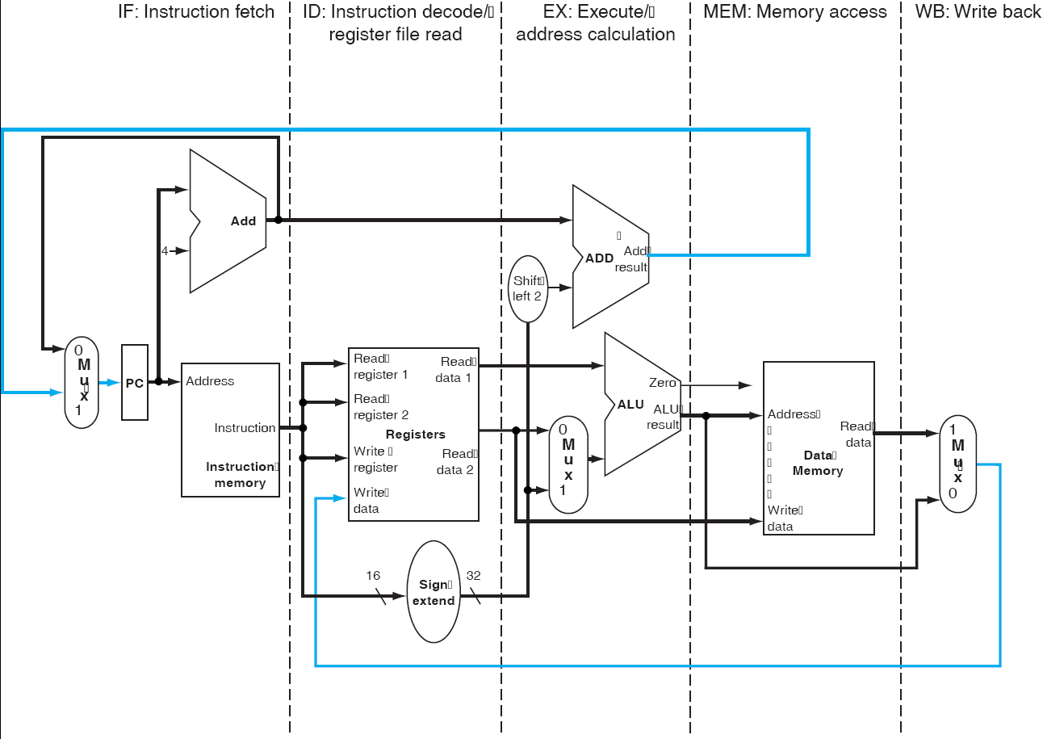
Single-Cycle Processor- Pipeline

Slide 39
The Basic Pipeline For MIPS
Cycle 1
Cycle 2
Cycle 3
Cycle 4
Cycle 5
Cycle 6
Cycle 7
I
n
s
t
r.
O
r
d
e
r
Ifetch
Reg
ALU
DMem
Reg
Ifetch
Reg
ALU
DMem
Reg
Ifetch
Reg
ALU
DMem
Reg
Ifetch
Reg
ALU
DMem
Reg
What do we need to add to actually split the datapath into stages?

Slide 40
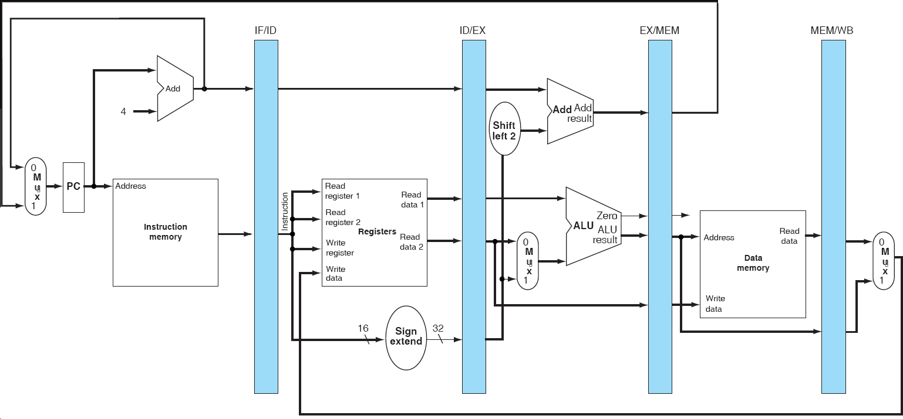
Basic Pipelined Processor

Slide 41
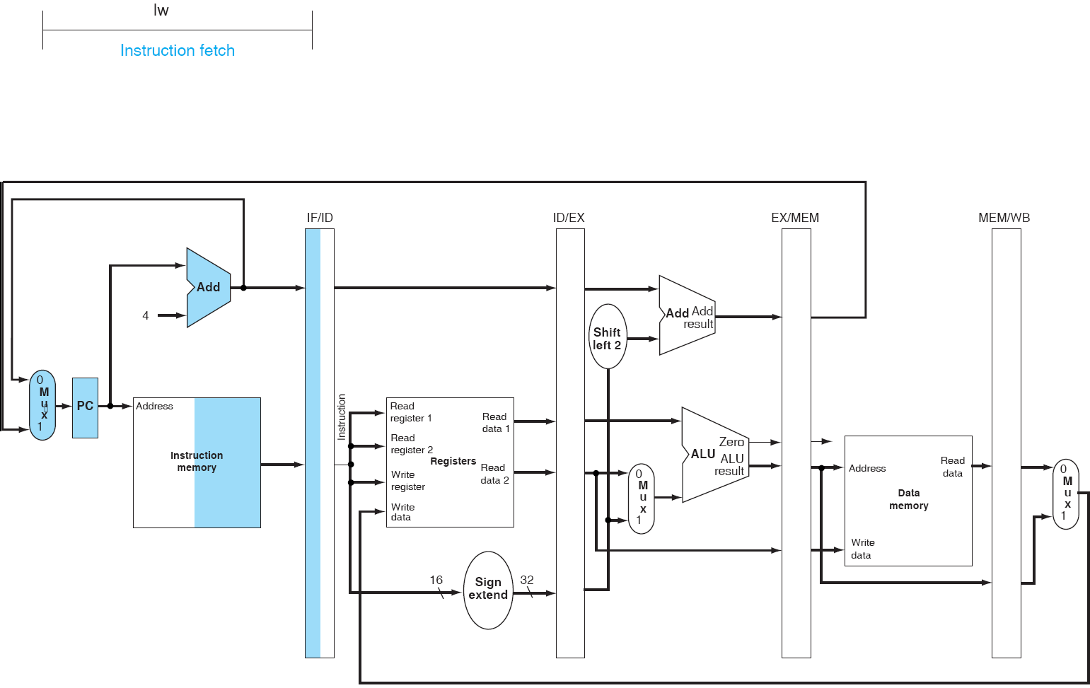
Pipeline example: lw
IF

Slide 42
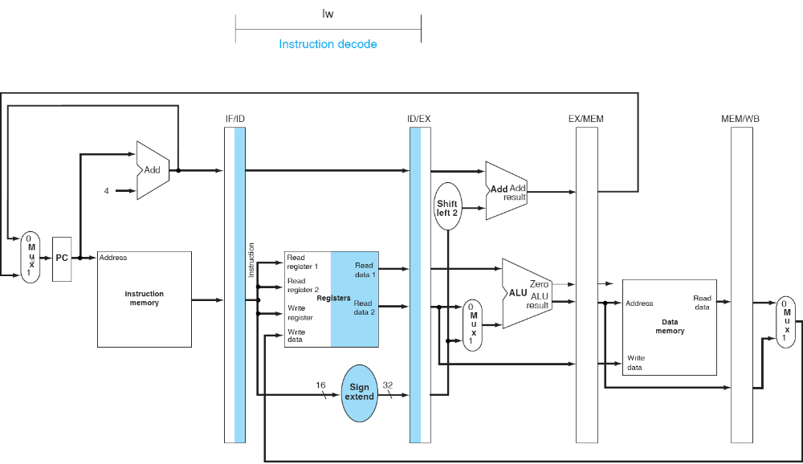
Pipeline example: lw
ID

Slide 43
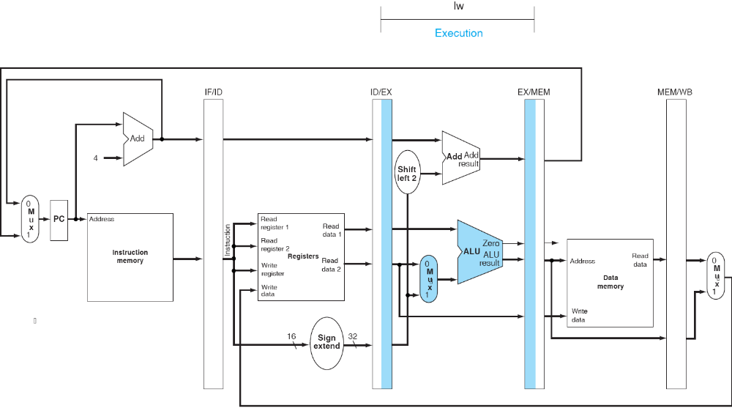
Pipeline example: lw
EX

Slide 44
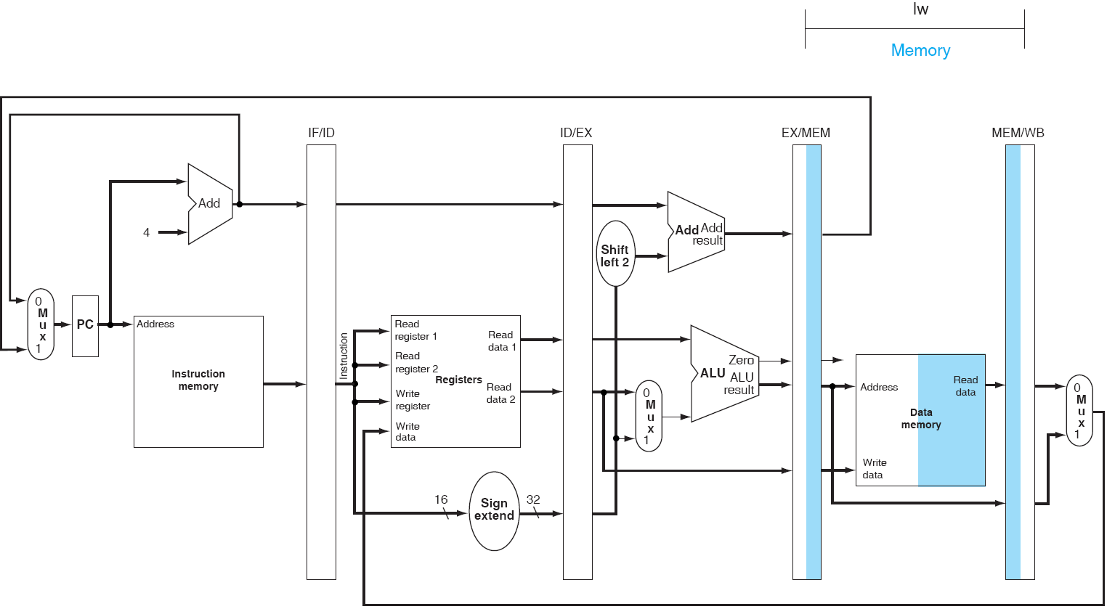
Pipeline example: lw
MEM

Slide 45
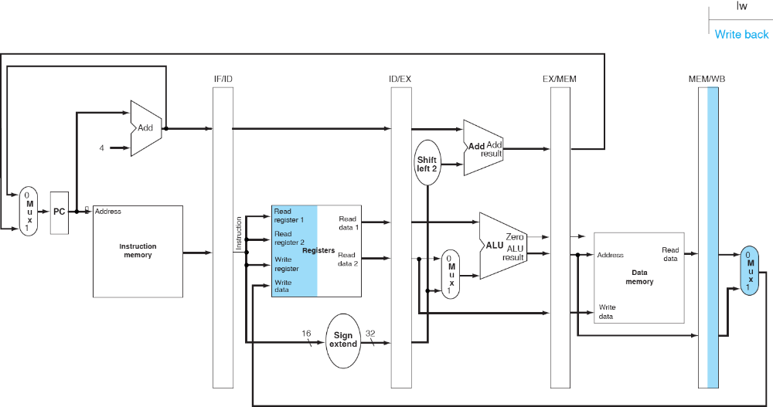
Pipeline example: lw
WB

Slide 46
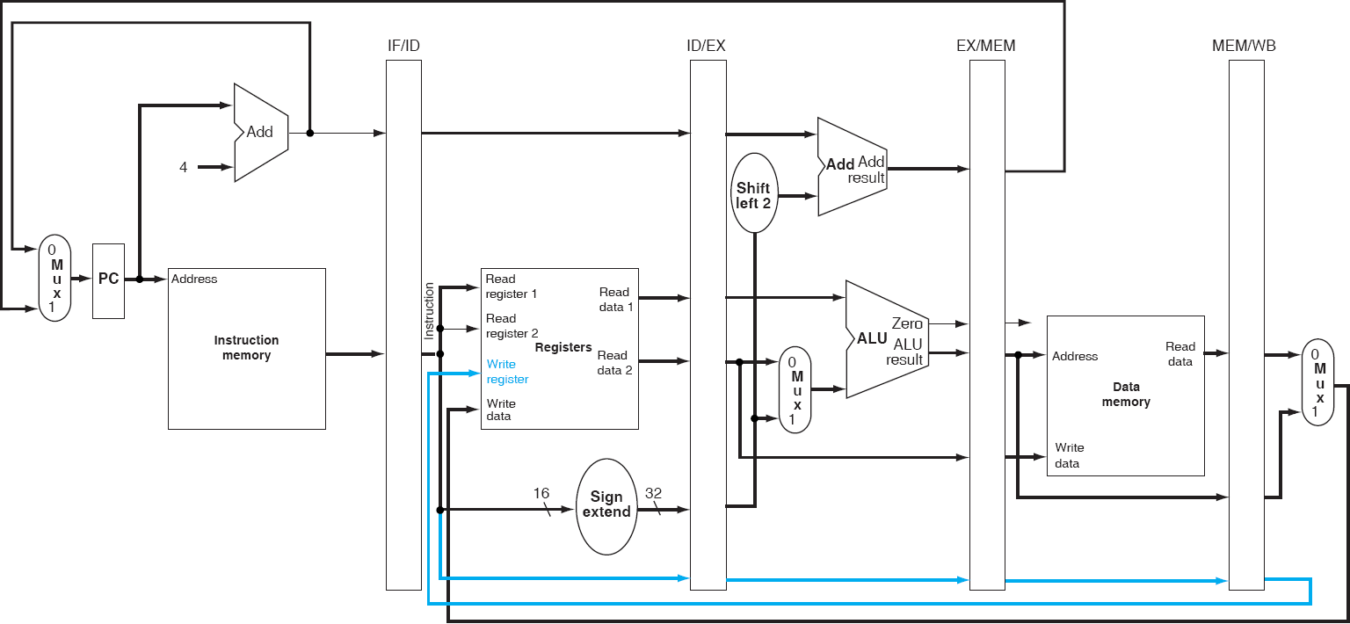
Basic Pipelined Processor (Corrected)

Slide 47
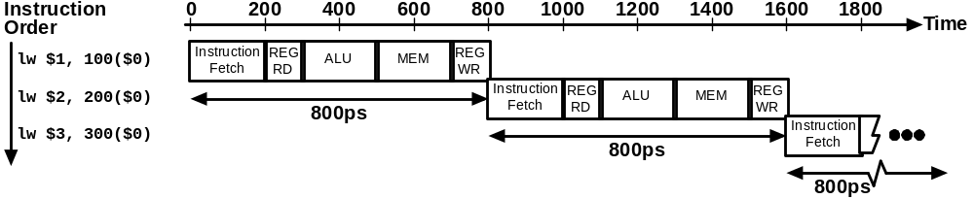
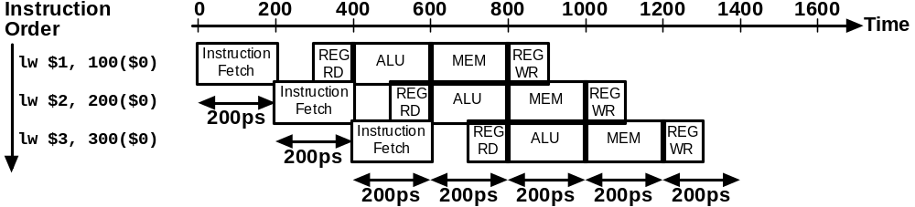
Single-Cycle vs. Pipelined Execution
Non-Pipelined
Pipelined

Slide 48
Speedup
Consider the unpipelined processor introduced previously. Assume that it has a 1 ns clock cycle and it uses 4 cycles for ALU operations and branches, and 5 cycles for memory operations, assume that the relative frequencies of these operations are 40%, 20%, and 40%, respectively. Suppose that due to clock skew and setup, pipelining the processor adds 0.2ns of overhead to the clock. Ignoring any latency impact, how much speedup in the instruction execution rate will we gain from a pipeline?
Average instruction execution time
= 1 ns * ((40% + 20%)*4 + 40%*5)
= 4.4ns
Speedup from pipeline
= Average instruction time unpiplined/Average instruction time pipelined
= 4.4ns/1.2ns = 3.7

Slide 49
Comments about Pipelining
The good news
  Multiple instructions are being processed at same time
  This works because stages are isolated by registers
  Best case speedup of N
The bad news
  Instructions interfere with each other - hazards
    Example: different instructions may need the same piece of hardware (e.g., memory) in same clock cycle
    Example: instruction may require a result produced by an earlier instruction that is not yet complete

Slide 50
Pipeline Hazards
Limits to pipelining: Hazards prevent next instruction from executing during its designated clock cycle
  Structural hazards: two different instructions use same h/w in same cycle
  Data hazards: Instruction depends on result of prior instruction still in the pipeline
  Control hazards: Pipelining of branches & other instructions that change the PC

Slide 51
Summary - Pipelining Overview
Pipelining increase throughput (but not latency)
Hazards limit performance
  Structural hazards
  Control hazards
  Data hazards

Slide 52
Pipelining Outline
Introduction
  Defining Pipelining
  Pipelining Instructions
Hazards
  Structural hazards 
  Data Hazards
  Control Hazards
Performance
Controller implementation

