Slide 1
Floating Point Arithmetic
Notes:
September 4, 1997
September 4, 1997

Slide 2
Introduction
Topics
  IEEE format for single and double precision floating point numbers
  Floating point addition and multiplication
  Support for floating point computation in MIPS
Notes:
September 4, 1997
September 4, 1997

Slide 3
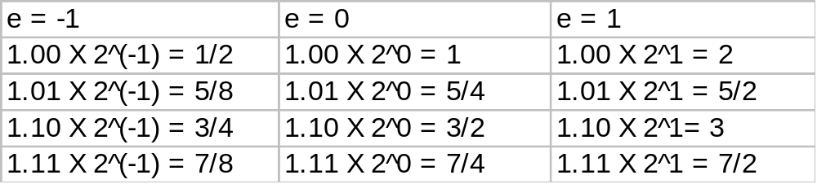
Floating Point Numbers
3 bit mantissa
exponent {-1,0,1}
0
1
2
3
Notes:
September 4, 1997
September 4, 1997

Slide 4
Floating Point
An IEEE floating point representation:-
  A Sign Bit (no surprise)
  An Exponent (“times 2 to the what?”)
  Mantissa (“Significand”)=1.xxxxx (thus, one bit of the mantissa is implied as 1)
  Note: This is called a normalized representation
mantissa = 0 is interpreted to be 1.0,
mantissa of all 1111 is interpreted to be 1.1111
Special cases are used to represent denormalized mantissas (true mantissa = 0), NaN [ not a number]
Notes:
September 4, 1997
September 4, 1997

Slide 5
Floating Point Standard
Defined by IEEE Std 754-1985
Developed in response to divergence of representations
Now universally adopted
Two representations
  Single precision (32-bit)
  Double precision (64-bit)
Notes:
September 4, 1997

Slide 6
IEEE Floating-Point Format
single: 8 bits
double: 11 bits
single: 23 bits
double: 52 bits
S
Exponent
Fraction
S: sign bit (0 ⇒ non-negative, 1 ⇒ negative)
Normalize significand: 1.0 ≤ |significand| < 2.0
  Always has a leading pre-binary-point 1 bit, so no need to represent it explicitly (hidden bit)
  Significand is Fraction with the “1.” restored
Exponent: excess representation: actual exponent + Bias
  Ensures exponent is unsigned
  Single: Bias = 127; Double: Bias = 1203
Notes:
September 4, 1997

Slide 7
Single-Precision Range
Exponents 00000000 and 11111111 reserved
Smallest value
  Exponent: 00000001
  ⇒ actual exponent = 1 – 127 = –126
  Fraction: 000…00 ⇒ significand = 1.0
  ±1.0 × 2^{–126} ≈ ±1.2 × 10^{–38}
Largest value
  exponent: 11111110
  ⇒ actual exponent = 254 – 127 = +127
  Fraction: 111…11 ⇒ significand ≈ 2.0
  ±2.0 × 2⁺¹²⁷ ≈ ±3.4 × 10⁺³⁸
Notes:
September 4, 1997

Slide 8
Double-Precision Range
Exponents 0000…00 and 1111…11 reserved
Smallest value
  Exponent: 00000000001
  ⇒ actual exponent = 1 – 1023 = –1022
  Fraction: 000…00 ⇒ significand = 1.0
  ±1.0 × 2^{–1022} ≈ ±2.2 × 10^{–308}
Largest value
  Exponent: 11111111110
  ⇒ actual exponent = 2046 – 1023 = +1023
  Fraction: 111…11 ⇒ significand ≈ 2.0
  ±2.0 × 2⁺¹⁰²³ ≈ ±1.8 × 10⁺³⁰⁸
Notes:
September 4, 1997

Slide 9
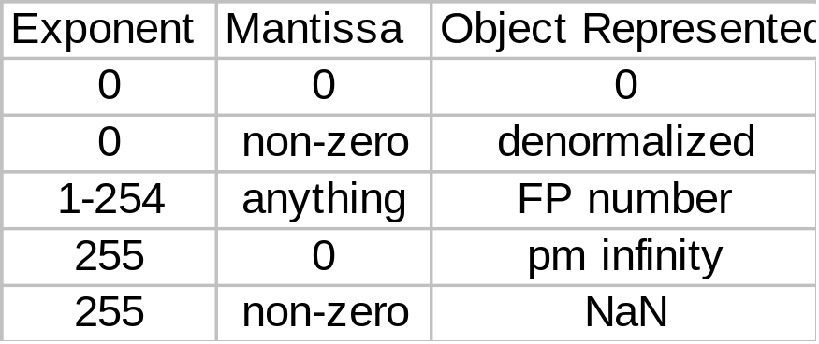
Representation of Floating Point Numbers
IEEE 754 single precision
31
30
23
22
0
Sign
Biased exponent
Normalized Mantissa (implicit 24th bit = 1)
(-1)^{s} × F × 2^{E-127}
Notes:
September 4, 1997
September 4, 1997

Slide 10
Why biased exponent?
For faster comparisons (for sorting, etc.), allow integer comparisons of floating point numbers:
Unbiased exponent:
Biased exponent:
1/2
0
1111 1111
000 0000 0000 0000 0000 0000
2
0
0000 0001
000 0000 0000 0000 0000 0000
1/2
0
0111 1110
000 0000 0000 0000 0000 0000
2
0
1000 0000
000 0000 0000 0000 0000 0000
Notes:
September 4, 1997
September 4, 1997

Slide 11
Basic Technique
Represent the decimal in the form +/- 1.xxx_{b} x 2^{y}
And “fill in the fields”
  Remember biased exponent and implicit “1.” mantissa!
Examples:
  0.0: 0 00000000 00000000000000000000000
  1.0 (1.0 x 2^0): 0 01111111 00000000000000000000000
  0.5 (0.1 binary = 1.0 x 2^-1): 0 01111110 00000000000000000000000
  0.75 (0.11 binary = 1.1 x 2^-1): 0 01111110 10000000000000000000000
  3.0 (11 binary = 1.1*2^1): 0 10000000 10000000000000000000000
  -0.375 (-0.011 binary = -1.1*2^-2): 1 01111101 10000000000000000000000
  1 10000011 01000000000000000000000 = - 1.01 * 2^4 = -20.0
Notes:
September 4, 1997
September 4, 1997

Slide 12
Basic Technique
One can compute the mantissa just similar to the way one would convert decimal whole numbers to binary.
Take the decimal and repeatedly multiply the fractional component by 2. The whole number portion is the next binary bit.
For whole numbers, append the binary whole number to the mantissa and shift the exponent until the mantissa is in normalized form.
Notes:
September 4, 1997
September 4, 1997

Slide 13
Floating-Point Example
Represent –0.75
  –0.75 = (–1)¹ × 1.1₂ × 2^{–1}
  S = 1
  Fraction = 1000…00₂
  Exponent = –1 + Bias
    Single: –1 + 127 = 126 = 01111110₂
    Double: –1 + 1023 = 1022 = 01111111110₂
Single: 1011111101000…00
Double: 1011111111101000…00
Lec 14
Systems Architecture
Notes:
September 4, 1997

Slide 14
Floating-Point Example
What number is represented by the single-precision float
11000000101000…00
  S = 1
  Fraction = 01000…00₂
  Fxponent = 10000001₂ = 129
x = (–1)¹ × (1 + 01₂) × 2^{(129 – 127)}
= (–1) × 1.25 × 2²
= –5.0
Notes:
September 4, 1997

Slide 15


Denormal Numbers
Exponent = 000...0 ⇒ hidden bit is 0
Smaller than normal numbers
  allow for gradual underflow, with diminishing precision
Denormal with fraction = 000...0
Two representations of 0.0!
Notes:
September 4, 1997

Slide 16
Infinities and NaNs
Exponent = 111...1, Fraction = 000...0
  ±Infinity
  Can be used in subsequent calculations, avoiding need for overflow check
Exponent = 111...1, Fraction ≠ 000...0
  Not-a-Number (NaN)
  Indicates illegal or undefined result
    e.g., 0.0 / 0.0
  Can be used in subsequent calculations
Notes:
September 4, 1997

Slide 17
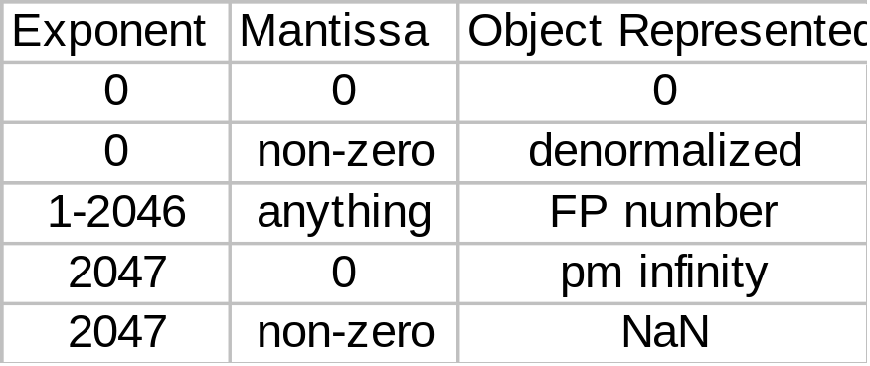
Representation of Floating Point Numbers
IEEE 754 double precision
31
30
20
19
0
Sign
Biased exponent
Normalized Mantissa (implicit 53rd bit)
(-1)^{s} × F × 2^{E-1023}
Notes:
September 4, 1997
September 4, 1997

Slide 18
Floating Point Arithmetic
fl(x) = nearest floating point number to x
Relative error (precision = s digits)
  |x - fl(x)|/|x| ≤ 1/2β^{1-s} for β = 2, 2^{-s}
Arithmetic
  x ⊕ y = fl(x+y) = (x + y)(1 + ε ) for ε < u
  x ⊗ y = fl(x × y)(1 + ε ) for ε < u
ULP—Unit in the Last Place is the smallest possible increment or decrement that can be made using the machine's FP arithmetic.
Notes:
September 4, 1997
September 4, 1997

Slide 19
Floating-Point Precision
Relative precision
  all fraction bits are significant
  Single: approx 2^{–23}
    Equivalent to 23 × log₁₀2 ≈ 23 × 0.3 ≈ 6 decimal digits of precision
  Double: approx 2^{–52}
    Equivalent to 52 × log₁₀2 ≈ 52 × 0.3 ≈ 16 decimal digits of precision
Notes:
September 4, 1997

Slide 20
Is FP addition associative?
Associativity law for addition: a + (b + c) = (a + b) + c
Let a = – 2.7 x 10²³, b = 2.7 x 10²³, and c = 1.0
a + (b + c) = – 2.7 x 10²³ + ( 2.7 x 10²³ + 1.0 ) = – 2.7 x 10²³ + 2.7 x 10²³ = 0.0
(a + b) + c = ( – 2.7 x 10²³ + 2.7 x 10²³ ) + 1.0 = 0.0 + 1.0 = 1.0
Beware – Floating Point addition not associative!
The result is approximate…
Why the smaller number disappeared?
Lec 14
Systems Architecture
Notes:
September 4, 1997
September 4, 1997

Slide 21
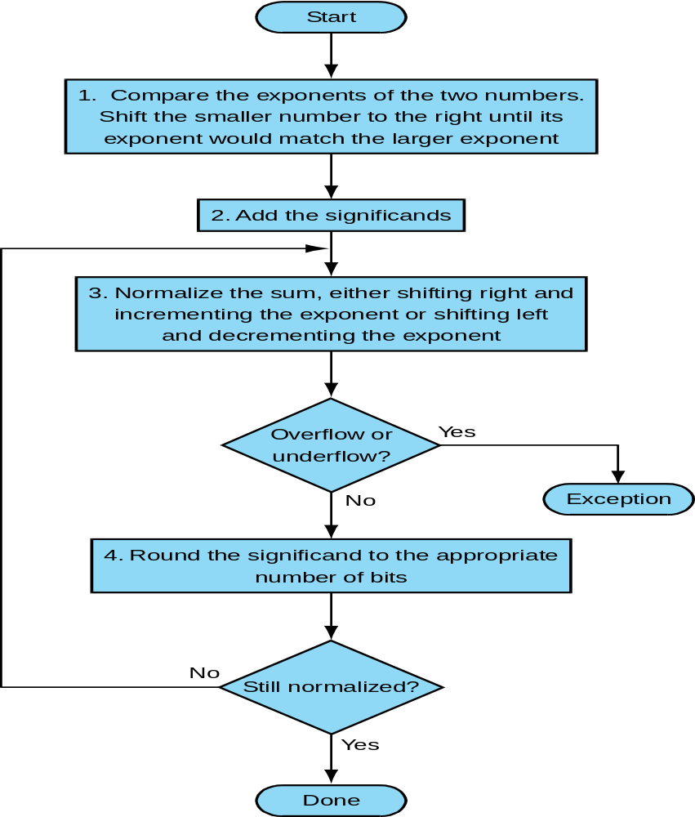
Floating point addition
Notes:
September 4, 1997
September 4, 1997

Slide 22
Floating-Point Addition
Consider a 4-digit decimal example
  9.999 × 10¹ + 1.610 × 10^{–1}
1. Align decimal points
  Shift number with smaller exponent
  9.999 × 10¹ + 0.016 × 10¹
2. Add significands
  9.999 × 10¹ + 0.016 × 10¹ = 10.015 × 10¹
3. Normalize result & check for over/underflow
  1.0015 × 10²
4. Round and renormalize if necessary
  1.002 × 10²
Lec 14
Systems Architecture
Notes:
September 4, 1997

Slide 23
Floating-Point Addition
Now consider a 4-digit binary example
  1.000₂ × 2^{–1} + –1.110₂ × 2^{–2} (0.5 + –0.4375)
1. Align binary points
  Shift number with smaller exponent
  1.000₂ × 2^{–1} + –0.111₂ × 2^{–1}
2. Add significands
  1.000₂ × 2^{–1} + –0.111₂ × 2–1 = 0.001₂ × 2^{–1}
3. Normalize result & check for over/underflow
  1.000₂ × 2^{–4}, with no over/underflow
4. Round and renormalize if necessary
  1.000₂ × 2^{–4} (no change) = 0.0625
Lec 14
Systems Architecture
Notes:
September 4, 1997

Slide 24
FP Adder Hardware
Much more complex than integer adder
Doing it in one clock cycle would take too long
  Much longer than integer operations
  Slower clock would penalize all instructions
FP adder usually takes several cycles
  Can be pipelined
Lec 14
Systems Architecture
Notes:
September 4, 1997

Slide 25

FP Adder Hardware
Step 1
Step 2
Step 3
Step 4
Notes:
September 4, 1997

Slide 26
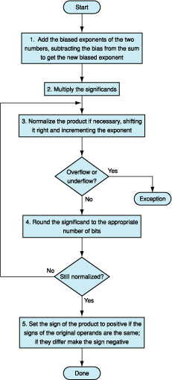
Floating Point Multiplication Algorithm
Notes:
September 4, 1997
September 4, 1997

Slide 27
Floating-Point Multiplication
Consider a 4-digit decimal example
  1.110 × 10¹⁰ × 9.200 × 10^{–5}
1. Add exponents
  For biased exponents, subtract bias from sum
  New exponent = 10 + –5 = 5
2. Multiply significands
  1.110 × 9.200 = 10.212 ⇒ 10.212 × 10⁵
3. Normalize result & check for over/underflow
  1.0212 × 10⁶
4. Round and renormalize if necessary
  1.021 × 10⁶
5. Determine sign of result from signs of operands
  +1.021 × 10⁶
Notes:
September 4, 1997

Slide 28
Floating-Point Multiplication
Now consider a 4-digit binary example
  1.000₂ × 2^{–1} × –1.110₂ × 2^{–2} (0.5 × –0.4375)
1. Add exponents
  Unbiased: –1 + –2 = –3
  Biased: (–1 + 127) + (–2 + 127) = –3 + 254 – 127 = –3 + 127
2. Multiply significands
  1.000₂ × 1.110₂ = 1.1102 ⇒ 1.110₂ × 2^{–3}
3. Normalize result & check for over/underflow
  1.110₂ × 2^{–3} (no change) with no over/underflow
4. Round and renormalize if necessary
  1.110₂ × 2^{–3} (no change)
5. Determine sign: +ve × –ve ⇒ –ve
  –1.110₂ × 2^{–3} = –0.21875
Notes:
September 4, 1997

Slide 29
FP Arithmetic Hardware
FP multiplier is of similar complexity to FP adder
  But uses a multiplier for significands instead of an adder
FP arithmetic hardware usually does
  Addition, subtraction, multiplication, division, reciprocal, square-root
  FP ↔ integer conversion
Operations usually takes several cycles
  Can be pipelined
Notes:
September 4, 1997

Slide 30
FP Instructions in MIPS
Single-precision arithmetic
  add.s, sub.s, mul.s, div.s
    e.g., add.s $f0, $f1, $f6
Double-precision arithmetic
  add.d, sub.d, mul.d, div.d
    e.g., mul.d $f4, $f4, $f6
Single- and double-precision comparison
  c.xx.s, c.xx.d (xx is eq, lt, le, …)
  Sets or clears FP condition-code bit
    e.g. c.lt.s $f3, $f4
Branch on FP condition code true or false
  bc1t, bc1f
    e.g., bc1t TargetLabel
Lec 14
Systems Architecture
Notes:
September 4, 1997

Slide 31
Rounding
Guard and round digits and sticky bit
  When computing result, assume there are several extra digits available for shifting and computation. This improves accuracy of computation.
  Guard digit: first extra digit/bit to the right of mantissa -- used for rounding addition results
  Round digit: second extra digit/bit to the right of mantissa -- used for rounding addition or multiplication results
  Sticky bit: third extra digit/bit to the right of mantissa – used for resolving ties such as 0.50...00 vs. 0.50...01
Notes:
September 4, 1997
September 4, 1997

Slide 32
Rounding examples
An example without guard and round digits
  Add 9.76 x 10²⁵ and 2.59 x 10²⁴ assuming 3 digit mantissa
    Shift mantissa of the smaller number to the right: 0.25 x 10²⁵
    Add mantissas: 10.01x 10²⁵
    Check and normalize mantissa if necessary: 1.00x 10²⁶
An example with guard and round digits
  Add 9.76 x 10²⁵ and 2.59 x 10²⁴ assuming 3 digit mantissa
    Internal registers have extra two digits: 9.7600 x 10²⁵ and 2.5900 x 10²⁴
    Shift mantissa of the smaller number to the right: 0.2590 x 10²⁵
    Add mantissas: 10.0190 x 10²⁵
    Check and normalize mantissa if necessary: 1.0019 x 10²⁶
    Round the result: 1.00 x 10²⁶
Lec 14
Systems Architecture
Notes:
September 4, 1997
September 4, 1997

Slide 33
Rounding examples
An example without guard and round digits
  Add 9.78 x 10²⁵ and 8.79 x 10²⁴ assuming 3 digit mantissa
    Shift mantissa of the smaller number to the right: 0.87 x 10²⁵
    Add mantissas: 10.65 x 10²⁵
    Normalize mantissa if necessary: 1.06 x 10²⁶
An example with guard and round digits
  Add 9.78 x 10²⁵ and 8.79 x 10²⁴ assuming 3 digit mantissa
    Internal registers have extra two digits: 9.7800 x 10²⁵ and 8.7900 x 10²⁴
    Shift mantissa of the smaller number to the right: 0.8790 x 10²⁵
    Add mantissas (note extra digit on the left): 10.6590 x 10²⁵
    Check and normalize mantissa if necessary: 1.0659 x 10²⁶
    Round the result: 1.07 x 10²⁶
Lec 14
Systems Architecture
Notes:
September 4, 1997
September 4, 1997

Slide 34
An example with guard and round digits and sticky bits
  Add 5.01 x 10⁻¹ and 2.34 x 10² assuming 3 digit mantissa
    Internal registers have extra two digits and shift: 0.0050 x 10² and 2.3400 x 10²
    Sum= 2.3450
    [ Sticky bit will set due to non zeros in the right of the round bit]
    With the sticky bit Sum= 2.35 meaning if some bits at right of the roud bit are off then we round it nearest to 2.35 . Incase of without sticky bits it will be 2.34
Lec 14
Systems Architecture

Slide 35
IEEE Rounding Modes
  Round toward – Infinity: always round toward the smaller number
  Round toward + Infinity: always round toward the larger number
  Round to Zero: always round toward the smallest absolute (truncate)
  Round toward Nearest Even: always round so that least significant bit (lsb) is zero
1.40 1.60 1.50 2.50 –1.50
Zero 1.00 2.00 1.00 2.00 –1.00
− ∞ 1.00 2.00 1.00 2.00 –2.00
+ ∞ 1.00 2.00 2.00 3.00 –1.00
Nearest Even (default)
1.00 2.00 2.00 2.00 –2.00
When rounding a binary fraction, the least significant digit of rounded result will be either 1 or 0. Nearest even mode always rounds the number so that the lsb is 0. Hence, the name. (If we omit the binary point, the rounded number would be even.)
It can be shown that if we assume uniform distribution of digits, rounding to nearest mode tends to have mean error = 0.
Lec 14
Systems Architecture
Notes:
September 4, 1997
September 4, 1997

Slide 36
FP Instructions in MIPS
Floating point operations are slower than integer operations
Data is rarely converted from integers to float within the same procedure
1980’s solution – place FP processing unit in a separate chip
Today’s solution – imbed FP processing unit in processor chip
Co-processor 1 features:
  Contains 32 single precision floating point registers: $f0, $f1, … $f31
  These registers can also act as 16 double precision registers:
  $f0/$f1, $f2/$f3, … , $f30/$f31 (only the first one is specified in the instructions)
  Uses special floating point instructions, which are similar (in format) to integer instructions but have .s or .d attached to signify that they work on fp numbers
  Several special instructions to move between “regular” registers and the co-processor registers
Lec 14
Systems Architecture
Notes:
September 4, 1997
September 4, 1997

Slide 37
FP Instructions in MIPS
lwc1 / swc1 – load/store word coprocessor 1
Move instructions (between processors)
mfc1 rt, rd Move floating point register rd to CPU register rt
mtc1 rd, rt Move CPU register rt to floating point register rd
mfc1.d rdest, frsrc1
Move frsrc1 & frsrc1 + 1 to regs rdest & rdest + 1
Single and double precision arithmetic instructions
Single add.s, sub.s, mul.s, div.s, c.lt.s
Double add.d, sub.d, mul.d, div.d, c.lt.d
Examples: add.s $f0, $f1, $f2 sub.d $f0, $f2, $f4
Lec 14
Systems Architecture
Notes:
September 4, 1997
September 4, 1997

