Slide 1
Badal Sircar
The man and his ideology
Manohar Khushalani

Slide 2
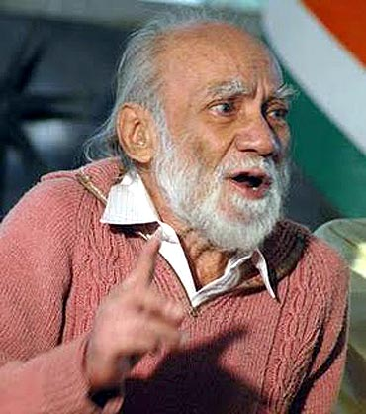
Badal Sircar
Born Suchindra Sircar in 1925,
Died known as Badal Sircar 2011
May 13, 2011, will be etched in the history of Bengal for two reasons: it brought to an end the 34-year-old Left Front regime in the state and it also marked the demise of Badal Sircar, one of the greatest thespians India has ever produced.

Slide 3
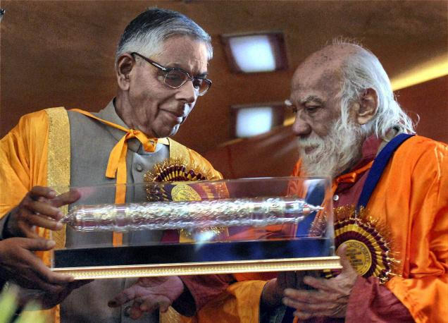
He was awarded the Padma Shri in 1972, the Sangeet Natak Akademi Award in 1968 and the Sangeet Natak Akademi Fellowship-Ratna Sadsya, the highest honour in the performing arts by the Government of India, in 1997. But when he was offered the Padma Bhushan by the Government of India in 2010, he declined it, his logic being: he was already a Sahitya Akademi Fellow, the highest recognition for any writer.

Slide 4
1960s
The 1960s was a definitive decade for the arts in many parts of the world, including India. Moving into a postcolonial era, Indian theatre was starting to be demarcated in national terms. Theatre has always been one of the most powerful media of sensitization and social communication in India. Communal violence and conflicts arising out of caste, religious, and gender identities have found a unique resonance and representation in post-Independence Indian theatre.

Slide 5
Importance in Indian Theatre
While looking at the contributors of theatre the name of Badal Sircar is included without any exception.
Badal Sircar contributed to the modern Indian drama and played roles as playwright, director, and actor to change the scenario contemporary theatre.
No other theatre personality has had such a deep and pervasive influence on theatre practice and theory in post-independence India as Badal Sircar.
As a writer of proscenium plays in the 1960s, all of which have been widely produced by leading directors in several Indian languages;
as the pioneer of non-proscenium political theatre in the 1970s;
as the mentor of countless directors and theatre activists who have carried his ideas to far corners of the country, his work is an integral part of contemporary Indian theatre history

Slide 6
Plays of Badal
Sircar started his dramatic career with some comedies and came to the lime light in 1965 with his celebrated Evam Indrajit.
His plays have been translated into English, Kannada, Gujrati, Marathi, Hindi languages and staged successfully.
When he was in Nigeria he wrote six serious plays.
His plays express all the major concerns, aspirations and frustrations of the new ruthless urban generation through the plays like Evam Indrajit(And Endrajit), Baki Itihas (The Other History), Trisangha Satabdi (The Thirtieth Century), and Shesh Nei (There’s No End). These four plays are called as Calcutta Quartet.
After writing such plays for the conventional stage for twenty years during 1950s and 60s he felt disappointed with proscenium theatre condition
Thus the formulation of a Third Theatre grew out of Sircar’s dissatisfaction with Conditions of the proscenium stage.

Slide 7
Satabdi
The first step in his exploration was Satabdi, a theatre group. He established Satabdi in 1967.
Satabdi first moved off the elevated platform to perform in rooms. This was alternately called “intimate theatre” or Anganmanch (an angan being an indoor courtyard, a decidedly intimate space in community life; and manch meaning stage).
In 1972 Satabdi performed Spartacus, its first Anganmanch piece, presented in a room at Kolkata’s Academy of Fine Arts, itself an established venue of conventional theatre.
This was his first major experiment in the direction of Third Theatre.

Slide 8
Delhi Theatre and Badal Sircar
The other plays specially written for Third theatre are Michhil (Procession), Bhoma, and Basi Khabar (Stale News).
Spartacus was performed in 1972
Michhil, performed in 1974,, in Ramchandrapur, a village in West Bengal, was the first play designed entirely for the open air.
In Delhi too Michil was performed as a street play in Hindustani as Jaloos and Spartacus was also Performed in Hindustani
Bhoma was translated into Hindustani and staged by Manohar Khushalani’s Theatre Group ‘Workshop Theatre’ which included well known media personalities such as Sudhir Mishra, Sushmita Mukherjee, Anil Mehta, Bina Pal, Meera Mishra, Meenu Moolchandani and Anamika Haksar

Slide 9
Sagina Mahato
Sircar’s Shatabdi, a new wave troupe that took Sircar’s plays to Kolkata’s Surendranath Park, now renamed Curzon Park, to involve the audience.
Sircar then did an experimental production of Gour Kishore Ghosh's Sagina Mahato which Satabdi had earlier enacted within the proscenium format when he realized the need to leave the proscenium theatre.
Sircar evinces: "With normal room-lights, we performed not by merely facing our audience, but also on' their sides and sometimes switching to the background, aptly, sharing space with them. Nearly everyone, who had previously seen Sagina, agreed that the play was far more effective in the reoriented scheme.”
In Delhi, many years later Manohar Khushalani also directed Sagina Mahato in Hindustani at Sri Ram Center, basement, which was a non proscenium performance space
This also helped in bringing the play to North Indian audiences.
Badal Sircar’s play is a direct criticism of the lumpen elements of the proletariat who were spoiling the movement and was the first sign of his disenchanment with the Communist Party

Slide 10
Cross Roads
In 1971, Badal Sircar and Satabdi reached the crossroads.
By the early ’70s Satabdi’s proscenium productions were unsustainable financially as well as artistically—the group could not afford to rent a theatre to show their work.
Sircar started questioning the very concept of theatre. Interestingly many others at the time, in both Bengal and elsewhere, were experiencing similar dissatisfactions with the proscenium stage.
But Sircar’s search of space brought him different answers. He realized that while cinema was a popular medium and could show much more than theatre, it lacked one fundamental element that was inherent to the theatre—liveness.

Slide 11
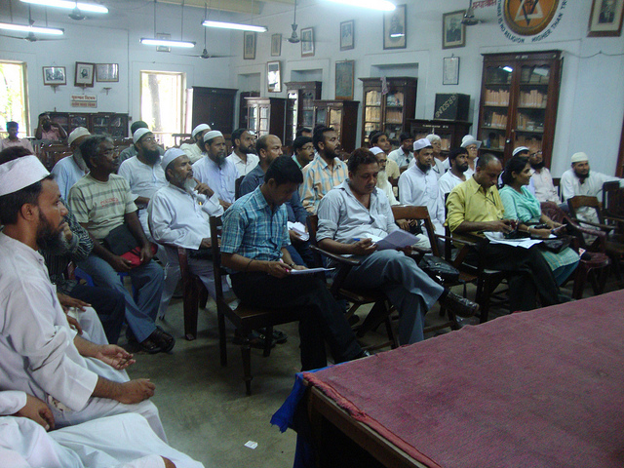
Theosophical Society
Sircar’s Group Satabdi had found a new home at Theosophical Society in Calcutta where they charged a token ticket of One Rupee only
The performance area was a modest hall where meetings also used to take place

Slide 12
Sircar’s special connect with Workshop Theatre in Delhi
During 1977 summer vacations Sircar conducted a “Third Theatre’ workshop at SRC in Delhi.
At the end of the workshop a group was formed by its participants called Workshop Theatre, the aim was to carry on with the concepts propounded by Sircar.
The Group included Manohar Khushalani, Sudhir- Sudhanshu Mishra, Sushmita Mukherjee, Anil Mehta, Bina Pal, Meera Mishra, Meenu Moolchandani, Ein Lal and Anamika Haksar
Sircar developed a special relationship with this group and travelled many times to Delhi to work with the group

Slide 13
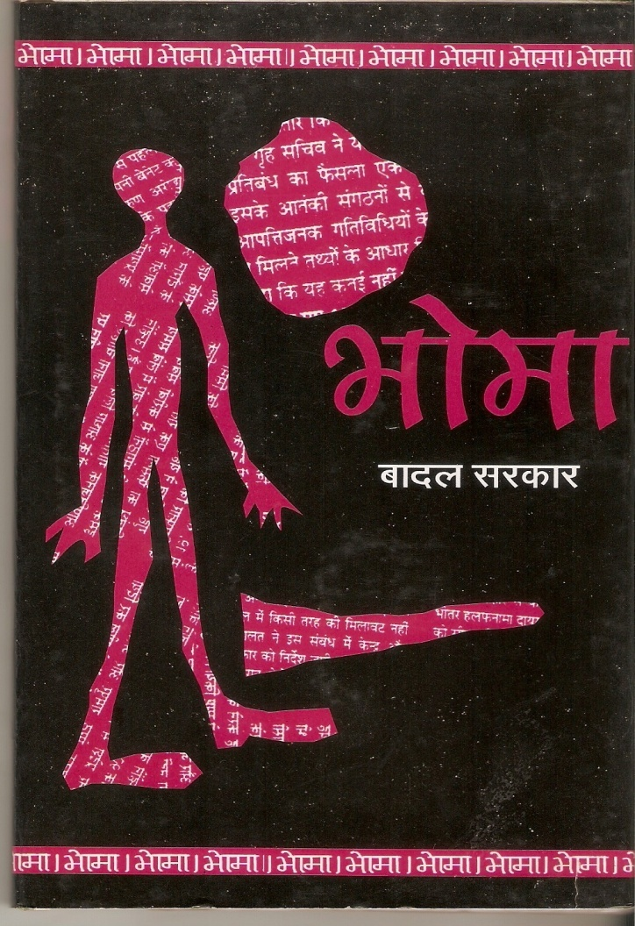
Sircar’s special connect with Workshop Theatre in Delhi
When Workshop Theatre, started translating Sircar’s Bhoma he helped in the translation conducted a special 10 day workshop from 9th July, 1978 and watched a few rehearsal’s as well.
It took several months to translate, rehearse and perform the play
Later the translation was published by Vidya Prakashan Mandir

Slide 14

Sircar’s special connect with Theatre in Delhi
When Manohar Khushalani directed Sagina Mahato in Delhi, Sircar was gracious enough to come and see the show, and give his comments on the way the play was performed
Members of Workshop Theatre and Prayog also met Badal Sircar in Calcutta during the Brecht International Festival and saw a performance of his troupe in The Theosopical Society

Slide 15
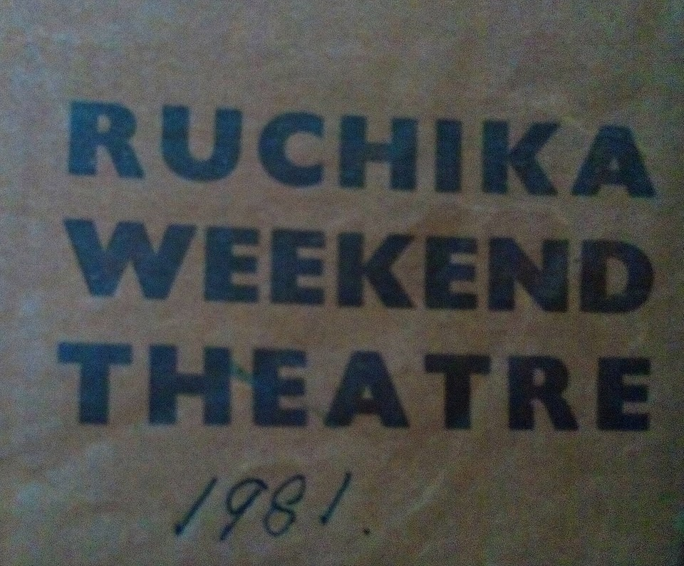
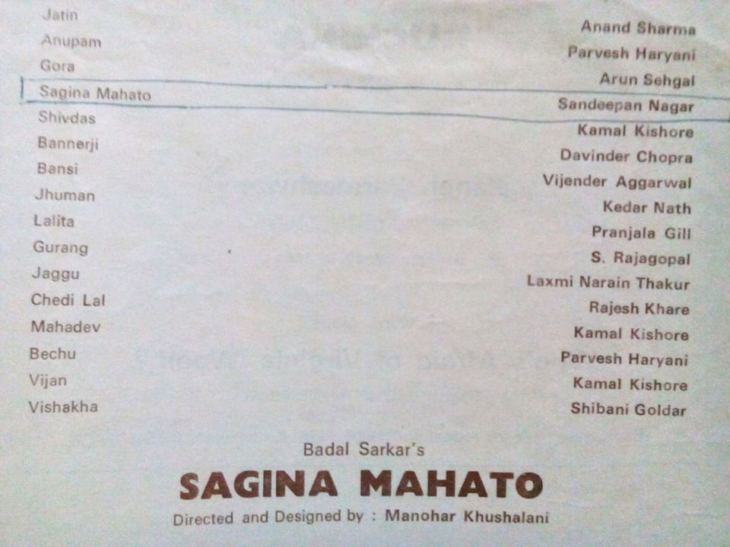
Sagina Mahato Brochure

Slide 16
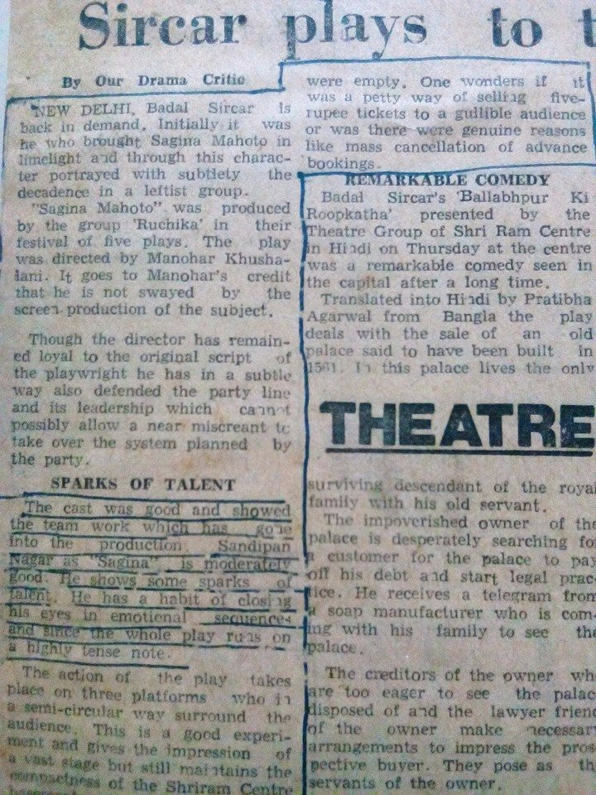
Sagina Mahato Press Accolade

Slide 17
The End

