Slide 1

Manohar Khushalani
manohar@iiitd.ac.in
www.stagebuzz.info
Manohar Khushalani

Slide 2

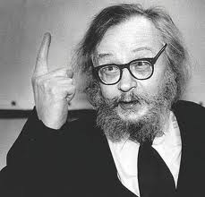
Manohar Khushalani

Slide 3

Polish-born U.S. stage director
Born Aug. 11, 1933, Rzeszw, Poland
Died Jan. 14, 1999, Pontedera, Italy
Joined the Polish Laboratory Theatre of Wrocaw in 1959 and founded a permanent company in 1965.
The Laboratory Theatre made its U.S. debut with Akropolis (1969); it was followed by Undertaking Mountain (1977) and Undertaking Earth (1977-78),
By this time Grotowski was living mostly in the U.S. Known as an avant-garde theorist, he sought to create dramatic tension by setting up emotional confrontations between audience and actors.
His book Towards a Poor Theater (1968) emphasized the centrality of the actor and advocated minimal stage sets.
He influenced U.S. experimental theatre movements, notably the Living Theatre.
He had the most powerful influence on the prolific Indian playwright director - Badal Sircar who was the founder of Third Theatre in India
Manohar Khushalani

Slide 4

His actors were so vocally and physically skilled that they could communicate clearly through sounds and movements.
The actors would create an inner harmony and peace of mind that would keep them healthy in both mind and body.
Grotowski actors believe that acting is a search for self knowledge and awareness.
Their style of training taught them to break free of limitations and realise their full potential.
Manohar Khushalani

Slide 5

Grotowski stated that an actor must begin by doing nothing. He called this creative passivity.
He believed that if a group of actors could remain completely still for several minutes in complete silence, with no outside noises or disturbances, then they would begin to experience an internal silence as well.
By making this silence happen, by evoking it, they could learn to concentrate intensely.
Manohar Khushalani

Slide 6

He believed in true contact between human beings.
He believed that real harmony in human relationships only developed when people really learned to look at each other and listen to each other.
He wanted actors to be more aware of the impact they had on other people
Manohar Khushalani

Slide 7

Like Brecht, Grotowski emphasised the use of emotion memory to recall an experience and recreate the feeling that went with that memory.
He demanded total honesty and total commitment from his actors in their use of emotion memory.
They had to make use of all their memories, no matter how painful or private.
This made their performances genuine. Through this process, actors would come closer to knowing the truth about themselves. It is an important path to self knowledge.
Grotowski demanded total commitment and belief in every activity, even the simplest exercise.
Manohar Khushalani

Slide 8

His actors were extremely physically skilled.
They developed a technique of movement which allowed them to control every move they made, even the smallest in every detail.
It is our bodies that express everything about us. Everything we think and feel is expressed through our bodies and everything we experience is felt through our bodies.
He gave actors physical skills for fully expressing their imaginations and their personalities.
Manohar Khushalani

Slide 9
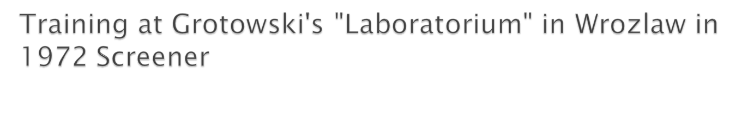
http://www.youtube.com/watch?v=dRyLLTvs00c
Manohar Khushalani

Slide 10

In his 'poor theatre' he always aimed for the simplest possible use of staging, lighting, costumes and special effects.
This forced actors to use all their skills to transform empty spaces and simple objects into a whole range of imaginative worlds.
Symbolism was essential in this form of theatre.
In the theatre of poverty, the only important elements were the actors themselves and their relationship with the live audience.
Often actors were in the audience's personal spaces, close enough to touch them.
Grotowski arranged the space he was using so that the audience would be completely involved in the theatre as possible.
Manohar Khushalani

Slide 11

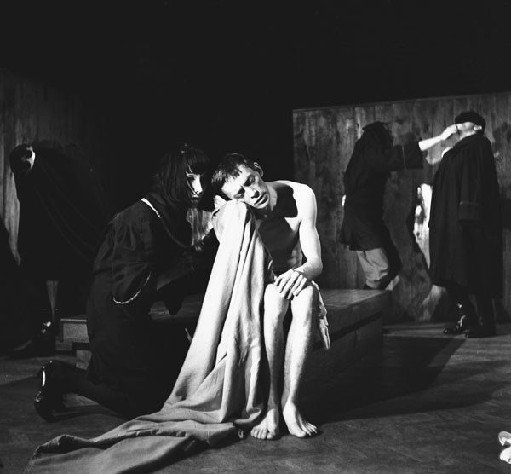
Manohar Khushalani

Slide 12

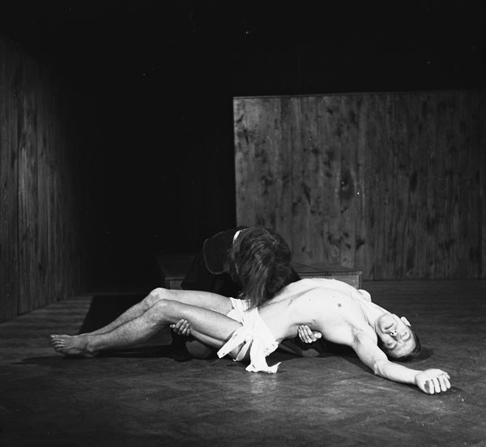
Manohar Khushalani

Slide 13

Grotowski warned his actors to avoid what he called 'the beautiful lie', both on stage and in their everyday lives.
By this he meant not doing something just because it looked good or because it was what people expected them to do.
Manohar Khushalani

Slide 14

Vocal training was essential.
They focussed their voices as though they were coming from different parts of their bodies.
They used full registers of their voices from very high to very low.
He emphasised clarity and used techniques such as singing, chanting and reciting poetry.
All actors were so vocally strong that they were able to recite atmospheric sounds of the world such as mechanics, animals, thunder and so on.
To Grotowski the voice is an instrument.
Manohar Khushalani

Slide 15

http://www.youtube.com/watch?v=dRyLLTvs00c
Physical Training at Odin Teatret, 1972
https://www.youtube.com/watch?v=s8dj4awiMJY
Manohar Khushalani

Slide 16
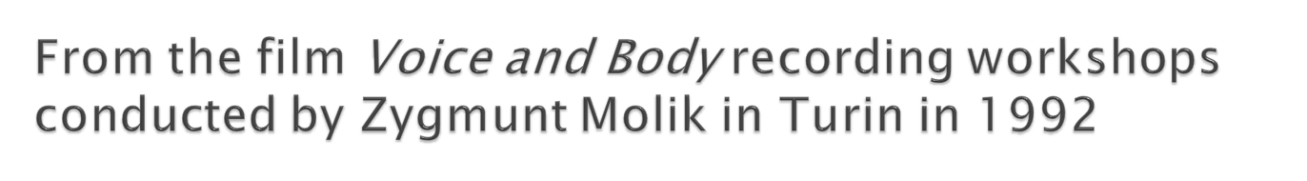
http://www.grotowski.net/mediateka/wideo/voice-and-body-staz-zygmunta-molika-turyn-1992
One of the original members of Jerzy Grotowski's acting company, Zygmunt Molik's Voice and Body Work explores the unique development of voice and body ...
Manohar Khushalani

Slide 17

Grotowski stated that an actor must begin by doing nothing!
He believed that if a group of actors could remain completely still for several minutes without disturbances, then they would be able to concentrate more intensely and use it as a creative passage.
Manohar Khushalani

Slide 18

Grotowsky differentiated between what he called the "Rich theatre" and the "Poor theatre." The "Rich" is one that is rich in faults. It draws upon other disciplines but fails to produce a work of art that has integrity. The Rich theater, in its attempt to compete with film and television, uses mechanical devices that are more appropriate for film and television.
Manohar Khushalani

Slide 19

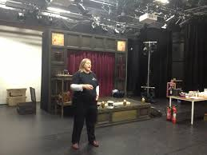
Manohar Khushalani

Slide 20

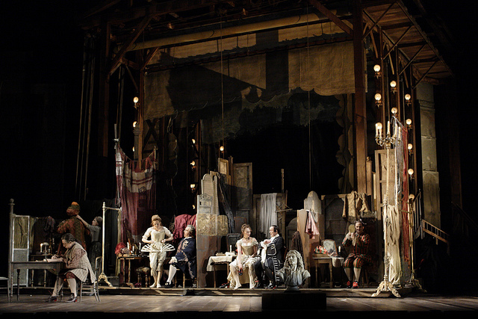
Manohar Khushalani

Slide 21

Grotowski proposed poverty in the theater, one in which a new space is designed for actors and spectators for each new work. He eliminated costumes, lighting, makeup, and music from his theater and insisted that the actors' physical flexibility is infinitely more interesting than costumes or makeup. Direct lighting and shadows can be utilized effectively without the need for elaborate lighting schemes and mechanisms. The actor can make his own music with his voice.
Manohar Khushalani

Slide 22

To this concept of 'poor theatre' Jerzy Grotowski (an atheist) added the concept of the 'priesthood' or sacredness of the actor. When the actor entered the sanctity of the performance space, then a special event occurred, much like the Mass in the Catholic Church. It was in this space, in the holy relationship between the actor and the audience, that an audience was challenged to think and be transformed by theatre. In this sense, Jerzy Grotowski was one of the key figures in the development of political theatre in the 20th Century.
Manohar Khushalani

Slide 23

His theatrical productions often contained political and social themes. The actor, depending only on the natural gifts of voice and body, could bring the sacred rituals of theatre and the themes of social transformation to the audience. The audience became pivotal to theatrical performance, and theatre became more than entertainment: it became a pathway to understanding
Manohar Khushalani

Slide 24

http://www.youtube.com/watch?v=fsKxJiPSdJU
A short video showing the directing methods adopted by the polish theatre practitioner Jerzy Grotowski.
Dramatised film version by Jordan Bostock and Paige Sweed.
Manohar Khushalani

