Slide 1

Manohar Khushalani
manohar@iiitd.ac.in
www.stagebuzz.info
Manohar Khushalani

Slide 2

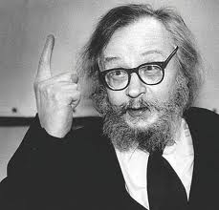
Jerzy Grotowski (August 11, 1933 - January 14, 1999) was a Polish theatre director and a leading figure of theatrical avant garde of the 20th century.
Manohar Khushalani

Slide 3

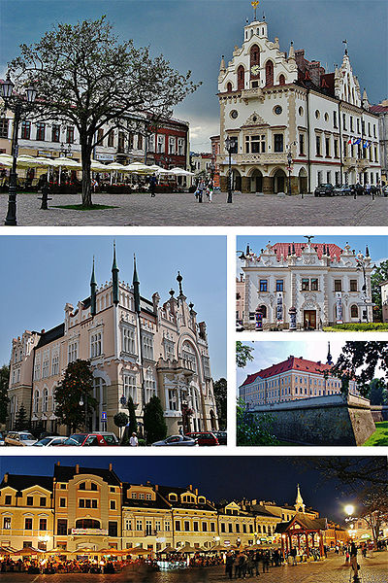

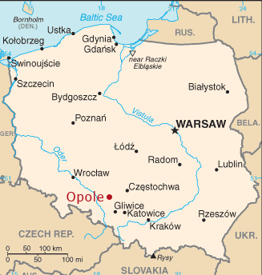
Jerzy Grotowski was born in Rzeszów in Poland and lived until the age of six in Przemyśl.
Manohar Khushalani

Slide 4

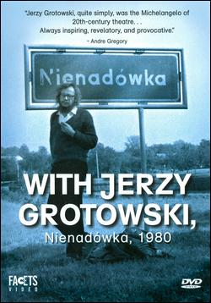
During World War II, the family was separated: his mother and brother moved with him to the small village of Nienadówka, [ɲenaˈdufka]
Here they were concealed from the Gestapo during the Nazi occupation of Poland.
Meanwhile his father served as an officer in the Polish Army and was later stationed in England.
Manohar Khushalani

Slide 5

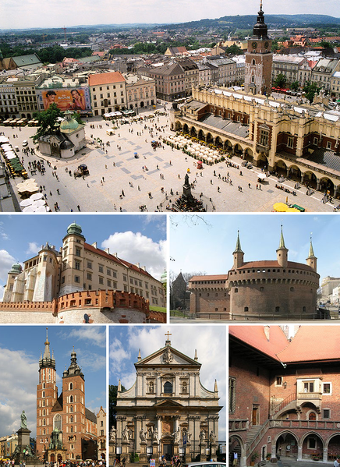
In 1955, Jerzy Grotowski graduated from the High Theatrical School in Kraków with a degree in acting.
Manohar Khushalani

Slide 6

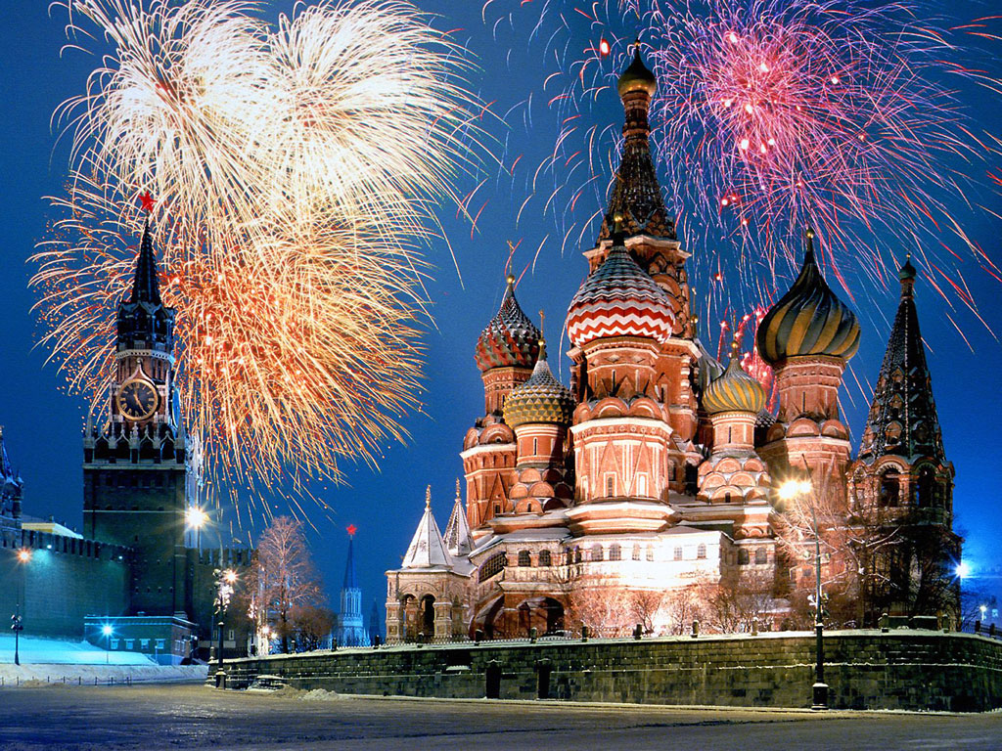
Soon after graduation he went on to Moscow to study directing at the Lunacharsky Institute of Theatre Arts (GITIS). During his stay in Moscow, until 1956, he learned about new trends in theatre pioneered by leading Russian figures such as Stanislavsky, Vakhtangov, Meyerhold and Tairov.
Manohar Khushalani

Slide 7

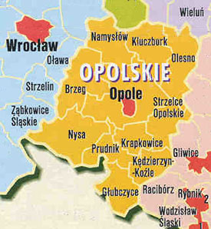
After returning to Poland, Jerzy Grotowski expanded his studies in directing at the theatrical school from which he had graduated (1956-1960). During that period he moved to Opole where he took over the post of director in a local theatre.
Manohar Khushalani

Slide 8

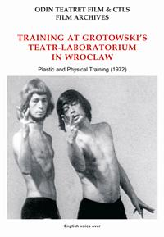
In 1965 he moved to Wrocław where he established and led a theatrical company - Laboratorium - which was in itself very innovative but under the overwhelming influence of Jerzy Grotowski's personality.
Manohar Khushalani

Slide 9


He was the author of Towards a Poor Theatre (1968), where he declared that theatre should not, because it could not, compete against the overwhelming spectacle of film and should instead focus on the very root of the act of theatre: actors in front of spectators.
Manohar Khushalani

