Slide 1

Presented by
Manohar Khushalani
@ IIITD

Slide 2

Sircar conducted workshops with individuals who become stimulated to do their own theatre. As a result, elements of Third Theatre have traveled far and wide, crossing boundaries of language, class, culture, and nationhood. Thus the Third Theatre has certain unique facets which can be elaborated as follows.

Slide 3

Third Theatre is the fusion of two theatres rural and urban theatre.
Sircar saw the inherent features of folk theatre i. e. live performer and his direct communication technique.
The emphasis was on the performers body rather than the set-ups and mechanical devices of the proscenium theatre.
Thus Sircar combined the features of the rural and the urban theatres and made third theatre as the synthesis of these two theatres.

Slide 4

In exploration of the theatre Sircar came to realize that the theatre is a human act.
Experience is the key word in every art and theatre is also a kind of art, where people come to have experience.
According to Badal Sircar theatre should be a collective exercise to awaken and enhance the social consciousness of participants, including the viewers.
Thus he preferred doing theatre in the open air where audience could participate.

Slide 5

There is no separate stage—the performance is at the same level on the floor;
Performers and the spectators are within the same environment.
It is intimate theatre. The performers can see the spectator clearly,
Can approach them individually, can whisper in their ears, can even touch them if they want

Slide 6

Third Theatre is anti-proscenium in nature.
In proscenium theatre elaborate stage set-ups, props, spotlight, costume, make-up etc. are used to create illusion of reality.
But in the Third Theatre emphasis is given on the performer’s body rather than set, props and costumes.
In Proscenium Theatre raised stage is used to keep distance from the spectator.
But the Third Theatre offers closeness to the spectator.

Slide 7

Third Theatre is portable, because it can be moved anywhere. As it does not require heavy set-up, spotlight, furniture, costumes etc. so it becomes portable.
Third Theatre is flexible, because plays can be performed anywhere, it does not require a stage. A theatre which can go to where the people are – without waiting for them to come to a specified place.
Since it reduces the cost of theatre, so it is inexpensive and can be offered freely.
Sircar believed in human relationship not in the buyer and seller relationship. He believed that theatre is a human act; it is art and not the source of earning money.

Slide 8

In the Third Theatre emphasis is given on the Acting rather than set-ups, costumes. Set-ups are made of collective human act.
Emphasis is totally on the Human Body.
For the free flow of action, games and exercises are taken up in the workshops.
Training is given to the performers through improvisations.
Instead of imitating certain stage voices and movements, the performers are taught to giving more from within, replacing the fake in theatre by a true expression of the self.
Freeing them from the constraints of realistic depiction, Sircar encouraged the performers to use movements, rhythm, mime, formations, and contortions to express them physically.

Slide 9

Third Theatre exhibits an openness and receptivity.
Sircar was influenced both by Indian folk theatre and western experimental theatre.
Sircar adopted direct communication technique and live performance from the Indian folk theatre. Open performance and emphasis on the performer’s body from the western theatre. Thus he combined these features and made the Third Theatre.
Sircar himself admits that he learned the most from observing and sometimes working with practitioners like Jerzy Grotowski, Joan MacIntosh, Judith Malina, Julian Beck, and Richard Schechner.
But merely observing is one thing and imitating them is other. Third or free theatre can never be like Grotowski’s physical theatre because, Sircar says, those conditions of performance are simply not available in India.

Slide 10

Badal Sircar focused on doing theatre rather than writing plays, because he had profound knowledge of Indian society where physical, psychological, cultural, mental, political, and spiritual dichotomies reclined. To bring about a change Sircar used theatre as a tool. He was conscious that the dichotomy in the cultural field cannot be removed without a fundamental change in the socio-economic situation, and he knew that it cannot be done through theatre. Though he knew that theatre by itself can never change the society, he firmly believes that theatre can be one of the many facets of a movement that is needed to bring about the desirable change, and that makes the idea of Third Theatre, a theatre of change meaningful to him.

Slide 11
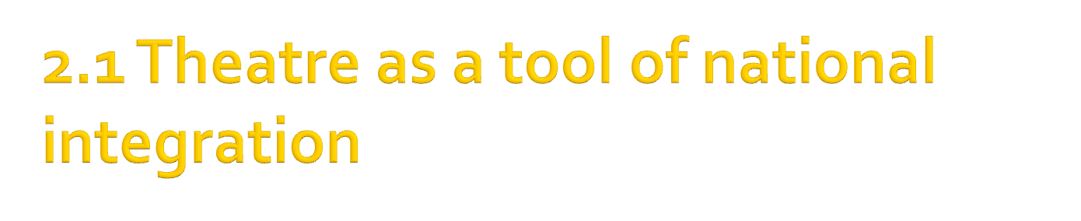
During his exploration Sircar realized the existence of two cultural trends that ran parallel to each other, giving rise to a fundamental dichotomy between urban and rural lives,
with this understanding he had come to realize the existence of two distinct kinds of theatre in rural and urban areas of India.

Slide 12

As he was basically a middle class man of Calcutta, he was attached to the city of Calcutta. A city of alien culture based on English education repressing, distorting, buying, promoting, putting up for sale the real culture of the country.
Sircar had an intimate feel of the urban conscience of this city and had a profound understanding of the middle class life, and through almost all his major plays, he is found probing into the Calcutta middle-class mind.
Sircar produced plays that hit the rural and urban dichotomy as he wished to create a link between the two theatres through his Third Theatre, a theatre of synthesis.

Slide 13

Sircar was active member of undivided Communist Party of India in 1940s, the decade of Independence.
Thereafter he says he criticized the Party and was suspended.
After a year of his suspension still he continued in organized politics.
Though in the early 50s he quit politics never to return, his personal political outlook did not change.

Slide 14
As he said party had let him down but the ideology of Marxism has kept him alive. Sircar depicts the accusations of his detractors and his defense against them in an autobiographical play Shesh Nei (There’s No End).
Later he confessed:
“After I left politics, there was a huge void. Many things came into my life then, one of them was theatre”

Slide 15

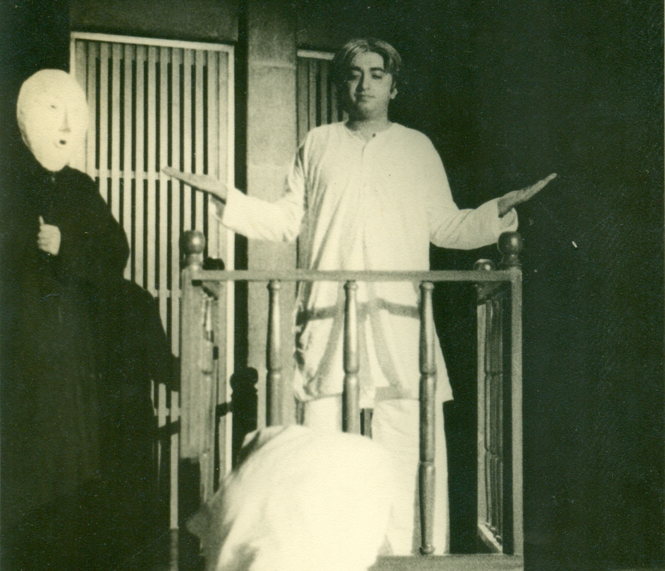
Show at IIC in 1978 directed in English By Tejeshwar Singh. With Manohar Khushalani, Brinda Singh, Bhaskar Ghosh, Siddharth Basu, Joy Sengupta

Slide 16

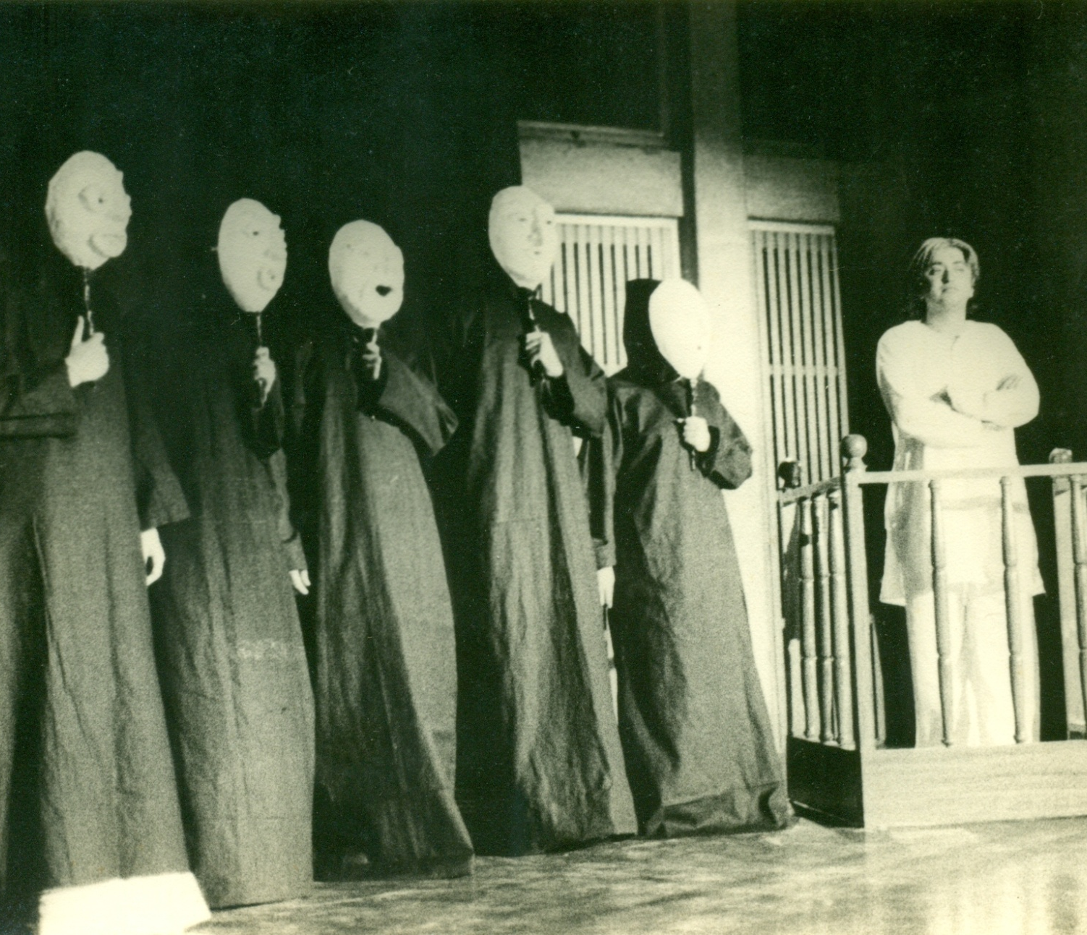
Show at IIC in 1978 directed in English By Tejeshwar Singh. With Manohar Khushalani, Brinda Singh, Bhaskar Ghosh, Siddharth Basu, Joy Sengupta

Slide 17

Though he left politics, it can be visualized that he was closely attached to the Communist principles.
His shift from proscenium to open-air theatre is also considered by some to be a kind of Marxist development. His play like Hattamalar Oparey depicts Marxist outlook.

Slide 18
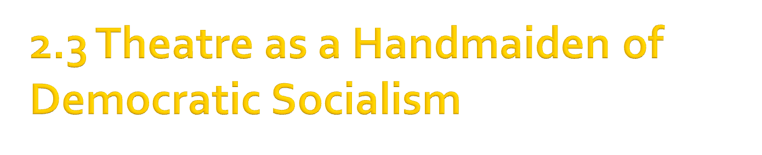
Some critics say that Sircar believed in Communism, simply because he wished to work for the society. Which is debatable
Just because he wished to change the world, critics thought he was a communist. May be he was utopian
The transition from depicting the alienation of the middle classes to writing about the lives of workers and peasants is arguably considered to be a Marxist progression.

Slide 19
His ideology is best outlined in his play Hattamalar Oparey (Beyond the Land of Hattamala, 1977). The story of two thieves—named Kena (Bought) and Becha (Sold), obviously representative of the evils of capitalism
They chance upon a land of no money that operates according to the Marxist principle of each to the best of his ability and to each according to his need.
After many escapades Kena and Becha decide shamefacedly to give up their evil ways and live in this new land, one as a mason and the other as a gardener.
Hattamala ends with the chorus singing “We’ll share what we have together. Come, let’s share everything together”.

Slide 20

http://www.youtube.com/watch?v=EGlcVVN2p9k
http://vimeo.com/24455561

Slide 21

1. Sircar, Badal. Interviewed by Shayoni Mitra, Calcutta 27 and 29 December.
2. Sircar, Badal. “The Third Theatre”, Pioneer. New Delhi, 1992
3. Sircar, Badal. “The Third Theatre” On Theatre, Calcutta: Seagull Books 2009.
4. Sircar, Badal. “Voyages in the Theatre: IV Shri Ram Memorial Lecture.” On Theatre Calcutta: Seagull Books 2009.
5. Sircar, Badal. Interviewed by Shayoni Mitra, Calcutta 27 and 29 December
6. Badal Sircar’s “Third Theatre: Feature and Functions” by Swati Bhise

Slide 22
7. Sircar, Badal. “Voyages in the Theatre: IV Shri Ram Memorial Lecture” On Theatre Calcutta: Seagull Books 2009.
8. Sircar, Badal. “The Changing Language of the Theatre” On Theatre, Calcutta: Seagull Books 2009.
9. Deshpande, Sudhanva. Interview with Shayoni Mitra. New Delhi, 14 January. 2004
10. Sircar, Badal. Interview. “Ideology has not failed me” , By Nilanjan Dutta

