Slide 1
Three Tier Architecture of DBMS
Vikram Goyal

Slide 2
Objective
Introduce Physical Data Independence
Introduce Logical Data Independence
Tree Tier DBMS Architecture

Slide 3
Physical Data Independence
Any change in Physical Layout of files on storage should not require change in Application Programs

Slide 4
Example of Physical Data Dependence
Class Employe1{
String employee-id;
String name;
int salary;
}
________________________________
Application Code:
Emp.employe-id = filename.ReadString(10);
Emp.name = filename.ReadString(40);
Emp.salary = filename.ReadNumeric(2);
Structure of Data is embedded inside the application Program

Slide 5
Drawbacks: Physical Data Dependence
What if File format is changed in the following way:
Order of attributes stored is changed
Number of Bytes used to store attributes is changed
What Else?

Slide 6
Solution to provide PDI
METADATA
Data about Data
Will record information about the Structure of the data file
Data File
Meta Data
Database

Slide 7
MetaData
Data File:
Class Employe1{
String employee-id;
String name;
int salary;
}
Meta Data:
Name of the Attribute : employee-id
Type of Attribute: String
Size of Attribute: 10
Name of the Attribute : name
Type of Attribute: String
Size of Attribute: 40
Name of the Attribute : Salary
Type of Attribute: Numeric
Size of Attribute: 2

Slide 8
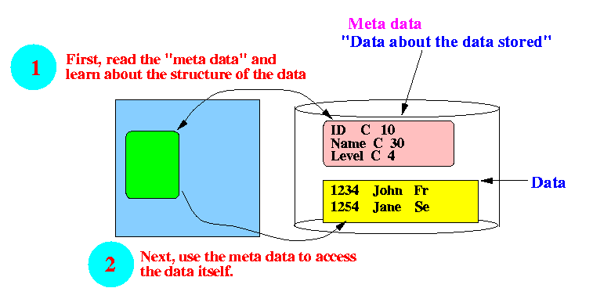
Physical Data Independence Process
The program must first know about the structure of the data file by using a metadata file.
http://www.mathcs.emory.edu/~cheung/Courses/377/Syllabus/1-files/physical1.html

Slide 9
Important Property of Metadata File
Structure of Metadata file does not change.
Why?
Is this statement any important?
Notes:
Statement relevance: Programs that use meta datafiles do not need to change(Because the structure of the meta data file do not change)

Slide 10
Examples of Metadata
Class Bank_Account{
Name character(40);
Account_number long;
Account_type char(1);
Balance long;
}
Rel_name, attr name, data type, size, position
Bank_account, Name, character, 40, 1
Bank_account, Account_number, 4, 2
Notes:
Ask for couple of structures and create Metadata for them.

Slide 11
How does metadata use provide PDI?
If a data file format changes:
That change will be recorded in metadata file.
The program which provides/accesses data first consults metadata, hence would know how the data from data file should be accessed.

Slide 12
What did we loose/gain?
Loose:
Due to Indirection
Complex Code
Efficiency
Gain
Due to Metadata (which has a fix structure)
Physical Data Independence
Format of Data file can change and we do not need to change the program.

Slide 13
DBMS Software Physical Data Independence
A database consist of many files.
Files may have different structure
DBMS code is not allowed to change. In fact it is not shared.
It allows us to define/change the structure of file, and then allow access to the data file.
Datafile and meta data file are changed when structure/format is changed.
PROGRAM is not changed.

Slide 14
A DBMS System must use the meta data technique.

Slide 15
Physical Data
Storage Layout
Clustered File
Non-clustered File
Issues related to Block Layout
Etc....... Will do later

Slide 16
Logical Data Independence
Ability to present information in different ways to different users.

Slide 17
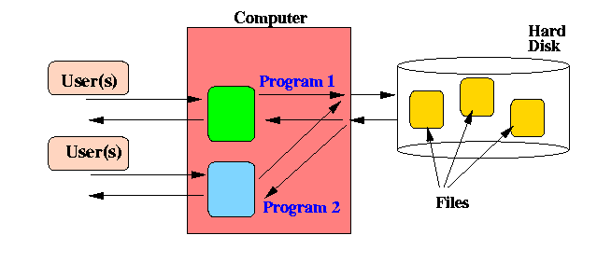
Need
Different users have different requirements.

Slide 18
Problem with Flat File System
Redundancy
Consistency
And many more.....

Slide 19
To avoid Flat File System Problem
Store data in consolidated form.
Conceptual Schema
One schema for each database application
Each user will have its own external schema
Human Resource
Accounts
Course Management

Slide 20
Logical Data Independence
Change in Conceptual schema should not demand change in application program accessing external schema.
The way you view (perceive) the data is INDEPENDENT from the way you store the data.

Slide 21
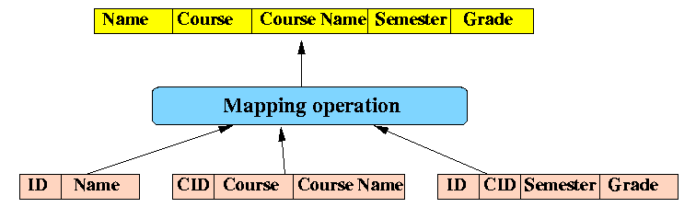
Student Grade Report
http://www.mathcs.emory.edu/~cheung/Courses/377/Syllabus/1-files/logical.html

Slide 22
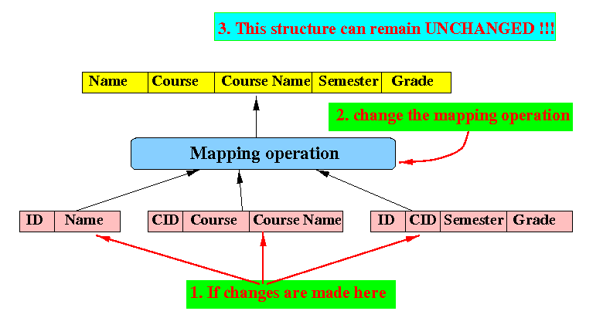
Logical Data Independence Example
http://www.mathcs.emory.edu/~cheung/Courses/377/Syllabus/1-files/logical.html

Slide 23
Logical Data Independence: A Big Deal?
The Logical Data Independence technique can maintain the end user data file structure in the same format
It will make end users very happy customers !

Slide 24
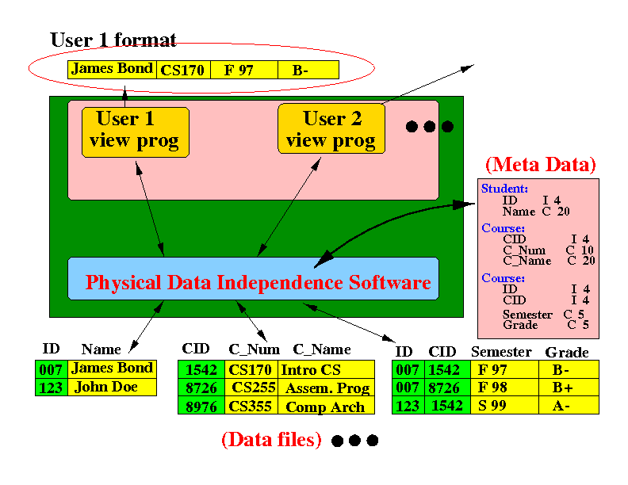
DBMS Software Architecture
http://www.mathcs.emory.edu/~cheung/Courses/377/Syllabus/1-files/logical.html

Slide 25
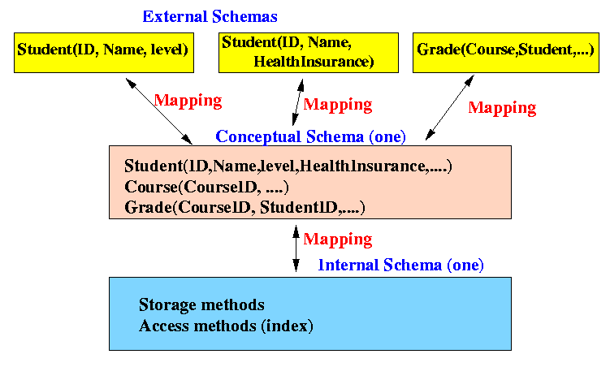
Three Tier Architecture
http://www.mathcs.emory.edu/~cheung/Courses/377/Syllabus/1-files/logical.html

Slide 26
Thanks

