Slide 1
Global Warming & Climate Change:
Science and Policy

Slide 2
Science

Slide 3
What is Global Warming and Climate Change?
Global warming and climate change refer to increasing average global temperatures.
Causes of higher global temperatures: Natural events and Human Activities
Primary cause of climate change is the “greenhouse effect”: caused by increase or decrease in the concentration of certain atmospheric gases such as Carbon Dioxide (CO₂).

Slide 4
What is Greenhouse Effect?
Energy from the sun drives the earth’s weather and climate, and heats the earth’s surface.
In turn, the earth radiates energy back into space;
Some atmospheric gases (water vapor, carbon dioxide, etc.) trap some of the out-going energy, retain heat somewhat like the glass panels of a greenhouse. This is termed as the Greenhouse effect.
As a result a gradual but steady rise in surface temperature might be induced as concentrations of GHGs increases and higher amounts of energy is trapped in earth’s atmosphere.

Slide 5
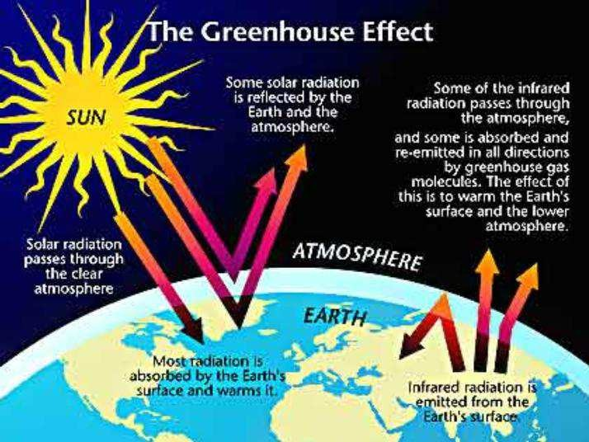

Slide 6
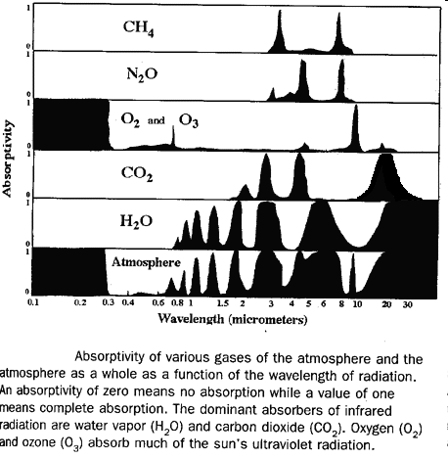

Slide 7
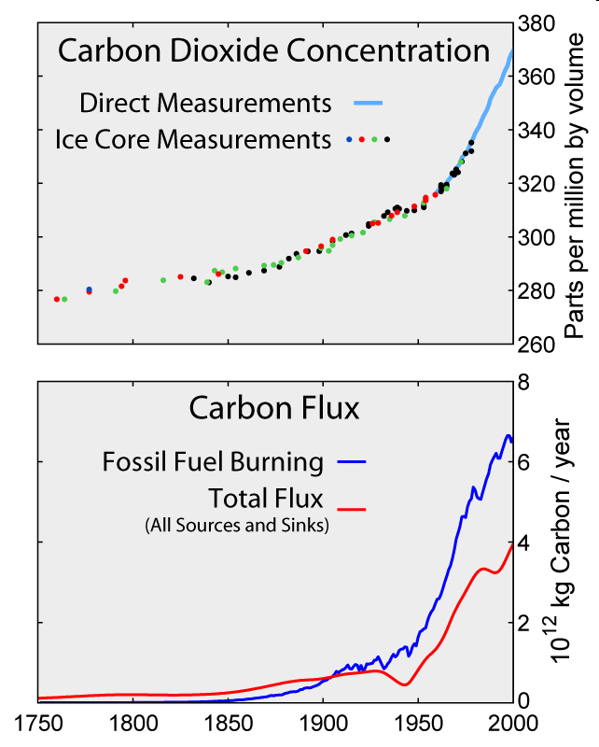

Slide 8
Greenhouse Gases
Six main greenhouse gases are:
carbon dioxide (CO₂)
methane (CH₄) (which is 20 times as potent a greenhouse gas as carbon dioxide)
nitrous oxide (N₂O), plus
three fluorinated industrial gases:
hydrofluorocarbons (HFCs),
perfluorocarbons (PFCs) and
sulphur hexafluoride (SF₆).
Water vapor is also considered a greenhouse gas

Slide 9
Gas | Pre-industrial Levels (1750s) | Present-day Levels (2010) | Increase (%)
Carbon dioxide | 280 ppm | 387 ppm | 107 ppm (~40%)
Methane | 700 ppb | 1,745 ppb | 1,045 ppb (~150%)
Nitrous oxide | 270 ppb | 314 ppb | 44 ppb (~16%)
CFC-12 | 0 | 533 ppt | 533 ppt

Slide 10
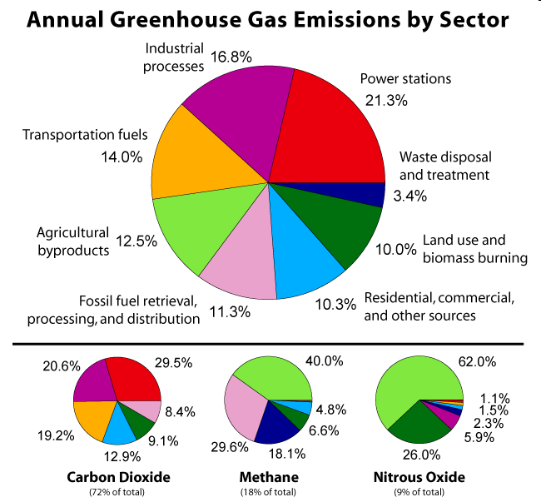

Slide 11
The Greenhouse effect is natural. What do we have to do with it?
Many of these greenhouse gases are actually life-enabling, for without them, heat would escape back into space and the Earth’s average temperature would be a lot colder.
However, if the greenhouse effect becomes stronger more heat gets trapped than usual and the warmer Earth might become less habitable for humans, plants and animals.
Carbon dioxide, though not the most potent of greenhouse gases, is the most significant one. Human activity has caused an imbalance in the natural cycle of the greenhouse effect and related processes

Slide 12
Impacts of Global Warming
Rapid changes in global temperature
Extreme Weather Patterns
More hurricanes and droughts
Longer spells of dry heat or intense rain
Scientists have pointed out that Northern Europe could be severely affected with colder weather if climate change continues, as the arctic begins to melt and send fresher waters further south. It would effectively cut off the Gulf Stream that brings warmth from the Gulf of Mexico, keeping countries such as Britain warmer than expected
Ecosystem Impacts
Rising sea levels
Increasing ocean acidification
Increase in pests and disease
Failing agricultural output; Increase in World hunger
Variability in weather is key

Slide 13
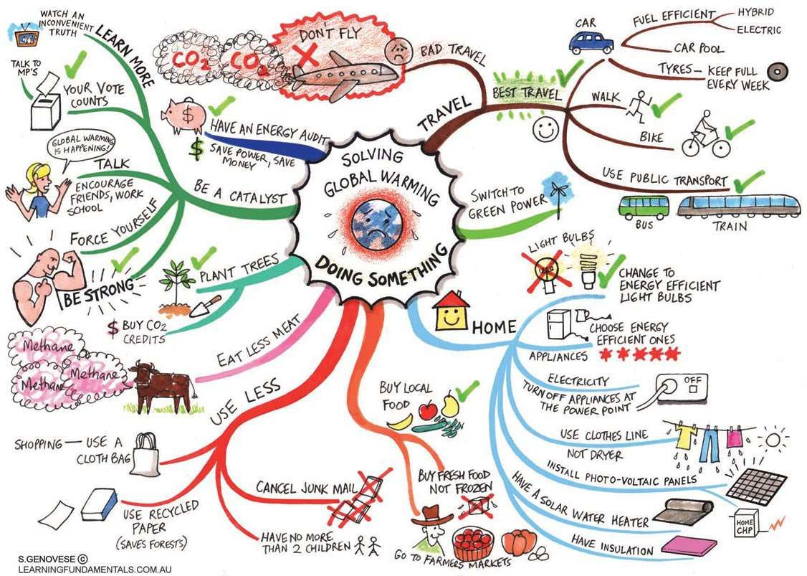

Slide 14
Differences in Greenhouse Gas Emission around the World
In terms of historical emissions, industrialized countries account for roughly 80% of the carbon dioxide buildup in the atmosphere to date.
Since 1950, the U.S. has emitted a cumulative total of
roughly 50.7 billion tons of carbon, while China (4.6 times more populous) and India (3.5 times more populous) emitted only 15.7 and 4.2 billion tons respectively (though these numbers are expected to rise quite rapidly).
Annually, more than 60 percent of global industrial carbon dioxide emissions originate in industrialized countries, where only about 20 percent of the world’s population resides.

Slide 15
Differences in Greenhouse Gas Emission around the World (contd.)
Much of the growth in emissions in developing countries results from the provision of basic human needs for growing populations, while emissions in industrialized countries contribute to growth in a standard of living that is already far above that of the average person worldwide
The United States is the world’s largest per-capita emitter of GHGs
Around 2007, China surpassed the US as the world’s largest emitter of greenhouse gases in terms of total output.

