Slide 1

Brain Tumor Classification
By Riya Sharma, Kushagra Singh and Moksh Yadav
Under Guidance of Dr. Pratistha Mathur

Slide 2

  The human brain is the major controller of the humanoid system. The abnormal growth and division of cells in the brain lead to a brain tumor, and the further growth of brain tumors leads to brain cancer.
  In the area of human health, Computer Vision plays a significant role, which reduces the human judgment that gives accurate results. CT scans, X-Ray, and MRI scans are the common imaging methods among magnetic resonance imaging (MRI) that are the most reliable and secure. MRI detects every minute objects.
  Our project aims to focus on the use of different techniques for the discovery of brain cancer using brain MRI. We use Convolution Neural Network (CNN) segmentation techniques for reliable detection of the tumor region. Training and testing datasets are used. Based on our machine, we will predict whether the subject has a brain tumor or not.

Slide 3

Introduction
Methodology
Input Dataset
Code Snippets
Output
Result
Conclusion
Future Scope
References

Slide 4

According to WHO, nearly 400,000 people around the world are affected by brain tumor and nearly 120,000 people have died due to it in the last decade.
Magnetic resonance imaging (MRI) is a non-invasive medical test that helps physicians diagnose and treat medical conditions. These images can be inspected on a computer monitor.
Automated brain tumor detection from MRI images is one of the most demanding tasks in today’s modern medical imaging research.
Automatic detection requires brain image segmentation, which is the process of separating the image into distinct regions, is one of the most vital and demanding aspect of computer aided clinical diagnostic tools.
Our model applies the image segmentation technique using Convolutional Neural Network(CNN) to build a neural network to detect different types of tumors in a patient’s brain.

Slide 5

We tried to come up with an exemplary which can accurately classify the tumor from 2D Brain MRI images. A fully-connected neural network can detect the tumor, but because of parameter sharing and sparsity of connection, we adopted CNN for our model.
A Six-Layer Convolutional Neural Network is introduced and implemented for tumor detection. The aggregated model consisting of stages including the hidden layers provides us with the most prominent result for the apprehension of the tumor.
ReLU is used as an activation function so that it’s not corroborating with the output. It also shows better convergence performance.
In this DeepNet architecture, progressively shorten the spatial size of the depiction for diminishing the chunk of parameters and computational time of the network. Working on the Brain MRI image can also cost the contamination of the overfitting and for this Max Pooling layer perfectly works for this perception.

Slide 6

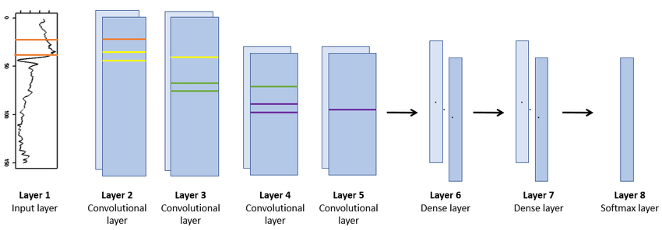
After the pooling layer, a pooled feature map is obtained. Flattening is one of the essential layers after the pooling because we’ve to transformed the whole matrix representing the input images into a single column vector and it’s imperative for processing. It is then fed to the Neural Network for the processing.
Two fully connected layers were employed Dense-1 and Dense-2 represented the dense layer. The dense function is applied in Keras for the processing of the Neural Network, and the obtained vector is work as an input for this layer.

Slide 7

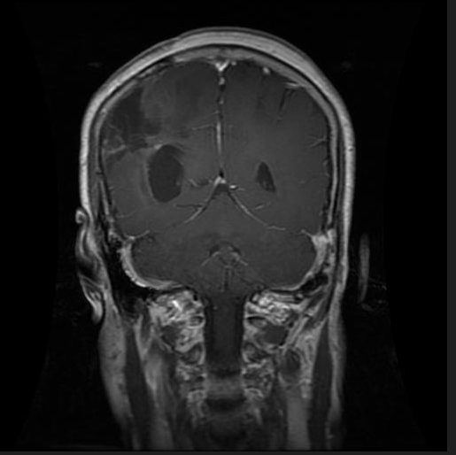
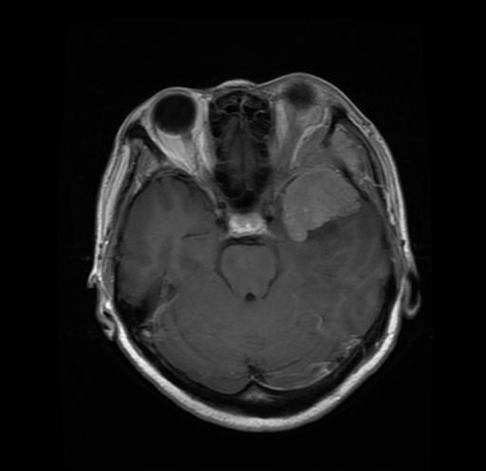
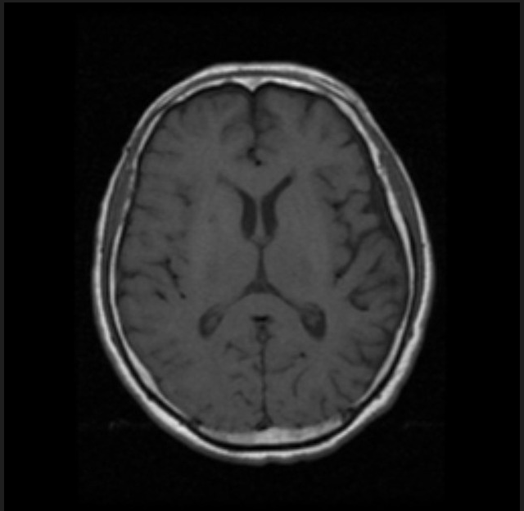
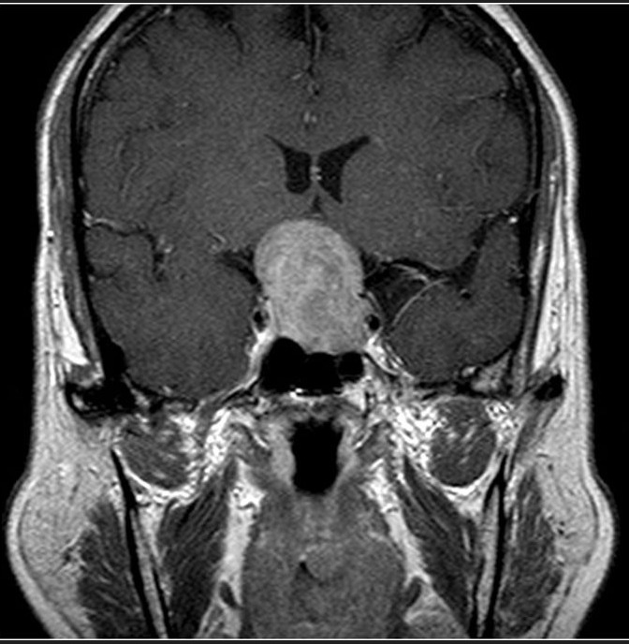
Glioma
Meningioma
No Tumor
Pituitary Tumor

Slide 8

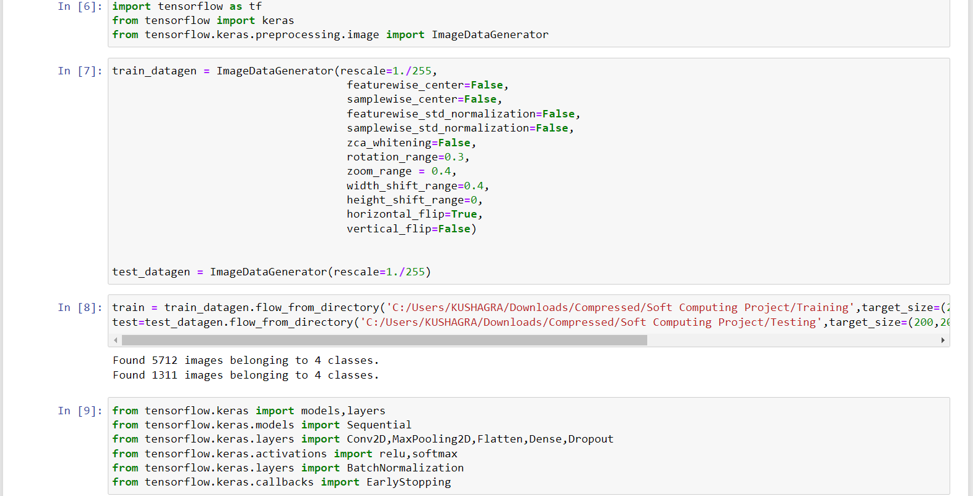

Slide 9

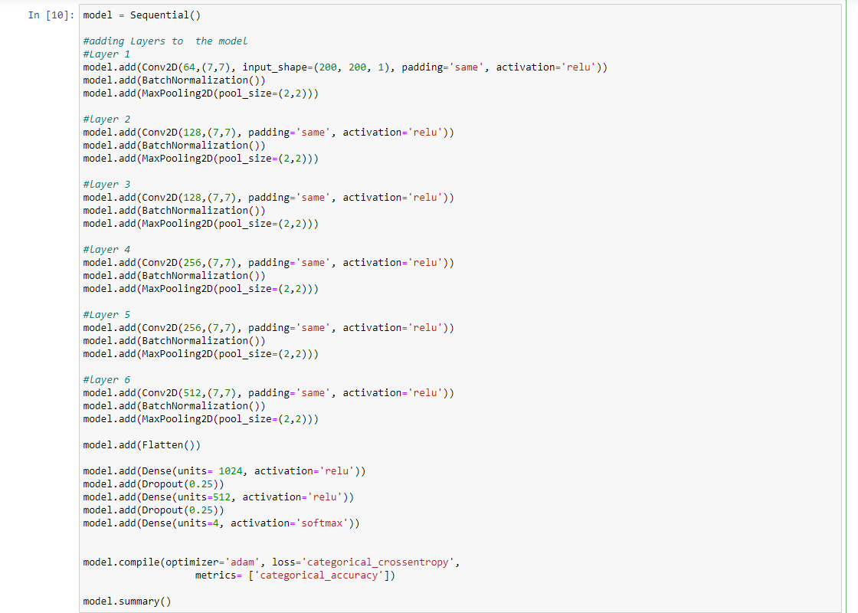

Slide 10

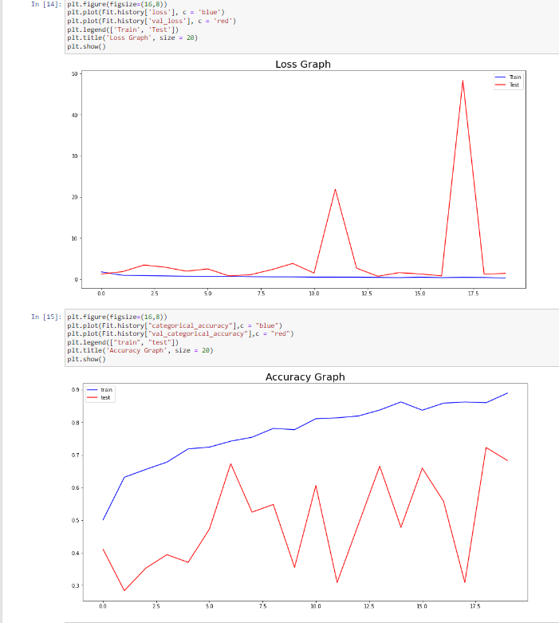

Slide 11

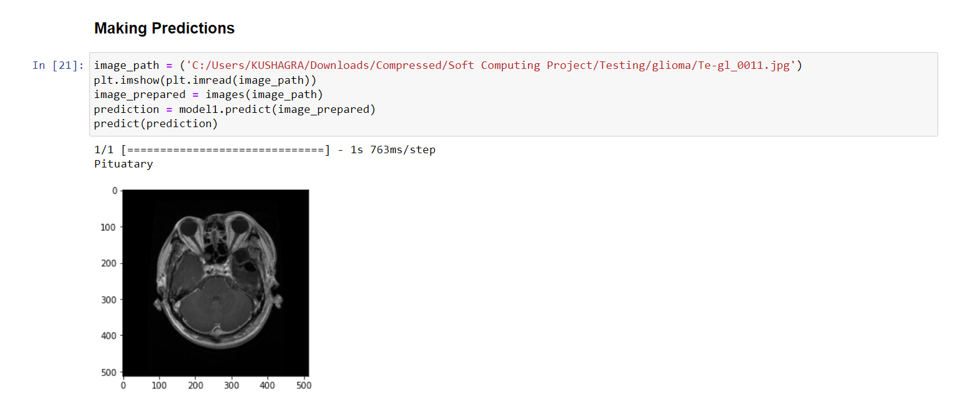
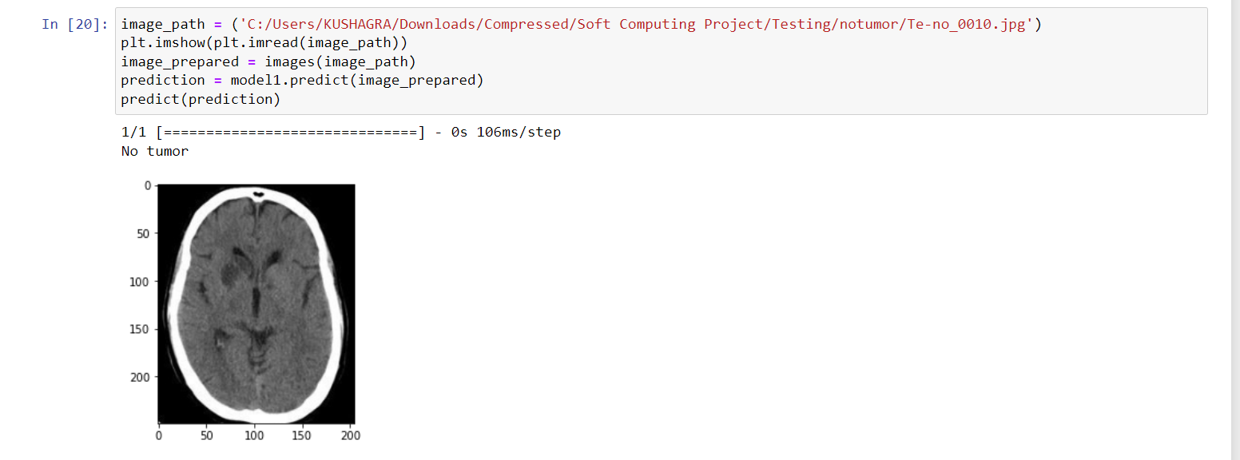

Slide 12

The main theme of this project is to study the automatic brain tumor analysis with high accuracy, performance and low complexity.
Neural Network (CNN) is established in the project. The result will be classified as a type of tumor or normal images of brain. CNN comes under the technique of deep learning, which consists of chain feed forward layers. Python language can also used for working. Database based on image net is used for classification.
The training accuracy achieved is above 90% and the testing accuracy achieved is close to 70%.

Slide 13

  In the future we can make many improvements on the above
  project.
  Some of them can be:
  1. Improving the accuracy of the project to determine the
  results more accurately.
  2. Recognition of tumor regions from MRI images.
  3. The proposed approach can be further improvised through in
  cooperating weakly trained algorithms that can identify the
  abnormalities with a minimum training data and self-
  learning algorithms would aid in enhancing the accuracy of
  the algorithm and reduce the computational time.
  4. We can create an online/offline application with an interface
  to allow normal users to access the trained model.

Slide 14

A.Sivaramakrishnan And Dr.M.Karnan “A Novel Based Approach For Extraction Of Brain Tumor In Mri Images Using Soft Computing Techniques,” International Journal Of Advanced Research In Computer And Communication Engineering, Vol. 2, Issue 4, April 2013.
Asra Aslam, Ekram Khan, M.M. Sufyan Beg, Improved Edge Detection Algorithm for Brain Tumor Segmentation, Procedia Computer Science, Volume 58,2015, Pp 430-437, ISSN 1877-0509.
B.Sathya and R.Manavalan, Image Segmentation by Clustering Methods: Performance Analysis, International Journal of Computer Applications (0975 – 8887) Volume 29– No.11, September 2011.
Kaggle for Dataset

Slide 15


