Slide 1

HealthCare Chatbot Application END TERM PRESENTATION
Minor Project Guide
Satpal Singh Kushwaha
(Assistant Professor)
Submitted By Sheenam Gupta Kushagra Singh
(209301520) (209301327)
Department of Computer Science & Engineering
School of Computer Science & Engineering
Manipal University Jaipur, India
March 2023

Slide 2
Contents
Introduction
Software/Hardware Requirements
Proposed Model
Implementation
Conclusion
References

Slide 3
INTRODUCTION
Chatbots have become prevalent in many sectors like online assistance, customer lead generation, customer service etc. But chatbots in healthcare are still rare and are in serious need due to patient overload in the country and shortage of doctors.
In this project, we implement the assistance of chatbot to human healthcare. Our chatbot will try to provide real time assistance to patients providing response to their various queries.

Slide 4
Objective Of The Project
The purpose of this chatbot is to improve access to healthcare information and services, reduce the burden on healthcare providers and enhance patient engagement and satisfaction
Brief Description
Our Chatbot uses machine learning algorithms to understand and respond to user queries in a natural and conversational manner. This project will explore the use of machine learning in healthcare chatbots and the potential benefits associated with their implementation.

Slide 5
SYSTEM REQUIREMENTS
Software Requirements
1. Natural Language Processing libraries – TensorFlow, NLTK
2. Jupyter Notebook or VSCode
3. NumPy, JSON, Pandas, Tkinter etc.
Hardware Requirements
1. Central Processing Unit (CPU) And Graphics Processing Unit.
2. Random Access Memory (RAM) And Network Interface Card.

Slide 6
PROPOSED MODEL
First we extract all the tags, patterns and responses from the intents file to variables.
We pre-process the data using tokenization and vocabularies to create sequences from inputs.
Then we create a deep learning model consisting of an Embedding, an LSTM, Flatten and a Dense layer.
Lastly the model makes the prediction based on the query, what intent the query possess.

Slide 7
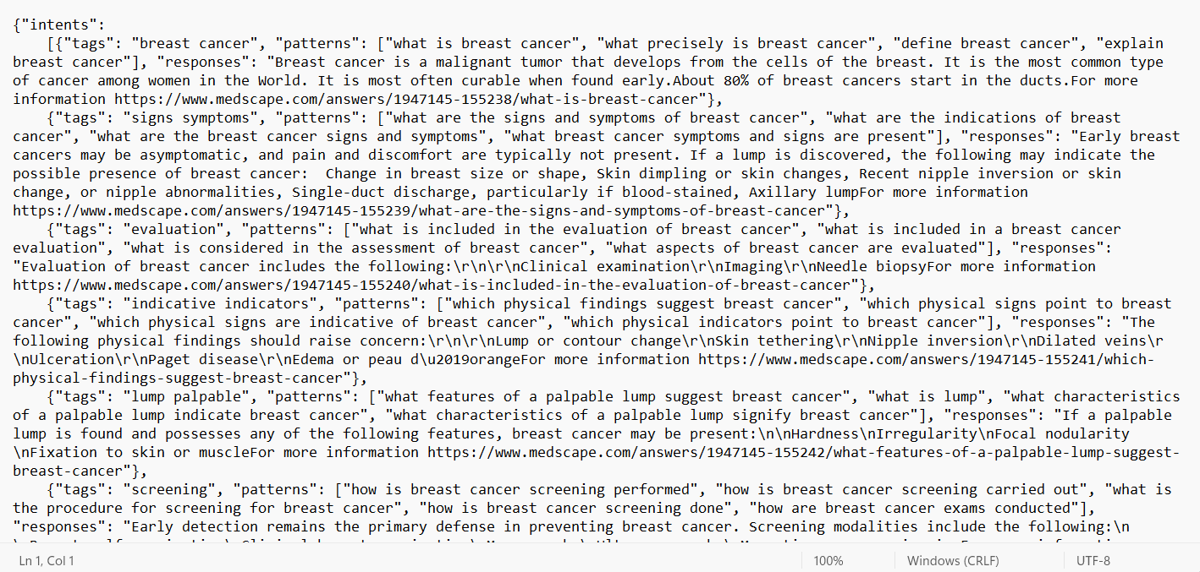
IMPLEMENTATION
Fig. 4.1 Dataset for the Model

Slide 8
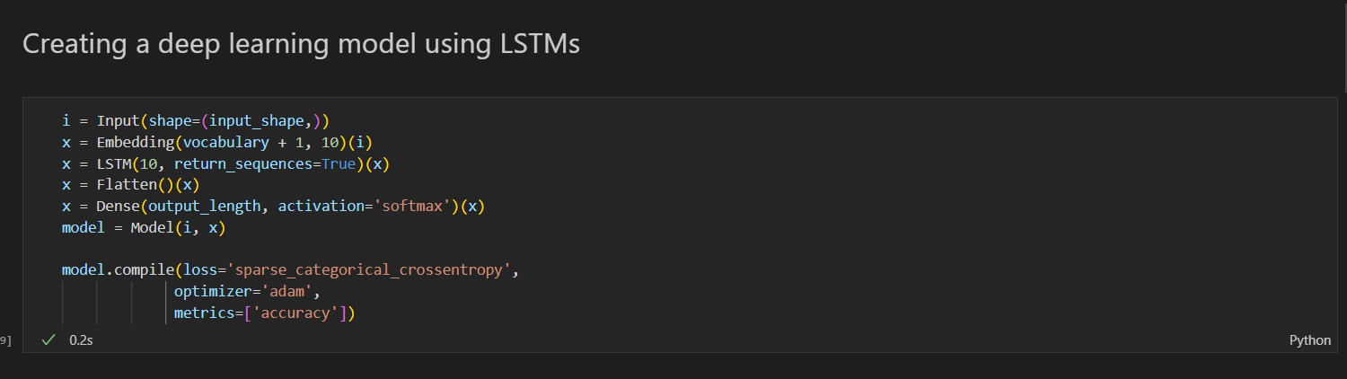
Fig 4.2 Deep Learning Model Architecture

Slide 9
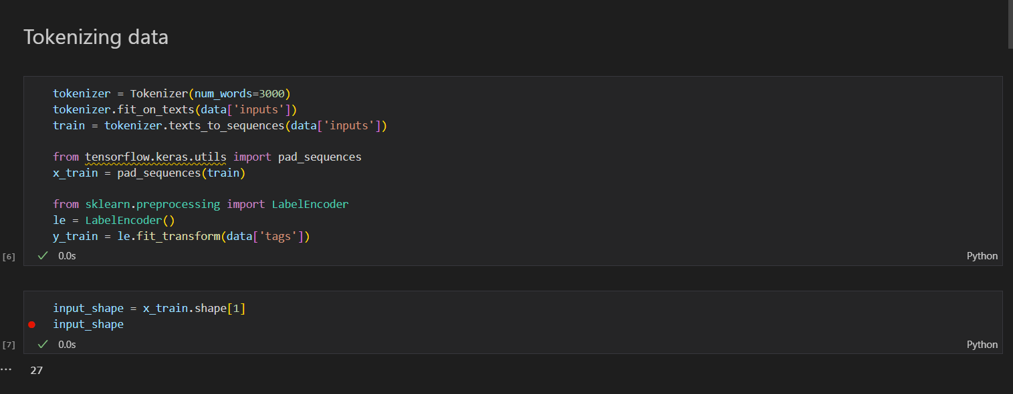
Fig 4.3: Tokenizer

Slide 10
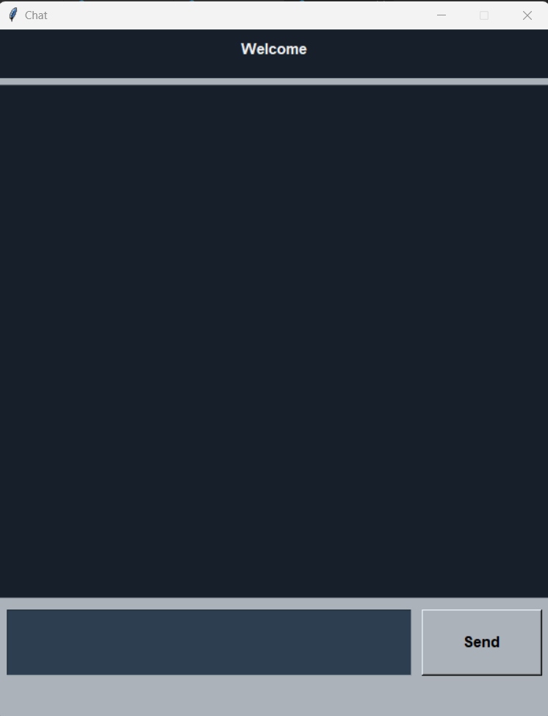
Fig 4.4 User Interface for Chatbot

Slide 11
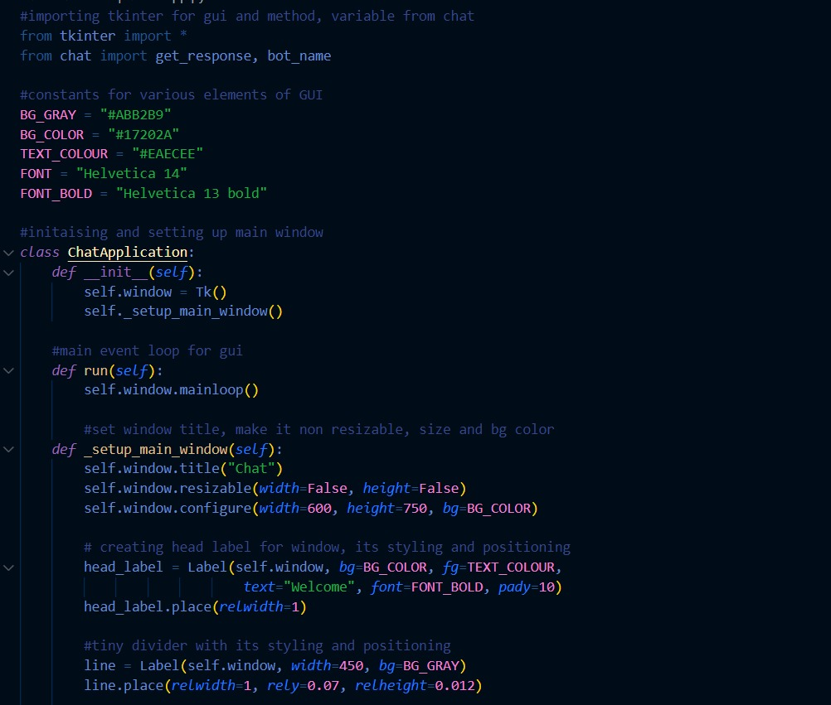
Fig 4.5 Code for UI

Slide 12
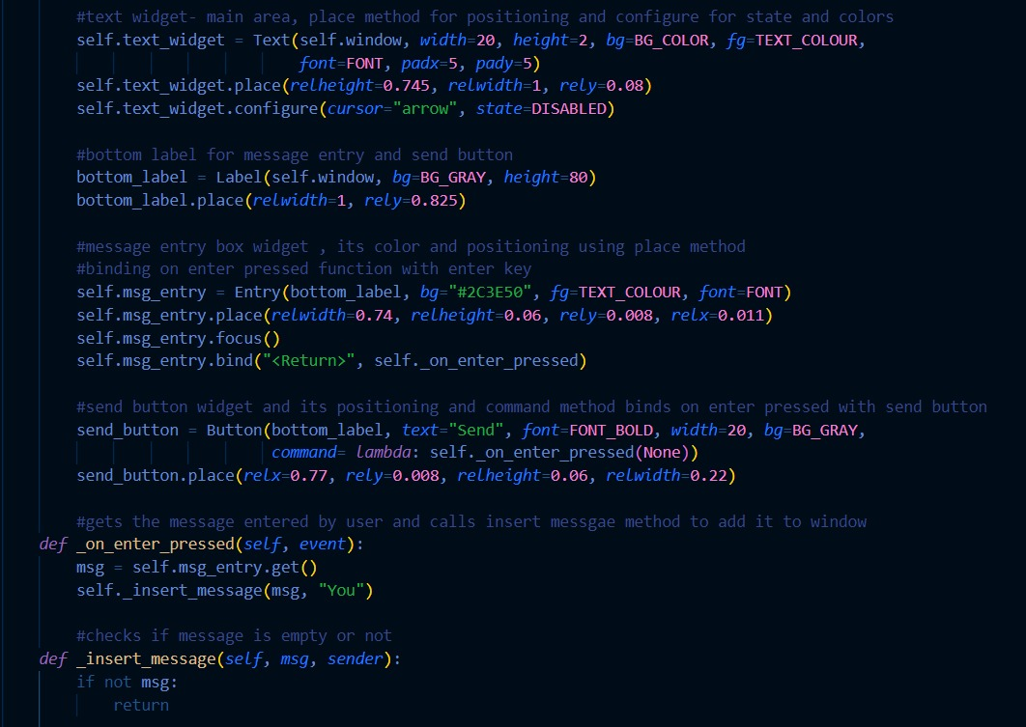
Fig 4.6 Code for UI continued

Slide 13
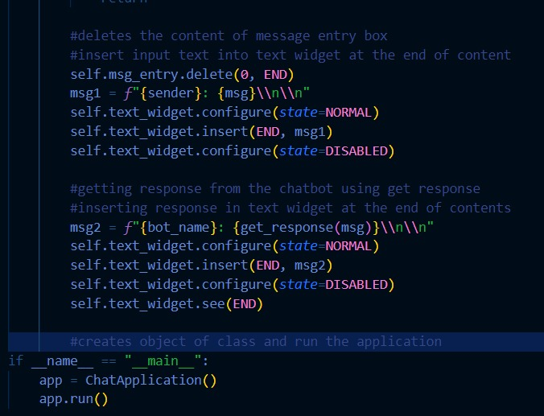
Fig 4.7 Main Message box

Slide 14
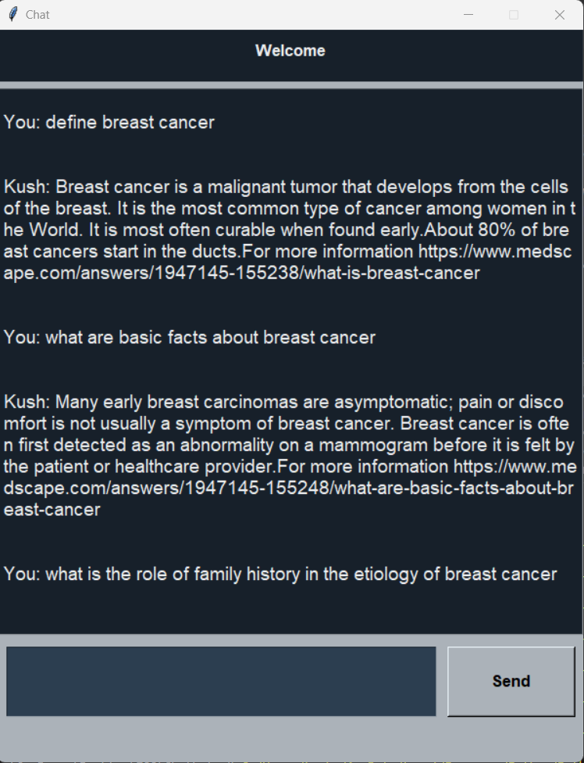
Fig 4.8 Conversation with Chatbot

Slide 15
Conclusion
This project aimed to develop and build a conversational chatbot that can interact with users and provide them with healthcare information and services. The chatbot is able to provide answers to a range of user questions, including medical advice and health education content.
Our chatbot can and will help improve healthcare access, quality and ultimately contribute to better health outcomes for patients.

Slide 16
Future Scope
There are a lot of interesting things that can be done to improve our chatbot. Some of them are:
Expanding the range of queries that the chatbot can answer to
Allowing speech recognition to answer to user queries
Integrating module to allow patients to contact hospitals and book appointments.
Having Chatbot predict certain health conditions and suggestive preventive solutions.

Slide 17
REFERENCES
Das, A. (2021) Aarogya-Bot: The AI-driven chatbot to answer your medical queries. Medium, 7 January. Available at: https://towardsdatascience.com/aarogya-bot-the-aidriven-chatbot-to-answer-your-medical-queries-4a76daf80fc4.
Lee, J. et al. (2019) BioBERT: A pre-trained biomedical language representation model for biomedical text mining, arXiv.org. Available at: https://arxiv.org/abs/1901.08746 (Accessed: March 5, 2023).
Liu, K. (2021) Building a chatbot for Mental Health Awareness and Education, Medium. Chatbots Life. Available at: https://chatbotslife.com/building-a-chatbot-formental-health-awareness-and-education-262ecd596591 (Accessed: April 4, 2023).

Slide 18
Thank You!!

