Slide 1
ABO
Arjun Moudgil (am7971)
Kushagra Agarwal (ka1745)
Qiao Feng (qf211)
Richa Desai (rd2291)

Slide 2
Introduction
What is ABO?
A network that links blood donors with hospitals that are in need of blood
Why ABO?
Blood is always needed
Rare blood can be hard to find
Emergency need for blood donation
Makes people more willing to donate since you can see immediate impact
Ensures fresh and healthy blood supply

Slide 3
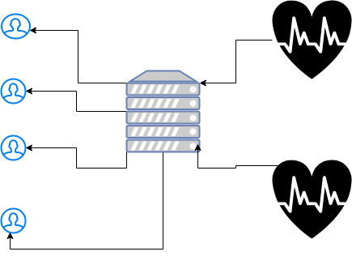
Architecture Diagram

Slide 4
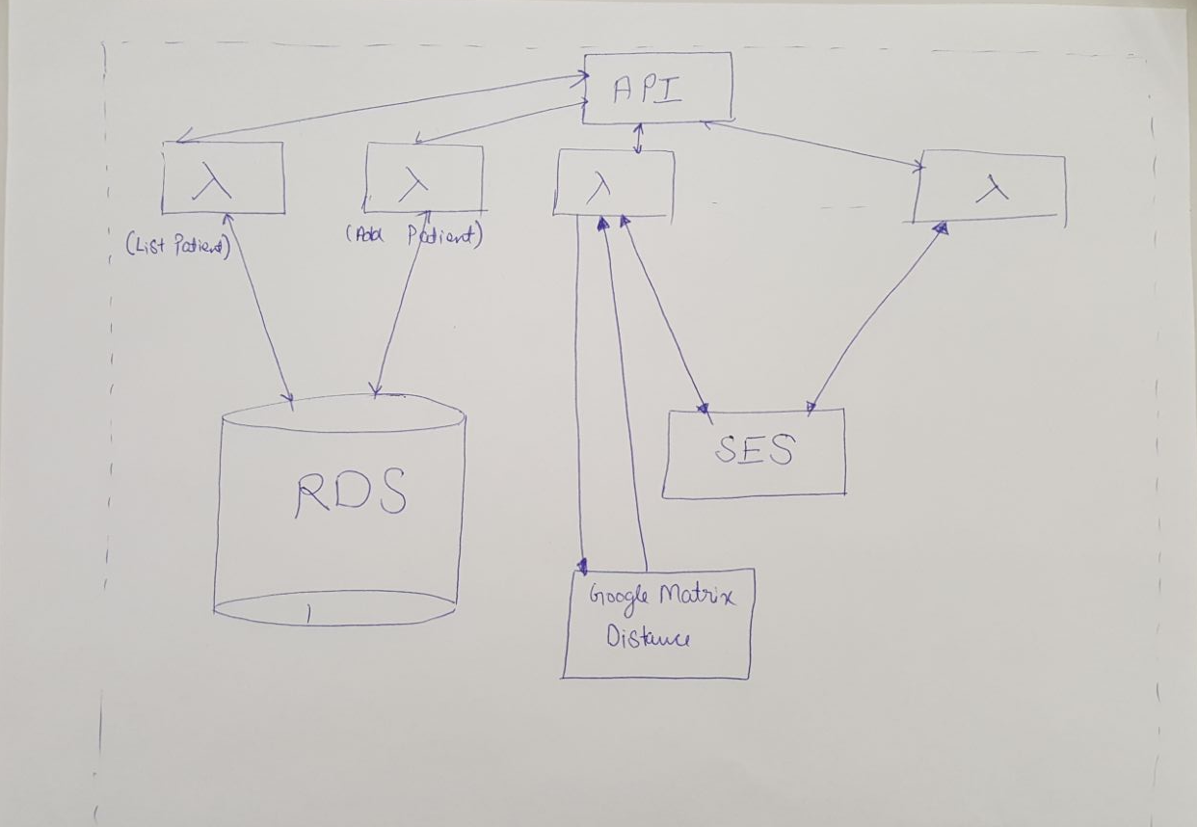

Slide 5
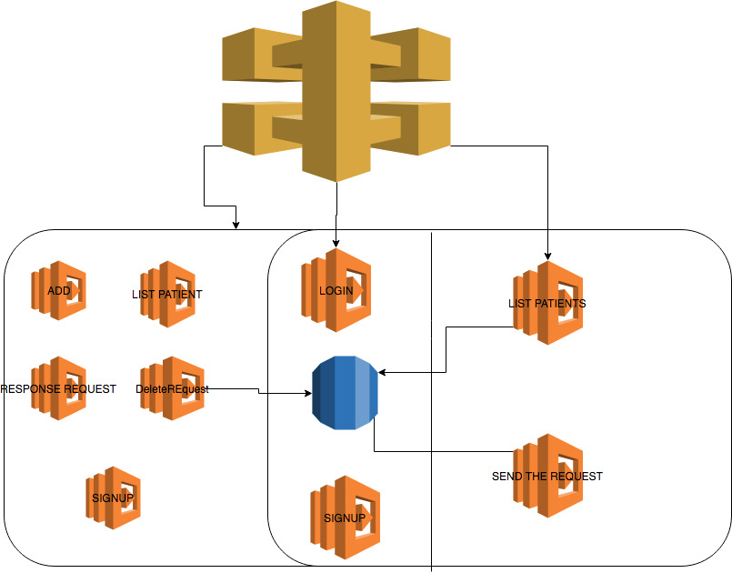

Slide 6
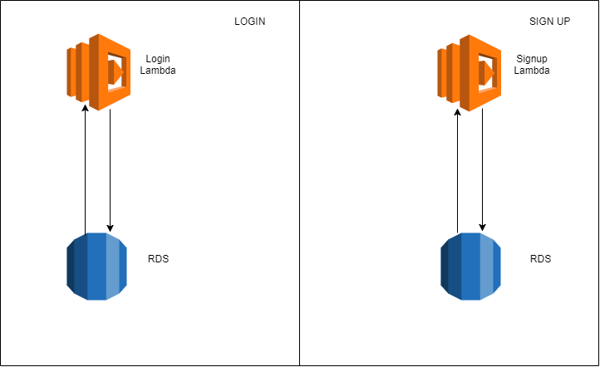

Slide 7
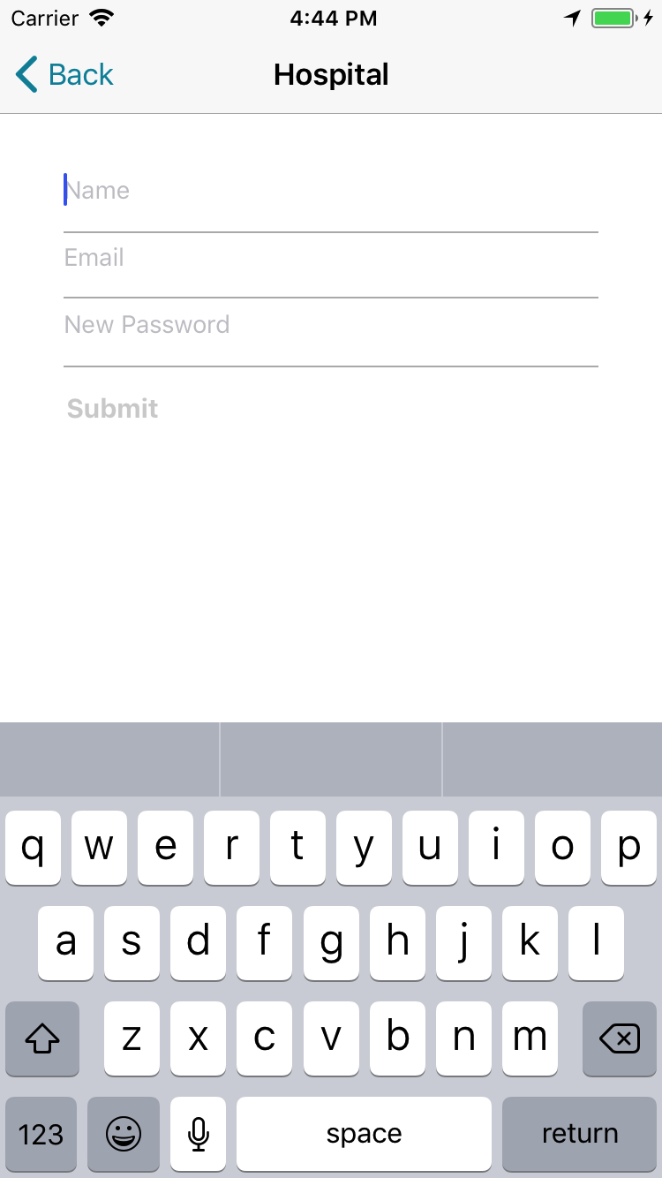
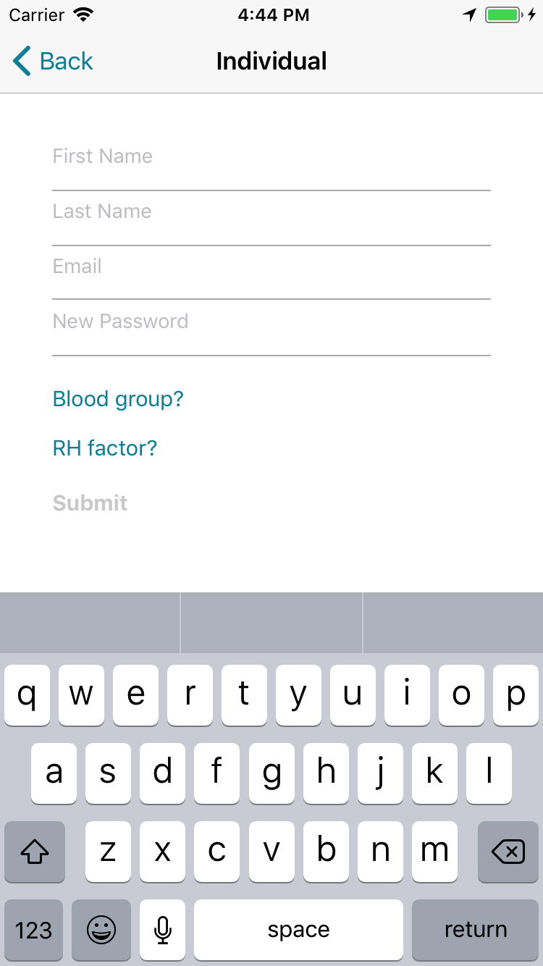

Slide 8
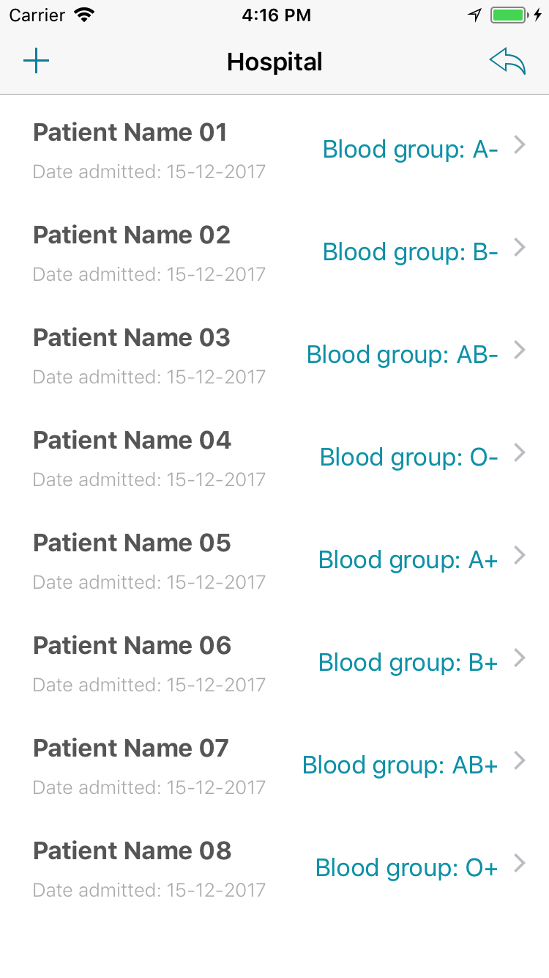
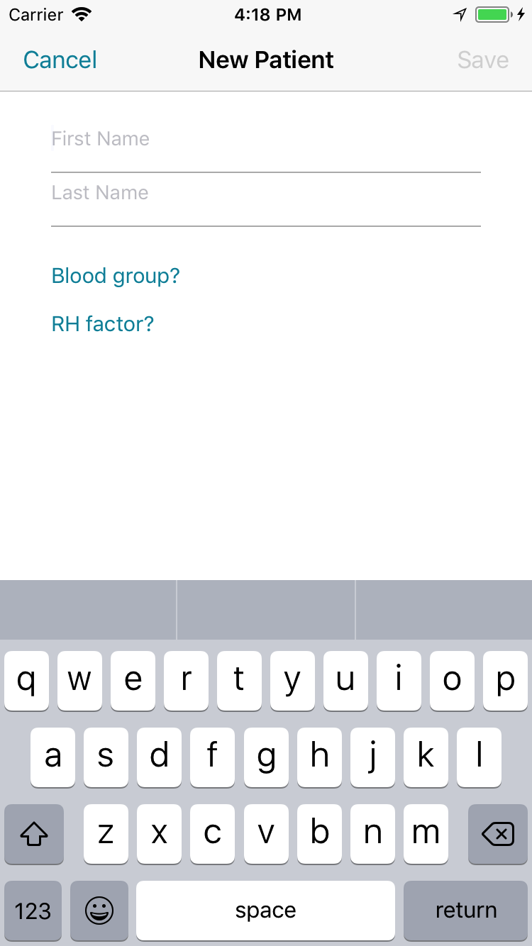

Slide 9
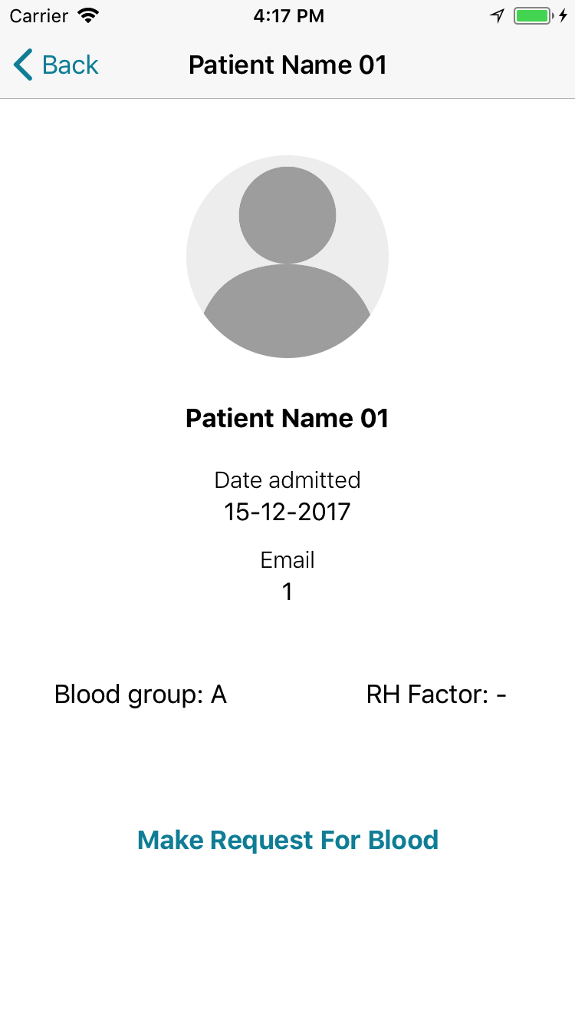
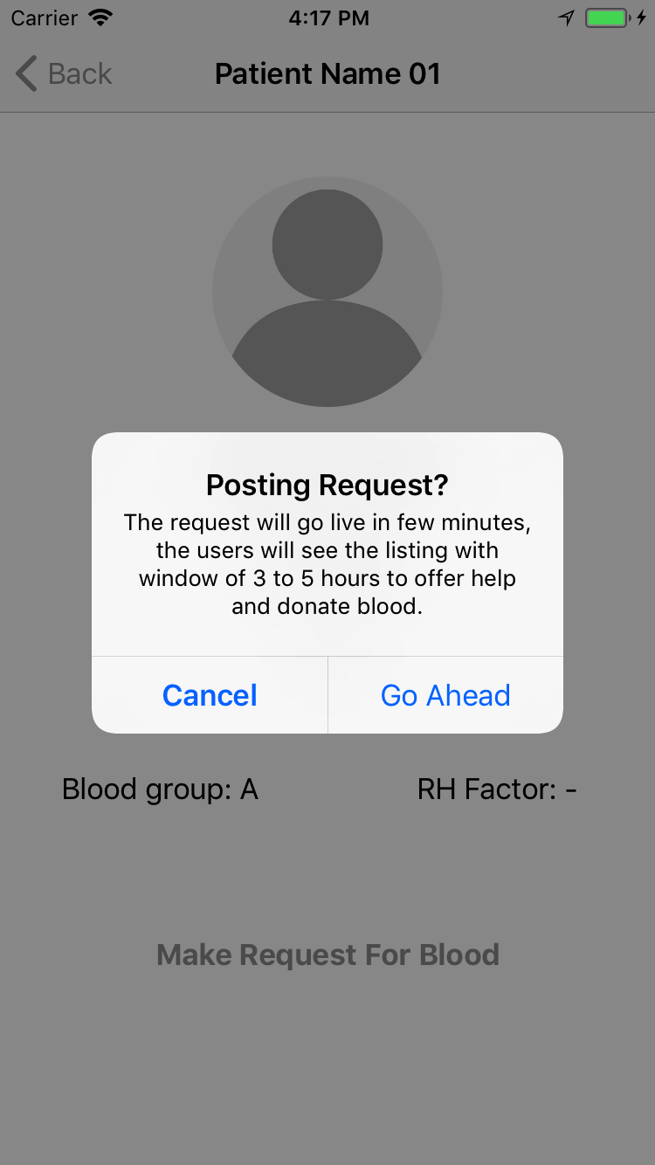

Slide 10
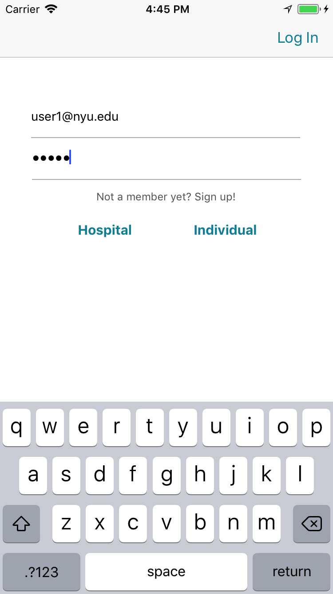
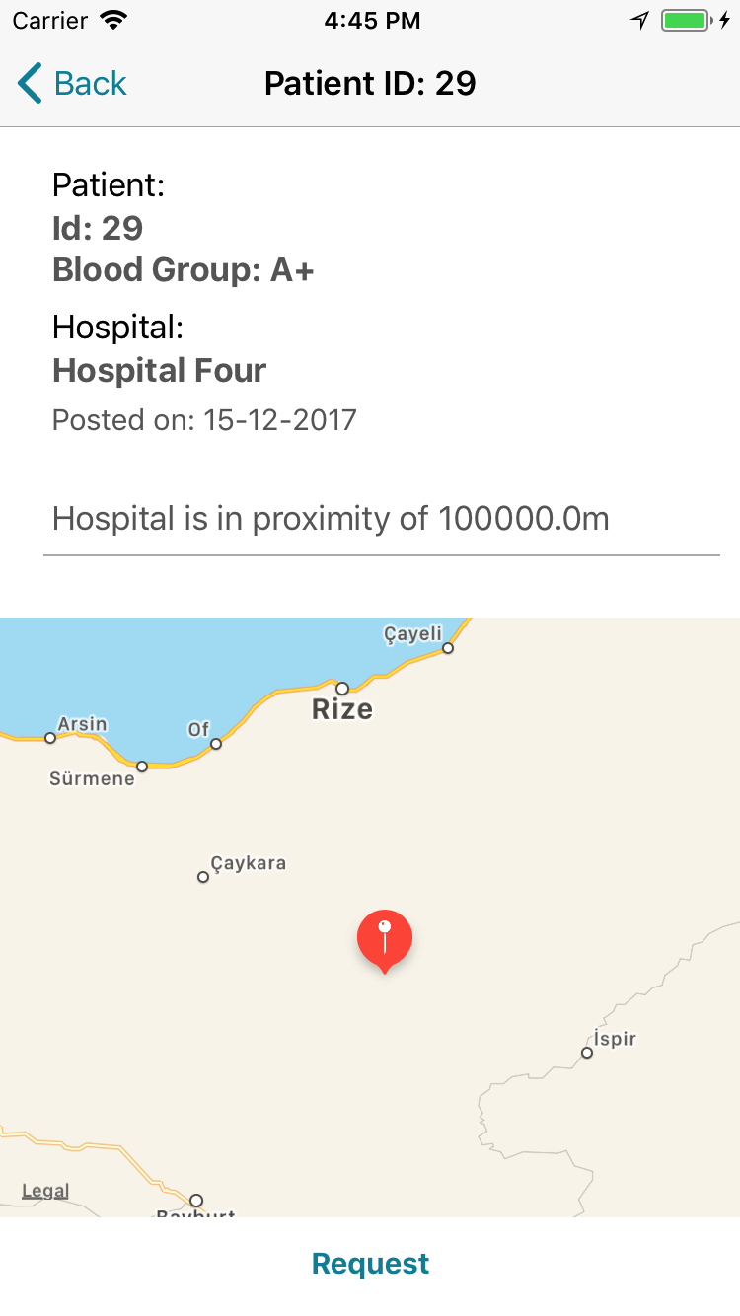

Slide 11
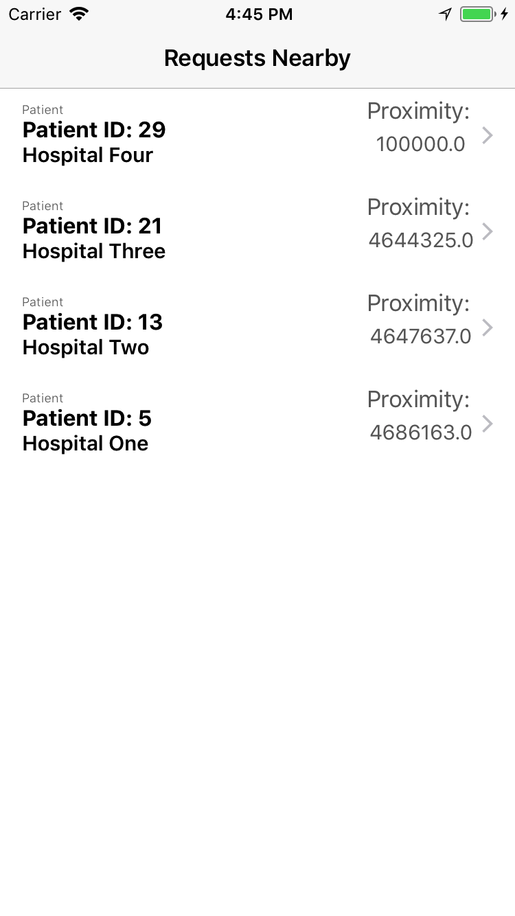
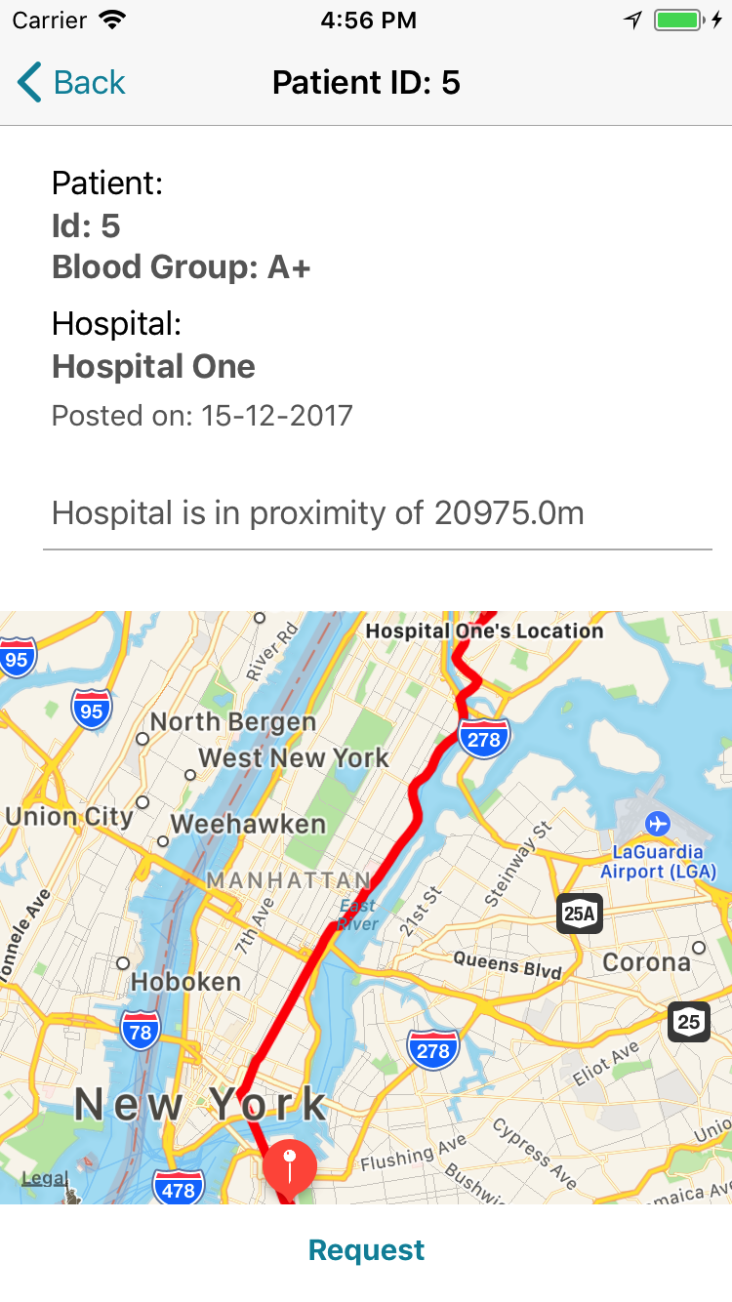

Slide 12
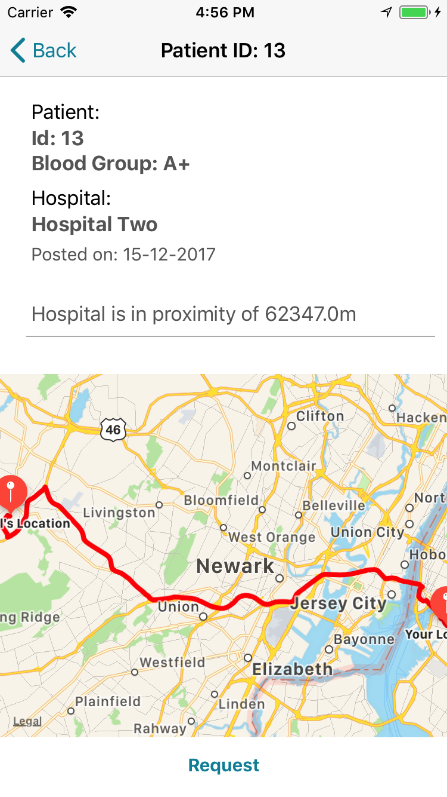

Slide 13
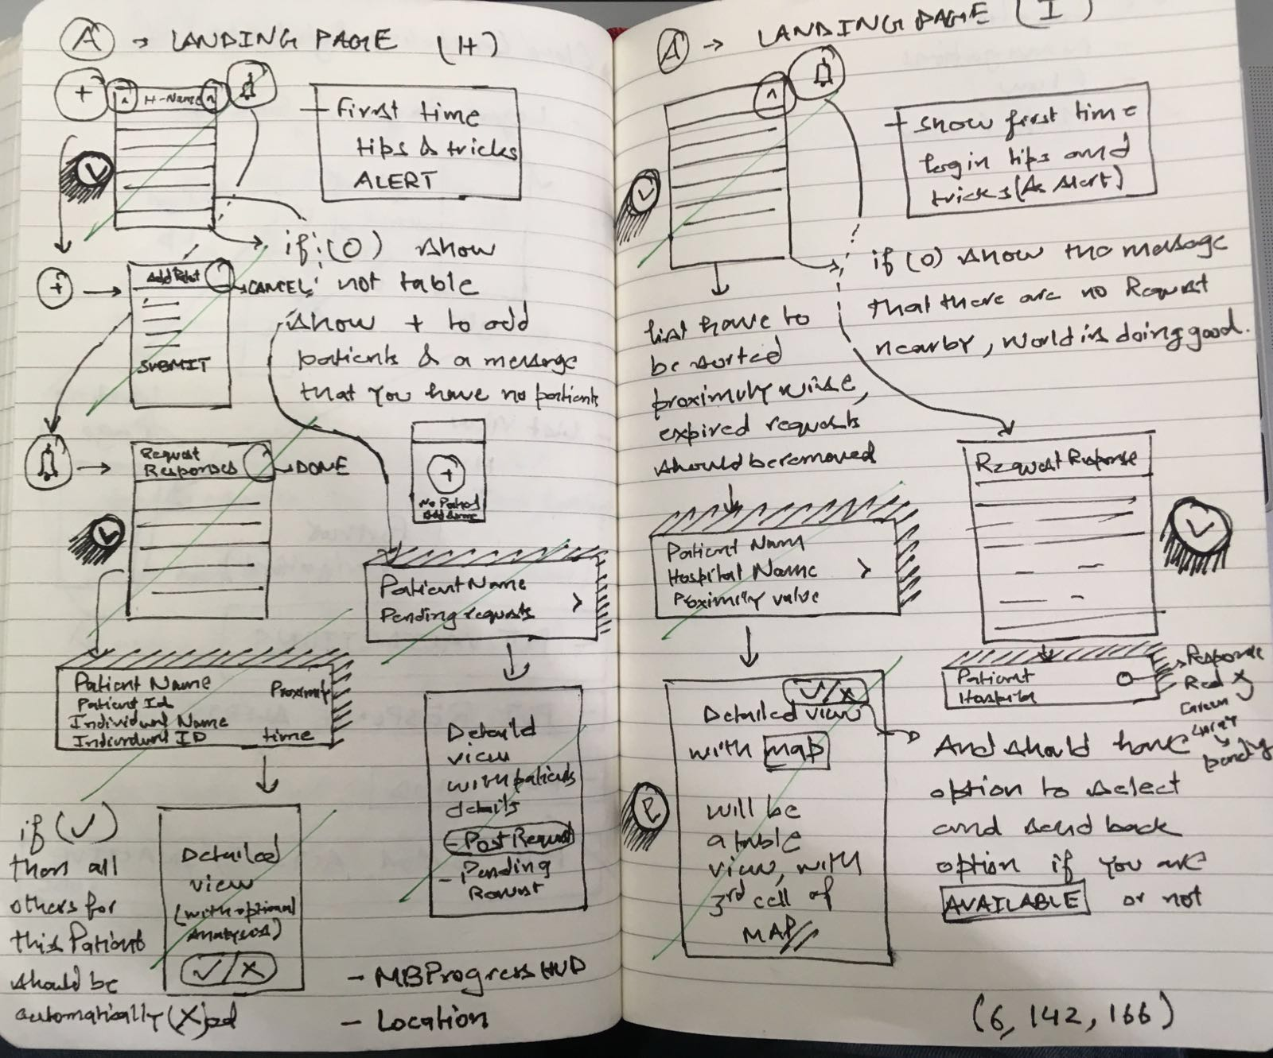

Slide 14
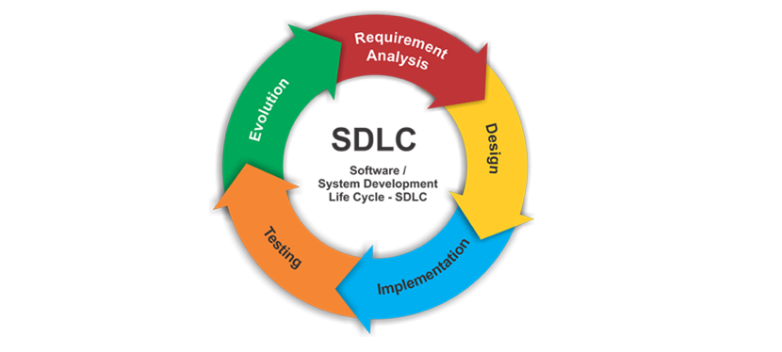
What did we learn?
Real life application of AWS – Lambda, SES, API Gateway, RDS
Life cycle of software development

Slide 15
What can be improved?
Scalable in applications and reach
Link with Facebook, Twitter and other social media
Make it compatible with different platforms
Automate the process of finding a suitable match

