Slide 1
MODELS OF COMPUTATION · RESEARCH PROJECT
Sample-Optimal Culprit Identification for Agent Failures
Fixed-Confidence Attribution with Automata-Aware Sequential Replay (AFCR)
Kushagra Yogendra Bansal (25bde0080) · Kartik Kesharwani (25bde0053)
Working title: “sample-optimal” names the research objective. We prove δ-correctness and a sample-complexity upper bound;
we do not claim minimax optimality. All experiments in this deck are synthetic.
synthetic
theory
pending
pending = ALFWorld / HotpotQA runs
Notes:
Title slide. Introduce both authors. Stress the honest framing up front: the title states the objective, and what we actually prove is δ-correctness of the stopping rule plus a sample-complexity upper bound for one strategy. All reported numbers are from synthetic simulations with exactly known ground truth; the real-benchmark stages (ALFWorld, HotpotQA) are implemented as adapters but have not been run.

Slide 2
MOTIVATION
literature
Why agent failures are hard to diagnose
Long horizons
Symptom ≠ cause
Judges are weak
Plan → search → tools → memory → answer. A single early slip can corrupt everything after it.
The step that executes the harmful action is often not the step that decided on it.
LLM-judge step attribution is correlational; best step-level accuracy ≈ 14 % on Who&When (Zhang et al., 2025).
Our question is interventional, not correlational:
“If this step had been repaired, how likely is the run to succeed?” — and how many replays do we need before we may say so with confidence 1 − δ?
AFCR · Fixed-confidence culprit identification · Kushagra Yogendra Bansal & Kartik Kesharwani
2
Notes:
Motivation. Long-horizon agents plan, search, call tools, store memory and answer. When the final answer is wrong, the developer holds a long trace and one question: which step is responsible? The last action is usually a symptom. Cite Zhang et al. (Who&When, ICML 2025, arXiv:2505.00212): the best step-level attribution accuracy they report is about 14 %, which is why LLM judging alone is not a satisfying answer.

Slide 3
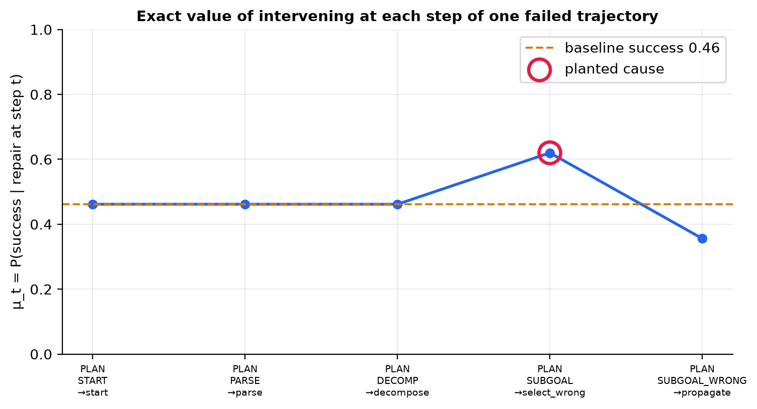
PROBLEM
synthetic
A failed trajectory with a hidden cause
What the figure shows
• Exact μ_t for one failed run (no sampling noise)
• Planted fault: a wrong decision at one step
• Earlier steps look “useful” only because a re-run re-rolls the fault
• After the fault the state is corrupted and μ_t drops
• Culprit := argmax_t μ_t, with ties and near-ties made explicit via ε
AFCR · Fixed-confidence culprit identification · Kushagra Yogendra Bansal & Kartik Kesharwani
3
Notes:
Figure 2 is computed exactly by dynamic programming over the 48-state automaton (no sampling). Steps before the planted fault only exceed the baseline slightly because re-running re-rolls the fault; after the fault the state is corrupted and the repair value falls. The step that maximises the repair value is the culprit under our definition.

Slide 4
PROBLEM
theory
Why last-action or judge-based debugging is not enough
Approach | What it answers | Gap for our question
Last action | which step executed the failure | symptom, not decision
LLM judge on the log | which step looks wrong | correlational; ≈ 14 % best step accuracy (Who&When)
Fixed-K counterfactual replay | effect of intervening at each step | K chosen in advance; no confidence statement; no stopping rule
Oracle-substitution replay | does a gold action flip the outcome | needs gold actions; one sample; no budget view
AFCR (this work) | which step is the best repair, certified at confidence 1 − δ | adaptive budget, valid stopping, abstention when unsure
We never claim that replay-based attribution is new: the contribution is the sequential, fixed-confidence treatment of the replay budget (see related-work matrix, next).
AFCR · Fixed-confidence culprit identification · Kushagra Yogendra Bansal & Kartik Kesharwani
4
Notes:
Association is not prediction is not intervention effect is not unique responsibility is not joint cause. We choose one well-defined causal estimand — the repair effect of a single step — and make its estimation statistically rigorous. Other estimands (Shapley credit, direct effects) are different questions and are listed as future work.

Slide 5
RELATED WORK
literature
Related work: what exists and what does not
Work | depth | step | replay | adaptive | fixed-conf | δ-PAC | prefix | automata
Garivier-Kaufmann 2016 | FULL-THM | – | – | ● | ● | ● | – | –
Who&When | KEY | ● | – | – | – | – | – | –
Causal Agent Replay | FULL | ● | ● | – | – | – | – | –
AgenTracer | KEY | ● | ● | – | – | – | – | –
Conformal Agent Error Attribution | KEY | ◐ | – | – | – | ◐ | – | –
Ma et al. causal attribution | KEY | ● | ◐ | – | – | – | – | –
AFCR (this work) | — | ● | ● | ● | ● | ● | ● | ●
● yes ◐ partial – no. Best-arm identification (Garivier & Kaufmann, 2016) supplies the statistics but is not an agent paper; no surveyed agent-attribution paper combines replay with fixed-confidence stopping. Novelty status: provisional (finite search).
AFCR · Fixed-confidence culprit identification · Kushagra Yogendra Bansal & Kartik Kesharwani
5
Notes:
Rows come from research/novelty_matrix.csv, built by reading the papers (read-depth column shows how much of each paper we verified). ● yes, ◐ partial, – no. Important corrections to the brief: Who&When has no replay and no Shapley; Shapley belongs to Causal Agent Replay. The AFCR row is what we implement; whether the combination is novel is provisional — the search was finite and the matrix is dated.

Slide 6
FORMALISATION
theory
Formal problem: best-arm identification over replays
Instance
Goal (fixed confidence)
• Failed trajectory τ of length T; candidate steps t ∈ {1,…,T}
• Pull(t): restore the exact state before step t, intervene, replay to the end → Y ∈ {0,1}
• μ_t = P(success | intervene at t) — unknown, estimated only by pulls
• Replay noise is the agent's own stochasticity (the policy π)
• Sampling rule: which step to replay next
• Stopping rule: a data-dependent time τ
• Recommendation: a step ĥ, or abstain
• δ-correct: P(τ < ∞ and ĥ ∉ target set) ≤ δ for every instance
• Targets: argmax (ε-tolerant), first-above-θ, last-above-θ
• Minimise rollouts E[τ] subject to δ-correctness
AFCR · Fixed-confidence culprit identification · Kushagra Yogendra Bansal & Kartik Kesharwani
6
Notes:
Arms are the candidate steps. Pulling arm t means: restore the original failed run just before step t, apply the intervention (repair = force the reference action; resample = redraw from the policy), re-simulate to the end, and observe success or failure. Y_t is Bernoulli(μ_t). The target is a function of the means: argmax up to ε, or the first / last step above a threshold θ. Assumptions A1–A6 in the paper make the arms well-defined and the pulls independent.

Slide 7
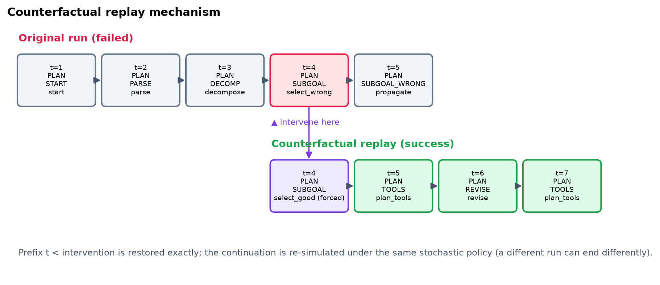
MECHANISM
synthetic
Counterfactual replay mechanism
AFCR · Fixed-confidence culprit identification · Kushagra Yogendra Bansal & Kartik Kesharwani
7
Notes:
Figure 3 uses a real sampled trajectory. The original run on top is restored up to the chosen step, one action is forced to the reference action, and the continuation on the bottom is re-simulated. One replay equals one sample of the outcome distribution — one Bernoulli pull. Repair vs resample are both implemented; resample is the null intervention and measures intrinsic sensitivity.

Slide 8
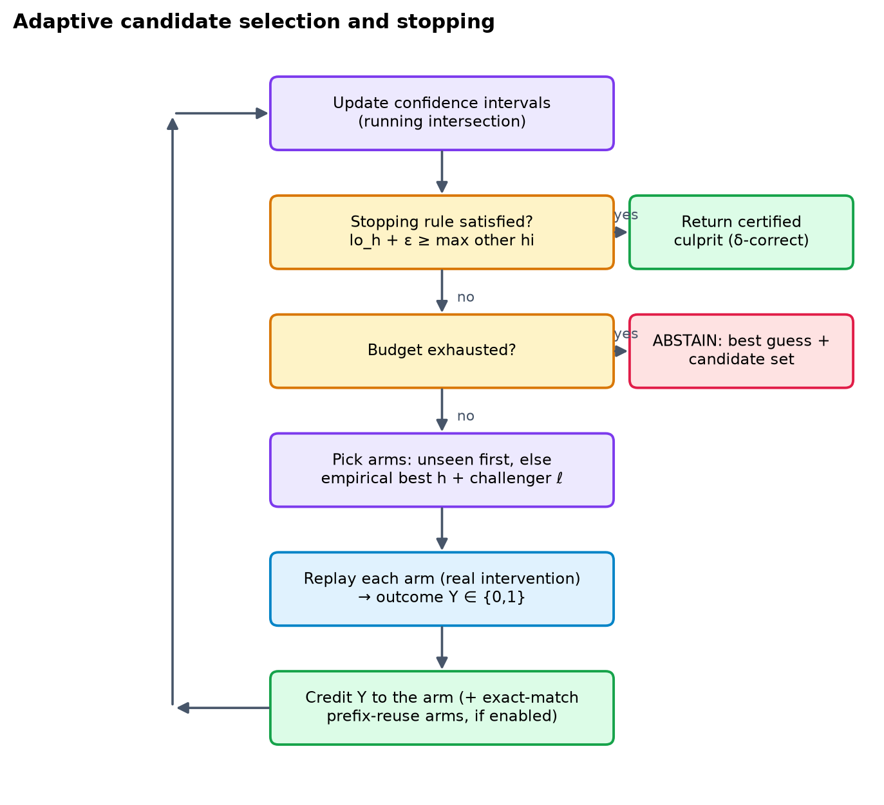
METHOD
theory
The adaptive algorithm: one round
Design rules
• Stopping rule ⟂ sampling rule
• Anytime-valid intervals (running intersection)
• Abstain, never fabricate
• Every result states whether the δ-guarantee applies
• Sharing prefixes is opt-in and validated
AFCR · Fixed-confidence culprit identification · Kushagra Yogendra Bansal & Kartik Kesharwani
8
Notes:
Figure 4: maintain a confidence interval per step, ask the stopping rule whether the target is certified, otherwise let the sampling rule pick the next step (LUCB picks the leader and its strongest challenger). The sampling rule is interchangeable — δ-correctness depends only on the confidence sequence and the stopping rule. Budget exhaustion is an abstention and is never reported as a certified answer.

Slide 9
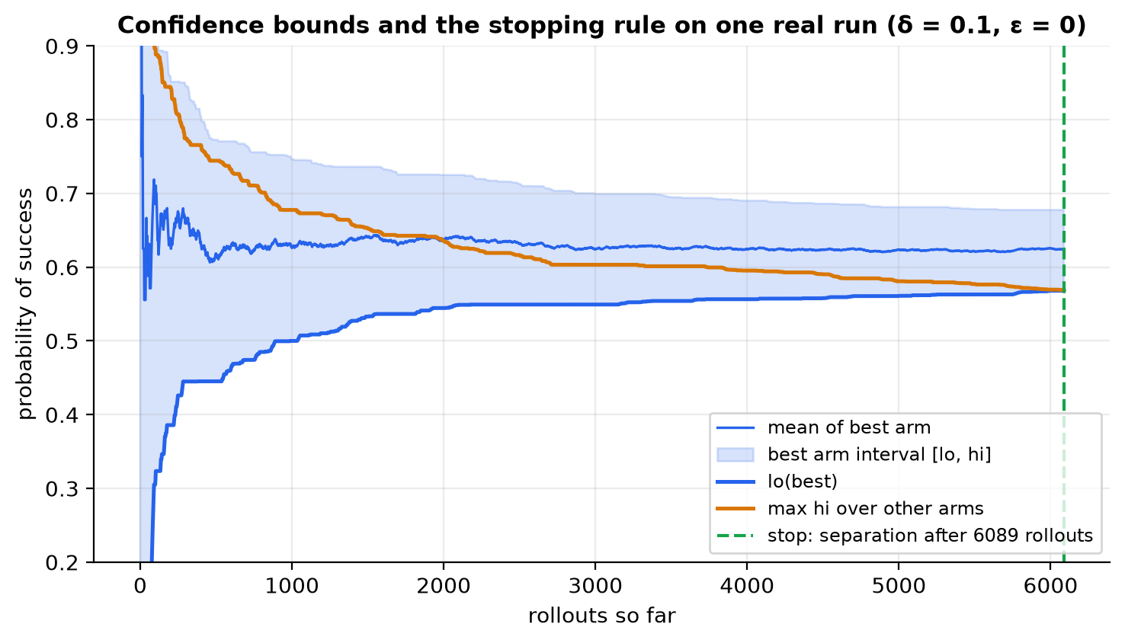
METHOD
theory
synthetic
Confidence sequences and the stopping rule
Stopping rule
stop when lo_h + ε ≥ max_{a≠h} hi_a
Confidence-sequence ablation (48 states)
sequence | mean rollouts
stack-KL | 18,448
KL-LUCB rate | 19,831
stack-Hoeffding | 22,764
n = 30 trials each, same seeds; all accuracy 93 %. Synthetic.
AFCR · Fixed-confidence culprit identification · Kushagra Yogendra Bansal & Kartik Kesharwani
9
Notes:
We use a stack-KL confidence sequence, x_n = ln(2Kn(n+1)/δ), intersected over time so intervals never widen. The stop test is lo_h + ε ≥ max over other arms of hi_a. Figure 5 is an actual run: intervals separate and the algorithm stops exactly when the separation margin reaches zero. Stack-KL is never wider than the Hoeffding version (tested) and is slightly looser than the LUCB-rate bound only in constants (ablation).

Slide 10
THEORY
theory
Theory: what is proven
Theorem 1 · δ-correctness
Theorem 2 · sample complexity
Theorem 3 · prefix reuse
Any sampling rule + stack confidence sequence + the separation stopping rule: P(stop with a wrong answer) ≤ δ. Abstention is not a δ-PAC event.
Successive elimination stops after O( Σ_a Δ_a⁻² · log(K / (δ Δ_a)) ) rollouts w.h.p. Gap-dependent, matches the lower-bound shape up to logs.
Matched (time, state, action) observations from other arms' replays are unbiased draws of the same arm (strong Markov property).
Not claimed: minimax / instance optimality of any algorithm; the lower bound T*(μ)·kl(δ, 1−δ) is a yardstick only.
Naively pooling all prefix-matched replays is NOT valid — kept as a negative control (next slides).
AFCR · Fixed-confidence culprit identification · Kushagra Yogendra Bansal & Kartik Kesharwani
10
Notes:
Theorem 1: for any sampling rule, the stopping rule built on an anytime-valid confidence sequence is δ-correct — a union bound over arms and time. Theorem 2: for successive elimination, an explicit sample-complexity upper bound of order Σ_a Δ_a⁻² log(K/(δΔ_a)); the full proof is in the paper appendix. Theorem 3: valid prefix reuse. We do NOT claim minimax optimality of any algorithm — the lower bound of Garivier–Kaufmann is used as a yardstick, not matched.

Slide 11
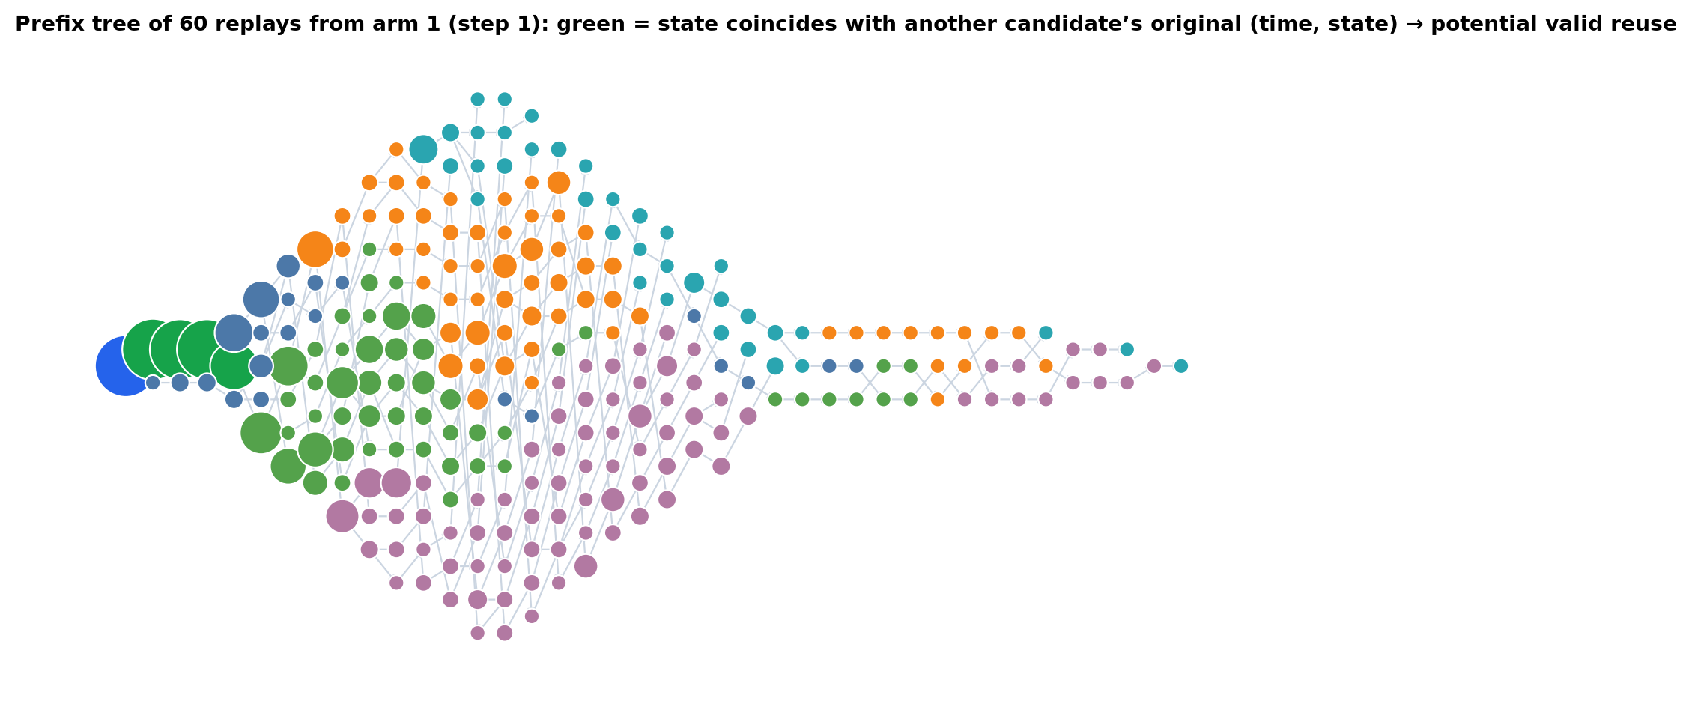
THEORY → EXPERIMENT
theory
synthetic
Prefix reuse: valid vs naive sharing
Sharing ablation (48 states)
sharing | mean rollouts | accuracy
none | 18,448 | 93 %
valid (Thm 3) | 12,693 | 97 %
naive ✗ | 5,355 | 47 %
• Valid sharing: 1.45× fewer rollouts than no sharing, accuracy not reduced.
• Naive sharing: accuracy collapses to 47 %; it stops early with a wrong answer. Never use it.
• Sharing is switched off automatically when state reconstruction is noisy (A1 violated).
AFCR · Fixed-confidence culprit identification · Kushagra Yogendra Bansal & Kartik Kesharwani
11
Notes:
Figure 10: replays that start later reach the same state at the same time with the same action as another arm's replay would; their remaining trajectory has the same law, so they can be credited to the other arm. We verified Theorem 3 numerically: matched observations agree with the exact value (|z| < 2) while naively pooled observations are biased (|z| about 20–30). In the main experiment naive sharing certifies a wrong answer far more often — shown honestly as a negative control with a small certified sample.

Slide 12
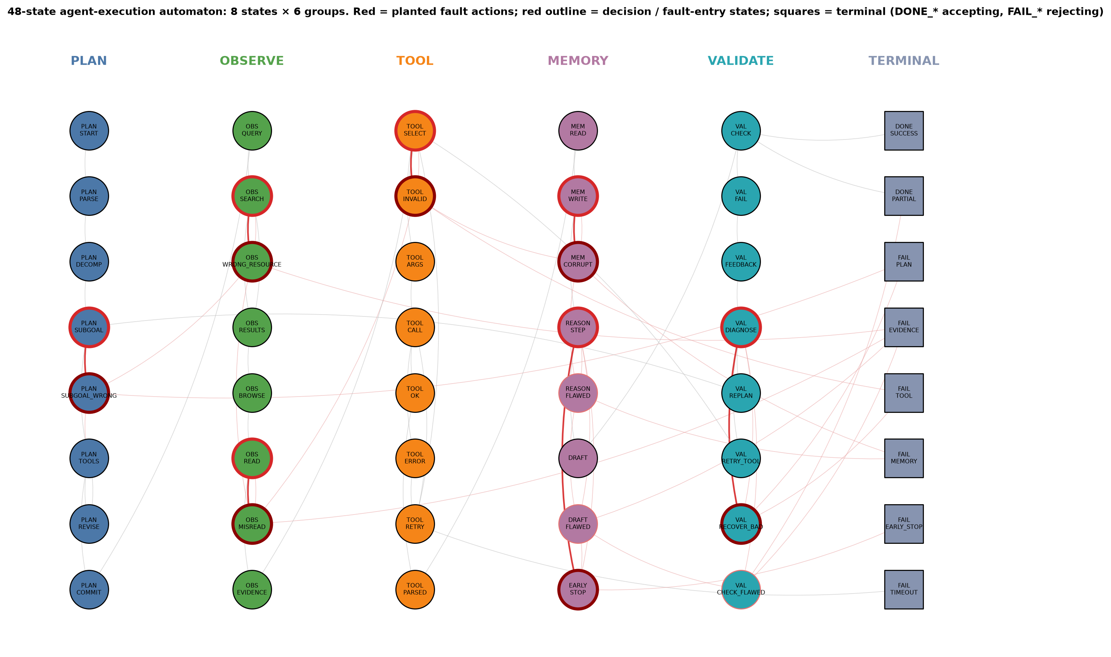
MODELS OF COMPUTATION
synthetic
The 48-state agent automaton
Structure
• 48 distinct logical states (6 × 8)
• Roles: benign, decision, fault entry, corridor, recovery, terminal
• Exact V_t(q) by backward induction
• Ground truth μ_t known — algorithms never see it
AFCR · Fixed-confidence culprit identification · Kushagra Yogendra Bansal & Kartik Kesharwani
12
Notes:
Six groups of eight states: PLAN, OBSERVE, TOOL, MEMORY, VALIDATE, TERMINAL. Seven decision states carry planted faults; corrupted states form a corridor to the failure terminals; recovery edges exist. The state count is validated programmatically (unique ids and labels; the DFA sink is not counted). Larger 64- and 96-state versions are generated the same way.

Slide 13
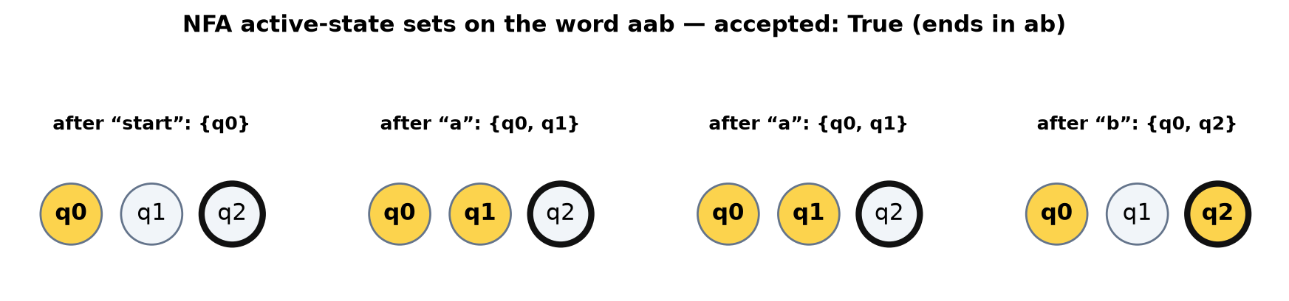
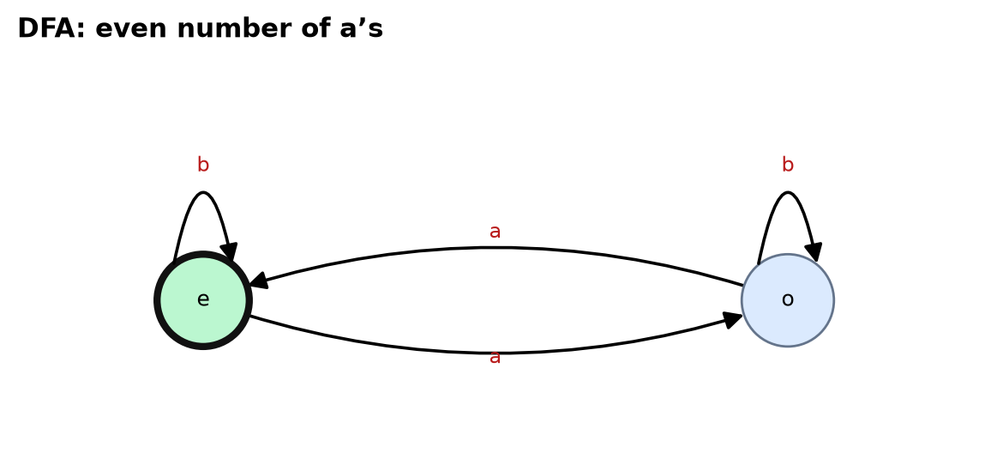
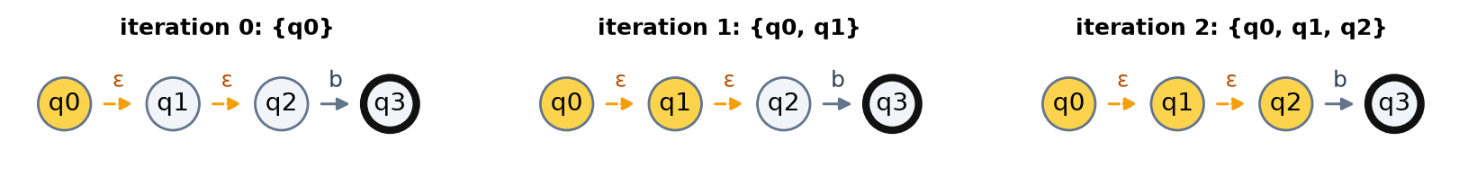
MODELS OF COMPUTATION
theory
Finite-state views of the same specification
NFA — active-state sets
DFA — total δ, explicit sink
ε-NFA — ε-closure
Nondeterminism in an NFA is a formal device (“some path accepts”). LLM sampling randomness is probabilistic and belongs to the probabilistic automaton below.
AFCR · Fixed-confidence culprit identification · Kushagra Yogendra Bansal & Kartik Kesharwani
13
Notes:
DFA: total transition function with an explicit sink, deterministic most-likely view. NFA: all possible successors, so we track active-state sets. ε-NFA: silent self-correction as ε-moves; ε-closure is computed before and after each symbol. Each view is tested: NFA→DFA subset construction and ε-removal preserve the language.

Slide 14
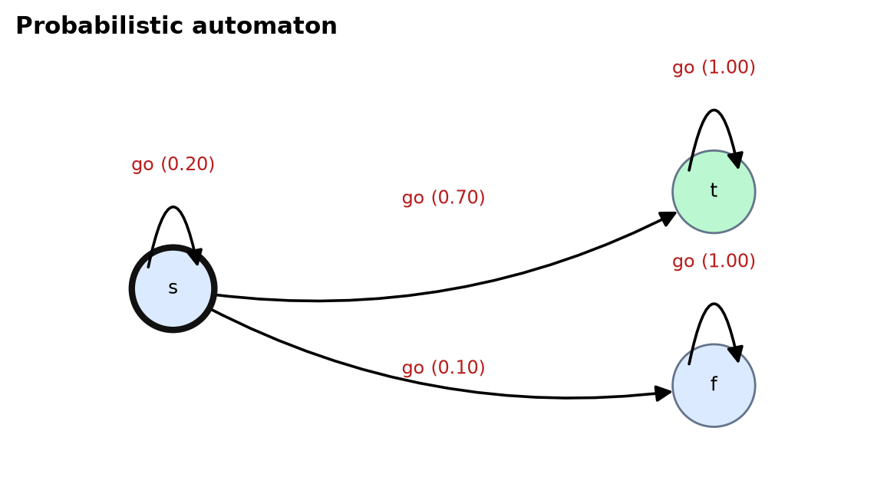
MODELS OF COMPUTATION
theory
Probabilistic automaton and labelled transition system
Why these two
• PA: P(w) = e_{q₀}ᵀ M_{a₁}…M_{aₙ} 1_F
• LTS: labelled actions, reachability, deadlocks
• Exact μ_t^rep = Σ P(q′|q,ρ(q)) V_t(q′)
• Exact μ_t^res = V_{t−1}(q_{t−1})
• Used as ground truth for every experiment
AFCR · Fixed-confidence culprit identification · Kushagra Yogendra Bansal & Kartik Kesharwani
14
Notes:
The probabilistic automaton is the natural model of a stochastic agent: each (state, action) maps to a distribution over successors, and the word probability is e_q0ᵀ M_a1 … M_an 1_F. The LTS carries the labelled actions — reasoning, tool use, observation, update, validation, recovery, success, failure — and supports reachability and deadlock analysis. Exact quantities used by the experiments are computed from these kernels.

Slide 15
MODELS OF COMPUTATION
theory
Beyond finite state: transducers, PDA, Turing machine
Model | Memory | Output / acceptance | Agent-trace use | Limit for attribution
Mealy | finite | output on transitions | controller reacting to observations | no acceptance notion
Moore | finite | output on states (n+1 for n inputs) | state = action being executed | Mealy→Moore needs state expansion
PDA | unbounded stack | final state / empty stack | nested or recursive tool calls | single stack, no probabilities
Turing machine (bounded) | tape (bounded here) | accept / reject / step_limit / tape_bound | general-computation demo | bound hit ⇒ unknown, not reject
PA | finite | P(w) over words | stochastic agent | Markov, finite memory
Implemented in src/afcr/automata: dfa, nfa (+ε), pa, lts, transducers (Mealy/Moore), pda, turing, benchmark48.
Only the PA/LTS views carry the causal interpretation; the others are formal-language demonstrations of the same specification.
AFCR · Fixed-confidence culprit identification · Kushagra Yogendra Bansal & Kartik Kesharwani
15
Notes:
All nine models are implemented and tested. The comparison table summarises acceptance, memory, nondeterminism and fit for agent traces. Important distinction: a finite-state machine cannot recognise arbitrarily deep nesting — a PDA can (our test shows a depth-3 bounded DFA failing on a depth-5 word). The bounded Turing machine reports step_limit/tape_bound as 'unknown', not 'reject'.

Slide 16
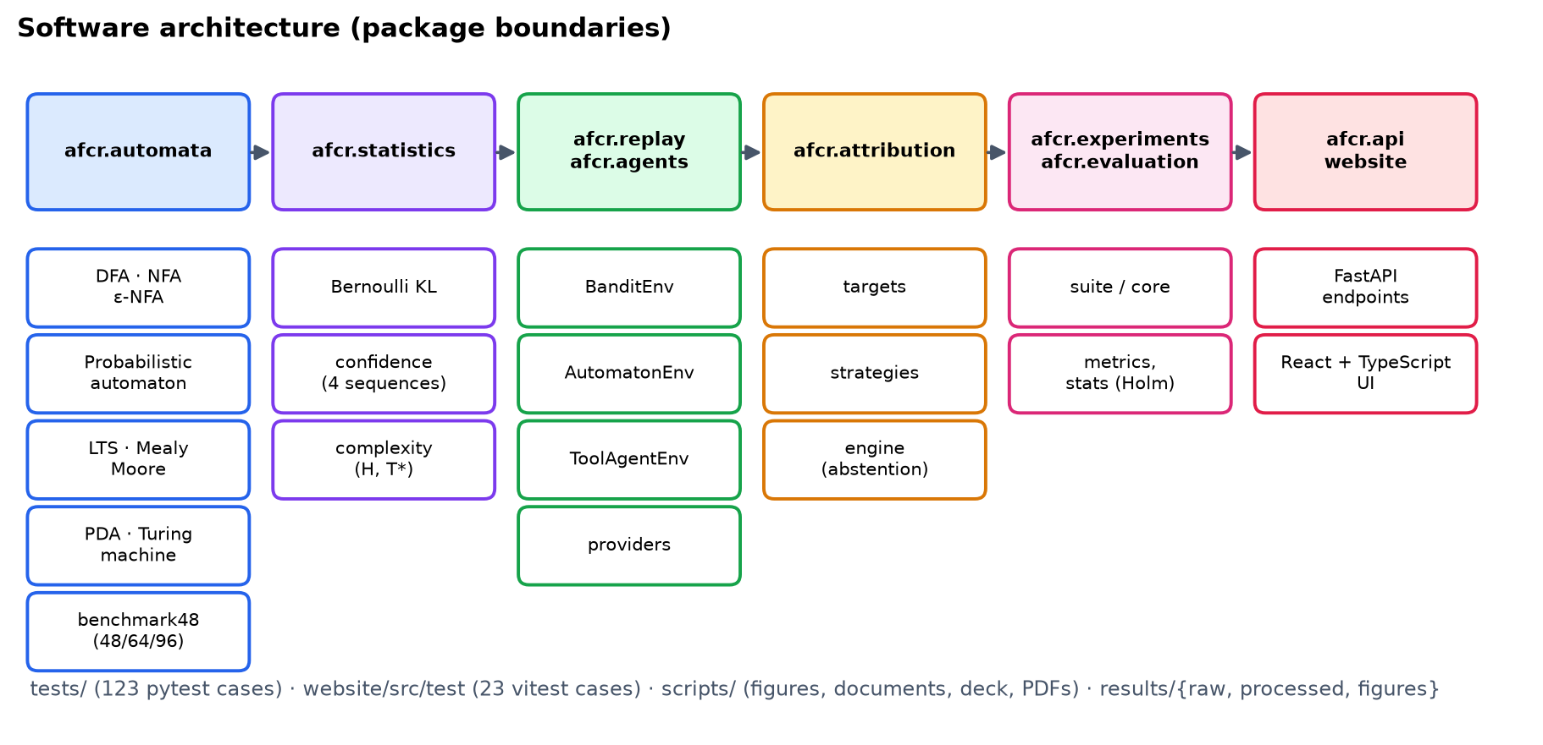
IMPLEMENTATION
theory
Software architecture
AFCR · Fixed-confidence culprit identification · Kushagra Yogendra Bansal & Kartik Kesharwani
16
Notes:
Packages: automata, statistics (the only place bounds are defined), replay (arms and exact ground truth), attribution (targets, algorithms, engine), agents and benchmarks, experiments and evaluation, and the FastAPI backend that serves the website. Every trial is a plain dict so any number can be regenerated from a JSON spec with python -m afcr.experiments.run_one.

Slide 17
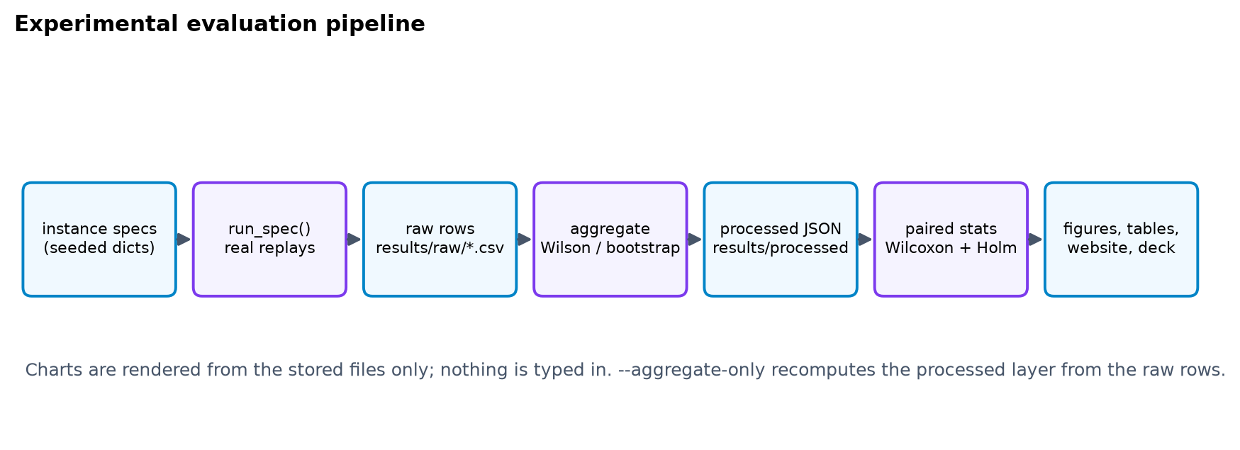
EVALUATION
synthetic
measured
Evaluation pipeline and protocol
group | rows
main | 990
gap_sweep | 450
K_sweep | 450
delta_sweep | 300
stress | 900
size_sweep | 270
group | rows
eps_sweep | 360
noise_sweep | 120
ablation | 450
budget_curve | 1,920
toolagent | 158
targets | 150
6,518 trial rows in total; δ = 0.1. SYNTHETIC only.
AFCR · Fixed-confidence culprit identification · Kushagra Yogendra Bansal & Kartik Kesharwani
17
Notes:
Twelve experiment groups, each with 30 paired trials per method unless noted (all methods share seeds so comparisons are paired). Rollout counts of trials that hit the budget cap are censored: means are lower bounds on the true cost. Accuracy intervals are Wilson; rollout intervals are bootstrap; paired tests are Wilcoxon signed-rank with Holm correction over the four primary comparisons. Total simulation time came from suite_meta.json.

Slide 18
RESULTS
synthetic
measured
Main result: adaptive allocation needs fewer rollouts
Accuracy of the answer (vs exact argmax): LUCB+prefix 93 %, LUCB 93 %, successive elim. 93 %, uniform 93 %, random 97 %. Native charts: right-click → Edit Data.
AFCR · Fixed-confidence culprit identification · Kushagra Yogendra Bansal & Kartik Kesharwani
18
Notes:
48-state automaton, 30 paired trials per method, δ = 0.1, budget cap 60 000 rollouts. Bars are mean rollouts; trials that abstained (budget exhausted) are censored at the cap, so uniform/random numbers understate their true cost. Equal-budget and CAR-style fixed-K do not certify anything by design — their rollouts are fixed in advance. LUCB with naive sharing is the invalid negative control.

Slide 19
RESULTS
synthetic
measured
Paired statistics with multiplicity control
comparison (A vs B) | n | mean A | mean B | saving | × cheaper | 95 % CI of diff | p (Holm)
LUCB vs Uniform | 30 | 20,637 | 36,929 | 16,292 | 1.79 | [11,060, 22,096] | 4.2e-05
LUCB vs Random | 30 | 20,637 | 37,911 | 17,275 | 1.84 | [11,536, 23,887] | 4.2e-05
LUCB vs Succ. elim. | 30 | 20,637 | 24,528 | 3,891 | 1.19 | [1,908, 6,404] | 7.3e-04
LUCB + prefix vs LUCB | 30 | 14,530 | 20,637 | 6,106 | 1.42 | [4,185, 8,177] | 3.1e-05
• Adaptive allocation (LUCB) vs uniform: 1.79× fewer rollouts on average.
• Valid prefix sharing on top of LUCB: 1.42× fewer again.
• All comparisons censored at the budget cap → the true savings are at least as large as shown.
AFCR · Fixed-confidence culprit identification · Kushagra Yogendra Bansal & Kartik Kesharwani
19
Notes:
Each row is a paired comparison on identical seeds. Wilcoxon signed-rank p-values are Holm-corrected over the four primary comparisons; all four reject at 0.05. Ratios are mean-rollout ratios (>1 means the first method is cheaper). 95 % intervals are bootstrap intervals of the paired mean difference. Synthetic data only: these are statements about our simulated benchmark, not about real agents.

Slide 20
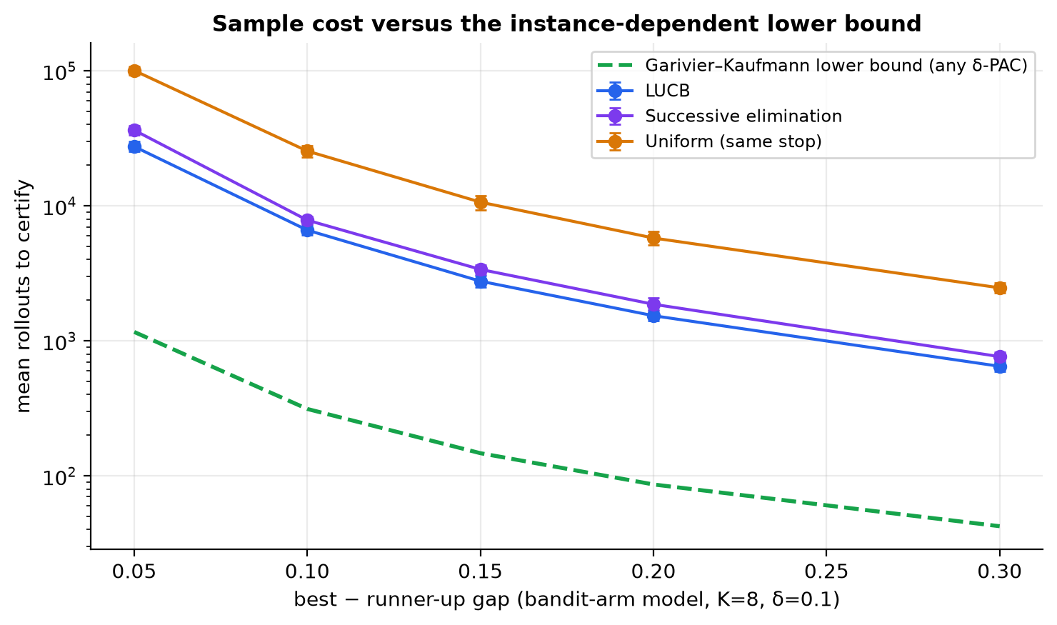
RESULTS
synthetic
measured
Cost versus gap and the lower bound
gap | LUCB | Uniform | ratio
0.05 | 27,515 | 100,600 | 3.7×
0.10 | 6,609 | 25,481 | 3.9×
0.15 | 2,769 | 10,660 | 3.9×
0.20 | 1,537 | 5,781 | 3.8×
0.30 | 648 | 2,471 | 3.8×
Mean rollouts, 30 trials per cell, K = 8. Synthetic.
AFCR · Fixed-confidence culprit identification · Kushagra Yogendra Bansal & Kartik Kesharwani
20
Notes:
Bandit-arm model with K = 8 arms; the best-vs-runner-up gap varies. Cost grows roughly like gap⁻² for uniform allocation (a test checks the log-log slope is between −3.2 and −1.3) and every method stays above the lower bound on average (also tested). The lower bound is a yardstick for an oracle-allocating algorithm: we do not claim to match it.

Slide 21
RESULTS
synthetic
measured
Scaling with the number of candidates and with δ
δ | mean rollouts | accuracy | wrong certified
0.01 | 3,221 | 100 % | 0 %
0.05 | 2,935 | 100 % | 0 %
0.1 | 2,784 | 100 % | 0 %
0.2 | 2,688 | 100 % | 0 %
0.4 | 2,531 | 100 % | 0 %
δ sweep: 60 trials per δ. 0 wrong certified answers in 300 trials is consistent with — not a proof of — δ-correctness.
AFCR · Fixed-confidence culprit identification · Kushagra Yogendra Bansal & Kartik Kesharwani
21
Notes:
Left: growth of cost with the number of candidate steps K at a fixed gap. Adaptive methods grow slowly because eliminated arms stop being sampled; uniform allocation grows roughly linearly with K. Right: the δ sweep shows the expected mild increase of cost as δ shrinks; empirical error stays at 0 in every cell — consistent with δ-correctness but not a proof (the guarantee is an upper bound).

Slide 22
RESULTS
synthetic
measured
Ablations: which design choices matter
factor | mean rollouts | accuracy | abstained
allocation = LUCB | 18,448 | 93 % | 17 %
allocation = succ. elim. | 20,944 | 93 % | 17 %
allocation = uniform | 36,493 | 97 % | 33 %
prefix sharing = valid | 12,693 | 97 % | 13 %
prefix sharing = naive ✗ | 5,355 | 47 % | 80 %
candidates = decision states only | 6,578 | 100 % | 3 %
ε = 0.02 | 14,222 | 100 % | 3 %
ε = 0.05 | 7,203 | 100 % | 0 %
Reading it
• Baseline (LUCB, stack-KL, all steps, ε = 0): 18,448 rollouts
• Naive sharing is fast because it is wrong
• ε > 0 trades exactness for cost; the guarantee becomes “within ε”
AFCR · Fixed-confidence culprit identification · Kushagra Yogendra Bansal & Kartik Kesharwani
22
Notes:
One factor at a time on the 48-state automaton, same seeds. Restricting candidates to decision states and using a small ε make the most difference on the planted-fault instances because they remove near-ties between harmless steps; valid prefix sharing gives a large saving at no cost in accuracy. Candidate restriction uses domain knowledge about decision states; it is reported as an assumption-dependent speed-up, not as part of the guarantee.

Slide 23
RESULTS
synthetic
measured
Larger automata and violated assumptions
reconstruction noise | mean rollouts | abstained | accuracy*
0.00 | 11,908 | 3 % | 97 %
0.10 | 23,514 | 23 % | 97 %
0.25 | 31,055 | 30 % | 100 %
0.50 | 54,780 | 70 % | 80 %
*accuracy against the argmax of the noisy replay context (the estimand actually sampled). Censored at the budget cap.
AFCR · Fixed-confidence culprit identification · Kushagra Yogendra Bansal & Kartik Kesharwani
23
Notes:
Left: the 48-, 64- and 96-state automata. Prefix reuse keeps the cost almost flat while the plain methods grow with trajectory length. Right: when state reconstruction is noisy (assumption A1 violated) we measure accuracy against the noisy-context argmax and the cost rises; the algorithm abstains more rather than certifying wrongly, and sharing is disabled automatically. This is a robustness stress test, not a guarantee.

Slide 24
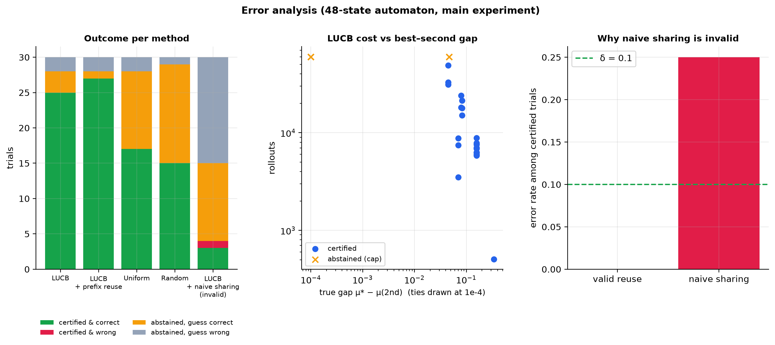
RESULTS
synthetic
measured
Negative controls and failure modes
What to take from it
• Naive sharing: 47 % accuracy, 87 % abstained — invalid by construction
• CAR-style fixed K: 0 % vs the argmax target — a different estimand (see notes)
• Uniform/random abstain most often at the cap
• Never certified a wrong answer in guaranteed runs (see consistency test)
AFCR · Fixed-confidence culprit identification · Kushagra Yogendra Bansal & Kartik Kesharwani
24
Notes:
Honest reporting: (1) naive sharing is invalid and the experiment shows it. (2) The CAR-style fixed-K rule is a different estimand — it reports the latest step whose effect excludes zero — so its 'accuracy' against the argmax-repair target is not a like-for-like comparison and should not be read as 'CAR is wrong'. (3) Several methods abstain on hard instances; abstention is a feature, not an error. Figure 18 breaks the failures down.

Slide 25
RESULTS
synthetic
measured
Stage B tool agent and alternative targets
Stage B variant | method | mean rollouts | accuracy | abstained
stochastic | LUCB | 6,623 | 100 % | 17 %
stochastic | LUCB + prefix | 5,578 | 100 % | 17 %
stochastic | Uniform | 11,612 | 100 % | 53 %
deterministic_phase0 | LUCB | 92 | 100 % | 0 %
deterministic_phase0 | Uniform | 121 | 100 % | 0 %
deterministic_phase4 | LUCB | 92 | 100 % | 0 %
deterministic_phase4 | Uniform | 125 | 100 % | 0 %
target | method | mean rollouts | accuracy | abstained
first_above | LUCB | 32,362 | 100 % | 0 %
first_above | Uniform | 60,000 | 100 % | 100 %
last_above | CAR-style fixed K | 1,320 | 3 % | 0 %
last_above | car_fixed_k500 | 6,600 | 3 % | 0 %
last_above | LUCB | 34,333 | 100 % | 53 %
• Same ordering as on the automaton: adaptive < uniform in rollouts.
• Threshold targets can legitimately end in “no step qualifies” or abstention; both are reported, not hidden.
AFCR · Fixed-confidence culprit identification · Kushagra Yogendra Bansal & Kartik Kesharwani
25
Notes:
Stage B is a second, structurally different synthetic environment: a tool-using agent (search, calculator, memory) with exact memoised DP ground truth, in a stochastic and a deterministic variant. The targets experiment replaces argmax by threshold rules: first-above-θ and last-above-θ. These are still synthetic — they test the implementation beyond the automaton, not real agent behaviour.

Slide 26
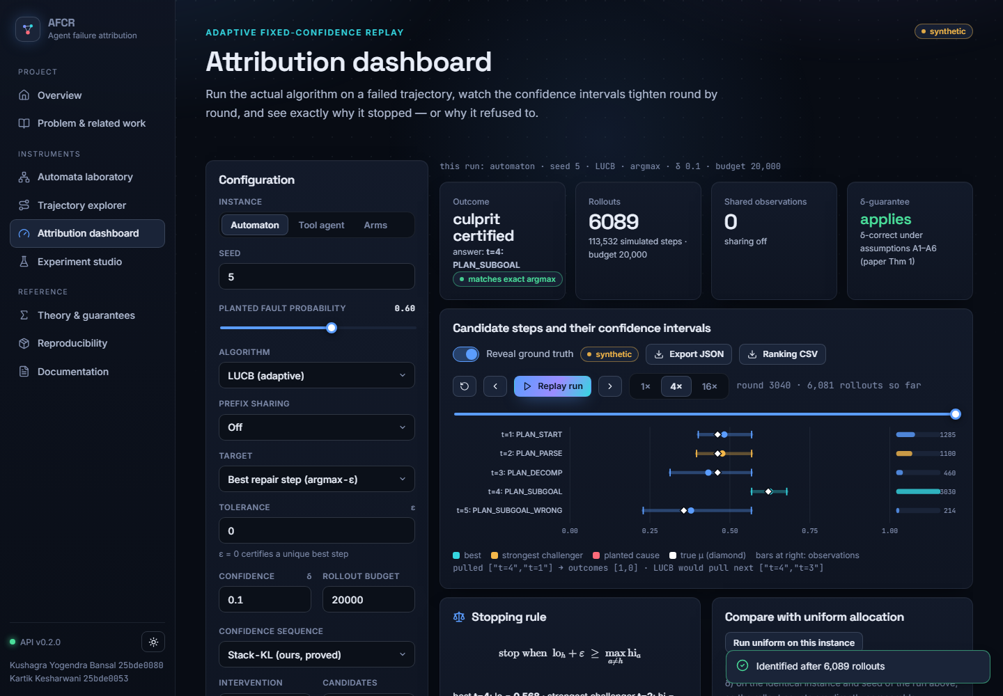
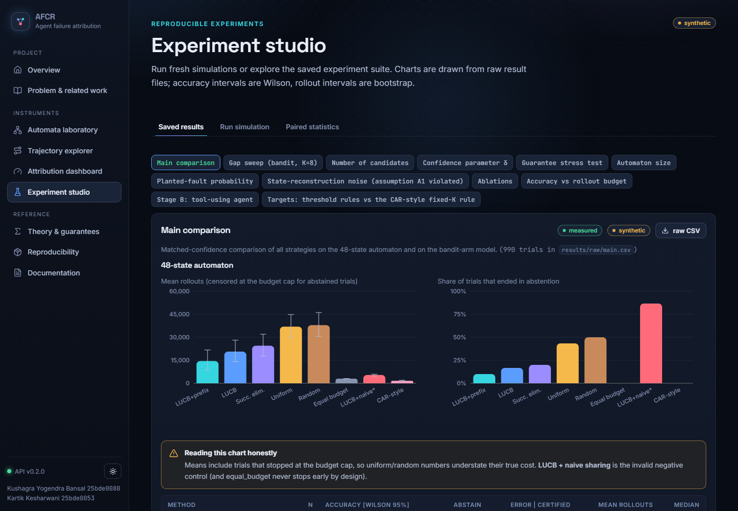
DEMONSTRATION
measured
The website: run the algorithm and watch it decide
Attribution dashboard — live run, replayable CI plot, stopping rule
Experiment studio — saved results from raw CSV
9 pages: overview · related work · automata lab · trajectory explorer · dashboard · studio · theory · reproducibility · docs
AFCR · Fixed-confidence culprit identification · Kushagra Yogendra Bansal & Kartik Kesharwani
26
Notes:
Screenshots of the running React/TypeScript site, served by the FastAPI backend on localhost. The dashboard calls the real algorithm, replays the rounds as a forest plot of confidence intervals, shows the stopping-rule margin, and can run uniform allocation on the identical instance. The Studio loads every saved result group and the paired statistics; exports are raw CSV/JSON. Pages carry synthetic/measured badges so no simulated number is mistaken for a benchmark result.

Slide 27
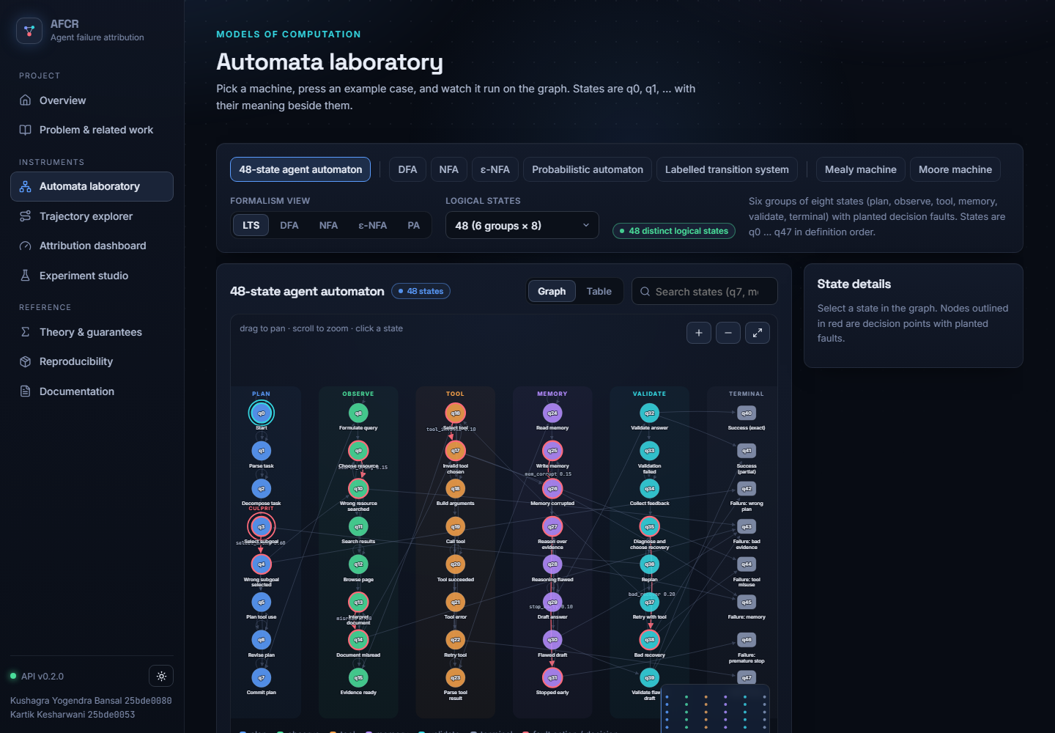
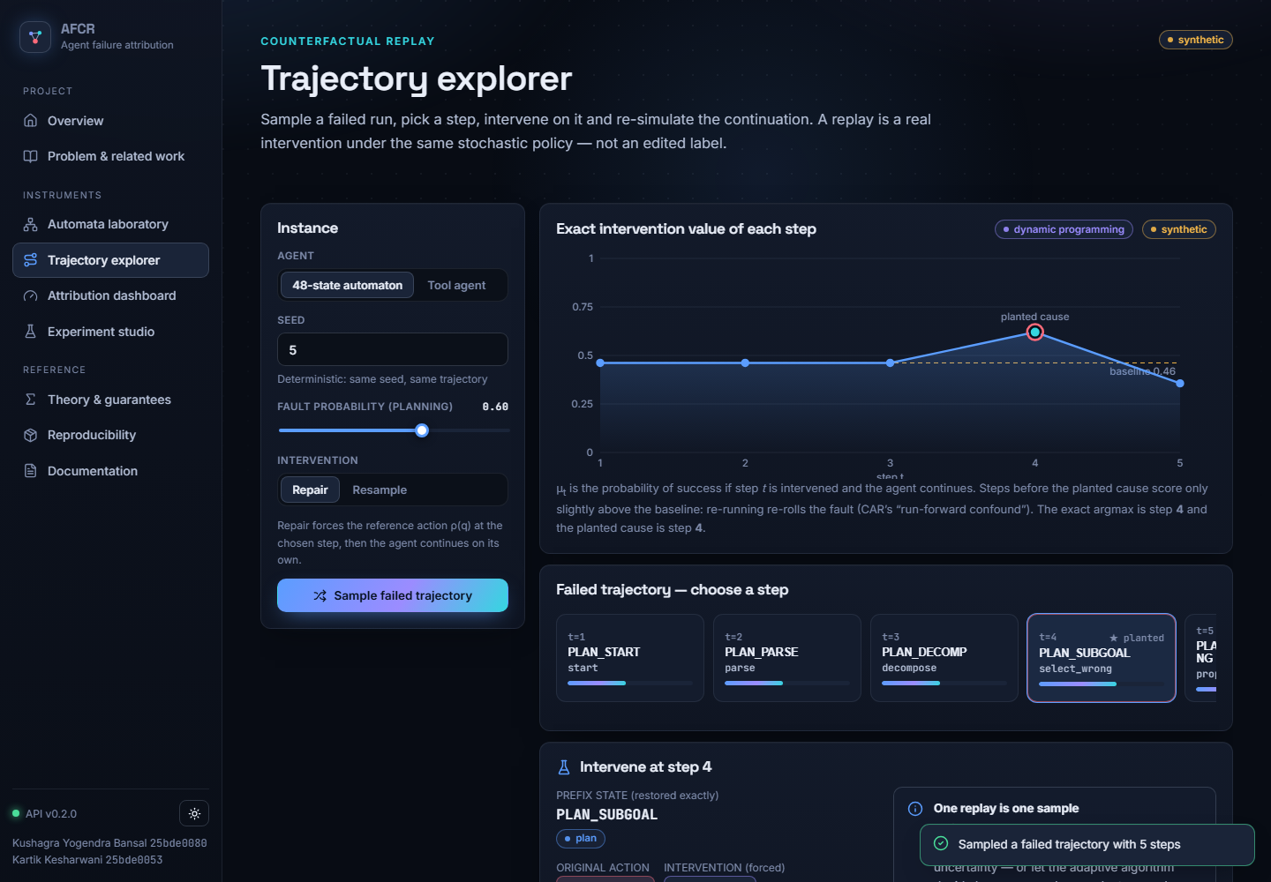
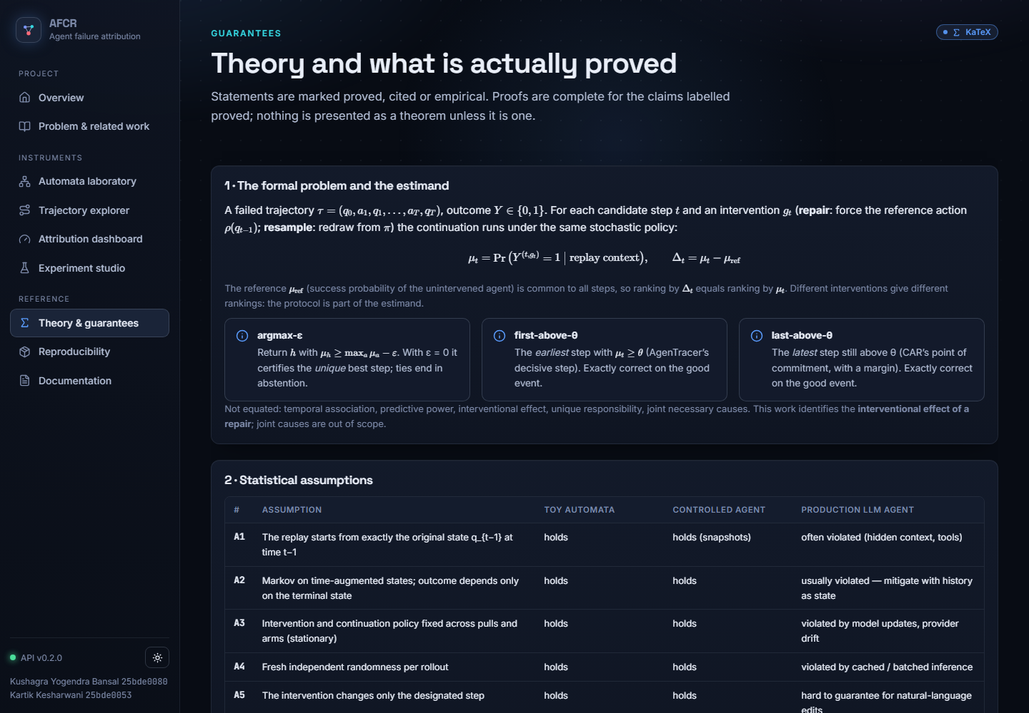
DEMONSTRATION
measured
The website: automata laboratory, explorer, theory
Automata laboratory
Trajectory explorer
Theory & guarantees
Custom cursor, spotlight and motion are disabled on touch devices and when the OS requests reduced motion; charts also skip animation then.
AFCR · Fixed-confidence culprit identification · Kushagra Yogendra Bansal & Kartik Kesharwani
27
Notes:
Left: all nine formalisms are interactive — pan, zoom, search states, step through traces; the 48-state automaton shows the planted culprit. Middle: the trajectory explorer samples a failed run, shows the exact μ_t, lets you intervene on a step and compare the original with the counterfactual. Right: the theory page lists the assumptions, theorems with expandable proofs and a claims ledger that marks what is proven, tested or pending.

Slide 28
QUALITY
measured
Testing and reproducibility
suite | tests | passed
api_automata | 36 | 36
api_http | 20 | 20
attribution | 16 | 16
automata | 14 | 14
configs | 13 | 13
results_consistency | 31 | 31
statistics | 34 | 34
toolagent_and_benchmarks | 15 | 15
frontend (vitest) | 46 | 46
Reproduce
python -m pytest -q
python -m afcr.experiments.suite --config configs/suite_default.json
python -m afcr.experiments.run_one configs/spec_automaton_prefix.json --seed 7
python scripts/make_figures.py
python scripts/build_pdfs.py
python scripts/build_deck.py
uvicorn afcr.api.app:app --port 8000
AFCR · Fixed-confidence culprit identification · Kushagra Yogendra Bansal & Kartik Kesharwani
28
Notes:
179 backend tests (pytest) and 46 frontend tests (vitest) all pass, run on this machine; the reports are stored in results/processed. Consistency tests recompute every reported summary from the raw CSV and check theory-level behaviour such as gap scaling and the lower bound. Config files in configs/ reproduce any single trial or a whole suite; seeds are explicit.

Slide 29
HONESTY
pending
synthetic
Limitations and honest status
Done and verified
Pending / not run
Not claimed
• 179 backend + 46 frontend tests passing
• δ-correctness (Thm 1), prefix validity (Thm 3) checked numerically
• 9 formal models + 48-state benchmark
• 12 experiment groups, raw → processed
• ALFWorld (Stage C) — adapter only
• HotpotQA (Stage D) — adapter only
• Real LLM provider evaluation
• Human-validated culprit labels
• Minimax / instance optimality
• Results on real agents
• That replay is new (it is not)
• Novelty beyond the finite literature search
AFCR · Fixed-confidence culprit identification · Kushagra Yogendra Bansal & Kartik Kesharwani
29
Notes:
State plainly what is not done. ALFWorld and HotpotQA adapters exist and are unit-tested with a mock agent, but we have not run them — so no claim about real agents. All performance numbers come from synthetic models with a Markov structure that makes ground truth computable. The OpenAI provider is implemented but untested. Theorem 2 is for successive elimination only. 'Sample-optimal' is the objective, not a result. Novelty is provisional.

Slide 30
WRAP-UP
theory
Conclusions and future work
What we showed
Next
• Culprit identification as fixed-confidence BAI over replays
• δ-correct for any sampling rule (Theorem 1)
• 1.79× fewer rollouts than uniform at equal confidence (synthetic)
• Valid prefix reuse: a further 1.42×; naive reuse is demonstrably wrong
• Abstention instead of fabricated answers
• Run Stage C/D on ALFWorld and HotpotQA
• Instance-optimal allocation (Track-and-Stop)
• Direct-effect estimands, joint (Shapley) credit
Kushagra Yogendra Bansal (25bde0080) · Kartik Kesharwani (25bde0053)
Code, paper, report and this deck: see README.md
Key references: Garivier & Kaufmann 2016; Zhang et al. 2025; Shah 2026 (CAR); AgenTracer 2025
AFCR · Fixed-confidence culprit identification · Kushagra Yogendra Bansal & Kartik Kesharwani
30
Notes:
Summary. We turned culprit identification into a fixed-confidence best-arm problem over counterfactual replays, proved δ-correctness for any sampling rule, gave a sample-complexity bound for successive elimination, validated prefix reuse, and measured on synthetic automata that adaptive allocation needs several times fewer rollouts. Future work: run ALFWorld/HotpotQA, tighten the bounds (instance-dependent), Track-and-Stop style allocation, direct-effect estimands with common random numbers.

