Slide 1
PORTFOLIO EDA PROJECT 05
Student Performance &
Academic Analytics
Empirical Exploratory Analysis of Socio-Demographic and Behavioral Drivers of Student Success
Author: Kushagra Pratap Singh | Dataset: UCI Secondary Student Performance (N=1,044)

Slide 2
STUDENT PERFORMANCE & ACADEMIC ANALYTICS
Research Objectives & Core Analytical Dimensions
1. Grade Distributions
Examine final grade spread (G3) and compare passing rates (>=10/20) between Math and Language.
2. Study Time Elasticity
Quantify academic gains per study tier and identify points of diminishing returns beyond 10 hours.
3. Attendance Dynamics
Resolve the attendance paradox by separating active test-takers from zero-grade exam dropouts.
4. Parental Background
Analyze the impact of maternal and paternal educational attainment and professions on outcomes.
5. Predictive History
Assess the deterministic correlation of Term 1 (G1) and Term 2 (G2) grades with final achievement.
6. Demographic Factors
Evaluate subject-specific performance disparities between male and female student cohorts.

Slide 3
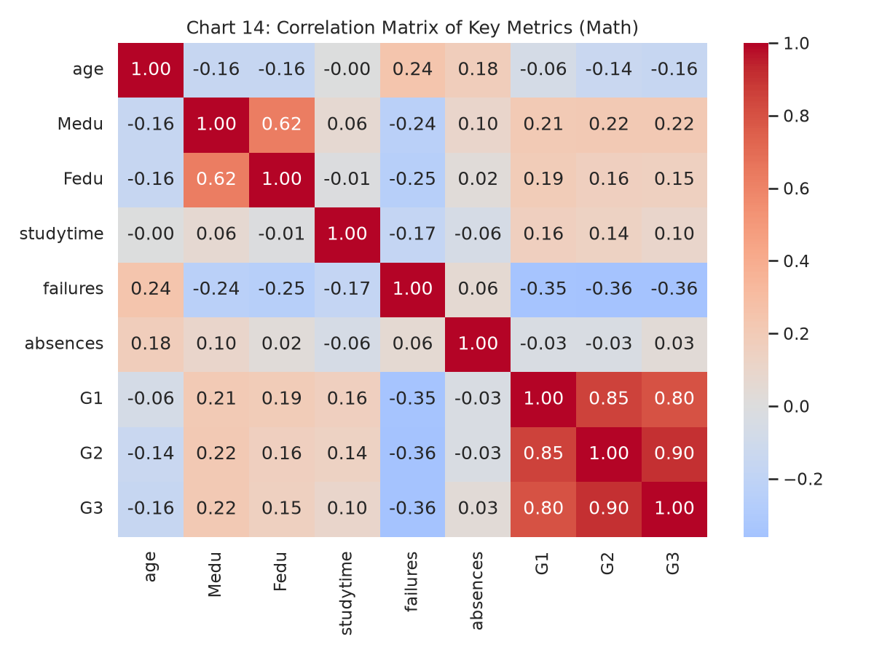
STUDENT PERFORMANCE & ACADEMIC ANALYTICS
Dataset Architecture & Preprocessing Methodology
• 1,044 Unified Evaluations
Combined Mathematics (395 records) and Portuguese Language (649 records) with full 100% attribute completeness (0 nulls, 0 duplicates).
• 382 Dual-Enrolled Cohort
Merged across 13 demographic anchor keys per Cortez & Silva specification to track students enrolled concurrently in both subjects.
• Dropout Isolation (53 Total)
Isolated 38 zero-grade entries in Math (9.6%) and 15 in Language (2.3%) as exam non-attenders rather than normal academic struggle.
• Feature Engineering
Constructed binary passing markers (G3 >= 10), term progression deltas (G3 - G1), and composite parental education indices ((Medu + Fedu)/2).

Slide 4
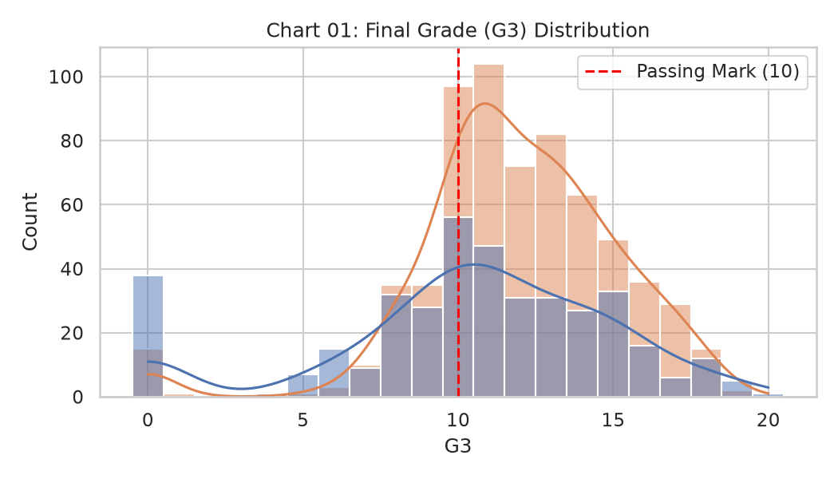
STUDENT PERFORMANCE & ACADEMIC ANALYTICS
Academic Disparities Across Curricula (Math vs. Language)
• Curriculum Performance Gap
Portuguese Language records significantly higher overall mastery (mean: 11.91, pass rate: 84.59%) compared to Mathematics (mean: 10.42, pass rate: 67.09%).
• Extreme Grade Dispersion
Math exhibits 41% higher standard deviation (4.58 vs. 3.23), demonstrating greater difficulty and student polarization.
• 4x Higher Dropout Rate
38 Math students (9.62%) received a zero mark, compared to only 15 in Portuguese (2.31%), indicating Math as the primary academic failure risk.
• The 10/20 Passing Line
Both subjects maintain a median score >= 10, but Math's bottom quartile (IQR: 8-14) falls dangerously below the passing threshold.

Slide 5
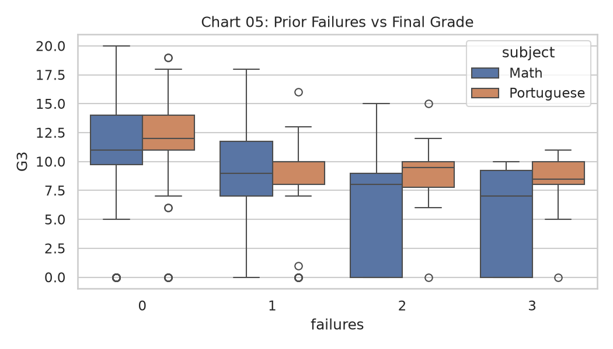
STUDENT PERFORMANCE & ACADEMIC ANALYTICS
Predictive Trajectories & Early Evaluation Lock-In
• Baseline Grade Determinism
Term 1 grade (G1) acts as an anchor (r = +0.801 with final G3). Performance is near-deterministic by Term 2 (G2 -> G3: r = +0.905).
• The Severe Failure Penalty
Prior subject failures correlate negatively with success (r = -0.360). Each prior failure penalizes final scores by an average of 2.19 points.
• Failure Degradation Spectrum
Students with 0 prior failures average 11.02/20. With 1 failure, average drops to 8.83. With >=2 failures, average drops below 7.50/20.
• Intervention Timeline Urgency
Waiting for Term 2 or final exams to intervene is too late; academic coaching must trigger upon receiving Term 1 evaluations.

Slide 6
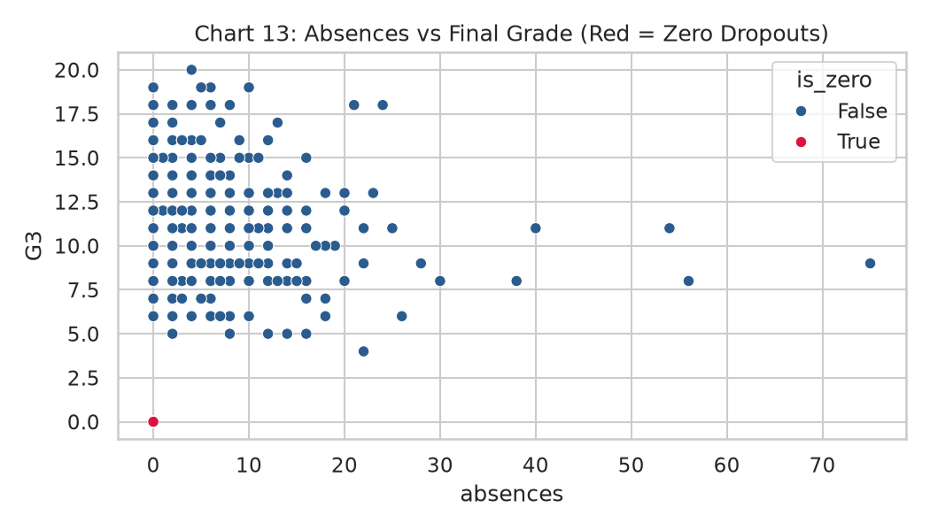
STUDENT PERFORMANCE & ACADEMIC ANALYTICS
The Attendance Paradox & Diminishing Study Returns
• The Attendance Paradox
Raw correlation between absences and Math marks appears flat (r = +0.034). This is an ecological fallacy caused by the zero-grade dropouts.
• True Absenteeism Penalty
Dropouts quit school early and accumulated 0 absences. When evaluating active examinees only, correlation flips to strongly negative (r = -0.213).
• Study Time Sweet Spot (5-10h)
Average Math marks rise from 10.05 (<2h) to 11.40 (5-10h/week). Portuguese scores rise from 10.84 to 13.23.
• Diminishing Returns (>10h)
Studying >10 hours/week yields no additional grade advantage (11.26 in Math), proving that study efficiency matters more than raw volume.

Slide 7
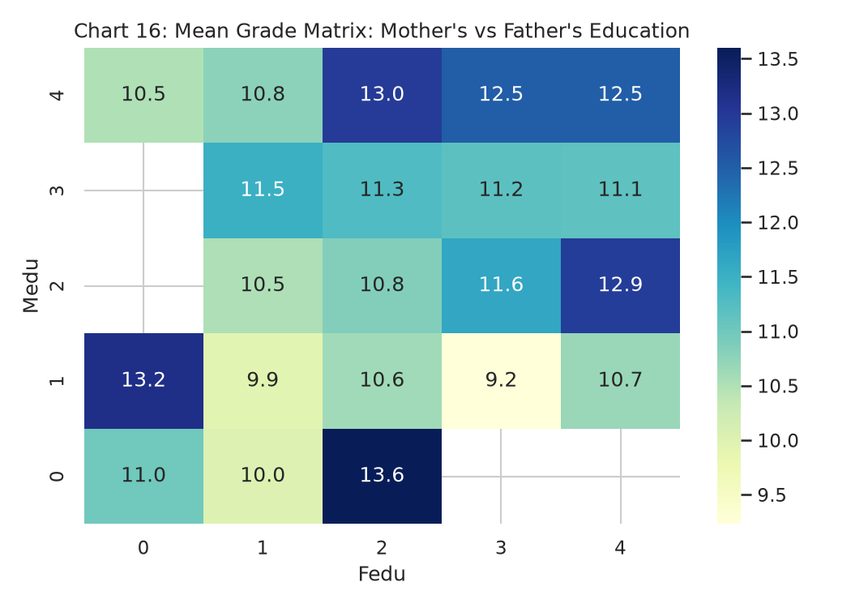
STUDENT PERFORMANCE & ACADEMIC ANALYTICS
Socio-Economic Gradients & Demographic Divergence
• Maternal Education Influence
Mother's education (Medu: r = +0.217) exerts a stronger correlation with student grades than Father's education (Fedu: r = +0.152).
• The Dual-Degree Advantage
Households where both parents completed tertiary education average 12.50 to 12.96, compared to 9.95 for primary-educated households.
• Occupational Disparities
Children of healthcare (12.15) and teaching (11.05) professionals achieve significantly higher grades than at-home parents (9.15).
• Subject-Specific Gender Gaps
Male students score higher in Mathematics (10.91 vs. 9.97); female students lead in Portuguese Language (12.25 vs. 11.41).

Slide 8
STUDENT PERFORMANCE & ACADEMIC ANALYTICS
Institutional Action Plan & Strategic Recommendations
1. Term 1 Early Warning Triggers — Deploy automated alerts for any student scoring G1 <= 9 or with prior failures to mandate tutoring before performance locks in by Term 2.
2. Real-Time Disengagement Intercepts — Monitor consecutive unexcused absences between Terms 1 and 2 to intercept course abandonment prior to exam non-attendance.
3. Restructure Institutional Support — Re-engineer 'schoolsup' from late-stage corrective assignments into proactive small-group mastery clinics early in the year.
4. Study Efficiency & Active Recall — Train students on active recall and problem-solving techniques rather than unguided, passive study volume beyond 10 hours/week.
5. First-Generation Scholar Equity — Establish structured faculty study halls and subsidized exam clinics for students whose parents lack higher education degrees.

