Slide 1
Innovate Corp. Q3 Financial Projections
Analyzing Performance and Future Outlook
Notes:
Welcome everyone. This presentation will provide a comprehensive overview of Innovate Corp.'s financial projections for Q3. We'll examine key performance indicators and discuss the factors influencing our outlook.

Slide 2

Q3 2024: Key Highlights
- Revenue Decline
- Increased losses
- Negative profit margin
- Sales growth decreased
- No dividend payout
Notes:
This slide summarizes the key takeaways from our Q3 performance. As you can see, revenue declined significantly, resulting in increased losses. We'll delve deeper into the reasons behind this later in the presentation.

Slide 3
Comparative Analysis: Q3 2024 vs. Q2 2025 (Projected)
- Lower revenue
- Higher losses
- Negative growth
- Market downturn
- No dividend
- Revenue increase
- Reduced losses
- Positive growth
- Market recovery
- Potential dividend
Notes:
Here, we're comparing our actual Q3 2024 results with our projected Q2 2025 performance. Note the stark contrast in key metrics. The projected improvement highlights our strategic initiatives and anticipated market recovery.

Slide 4
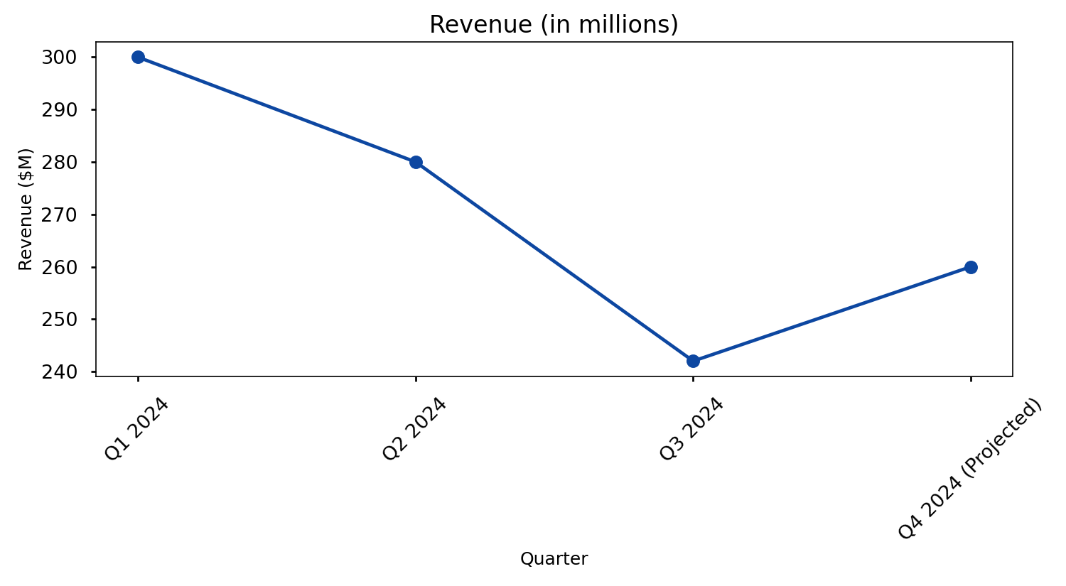
Revenue Trends
Notes:
This line chart illustrates the trend in our revenue over the past few quarters. While Q3 shows a dip, our projections for Q4 indicate a potential recovery.

Slide 5
Key Financial Metrics (Q3 2024)
Metric | Q3 2024 | Change from Q2 2024 | Industry Average
Revenue | $242.2M | -22.7% | $300M
Net Loss | ($15.3M) | -109.6% | ($5M)
Profit Margin | -7.6% | N/A | 5%
Market Cap | $73.9M | N/A | $150M
Notes:
This table provides a detailed breakdown of our Q3 financial performance, comparing it to the previous quarter and industry averages. We can see that while our market cap is low, our performance is being compared against a high-performing industry average.

Slide 6

Challenges and Opportunities
- Address revenue decline
- Improve operational efficiency
- Strategic partnerships
- Market volatility
- Cost reduction
Notes:
This slide highlights the challenges we faced in Q3 and the opportunities we see for future growth. We're addressing the revenue decline through strategic initiatives and cost reduction measures.

Slide 7

Q4 Outlook and Conclusion
- Revenue stabilization
- Profitability improvement
- Cost optimization
- New projects launch
- Long-term growth
Notes:
In closing, although Q3 presented challenges, we are confident in our ability to stabilize revenue and improve profitability in Q4 and beyond. Our strategic initiatives are designed for long-term growth and success. Thank you.

Slide 8
References
INNOVATE Corp. Announces Third Quarter 2024 Results (https://www.innovate-ir.com/news-releases/news-release-details/innovate-corp-announces-third-quarter-2024-results)
Can INNOVATE Corp. Equity Right sustain earnings growth (https://bradfordtaxinstitute.com/market-outlook/Can-INNOVATE-Corp.-Equity-Right-sustain-earnings-growth)
INNOVATE Corp. Announces Second Quarter 2025 Results (https://finance.yahoo.com/news/innovate-corp-announces-second-quarter-200500204.html)
Is Innovate Corp (VATE) Stock a Good Investment? (https://www.aaii.com/investingideas/article/24032-is-innovate-corp-vate-stock-a-good-investment)
INNOVATE Corp. (VATE) Analyst Ratings, Estimates & Forecasts (https://finance.yahoo.com/quote/VATE/analysis/)

