Slide 1
The Rise of Quantum Computing
Revolutionizing Computation and Beyond
Notes:
Welcome everyone! Today, we'll explore the exciting world of quantum computing – a field poised to redefine our technological landscape. We'll cover its fundamental principles, its potential impact on various industries, and the ongoing breakthroughs shaping its future.

Slide 2
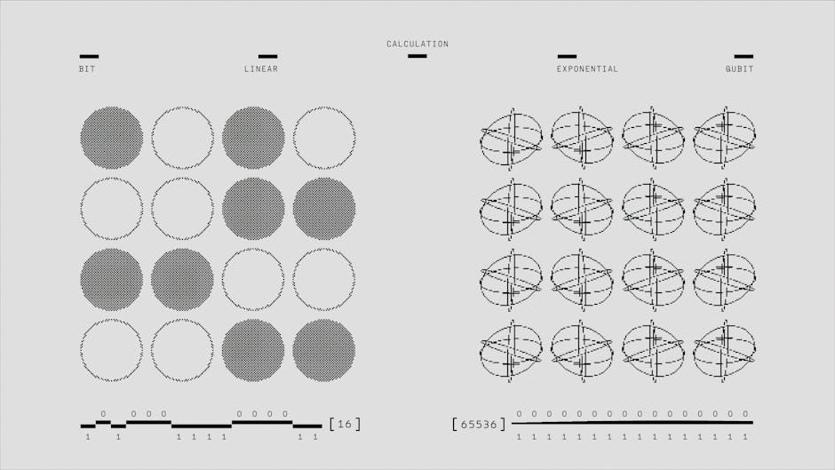
Understanding Quantum Computing
- Qubits: Superposition and entanglement
- Exponential computational power
- Solving unsolvable problems
- Beyond classical limitations
- Early stages of development
Notes:
This slide introduces the core concept of quantum computing. We'll discuss qubits, their unique properties, and how they enable quantum computers to tackle problems far beyond the reach of classical computers. We'll also touch on the current developmental stage of this technology.

Slide 3

Quantum Mechanics: The Foundation
- Subatomic particle behavior
- Superposition and entanglement explained
- Probability and wave functions
- Quantum algorithms
- Practical applications
Notes:
Here, we'll delve into the quantum mechanics principles underpinning this technology. It's crucial to understand superposition and entanglement to grasp the power of quantum computing. We'll keep it concise and focus on the relevance to the topic.

Slide 4
Quantum vs. Classical Computing
- Binary bits
- Sequential processing
- Limited scalability
- Predictable outcomes
- Current technology
- Qubits
- Parallel processing
- High scalability
- Probabilistic
- Future tech
Notes:
This slide offers a direct comparison between classical and quantum computing. Highlight the key differences in their architecture, processing capabilities, and potential. This is a good place to address any questions about the fundamental differences.

Slide 5
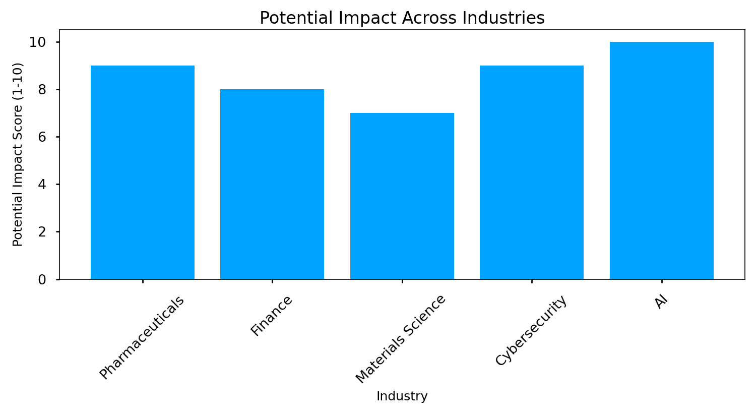
Industries Transformed by Quantum Computing
Notes:
Now, we'll look at the transformative potential of quantum computing across various sectors. This chart visualizes the estimated impact – it's crucial to remember that these are projections, and the actual impact will depend on further technological advancements.

Slide 6
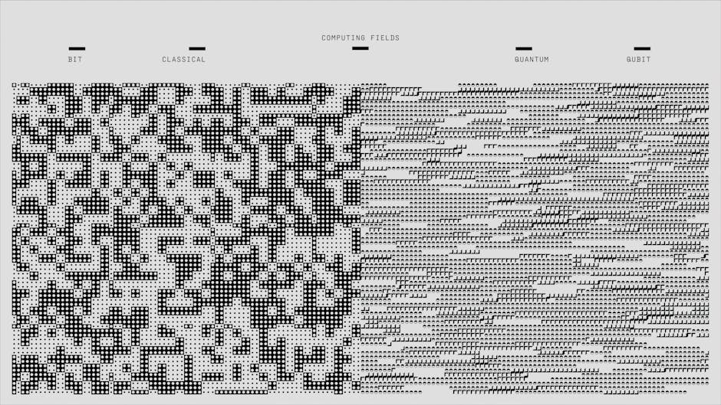
Challenges and Roadblocks
- Qubit stability and coherence
- Error correction and mitigation
- Scalability and cost
- Algorithm development
- Workforce development
Notes:
Despite its enormous potential, quantum computing faces significant hurdles. This slide outlines the key challenges – from maintaining qubit stability to developing effective error correction techniques and managing the high costs associated with this technology.

Slide 7

The Future of Quantum Computing
- Continued research and development
- Increased investment and collaboration
- Development of quantum algorithms
- Potential for disruptive innovations
- Ethical considerations
Notes:
Finally, let's look ahead. The future of quantum computing is bright, but it requires continued dedication to research, development, and collaboration. We'll discuss the potential for disruptive innovations, and touch upon the ethical implications that need to be addressed as this technology matures.

Slide 8
References
The Rise of Quantum Computing (https://www.mckinsey.com/featured-insights/the-rise-of-quantum-computing)
Quantum Computing Is Coming, And It's Reinventing The ... (https://www.forbes.com/sites/qai/2023/01/24/quantum-computing-is-coming-and-its-reinventing-the-tech-industry/)
What Is Quantum Computing? | IBM (https://www.ibm.com/think/topics/quantum-computing)
The Rise of Quantum Computing: What It Means ... (https://www.eimt.edu.eu/the-rise-of-quantum-computing-what-it-means-for-cybersecurity)
The rise of quantum computing (https://www.insights.onegiantleap.com/blogs/the-rise-of-quantum-computing/)

