Slide 1
Networks & System Security
SIL765
Certification Authority
Kushagra Madan : 2014CS10232
Pragnesh Jogadiya : 2014CS10246

Slide 2
Overview
In this project, we have built a Certification Authority which has public keys of all the clients and corresponding to which the clients themselves have their private keys. Public key of Certification Authority is known to all the clients. Certification Authority will provide a certificate to clients on request.
2048 bit RSA algorithm has been used for secure communication between CA and client as well as between client and client.
CA
Certificate
Request
Certificate
(1) Client ID 1
Client 1
(2) Certificate
Client 2
(3)”Hello”

Slide 3
Format of Certificate
Format of Certificate: CERT_{A} = ENC_{PRX} (ID_{A}, KU_{A}, T_{A}), where
PR_{X} is private key of certification authority (PU_{X} is public key of certification authority)
ID_{A} is user ID,
KU_{A} is public key of A,
T_{A} is time of issuance of certificate.
ID_{A} (Client ID)
KU_{A} (Public Key of Client)
T_{A}(Time of issuance)
Encrypted Hash
Certificate Format

Slide 4
Certification Authority
Certification authority has public keys of all clients and its public key is known to all clients. On request from client, CA issues certificate encrypted with its private key to client which includes, client ID, public key of client and time of issuance of certificate.
CERT_{A} = ENC_{PRX} (ID_{A}, KU_{A}, T_{A})
Certificate
CA
Client
Request
Certificate

Slide 5
Client
Client will have three options available.
(1) Get certificate from certification authority.
(2) Send hello to a particular client.
(3) Receive message from client.
Getting certificate from certification authority.
On selecting the first option, client will request a public key certificate from CA. On receiving the request, CA will send client’s certificate encrypted with CA’s private key to the client. Client can decrypt it using the public key of CA.

Slide 6
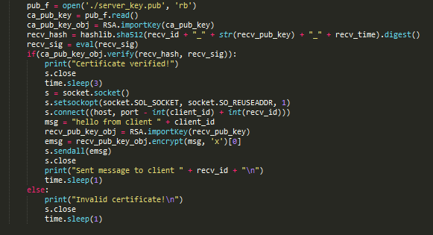
Client
2. Send hello to client
On selecting the second option, client will send its client ID to a receiving client. On receiving the client ID, receiver will send its certificate to sender. Sender will verify certificate and after verifying, it will send “hello” message encrypted with its own private key to the receiver.
Code Snippet in which client is sending “hello” to another client.

Slide 7
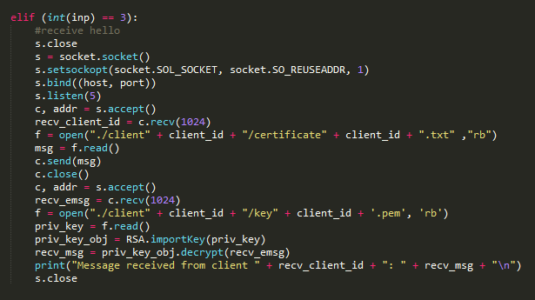
Client
3. Receive message from client.
On selecting the third option, client will wait to receive message from sender client.
Code Snippet in which client is waiting for sender’s message.

Slide 8
Communication Between Clients
For communication between clients, following steps are taken.
Receiving client will wait for the sender’s client ID.
On receiving the ID, receiver will send its certificate to sender.
(3) Sender will verify the certificate sent by the receiver.
(4) After verification of certificate sent by receiver, sender will send “hello’ to receiver.
(1) Client ID 1
Client 1
Client 2
(2) Certificate
(3)”Hello”

Slide 9
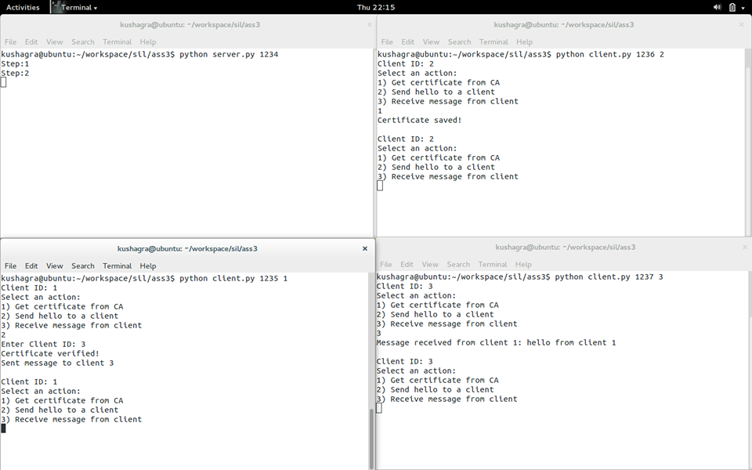
Sample Run

Slide 10
Thank You!

