Slide 1
Normalization

Slide 2
Introduction to Database Design
A good database design practice is essential to develop good relational schemas at logical level.
Good database design is needed for:
Clarity in understanding the database and
To formulate good queries
This is achieved by schema refinement.

Slide 3
Functional Dependencies
Functional Dependency is a constraint between two sets of attributes from the database.
Function Dependency
Denoted by X → Y between two sets of attributes in R, and specifies a constraint on the possible tuples that can form a relational instance r of R.
Values of Y component are determined by X component.
(or) Y is functionally dependent on X.

Slide 4
X→Y
Thus, X functionally determines Y in a relation schema R if and only if whenever two tuples of r(R) agree on their X values they must necessarily agree on their Y values, but Y → X is not true (need not be)
Ex: ssn → ename; {ssn, pnumber} → Hours
Note: FDs cannot be inferred. They should be defined by someone who knows the semantics of the database very well.

Slide 5
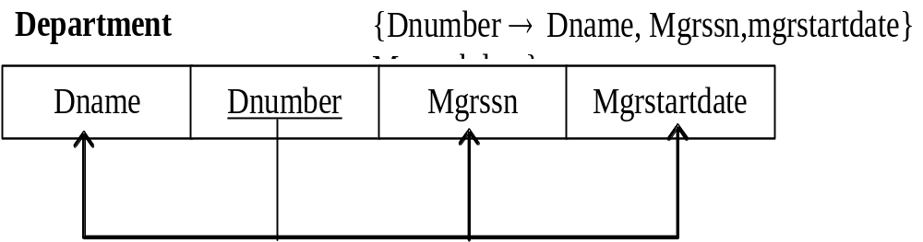
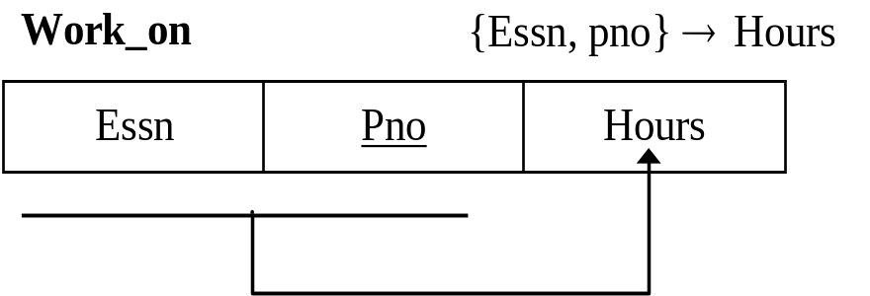
Diagrammatic Notation

Slide 6
Normalization & Normal forms
Normalization process is first proposed by
Raymond Boyce and Edgar Codd in 1972.
Normalization of data – is the process of analyzing relation schemas based on their FDs and PKs/Keys to achieve the desirable properties of –
(i)Minimal redundancy
(ii)Minimal anomalies

Slide 7
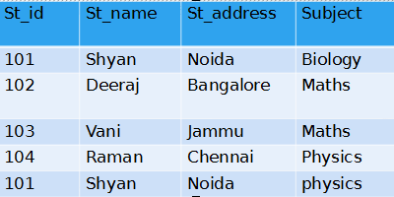
Anamolies
Anamolies are problems that can occur in poorly planned, un-normalized database where all the data is stored in one table.
Update Anamoly: If a student repeats more than once in the table, change in st_address in one row,requires to update all the rows.
Insert Anamoly: Suppose a new student gave all details and not opted any subject, then we need to insert NULL, leading to insertion anamoly.
Delete Anamoly: Student 101 has only one subject, if we drops that record, the whole info about him will be deleted.

Slide 8
First Normal Form (INF)
It states that the domain of any attribute must include only atomic (single / simple/ individual) values.
In the example given below, under the column Dloc each row has more than on values.
Ex.: Dept
DId | Dname | Dloc
10 | Engg | HYD CHENNAI
20 | Mark | HYD MUMBAI

Slide 9
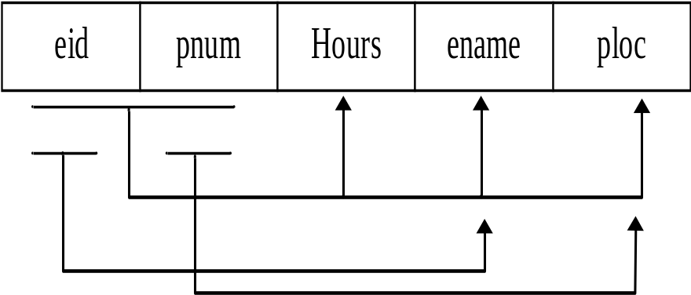
2. Second Normal Form (2NF)
It is based on full functional dependency.
{X → A} is fully functional if we remove any attribute from X then that FD does not hold anymore.
Condition for 2NF: All non-key attributes are fully functionally dependent on key (or) no non-key attribute should be dependent on part of key(partial dependency).

Slide 10
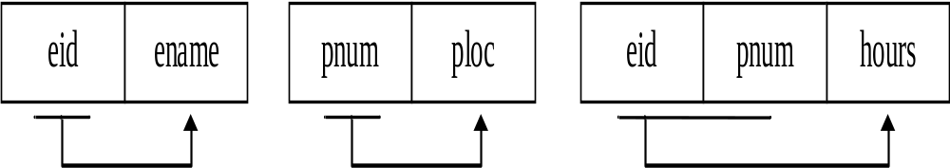
Here, {ename} is a non key attribute and determined by {eid} which is part of the key. Hence we say that ename not fully functionally dependent on key.
The relation shown is not in 2NF. Now we can decompose this in to three relations as shown below.

Slide 11
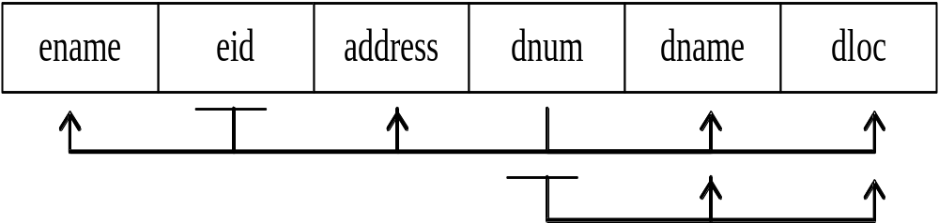
3. Third Normal form (3NF)
It is based on transitive dependency.
According to this, a relation should not have a non key attribute functionally determined by another non key attribute. i.e., there should be no transitive dependency.
Not in 3NF, because Dname is transitively dependent on eid.

Slide 12
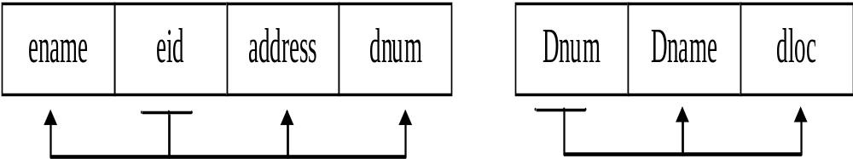
Now we can decompose the above into 2 relations.
Condition for 3NF
For each FD, X → A in database
X must be a superkey or
A is key attribute

Slide 13
BCNF (Boyce Codd Normal Form)
It is a stricter form of 3NF
Condition
For each FD X → A
X must be a superkey

Slide 14
Un - Normalised Form
PROJNUM | PROJNAME | EMPNUM | EMPNAME | JOBCLASS | CHG_HOUR | HOURS
10 | Evergreen | 103 | June E.Arbough | Elect.Engg | $84.50 | 23.8
 |  | 101 | John G.News | Database Designer | $105.00 | 19.4
 |  | 105 | Alice K johnson | Database Designer | $105.00 | 35.7`
20 | Sylicon | 106 | Wiliam Smithfield | Programmer | $35.75 | 12.6
 |  | 102 | David H.Senior | System Analyst | $96.75 | 23.8

Slide 15
First Normal Form (1 NF)
A table is said to be in First normal form provided the intersection of every row and column contain only atomic values.
No repeating groups. Repeating groups are removed into a new entity.
Solution:
u Create a new table with a primary key that contains the relevant or functional dependent attributes

Slide 16
Update Anomalies
Insertion: A subset of a tuple can’t be inserted.
Deletion: Valuable information may be lost in the process.
Updation: May have to be repeated for the same piece of information.

Slide 17
UNF to 1NF
Project
PROJNUM | PROJNAME
10 | Evergreen
20 | Sylicon
Employee
PROJNUM | EMPNUM | EMPNAME | JOBCLASS | CHG_HOUR | HOURS
10 | 103 | June E.Arbough | Elect.Engg | $84.50 | 23.8
10 | 101 | John G.News | Database Designer | $105.00 | 19.4
10 | 105 | Alice K johnson | Database Designer | $105.00 | 35.7`
20 | 106 | Wiliam Smithfield | Programmer | $35.75 | 12.6
20 | 102 | David H.Senior | System Analyst | $96.75 | 23.8

Slide 18
Second Normal Form (2 NF)
Each column must depend on the *entire* primary key
A relation is in 2nd normal form if it is in the 1st normal form and every nonkey attribute is fully functionally dependent on the whole key (which might be a compound key). Attributes that are wholly dependent on only part of the primary key or primary compound key are removed into a separate entity.
In order to reduce a table to 2 NF create a separate table containing the column that is partially dependent on the candidate key and that subset of candidate key on which it depends.
Note: The 2 NF may contain transitive dependencies.

Slide 19
2 NF
Project
Employee
PROJNUM | PROJNAME
10 | Evergreen
20 | Sylicon
EMPNUM | EMPNAME | JOBCLASS | CHG_HOUR
103 | June E.Arbough | Elect.Engg | $84.50
101 | John G.News | Database Designer | $105.00
105 | Alice K johnson | Database Designer | $105.00
106 | Wiliam Smithfield | Programmer | $35.75
102 | David H.Senior | System Analyst | $96.75
Assign
PROJNUM | EMPNUM | HOURS
10 | 103 | 23.8
10 | 101 | 19.4
10 | 105 | 35.7`
20 | 106 | 12.6
20 | 102 | 23.8

Slide 20
Problem with 2 NF
Since a table in 2 NF may have transitive dependencies, it may contain two or more non-key columns that are functionally dependent. This will result in unnecessary duplication of data.
Example: In the Employees table the CHG_HOUR column is dependent on JOBCLASS.

Slide 21
Third Normal Form (3 NF)
A Table is said to be in third normal form provided it is in second normal form and every non-key column is non-transitively dependent on candidate key.
In order to reduce a table to 3 NF create a separate table containing the columns that are functionally dependent.

Slide 22
3 NF
Project
Employee
PROJNUM | PROJNAME
10 | Evergreen
20 | Sylicon
EMPNUM | EMPNAME | JOBCLASS
103 | June E.Arbough | Elect.Engg
101 | John G.News | Database Designer
105 | Alice K johnson | Database Designer
106 | Wiliam Smithfield | Programmer
102 | David H.Senior | System Analyst
Job
Assign
JOBCLASS | CHG_HOUR
Elect.Engg | $84.50
Database Designer | $105.00
Programmer | $35.75
System Analyst | $96.75
PROJNUM | EMPNUM | HOURS
10 | 103 | 23.8
10 | 101 | 19.4
10 | 105 | 35.7`
20 | 106 | 12.6
20 | 102 | 23.8

Slide 23
3 NF (ALTERNATIVE)
Project
Employee
PROJNUM | PROJNAME
10 | Evergreen
20 | Sylicon
EMPNUM | EMPNAME | JOBCODE
103 | June E.Arbough | J1
101 | John G.News | J2
105 | Alice K johnson | J2
106 | Wiliam Smithfield | J3
102 | David H.Senior | J4
Job
Assign
JOBCODE | JOBCLASS | CHG_HOUR
J1 | Elect.Engg | $84.50
J2 | Database Designer | $105.00
J2 | Programmer | $35.75
J3 | System Analyst | $96.75
J4
PROJNUM | EMPNUM | HOURS
10 | 103 | 23.8
10 | 101 | 19.4
10 | 105 | 35.7`
20 | 106 | 12.6
20 | 102 | 23.8

Slide 24
Summary of Normal Forms
Input | Operation | Output
Un-normalized Table | Create separate rows for every combination of multivalued columns | Table in 1 NF
Table in 1 NF | Eliminate Partial dependencies | Tables in 2NF
Tables in 2 NF | Eliminate Transitive dependencies | Tables in 3 NF

Slide 25
Limitations of Normalization
Full normalization may not be always desirable.
Use your Experience.
Adverse effect in retrieval.

