Slide 1

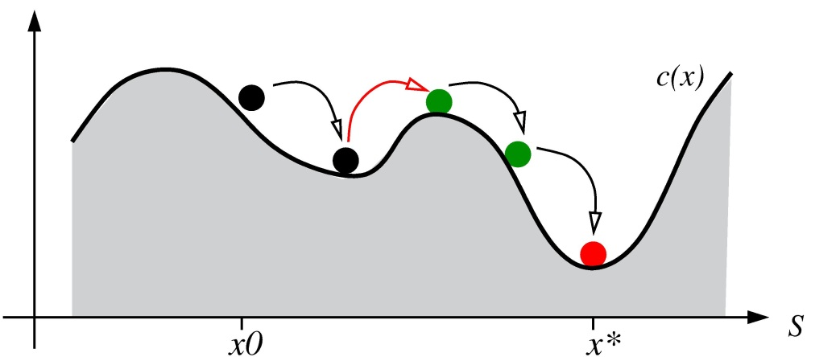
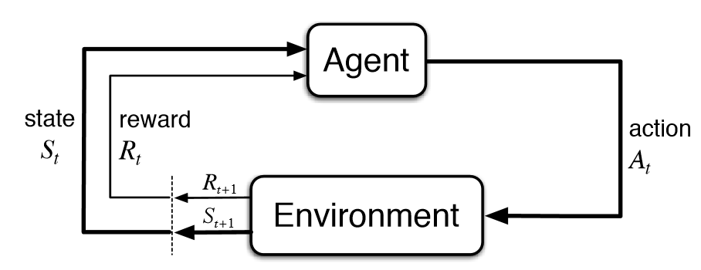
Bitcoin Trading with Reinforcement Learning
Douglas Smith and Kushagra Sharma
dasmith@college.harvard.edu and ksharma@college.harvard.edu
CS182: Artificial Intelligence
Fall 2017
Introduction
We experimented with Approximate Q-learning agents that trade Bitcoin. Because of the large continuous state space of the bitcoin market, traditional Q-learning would fail in this context. The feature sets we have chosen so far have failed to beat the buy and hold strategy, but still make a profit over 4-month span of trading. We plan to investigate other feature sets and potentially classification algorithms to improve these results.
Bitcoin and cryptocurrencies have become extremely popular in recent history. In particular, these currencies have seen astronomical returns in the past few years. While there exist a plethora of institutionalized algorithmic trading firms for the stock market, there are few, if any, analogous firms for the cryptocurrency market. Furthermore, being a digital currency with all on-chain transactions stored on the blockchain which is publicly accessible, nearly all Bitcoin data that you could possibly want is accessible online. This accessibility makes Bitcoin trading a natural application for reinforcement learning techniques.
blah blah blah
Data
For training and testing, we gathered Coinbase Bitcoin 1-minute data from 12-01-2014 to 10-20-2017, which includes open, high, low, and close prices along with volume indicators. We aggregated this into 15 minute data with other market indicators such as Relative Strength Index.
Experiments:
For each feature set, we trained the RL agent for 2000 episodes lasting 3 days each on the first 90% of data. We then tested how the agent performed on the last 10% of data 100 times.
Conclusions
Approach
Traditional Approximate Q-learning is not the best choice for beating the Bitcoin market. This is mostly because it is difficult to pick the correct features, especially with a lack of economics background, and that traditional Approximate Q-learning only uses a weighted sum of the features to approximate Q-values.
Other choices that could work better include Q-learning, where you approximate the Q function with a neural network. This will allow the agent to learn a non-linear approximation function. Several projects online indicate that this can perform better than the buy and hold strategy.
Treating the market like a game, we decided the best algorithm for bitcoin trading would be Reinforcement Learning. With RL, we can have an agent learn to behave optimally on past market data and then use that agent in the present. In particular, we chose to implement approximate Q-learning due to the challenges of identifying the exact state of the market and the large, continuous state space. With approximate Q-learning, instead of learning Q values for each state-action pair, we instead learn weights for chosen features that describe the state, which we then use to approximate Q-values.
We implemented this by creating a framework with which our agent could buy, sell, or hold at each timestamp.
Reward Function: T_{t+1} – T_{t}
where T_{i} is the agent’s total assets at time i.
Results
blah blah blah
blah blah blah
Figure 2. And all about Figure 2.
Citations and Links
Stuart J. Russell and Peter Norvig. 2003. Artificial Intelligence: A Modern Approach (2 ed.). Pearson Education.
Cbyn, BitPredict, (2016), GitHub repository, https://github.com/cbyn/bitpredict
Poon, Vincent. “Trading Bitcoin with Reinforcement Learning.” Launchpad.AI, 6 Sept. 2017, launchpad.ai/blog/trading-bitcoin.
Figure 1. shows how an agent interacts with its environment in reinforcement learning
John A. Paulson School of Engineering and Applied Sciences

