Slide 1

Course Introduction
Data Structures KCS301
Week 1
Department of Computer Science and Engineering

Slide 2
Course Objective:
The main objective of the course is to provide an introduction to basic data structures and algorithms for manipulating them by using C programming language.
This course specifically has the following objectives:
The fundamental design, analysis and implementation of basic data structures and algorithms.
The analysis of the data structure needs of particular problems.
The design, analysis and implementation of C programs by using basic data structures and algorithms.

Slide 3
Course Outcomes:
Having successfully completed this course, Students would be able to
CO1: Define [L1:Knowledge] facts, terms and basic concepts of various data structures like Array, List, Stack, Queue, Tree and Graph using C as the programming language with static or dynamic implementations.
CO2: Express [L2: Comprehension] the basic understanding using programming techniques for illustrating solution of problems.
CO3: Employ [L3: Application] different operations on data structures by applying knowledge and facts gained.
CO4: Analyze [L4: Analysis] the performance of data structures and algorithms to solve problems and also to draw conclusions regarding the best data structure for the problem.

Slide 4
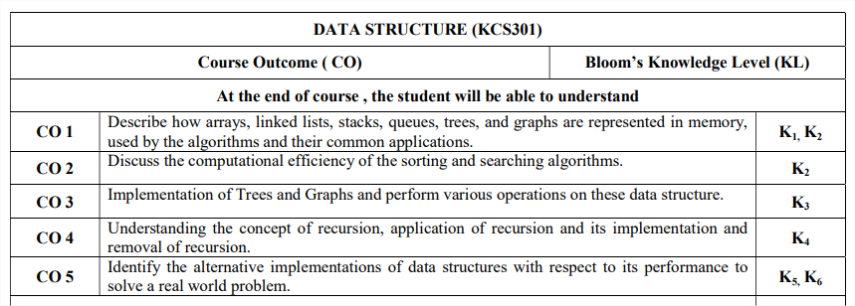

Slide 5
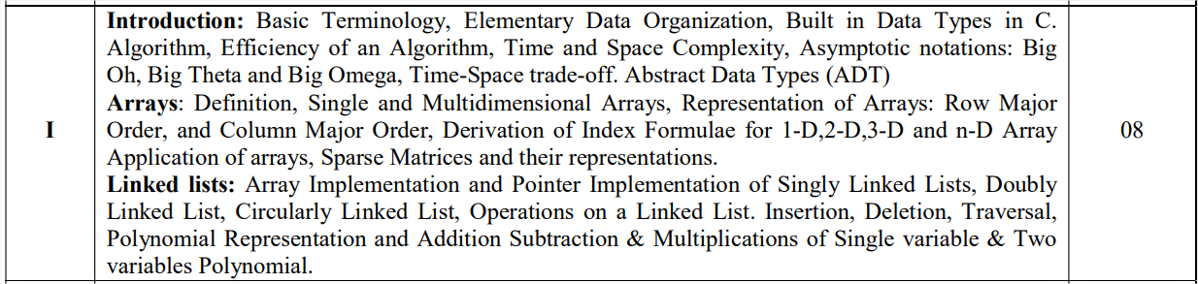
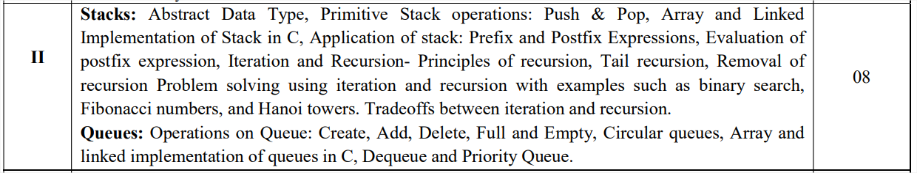
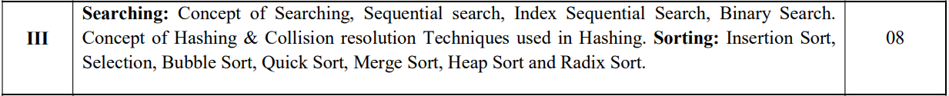

Slide 6
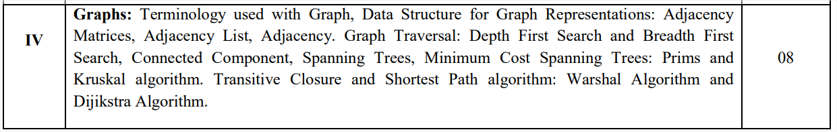
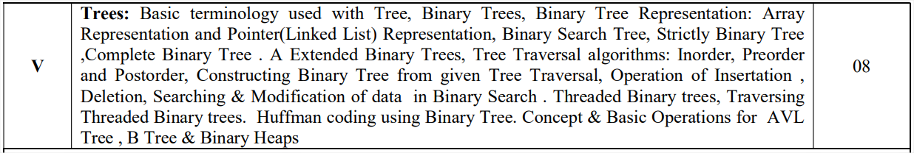

Slide 7
Algorithm
An essential aspect to data structures is algorithms. Data structures are implemented using algorithms. An algorithm is a procedure that you can write as a C function or program, or any other language. An algorithm states explicitly how the data will be manipulated.

Slide 8
Algorithm Efficiency
Two Factors:
1. Running Time Complexity: Time required to finish the task. Depends on
Input
Input Size
2. Space complexity: Extra space required to store intermediate results at run time.

Slide 9
Analysis of Algorithms
Time complexity is given more preference than space complexity.
Types of Analysis
Worst Case (Usually)
Average Case (Some Times)
Best Case (Not Reliable)
Challenge: How to make it machine independent?
The Big idea is – Growth Rate of time (Asymptotic Analysis)

Slide 10
Asymptotic Notation
Having the expressions for the best, average and worst cases, for all three cases we need to identify the upper and lower bounds. To represent these upper and lower bounds, we need some kind of syntax, and that is the subject of the following discussion. Let us assume that the given algorithm is represented in the form of function f(n).

Slide 11
Big Oh Definition (O)
Definition: Let f(n) and g(n) be functions, where n is a positive integer.
We write f(n) = O(g(n)) (read as "f of n is big oh of g of n.“) if and only if there exists constants real number c>0 and positive integer n₀ s.t.
0 <= f(n) <= cg(n) for all n >= n₀

Slide 12
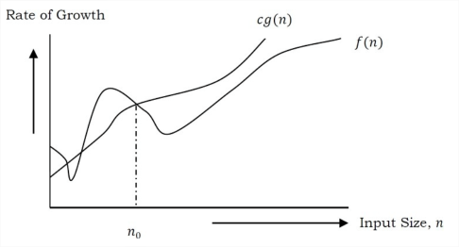
Big Oh Definition

Slide 13
Big Oh Properties
Fastest growing function dominates a sum
O(f(n)+g(n)) is O(max{f(n), g(n)})
Product of upper bounds is upper bound for the product
If f is O(g) and h is O(r) then fh is O(gr)
f is O(g) is transitive
If f is O(g) and g is O(h) then f is O(h)
Hierarchy of functions
O(1), O(logn), O(n^{1/2}), O(nlogn), O(n²), O(2^{n}), O(n!)

Slide 14
Rules for calculating Big-oh
Base of Logs ignored
log_{a}n = O(log_{b}n)
Power inside logs ignored
log(n²) = O(log n)
Base and powers in exponents not ignored
3^{n} is not O(2^{n})
₂
a^{(n )} is not O(a^{n})
If T(x) is a polynomial of degree n, then T(x) = O(x^{n})

Slide 15
Big-oh Examples
1. 2n³ + 3n² + n = 2n³ + 3n² + O(n)
= 2n³ + O( n² + n)
= 2n³ + O( n² )
= O(n³ ) = O(n⁴)
2. 2n³ + 3n² + n = 2n³ + 3n² + O(n)
= 2n³ + O(n² + n)
= 2n³ + O(n²) = O(n³)

Slide 16
Big-Omega (Ω)
Definition: Let f(n) and g(n) be functions, where n is a positive integer.
We write f(n) = Ω(g(n)) (read as "f of n is big omega of g of n.“) if and only if there exists constants real number c and positive integer n₀ s.t.
f(n) >= cg(n)>0 for all n >= n₀

Slide 17
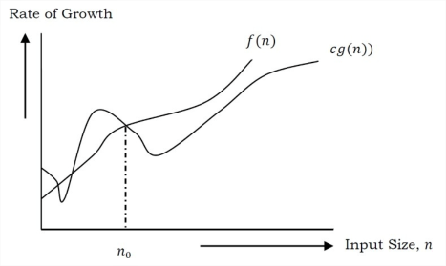
Big Omega (Lower Bound Function)

Slide 18
Big-Omega Example
Example: n ^{1/2} = Ω( lg n) .
Use the definition with c = 1 and n₀ = 16. Checks OK. Let n > 16: n ^{1/2} > (1) lg n if and only if n > ( lg n )²
by squaring both sides.
This is an example of polynomial vs. log.
n | (log n)^2 | Diff
16 | 16 | 0
17 | 16.71 | 0.29
18 | 17.39 | 0.61
19 | 18.04 | 0.96
20 | 18.68 | 1.32
21 | 19.29 | 1.71
22 | 19.89 | 2.11
23 | 20.46 | 2.54
24 | 21.02 | 2.98

Slide 19
Theta (θ)
Definition: Let f(n) and g(n) be functions, where n is a positive integer.
We write f(n) = θ(g(n)) (read as "f of n is theta of g of n.“) if and only if there exists constants real numbers c1 and c2 and positive integer n₀ s.t.
0 < c1g(n) <= f(n) <= c2g(n) for all n >= n₀

Slide 20
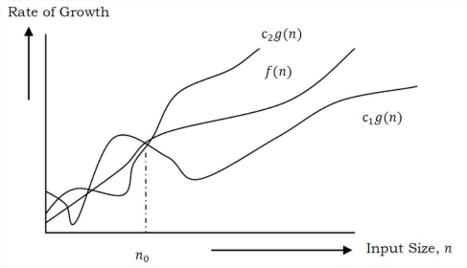
Theta Notation

Slide 21
Theta Example
Example: f(n) = n² - 5n + 13.
The constant 13 doesn't change as n grows, so it is not crucial. The low order term, -5n, doesn't have much effect on f compared to the quadratic term, n².
Q: What does it mean to say f(n) = Q(g(n)) ?
A: Intuitively, it means that function f is the same order of magnitude as g.

