Slide 1


CS598 DLH Project: Graph Attention Networks
Original Authors:
Petar Velickovic
Guillem Cucurull
Arantxa Casanova
Adriana Romero
Pietro Liò
Yoshua Bengio
Project By:
Ricardo Ruy Valle-Mena
Kushagra Soni

Slide 2
Introduction
Graph Attention Networks (GAT) are a type of neural network that operates on graph-structured data.
Proposed by Petar Velickovic et al. in the paper "Graph Attention Networks" in 2018.
Works on arbitrarily-structured graphs
Processes nodes in parallel
Reuses learned weights across nodes, like CNNs

Slide 3
objectives
Reproduce paper as closely as possible
Architectures
Datasets
Training/testing methodology
Try out model variants

Slide 4
Replication - architectures
For Cora and Citeseer datasets:
Two-layer GAT models
First layer has 8 attention heads, each head outputs 8-dimensional data, uses an exponentional linear unit (ELU) as the activation function
Second layer has one attention head, outputs C-dimensional data (C = number of classes in dataset), and uses softmax as the activation function
Uses L2 regulariztion with lambda = 0.0005 and dropout with p = 0.6
For Pubmed dataset, the model is almost the same as for Cora and Citeseer, but second layer has 8 attention heads and L2 regularization uses lambda = 0.001.
For PPI dataset:
Three-layer GAT model
First two layers have 4 attention heads, output 256-dimensional data, and use ELU activation
Third layer has 6 attention heads, outputs 121-dimensional data, and uses softmax activation

Slide 5
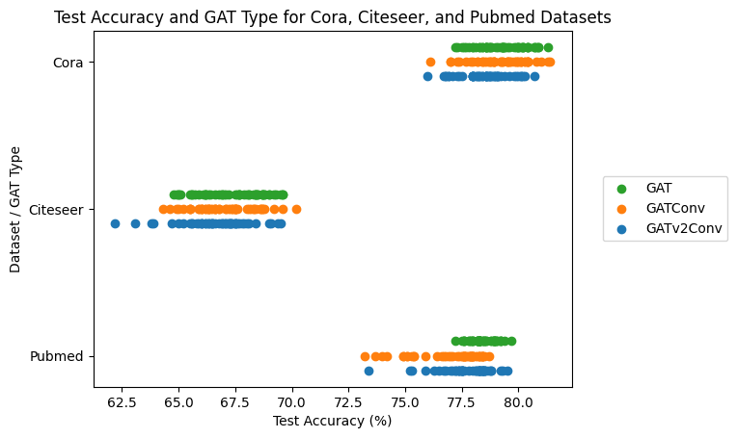
Replication - results
Ran GAT, GATConv and GATv2Conv models 50 times on Citeseer, Cora and Pubmed datasets
Results a bit worse than results reported in paper for all variants and all datasets
PPI dataset was very slow to run, so we only ran it once, but our architecture was wrong so we didn't record the resuls
GATConv accuracy means
Citeseer = 0.6675, Cora = 0.7926, Pubmed = 0.7682
GATv2Conv accuracy means
Citeseer = 0.6648, Cora = 0.7859, Pubmed = 0.7754
GAT accuracy means
Citeseer = 0.6725, Cora = 0.7892, Pubmed = 0.7812

Slide 6
Ablations - architectures
Single-layer GAT model, 8 heads, dropout with p = 0.6, L2 regularization with with lambda = 0.0005, and softmax activation function
Same as above, with ELU followed by softmax instead of just softmax
Three-layer GAT
First two layers have 8 heads, project data to 8 dimensions, have ELU activation
Third layer has 1 head and uses softmax activation
All layers use dropout with p = 0.6 and L2 regularization with lambda = 0.0005

Slide 7
Ablations - results
Single-layer GAT 1
Citeseer accuracy: 0.6270
Cora accuracy: 0.7320
Pubmed accuracy: 0.7040
Single-layer GAT 2
Citeseer accuracy: 0.6490
Cora accuracy: 0.7600
Pubmed accuracy: 0.7160
Three-layer GAT
Citeseer accuracy: 0.6650
Cora accuracy: 0.7930
Pubmed accuracy: 0.7660
Both single-layer GATs appear to perform worse than all three two-layer GATs from the replication
Second single-layer GAT seems to do a bit better than first single-layer GAT
Three-layer GAT seems to perform about equally to the two-layer GATs from the replication, perhaps a little bit better on Cora data

