Slide 1


CS598 DLH Project: Reproduce and Experiment with Graph Attention Networks
Original Authors:
Petar Velickovic
Guillem Cucurull
Arantxa Casanova
Adriana Romero
Pietro Liò
Yoshua Bengio
Project By:
Ricardo Ruy Valle-Mena
Kushagra Soni

Slide 2
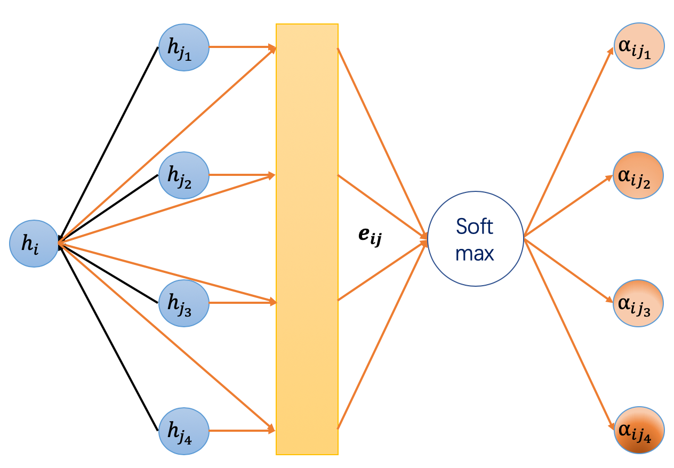
Graph Attention Networks (GAT) - Introduction
Graph Attention Networks (GAT) is a type of neural network that operates on graph-structured data.
Proposed by Petar Velickovic et al. in the paper "Graph Attention Networks" in 2018.
GAT is based on the attention mechanism, which allows the network to selectively attend to different nodes when computing node representations.

Slide 3

Graph Attention Networks (GAT) - Background
Graphs are ubiquitous data structures used to model relationships between entities in various domains such as social networks, bioinformatics, and recommendation systems.
Traditional neural networks cannot be applied directly to graphs due to the irregular and varying size of graphs.
Graph Convolutional Networks (GCN) was introduced as a way to extend convolutional neural networks (CNN) to graphs.
However, GCN has limitations such as over-smoothing and the inability to capture multi-hop relations.

Slide 4
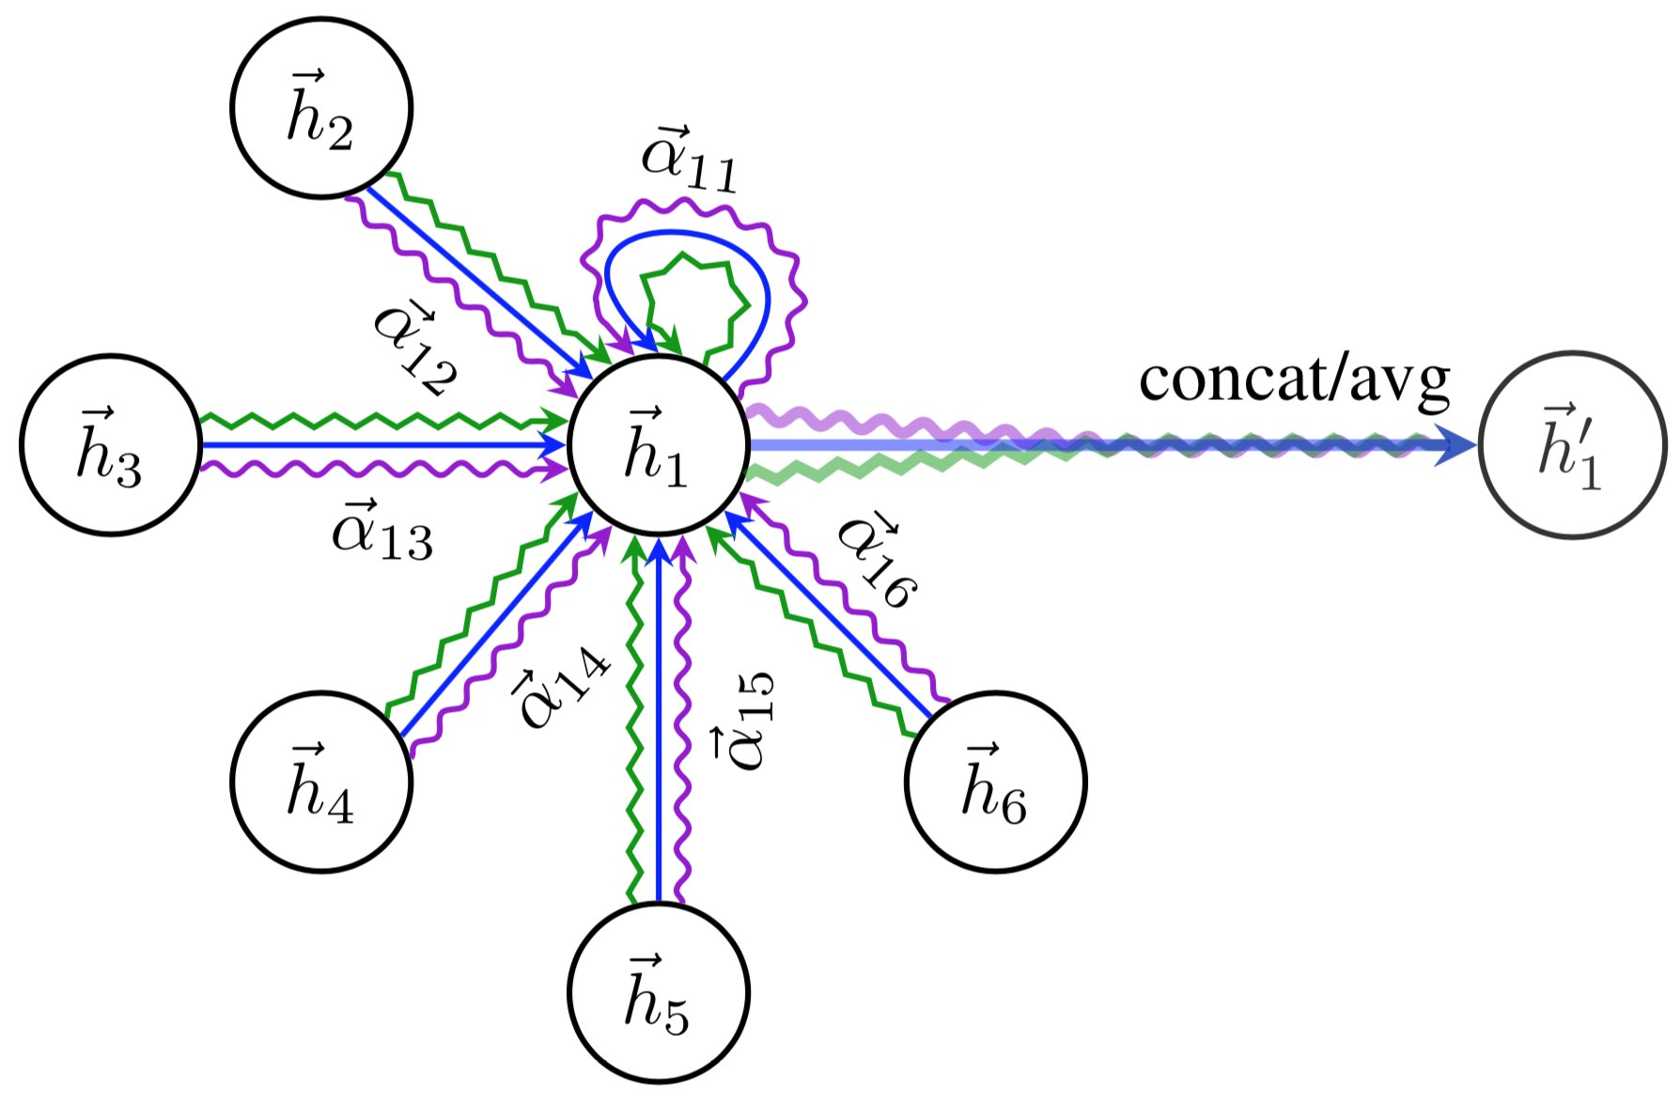
Graph Attention Networks (GAT) - architecture
GAT extends the GCN architecture by introducing the attention mechanism.
The attention mechanism computes weights for each neighboring node based on the current node's representation, allowing the network to selectively attend to important neighbors.
The attention weights are computed as a learned function of the node features and the weight matrix.
Multiple attention heads are used to compute multiple representations for each node, which are then concatenated and passed through a non-linearity to compute the final node representation.

Slide 5
Graph Attention Networks (GAT) - ADVANTAGES
GAT has several advantages over GCN:
The attention mechanism allows for selective and adaptive aggregation of neighbor nodes.
Multi-head attention allows for capturing different types of dependencies.
GAT can capture long-range dependencies by attending to distant nodes in the graph.
GAT can handle graphs with varying size and structure.

Slide 6
Original paper implementation - background and problem
GATs were proposed to overcome limitations of other graph neural network architectures, such as GCNs, GraphSAGE, and DeepWalk.
These limitations included:
Inability to operate on arbitrarily structured graphs,
Need to sample from input graphs, learning separate weight matrices for different node degrees, and
Inability to parallelize across nodes.
GATs offer a solution to these limitations and allow for more efficient and effective processing of graph-structured data.

Slide 7
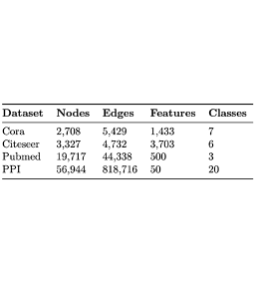
Original paper implementation - Model & DATA description
The GAT model used four datasets, including Cora, Citeseer, Pubmed, and Protein-Protein Interaction (PPI), with varying features, classes, and sparsity.
For Cora and Citeseer,
2-layer GAT with 8 attention heads in the first layer and 1 attention head in the second layer,
L2 regularization with lambda = 0.0005
dropout with p = 0.6 to prevent overfitting
Achieved classification accuracies ~ 83.0% (Cora) and 72.5% (Citeseer).
For PubMed,
2-layer GAT with 8 attention heads in both first layer and second layers
L2 regularization coefficient of 0.001
Achieved an accuracy ~ 79%.
For protein-protein interaction,
3-layer GAT with 4 attention heads in the first two layers and 6 attention heads in the third layer
Achieving a micro-averaged F1 score of approximately 0.973.

Slide 8
Reproducing & experimenting GAT - Scope & objective
Reproducing Graph Attention Networks (GATs) results using Cora, Citeseer, PubMed, and Protein-protein interaction datasets.
Aim for high classification accuracies and micro-averaged F1 score
Test the hypothesis that the results will be similar or better than previous studies.
Ablation studies and architectural variations will be conducted, such as replacing the self-attention mechanism and shared weight matrix with other metrics or the encoding phase of an autoencoder.

Slide 9
Reproducing & experimenting GAT - Methodology
Datasets used in the original paper are publicly available, including in the Pytorch Geometric library
The datasets are relatively small, with the largest being 15.5MB when compressed.
Experiments are run locally and on Google Colab, providing sufficient computational resources.
The official GAT implementation was modified to suit the project's needs and to run model variants
The project aims to deepen understanding of GATs and contribute to ongoing research in the field.

Slide 10
Reproducing & experimenting GAT - model implementation
GAT Variants Explored in the Project:
GAT bundled with Pytorch Geometric:
Tried to follow the paper's methodology, but not flexible enough
Pytorch Geometric GATConv class:
Allows specifying different activation functions at each layer
Pytorch Geometric GATv2Conv class:
more advanced;
includes improvements to its architecture and implementation
more computationally expensive
difficult to train than the original GATConv
Rewriting GAT from scratch:
Followed mathematical description in the paper, but slower implementation
Notes:
In our project, we explored different variants of the GAT model used in the paper.
We started by using the GAT model bundled with Pytorch Geometric, which was not flexible enough to follow the paper's methodology exactly.
However, this helped us understand how to feed the data into the model and set everything up.
We then aimed to build our own graph attention network implementation using Pytorch Geometric GATConv class, which allowed us to specify different activation functions at each layer.
Additionally, we attempted to rewrite GAT from scratch by following the mathematical description in the paper, but our implementation may be slower than existing ones.

Slide 11
Reproducing & experimenting GAT - computational requirements
To implement the GAT model and reproduce its results using PyTorch version 1.9.0 on two platforms.
Two local systems: a Macbook and a Windows with an Intel Core i7 CPU, 16GB RAM, and Intel UHD GPU.
Google Colab's free GPU instance with 12GB of RAM.
PyTorch and necessary dependencies installed using pip package manager on the local system, and within the Google Colab notebook environment.

Slide 12
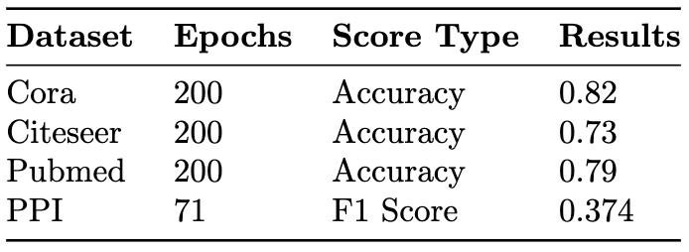
Reproducing & experimenting GAT - findings & RESULTS
Pytorch Geometric GAT implementation not flexible enough to exactly replicate paper's experiments
Preliminary results are encouraging.
Training accuracy reaches 100% on Citeseer, Cora, and Pubmed datasets.
Training the model on PPI dataset is significantly slower than on other datasets.
Test accuracy on Pubmed dataset is essentially indistinguishable from paper's results
Test accuracy on Citeseer and Cora datasets are about 5% worse than paper's results
Results for PPI dataset are reported on training set, achieving a micro-averaged F1 score of 0.374 after 71 epochs.
Results for other datasets are accuracy scores on test set after 200 epochs of training
Signs of overfitting observed in experiments

Slide 13
Reproducing & experimenting GAT - conclusion & future works
Conclusion:
Encouraging preliminary results, but more work needed to improve accuracy and address overfitting
Further investigation and experimentation required to fully replicate paper's results.
Future Work:
Attempted to implement our own early stopping mechanism to reduce overfitting and improve test accuracy

