Slide 1
Time series analysis on Covid 19 Summarized Twitter data Using Modified TextRank
By Kushagra Chitkara, Ajit Das and Apurba Sarkar

Slide 2
Introduction
Automatic summarization is a research field that is currently very important because of the complexity of the task
In general, Text summarization approaches can be categorized into two types 1)extractive summarization 2) abstractive summarization
Extractive summary is a subset of the sentences of the original text whereas abstractive summary express the ideas in the source document using different words.
Text summarization is also classified as Indicative and informative. Indicative summary identifies the topics of the document which is mainly used for quick categorization and the informative summary elaborates these topics and includes conclusions, suggestions and recommendations according to the reader's interest
The proposed work is developed on extractive summarization technique.
The modified TextRank uses the intuition behind the PageRank algorithm
In PageRank, important web pages are linked with other important web pages
Similarly, in our approach we assume the important sentences are linked or similar to other important sentences of the input document

Slide 3
Bag Of Words (Vector) Representation of the Sentences
 | W1 | W2 | …. | …. | …. | W1500
S1 | 1 | 1 | …… | …… | …… | 1
S2 | 0 | 1 | …… | …… | …… | 0
S3 | 1 | 0 | …… | …… | …… | 1
…… | …… | …… | …… | …… | …… | ……
…… | …… | …… | …… | …… | …… | ……
…… | …… | …… | …… | …… | …… | ……
S1000 | 1 | 1 | 0 | 0 | 1 | 1
The sentences and bag of words is represented as a matrix where, each row represents a sentence and columns represents the bag of words identified from these sentences
The matrix value represents the number of times it has occurred in the sentence

Slide 4
Cosine Similarity Matrix
 | S1 | S2 | …. | …. | …. | S1000 | Avg
S1 | 1 | .87 | 0.73 | 0.53 | …… | …… | .39
S2 | 0.87 | 1 | 0.55 | 0.63 | …… | …… | .25
S3 | 0 | .45 | 1 | …… | …… | …… | .17
…… | …… | …… | …… | …… | …… | …… | .48
…… | …… | …… | …… | …… | …… | …… | .36
S1000 | 0.33 | 0.42 | …… | …… | …… | 1 | .41
The net average value is 0.39

Slide 5
Similarity Graph
Each vertex is a sentence vector
Edges are established between vertices, if the similarity measure between the vertices > the pre-defined threshold value (which is average weight of the cosine similarity matrix)
Thus removing nodes which are having less coherence (500 nodes removed)

Slide 6

Modified TextRank weight assignment to the Vertex
In traditional PageRank the initial PageRank value of each node is set to 1/T.
TextRank score of each node of the graph is initialized by the average weight of the edges adjacent (linked) to it.
For weight assignment, a score is assigned to every sentence or node via modified TextRank as defined by the formula below.
Vertex | Weight of Vertex
S1 | .49
S2 | 0.87
S3 | 0.23
…… | ……
…… | ……
…… | ……
S500 | 0.33
Ordered weights | Vertex
0.87 | S2
0.79 | ……
0.69 | ……
…… | ……
…… | ……
…… | ……
0.49 | S1
Where TR(S(u)) is the text rank of the sentence corresponding to node u, TR(S(v)) is the text rank of the sentence for node v such as v € adj(u), d is a scalar damping factor, deg(S(v)) is the degree of node v, T is the total no of nodes present in the graph.

Slide 7
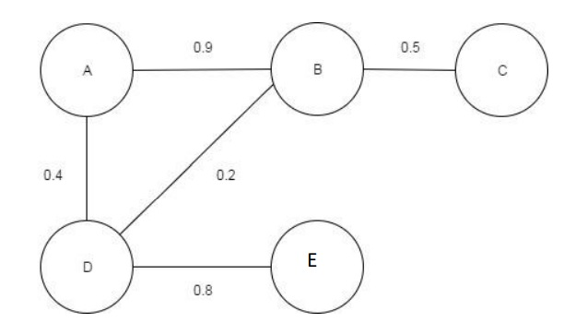
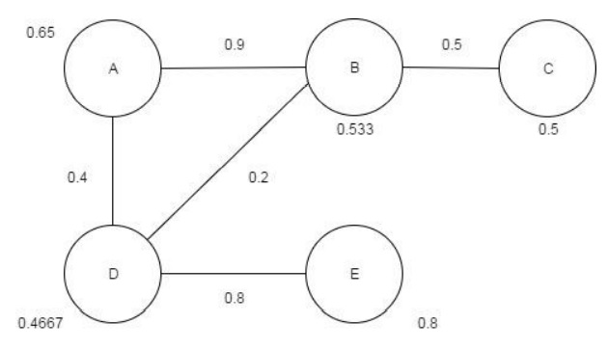
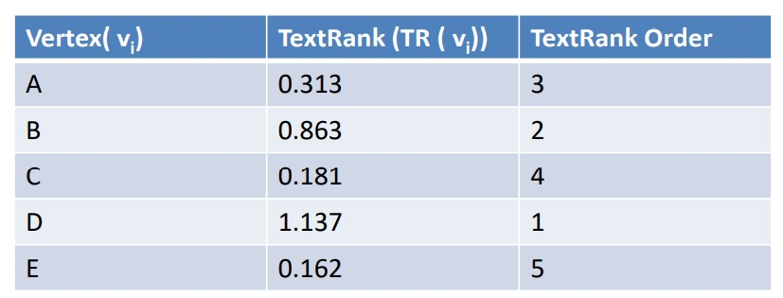
Illustration of the method
A small document with 13 sentences is taken as input
Constructed the similarity matrix by using cosine similarity equation
Average of all the weights between the edges are calculated
The edges which are below the average value are removed.
Thus we have a graph of five vertices
We mark the vertex set as {A, B, C, D, E}.
The TextRank of vertices.
TR(A) = (0.9 + 0.4)/2 = 0.65, TR(B) = (0.9 + 0.5 + 0.2)/3 = 0.533, TR(C) = 0.5/1 = 0.5, TR(D) = (0.4 + 0.8 + 0.2)/3 = 0.4667, TR(E) = 0.8/1 = 0.8.
Final TextRank(TR) of each vertex
TR(A) = d/5+ (1-d)x( TR(D)/3 + TR(B)/3 ) = 0.15/5 + 0.85x( 0.4667/3 + 0.533/3 ) = 0.313.
Similarly, TR(B) = 0.863, TR(C) = 0.181, TR(D) = 1.137, TR(E) = 0.162. Here damping factor d = 0.15.

Slide 8
Arranging Vertices and selecting sentences
Arrange the weighted vertices of the graph in descending order of their weight
Take first n vertices from the sorted list
Arrange those n sentences according to the sentence index which we have assigned earlier
These n arranged sentences are placed in a file called summary file
Output the summary file

Slide 9
Parameters of the Algorithm
Parameter | Value
Damping factor – d | 0.15
Similarity threshold value | Average weight of the cosine similarity matrix
No of sentences in the output summary | 10%, 15%, 20%, 25% of the number of sentences in the original document

Slide 10
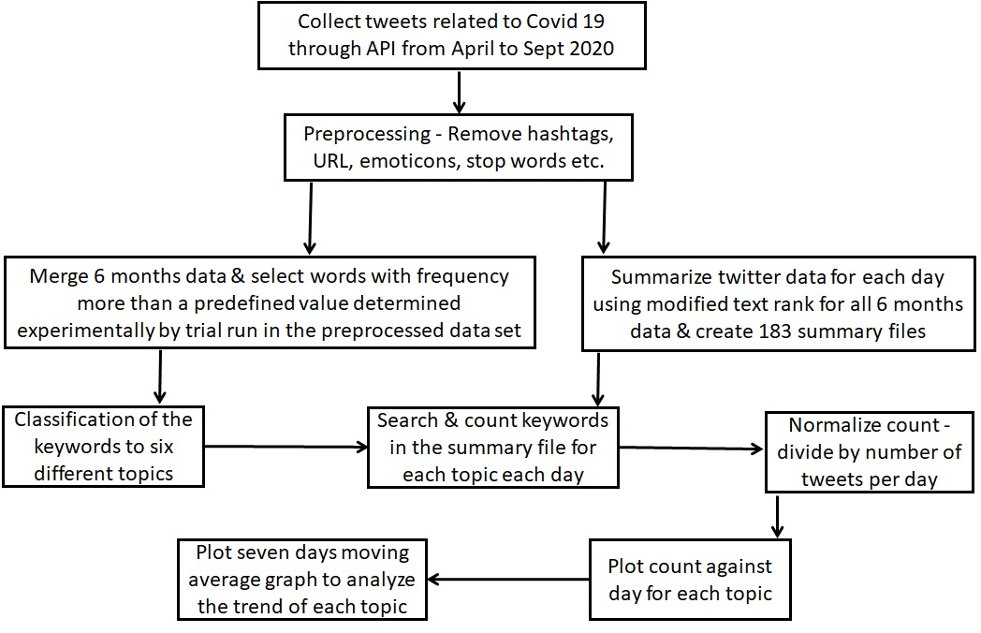
Application in Covid 19 Twitter data

Slide 11
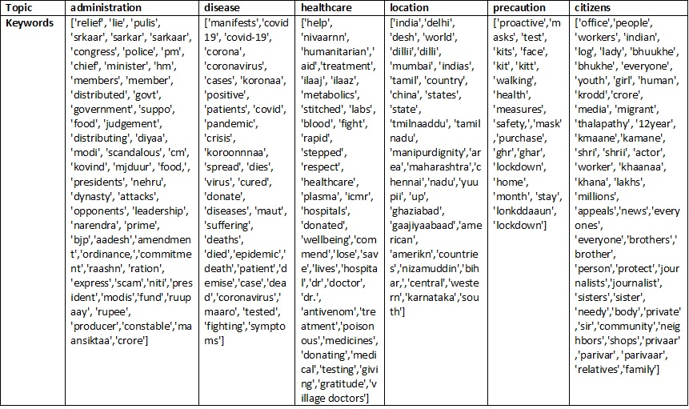
Topics & Keywords

Slide 12
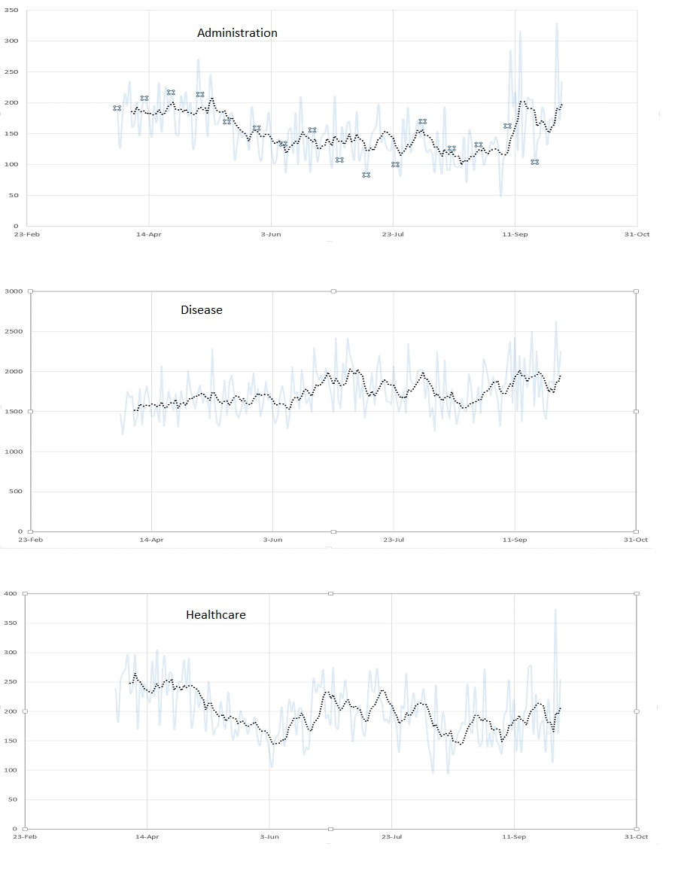
Time series analysis of Topics

Slide 13
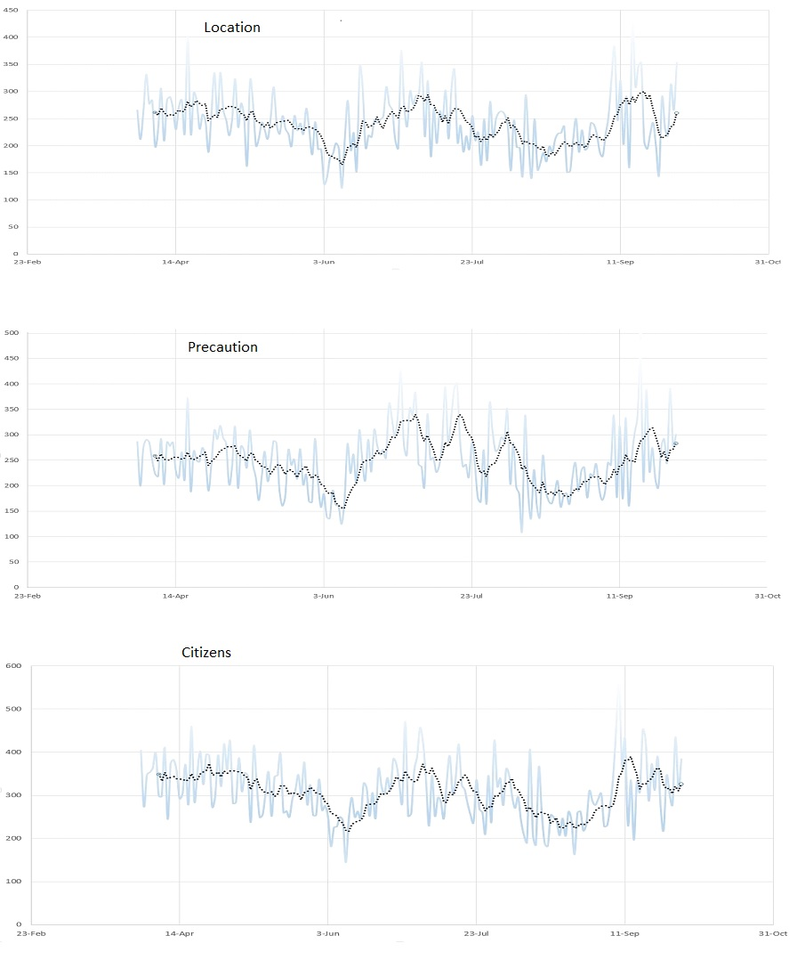
Time series analysis of Topics

Slide 14
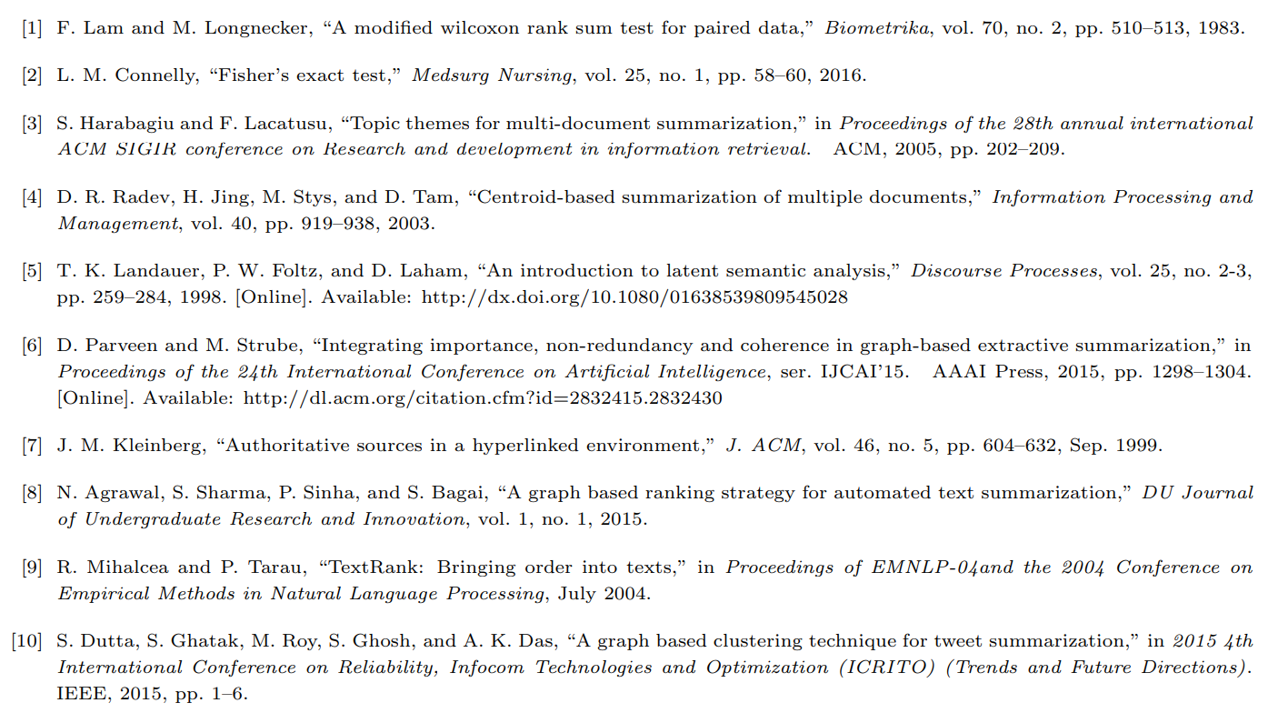
References

Slide 15
Thank You

