Slide 1

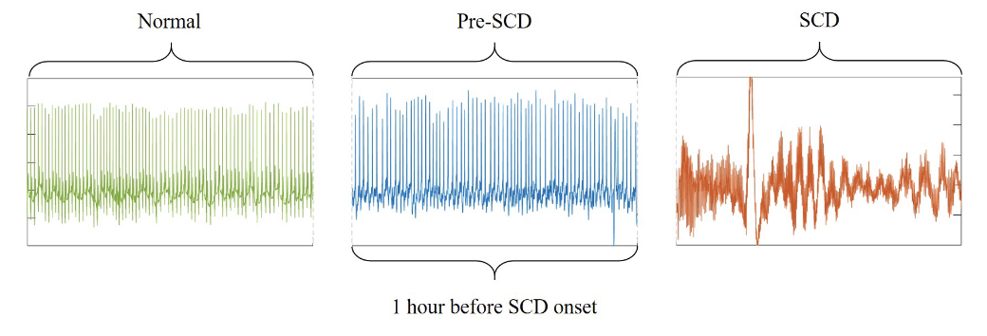
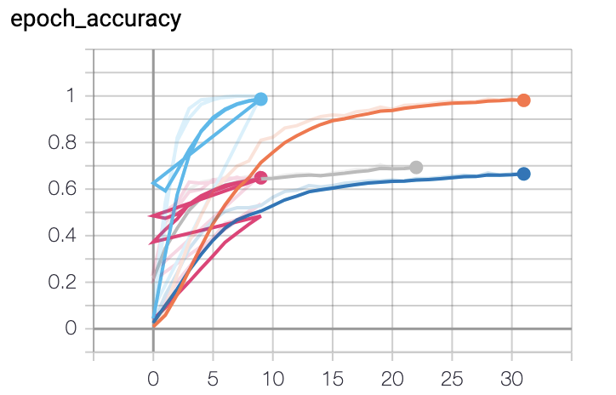
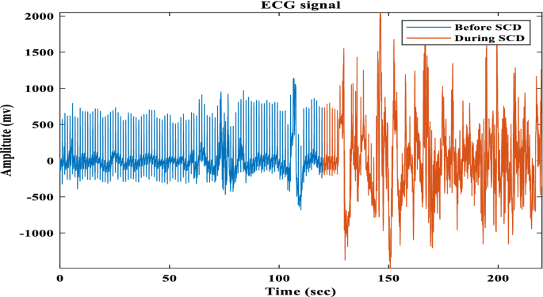
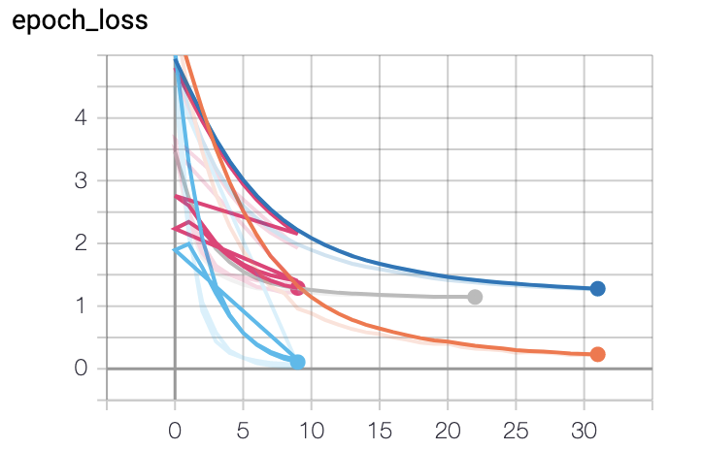
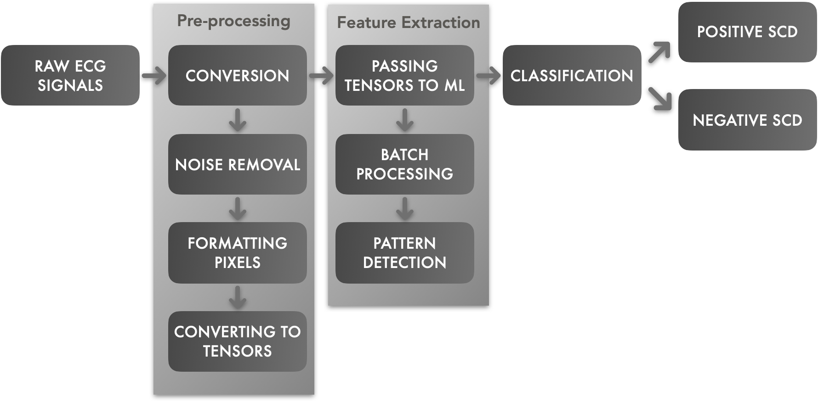
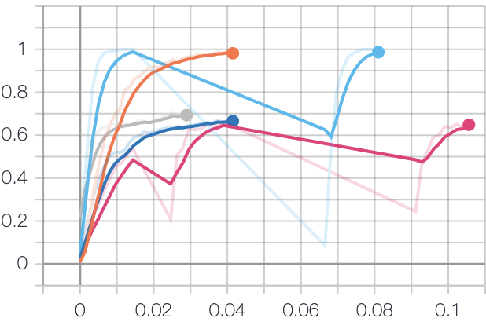
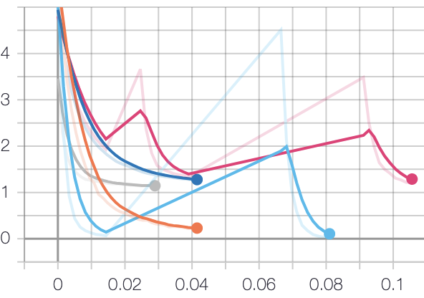
ECG based Sudden Cardiac Death prediction & analysis.
Kushal A. Gurram
Seidenberg School of Computer Science & Information Systems
SCD syndrome is a sudden failure in cardiac activity due to multiple physiological and mechanical substrates, including different electronic predispositions. Moreover, some individuals have no demonstrable predispositions. The objective of this analysis is to analyze various factors (electrical and mechanical) to determine the key factors resulting SCD.
The data is collected from Holter Database hosted by PhysioNet. The data set includes 23 subjects with underlying sinus rhythm (4 with intermittent pacing), who was continuously paced, and with 4 atrial fibrillation. All patients had a sustained ventricular tachyarrhythmia, and most had an actual cardiac arrest. The objective of this study is to identify the target trends (electromagnetic graphs, physiological and mechanical) which results in SCD.
INTRODUCTION
METHOD
RESULTS
CONCLUSION
The aim here is to identify the patterns in the Electrocardiaogram (ECG) signals of subjects recorded resulting in a Sudden Cardiac Death(SCD).
The method followed here can be broken down as follows:
Feature Classification:
Although the ECG wave looks more like a sign wave, each frequency and each node (the crusts and the troughs) represent a unique feature of the heart rhythm. In this phase researchers concentrate on a unique feature and build their work on it.
Analysis method:
This is a phase to come up with a methodology to process the dataset for the target feature. Most of the analysis is done using advanced computer methods like Machine learning, Neural networks, etc.
Target Detection:
The output of the analysis is to predict the feature on a scale. It is the objective of the target detection phase.
The model here (mobilenet.v2) is built using Keras, and this model showed an accuracy of 75.67%.
The model classified the ECG signal and identified patterns in the wave which result to a positive SCD.
The model here (mobilenet.v2) is built using Keras, and this model showed an accuracy of 75.67%.
The model’s trained and loss can be seen below,
The below waveform is the classification by the model of various patterns in a given ECG signal.
Then prediction reaches a general average accuracy of 87.3%. as criterion based on the sum of absolute coefficients was used it’s possible to achieve to predicted 30 min before the SCD event.
The results reported in this experiment indicate that the methodology here is feasible and promising.
Flow diagram
REFERENCES
Early prediction of cardiac arrest
https://luke-plewa.github.io/Thesis.pdf
Detection and prediction of sudden cardiac death (SCD) for personal healthcare
https://pubmed.ncbi.nlm.nih.gov/18002521/
ECG-Based Identification of Sudden Cardiac Death through Sparse Representations
https://mdpi-res.com/d_attachment/sensors/sensors-21-07666/article_deploy/sensors-21-07666-v2.pdf?version=1637307634
OBJECTIVES
The relative accuracy and loss are as follows,
To analyze and determine the key factors and series of behavioral patterns resulting a SCD a detailed analysis on the Electronic Cardio Graph is to be done including all other features given in the data set.
The success of the study can be measured by running a machine learning analysis on the data and evaluating the results.
To achieve the objective of the analysis a detailed Exploratory Data Analysis (EDA) is to be performed along with a scientific analysis defining the story behind the electromagnetic graphs. The progress can be measured by setting up checkpoints and the quality of the analysis.
epoch_accuracy epoch_loss

