Slide 1

SLIDE 1 OF 10 • [ AI & CYBER DEFENSE INNOVATION ]
CyberShield
AI-Powered Digital Attack Prediction & Adaptive Deception System
▶ Core Concept
An autonomous cybersecurity platform that flips the advantage against cyber attackers by predicting their next moves, trapping them in realistic decoy environments, and neutralizing threats before data breaches occur.
▶ Key Paradigm
PREDICT -> DECEIVE -> OBSERVE -> LEARN -> DEFEND
▶ Design Philosophy
Move beyond reactive 'detect-and-block' firewalls by combining AI threat prediction, adaptive honeypots, attacker de-anonymization, and automated defense.
💡 Key Cybersecurity Takeaway: Deception-based defense gives defenders the upper hand by confusing and trapping adversaries instead of just blocking them.

Slide 2

SLIDE 2 OF 10 • [ THE CYBERSECURITY PROBLEM ]
Why Traditional Firewalls Fail
The fundamental flaw in reactive 'Detect & Block' security models
▶ The Attacker Asymmetry
Traditional firewalls only react after an attack hits. Attackers get unlimited free attempts to probe, scan, and find a single weakness.
▶ Cloaked Infiltration
Modern adversaries hide behind VPNs, Tor exit nodes, and residential proxies. When blocked, they immediately switch to a new IP address in seconds.
▶ Zero-Day Blindspots
Signature-based antivirus tools cannot stop unknown zero-day exploits. Once inside, hackers move laterally undetected for an average of 200+ days.
💡 Key Cybersecurity Takeaway: Defenders must succeed 100% of the time, while attackers only need to find ONE flaw. CyberShield flips this asymmetry.

Slide 3

SLIDE 3 OF 10 • [ THE NEW STRATEGY ]
The CyberShield Paradigm
Shifting from reactive defense to proactive deception & behavioral analysis
▶ 1. Predict
AI analyzes incoming traffic patterns, headers, and commands to forecast the attacker's next moves.
▶ 2. Deceive
Instead of showing a 403 Forbidden error, the system feeds attackers realistic fake data, simulated portals, and dummy databases.
▶ 3. Observe & Defend
Hackers spend hours exploiting useless decoy traps while CyberShield extracts threat intelligence and executes automated firewall drops.
💡 Key Cybersecurity Takeaway: By feeding fake data instead of errors, you keep hackers busy attacking illusions while you collect their forensic fingerprints.

Slide 4
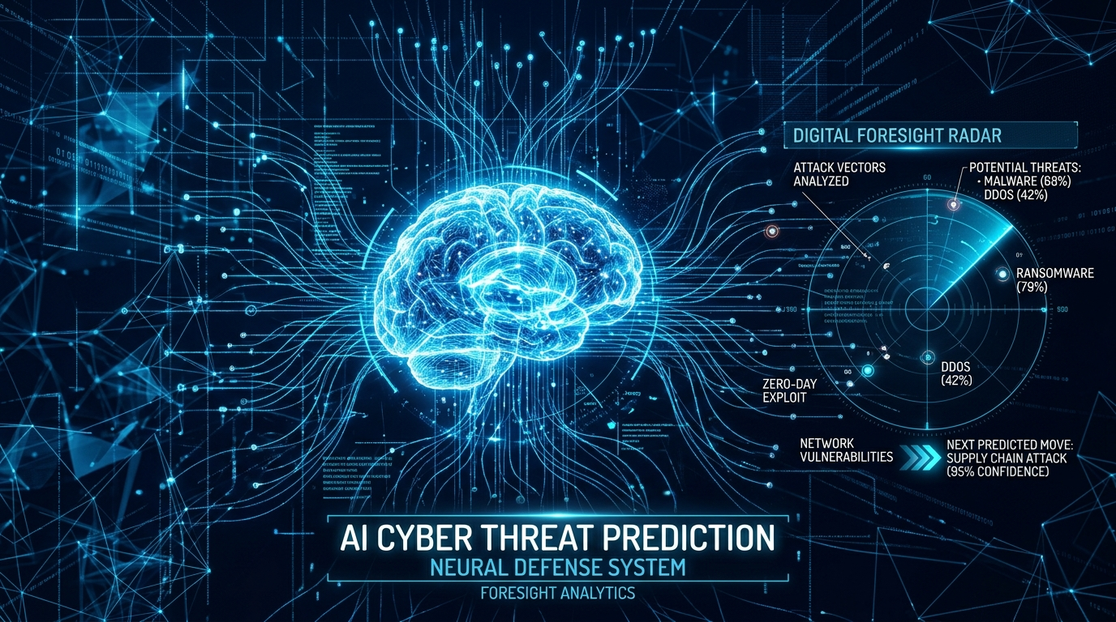
SLIDE 4 OF 10 • [ ARTIFICIAL INTELLIGENCE CORE ]
AI Attack Prediction & Kill-Chain Foresight
Anticipating the adversary's next 3 steps using Machine Learning & Markov Models
▶ Random Forest Classifier
Categorizes incoming payloads in sub-2ms into: Reconnaissance, Brute Force, Web Injection, Privilege Escalation, and Exfiltration.
▶ Markov Kill-Chain Engine
Maps MITRE ATT&CK progression: e.g., Recon scan triggers 48% probability of SQL Injection, preparing decoy database traps in advance.
▶ Dynamic Risk Scoring
Calculates payload entropy, signature confidence, and reputation score to assign Low, Medium, High, or Critical threat tiers (0 to 100).
💡 Key Cybersecurity Takeaway: Markov Transition Chains model the hacker's kill-chain flow, allowing defenders to set traps BEFORE the hacker executes the exploit.

Slide 5
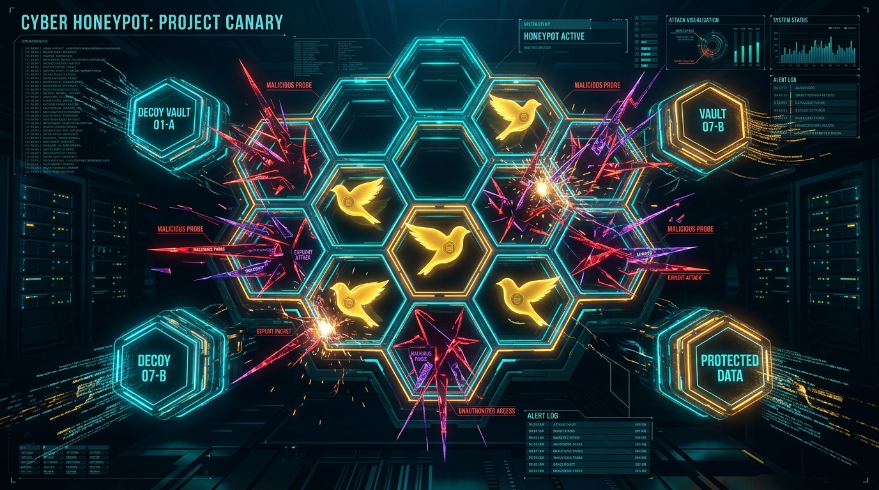
SLIDE 5 OF 10 • [ ACTIVE DECEPTION LAYER ]
Adaptive Honeypots & Canary Tripwires
Planting digital landmines and fake assets to mislead and trap hackers
▶ Dynamic Decoy Services
Automatically deploys fake Admin Portals (/admin/auth), dummy REST APIs, synthetic database dumps, and infinite SSH tarpits (Port 2222).
▶ What is a Canary Token?
Planted fake AWS API keys and JWT tokens. The moment an attacker steals or queries with them, an instant high-priority alarm fires.
▶ Cognitive Confusion for Hackers
Attackers believe they have breached sensitive databases, wasting their time and resources on fabricated zero-value data.
💡 Key Cybersecurity Takeaway: Canary Tokens act like radioactive dye: when an attacker steals them, any attempt to use them instantly triggers a critical alert.

Slide 6
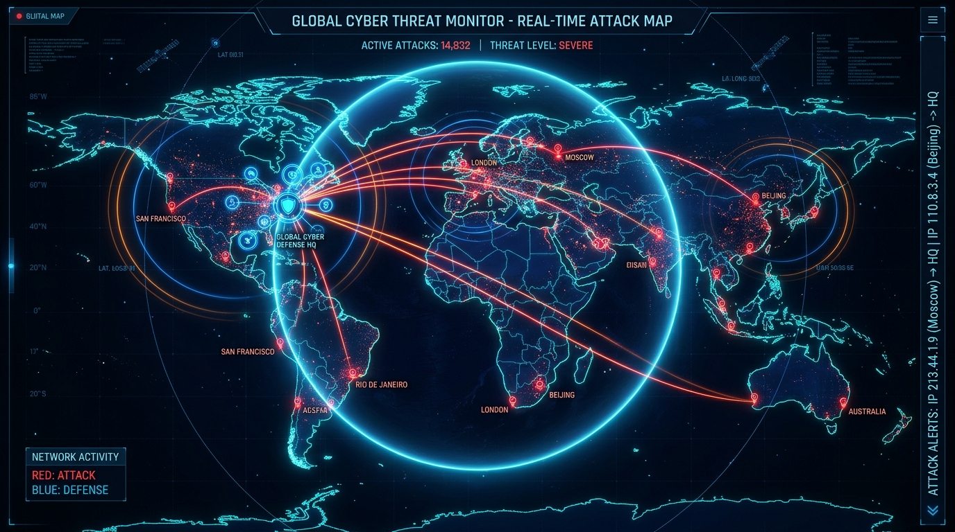
SLIDE 6 OF 10 • [ THREAT ATTRIBUTION ]
Attacker De-Anonymization & Physical GPS Mapping
Unmasking adversaries hidden behind commercial VPNs, Proxies, and Tor gateways
▶ VPN & Proxy Detection
Identifies commercial VPN tunnels (Nord, Mullvad, M247) and Tor exit relays by analyzing TCP TTL, MTU sizes, and ASN databases.
▶ WebRTC Internal LAN IP Leak
Extracts the attacker's real private internal subnet IP (e.g. 192.168.1.54) leaked through browser STUN candidate reflex exchange.
▶ Layer-2 MAC & Real Port Tracking
Resolves hardware MAC addresses via ARP cache in lab setups, and tracks the exact source ephemeral socket port (e.g. 53500) and GPS location.
💡 Key Cybersecurity Takeaway: Browser WebRTC STUN protocols and TCP packet timing can reveal a hacker's true private IP and physical location even behind VPNs.

Slide 7
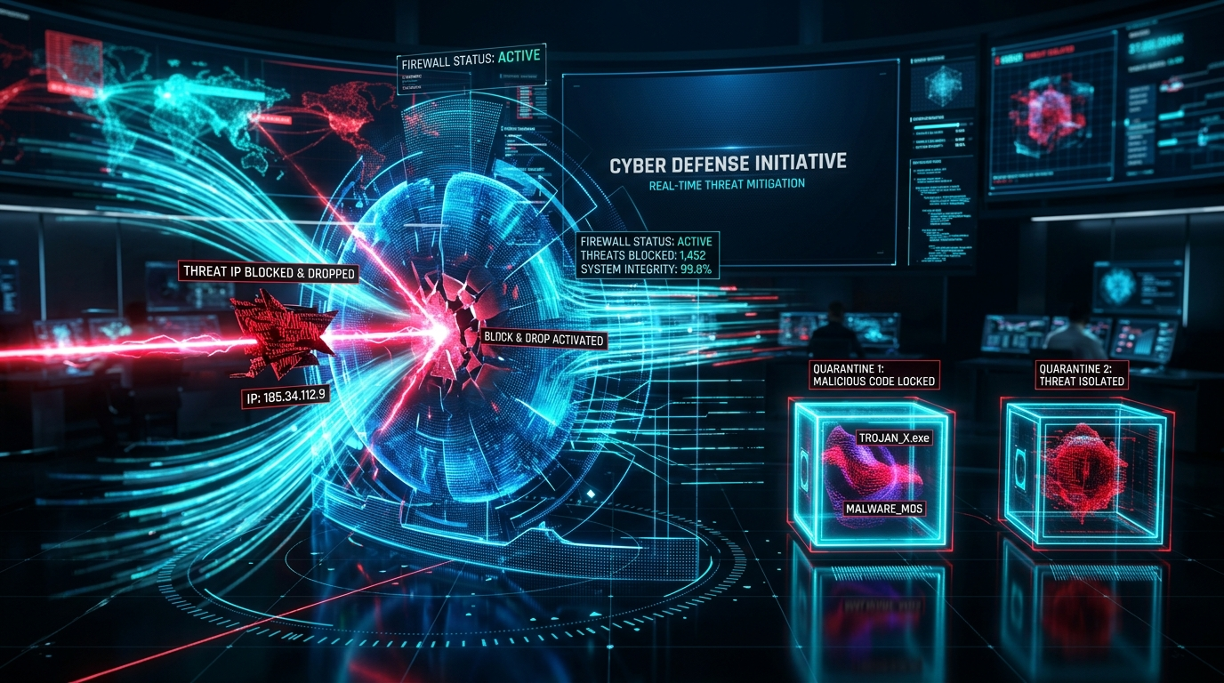
SLIDE 7 OF 10 • [ AUTONOMOUS RESPONSE ]
Automated Defense & Kernel Firewall
Instant mitigation without requiring manual operator intervention
▶ Auto-Firewall Blacklisting
When risk score exceeds 72/100 or a Canary token is tripped, CyberShield instantly enforces a kernel-level IP_DROP_BLOCK rule.
▶ Deception Sandbox Isolation
Suspicious intermediate sessions (Score 50-70) are silently routed to an isolated container sandbox where malware can be safely studied.
▶ Dropped Packet Telemetry
Monitors dropped attack requests, maintains active quarantine logs, and allows one-click operator override (Block/Unblock).
💡 Key Cybersecurity Takeaway: Automated response closes the critical time gap between threat detection and containment, preventing lateral movement.

Slide 8
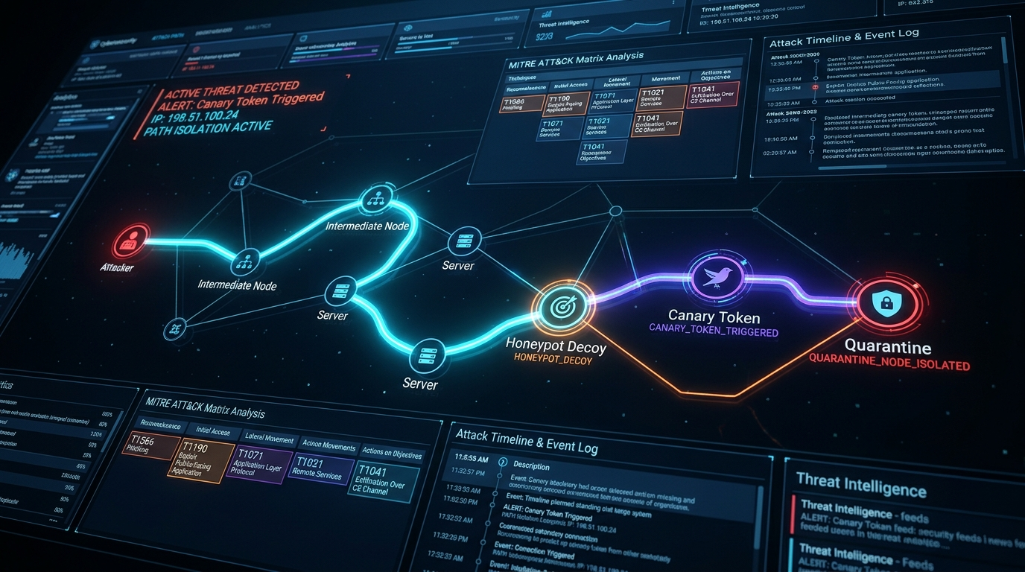
SLIDE 8 OF 10 • [ SITUATIONAL AWARENESS ]
Attack-Path Visualizer & SOC Operations
Mapping real-time intrusion flow and enterprise MITRE ATT&CK coverage
▶ Interactive Traversal Graph
Renders animated visual paths: Attacker IP -> Probe Vector -> Honeypot Decoy -> Canary Token -> Quarantine.
▶ MITRE ATT&CK Matrix Alignment
Maps each attack event to standard industry techniques (T1595 Recon, T1110 Brute Force, T1190 Exploit, T1068 Priv-Esc, T1048 Exfiltration).
▶ Digital Forensics Vault
Records raw HTTP headers, payload hex strings, timestamps, and generates 1-click exportable Forensic Incident JSON reports.
💡 Key Cybersecurity Takeaway: Graph-based visualization transforms confusing log files into clear visual stories showing how the attacker was outsmarted step-by-step.

Slide 9

SLIDE 9 OF 10 • [ EVALUATION & VERIFICATION ]
Interactive Cyber Attack Simulation Lab
Testing the autonomous defense pipeline with realistic multi-vector cyber attacks
▶ Multi-Vector Attack Suite
1-Click simulation of Reconnaissance Scans, SSH Brute Force on port 2222, SQL Injection, and Canary Exfiltration.
▶ VPN Cloaking Test
Validates WebRTC LAN IP de-cloaking, real ephemeral port discovery, and physical GPS coordinate mapping.
▶ Real-Time Verification
Proves that predictive models, honeypot traps, and auto-drop firewall rules work in harmony under realistic cyber conditions.
💡 Key Cybersecurity Takeaway: Simulation testing validates that AI classifiers, honeypots, and firewalls work in harmony under realistic cyber combat conditions.

Slide 10

SLIDE 10 OF 10 • [ CONCLUSION & IMPACT ]
The Future of Proactive Cyber Defense
Empowering both enterprise real-time security and next-generation cybersecurity training
▶ Key Architectural Takeaway
CyberShield turns the defender's dilemma upside down: defenders no longer need to be right 100% of the time, because attackers are trapped in illusions.
▶ Dual Purpose Utility
Serves as an autonomous perimeter defense mesh for enterprises, and as a safe digital forensic sandbox for cybersecurity education.
▶ Full Technology Stack
Python FastAPI, Scikit-Learn, PyTorch, React, Tailwind CSS, WebSockets, and GPS Geolocation Engine.
💡 Key Cybersecurity Takeaway: Deception technology combined with AI prediction represents the next frontier in proactive cyber resilience.

