Slide 1





Udyam Saathi
First-level assessment of business ideas
Straw Hat Pirates
Kartik Verma Kushal Soni
Bhavana Suthar Kanav Trivedi
Notes:
Opening (25 seconds): We are Straw Hat Pirates: Kartik Verma, Kushal Soni, Bhavana Suthar and Kanav Trivedi. Udyam Saathi helps people submit business ideas as text, PDF or supported regional-language audio. It turns the input into structured, source-linked evidence for a first-level assessment and a useful next question. Human assessors retain the decision.
Project evidence: planning/SESSION_HANDOFF.md and models/PROVENANCE.md. Original organizer template: CO PPT.pptx. Preserve its branding. No team photo was supplied; no photograph or team role is invented.

Slide 2
PROBLEM STATEMENT
Business ideas arrive in different forms
Regional speech
Incomplete numbers
Scanned and handwritten forms
Conflicting claims and missing context
Assessors need comparable evidence and visible uncertainty
Notes:
Problem (30 seconds): A person may describe an idea clearly in a recording while leaving an investment field blank on paper. An assessor must recover the meaning, separate revenue from profit, detect inconsistencies and compare ideas consistently. A polished answer is not automatically a stronger business. Our proposed workflow makes evidence and unknowns visible instead of guessing missing facts.
Source: planning/HACKATHON_RESET.md, organizer problem-statement summary, and domain/scoring.py. Benefits are intended benefits, not measured assessor-time improvements.

Slide 3
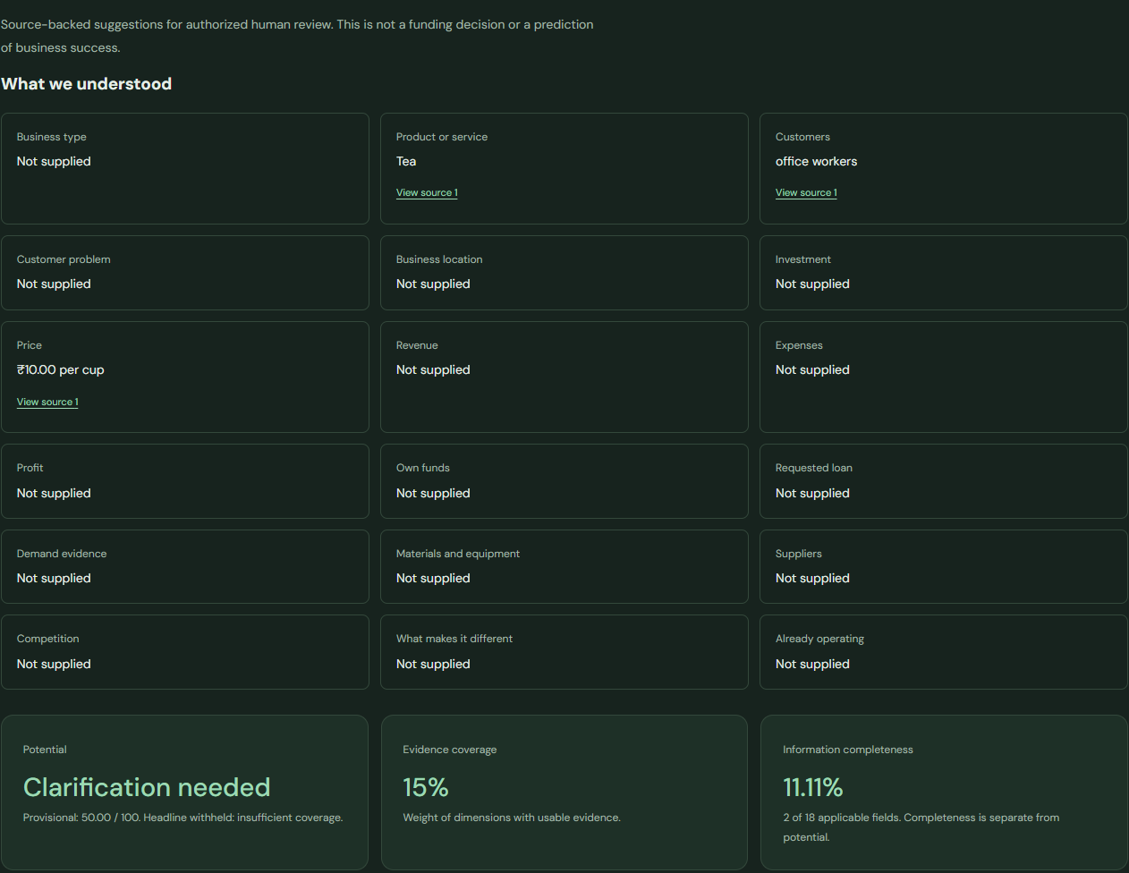
    PROPOSED SOLUTION
Submit in your own format
Text, PDF or supported audio
Understand the evidence
Source-linked facts and six rating domains
Improve the next version
Focused questions and assessor review
Application screenshot (synthetic test data)
Notes:
Solution (40 seconds): The guided interview is optional. Text, PDF and audio all enter the same versioned processing workflow. The saved assessment separates business potential, evidence coverage and information completeness. A missing value stays missing. A conflict preserves its alternatives and source references. Up to three prioritized questions help create a linked revision. Assessors can review or correct the source while preserving earlier versions.
Screenshot: .local/product-ui-3c9d9d9987e149f09495b163cac21c68/evidence-radar-desktop-dark.png. This is an actual local browser screenshot using synthetic Auth/model/vector fixtures and a real local API/PostgreSQL; it does not establish model quality. Sources: evals/reports/product-ui.json and apps/api/app/domain/questions.py.

Slide 4
TECH STACK
APPLICATION
LOCAL PRETRAINED MODELS
React + TypeScript
Qwen3-VL 2B
Applicant and assessor workspaces
Structured facts and domain judgments
FastAPI
Whisper + PaddleOCR
Validation and durable jobs
Speech and scanned documents
Supabase + pgvector
NLLB + MiniLM
Auth, PostgreSQL, private files, retrieval
Translation and semantic similarity
Notes:
Stack (35 seconds): React and TypeScript provide the browser interface. FastAPI validates requests and coordinates jobs. Supabase is the one application database, authentication and private-storage service. pgvector retrieves accessible related submissions. The owned worker runs pinned third-party pretrained models: Qwen3-VL-2B-Instruct, PaddleOCR-VL-1.5, Whisper large-v3-turbo, a separately selected Vaani Odia Whisper, NLLB-200-distilled-600M and all-MiniLM-L6-v2. We did not train those foundation models. Groq is optional explanation only, and OpenStreetMap supplies bounded confirmed-area context. Neither optional feature replaces the core score.
Sources: models/manifest.json, models/PROVENANCE.md, apps/api/app/worker/manifest.py. Upstream model cards: https://huggingface.co/Qwen/Qwen3-VL-2B-Instruct ; https://huggingface.co/PaddlePaddle/PaddleOCR-VL-1.5 ; https://huggingface.co/openai/whisper-large-v3-turbo ; https://huggingface.co/facebook/nllb-200-distilled-600M ; https://huggingface.co/sentence-transformers/all-MiniLM-L6-v2 . NLLB limits this selection to a research/noncommercial prototype; it is not a commercially licensed configuration.

Slide 5
TECHNICAL APPROACH
01
02
03
04
Extract
Translate
Structure
Assess
Text, PDF or audio
Keep original sources
Validate fields and quotes
Six evidence-based domains
Missing stays unknown
Conflicts trigger questions
Durable checkpoints preserve progress when processing stops
Notes:
Approach (50 seconds): Four durable stages are extract, translate, structure and assess. Qwen proposes structured facts and judgments, but the application checks allowed types, source quotes, references and ratings. Deterministic scoring uses weights: clarity 15, customer need 20, market 20, feasibility 25, competition 10 and differentiation 10. Automated ratings are 0 to 3 on a 0 to 4 contract; therefore the current automated potential ceiling is 75/100. Missing or ambiguous evidence produces null rather than zero. Coverage below 70%, source-review flags, unresolved offer/customers or critical conflicts can withhold the headline. Ranking requires 100% coverage and an otherwise eligible headline. These are proposed rubric rules, not official sector standards or trained success probabilities.
Fallback: one JSON repair attempt, then an unassessed domain if the judgment remains invalid. Other required-stage failures remain visible; no automatic backup LLM is verified. Worker leases, fencing and checkpoints permit controlled recovery. Sources: apps/api/app/pipeline/assess.py, providers/local_models.py, domain/scoring.py and worker/runtime.py.

Slide 6
FEASIBILITY, VIABILITY & ASSUMPTIONS
192
Real model pipeline
3 synthetic text cases passed
API tests passed
87 to 140 seconds per case
15 local browser journeys
Browser model/Auth data use fixtures
Owned laptop requires power and internet
Open validation: language accuracy, fairness and assessor impact
Notes:
Feasibility (45 seconds): Prior measured checks include 192 API tests and 15 local browser journeys. Browser Auth, model outputs and vectors are fixtures, while the local browser/API/PostgreSQL path is real. Separate actual owned-GPU inference passed three authored synthetic cases: positive 140.219 seconds, missing 88.109 seconds and conflicting 86.860 seconds. These are example-specific functional assertions, not population accuracy. Scan and regional-audio pipelines also have measured functional runs, with source-review limits retained.
Viability: core inference avoids a paid model API, but hardware, electricity, network, Supabase limits and optional provider quotas still constrain operation. The owned worker requires laptop uptime. Human transcript/translation accuracy, WER, retrieval Recall@5, fairness and impact remain unvalidated. NLLB has a noncommercial/research restriction. No public deployment claim is made.
Sources: planning/SESSION_HANDOFF.md, evals/reports/product-ui.json, evals/reports/judge-inference.json, models/PROVENANCE.md. These are existing measurements, not tests rerun for this presentation.

Slide 7
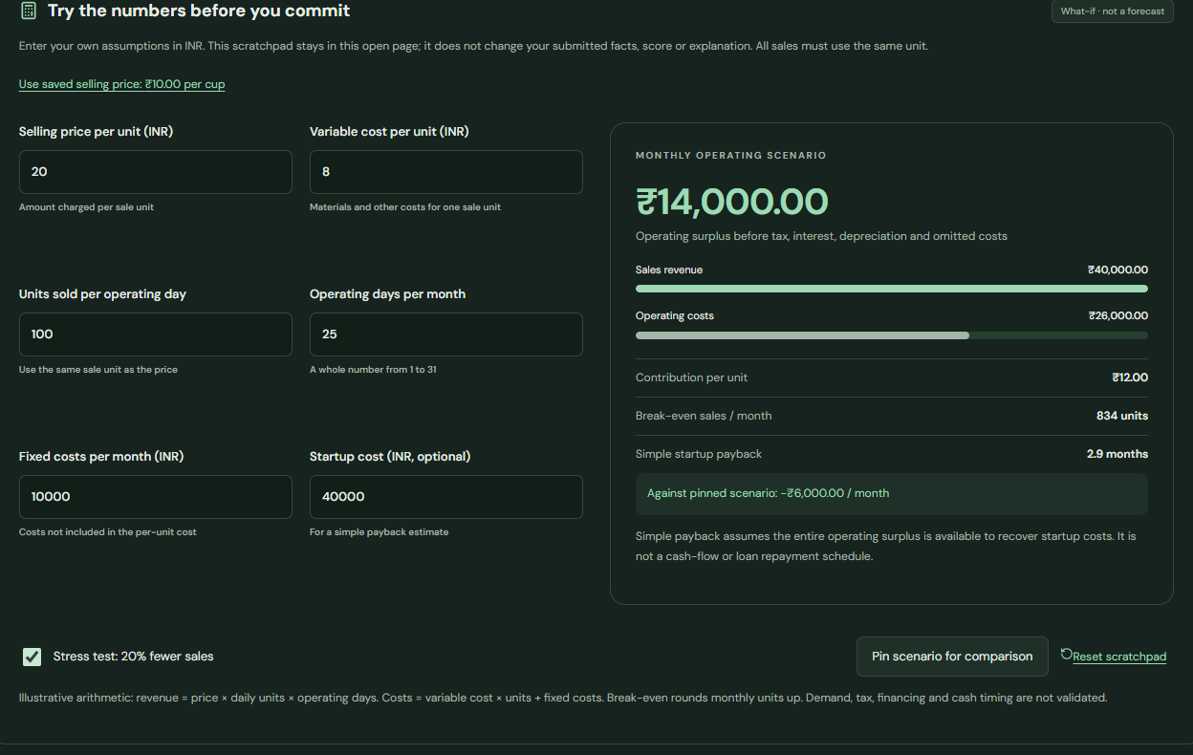
IMPACT & BENEFITS
Applicants
Understand gaps and answer useful questions
Assessors
Compare ideas and trace every review
What-if planner (synthetic test data)
20% fewer sales: INR 20,000 to INR 14,000 surplus
Illustrative assumptions, not a demand forecast
Notes:
Benefits (40 seconds): Applicants can understand unknowns and improve a revision; assessors can inspect source evidence, related ideas, local context, versions and four comparison views. The planner lets a person test assumptions without changing the saved assessment. Demonstration assumptions are price INR 20, variable cost INR 8, 100 daily units, 25 operating days, fixed monthly cost INR 10,000 and startup INR 40,000. The operating surplus is INR 20,000. With 20% fewer sales, variable costs also fall and surplus is INR 14,000. Break-even is 834 units/month. This arithmetic is not verified demand, net profit or business survival.
Screenshot is from a local browser verification using synthetic inputs/providers, not beneficiary data. Source: .local/product-ui-3c9d9d9987e149f09495b163cac21c68/business-plan-desktop-dark.png, evals/reports/product-ui.json and the financial scenario module in apps/web/src. Impact is expected; time savings and real business outcomes have not been measured.

Slide 8
CONCLUSION
A reviewable assessment,
with unknowns visible
Evidence and focused follow-up questions
Comparisons, planning and human review
Next: independent evaluation and an assessor pilot
Notes:
Conclusion (30 seconds): Our contribution is a traceable workflow around pretrained inference, covering private original inputs, validated evidence, deterministic totals, durable jobs, clarification revisions and assessor tools. We fitted a small relevance classifier but rejected promotion: 102 heuristic pairs, 98 relevant and 4 irrelevant, no independently reviewed labels and holdouts without irrelevant examples. Frozen MiniLM plus the advisory rules/cosine baseline remains selected. We do not claim new foundation-model training, calibrated business-success prediction, measured fairness or achieved impact. The next step is independently reviewed references, rubric calibration, subgroup evaluation, an assessor pilot and a separately approved deployment.
Sources: training/MODEL_CARD.md, evals/reports/relevance.json, planning/SESSION_HANDOFF.md. If a source path differs between branches, use evals/reports/relevance.json and models/PROVENANCE.md as the experiment/provenance record.

Slide 9
THANK YOU
Udyam Saathi
Straw Hat Pirates
Kartik Verma Kushal Soni
Bhavana Suthar Kanav Trivedi
Questions?
Notes:
Close (10 seconds): Thank you. We can demonstrate evidence, a missing/conflicting case, clarification history, comparison graphs and the financial planner. Questions are welcome.
Team: Kartik Verma, Kushal Soni, Bhavana Suthar and Kanav Trivedi. Team name: Straw Hat Pirates. No organizer photo-booth team photo was supplied; the slide uses names rather than a fabricated image. The nine-slide source format and all organizer artwork remain preserved.

