Slide 1
TRON Programming Contest 2026 · RTOS Application, Students
RTOS-Coupled
Adaptive Edge AI
The kernel measures its own silicon and reshapes inference to fit a deadline
98.2 ms
94.0 %
120 ms
adaptive latency
core accuracy
deadline held
NUCLEO-H533RE Cortex-M33 at 250 MHz · µT-Kernel 3.0 · keyword spotting · open source, MIT
Notes:
Adaptive keyword spotting where the RTOS is an active co-optimiser rather than a scheduler. Every number in this deck is measured on the board.

Slide 2
THE PROBLEM
Every optimisation decision is frozen at compile time
Deploying a model on a microcontroller means fixing every execution choice before the board has seen a single sample. The RTOS runs the model but does not shape it.
Static FP32
125.9 ms
misses the deadline
Fixed at build time, and never revisited
capture window length
Static INT8
101.5 ms
whether features are extracted at all
leaves performance unused
task priority ordering
numeric precision, every layer
Neither can express the configuration that is actually best.
Notes:
The framing: this is not FP32 versus INT8. The best configuration is neither.

Slide 3
THE IDEA
Five tasks, and every link is a kernel primitive
µT-Kernel reads the DWT cycle counter and the signal statistics, then writes back into how the model executes. Each of the four levers is a native kernel call, not a library shim.
T1
T2
T3
T4
T5
DMA ingest
variance + gate
MFCC features
inference
controller
T5 measures, then writes back into all four levers
tk_snd_mbx
tk_ref_flg
tk_chg_pri
tk_get_mpl
capture window resize
feature gate
task urgency
layer weight streaming
Every stage handoff is tk_set_flg and tk_wai_flg. Remove the kernel and the adaptive loop does not degrade, it stops.
Notes:
Every arrow in the pipeline is a native uT-Kernel primitive. The RTOS is load bearing, not incidental.

Slide 4
MEASURED ON HARDWARE
The adaptive point is faster than either static build
CONFIGURATION
LATENCY
DEADLINE
CORE IDLE
Static FP32
125.9 ms
missed
23.5 %
98.2 ms
Static INT8
101.5 ms
met
39.9 %
faster than the best static compile, at identical accuracy
Adaptive
98.2 ms
met
42.0 %
The deadline is the classification period itself, derived from the inference stride, not chosen after seeing the costs.
Core accuracy is 94.0 percent in all three configurations, so the speedup costs nothing.
Notes:
The headline. Adaptive is not a compromise between the two static builds, it beats both.

Slide 5
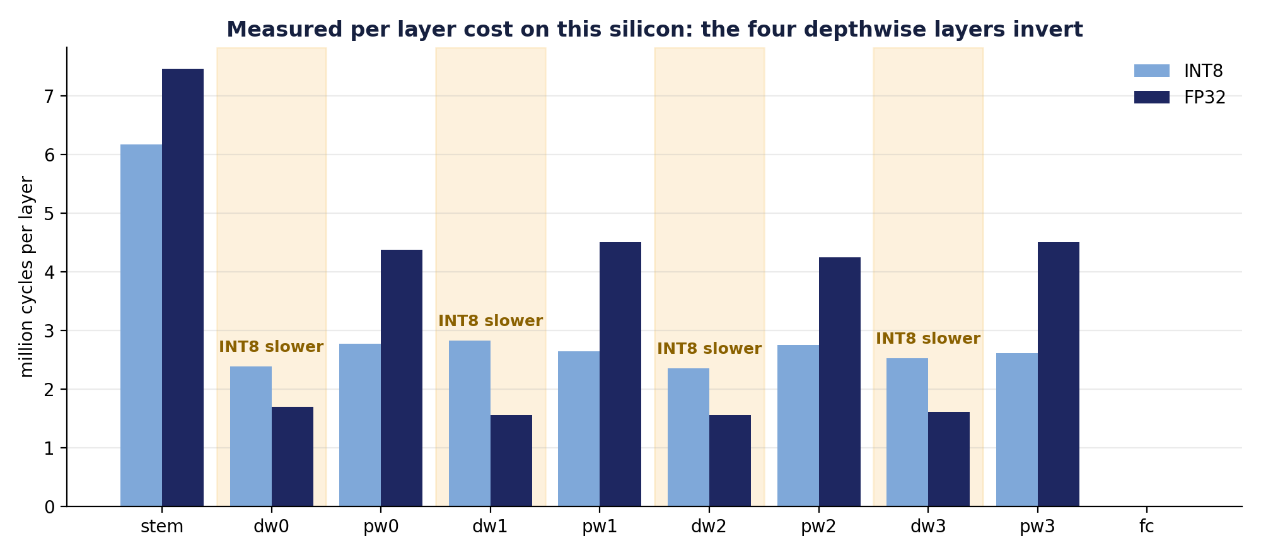
THE MECHANISM
Why a mixed configuration wins
Four depthwise layers
Every other layer
So the optimum is mixed
57 percent slower in INT8, their kernels cannot pack
32 percent faster in INT8, packed SXTB16 and SMLAD
no single precision build can express it
The fully connected layer is a few thousand cycles, invisible at this scale.
Notes:
This asymmetry is the whole reason a mixed operating point exists. It was measured, not assumed.

Slide 6
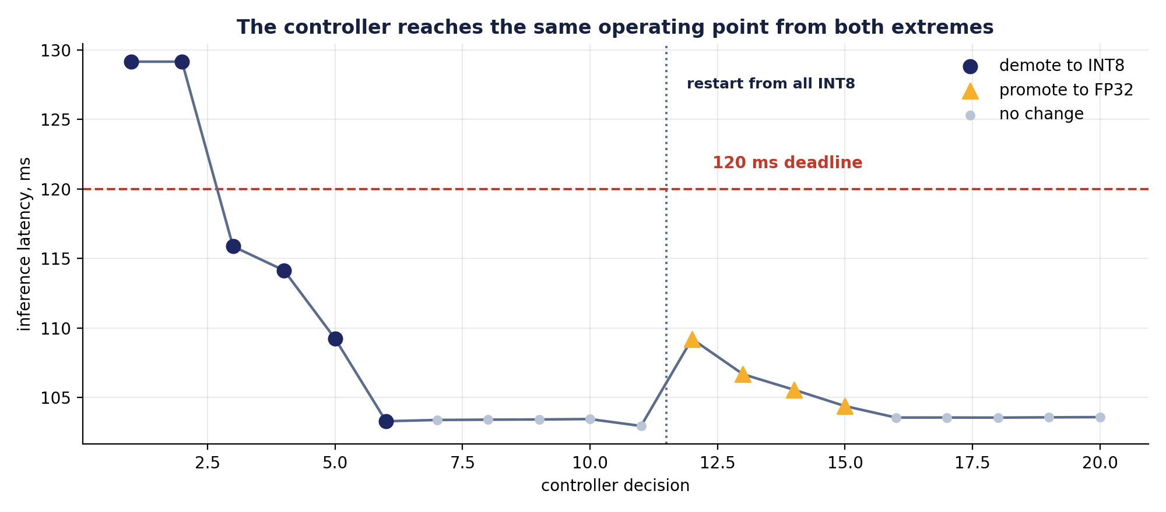
THE CLOSED LOOP
The kernel finds it by measuring, not by being told
1
Calibrate
T4 runs both pure precisions on its first two inferences and records what every layer costs
2
Rank
T5 ranks layers by that measured delta, never by index
3
Hill climb
every accepted move strictly reduces cost, so the walk cannot cycle
6 demotions from all FP32 4 promotions restarting from all INT8 same mask both times
Converging to the same point from both extremes makes it a property of the silicon, not of where the search began.
Notes:
Path independence is the strongest form this claim can take.

Slide 7
METHOD
What the measurements refuted
Predicted
Measured
Diagnosed
Rewritten
Result
INT8 is 3 to 4 times faster, from an ALU cycle count argument
28 percent SLOWER on the first hardware run
scalar INT8 pays a per element offset add and a 64 bit requantisation while FP32 rides the FPU
folded offsets, packed SXTB16 and SMLAD, bit identical against the golden reference
1.22 times faster, and the depthwise asymmetry that makes the whole contribution visible
The refutation is what produced the real result.
Also corrected: this part has no SMPS, so the power measurement point is the IDD jumper, not an SMPS as the program plan stated.
Notes:
A judge who finds an error themselves reads it as a mistake. One you hand them reads it as method.

Slide 8
RESULTS
The three characteristics the contest rewards
1
Real time
2
Power
3
Footprint
The deadline is derived from the application, not tuned to the answer. Under live pipeline load the converged mask ran every traced inference at 101 ms, while static FP32 was over on all 45 of its.
The kernel idle hook shipped empty, so the core spun at 250 MHz between blocks. It now sleeps under BASEPRI. Identical audio, identical windows.
Layer weights are streamed through tk_get_mpl so only the working layer occupies SRAM, with peak pool use measured rather than asserted.
120 ms
1.79×
117 KB
held under live load
longer asleep than FP32
of 272 KB SRAM
Notes:
Each of the three is backed by a measurement, and the power one is a ratio rather than a wattage.

Slide 9
CORRECTNESS
The device is never the first implementation
A NumPy reference of exactly the device arithmetic is checked against the trained float model. The real device C is then compiled for the host and checked against that reference. Only then does it reach the board.
Float model
NumPy reference
Device C on host
Hardware
PyTorch, 92.8 % test
exact device arithmetic
the same source as the board
94.0 % core accuracy
Agreement at every step, on the same inputs
transform
MFCC frame
inference logits
1.4 × 10⁻⁵
5.5 × 10⁻⁶
5 × 10⁻⁸
A disagreement on hardware is therefore a hardware question, never an open one.
Notes:
This is why the board brought up cleanly: the maths was settled before any flash.

Slide 10
LIMITS
What is not claimed
Stating the limits precisely is part of the result.
Two different accuracies
Power is a ratio
TrustZone is cut
94.0 percent is core accuracy, scored on pre computed feature grids. End to end accuracy through capture, gate and features is 47 to 57 percent, and at this sample size the three configurations are not statistically separable.
Idle residency, not a wattage. No ammeter was used. The firmware side is ready and the absolute current at the IDD jumper is still to be measured.
The program plan promised secure world weight isolation in section 6.6. It was cut as separable from the co-optimisation thesis, and the descope is documented rather than glossed over.
WHAT WOULD CLOSE IT
WHAT WOULD CLOSE IT
WHAT WOULD CLOSE IT
a wider replay corpus and a longer live phase
a DC ammeter in series at the IDD jumper
a secure world partition behind an NSC veneer
Every figure in this deck traces back to a timestamped run under experiments/ with its raw device capture alongside it.
Notes:
Intellectual honesty scores better than an overreaching claim.

Slide 11
A template, not a one off
The signal source is one interface with two implementations, and the pipeline above it does not know where samples come from. The task graph and the adaptation primitives carry over to any sensor domain: vibration, audio, temperature, biosignals.
98.2 ms
1.79×
0
adaptive latency
longer asleep
dropped blocks
github.com/kushal-script/utkernel-rtos-adaptive-kws
MIT licensed · builds and reproduces every number from the board alone, no external hardware
Notes:
Open source, reproducible from the board alone.

