Slide 1

Log Analytics System for a Web Server
Review 3
HDFS · Apache Spark · Spark SQL · Spark MLlib · Apache Superset
Faculty Name: Dr. Senthil Kumar K
Team Member Info:
Kushal Mohan – RA2411028010082
Kriti Singh – RA2411028010081
Gargi Singh – RA2411028010102
Big Data Essentials · Department of Networking and Communications
Notes:
Presenter: Kushal. Good morning. We are Kushal, Kriti and Gargi, and this is our Review 3 of the Log Analytics System for a web server, guided by Dr. Senthil Kumar K.

Slide 2
Contents
Abstract
Introduction
Literature Review Table
Gaps Identified
Proposed Model
Overall System Architecture Diagram
Dataset
Preprocessing (Big Data Analysis and its steps)
Results of Preprocessing (graphs and tables)
Classification (proposed model: Factorization Machine)
Results of Classification using the proposed model
Comparison with the existing classifier models
Visualization (Dashboard) details with snapshots
Team Member Tasks
References
Geotagged photo taken during Review 3
Google Colab Implementation link
Notes:
Presenter: Kushal. These are the seventeen parts of today's review.

Slide 3
Abstract
Web servers log every request, but millions of raw text lines are too large and unstructured for normal tools. We built a Log Analytics System on a 10-container Docker cluster with Hadoop HDFS (2 DataNodes, replication 2), Apache Spark, Spark SQL, Spark MLlib and Apache Superset.
On 3,461,613 NASA web-server requests (July–August 1995), Spark ETL produces clean, date-partitioned Parquet (8.6× smaller) and 11 Spark SQL reports. A contextual Z-score finds 12 unusual hours, recovering the STS-70 Shuttle launch (z = 5.90). A Gaussian Mixture Model separates 1,829 automated hosts without labels.
For attack detection, a Factorization Machine trained on 1.31 M labelled requests (after removing a measured dataset bias) reaches F1 = 0.9669 and transfers best to unseen data (F1 0.968 vs 0.846 for SVM). All results are shown in 6 Superset dashboards inside the LogLens application.
3.46 M
12
1,829
0.9669
log lines processed
unusual hours (Z-score)
bots found (GMM)
attack F1 (FM)
Keywords: Hadoop HDFS, Apache Spark, Spark MLlib, Apache Superset, anomaly detection, GMM, Factorization Machine, web attacks
Log Analytics System for a Web Server · Review 3
3
Notes:
Presenter: Kushal. In one minute: what we built, on what data, and what we found.

Slide 4
Introduction
Problem
Motivation
Every request becomes one line in an access log; busy sites write millions a day.
Too big for spreadsheets, no structure to query.
Owners never see broken links, peaks, bots or attacks hidden in their own logs.
Logs are a rich, neglected data source.
Hadoop + Spark were built for exactly this: split, process in parallel, summarise.
Common Log Format is still written by Apache and Nginx today.
Objectives
Store logs safely in replicated HDFS with an immutable raw zone
Clean every line with Spark into typed, date-partitioned Parquet, keeping bad lines as rejects
Answer traffic, error and performance questions with Spark SQL; find unusual hours (Z-score) and bots (GMM)
Detect attacks with a Factorization Machine, compared fairly with 7 MLlib models and tested on new data
Show everything only with big data visualization tools: Apache Superset dashboards in the LogLens app
Log Analytics System for a Web Server · Review 3
4
Notes:
Presenter: Kushal. Why web logs need big data tools, and what we set out to do.

Slide 5
Literature Review Table
# | Author (Year) | Method | Key finding | Limitation / use in our work
1 | Shvachko et al. (2010) | HDFS: NameNode + replicated DataNodes | Fault-tolerant storage on cheap machines | Our raw → models zones, replication 2
2 | Zaharia et al. (2012) | Spark RDDs in memory | Up to 20× faster than MapReduce | Engine of every job
3 | Armbrust et al. (2015) | Spark SQL + Catalyst | SQL and code optimised together | 11 reports and Z-score in SQL
4 | Arlitt & Williamson (1997) | Workload study incl. NASA logs | Common web traffic patterns | Single machine; we repeat at scale
5 | Cooley et al. (1999) | Log cleaning + sessions | Logs need preprocessing first | Our rejects and 30-min sessions
6 | Chandola et al. (2009) | Anomaly detection survey | Statistical scores work when 'normal' is modelled | Contextual Z-score per hour
7 | Du et al. (2017) | DeepLog: LSTM on logs | Learns normal log sequences | System logs only, needs GPU
8 | Reynolds (2009) | Gaussian Mixture Models | Soft clusters of different shapes | Bot detection without labels
9 | Rendle (2010) | Factorization Machines | Pairwise interactions, linear time | Our attack classifier
10 | Geirhos et al. (2020) | Shortcut learning | Models exploit incidental cues | Led to our '?' bias fix
Log Analytics System for a Web Server · Review 3
5
Notes:
Presenter: Kriti. The papers our design builds on, and what each one left open.

Slide 6
Gaps Identified
Gap in existing work
How our system addresses it
Web-mining studies ran on single machines and small data
End-to-end HDFS + Spark pipeline on 3.46 M lines, 10 containers
Bad log lines are silently dropped; quality is hidden
Rejects folder + printed parse rate (1 malformed line of 3,461,613)
Bots in Common Log Format (no user-agent) are hard to find
GMM on 9 behaviour features, validated with held-out robots.txt crawlers
Attack detectors are scored on one mixed split; dataset bias is not measured
'?' shortcut measured and removed; 5 random splits, McNemar's test, cross-dataset test
Log dashboards are hand-coded or copy data out of the cluster
Superset reads HDFS live through the Spark Thrift Server; built from code
Log Analytics System for a Web Server · Review 3
6
Notes:
Presenter: Kriti. Five gaps in existing work and how our system closes each one.

Slide 7
Proposed Model
When was traffic unusual?
Contextual Z-score (Spark SQL)
Each hour is compared with the same hour of day on all 58 days; |z| > 3 is flagged.
1
Which clients are bots?
Gaussian Mixture Model (Spark MLlib, unsupervised)
9 behaviour features per host, 3 components; the one with HEAD requests, slow pacing and few images is 'automated'.
2
Is a request an attack?
Factorization Machine (Spark MLlib, supervised) ★ proposed classifier
Character 1-3-grams (12,292 features); learns a weight for every pair of features. Compared with 7 MLlib models.
3
How do users see it?
Apache Superset + LogLens app
Superset dashboards on the Spark Thrift Server, embedded in the LogLens application with an attack checker.
4
Log Analytics System for a Web Server · Review 3
7
Notes:
Presenter: Kushal. The system answers three questions with three methods, and shows everything with big data visualisation tools.

Slide 8
Overall System Architecture Diagram
Path 1 · web log analytics
NASA web logs
HDFS raw zone
Spark ETL
Clean Parquet
3.46 M raw lines
2 copies of every block
cleaning + parsing
58 date folders
Three analyses
on the clean table
Spark SQL reports
Z-score anomalies
GMM bot detection
11 reports
12 unusual hours
1,829 bots (Spark MLlib)
Path 2 · attack detection
Attack datasets
Preprocessing
FM training
Test on new data
1.31 M labelled requests
bias fix + 12,292 features
Spark MLlib · F1 0.967
cross-dataset · F1 0.968
saved model
Spark Thrift Server
Apache Superset
LogLens app
Spark SQL over JDBC · 27 tables
6 dashboards · 56 charts
embedded dashboards + attack checker
Everything runs as 10 Docker Compose containers; every result is stored in HDFS and read by Superset through the Thrift Server.
Log Analytics System for a Web Server · Review 3
8
Notes:
Presenter: Kriti. Two paths feed one application. Path 1: NASA logs go into HDFS, Spark cleans them into Parquet, and three analyses run on the clean table. Path 2: the labelled attack data is preprocessed, the Factorization Machine is trained and tested on new data. All results are served by the Spark Thrift Server to Apache Superset, which the LogLens app embeds.

Slide 9
Dataset
NASA-HTTP (main)
HttpParams (labelled)
Fwaf (labelled)
Real web-server access logs of NASA Kennedy Space Center
July + August 1995 (58 days)
3,461,613 requests, 356 MB
137,978 client hosts
Unlabelled: used for traffic analytics, anomalies and bots
31,067 HTTP parameter values
normal, SQL injection, XSS, command injection, path traversal
Used to train and test attack detection
1,342,657 URLs
1,294,531 normal
48,126 malicious
Used to train and test attack detection
One raw NASA log line (Common Log Format) and its 7 fields
199.72.81.55 - - [01/Jul/1995:00:00:01 -0400] "GET /history/apollo/ HTTP/1.0" 200 6245
host | timestamp | method | URL (endpoint) | protocol | status | bytes
199.72.81.55 | 01/Jul/1995:00:00:01 -0400 | GET | /history/apollo/ | HTTP/1.0 | 200 | 6245
Learning type: supervised binary classification, 2 classes (0 = normal, 1 = attack) on the labelled data; unsupervised clustering (bots) and statistics (Z-score) on the unlabelled NASA logs.
Log Analytics System for a Web Server · Review 3
9
Notes:
Presenter: Kriti. We use one real unlabelled dataset for analytics and two public labelled datasets for attack detection.

Slide 10
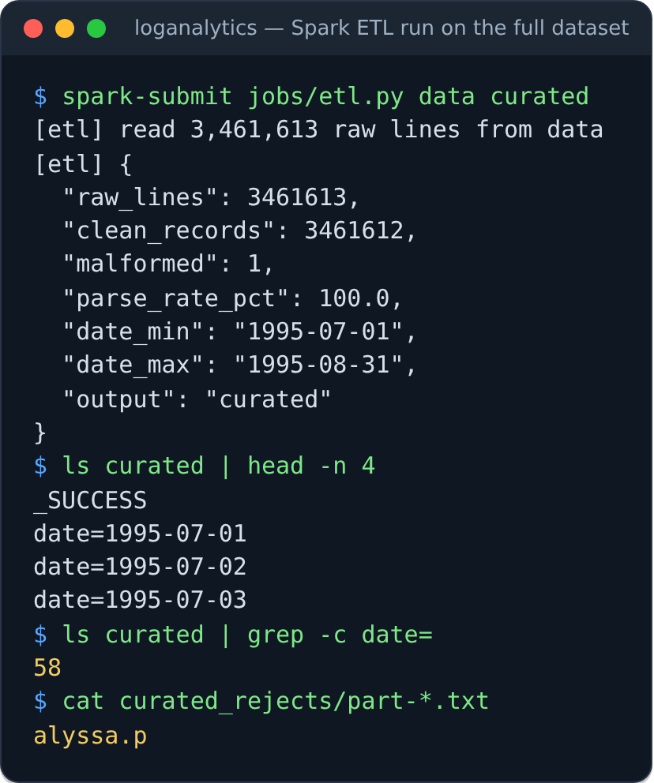
Preprocessing: Big Data Analysis Steps
1
Ingest
hdfs dfs -put: logs into the HDFS raw zone, 128 MB blocks, 2 copies
2
Read
Spark reads the raw zone as one text column, split into partitions
3
Parse
5 regular expressions cut each line into 7 fields
4
Cast
timestamp (New York time), status → int, bytes → long ('-' = 0)
5
Validate
lines without host/time/status → rejects folder, parse rate printed
6
Derive
date, hour, day of week, file type
7
Store
Snappy Parquet, partitioned by date → HDFS curated zone
8
Analyse
11 Spark SQL reports, Z-score, GMM → HDFS reports zone
Real run of the ETL on the cluster: 3,461,613 lines in, 1 malformed line kept for audit.
Log Analytics System for a Web Server · Review 3
10
Notes:
Presenter: Kushal. Kriti loads the raw logs into HDFS; my Spark job turns raw text into a typed table, keeping bad lines instead of dropping them.

Slide 11
Preprocessing for Classification
Step | What happens | Rows
1-2 Load + label | HttpParams + Fwaf, attack types → 1 class | 1,373,724
3 Clean | URL-decode, lower-case, trim, drop empty | 1,373,657
3b Bias fix | keep only the part after '?' | —
4 De-duplicate | 66,987 duplicates removed | 1,306,518
5 Conflicts | 501 requests with both labels removed | 1,306,017
7 Split 80/20 | train balanced 4 normal : 1 attack | 153,847
 | test with the real mix (never trained on) | 261,076
Why the bias fix?
Before: 42.2% of attacks but only 2.5% of normal requests contained '?'.
A model could learn the shortcut "has a query string = attack".
Fix: '/top.php?stuff=1 or 1=1' → 'stuff=1 or 1=1'
After: 2.7% vs 0.8%; the model must read what is sent.
Final dataset: 1,306,017 requests
1,267,605 normal (97.06%) · 38,412 attack (2.94%)
All steps run in Spark (jobs/ml_preprocess.py); data read from and written to HDFS.
Features (12,292)
character 1-, 2-, 3-grams, each hashed into 4,096 buckets, + length, special chars, digits, attack keywords; scaled 0-1
Log Analytics System for a Web Server · Review 3
11
Notes:
Presenter: Kushal. For the labelled data we clean, remove a dataset bias, de-duplicate and split. The bias fix is the most important step.

Slide 12
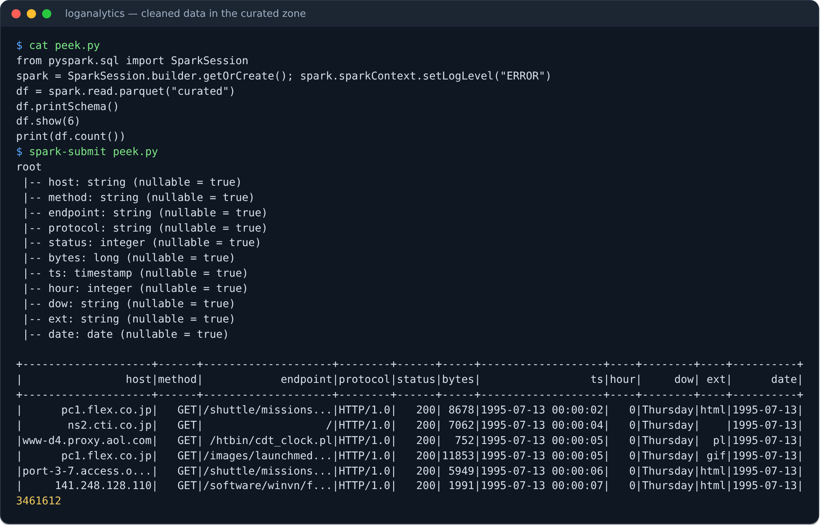
Results of Preprocessing: Raw Logs → Table
3,461,612
1
58
8.6×
clean rows (of 3,461,613)
malformed line, kept as a reject
date partitions (Parquet)
smaller: 356 MB → 41.5 MB
After: the same requests as typed columns (host, method, endpoint, protocol, status, bytes, ts, hour, dow, ext, date).
Log Analytics System for a Web Server · Review 3
12
Notes:
Presenter: Kushal. One text line became eleven typed columns, nothing was lost silently, and the data is 8.6 times smaller.

Slide 13
Results of Preprocessing: Labelled Data
 | Normal | Attack | Total | Purpose
Training set | 123,100 | 30,747 | 153,847 | all attacks + 4 normal per attack
Test set | 253,411 | 7,665 | 261,076 | real 97 : 3 mix, never seen in training
Screenshot of the full run: docs/ml_results/ml_preprocessing.png (every step prints its row counts).
Log Analytics System for a Web Server · Review 3
13
Notes:
Presenter: Kushal. Attacks are only 3% of the data, so we balance the training set and keep the real mix in the test set.

Slide 14
Classification: Proposed Model (Factorization Machine)
ŷ(x) = σ( w₀ + Σᵢ wᵢxᵢ + Σᵢ Σⱼ>ᵢ ⟨vᵢ, vⱼ⟩ xᵢxⱼ )
bias + one weight per feature (like logistic regression) + a weight for every PAIR of features, factorised through 8-dimensional vectors vᵢ
Why a Factorization Machine?
Settings (chosen on a validation split)
Attacks are combinations: a quote AND 'or' AND a comment marker
Learns pair weights even for pairs never seen together
Linear time O(k·n) on sparse input; built into Spark MLlib
factor size k = 8, step 0.2 (best of k ∈ {4, 8, 16}, step ∈ {0.05, 0.2})
100 iterations, L2 = 10⁻⁴; validation F1 0.988
test set never used for tuning
Pipeline inside Spark ML (saved to HDFS as one model for the app)
request text
characters
1-, 2-, 3-grams
HashingTF
3 × 4,096
+ 4 counts
MaxAbsScaler
FM → P(attack)
Task: supervised binary classification, 2 classes (normal / attack). Main metric: F1, because 97% of requests are normal.
Log Analytics System for a Web Server · Review 3
14
Notes:
Presenter: Kushal. Our classifier is a Factorization Machine. It is logistic regression plus a learned weight for every pair of features.

Slide 15
Results of Classification using the Proposed Model
0.9669
98.5%
95.0%
99.80%
F1 (attack class)
attacks caught (recall)
precision
accuracy
Confusion matrix (test set, 261,076 requests)
What it means
Predicted normal
Predicted attack
7,547 of 7,665 attacks caught
399 false alarms among 253,411 normal requests (0.16%)
118 attacks missed
Actual normal
253,012
399
TN · 99.84%
FP · 0.16%
Actual attack
118
7,547
FN · 1.54%
TP · 98.46%
On the real NASA logs
31,026 URLs scored, 120 flagged (0.05% of requests)
Checked by hand: 0 real attacks; mostly searches with 'select' and pages named 'description'
Result from the run on the Docker cluster (jobs/ml_train.py). The saved model, reloaded from HDFS, gives the same F1 = 0.9669.
Log Analytics System for a Web Server · Review 3
15
Notes:
Presenter: Kushal. On 261,076 unseen requests the FM reaches F1 0.9669: it catches 98.5% of attacks with 399 false alarms.

Slide 16
Comparison with the Existing Classifier Models
Model | Prec. | Recall | F1 | Time (s)
Linear SVM | 0.949 | 0.989 | 0.9686 | 5
Factorization Machine ★ | 0.950 | 0.985 | 0.9669 | 67
Logistic Regression | 0.946 | 0.986 | 0.9651 | 4
Decision Tree | 0.929 | 0.959 | 0.9437 | 27
Gradient Boosted Trees | 0.819 | 0.963 | 0.8853 | 132
Naive Bayes | 0.915 | 0.803 | 0.8553 | 0
Multilayer Perceptron | 0.779 | 0.939 | 0.8512 | 44
Random Forest | 0.957 | 0.711 | 0.8158 | 24
Linear SVM, FM and Logistic Regression lead; trees, Naive Bayes and the neural network trail.
Accuracy is above 99% for all 8 and does not separate them; F1 does (0.816 – 0.969).
★ = our model.
Log Analytics System for a Web Server · Review 3
16
Notes:
Presenter: Gargi. Same features, same test set, all in Spark MLlib. The FM is within 0.002 F1 of the best model, the linear SVM.

Slide 17
Comparison: Stability and New Data
Inside one dataset
SVM 0.9697 ± 0.0007
FM 0.9611 ± 0.0062
McNemar's test: SVM better on 4 of 5 splits (p < 0.05)
On new data (Fwaf → HttpParams)
FM 0.968 vs LR 0.897 vs SVM 0.846
6-14× fewer false alarms than LR and SVM
Conclusion: the SVM is the most accurate inside one dataset; the FM generalises best to data it was not trained on, so the FM is the deployed model. With only the small HttpParams set to learn from, every model fails.
Log Analytics System for a Web Server · Review 3
17
Notes:
Presenter: Gargi. Repeated on 5 random splits, the SVM is best inside one dataset. On a dataset it was not trained on, the FM is clearly best. That is why we deploy the FM.

Slide 18
Big Data Analysis Results: Anomalies and Bots
Bot detection: GMM, 3 components
 | Hosts | HEAD % | Gap (s) | Images %
C0 human | 32,503 | 0.04 | 5 | 63.2
C1 human | 3,772 | 0.10 | 2 | 70.2
C2 automated | 1,829 | 2.50 | 18 | 33.5
6.36%
11.6×
of requests are automated
lift on robots.txt crawlers
9 features per host: HEAD share, pacing, images, sessions, URLs, errors…
15 of 27 known crawlers fall in C2 (no labels used to train).
GMM beats K-Means: the bot group is small and elongated.
Peak: 09:00-10:00, 14,926 requests vs a normal 3,080: z = 5.90, the STS-70 launch at 9:41 a.m.
Only anomalous day: 13 July (z = 3.62).
Log Analytics System for a Web Server · Review 3
18
Notes:
Presenter: Gargi (Z-score) and Kriti (GMM). The Z-score finds the STS-70 Space Shuttle launch from the traffic alone, and the GMM separates 1,829 automated hosts without labels.

Slide 19
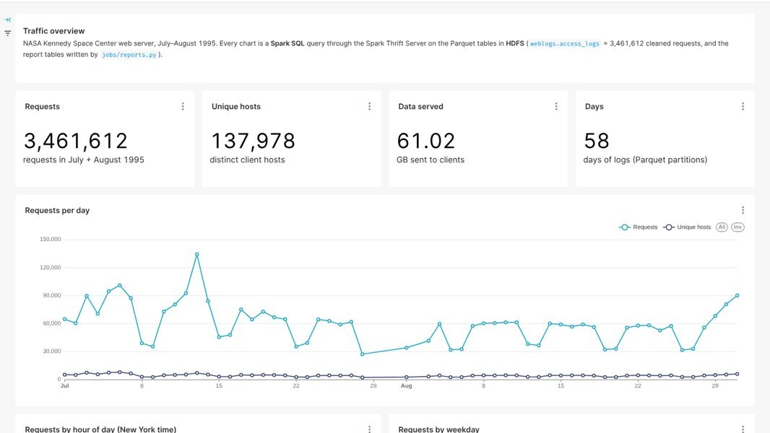
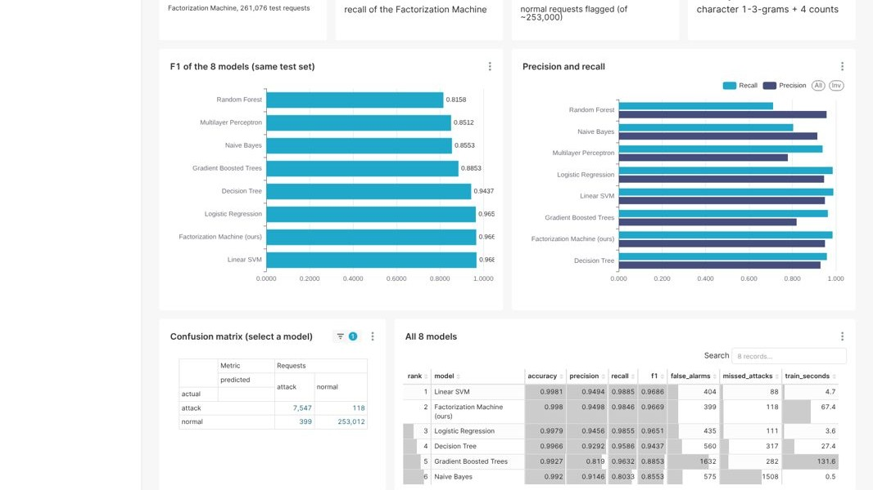
Visualization: Apache Superset Dashboards
1 · Traffic overview dashboard
5 · Attack detection (ML) dashboard
HDFS
Spark Thrift Server
Apache Superset
Parquet tables
Spark SQL over JDBC :10000
6 dashboards · 56 charts :8088
Dashboards: Home · Traffic · Errors & performance · Anomalies (Z-score) · Bot detection (GMM) · Attack detection (ML)
Nothing is copied out of HDFS; filters, cross-filters and SQL Lab work live on the cluster.
All dashboards are created from code (superset/build_dashboards.py), so they can be rebuilt any time.
Log Analytics System for a Web Server · Review 3
19
Notes:
Presenter: Gargi. The frontend uses only big data visualisation tools. Superset queries the HDFS tables through the Spark Thrift Server, so every chart is a live Spark SQL query.

Slide 20
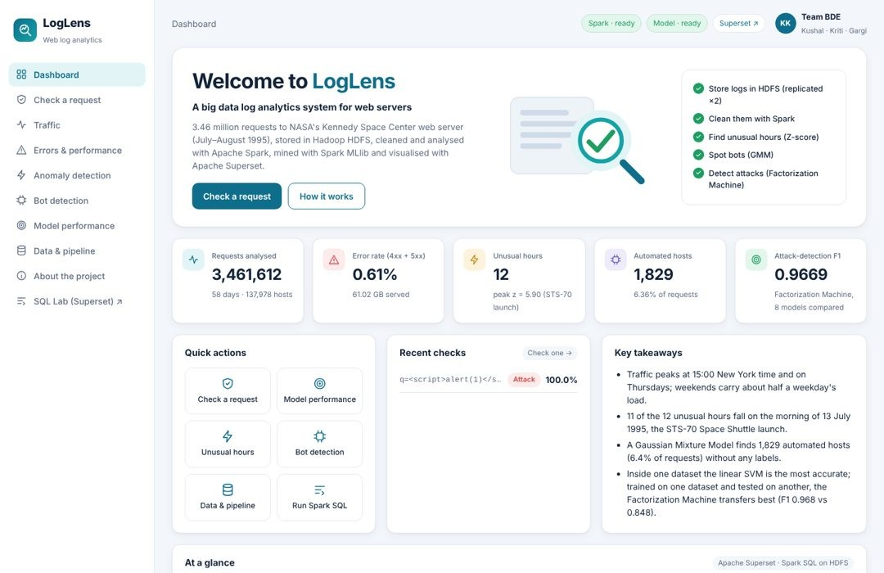
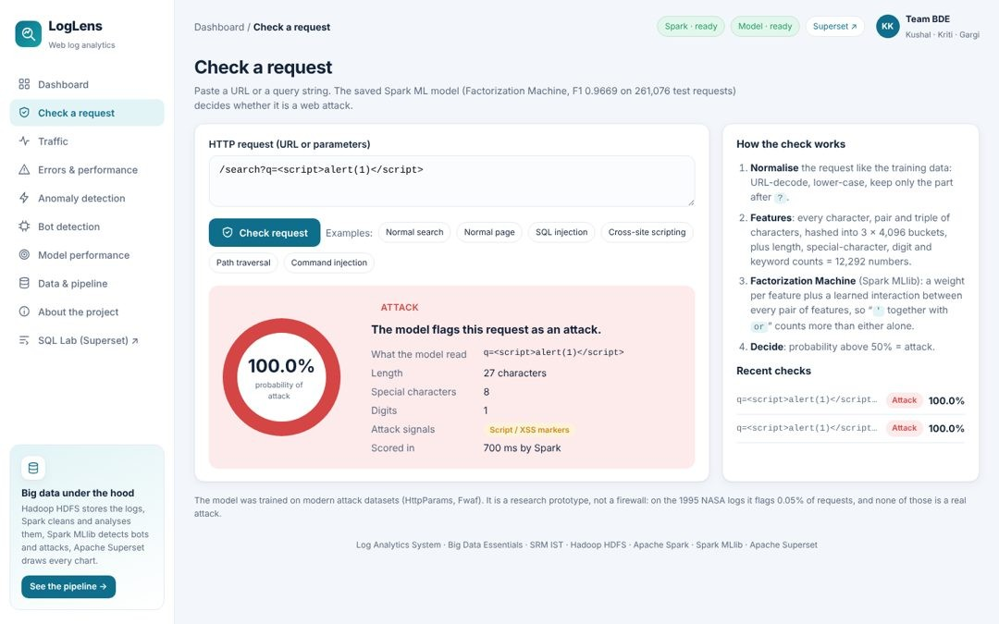
Visualization: LogLens Application
Check a request: the saved FM model
Home: live numbers from HDFS + embedded Superset dashboard
Example
Pages: Dashboard · Check a request · Traffic · Errors · Anomalies · Bots · Model performance · Data & pipeline
Every chart is an embedded Superset dashboard (guest token for one dashboard only)
Runs in Docker at http://localhost:3080
/search?q=<script>alert(1)</script>
→ ATTACK, 100.0% probability, signal: script / XSS marker, scored by Spark in ~0.7 s
/htbin/wais.pl?apollo+13+mission → NORMAL, 0.04%
Log Analytics System for a Web Server · Review 3
20
Notes:
Presenter: Gargi. LogLens is the application. Its charts are the Superset dashboards embedded with a guest token; the Check a request page runs our saved Factorization Machine on any URL.

Slide 21
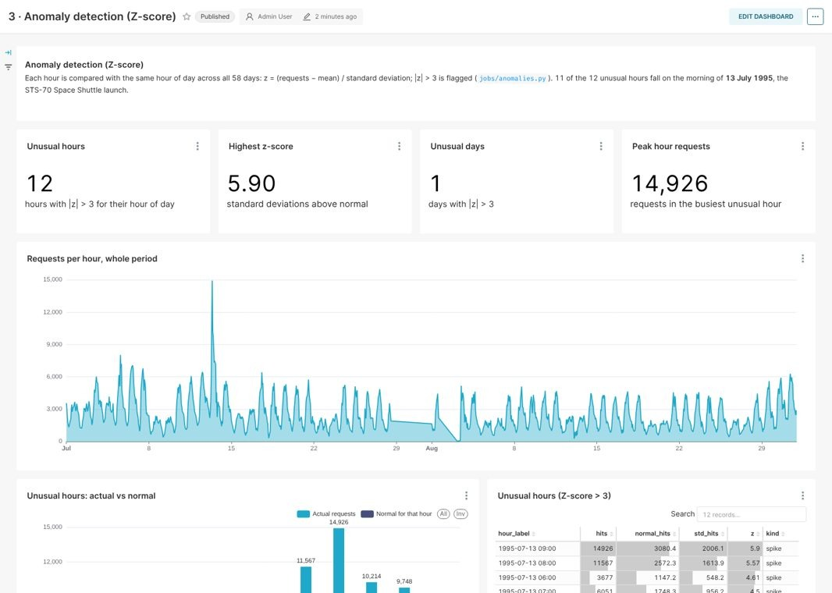
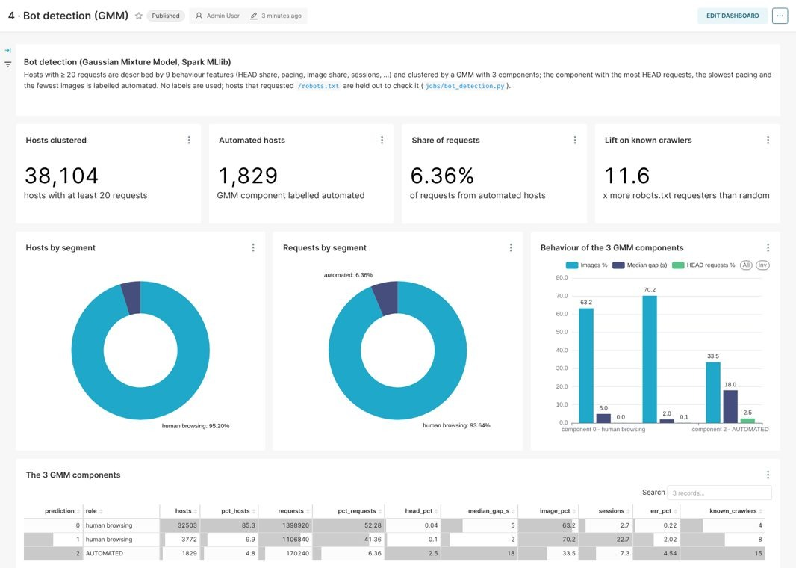
Visualization: Dashboard Snapshots
3 · Anomalies (Z-score) dashboard
4 · Bot detection (GMM) dashboard
Anomalies: headline tiles (12 unusual hours, peak z = 5.90), requests per hour over both months, unusual hours vs their normal level
Bots: 38,104 hosts clustered, 1,829 automated, share of requests by segment, behaviour of the 3 GMM components, automated host list
All 6 dashboards (Home, Traffic, Errors, Anomalies, Bots, Attacks) have filters, cross-filters and SQL Lab
Log Analytics System for a Web Server · Review 3
21
Notes:
Presenter: Gargi. Two more of our six dashboards: anomalies and bot detection. Every chart is a live Spark SQL query on HDFS.

Slide 22
Team Member Tasks
Kriti Singh
Kushal Mohan
Gargi Singh
RA2411028010081
RA2411028010082
RA2411028010102
HDFS storage + bot detection
Spark ETL + attack model
Analysis + visualization
Docker cluster, HDFS: NameNode + 2 DataNodes
Raw zone ingest, 2 copies, fsck checks
GMM bot detection (Spark MLlib)
1,829 automated hosts found
Spark ETL: cleaning, parsing
Clean Parquet, 58 date folders
Preprocessing: bias fix, 12,292 features
FM training (F1 0.967)
11 Spark SQL reports
Z-score anomalies (12 hours)
Test on new data (F1 0.968)
Thrift Server, Superset, LogLens app
Together (all three members)
Comparison with 7 Spark MLlib classifiers
5-split stability test and McNemar's test
35 automated tests
IEEE paper · this presentation
Log Analytics System for a Web Server · Review 3
22
Notes:
Presenter: Kriti. The split follows the architecture: each step in the two paths has one owner.

Slide 23
References
[1] K. Shvachko et al., "The Hadoop distributed file system," IEEE MSST, 2010, pp. 1–10.
[2] M. Zaharia et al., "Resilient distributed datasets," USENIX NSDI, 2012, pp. 15–28.
[3] M. Armbrust et al., "Spark SQL: Relational data processing in Spark," ACM SIGMOD, 2015, pp. 1383–1394.
[4] X. Meng et al., "MLlib: Machine learning in Apache Spark," JMLR, vol. 17, no. 34, pp. 1–7, 2016.
[5] S. Rendle, "Factorization machines," IEEE ICDM, 2010, pp. 995–1000.
[6] D. A. Reynolds, "Gaussian mixture models," Encyclopedia of Biometrics, Springer, 2009, pp. 659–663.
[7] M. F. Arlitt and C. L. Williamson, "Internet web servers: Workload characterization and performance implications," IEEE/ACM Trans. Networking, vol. 5, no. 5, 1997.
[8] V. Chandola, A. Banerjee and V. Kumar, "Anomaly detection: A survey," ACM Computing Surveys, vol. 41, no. 3, 2009.
[9] R. Geirhos et al., "Shortcut learning in deep neural networks," Nature Machine Intelligence, vol. 2, 2020.
[10] Q. McNemar, "Note on the sampling error of the difference between correlated proportions," Psychometrika, vol. 12, 1947.
[11] Internet Traffic Archive, "NASA-HTTP: Two months of HTTP logs from the KSC-NASA WWW server."
[12] Morzeux, "HttpParamsDataset," GitHub; F. Ahmad, "Fwaf: Machine learning driven web application firewall," GitHub, 2017.
[13] Apache Software Foundation, "Apache Superset documentation" and "Spark SQL Thrift JDBC/ODBC server," Spark 3.5.3 docs.
Log Analytics System for a Web Server · Review 3
23

Slide 24
Geotagged Photo taken during Review 3
Insert the geotagged photo here
(photo with location and date stamp, taken during the Review 3 presentation)
Log Analytics System for a Web Server · Review 3
24
Notes:
Insert the geotagged photo taken during the Review 3 presentation here.

Slide 25

Google Colab Implementation Link
Google Colab notebook (scan or click):
https://colab.research.google.com/github/kushal040511/Web-server-log-analytics-system/blob/combined-project/notebooks/LogAnalytics_Colab.ipynb
Source code (GitHub):
https://github.com/kushal040511/Web-server-log-analytics-system
Notebook: installs Java, Hadoop and Spark, starts HDFS, runs the ETL, the reports, the Z-score and the ML stage (Runtime → Run all)
Full system on the Docker cluster: make data build up all ml bi
Log Analytics System for a Web Server · Review 3
25
Notes:
Presenter: Kushal. The whole pipeline, including the ML stage, runs in this Colab notebook with Runtime, Run all.

