Slide 1

BDE PROJECT REVIEW · 50% REVIEW · BIG DATA ESSENTIALS
LOG ANALYTICS SYSTEM
3.46 M log lines · 2 DataNodes · 7 containers
PRESENTED BY
UNDER THE GUIDANCE OF
INSTITUTION
SRM Institute of Science and Technology
Academic Year 2026–27
Kushal Mohan
Reg. No: RA2411028010082
DR. Senthil Kumar K
Assistant Professor
NWC
Kriti Singh
Reg. No: RA2411028010081
Gargi Singh
Reg. No: RA2411028010102
Notes:
Presenter: Kushal
Good morning, ma'am. I am Kushal Mohan, and with me are Kriti Singh and Gargi. Our project is a Log Analytics System. In simple words, we built a big data pipeline that takes 3.46 million raw web-server log lines from NASA and turns them into clear reports on traffic, errors and size. It runs on a real Hadoop and Spark cluster: HDFS with two DataNodes, inside seven Docker containers. Each of us owns one big data tool. Kriti built the Hadoop HDFS storage, I built the Apache Spark ETL that cleans the data, and Gargi built the Spark SQL reports, a Z-score anomaly detection algorithm, and the website that shows them. We will also present our proposed deep-learning model and its comparison with five machine-learning algorithms. Kriti will start with the problem.

Slide 2



Problem Statement
01 · PROBLEM STATEMENT
THE PROBLEM WE ARE SOLVING
Every request to a website is written as one line in the server's access log, and a busy server writes millions of these lines every day. Hidden inside them are broken links, traffic peaks, wasted bandwidth and suspicious requests, but the files are too large for spreadsheets or a single script, and raw text has no structure that can be queried. Our problem is to build a scalable system that stores such logs safely in a distributed file system (HDFS), cleans and structures them with Apache Spark, and answers traffic, error and size questions quickly, shown on 3.46 million real requests to NASA's web server. We also detect malicious requests automatically with a Factorization Machine in Spark MLlib, compared with seven standard machine-learning models on the same data.
WHY OUR SYSTEM IS DIFFERENT
Real distributed stack
Every number traceable
Raw data never edited
HDFS with 2 replicas and a Spark cluster, not one script
Each figure on the website comes from one Spark SQL query
Any result can be rebuilt from the untouched raw zone
Notes:
Presenter: Kriti
Thank you, Kushal. Every time someone opens a page on a website, the server writes one line in its access log, and a busy server writes millions of these lines every day. Inside them are useful answers: which links are broken, when traffic peaks, how much bandwidth is used, and which requests look suspicious. But these files are too big for Excel or a single script, and plain text has no columns we can query. So our problem is to build a scalable system that stores these logs safely in HDFS, cleans them into structured data with Spark, and answers these questions quickly. We show it on 3.46 million real requests to NASA's web server. We also propose a deep-learning model to detect malicious requests, which we will implement in the next phase. What makes our system different: it is a real distributed stack, every number on our website comes from one Spark SQL query, and the raw data is never edited, so any result can be rebuilt.

Slide 3






Aim and Scope
02 · AIM AND SCOPE
SCOPE OF THIS 50%
Data NASA web logs, Jul–Aug 1995, 3.46 M lines
AIM
Storage HDFS, 2 DataNodes, 2 copies of every block
Turn raw web-server logs into clear traffic, error and size reports on a real HDFS + Spark cluster.
Processing Spark ETL into Parquet, split by date
Reports 11 Spark SQL reports + Z-score anomaly detection
Output 4-page website with CSV / JSON downloads
Principle: raw data is never edited
Notes:
Presenter: Kriti
Our aim is to turn raw web-server logs into clear traffic, error and size reports on a real HDFS and Spark cluster. For this 50%, the scope is: the NASA logs from July and August 1995; storage in HDFS with two copies of every block; Spark ETL into Parquet files split by date; 11 Spark SQL reports on 4 topics, plus Z-score anomaly detection; and a 4-page website with CSV and JSON downloads. In the next 50% we will code and train our deep-learning model and measure it against the machine-learning models. One principle runs through the whole project: the raw data is never edited.

Slide 4
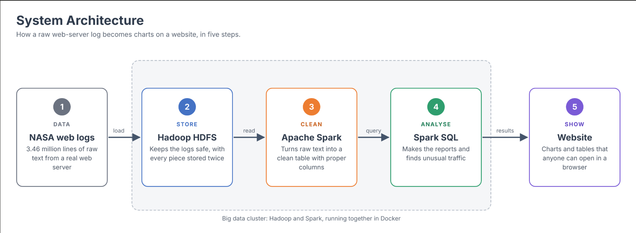
02 · AIM AND SCOPE · SYSTEM ARCHITECTURE
Notes:
Presenter: Kriti
This is how the pipeline fits together. Please follow the arrows from left to right. The NASA logs come from outside. Everything in the grey box runs inside our Docker cluster: seven containers from one image, on one laptop. The logs first land in the HDFS raw zone, written once, with two copies. Spark ETL parses and cleans them and writes the curated zone as Parquet, split by date. Spark SQL runs the 11 reports and the anomaly detection on that clean data, the export step writes dashboard.json and CSV files, and the Flask website shows them. The colours show who built what: blue is my part, Hadoop HDFS; orange is Kushal's part, the Apache Spark ETL; and grey is Gargi's part, the Spark SQL reports and the website. HDFS has three zones: raw for the original logs, curated for the clean Parquet, and reports for the output tables. Next, how we split this 50%.

Slide 5
Team Member Task Status
03 · 50% SPLIT
1
KRITI SINGH
2
KUSHAL MOHAN
3
GARGI SINGH
Hadoop HDFS
Apache Spark
Algorithm/Spark SQL
in Docker
PySpark ETL
reports + website
Docker image: Java 11, Hadoop 3.3.6, Spark 3.5.3
7-container cluster: NameNode, 2 DataNodes, Spark
Replication 2, 128 MB blocks
NASA logs downloaded into the raw zone
etl.py parses every log line with regex
Converts types, keeps bad lines as rejects
Adds date, hour, day of week, extension
Writes Snappy Parquet split by date
11 SQL reports on 4 topics
Z-score anomaly detection
Export to JSON and CSV
4-page Flask website, SVG charts
OUTPUT
OUTPUT
OUTPUT
356 MB of raw logs, every block stored twice
3,461,612 clean rows in 58 date folders
Reports, 12 unusual hours and the website
Equal thirds: each member owns one big data tool and one stage of the pipeline: store (HDFS) → clean (Spark) → analyse and show (Spark SQL).
Notes:
Presenter: Kriti
We split the first 50% into equal thirds. Each of us owns one big data tool and one stage of the pipeline. I own Hadoop HDFS: the Docker cluster with two DataNodes, replication 2, and the NASA logs loaded into the raw zone. My output is 356 MB of raw logs with every block stored twice. Kushal owns Apache Spark: his ETL job parses, types and cleans every line and writes Parquet split by date. His output is 3,461,612 clean rows in 58 date folders. Gargi owns Spark SQL: the 11 reports, the Z-score anomaly detection, the export and the website. Her output is the reports, the 12 unusual hours and the website. So the data flows from store, to clean, to analyse and show. I will start with my part.

Slide 6
Cluster and HDFS Storage
04 · KRITI'S PART · HADOOP HDFS
docker-compose.yml · one network · one image
1
One Docker image
Java 11 + Hadoop 3.3.6 + Spark 3.5.3. entrypoint.sh gives each container its role.
namenode
Index: file → blocks → DataNodes · :9870
spark-master
:8080
2
7-container cluster
Containers find each other by name; each DataNode has its own volume.
spark-worker
3 cores · 3 GB
datanode1
datanode2
3
HDFS configured
core-site: hdfs://namenode:8020. hdfs-site: replication 2, 128 MB blocks.
B1
B2
B1
B2
client
hdfs · spark-submit
B3
B4
B3
B4
4
Data loaded and verified
make ingest puts the logs in /data/weblogs/raw; make fsck shows 2 copies of every block.
web
:8050
Same 4 blocks on both DataNodes = 8 copies
Fault test: stop datanode2 → the logs are still readable
Notes:
Presenter: Kriti
My module is the cluster and HDFS storage, and my big data tool is Hadoop HDFS. I wrote one Docker image with Java 11, Hadoop 3.3.6 and Spark 3.5.3. Docker Compose starts it as seven containers on one network: a NameNode, two DataNodes, a Spark master, a Spark worker with 3 cores and 3 GB, a client to submit jobs, and the web server. The NameNode is the index: it knows which file is made of which blocks, and where each block lives. The DataNodes store the actual blocks. I configured a replication factor of 2 and a block size of 128 MB. So our logs become 4 blocks, and each block is stored on both DataNodes: 8 copies in total. The command make ingest puts the logs into /data/weblogs/raw, and make fsck proves that every block has 2 copies. We also did a fault test: we stopped datanode2, and the logs were still readable from datanode1. That is the fault tolerance of HDFS. Next, the data I loaded.

Slide 7

NASA-HTTP Web Server Logs
04 · RAW DATA · NASA-HTTP LOGS
ONE LOG LINE, EXACTLY AS THE SERVER WROTE IT
3.46 M
58
199.72.81.55 - - [01/Jul/1995:00:00:01 -0400] "GET /history/apollo/ HTTP/1.0" 200 6245
requests (log lines)
days of traffic, Jul–Aug 1995
199.72.81.55 | Visitor's host (IP address or name)
[01/Jul/1995:00:00:01 -0400] | Date and time, Florida time zone
"GET /history/apollo/ HTTP/1.0" | Method, page requested, protocol
200 | Status: 200 OK, 304 not modified, 404 not found
6245 | Bytes sent back
137,978
356 MB
unique visitor hosts
raw text (37 MB compressed)
Known gaps in the data
No logs for 29–31 Jul, and the server was down from 1 Aug 14:52 to 3 Aug 04:36 (Hurricane Erin). We keep the gaps; nothing is filled in.
Common Log Format, still used by Apache and Nginx today. Source: Internet Traffic Archive.
Notes:
Presenter: Kriti
Our dataset is NASA-HTTP: every request made to the NASA Kennedy Space Center web server in July and August 1995. It has 3.46 million requests over 58 days, from 137,978 unique visitor hosts. It is 356 MB of raw text, or 37 MB compressed. On the right is one line exactly as the server wrote it: the visitor's host, the date and time, the request with the method and the page, the status code, such as 200 for OK or 404 for not found, and the bytes sent back. This is the Common Log Format, which Apache and Nginx still use today. The data has known gaps: there are no logs for 29 to 31 July, and the server was down from 1 to 3 August because of Hurricane Erin. We keep those gaps; we do not fill anything in.

Slide 8
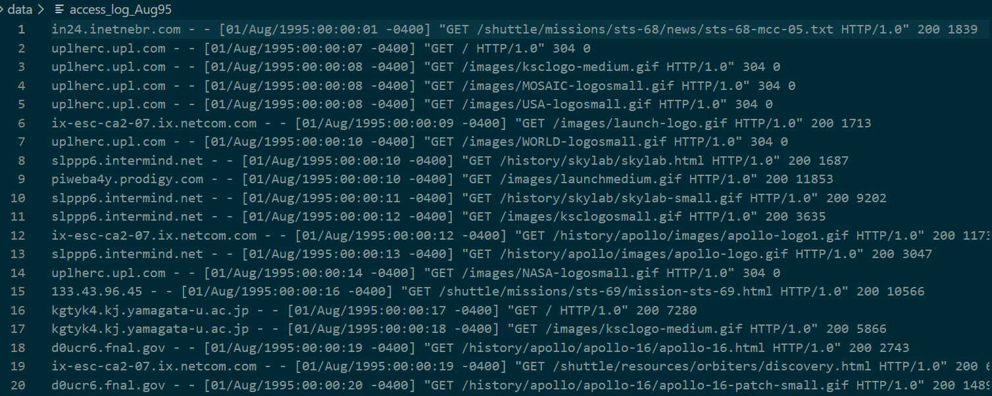
Raw Data: What Lands in the HDFS Raw Zone
04 · RAW DATA SCREENSHOT
SCREENSHOT · THE FIRST 20 LINES OF access_log_Aug95, EXACTLY AS DOWNLOADED
Two plain-text files, 356 MB, 3,461,613 lines. No columns and no types, which is why the data must be preprocessed.
Notes:
Presenter: Kriti
This is a screenshot of the raw data itself. The two files are 196 MB for July and 161 MB for August. Here are the first 12 lines of the July file, exactly as NASA's server wrote them: host, timestamp, request, status code and bytes. For a computer this is just text: there are no columns and no types, so nothing can be counted or grouped yet. That is why we need preprocessing. The command make ingest copies these files into the HDFS raw zone, where they are never edited. Kushal will now show how the data is preprocessed.

Slide 9
What the Data Looks Like, Before and After
05 · PREPROCESSING (1 OF 2) · KUSHAL MOHAN
BEFORE · RAW TEXT IN THE HDFS RAW ZONE
AFTER · ONE TYPED ROW IN THE CURATED ZONE
199.72.81.55 - - [01/Jul/1995:00:00:01 -0400] "GET /history/apollo/ HTTP/1.0" 200 6245
unicomp6.unicomp.net - - [01/Jul/1995:00:00:06 -0400] "GET /shuttle/countdown/ HTTP/1.0" 200 3985
host string | 199.72.81.55
ts timestamp | 1995-07-01 00:00:01
method string | GET
endpoint string | /history/apollo/
protocol string | HTTP/1.0
status int | 200
bytes long | 6245 ('-' would become 0)
date date | 1995-07-01 (its folder)
hour int | 0
dow string | Saturday
ext string | '' (URL ends in /)
What Spark sees before cleaning
One text column called value, one row per line. No columns, no types: nothing can be counted, filtered or grouped yet.
After etl.py, in our run
3,461,613 lines in → 3,461,612 rows out · 1 reject · 58 date folders of Snappy Parquet
11 columns per row: 7 cut out of the text, 4 added for the reports (date, hour, dow, ext). Stored by column, so a report reads only what it needs.
Notes:
Presenter: Kushal
Thank you, Kriti. I am Kushal, and my big data tool is Apache Spark. My job, etl.py, is where the preprocessing happens. This is what preprocessing does to the data. On the left is the data before: raw text in the HDFS raw zone. When Spark first reads it, it sees only one text column, called value, with one row per line. There are no columns and no types, so nothing can be counted, filtered or grouped yet. On the right is the same first line after preprocessing: one typed row in the curated zone. host is a string, ts is a real timestamp, status is an integer and bytes is a long number. If bytes is a dash, which means no body was sent, we store 0. We also add four columns for the reports: date, hour, day of the week and file extension. So each row has 11 columns: 7 cut out of the text and 4 added. Because Parquet stores data by column, a report reads only the columns it needs.

Slide 10
How etl.py Preprocesses Every Line
05 · PREPROCESSING (2 OF 2) · KUSHAL MOHAN
1
2
3
4
5
6
7
Read
Cut
Type
Fix
Validate
Add
Write
spark.read.text: one row per log line
regexp_extract pulls out 7 fields
time → timestamp, status → int, bytes → long
'-' in bytes means no body → 0
no time, status or host → rejects folder
date, hour, dow and ext columns
Parquet + Snappy, partitionBy(date)
THE REGULAR EXPRESSIONS THAT CUT A LINE INTO FIELDS
CLEANING RULES
host ^(\S+)
time \[(\d{2}/\w{3}/\d{4}:\d{2}:\d{2}:\d{2} [+\-]\d{4})\]
request "(\S+)\s(\S+)\s*(\S*)" → method, URL, protocol
status \s(\d{3})\s
bytes \s(\d+|-)$
parsed time format: dd/MMM/yyyy:HH:mm:ss Z
A bad line is never deleted: it is copied to curated_rejects to inspect
The parse rate is printed every run, with a warning below 99%
Raw logs are never changed: fix a rule, run make etl again
Spark runs it in parallel, one task per HDFS block
Notes:
Presenter: Kushal
Here is exactly how etl.py preprocesses every line, in seven steps. Read each line. Cut out 7 fields with regexp_extract. Convert the types. Fix the dash in bytes to 0. Validate that time, status and host exist; if not, the line goes to the rejects folder. Add the date, hour, day and extension columns. And write Parquet with Snappy, partitioned by date. Below are the actual regular expressions we use for each field, and the time format we parse. Our cleaning rules are simple: a bad line is never deleted, it is copied to curated_rejects; the parse rate is printed on every run, with a warning if it falls below 99%; the raw logs are never changed; and Spark runs all of this in parallel, one task per HDFS block. The next slide shows the result.

Slide 11
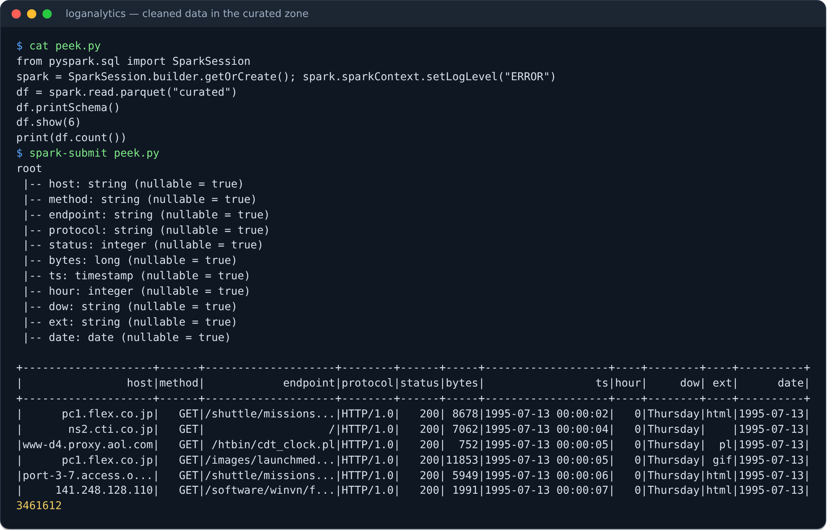
Preprocessing Output: Clean, Typed Data
05 · PREPROCESSING OUTPUT
SCREENSHOT · READING THE CURATED PARQUET BACK WITH SPARK
RESULT
3,461,612 rows
From 3,461,613 raw lines; the 1 reject is a truncated line
11 typed columns
string, integer, long, timestamp and date instead of one text column
58 date folders
Snappy Parquet, one folder per day, so a one-day query reads one folder
Notes:
Presenter: Kushal
This screenshot shows the result: we read the curated Parquet back with Spark. The schema shows 11 typed columns: host, method, endpoint and protocol as strings, status and hour as integers, bytes as a long number, ts as a real timestamp, day of week and extension as strings, and date as a date. Below are the first rows, already split into columns, and the count: 3,461,612 rows. On the right are the three results: 3,461,612 rows from 3,461,613 raw lines, with one reject; 11 typed columns instead of one text column; and 58 date folders of Snappy Parquet, so a one-day query reads only one folder.

Slide 12








Spark ETL into Parquet
06 · KUSHAL'S PART · APACHE SPARK
1 Read
2 Parse
3 Clean
4 Store
5 Verify
Raw logs from the HDFS raw zone
Regex splits each line into host, time, method, URL, status, bytes
Malformed lines kept aside as rejects, not deleted
Parquet + Snappy, one folder per day: 58 folders
Parse rate checked: 3,461,612 rows, 1 reject
WHAT APACHE SPARK GIVES US
Parallel
11 typed columns
Rejects kept
Safe to re-run
One task per HDFS block, run on the worker's 3 cores
7 cut from each line, plus date, hour, dow and ext
Bad lines saved to curated_rejects; nothing is silently lost
Raw zone untouched: fix a rule, run make etl again
Notes:
Presenter: Kushal
So here is my part on one slide: the Spark ETL, written in PySpark. ETL means extract, transform and load. It runs in five steps. One, Spark reads the raw logs directly from Kriti's HDFS raw zone. Two, a regular expression splits every line into host, time, method, URL, status and bytes. Three, any line that does not match is kept aside as a reject, not deleted. Four, Spark stores the clean rows as Parquet with Snappy compression, one folder per day, which gives 58 folders. Five, it verifies the result: the parse rate is printed on every run. In our run, 3,461,613 lines went in and 3,461,612 clean rows came out: the only reject is one truncated line in the July file. Spark matters here because it works in parallel: one task per HDFS block, on the worker's 3 cores. Every row gets 11 typed columns, bad lines are never silently lost, and because the raw zone is untouched, we can fix a rule and simply run make etl again. Here is the output of the job.

Slide 13
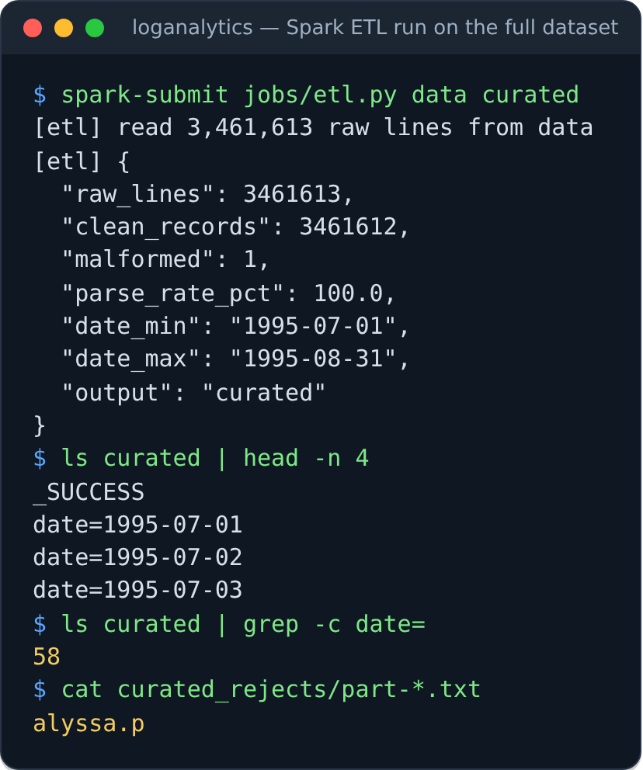
Output of the Spark ETL Job
06 · KUSHAL'S OUTPUT
SCREENSHOT · etl.py ON THE FULL DATASET
WHAT THE OUTPUT SHOWS
3,461,613 lines read
Every line of both log files
1
3,461,612 clean records
Parse rate 100.0% after rounding: one line could not be parsed
2
58 date folders
date=1995-07-01 to date=1995-08-31, minus the 4 days missing from the source
3
1 reject, kept
The truncated July line alyssa.p, saved in curated_rejects, never deleted
4
Run in Spark local mode on the full dataset to capture this screen. On the cluster the same job is make etl, reading from hdfs://namenode:8020/data/weblogs/raw.
Notes:
Presenter: Kushal
This is the actual output of etl.py on the full dataset. It read 3,461,613 raw lines and wrote 3,461,612 clean records; the parse rate rounds to 100 percent. The output has 58 date folders, from 1 July to 31 August, minus the four days missing from the source. And the rejects folder holds exactly one line: a truncated July line that reads only alyssa dot p. We keep it; we never delete it. Now Gargi will show how Spark SQL turns this clean data into answers.

Slide 14




Spark SQL Reports and Website
07 · GARGI'S PART · SPARK SQL
Spark SQL reports
reports.py runs 11 SQL queries on the curated Parquet
11 reports, 4 topics
CSV and JSON downloads
Export: dashboard.json + CSV
export_dashboard.py writes ./output, outside the cluster
Traffic, content, errors and size: one website page per topic
Every table can be downloaded for checking
Flask server
app.py serves pages, data API and downloads on :8050
ONE OF THE 11 REPORTS, AS WRITTEN IN reports.py
SELECT hour,
COUNT(*) AS hits,
COUNT(DISTINCT host) AS visitors
FROM access_logs -- the curated Parquet
GROUP BY hour
ORDER BY hour
Browser
Charts and searchable tables
Notes:
Presenter: Gargi
Thank you, Kushal. My module is the Spark SQL reports and the website, and my big data tool is Spark SQL. Spark SQL lets us query 3.46 million rows with plain SQL, and Spark runs each query in parallel on the cluster. My script, reports.py, reads Kushal's curated Parquet, registers it as a table called access_logs, and runs 11 SQL queries on 4 topics: traffic, content, errors and size. On the right is one of them, exactly as written: it groups every request by hour and counts the hits and the distinct visitors. Other reports find the top URLs, the 404 broken links, the status codes, and the response sizes using percentile_approx. Each report table is saved in the HDFS reports zone. Then export_dashboard.py writes them to dashboard.json and CSV files outside the cluster, the Flask server serves the pages, a data API and downloads on port 8050, and the browser shows charts and searchable tables. Every table can be downloaded as CSV or JSON, so anyone can check our numbers. And because the website reads only the exported files, it keeps working even when the cluster is off.

Slide 15
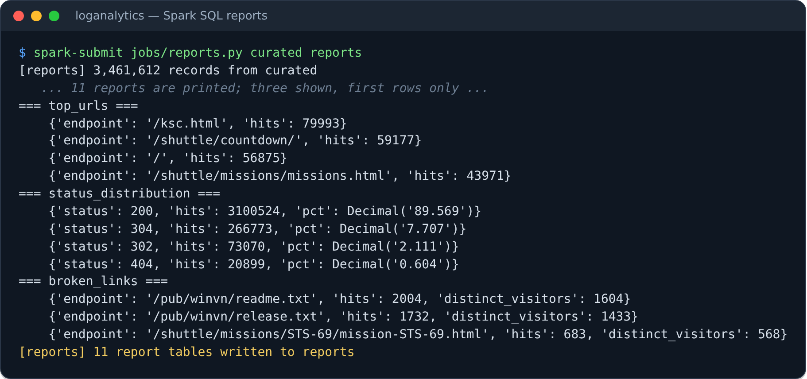
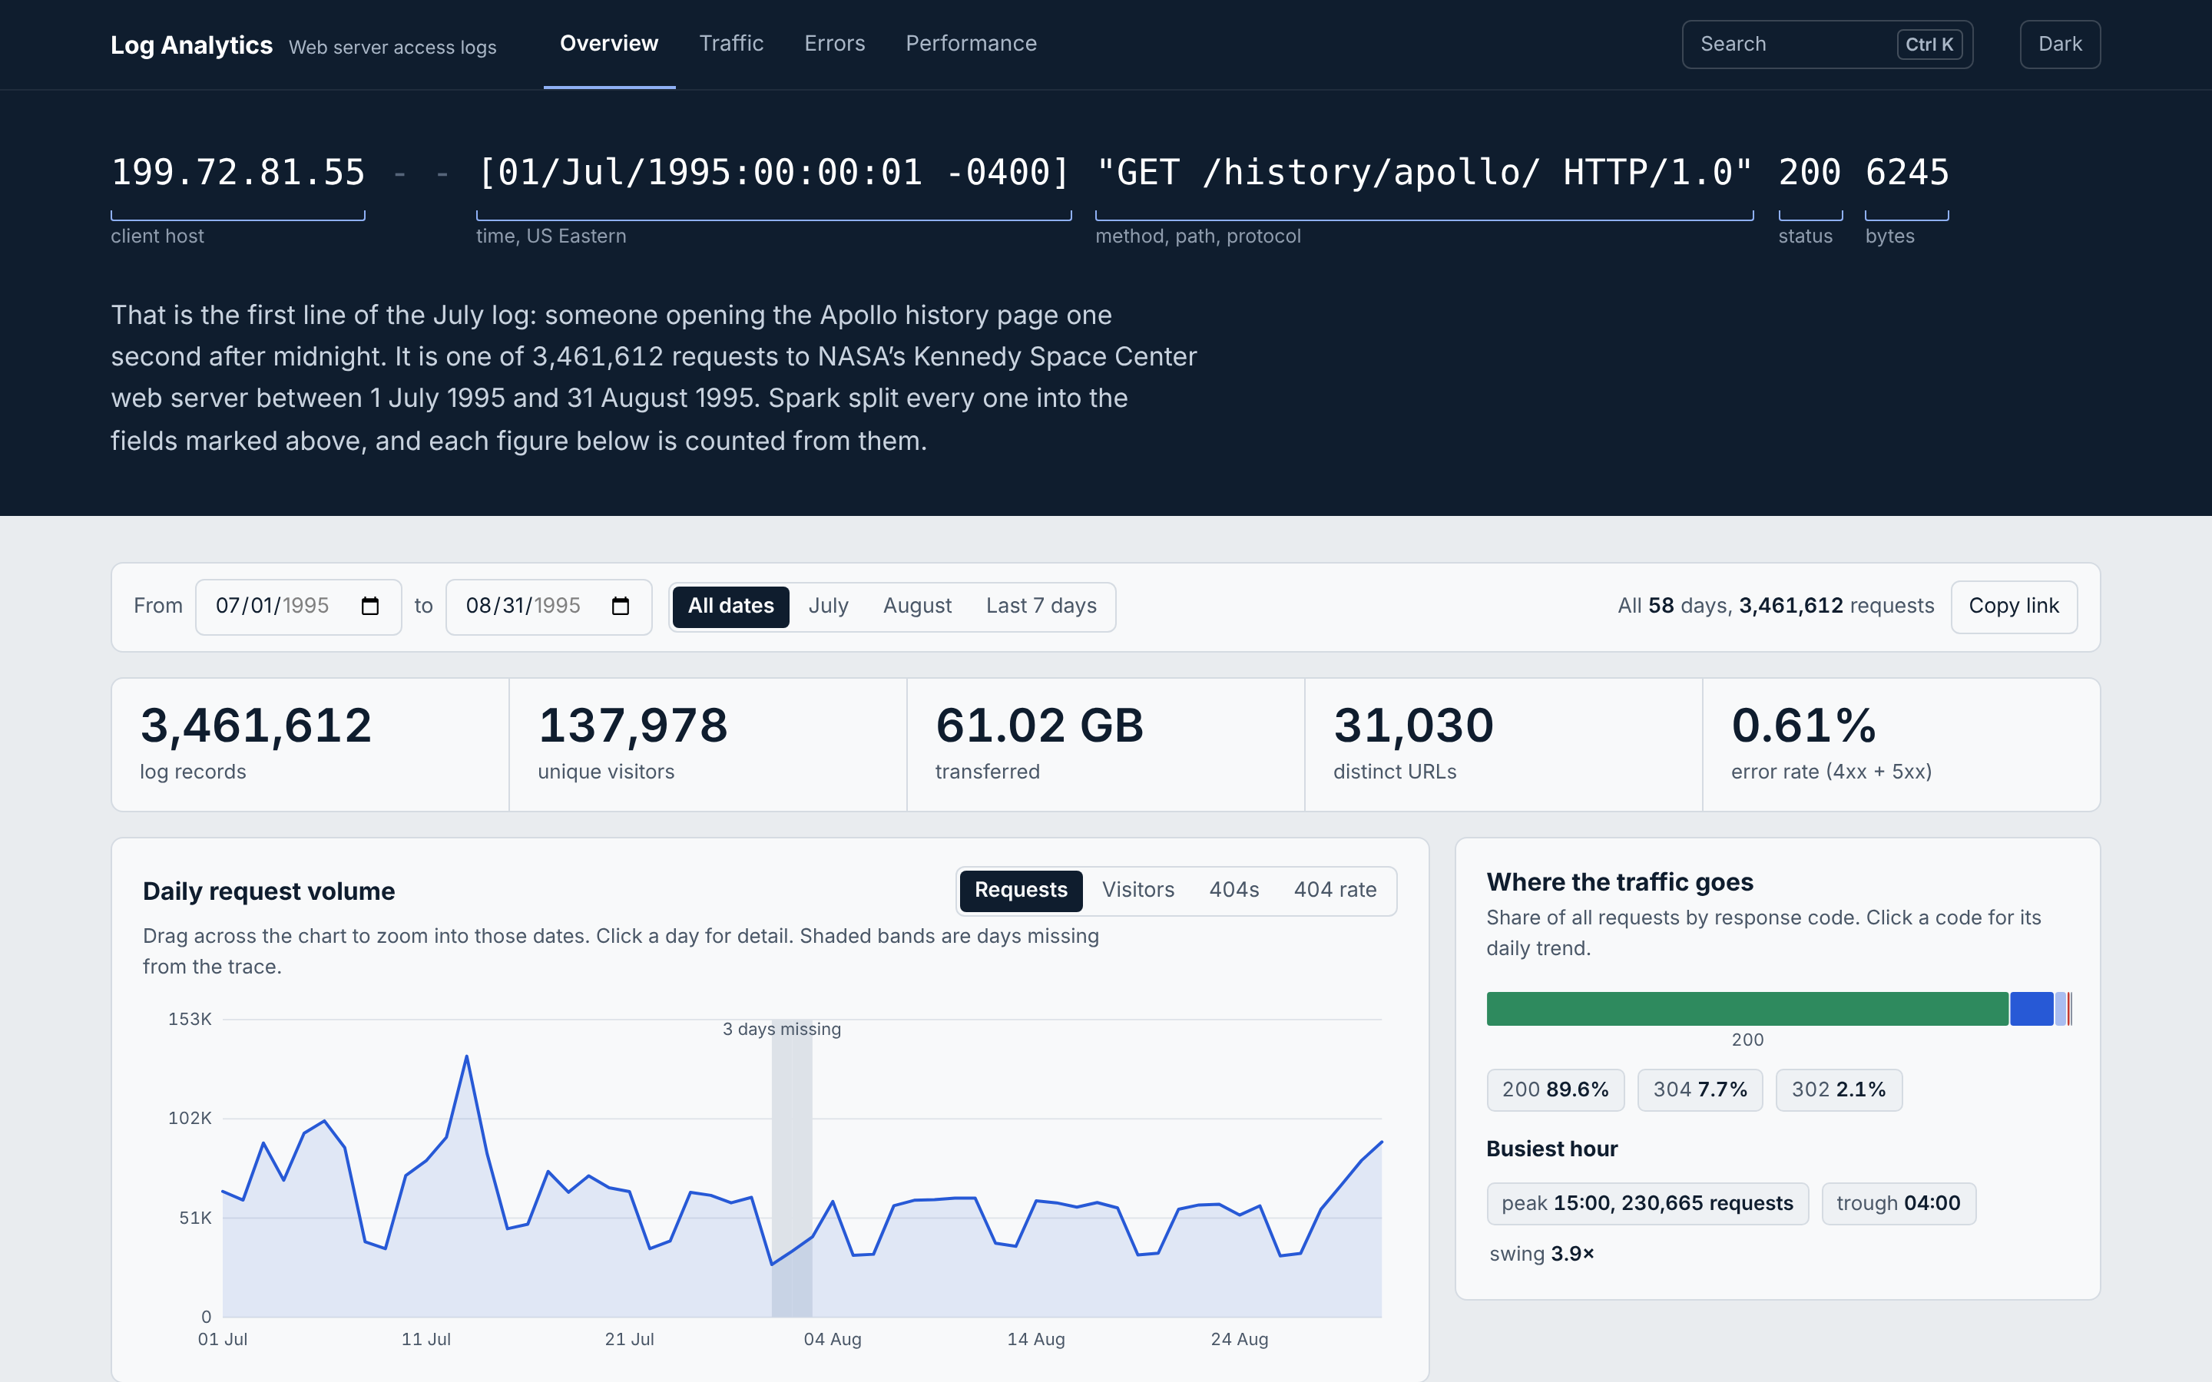
Output: Spark SQL Reports and the Website
07 · GARGI'S OUTPUT
SCREENSHOT · reports.py OUTPUT
WEBSITE · OVERVIEW PAGE, localhost:8050
WHAT THE REPORTS SAY
79,993 hits
/ksc.html, the most-visited page
89.6% OK
of all requests returned status 200
20,899 not found
404 errors across 3,544 URLs
2,004 hits
worst broken link: /pub/winvn/readme.txt
Every number on the site comes from one Spark SQL report; the pages only display the exported results.
Notes:
Presenter: Gargi
Here is my output. On the left is the actual output of reports.py: it reads all 3,461,612 records and prints each report. The top page is ksc.html with 79,993 hits; 89.6% of requests got status 200, and 20,899 were 404 Not Found. The worst broken link is /pub/winvn/readme.txt, requested 2,004 times. Below it is the Traffic page of our website, listing the unusual hours found by the anomaly detection. On the right is the Overview page: 3,461,612 log records, 137,978 unique visitors, 61 GB transferred, the daily request volume and where the traffic goes. Every number on the site comes from one Spark SQL report.

Slide 16
What the Logs Show So Far
07 · GARGI'S OUTPUT · FIRST RESULTS
134,203
requests on 13 Jul, the busiest day: the Space Shuttle STS-70 launch
89.6%
of requests succeeded (200 OK); 20,899 were 404 Not Found
3–4 PM
busiest hour of the day; 4–6 AM is the quietest
Empty days are missing data: no logs for 29–31 Jul, and 2 Aug was lost to Hurricane Erin.
From our Spark SQL reports on all 3,461,612 rows.
Notes:
Presenter: Gargi
These are the first results from our Spark SQL reports, on all 3,461,612 rows. The chart shows requests per day. The busiest day was 13 July, with 134,203 requests: that was the day of the Space Shuttle STS-70 launch. The empty days are missing data: there are no logs for 29 to 31 July, and 2 August was lost to Hurricane Erin. 89.6% of all requests succeeded with status 200 OK, and 20,899 requests were 404 Not Found, which point us to broken links. The busiest hour of the day is 3 to 4 PM, and 4 to 6 AM is the quietest. Next, our algorithm finds unusual hours like these automatically.

Slide 17
Z-score Anomaly Detection: Finding Unusual Traffic
08 · ALGORITHMS (1 OF 3) · Z-SCORE ANOMALY DETECTION
THE ALGORITHM IN 4 STEPS · PLAIN SPARK SQL, NO MLLIB
RESULT ON ALL 3,461,612 REQUESTS · TOP 5 OF 12
1
Count
Requests for every date and hour: 1,369 hour slots
Date and hour | Requests | Normal | Z-score
13 Jul, 09:00 | 14,926 | 3,080 | 5.90
13 Jul, 08:00 | 11,567 | 2,572 | 5.57
13 Jul, 06:00 | 3,677 | 1,147 | 4.61
13 Jul, 07:00 | 6,051 | 1,748 | 4.50
13 Jul, 10:00 | 10,214 | 3,342 | 4.20
2
Baseline
Mean and standard deviation of each hour of the day, across all 58 days
3
Score
z = (requests − mean) ÷ standard deviation
4
Flag
|z| > 3 is an anomaly: above 0 a spike, below 0 a drop
12 hours flagged, 11 of them on 13 July
The strongest is 9–10 AM (z = 5.9), the hour of the Space Shuttle STS-70 launch at 9:41 AM. 13 July is also the only unusual day (z = 3.62). The 12th hour is 31 Aug, 04:00 (z = 3.05).
-- step 2: the normal level for each hour of the day
SELECT hour, AVG(hits) AS mean_hits,
STDDEV_POP(hits) AS std_hits
FROM hourly GROUP BY hour
-- steps 3 and 4: score every hour, keep the unusual ones
(hits - mean_hits) / std_hits AS z ... WHERE ABS(z) > 3
Each hour is compared only with the same hour on other days, so a busy afternoon is not flagged just for being an afternoon. Run it with make anomalies.
Notes:
Presenter: Gargi
Now our algorithm: Z-score anomaly detection, written in plain Spark SQL with no machine-learning library. It answers a simple question: which hours had far more, or far less, traffic than normal? It works in four steps. One, count the requests for every date and hour: 1,369 hour slots. Two, for each hour of the day, find the normal level: the mean and the standard deviation of that hour across all 58 days. Three, give every hour a z-score: requests minus the mean, divided by the standard deviation. It says how many standard deviations an hour is from normal. Four, flag every hour where the z-score is above 3 or below minus 3; under a normal distribution only about 0.3% of values fall that far out. We compare each hour only with the same hour on other days, so a busy afternoon is not flagged just for being an afternoon. On all 3.46 million requests it flagged 12 hours, and 11 of them are on 13 July. The strongest is 9 to 10 AM, with 14,926 requests against a normal 3,080: a z-score of 5.9. That is the hour the Space Shuttle STS-70 launched, at 9:41 AM. 13 July is also the only unusual day, with a z-score of 3.62. So without being told anything about the launch, the algorithm found it from the numbers alone. It found no drops, because hours when the server was down have no rows at all; they show as gaps, not as low counts. It runs with make anomalies, and the flagged hours appear on the Traffic page of our website. The next slide shows the same result as a before-and-after chart.

Slide 18
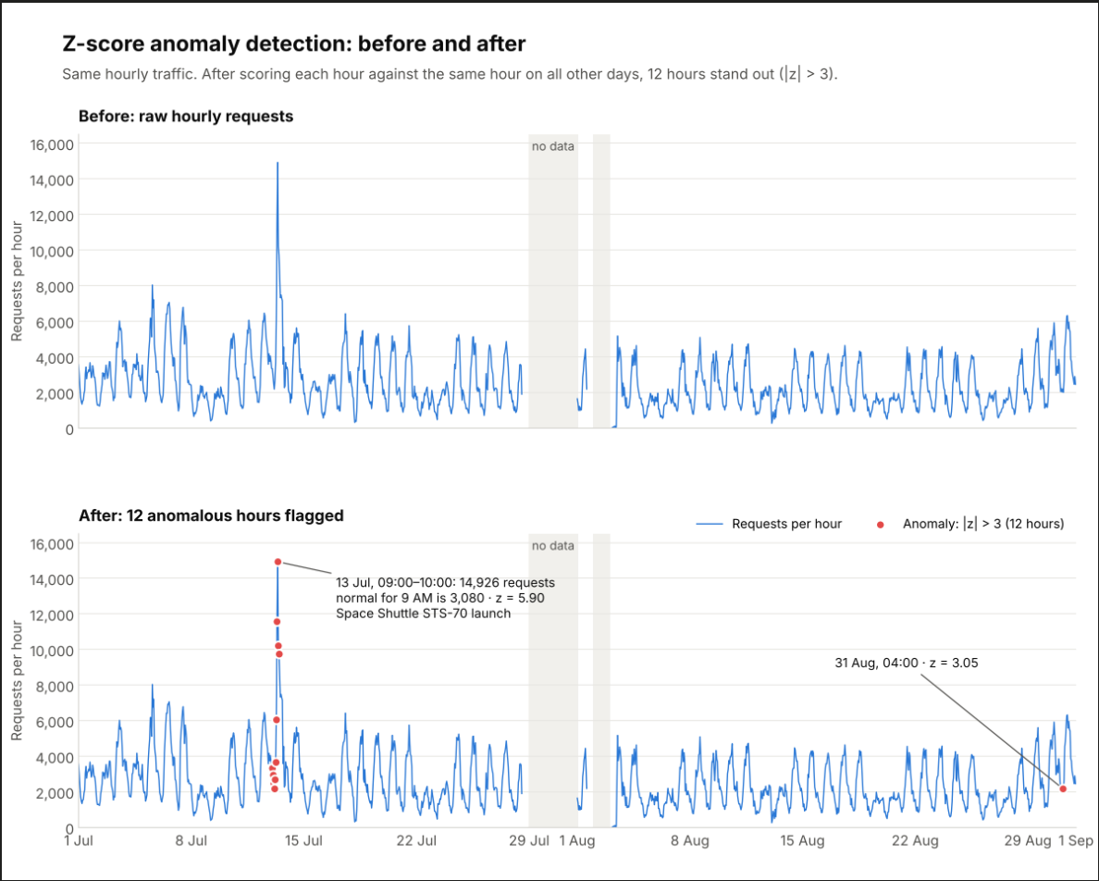
08 · ALGORITHMS (1 OF 3) · Z-SCORE: BEFORE AND AFTER
Notes:
Presenter: Gargi
This is the same result as a picture. The top chart is the raw hourly traffic for July and August: every afternoon is a peak, so the unusual hours cannot be picked out by eye. The bottom chart is after the Z-score: the 12 red dots are the hours with |z| above 3. Eleven of them are on 13 July, around the Space Shuttle STS-70 launch, and the twelfth is 31 August at 4 AM. The grey bands are the days with no data. Next, our machine-learning model for attack detection.

Slide 19
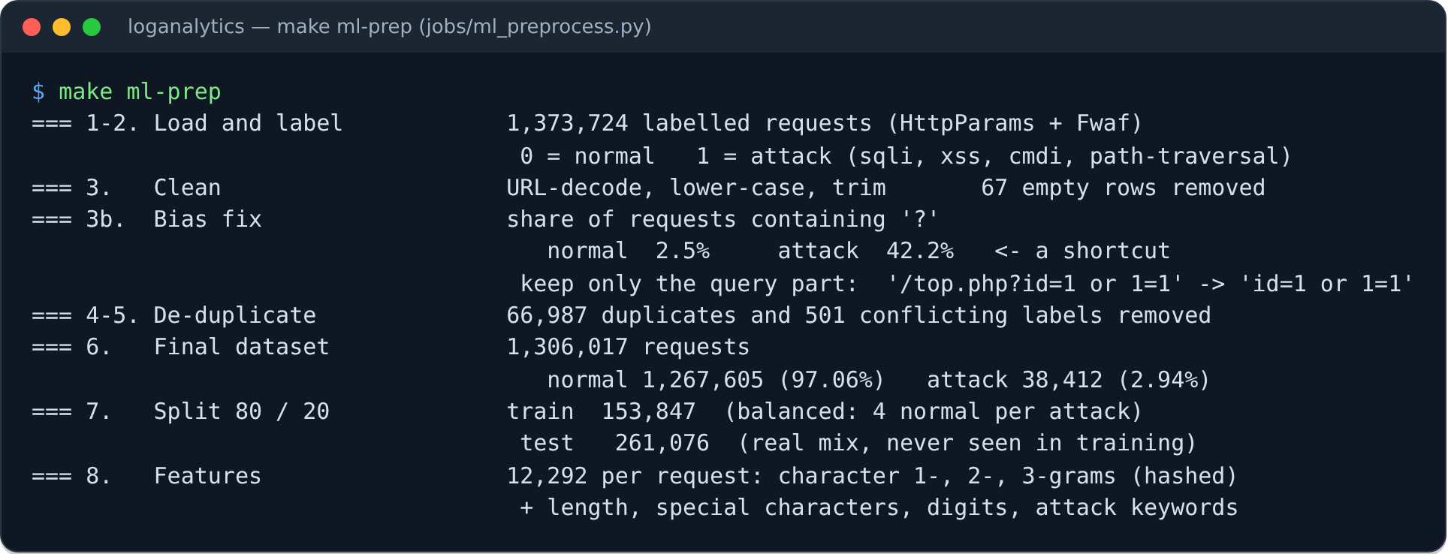
Attack Detection: Data and Preprocessing
08 · ALGORITHMS (2 OF 3) · ML PREPROCESSING
OUTPUT · make ml-prep ON THE LABELLED ATTACK DATA
THE SET-UP
Supervised, 2 classes
Normal or attack (SQL injection, XSS, command injection, path traversal)
Labelled data, in HDFS
1,306,017 requests from HttpParams + Fwaf; the NASA logs have no labels
Training set: all 30,747 attacks + 4 normal requests per attack = 153,847. Test set: 261,076 requests with the real mix (97% normal), never seen in training. Every step reports its row counts.
Bias removed
42% of attacks but 2.5% of normal requests had '?': only the query part is kept
Notes:
Presenter: Kushal
Our second algorithm is machine learning for web-attack detection. It is supervised binary classification with 2 classes: normal and attack, where attack means SQL injection, cross-site scripting, command injection or path traversal. The NASA logs have no labels, so the models learn from two labelled public datasets, HttpParams and Fwaf, which we load into HDFS. Preprocessing: we URL-decode, lower-case and trim every request, remove 66,987 duplicates and 501 requests labelled both ways. We also found a bias: 42% of attacks contain a question mark but only 2.5% of normal requests do, so a model could learn 'question mark means attack'. We keep only the query part, which removes that shortcut. That leaves 1,306,017 requests. We split 80/20: the training set has all attacks plus 4 normal per attack, and the test set keeps the real mix and is never seen in training. Each request becomes 12,292 features from its characters and character pairs and triples.

Slide 20
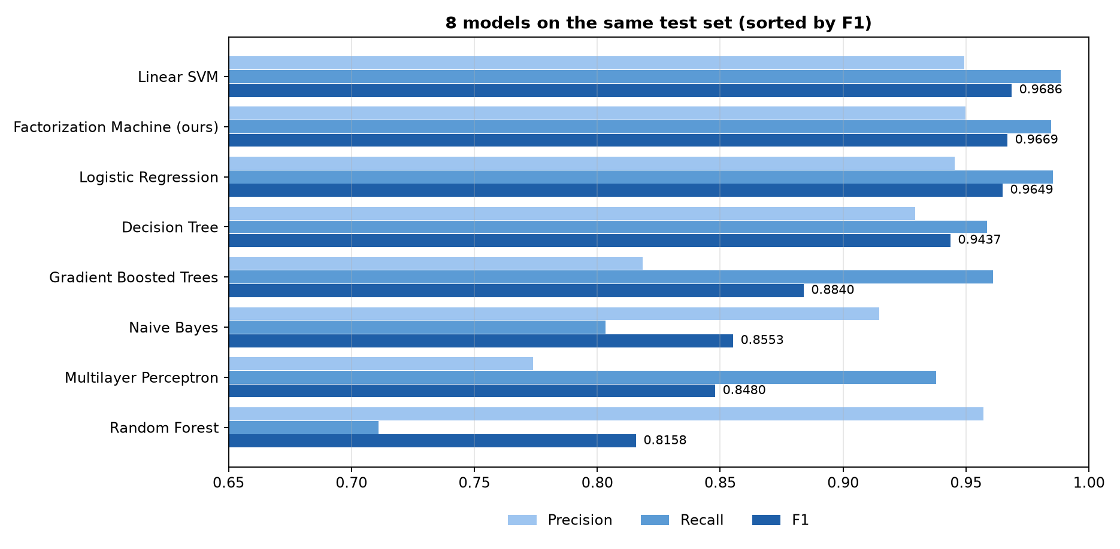
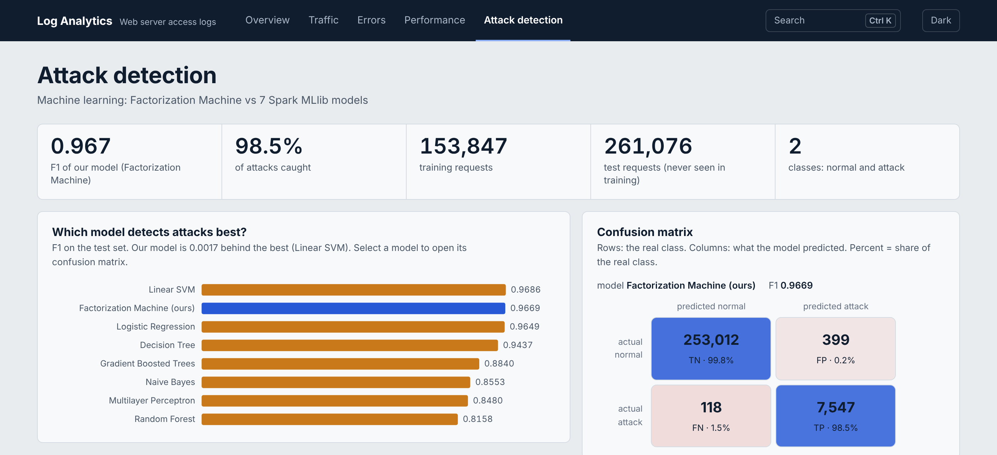
Factorization Machine vs 7 Spark MLlib Models
08 · ALGORITHMS (3 OF 3) · ATTACK DETECTION RESULTS
F1 ON THE SAME 261,076 TEST REQUESTS
WEBSITE · ATTACK DETECTION PAGE, localhost:8050/ml
WHAT THE RESULTS SAY
Our Factorization Machine is on par with the best model and ahead of Logistic Regression, the trees, Naive Bayes and the neural network. On the unlabelled NASA logs its flags are candidates to check, not confirmed attacks.
F1 0.967
our FM; 0.002 behind the best (Linear SVM)
98.5% caught
7,547 of 7,665 attacks; 399 false alarms
8 models
same features and test set, all in Spark MLlib
120 NASA URLs
flagged (0.39%); none a confirmed attack
Notes:
Presenter: Kushal
Here are the results on 261,076 test requests the models never saw. Our model is a Factorization Machine: like logistic regression, but it also learns a weight for every pair of features, for example a quote together with 'or' together with a comment. It reaches F1 0.967 and catches 98.5% of attacks: 7,547 of 7,665, with 399 false alarms out of more than 253,000 normal requests. Linear SVM is 0.002 higher, so we say our model is on par with the best, and it is ahead of logistic regression, the tree models, Naive Bayes and the neural network. We use F1, not accuracy, because 97% of requests are normal. On the right is the Attack detection page of our website, with the confusion matrix. Finally, we ran the model over all 31,026 NASA URLs: it flagged 120. Checked by hand, most are searches with words like 'select' or 'transcript', not attacks. That is an honest limitation: the training data is modern, the NASA logs are from 1995.

Slide 21

Future Plans: Where We Are and What Comes Next
09 · FUTURE PLANS
NEXT · TOWARDS THE FINAL REVIEW
COMPLETED SO FAR
80%
1
Wider training data
Add labelled traffic closer to real web servers (e.g. CSIC 2010), so the model transfers to logs like NASA's.
2
Hand-check NASA flags
Label a random sample of flagged NASA URLs to measure the real precision on our own data.
Hadoop HDFS cluster
KRITI
3
Scalability test
Run the pipeline on 5× and 10× the data on the cluster and measure how the time grows.
Apache Spark ETL
KUSHAL
4
Research paper
Pipeline, bias-aware evaluation and results, written up for publication.
Spark SQL reports + website
GARGI
Spark MLlib attack detection
TEAM
5
Final demo
Full pipeline live: HDFS, Spark, the website and the Attack detection page.
Notes:
Presenter: Gargi
What is next. The whole pipeline now works end to end, including machine learning. One, wider training data closer to real web servers, so the model transfers better to logs like NASA's. Two, hand-check a random sample of the NASA URLs the model flagged, to measure its real precision on our own data. Three, a scalability test on 5 and 10 times the data. Four, the research paper. And five, the final live demo. Kushal will close.

Slide 22
References (1 of 3)
10 · REFERENCES (1 OF 3)
[1]
J. Dean and S. Ghemawat, "MapReduce: Simplified data processing on large clusters," in Proc. 6th USENIX Symp. Operating Systems Design and Implementation (OSDI), San Francisco, CA, USA, 2004, pp. 137–150.
[2]
S. Ghemawat, H. Gobioff, and S.-T. Leung, "The Google file system," in Proc. 19th ACM Symp. Operating Systems Principles (SOSP), 2003, pp. 29–43.
[3]
K. Shvachko, H. Kuang, S. Radia, and R. Chansler, "The Hadoop distributed file system," in Proc. IEEE 26th Symp. Mass Storage Systems and Technologies (MSST), 2010, pp. 1–10.
[4]
M. Zaharia et al., "Resilient distributed datasets: A fault-tolerant abstraction for in-memory cluster computing," in Proc. 9th USENIX Symp. Networked Systems Design and Implementation (NSDI), 2012, pp. 15–28.
[5]
M. Armbrust et al., "Spark SQL: Relational data processing in Spark," in Proc. ACM SIGMOD Int. Conf. Management of Data, 2015, pp. 1383–1394.
[6]
S. Melnik et al., "Dremel: Interactive analysis of web-scale datasets," Proc. VLDB Endowment, vol. 3, no. 1–2, pp. 330–339, 2010.
[7]
M. F. Arlitt and C. L. Williamson, "Internet web servers: Workload characterization and performance implications," IEEE/ACM Trans. Networking, vol. 5, no. 5, pp. 631–645, 1997.
Notes:
Presenter: Kushal
These are our references. The first seven are the core papers behind our tools: MapReduce, the Google File System, HDFS, Spark's resilient distributed datasets, Spark SQL, Dremel for columnar storage, and a study of web-server workloads.

Slide 23
References (2 of 3)
10 · REFERENCES (2 OF 3)
[8]
R. Cooley, B. Mobasher, and J. Srivastava, "Data preparation for mining World Wide Web browsing patterns," Knowledge and Information Systems, vol. 1, no. 1, pp. 5–32, 1999.
[9]
J. Srivastava, R. Cooley, M. Deshpande, and P.-N. Tan, "Web usage mining: Discovery and applications of usage patterns from web data," SIGKDD Explorations, vol. 1, no. 2, pp. 12–23, 2000.
[10]
M. Greenwald and S. Khanna, "Space-efficient online computation of quantile summaries," in Proc. ACM SIGMOD Int. Conf. Management of Data, 2001, pp. 58–66.
[11]
Internet Traffic Archive, "NASA-HTTP: Two months of HTTP logs from the KSC-NASA WWW server." [Online]. Available: https://ita.ee.lbl.gov/html/contrib/NASA-HTTP.html
[12]
Apache Software Foundation, "Apache Hadoop 3.3.6 documentation." [Online]. Available: https://hadoop.apache.org/docs/r3.3.6/
[13]
Apache Software Foundation, "Apache Spark 3.5.3 documentation: Spark SQL guide." [Online]. Available: https://spark.apache.org/docs/3.5.3/sql-programming-guide.html
[14]
Pallets Projects, "Flask documentation." [Online]. Available: https://flask.palletsprojects.com/
Notes:
Presenter: Kushal
The rest are web-usage mining papers on preparing log data, the quantile algorithm behind percentile_approx, and the official sources for the NASA dataset, Hadoop, Spark and Flask.

Slide 24
References (3 of 3)
10 · REFERENCES (3 OF 3)
[15]
V. Chandola, A. Banerjee, and V. Kumar, "Anomaly detection: A survey," ACM Computing Surveys, vol. 41, no. 3, pp. 1–58, 2009.
[16]
S. Rendle, "Factorization machines," in Proc. IEEE Int. Conf. Data Mining (ICDM), 2010, pp. 995–1000.
[17]
X. Meng et al., "MLlib: Machine learning in Apache Spark," J. Machine Learning Research, vol. 17, no. 34, pp. 1–7, 2016.
[18]
C. Cortes and V. Vapnik, "Support-vector networks," Machine Learning, vol. 20, no. 3, pp. 273–297, 1995.
[19]
L. Breiman, "Random forests," Machine Learning, vol. 45, no. 1, pp. 5–32, 2001.
[20]
Morzeux, "HttpParamsDataset," GitHub repository. [Online]. Available: https://github.com/Morzeux/HttpParamsDataset
[21]
F. Ahmad, "Fwaf: Machine learning driven web application firewall," GitHub repository, 2017. [Online]. Available: https://github.com/faizann24/Fwaf-Machine-Learning-driven-Web-Application-Firewall
Notes:
Presenter: Kushal
References 15 to 21 are behind our algorithms: the anomaly detection survey for the Z-score; Rendle's Factorization Machines, which is our model; Spark MLlib, where all 8 models run; support vector machines and random forests among the comparison models; and the two labelled attack datasets we train on, HttpParams and Fwaf.

Slide 25
Thank You
Questions are welcome
Log Analytics System: a distributed HDFS + Spark pipeline for web server access logs
Kushal Mohan · Kriti Singh · Gargi Singh | SRM Institute of Science and Technology
Notes:
Presenter: Kushal
Thank you, ma'am. That is our Log Analytics System at the 50% stage. We are happy to take questions: Kriti on the cluster and HDFS, me on Spark, preprocessing and the ML model, and Gargi on Spark SQL, anomaly detection and the website.

