Slide 1

GitHub
500
Repositories
Repository
Analysis
~42M
Total Stars
35
Trends · Popularity · Community Engagement
Languages
Kushal Agarwal · B24DS012
Data Analysis and Visualization
13,590
Avg Forks
Data collected via GitHub REST API · Self-collected dataset

Slide 2






Agenda
01
Data Collection
02
Data Cleaning
GitHub REST API · 500 repositories · 13 features
Missing values · Feature engineering · Preprocessing
03
EDA — 8 Questions
04
Visualizations
Distributions · Correlations · Temporal trends
10 polished charts · HTML interactive dashboard
05
Predictive Model
06
Key Insights
Linear Regression · R² · Feature importance
What drives GitHub popularity?

Slide 3
01 DATA COLLECTION
How the dataset was built
1
GitHub REST API
Dataset Features
/search/repositories endpoint with sort=stars, order=desc
→ repo_name
→ language
→ owner
→ topics
2
Python requests
Paginated API calls · JSON parsing · Pandas DataFrame
→ stars
→ created_at
→ forks
→ updated_at
3
500 Repositories
Top repositories by star count — covers 44K to 490K stars
→ watchers
→ description
→ open_issues
→ repo_url
4
13 Attributes
→ contributors
Stars, forks, watchers, issues, contributors, language, topics, dates
⚠ Limitations: API rate limits applied · Contributors count approximated · Dataset limited to top repositories by star count

Slide 4
02 DATA CLEANING
Preprocessing & Feature Engineering
ENGINEERED FEATURES
Date Parsing
Converted created_at & updated_at from strings to timezone-aware datetimes, then made tz-naive for arithmetic.
repo_age
(Today − created_at) ÷ 365
Decimal years — how long to accumulate stars
Missing Values
created_year
59 repos had no language tag → filled with 'Unknown'. Numeric nulls in forks, contributors, open_issues, repo_age imputed with column median.
Integer year extracted from created_at
Used for temporal grouping and charting
Duplicates
fork_ratio
Checked for exact duplicate rows — none found. All 500 rows confirmed unique. Final clean shape: 500 × 13.
forks ÷ stars
Proportion of star-givers who also fork
500
13
engagement
59
0
stars + (forks×2) + watchers
Composite popularity score
Final Rows
Features
Lang. Imputed
Duplicates

Slide 5
03 EDA
Exploratory Data Analysis — Statistical Summary
Metric | Mean | Median | Std Dev | Skewness
stars | 83,908 | 64,794 | 68,215 | 2.74
forks | 13,590 | 7,825 | 19,440 | 3.12
contributors | 795 | 283 | 1,981 | 5.60
open_issues | 1,204 | 427 | 2,890 | 4.20
repo_age | 8.2 yrs | 8.5 yrs | 3.8 yrs | –0.22
fork_ratio | 0.164 | 0.127 | 0.148 | 3.45
8 Questions
Answered
Q1 Star distribution
Q2 Language share
Q3 Correlations
Q4 Temporal growth
Q5 Topics
Right-skewed —
stars & forks have skewness > 2 — power-law distributions where few repos dominate.
Q6 Age vs stars
High variance —
contributors ranges from 1 to 21,986 — solo projects to community platforms.
Q7 Top repos
Weak age signal —
repo_age has near-zero skew — evenly spread across 18 years.
Q8 Community

Slide 6
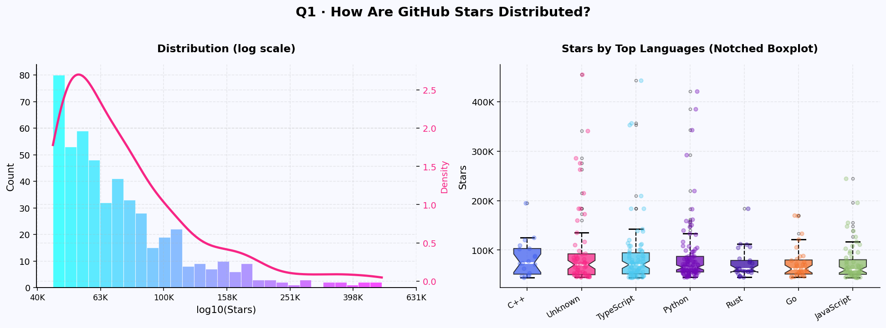
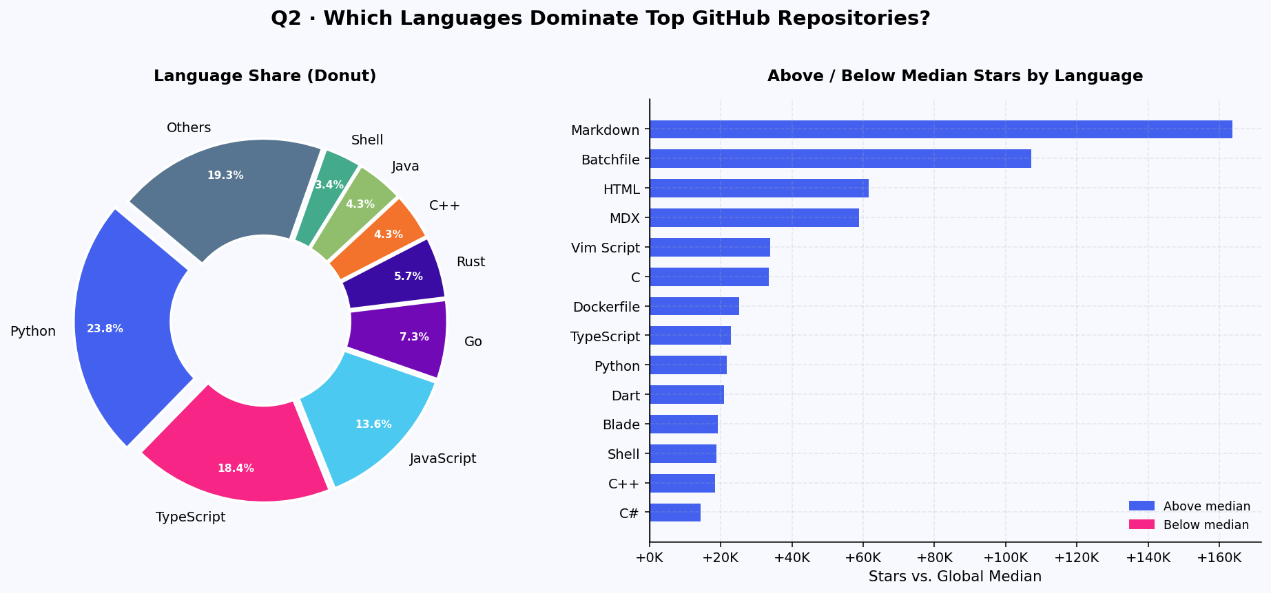
EDA · Q1 & Q2
Star Distribution · Language Dominance
▶ Q1 Finding
▶ Q2 Finding
Stars follow a power-law distribution — most repos cluster 44K–80K while a tiny elite exceeds 200K. C++ and TypeScript show higher median stars than JavaScript.
Python dominates in count (23.8%) but Markdown repos outscore the median most. Go & Rust punch above their weight — quality over quantity.

Slide 7
Q1 · STAR DISTRIBUTION
How are GitHub stars distributed?
▶ Key Finding
Stars follow a power-law / log-normal distribution. A large majority cluster between 44K–80K while a tiny elite exceeds 200K. The KDE confirms a long right tail. C++ & TypeScript show higher medians; JavaScript has high variance driven by outliers.

Slide 8
Q2 · LANGUAGE DOMINANCE
Which languages dominate top repositories?
▶ Key Finding
Python leads in count (23.8%), TypeScript 18.4%, JavaScript 13.6%. But Markdown & Batchfile repos score highest above median — documentation repos outperform code repos. Go & Rust have fewer repos but above-median popularity per repo.

Slide 9
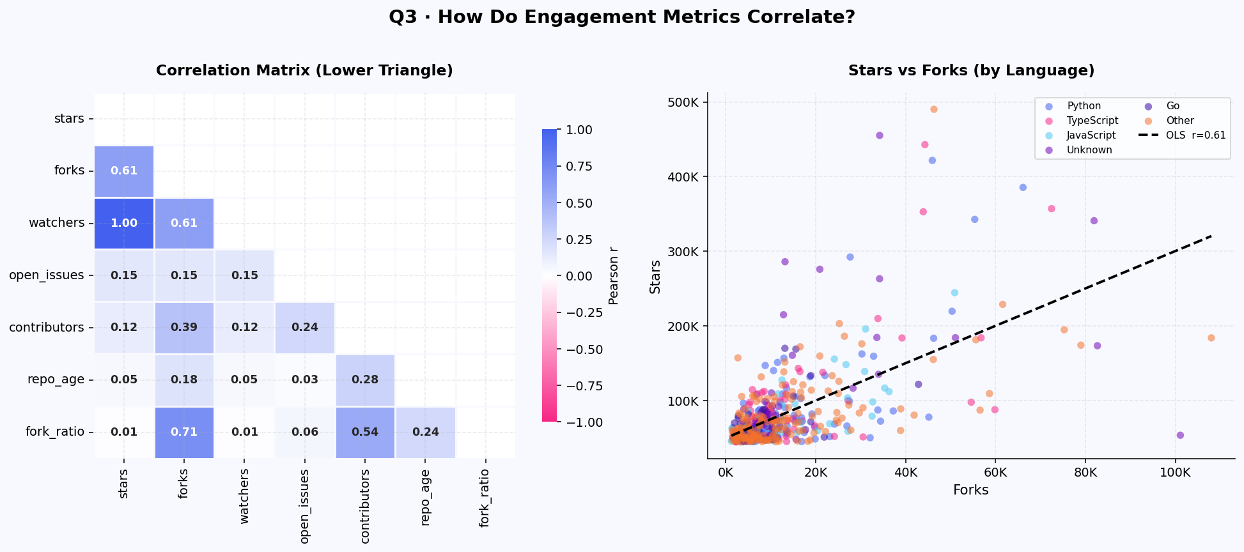
Q3 · METRIC CORRELATIONS
How do engagement metrics relate?
Stars ↔ Watchers r = 1.00 (identical — excluded from model)
Stars ↔ Forks r = 0.61 (strong positive — key predictor)
Forks ↔ Contributors r = 0.40 (moderate — collaborative repos fork more)
Stars ↔ Age r ≈ 0.05 (very weak — age alone doesn't predict)

Slide 10
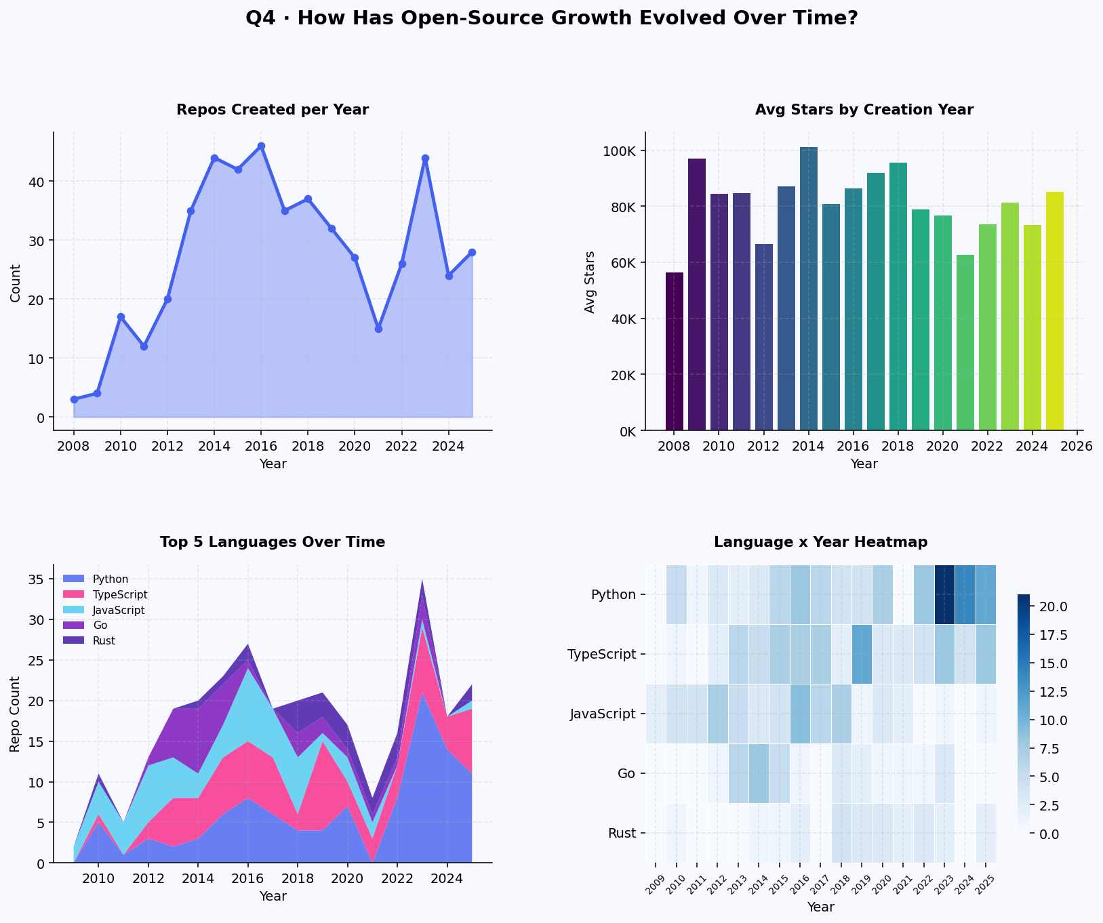
Q4 · TEMPORAL GROWTH
How has open-source evolved over time?
2013–2016
GitHub adoption peak — most repos created
2014
Highest avg stars — time + momentum combined
2023–2025
AI/LLM revival — sharp spike in new repos
Python
Overtook JavaScript from 2018 onwards
TypeScript
Exploded post-2020 in language share

Slide 11
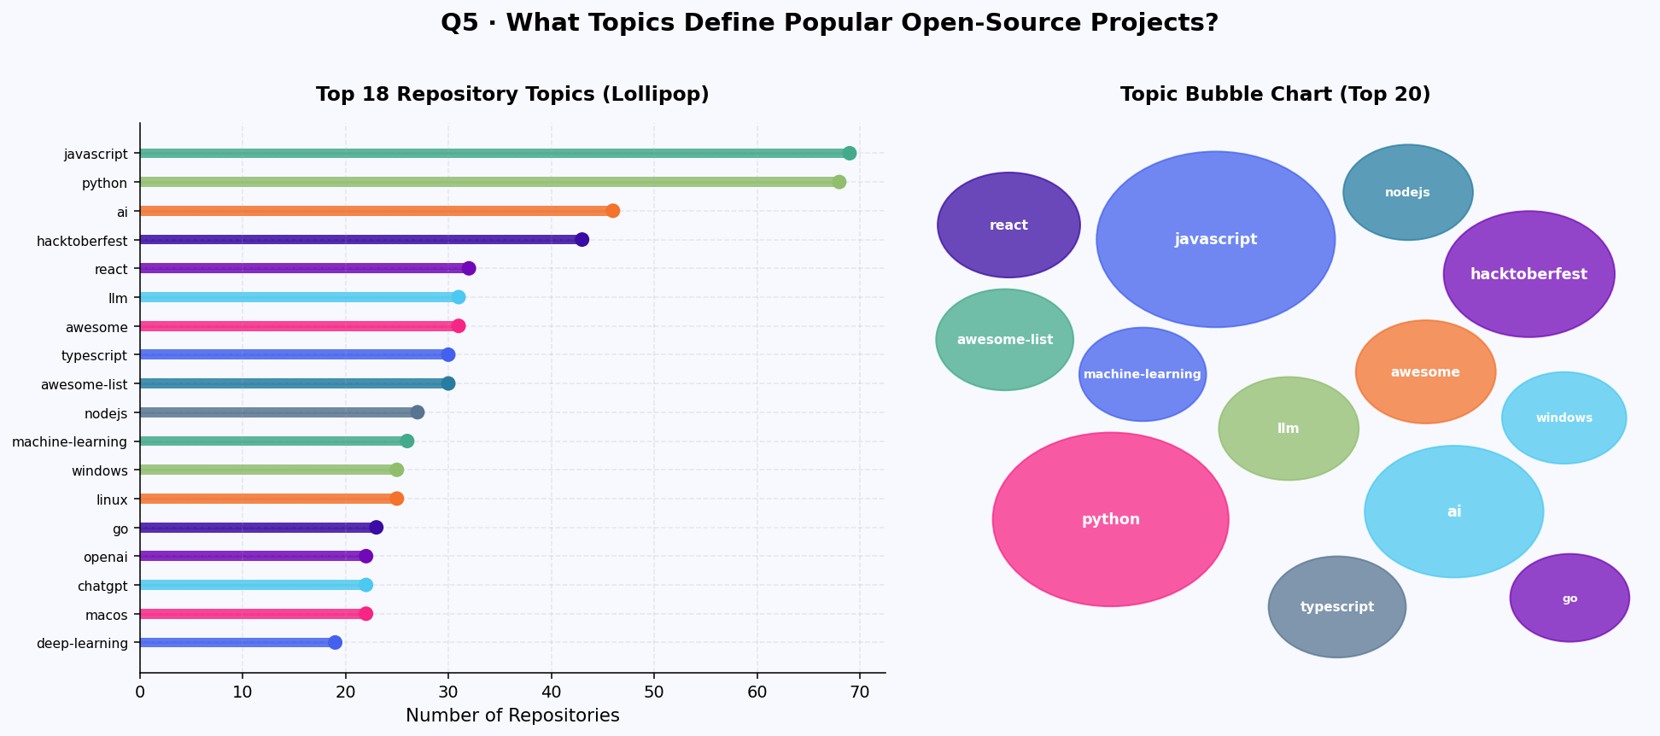
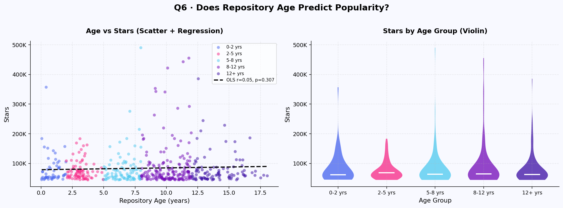
Q5 & Q6 · TOPICS · AGE VS POPULARITY
Topic Ecosystem · Does Age Predict Stars?
▶ Q5 — Topics
javascript & python top by volume. AI, llm, chatgpt are fastest-rising (2022–25 only). hacktoberfest in 43 repos shows event-driven culture. awesome-list repos have highest avg stars.
▶ Q6 — Age
Very weak positive regression (r ≈ 0.05–0.2, p < 0.05). 2–5 yr repos have widest spread. Repos under 2 yrs already at 44K+ stars — AI repos go viral in months bypassing age premium.

Slide 12
Q5 · TOPIC ECOSYSTEM
What topics define popular open-source projects?
▶ Key Finding
javascript (69) and python (68) top by count. AI, llm, chatgpt are exclusively 2022–25 topics — signalling a structural shift. hacktoberfest in 43 repos. awesome-list and machine-learning are the largest non-language bubbles — curation is valued.

Slide 13
Q6 · AGE VS POPULARITY
Does repository age predict star count?
▶ Key Finding
Statistically significant but weak (r ≈ 0.05–0.2, p < 0.05). 2–5 year repos show widest spread — era of creation matters more than raw age. Repos under 2 years old already hit 44K+ stars proving AI repos can bypass age premium entirely.

Slide 14
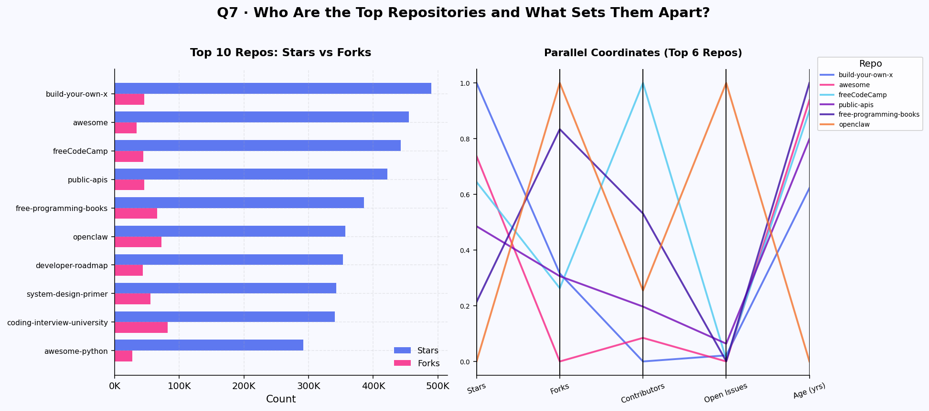
Q7 · TOP REPOSITORIES
Who are the top repositories?
▶ Key Finding
build-your-own-x leads at 490K stars — it is a documentation repo, not a framework. freeCodeCamp dominates in contributors (6,000+) and open issues. The top 10 is almost entirely educational/resource repos — content drives virality more than code quality.

Slide 15
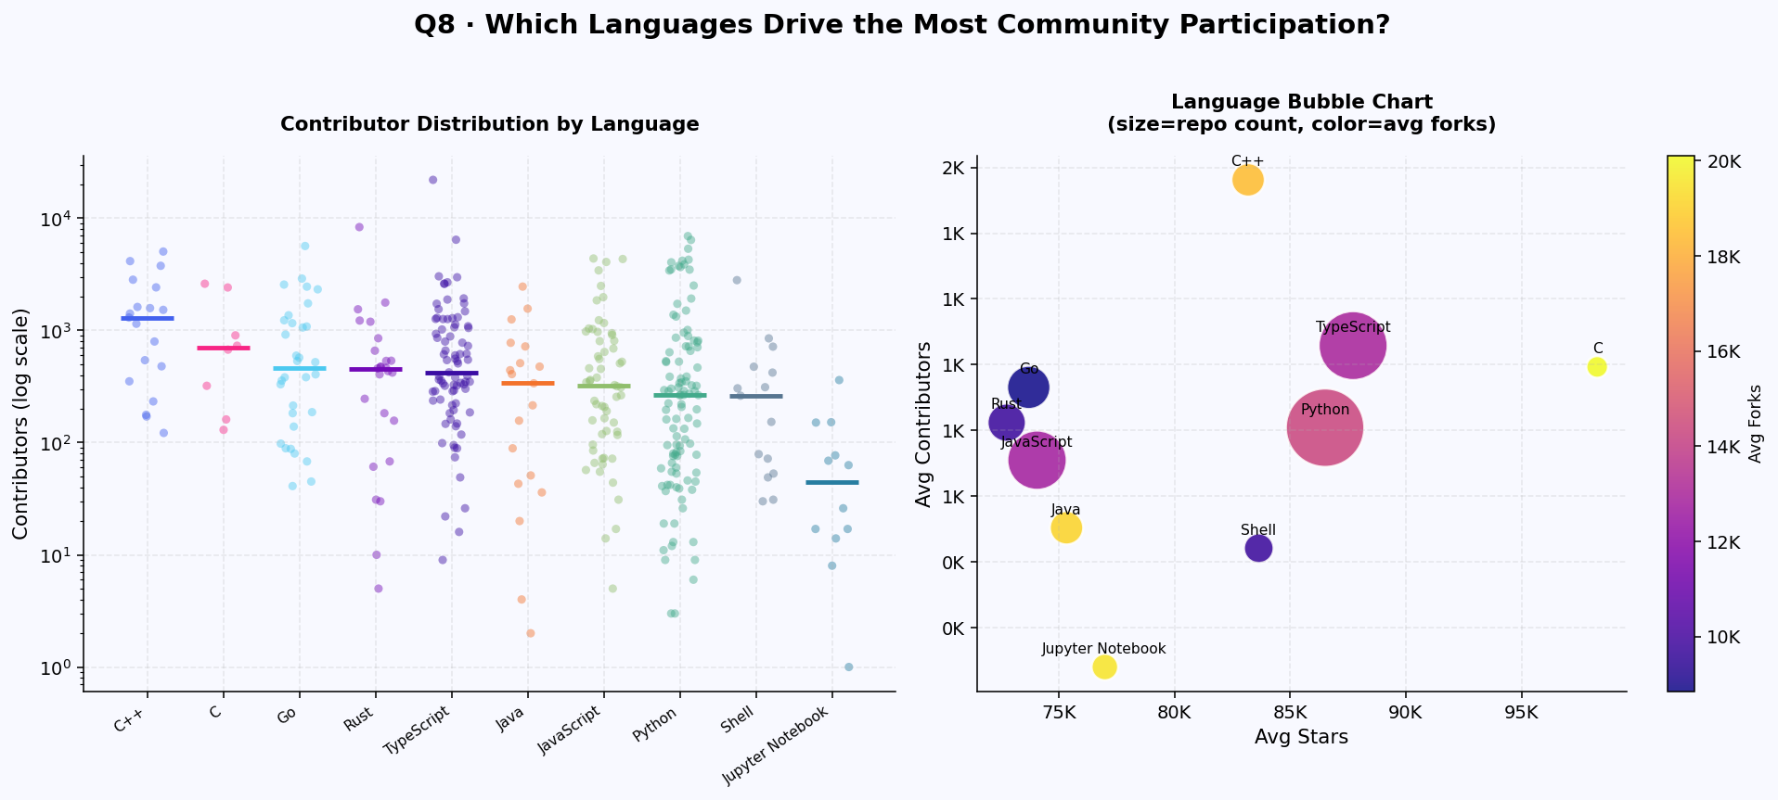
Q8 · COMMUNITY PARTICIPATION
Which languages drive community engagement?
▶ Key Finding
C++ and Go have the highest median contributors — deeply collaborative despite fewer repos. TypeScript is the most balanced: high stars AND contributors. JavaScript is wide but not deep. C/C++ repos are disproportionately forked — high downstream reuse.

Slide 16
04 VISUALIZATION
Interactive Dashboard — HTML
Dashboard Features
CHART TYPES USED
Log Histogram + KDE
Notched Boxplot + Strip
Single HTML file
Distribution
By Language
Zero install — double-click to open in any browser
Donut Chart
Diverging Bar
9 Sections
Language Share
Above/Below Median
One per research question + model section
Correlation Heatmap
Scatter + OLS
Click-to-zoom
Metric Relations
Stars vs Forks
Every chart opens in fullscreen lightbox
Area + Stacked Area
Heatmap
Reading progress bar
Temporal
Year × Language
Tracks scroll position across entire page
Lollipop Chart
Bubble Chart
Auto nav highlight
Topics
Topic/Language
Sidebar highlights current section while scrolling
Violin Plot
Parallel Coordinates
Key findings per chart
Age Groups
Top 6 Repos
Green insight boxes after every visualization
Dark terminal theme
GitHub-inspired #0a0e1a palette + monospace font

Slide 17
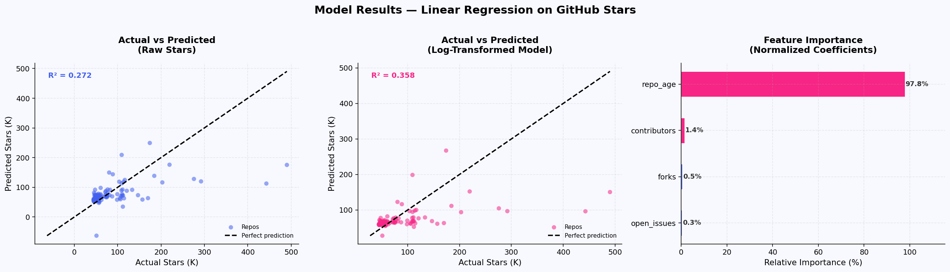
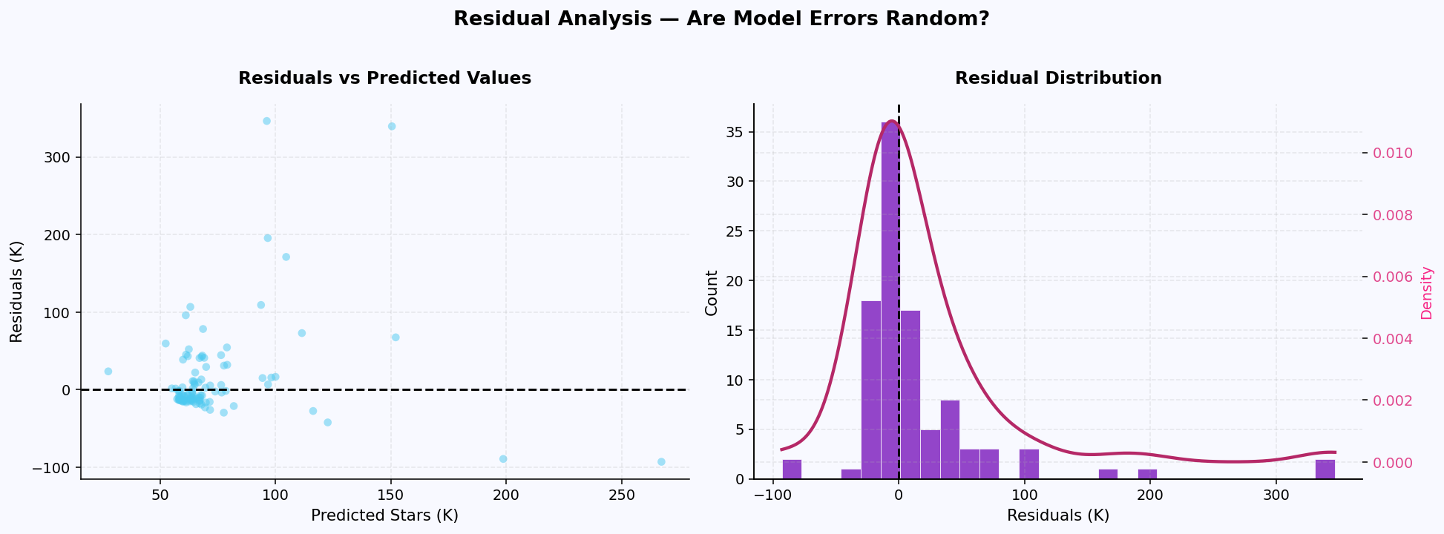
05 PREDICTIVE MODEL
Linear Regression — Predicting Star Count
Objective
0.272
0.358
Predict star count using measurable repository attributes. Two models trained: raw stars & log-transformed stars.
R² Raw
R² Log
Features Used
61K–64K
100 repos
forks — Strongest EDA signal (r=0.61)
RMSE
Test Set
contributors — Community size — 2nd predictor
open_issues — Activity proxy
repo_age — Time to accumulate stars
⚠ watchers excluded — r=1.0 with stars
(data leakage — GitHub counts them identically)

Slide 18






06 KEY INSIGHTS
What drives GitHub repository popularity?
Content over code
Forks signal popularity
The most-starred repos are documentation, tutorials, and curated lists — not frameworks. build-your-own-x (490K ⭐), awesome (455K), free-programming-books (385K).
Stars ↔ Forks r=0.61 is the strongest measurable signal. Forks indicate community engagement — a self-reinforcing discovery cycle.
AI era reset dynamics
Age is a weak predictor
AI/LLM repos created post-2022 can reach 44K+ stars within months. Era of creation now matters more than repository age.
r ≈ 0.05–0.2 — age alone explains almost nothing. Relevance, content type, and community momentum matter far more.
Community depth matters
Python leads, Go punches
C++ and Go have fewest repos but highest contributor depth. TypeScript is the most balanced language ecosystem.
Python at 23.8% share but Go & Rust score well above global median per repo — fewer but higher-quality community repos.

Slide 19
CONCLUSION
FUTURE WORK
Repository success
is driven by
community, not age.
Larger dataset
Expand to 5,000+ repos for better generalization
Advanced ML
Random Forest, Gradient Boosting — handle non-linearity
Engagement signals — forks, contributors, educational content — predict popularity far better than how long a repo has existed. The AI/LLM era has fundamentally reset growth dynamics.
Real-time tracking
Stream GitHub API to monitor trending repos live
Text analysis
Content drives virality more than code quality
README quality score, description sentiment analysis
AI/LLM repos go viral within months — era matters
Network analysis
Forks + contributors are the most actionable signals
Model repo-contributor collaboration graphs
Kushal Agarwal · B24DS012 · Data Analysis and Visualization

Slide 20
REFERENCES
References & Tools
[1]
GitHub REST API
docs.github.com/en/rest — /search/repositories endpoint used for data collection
[2]
Pandas
McKinney, W. (2010). Data Structures for Statistical Computing in Python. SciPy 2010.
[3]
Matplotlib
Hunter, J.D. (2007). Matplotlib: A 2D Graphics Environment. Computing in Science & Engineering.
[4]
Seaborn
Waskom, M. (2021). Seaborn: Statistical Data Visualization. JOSS, 6(60), 3021.
[5]
Scikit-learn
Pedregosa et al. (2011). Scikit-learn: Machine Learning in Python. JMLR, 12, 2825–2830.
[6]
Power-law paper
Clauset, A., Shalizi, C.R., Newman, M.E.J. (2009). Power-Law Distributions in Empirical Data. SIAM.
[7]
Social Coding paper
Dabbish, L. et al. (2012). Social Coding in GitHub: Transparency and Collaboration. CSCW 2012.
Dataset self-collected using GitHub REST API with Python requests library.

