Slide 1


Adidas Sales Analysis
By Kushal Babu S

Slide 2
Overview
An interactive dashboard to analyze Adidas US sales data.
Tracks sales trends, profit distribution, and product performance.
Provides region-wise and state-wise sales insights.
Helps identify top-performing retailers and products.

Slide 3
Objective
Analyze Adidas US sales trends and performance.
Understand profit and product-wise contributions.
Identify high and low-performing regions and retailers.
Enable better business decisions through visualization.

Slide 4
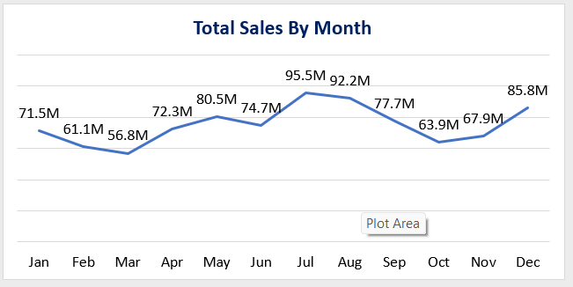
Sales By Month
The chart shows monthly sales trends, with sales rising from March and peaking in July, followed by a decline until October.
Sales recover towards the end of the year, ending with strong performance in December.

Slide 5
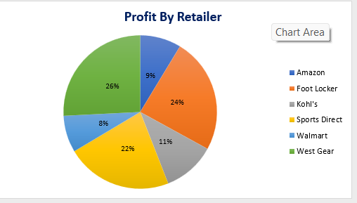
Profit By Retailers
West Gear contributes the highest share of profit (26%), followed by Foot Locker (24%) and Sports Direct (22%), while Amazon and Walmart account for the lowest profit shares.

Slide 6
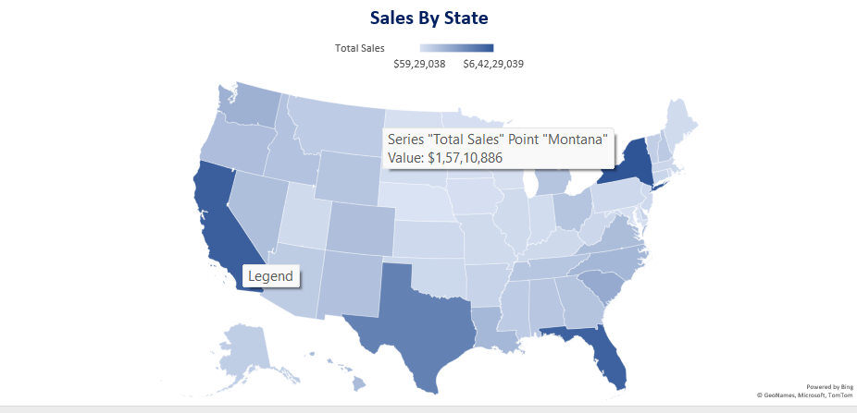
Sales By States
Sales show a strong geographical variation, with a few key states driving the majority of total sales, while most states contribute at a moderate to low level.

Slide 7
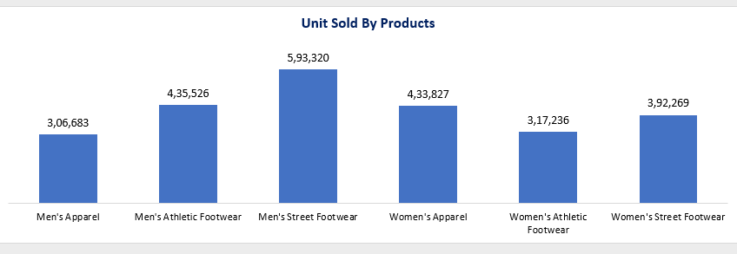
Unit Sold By Product
Men’s Street Footwear leads overall unit sales, with men’s footwear categories outperforming women’s segments, highlighting stronger demand in the men’s product line.

Slide 8
Tools Used
Microsoft Excel – Data cleaning, preprocessing, and analysis
Excel Pivot Tables & Pivot Charts – Aggregating sales, profit, and unit data
Excel Data Visualization Tools – Bar charts, pie charts, and filled map (state-wise sales)
Microsoft PowerPoint – Presenting insights and business analysis

Slide 9
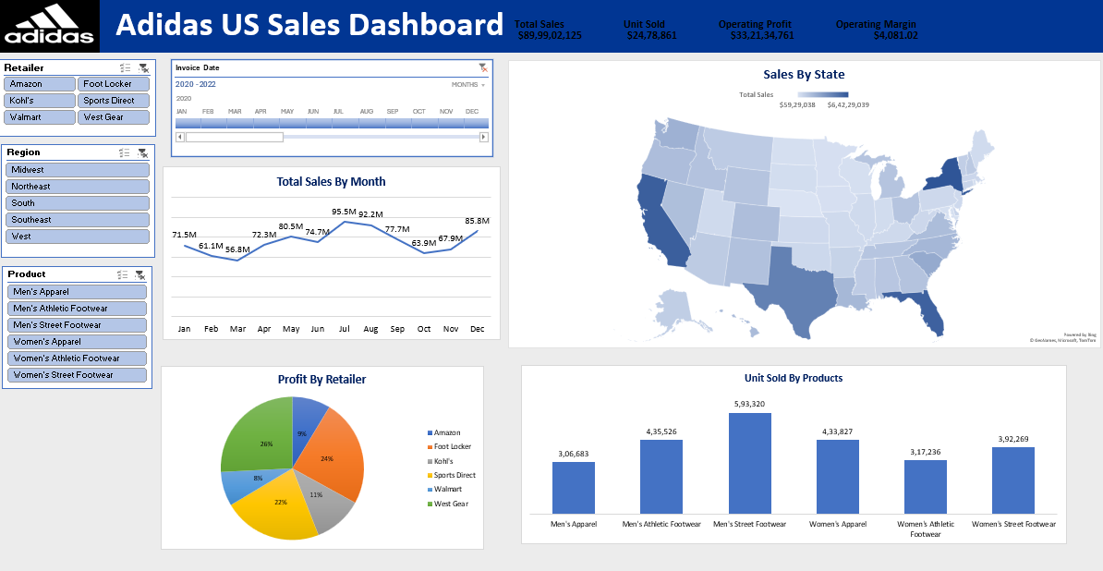
Dash Board

Slide 10
Insights
Seasonality: Sales rise from March, peak in July, dip till October, and rebound in December.
Top Retailers: West Gear, Foot Locker, and Sports Direct drive the majority of profits.
Regional Performance: Sales are concentrated in a few key states; most states show moderate to low sales.
Product Demand: Men’s Street Footwear leads unit sales; men’s categories outperform women’s.
Low Performers: Amazon, Walmart, and women’s athletic footwear show lower contribution.

Slide 11
Recommendation
Focus on Top Categories: Increase inventory and promotions for high-performing products like Men’s Street Footwear and Women’s Apparel.
Improve Low Performers: Boost Men’s Apparel and Women’s Athletic Footwear through targeted discounts and new designs.
Seasonal Inventory Planning: Align stock levels with peak demand months such as July and December.
Data-Driven Strategy: Use regional and customer insights to optimize pricing, placement, and promotions.

Slide 12
Conclusion
Adidas sales show strong seasonality, with peak performance in mid-year and year-end.
Profits are driven by a few key retailers and states, indicating concentrated performance.
Men’s Street Footwear is the top-performing category, while some segments remain underutilized.
Focusing on high-demand products, peak seasons, and improving low-performing channels can significantly enhance overall sales and profitability.

Slide 13
Thank You

