Slide 1







NEBULON '26
Round 2 PPT Submission
Team Name : Matrix
Problem Statement : PS1
Team Members : Ronit Roy
Darshan Warke
Kushal Bhoir
Product Name : SME Business Health & Insights Platform
NEBULON '26 | TRANSSTADIA INSTITUTE
Notes:
1.7.2013
1
‹#›

Slide 2
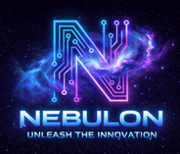
Problem Identified
The Inventory Guessing Game: Relying on "gut feeling" for inventory leads to wasted capital on overstocking or missed revenue from stockouts.
The Data Literacy Barrier: Owners lack the technical skills (e.g., SQL, Python) needed to extract quick, meaningful answers from their own raw sales data.
Dashboard Fatigue: Traditional software provides static charts and numbers, but fails to tell the business owner what actions to actually take to grow revenue.
NEBULON '26 | TRANSSTADIA INSTITUTE
Notes:
1.7.2013
4
‹#›

Slide 3
Solution / Approach
Predictive Inventory Forecasting (The ML Approach): We engineered a Machine Learning model that analyzes historical sales, weather, and promotions to mathematically predict exact future demand, completely eliminating the "inventory guessing game."
Conversational Data Agent (The Generative AI Approach): Powered by LangChain and Llama 3.1, our platform allows business owners to drag-and-drop raw CSV files and ask plain-English questions to get instant data analysis—bypassing the data literacy barrier with zero SQL or coding required.
Automated Actionable Strategy: Instead of stopping at static charts, our data pipeline feeds real-time dashboard metrics directly into our AI to instantly generate concrete, strategic business moves, curing "dashboard fatigue" by telling the owner exactly what to do next.
NEBULON '26 | TRANSSTADIA INSTITUTE
Notes:
1.7.2013
4
‹#›

Slide 4
Tech Stack
🌐 Client Layer (Frontend):
HTML5, CSS3, Vanilla JavaScript
Focus: Zero-dependency, lightning-fast UI.
⚙️ Core Engine (Backend):
Python & Flask (API Routing)
Pandas (Data Processing & KPI Extraction)
🧠 Intelligence Layer (AI & ML):
Machine Learning (Linear Regression Demand Modeling)
LangChain + NVIDIA Llama 3.1 NIM (Generative AI & Chat Agent)
NEBULON '26 | TRANSSTADIA INSTITUTE
Notes:
1.7.2013
4
‹#›

Slide 5
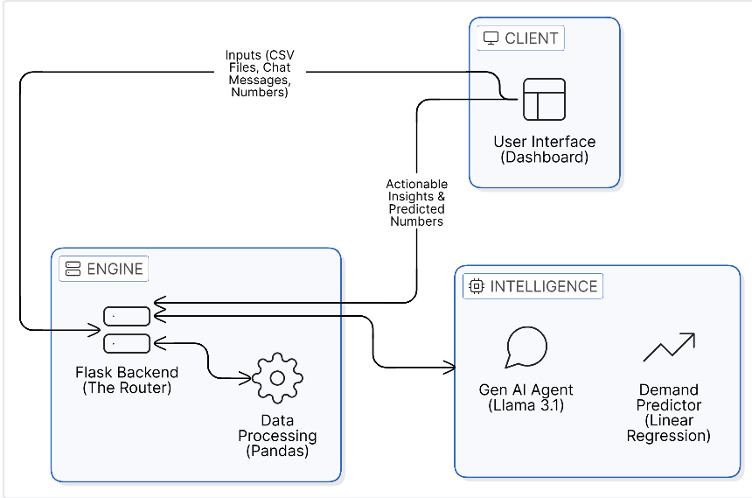
Workflow / Architecture
NEBULON '26 | TRANSSTADIA INSTITUTE
Notes:
1.7.2013
4
‹#›

Slide 6
Impact / Benefits
Better Decision-Making: Move from "gut feeling" to data-backed strategies using real-time dashboard analytics and AI-generated insights.
Improved Efficiency: Instantly identify top-performing products and sales trends, allowing owners to focus resources where they matter most.
Reduced Manual Work: Automation of data cleaning and KPI calculation eliminates hours of tedious spreadsheet management and manual entry.
Predictive Insights: Anticipate market shifts and customer demand using Machine Learning, shifting the business from reactive to proactive.
Affordable AI for SMEs: High-end data science capabilities (Llama 3.1 & Scikit-Learn) delivered in a cost-effective, accessible package for small business budgets.
NEBULON '26 | TRANSSTADIA INSTITUTE
Notes:
1.7.2013
4
‹#›

