Slide 1
Biztech Solutions Internship
Student Name: Kushal Navin Bhoir
Course Name: Data Analytics
Duration: 1 Month
Date: 16 Feb 2026

Slide 2
Introduction
Worked on real-world and gain real-world experience, improve your skills, and build your career foundation.
Objective: Data cleaning, analysis, Create new calculated column, EDA, create dashboard for visualization and Get some insights.
Learned Python, Data cleaning, EDA, Power BI

Slide 3
Project 1 (Overview)
Finance Analysis
Purpose of Project: Analyze global economic data using tools like Python and Power BI to identify meaningful patterns, trends, and insights that support data-driven decision-making.
Tools: Python, Pandas, seaborn, matplotlib, Power BI

Slide 4
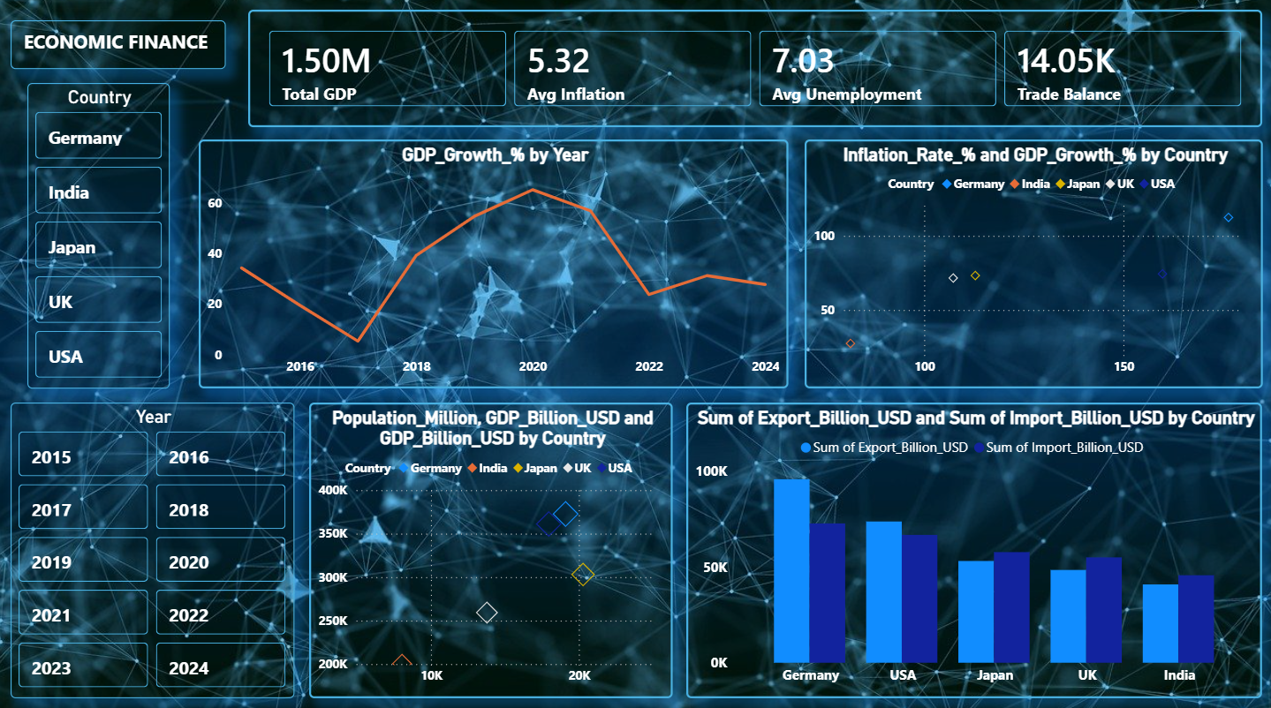
Project 1 (Working)
Finance Analysis
Steps of Project:
Load data
Analys data
Perform EDA
Create dashboard
Create New Columns
Features: Performed data cleaning, feature engineering, EDA, and built an interactive Power BI dashboard with KPIs and insights for economic analysis.
Output:

Slide 5
Project 2 (Overview)
Taxi Analysis
Purpose: Analyze cab trip data to extract meaningful insights that help improve business decisions and customer experience.
Tools: Python, Pandas, seaborn, matplotlib, Power BI

Slide 6
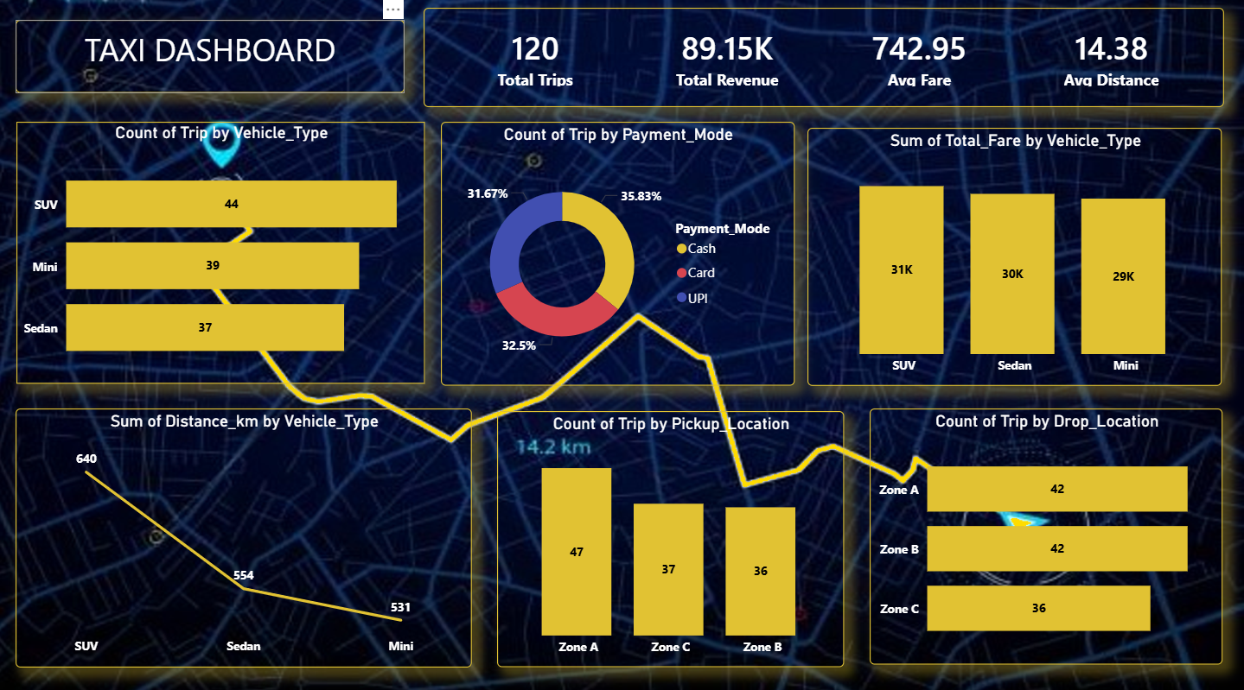
Project 2 (Working)
Taxi Analysis
Steps of Project:
Load data
Analys data
Perform EDA
Create dashboard
Create New Columns
Features: Performed data cleaning, feature engineering, EDA, and built an interactive Power BI dashboard to generate actionable insights from taxi data.
Output:

Slide 7
Project 3 (Overview)
Airline Analysis
Purpose of Project: Analyze airline flight data to identify patterns in flight delays, airline performance, and airport operations using data analysis techniques.
Tools: Python, Pandas, seaborn, matplotlib, Power BI

Slide 8
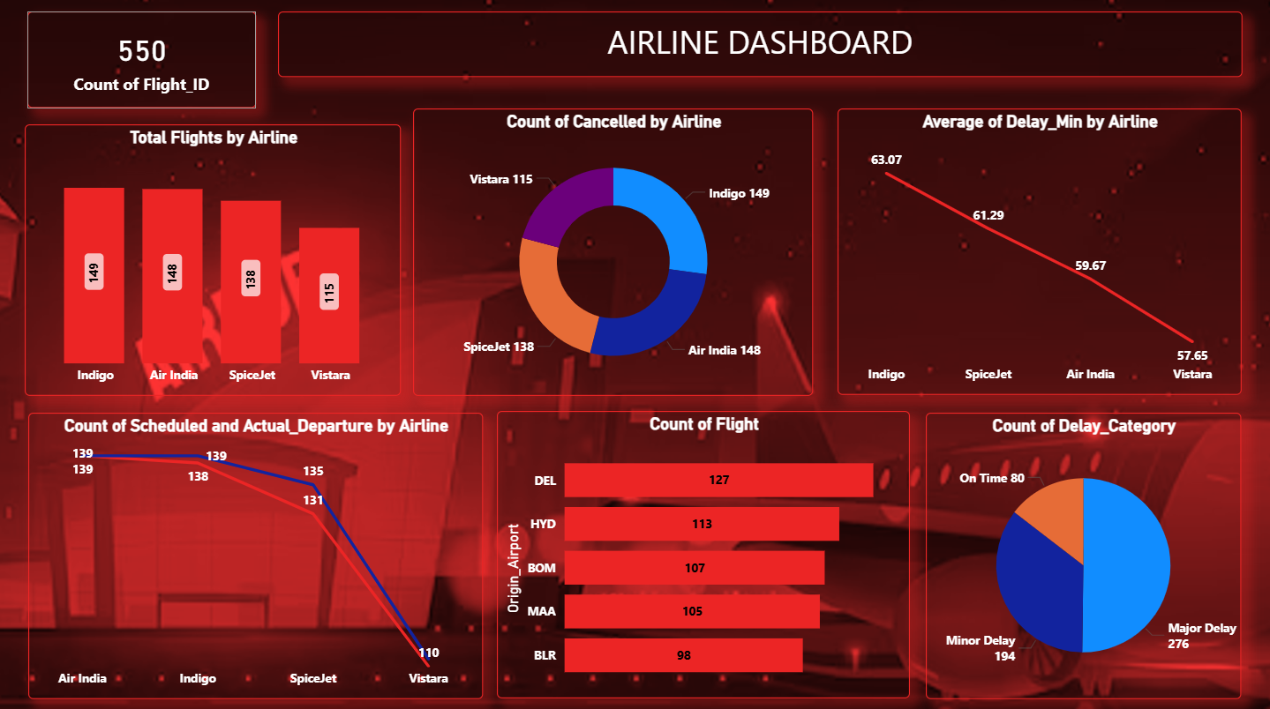
Project 3 (Working)
Airline Analysis
Steps of Project:
Load data
Analys data
Perform EDA
Create dashboard
Create New Columns
Features: Performed data cleaning, feature engineering, EDA, and built an interactive Power BI dashboard to analyze airline delays and performance.
Output:

Slide 9
Skills Learned
Technical: Excel, Python, Pandas, Numpy, seaborn, matplotlib, Power BI, EDA
Soft Skills: Communication, Problem Solving, presentation

Slide 10
Conclusion
Internship Experience: Gained hands-on experience in data analysis
What You Learned: Improved problem-solving skills,Understanding data, data cleaning, visualization
Future Benefits: Ready for real-world data analyst role

Slide 11
Thank You..
Kushal Bhoir

