Slide 1
Verified Fee Reconciliation: review and rebuild of the APM fee-matching requirement
Product Manager assignment, Intellipaat
Kushal Chakrabarty · 27 October 2026
Supporting documents: 2_PRD (PDF) · 3_Wireframes folder (workflow + 3 screens)
Notes:
Scope: gap review of the APM draft, handling of the nine sample records, solution and PRD, wireframes, engineering handoff, APM feedback, founder reporting.

Slide 2
10 of 12 gaps in the APM draft block engineering; most concern proof of payment and financial control
Business rules
User journeys
Technical and integration
BLOCKER "Paid" not defined; screenshots and counsellor entries treated as payment
BLOCKER No fee component order, overpayment or credit-balance rule
BLOCKER Only student upload defined; no Ops, Finance or approval journey
LATER Student cannot see pending vs verified or raise a mismatch
BLOCKER No bank / gateway / UPI feed; no source of truth for money received
BLOCKER System of record and sync with the student-management system undefined
Data accuracy and control
Exception handling
Usability and reporting
BLOCKER Name fallback allocates to the wrong student (shared surnames, parents paying)
BLOCKER Counsellors can edit payments and mark cash paid; no maker-checker or audit trail
BLOCKER No duplicate detection; P4 would be credited and receipted twice
BLOCKER Splits, partial payments, reversals, refunds and early payments not handled
LATER Dashboard lacks UTR, evidence status, fee component and age; no ageing or tie-out reports
BLOCKER "Eliminate manual reconciliation" and the 2-week estimate are not measurable or validated
Blocker: changes the data model or money rules; resolved in the PRD before build. Full table: PRD Appendix A.
Notes:
Most serious: a screenshot treated as payment, and name-based allocation. Both are resolved by D1 (bank feed is the only proof of payment) and D3 (auto-allocate only on an ID-grade identifier). The two non-blocking gaps can follow in a later release without rework.

Slide 3
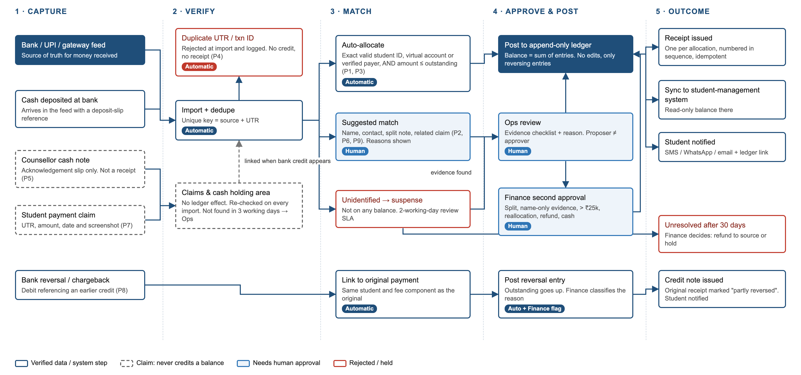
Payments are confirmed by the bank feed, then allocated, then receipted
Notes:
Claims (screenshots, cash notes) are held with no ledger effect and rechecked on every import. Duplicates are rejected at import. Auto-allocation requires an ID-grade identifier; everything else goes to review with an approver set by the evidence level. Reversals post as new entries with a credit note.

Slide 4
Of ₹1.4 lakh reported, ₹1 lakh is bank-confirmed and ₹25,000 posts automatically
Rec | Amount | Evidence | Result | Cannot yet conclude / note | Needed to allocate
P1 | ₹10,000 | Bank-confirmed | Allocated (auto) → S101 | Reference names S101; sender contact not needed | Nothing. Sender account offered for linking
P2 | ₹20,000 | Bank-confirmed | Suggested (Low) | Owner unknown; surname match to S102 only; may relate to claim P7 | Claim UTR = bank UTR, or payer confirmed as S102 guardian
P3 | ₹15,000 | Bank-confirmed | Allocated (auto) → S103 | Reference names S103 | Nothing
P4 | ₹10,000 | Same UTR as P1 | Duplicate | No new money; no ledger entry or receipt | Nothing; logged in import report
P5 | ₹10,000 | Counsellor report | Cash: Reported | Cash not shown to have reached the college | Deposit credit linked and verified by Finance
P6 | ₹30,000 | Bank-confirmed | Pending approval (split) | Split S101 ₹15k + S104 ₹15k per payer note; S101 overpayment to check | Finance approval; overpayment check
P7 | ₹20,000 | Screenshot only | Claim: Awaiting bank | No evidence money was paid; may be P2 | Readable UTR matching a credit; Ops after 3 working days
P8 | −₹5,000 | Bank debit | P3 partly reversed | S103 outstanding +₹5,000; credit note; reason unknown | Finance classifies reason
P9 | ₹25,000 | Bank-confirmed | Suggested (Medium) | Owner unknown; payer name equals S104 name | Student ID from payer, or payer confirmed by S104
₹1,00,000
₹25,000
₹75,000
₹40,000
bank-confirmed credits; ₹95,000 net of P8
posted automatically (P1, P3); P8 reversal also automatic
awaiting human decision (P2, P6, P9)
not bank-confirmed (P4, P5, P7); all credited under the APM draft
Preventing wrong balances and duplicate receipts: duplicate UTR rejected (FR-02) · only bank-confirmed credits post (BR1) · balances derived from append-only ledger (FR-23) · one receipt per allocation (FR-24) · maker-checker (BR8) · daily tie-out (FR-28)
Notes:
Controls against incorrect balances and duplicate receipts: duplicate rejection on source + UTR (FR-02); only bank-confirmed credits post (BR1-BR2); append-only ledger with derived balances (FR-23); one receipt per allocation (FR-24); maker-checker (BR8); overpayment hold (FR-10); daily tie-out (FR-28). P2 and P7 share amount and student; the system links them for review but does not treat them as the same payment.

Slide 5
Auto-allocation requires a bank-confirmed credit and an ID-grade identifier; all other cases go to review
Automatic
Approval matrix (proposer cannot approve, BR8)
Import and duplicate rejection (source + UTR)
Allocation: one student ID, virtual account or verified payer; amount ≤ outstanding
Reversal linked to original; credit note issued
Receipts, SMS sync, notifications, SLA escalation
Action | Proposes | Approves
Auto-allocation | System | Ops lead samples 5% daily
High confidence (e.g. claim UTR match), ≤ ₹25,000 | Ops executive | Ops lead
Medium / Low confidence, split, > ₹25,000 | Ops executive | Finance
Cash note → verified | Counsellor (note) | Finance, against deposit
Reallocation of posted payment | Ops / Finance | Finance (other user)
Refund | Finance | Finance head
Parameter or role change | Admin | Finance head
Balance or ledger edit | Not available | Not available
Manual review only
Name, contact or amount matches
Splits across students; overpayments
Cash, refunds, reallocations
Inactive or unregistered students
Rules: fee components paid in due-date order (BR5) · excess held as credit balance (BR6) · suspense SLA 2 working days, Finance decision at 30 days (BR10) · credits for unregistered students re-matched on registration (BR9). Edge cases: Appendix C.
Notes:
₹25,000, 5% and the SLA values are defaults in PRD section 7.3, pending Finance-head sign-off on 29 Oct. Auto-allocation of exact-UTR claims is a phase 2 option if the phase 1 sampling error rate is below 0.5%.

Slide 6
Phase 1 covers intake, matching, approvals and the ledger; phase 2 targets pre-identified payments
User | Responsibilities in the system
Student | Views ledger; submits UTR and screenshot; raises mismatch; downloads receipts
Counsellor | Creates cash notes; submits claims for assigned students. No allocation or approval
Operations | Works suspense queue; proposes allocations; Ops lead approves High-confidence items
Finance | Verifies cash; approves high-risk allocations, reallocations, refunds; daily tie-out
Admin | Users, roles, parameters (with approval); audit export. No ledger access
Phase 1
Feed intake, duplicate rejection, matching rules
Claims, cash notes, reversals, refunds, approvals
Ledger, receipts, SMS sync, notifications, audit, reports
Phase 2
Per-student virtual account / payment link (founder decision)
Screenshot OCR; accounting export; payer self-registration
Success metrics (baselines from last term, week 1)
Unverified credits: 0 · duplicate receipts: 0
Auto-allocation rate ≥ 60% of bank credits
≥ 90% of suspense items resolved within 2 working days
Import-to-receipt ≤ 1 hour (P90) · mismatch tickets −50%
Notes:
Out of scope: fee structures, scholarships, online checkout, replacing the SMS or accounting system. Delivery estimate to come from engineering after the walkthrough; the APM's 2-week figure covered only a dashboard.

Slide 7
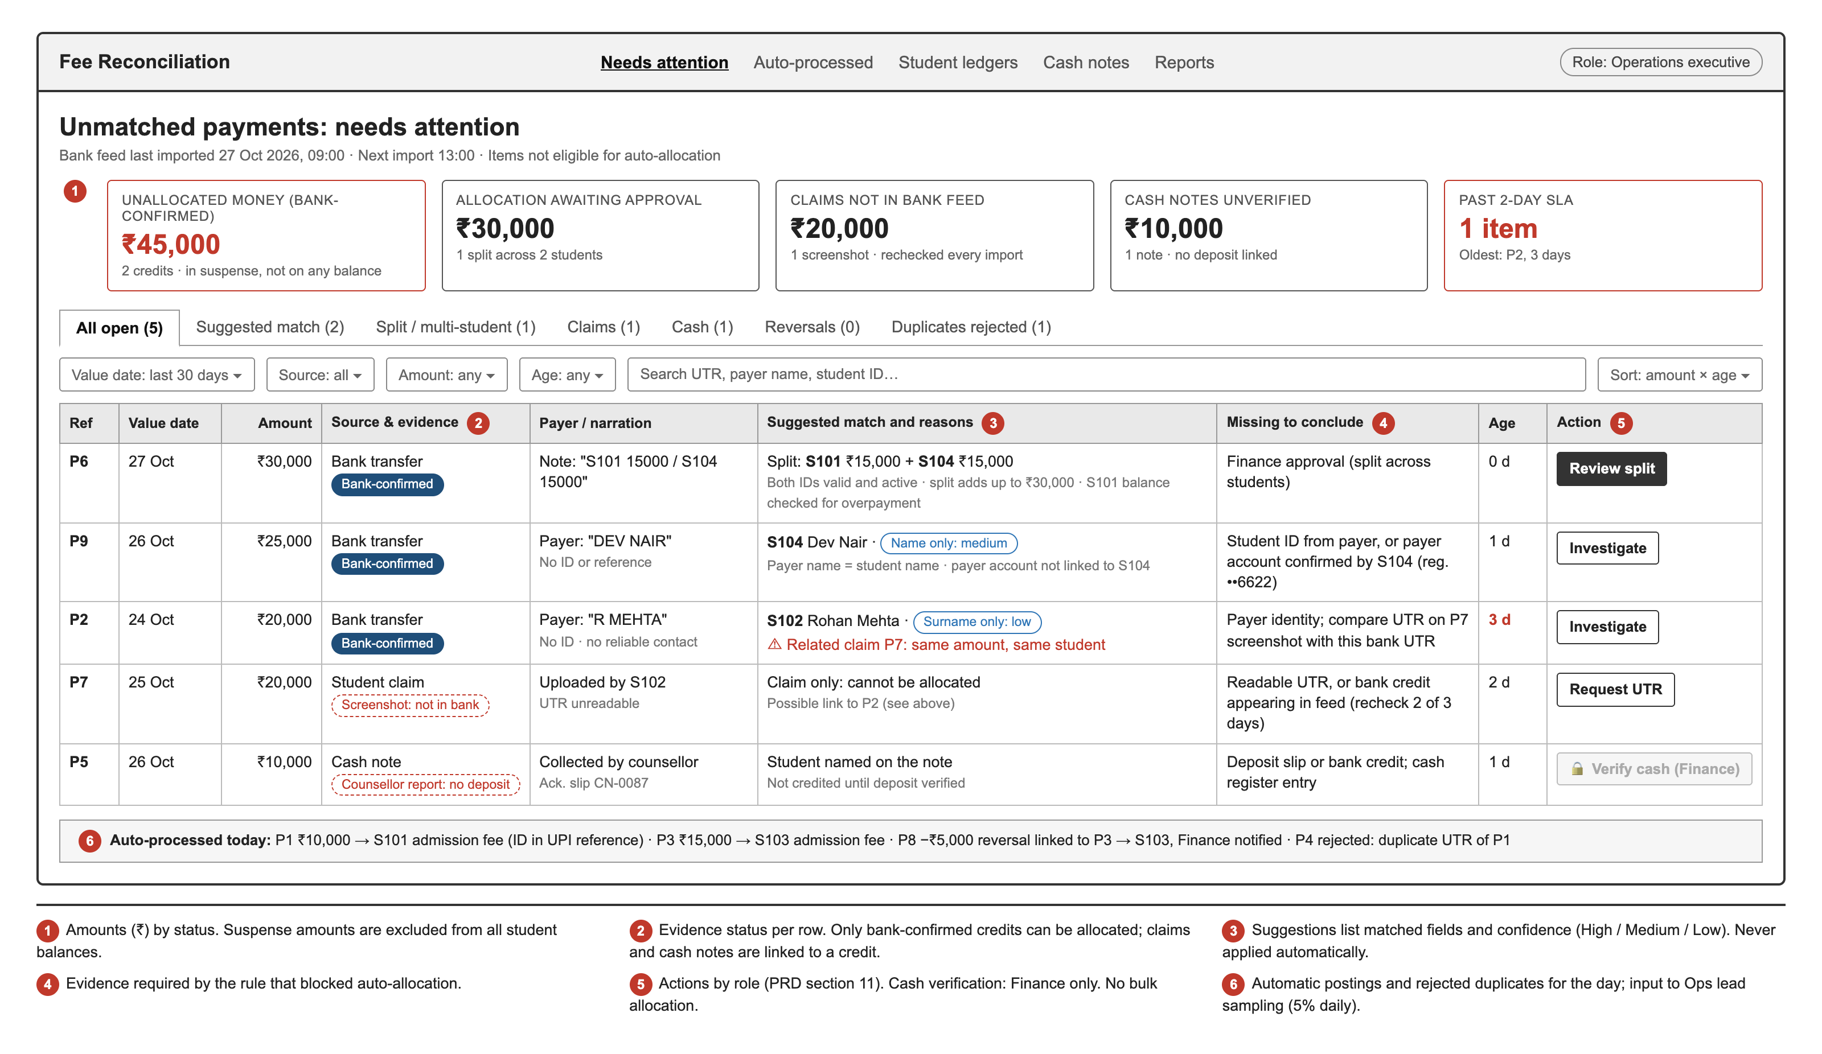
Screen 1: the unmatched payment dashboard ranks suspense items by amount and age and lists missing evidence
Tiles show amounts (₹) by status
Evidence status on every row
Suggestions show reasons and confidence; no auto-apply
"Missing to conclude" column per item
Role-based actions; no bulk allocation
Notes:
Rows P6, P9, P2, P7, P5 are the sample records that cannot post automatically. The bottom strip lists automatic postings (P1, P3, P8) and the rejected duplicate (P4) for Ops lead sampling.

Slide 8
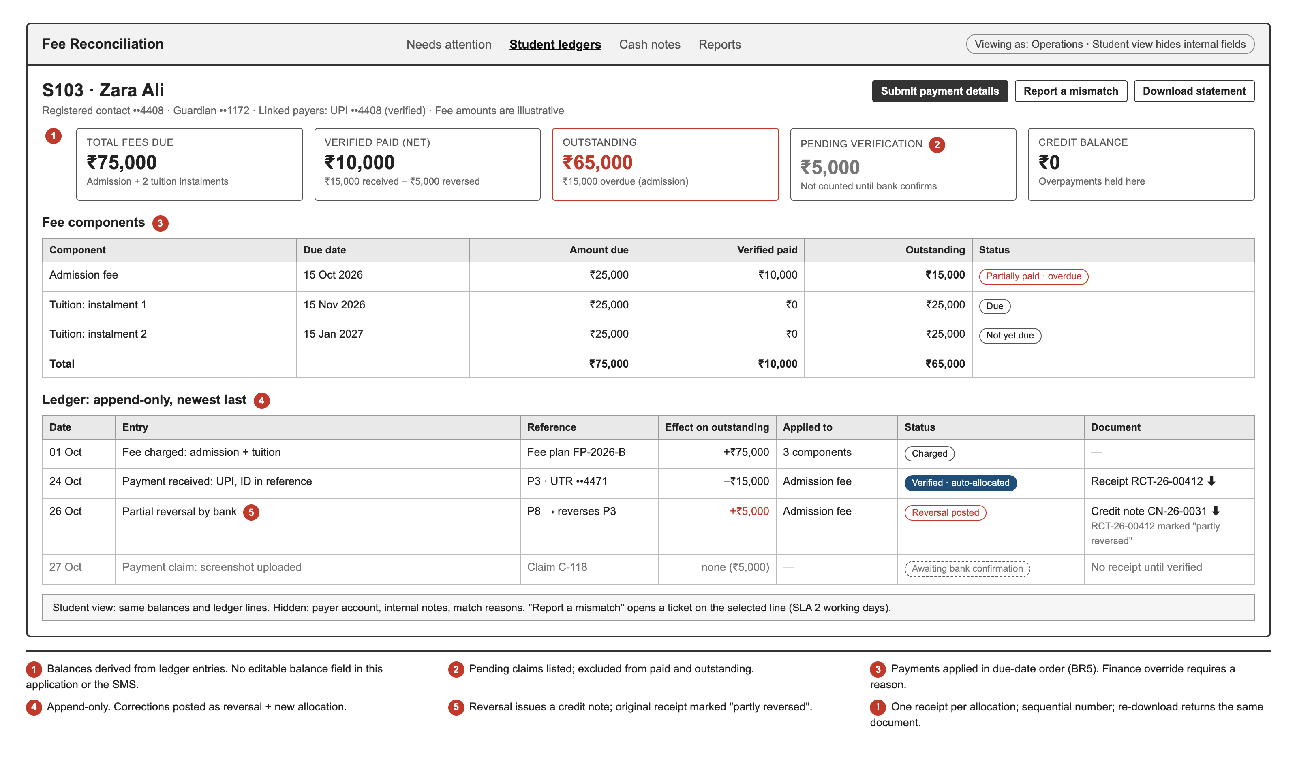
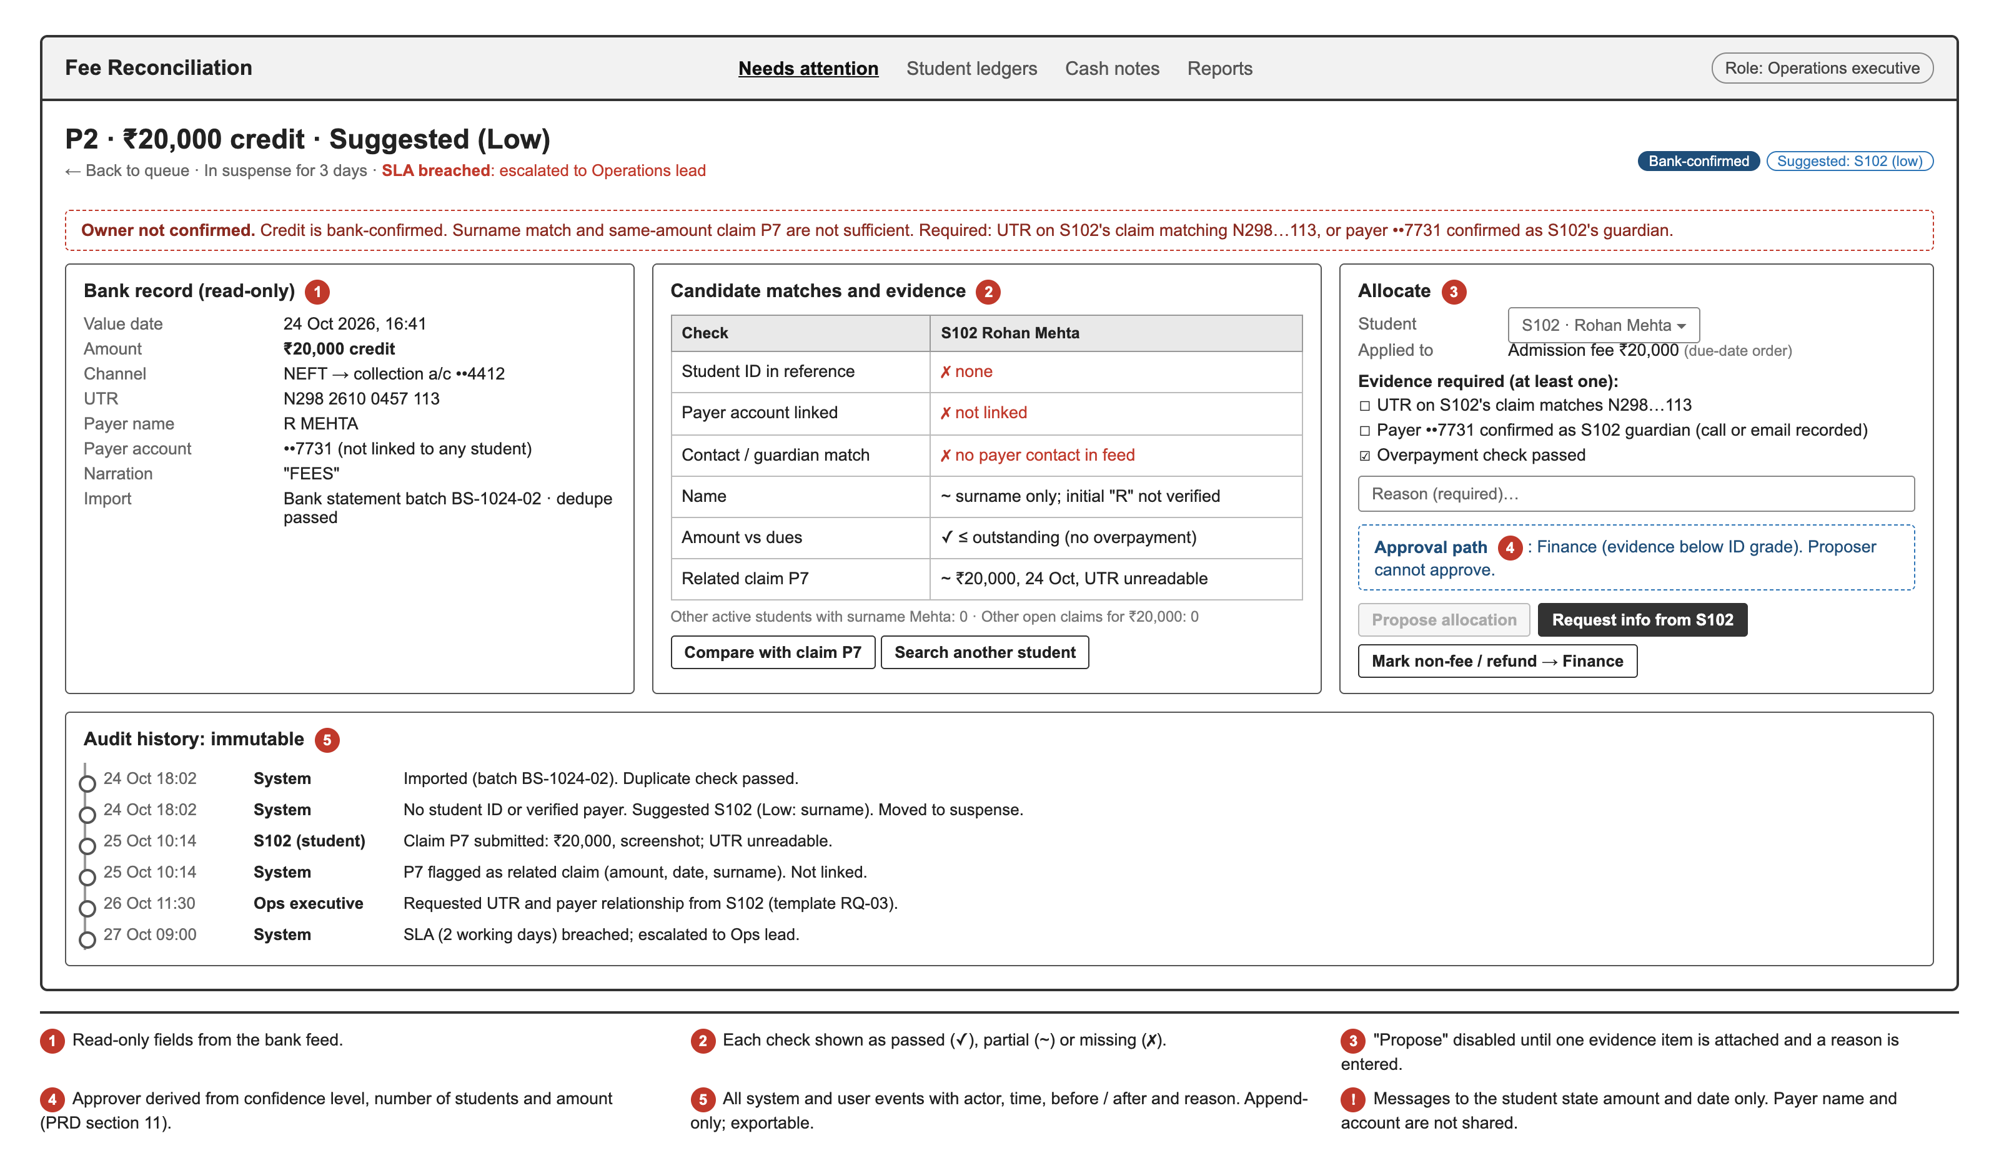
Screens 2 and 3: the fee ledger and reconciliation detail link each entry to a bank record and audit history
Student Fee Ledger (S103). Balance derived from entries; pending claim excluded from totals; reversal posted with its own credit note.
Reconciliation Detail (P2). Bank record read-only; evidence checklist; "Propose" disabled until complete; approval path shown; audit history.
Full-size wireframes: 3_Wireframes folder and PRD section 12
Notes:
S103 shows a verified payment, a reversal and a pending claim together. P2 has a confirmed credit with no confirmed owner and a related screenshot claim.

Slide 9
Engineering handoff: five open questions; release gated on 14 acceptance criteria and a 2-week parallel run
Questions for engineering
Dependencies
Release criteria
Q1 Which feeds are available, how often, and which fields (UTR, payer account, narration) are reliable?
Q2 Can the SMS accept balance updates by API and lock manual balance edits?
Q3 How is one payment in both gateway and bank feeds recognised as one?
Q4 Can fee components and due dates be read per student?
Q5 How are ledger and audit records protected from edits, and receipt numbers kept sequential?
Bank / gateway feed access (Finance); fallback: statement file
SMS API (engineering / vendor)
Opening balances tied out (Finance)
Notification templates (APM, Ops)
Parameter sign-off (Finance head, 29 Oct)
All High-priority requirements built
AC1–AC14 and 12 test scenarios pass, including T-SAMPLE
Parallel run: no unexplained difference
Permission tests pass for every role
Training, runbook, rollback plan
Notes:
PM owns product behaviour and acceptance; engineering owns implementation, reviewed jointly. Details: PRD sections 15 and 16.

Slide 10
APM feedback: five corrections, four tasks returned, three decisions kept by the PM
Strengths
Corrections
PM-owned decisions
Correct problem selection
Covered cash and manual fallback
Included student self-service and receipts
Screenshot is evidence, not payment
No allocation on name
Separate recording from approval; add audit
Define duplicates, splits, reversals, refunds
Replace "eliminate reconciliation in 2 weeks" with metrics
Evidence standard and approval matrix (with Finance)
Phase 1 scope
System of record (with engineering)
Returned to APM
Pre-engineering checks
Development plan
Write T-SAMPLE expected results independently
Shadow Ops for a day; collect baselines
Draft notification templates
Validate data fields against the SMS
Finance sign-off on rules
Every AC testable
Sample walkthrough reproduced by a second person
Open items have owner and date
Failure-mode note per rule before review
Weekly 30-min spec review against a checklist
APM leads next engineering walkthrough
Notes:
Full feedback: PRD Appendix B.

Slide 11
Founder update format: status, progress, risks and two decisions due 6 Nov
Monday update · week of 26 Oct · Verified Fee Reconciliation · Status: on track for engineering kickoff 3 Nov
Completed
Pending
Decisions made
Risks
Readiness
APM draft review (12 gaps)
PRD v1.0 and 3 wireframes
Sample data walkthrough
Parameter sign-off (Wed)
Bank feed field list (Thu)
Notification templates (Fri)
Bank feed is sole proof of payment
No allocation on name
Finance verifies cash
Bank API lead time unknown
SMS API may need vendor work
Opening-balance migration
14 AC, 12 test scenarios written
2-week parallel run planned
Release checklist agreed
Founder decisions
Pursue per-student virtual accounts / payment links with bank or gateway (phase 2). Due 6 Nov.
Approve refund to source for suspense credits unresolved at 30 days. Due 6 Nov.
Notes:
Sent Monday and Thursday. Parameters, screens and test plans are settled by PM and Finance and reported, not escalated.

Slide 12
Appendix A: acceptance criteria
ID | Criterion
AC1 | Credit with one active student ID, amount ≤ outstanding → allocated, posted, receipted within 15 min, no human step
AC2 | Existing source + UTR → no ledger entry, no receipt; logged as duplicate
AC3 | Claim or cash note without linked bank credit → paid / outstanding unchanged; no receipt
AC4 | Claim UTR + amount match an unallocated credit → linked; allocation proposed; Ops lead approval
AC5 | Unlinked claim after 3 working days of imports → Not found; assigned to Ops
AC6 | Medium / Low suggestion → cannot post without Finance approval
AC7 | Split lines ≠ credit amount → proposal blocked, difference shown
AC8 | Debit referencing a posted credit → reversal on same student and component; credit note; receipt marked; Finance flag
AC9 | Proposer attempts approval → rejected by server; logged
AC10 | Displayed or synced balance = sum of ledger entries; no UI or API sets it
AC11 | Create / approve / reverse / parameter change → audit record (actor, time, before / after, reason), not editable
AC12 | Credit above outstanding → excess held as credit balance; Finance task
AC13 | Credit for unregistered ID → re-matched and allocated when the student record is created
AC14 | Receipt re-downloaded → same number and document

Slide 13
Appendix B: test scenarios
ID | Type | Scenario | Expected result
T-SAMPLE | Fixture | Load P1–P9 and S101–S104 with test fee components | Results match the nine-record table (PRD section 9)
T1 | Normal | Import P1 | S101 admission −₹10,000; receipt; notification
T2 | Normal | Ops proposes P6 split; Finance approves | Two allocations, two receipts; S101 overpayment check
T3 | Normal | Student submits claim with P9's UTR as S104 | Linked; High confidence; Ops lead approves; receipt
T4 | Exception | Import P4; re-import the full statement | No new entries; duplicates logged
T5 | Exception | P7 with no matching credit for 3 working days | No balance change; Not found; assigned to Ops
T6 | Exception | Counsellor attempts to mark P5 paid | Not possible; cash note only; Finance verifies against deposit
T7 | Exception | P8 after P3 receipt issued | Reversal; credit note; S103 outstanding +₹5,000
T8 | Exception | Ops executive proposes P2 → S102 and approves it | Approval rejected; Finance required
T9 | Exception | Two approvers act on the same item at once | One allocation; second user sees conflict
T10 | Exception | Reallocate a posted payment | Reversal + new allocation; receipts replaced; both students notified
T11 | Exception | Feed down for 24 hours | Banner shown; claims not moved to Not found

Slide 14
Appendix C: edge cases
Case | Behaviour
Overpayment | Excess held as credit balance; Finance applies to next instalment or refunds (BR6)
One transfer, 3+ students | Split flow; valid ID per line; total must match (BR7)
Payment before registration | Suspense, "pending registration"; re-matched on record creation (BR9)
Withdrawn / inactive student | No auto-allocation; routed to Finance (BR4)
Feed late or missing | Banner; claim Not-found transitions paused
Case | Behaviour
Student disputes a decision | Mismatch ticket on the ledger line; 2-working-day SLA (FR-30)
Payer types wrong valid ID | Auto-allocated; student notified; corrected by reallocation (FR-25)
Same amount and day, different UTR | Flagged "possible duplicate"; not rejected (FR-03)
Cash not deposited in 2 working days | Escalated to Finance head; counsellor's new notes blocked (FR-19)
Refund after receipt | Posted on bank debit; credit note; receipt marked (FR-22)

Slide 15
Appendix D: release checklist
Functional
Finance
All High-priority requirements built
AC1–AC14, T-SAMPLE and T1–T11 pass in staging
Student view hides payer details
Rules and parameters signed off
Opening balances tied out
2-week parallel run: no unexplained difference
Controls
Operations
Permission tests pass for every role
Ledger and audit records cannot be edited
Feed and sync failure alerts active
Ops and Finance trained
Notification templates approved
Runbook, support owner, rollback plan

