Slide 1
Introduction to Hbase Schema Design
CS 839 - NoSQL Systems Class Presentation
Amandeep Khurana
Kushal Dasari, IMT2021035, IIIT Bangalore
ScaDS.ai Lab

Slide 2
Background
The number of applications that are being developed to work with large amounts of data has been growing rapidly in the recent past
To support this new breed of applications , several new data management systems have been developed, Apache HBase is one such system.
Some call this the big data revolution.

Slide 3
Introduction to HBase
It is an open source distributed database, modeled around Google Bigtable.
It suitable for applications that need fast random access to large amounts of data. It is built atop Apache Hadoop and is tightly integrated with it.
HBase is very different from traditional relational databases like MySQL, PostgreSQL, Oracle, etc. in how it’s architected and the features that it provides to the applications using it.

Slide 4
HBase trades off some of these features for scalability and a flexible schema. This also translates into HBase having a very different data model.
I will introduce you to the basics of HBase table design by explaining the data model.

Slide 5
HBase Data Model
it’s a sparse, distributed, persistent multidimensional sorted map, which is indexed by a row key, column key, and a timestamp.
The easiest way to describe HBase’s data model is in the form of tables, consisting of rows and columns. This is likely what you are familiar with in relational databases.
I’ll define some concepts that I’ll later use:
Table: HBase organizes data into tables, Table names are Strings.
Row: Within a table, data is stored according to its row. Rows are identified uniquely by their row key. Row keys do not have a data type and are always treated as a byte[ ] (byte array).
Byte array representation This representation is flexible and can accommodate various types of data, including text, numbers, or binary data.

Slide 6
Column Family: Data within rows in HBase is organized into column families, which also dictate the physical storage arrangement, Column families must be predetermined and are not readily modifiable, they are consistent across all rows in a table.
Column Qualifier: Data within a column family is addressed via its column qualifier. Column qualifiers need not be consistent between rows. Like row keys, column qualifiers do not have a data type and are always treated as a byte[ ].
Cell: A combination of row key, column family, and column qualifier uniquely identifies a cell.
Timestamp: Values within a cell are versioned. Versions are identified by their version number, which by default is the timestamp of when the cell was written. If a timestamp is not specified during a write, the current timestamp is used. If the timestamp is not specified for a read, the latest one is returned. The number of cell value versions retained by HBase is configured for each column family. The default number of cell versions is three.

Slide 7
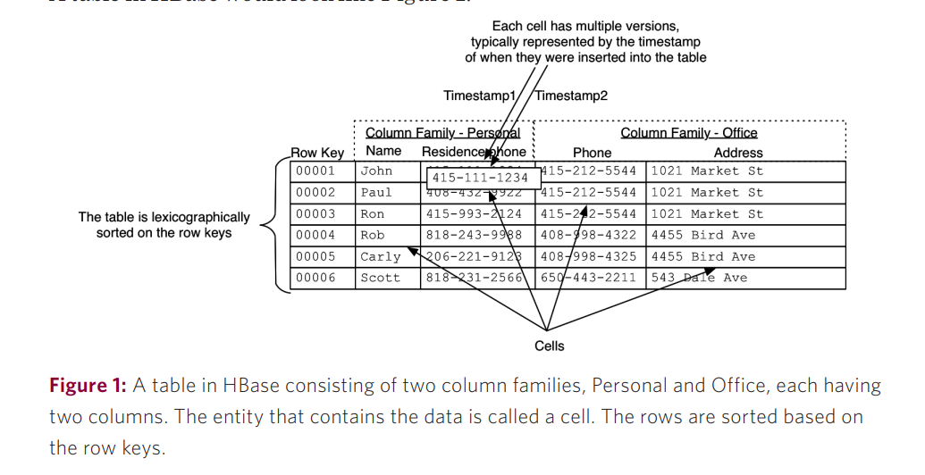
A table in HBase would look like this:

Slide 8
HBase exposes its functionality to clients through an API detailing three primary methods for data manipulation: Get, Put, and Scan.
Get: This method is used to retrieve data from HBase for a specific row. It requires the client to provide the row key corresponding to the desired data. Essentially, it allows clients to fetch the contents of a specific row.
Put: Put method is employed to insert or update data in a specific row. Similar to the Get method, it also requires the client to provide the row key, along with the data to be inserted or updated.
Scan: The Scan method enables clients to retrieve data over a range of rows. This range can be defined by specifying start and stop row keys, allowing clients to fetch data within a specific interval of rows. Alternatively, if no start and stop row keys are defined, the Scan operation scans the entire table, enabling clients to retrieve data from the entire dataset.

Slide 9
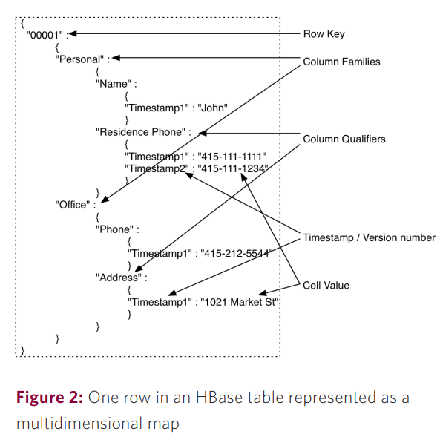
Sometimes, it’s easier to understand the data model as a multidimensional map.
The row key maps to a list of column families
column families map to a list of column qualifiers. which map
to a list of timestamps, each of which map to a value.
In HBase, row keys serve a similar purpose to primary keys
in relational databases. Once an HBase table is set up, you cannot
alter which column serves as the row key.
Example:
In other words, the column Name in the Personal column family
cannot be chosen to become the row key after the data has been
put into the table

Slide 10
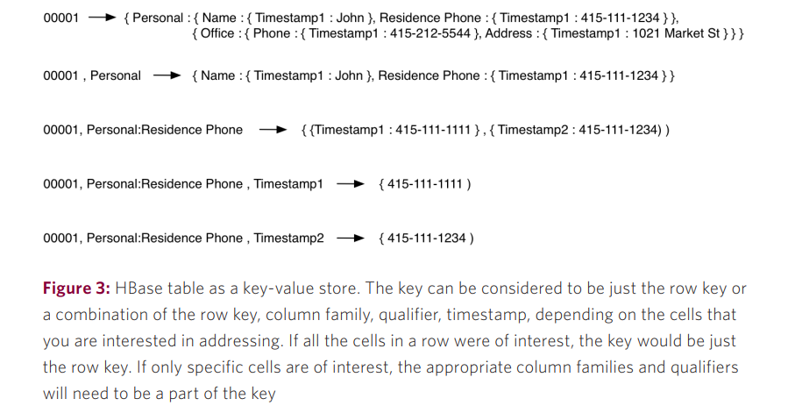
Key-value Representation
There are various ways of describing this data model. You can view the same thing as a key-value store.

Slide 11
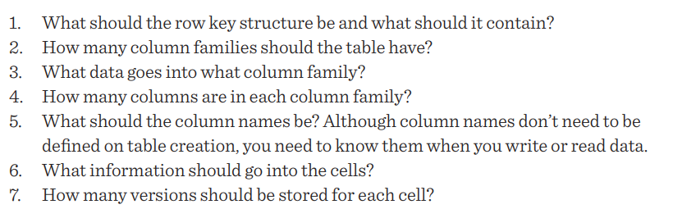
HBase Table Design
Designing HBase tables can be defined as answering the following questions in the context of a use case:
The most important thing to define in HBase tables is the row-key structure. In order to define that effectively, it is important to define the access patterns (read as well as write) up front.

Slide 12
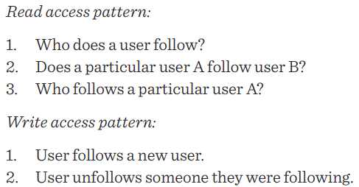
Example- Twitter
Let’s try to model the Twitter relationships (users following other users) in HBase tables.
The first step in starting to model tables is to define the access pattern of the application. In the context of follower-followed relationships for an application like Twitter, the access pattern can be defined as follows:
Let’s consider a few table design options and look at their pros and cons.

Slide 13
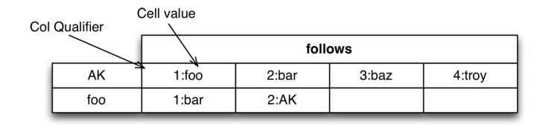
Consider the table stores a list of users being followed by a particular user in a single row, where the row key is the user ID of the follower user and each column contains the user ID of the user being followed.
This table design works well for the first read pattern that was outlined.
It also solves the second one, but it’s likely to be expensive if the list of users being followed is large and will require iterating through the entire list to answer that question.
Adding users is slightly tricky in this design. There is no counter being kept so there’s no way for you to find out which number the next user should be given unless you read the entire row back before adding a user. That’s expensive

Slide 14
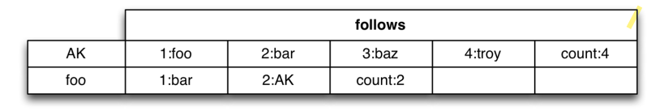
A possible solution is to just keep a counter then and the table will now look like this.
Unfollowing users is still tricky since you have to read the entire row to find out which column you need to delete.
It also isn’t ideal for the counts since unfollowing will lead to holes.
The steps to add users in this scheme are shown in this table.

Slide 15
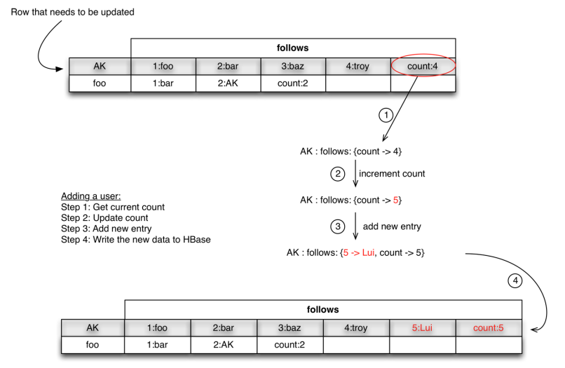

Slide 16
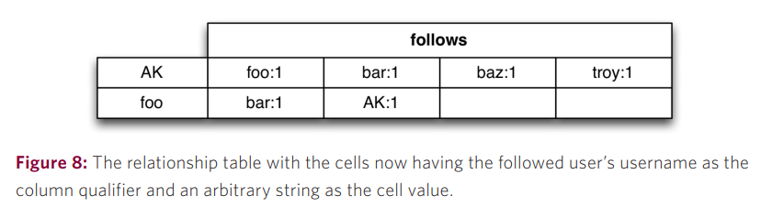
One of the properties that I mentioned earlier was that the column qualifiers are dynamic and are stored as byte[ ] just like the cells. That gives you the ability to put arbitrary data in them, which might come to your rescue in this design.
Consider this table. In this design, the count is not required, so the addition of users becomes less complicated. The unfollowing is also simplified. The cells in this case contain just some arbitrary small value and are of no consequence.
The only problem left is : who follows a particular user?? you need to do a full table scan to answer this question to overcome this problem there are two solutions:-

Slide 17
Maintain Another Table (Reverse List): The first solution involves creating another table dedicated to maintaining the reverse list of users who follow a particular user. In this table, each row would represent a user being followed, and the columns would contain the user IDs of those who follow them. This allows for efficient lookup of followers for a specific user without the need for a full table scan.
Persist Information in the Same Table with Different Row Keys: The second solution suggests persisting the reverse list information within the same table but with different row keys. This involves storing the follower-followed relationships in a separate section of the table, possibly with different row keys that enable efficient retrieval of followers for a specific user.
There are also further optimizations possible in the current table structure. Consider this table:

Slide 18
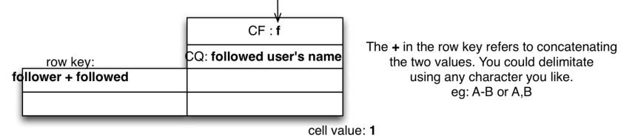
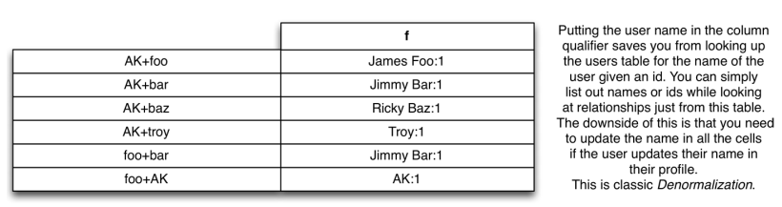
The row key now contains the follower and followed user.
Getting a list of followed users now becomes a short Scan instead of a Get operation. There is little performance impact of that as Gets are internally implemented as Scans of length 1.
Unfollowing, and answering the question “Does A follow B?” become simple delete and get operations, respectively.
Notice that the row key length is variable across the table.

Slide 19
The variation can make it difficult to reason about performance since the data being transferred for every call to the table is variable
Solution Using Hash Values: The proposed solution involves using hash values of individual user IDs to achieve consistent row key lengths. Instead of directly concatenating user IDs, each user ID is hashed individually, resulting in fixed-length hash values.
Consistent Row Key Lengths: By concatenating the hashed values instead of the original user IDs, the resulting row key lengths become consistent. This ensures that the amount of data transferred for each table call remains predictable, simplifying performance analysis.
Querying with Hash Digests: When querying the table, the user IDs are hashed again to generate hash digest values. These hash digest values are used to query the table, ensuring consistent row key lengths and facilitating efficient data retrieval
The final table look like this!!

Slide 20
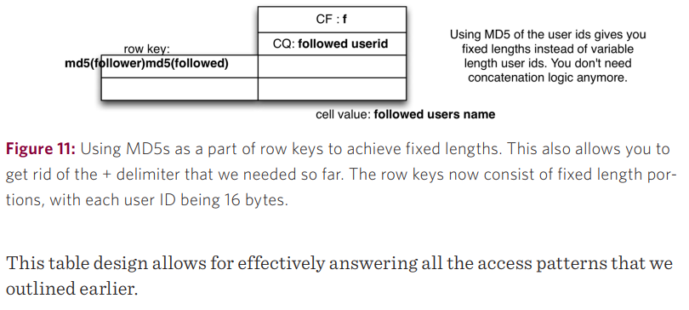

Slide 21
Summary
Row Keys:Crucial for table design and application interaction , and Determine performance capabilities.
Table Flexibility:Store data in byte[] format, providing versatility.
Column Family Organization: Group data with similar access patterns in the same column family.
Indexing: Done only for row keys, utilize for efficient data retrieval.
Table Structure: Consider trade-offs between tall and wide tables for atomicity and simplicity.
Hashing: Enables fixed-length keys and better distribution, sacrificing key ordering.
Column Qualifiers:Column qualifiers can be used to store data.
Column Family Length:The length of the column family name impacts the size of data sent over the wire
to the client (in Key Value objects). Be concise.

Slide 22
Thank You

