Slide 1
RE Report
Predicting Quantum state of a qubit
Coding phase
Kushal Dasari(IMT2021035)
Karthikeya(IMT2021504)
Asrith(IMT2021509)

Slide 2
Description of all files
dataloder.py:it basically splits the data into training and validation.
ed_quantum.py:- it creates the data,it takes input as Qubit number,measurement,sample number and file name.
Data format:result = ([meas_res1, meas_res2, output], [states_in1, states_in2], [fixed_states_in1, fixed_states_in2])
training data: 95000 samples
validation data: 5000 samples
io.py:-contains the data paths and file paths formats which can be used used commonly for all other files.
model.py:-it contains functions to train,test and run the data.
1_qubit_tomography.py: Script for analysing the quantum state of a single qubit using tomography techniques.
2_qubit_tomography.py: Script for analysing the quantum state of a two-qubit system using tomography techniques.

Slide 3
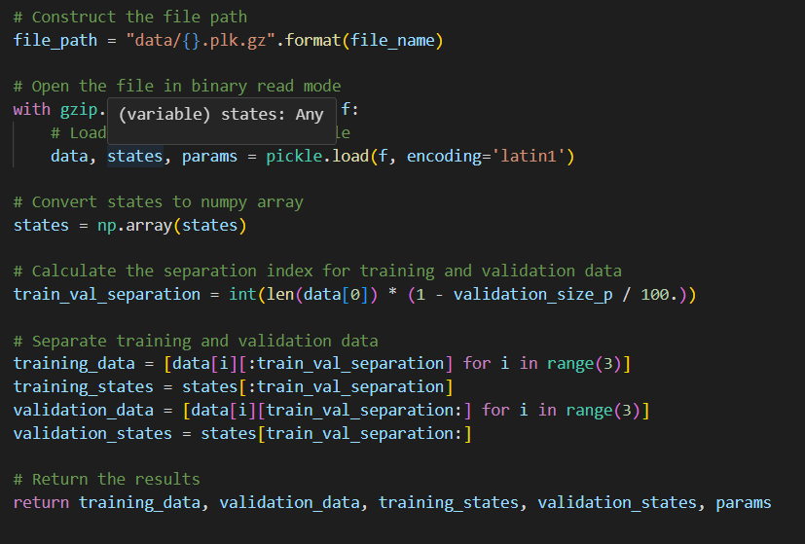
Data_loder.py
Load the data file and open the file in read mode.
Splitting the data into training and validation data.

Slide 4
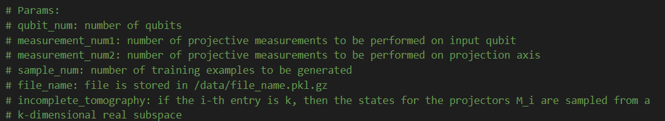
Ed_quantum.py: For creation of the data synthetic
Inputs to be given for creating the data

Slide 5
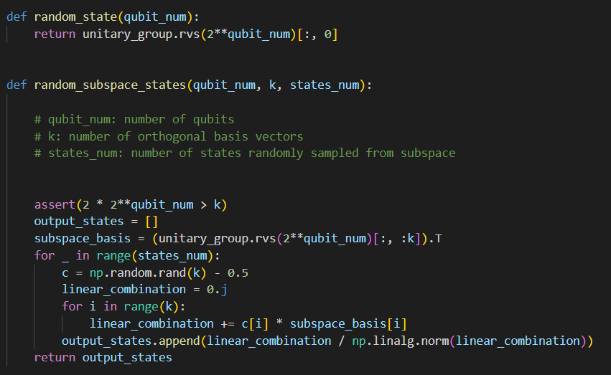
Quantum State Generation: The code provides functions (random_state and random_subspace_states) to generate random quantum states,
random_state generates a random quantum state for a given number of qubits,
random_subspace_states generates random states from a k-dimensional subspace of the full Hilbert space.

Slide 6
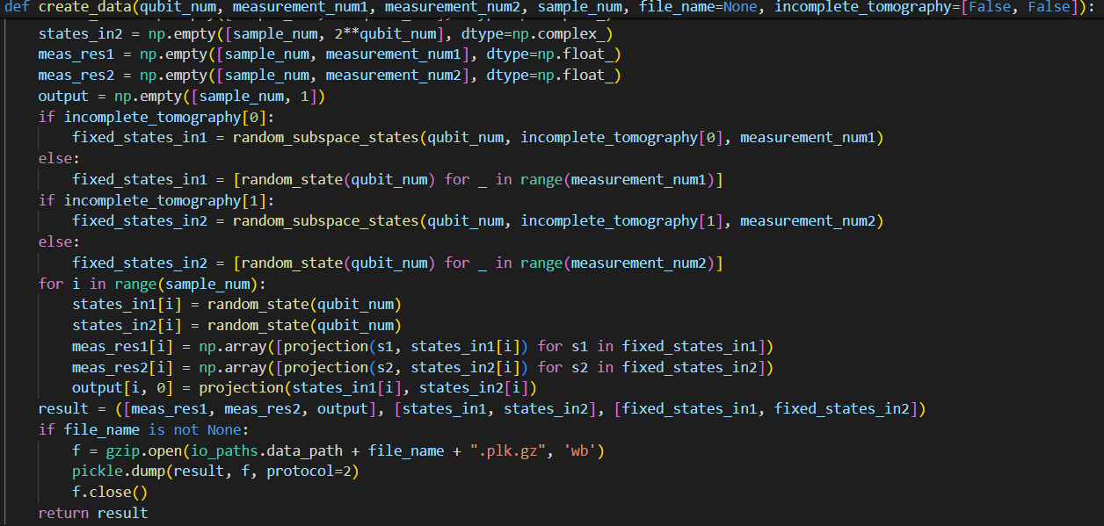
Data Generation Framework:
This function serves is used to generating synthetic data for training quantum information processing models.
It allows customization of parameters such as the number of qubits, the number of measurements, and whether to perform incomplete tomography.
By generating random input states, performing measurements, and calculating output labels, this function provides a comprehensive dataset for training quantum models.
After creating data we are storing this data in our local system.

Slide 7
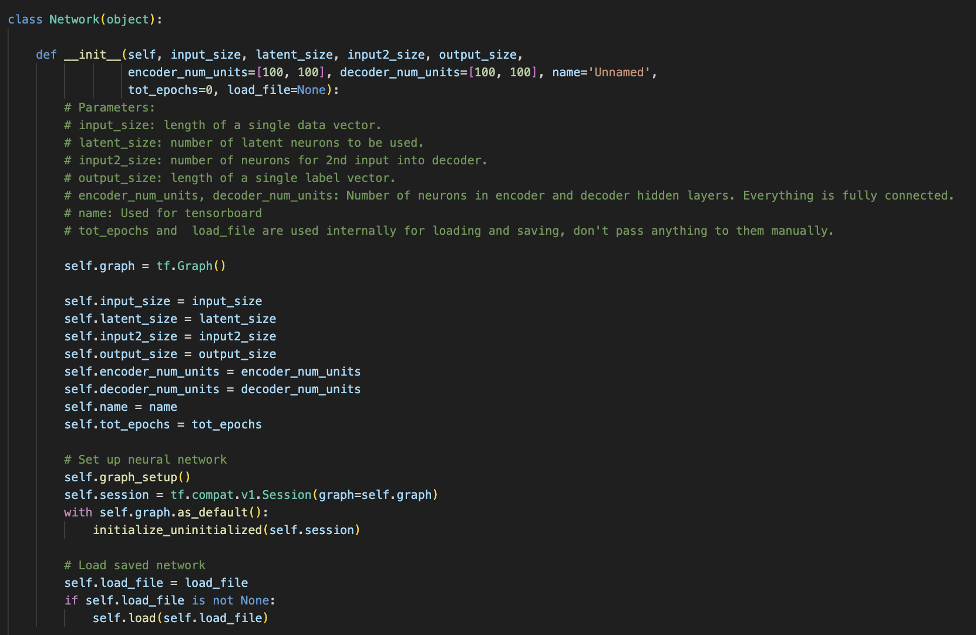
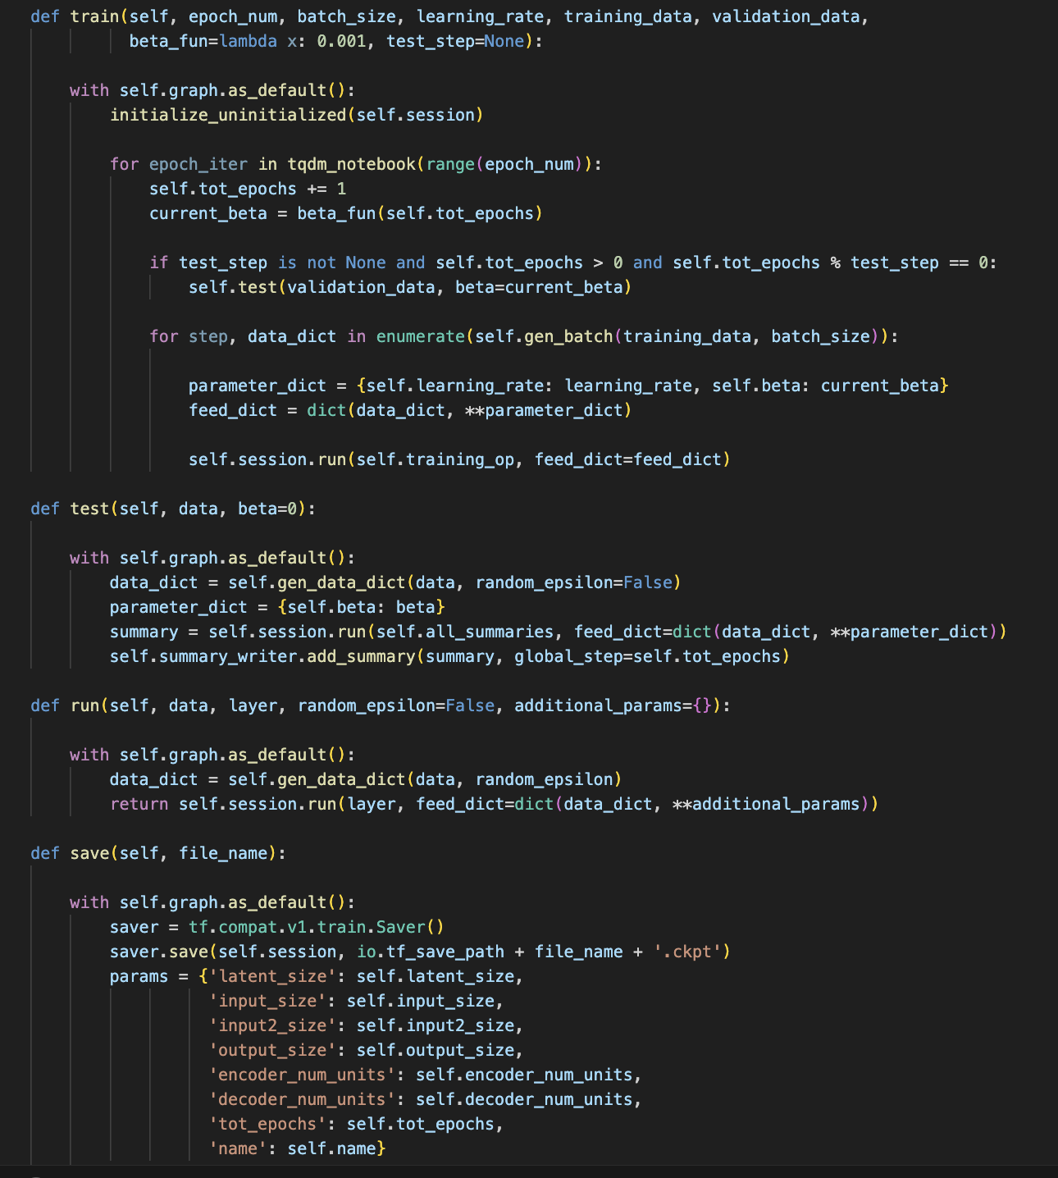
model.py:
train:
Trains the neural network for a specified number of epochs using provided training data. It updates the network parameters using backpropagation.
Test:
Evaluates the performance of the trained model on validation data.
run:
Executes the trained model on new data for inference.
save:
Saves the trained model parameters and configuration to disk.
from_saved:
Initializes a new network from saved data.
Initializes the neural network with parameters such as input size, latent size, input2 size, output size, etc.

Slide 8
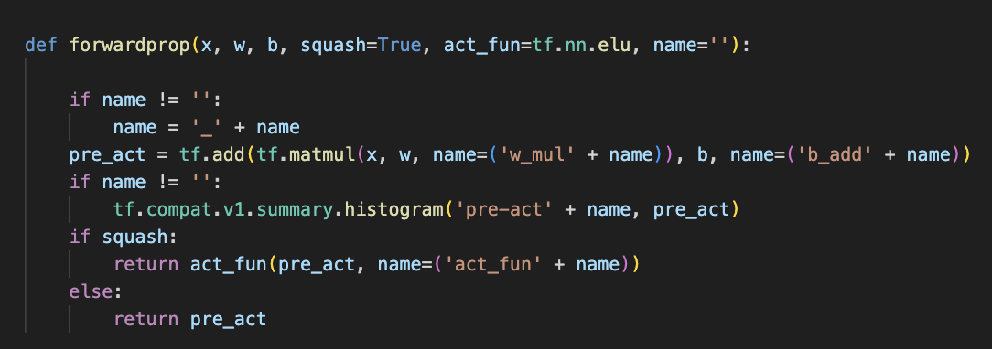
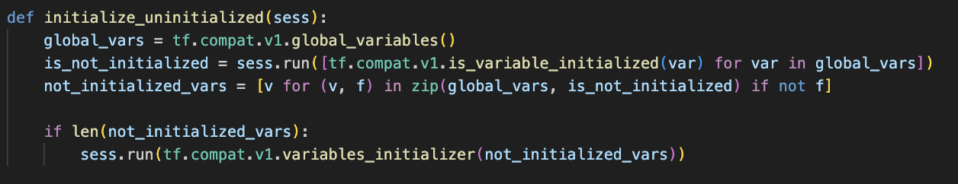
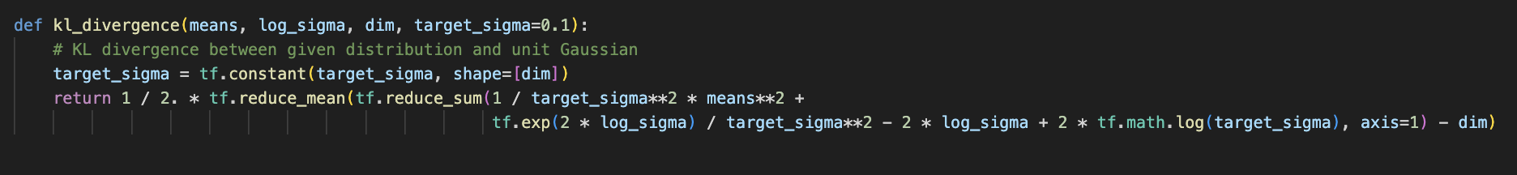
This function implements the forward propagation step of a neural network layer.
If squash is set to True, it applies the activation function; otherwise, it returns the pre-activation output.
This function initializes any uninitialized variables within a TensorFlow session.
This function calculates the Kullback-Leibler (KL) divergence between a given distribution (characterized by means and log of standard deviation) and a unit Gaussian distribution.
It computes the KL divergence for each sample in the batch and then averages them.

Slide 9
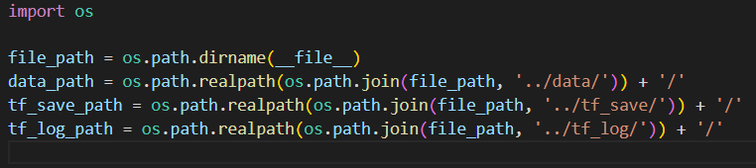
IO.py contains input and data paths
It stores the data that we created earlier in the local system
It also stores the saved model in tf_save .(pre-trained model)
We can directly access the data that we created and the model that we constructed directly by doing this.

Slide 10
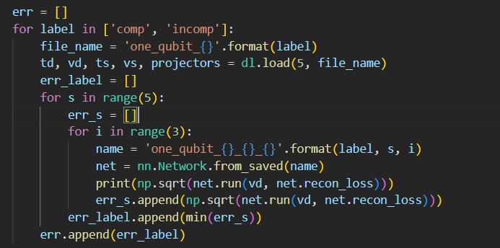
1_qubit_tomography.py: for predicting the optimal latent neurons
It basically iterate all the data files that we created and split the data into training and validation using data_loader.py code.
After it loads the pre-trained model, It then evaluates this on validation data (vd) using the net.run method, specifically calculating the square root of the reconstruction loss (net.recon_loss). The result of this evaluation is printed .

Slide 11
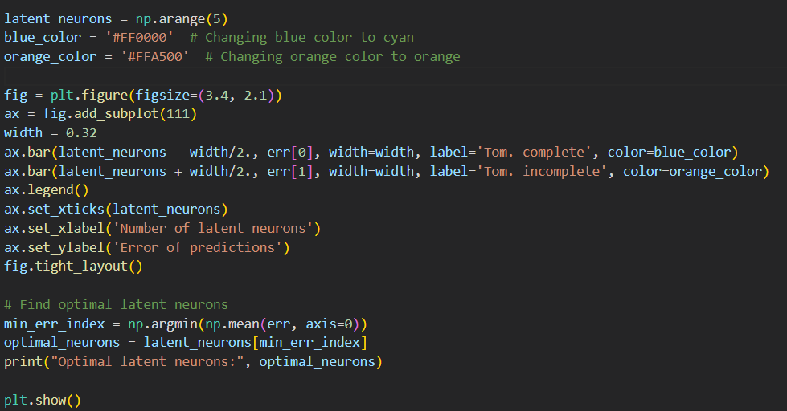
After this we plotted the plot between Number of latent neurons and error we have calculated in the previous slide.
And we also predicted the optimal latent variables by calculating the minimum among all errors.

Slide 12
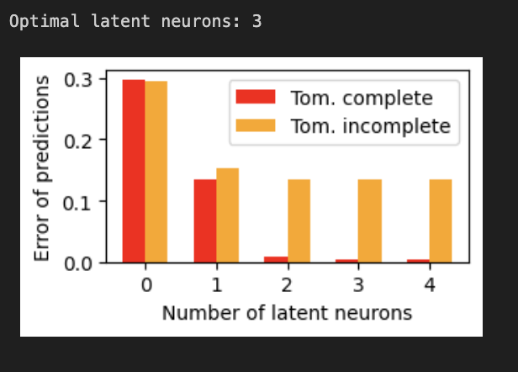
Prediction: for one qubit
2

Slide 13
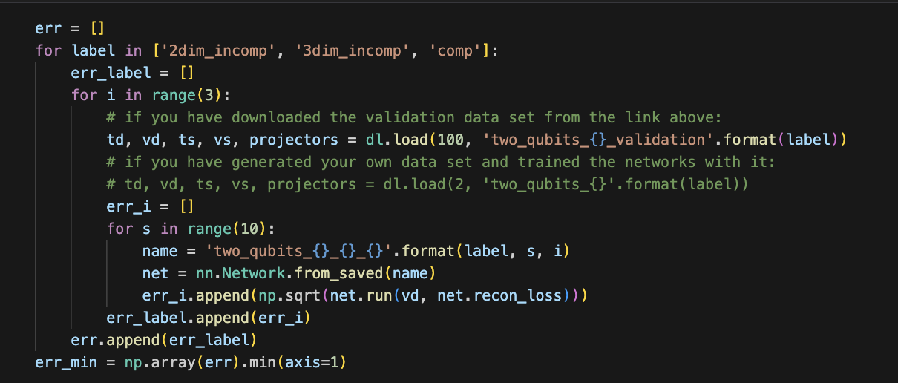
2_qubit_tomography.py:
Here we basically implement the same steps which have been implemented in the case of one qubit.

Slide 14
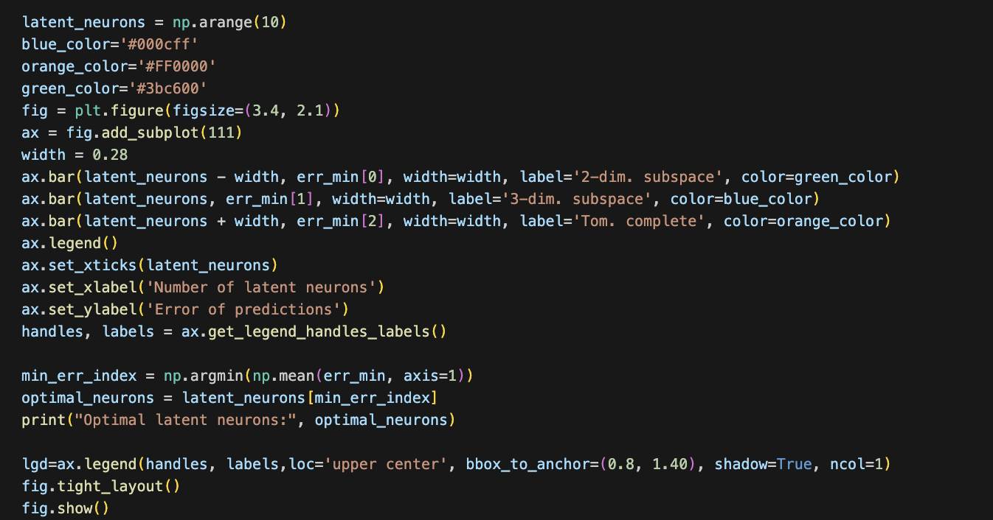
After this we plotted the plot between Number of latent neurons and error we have calculated in the previous slide.
And we also predicted the optimal latent variables by calculating the minimum among all errors.

Slide 15
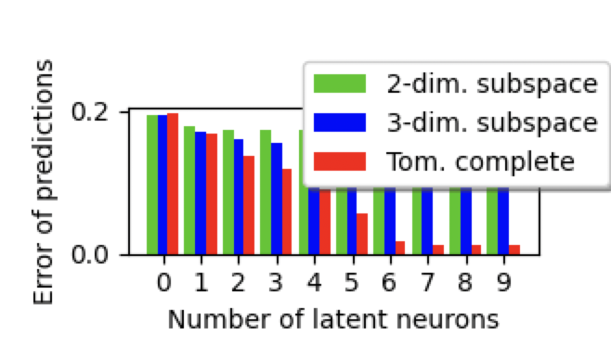

Prediction: for two qubit
6

Slide 16
Thank you

