Slide 1
Discovering physical concepts with NN
By Raban Iten, Tony Metger, Henrik Wilming, Lídia del Rio, and Renato Renner

Slide 2
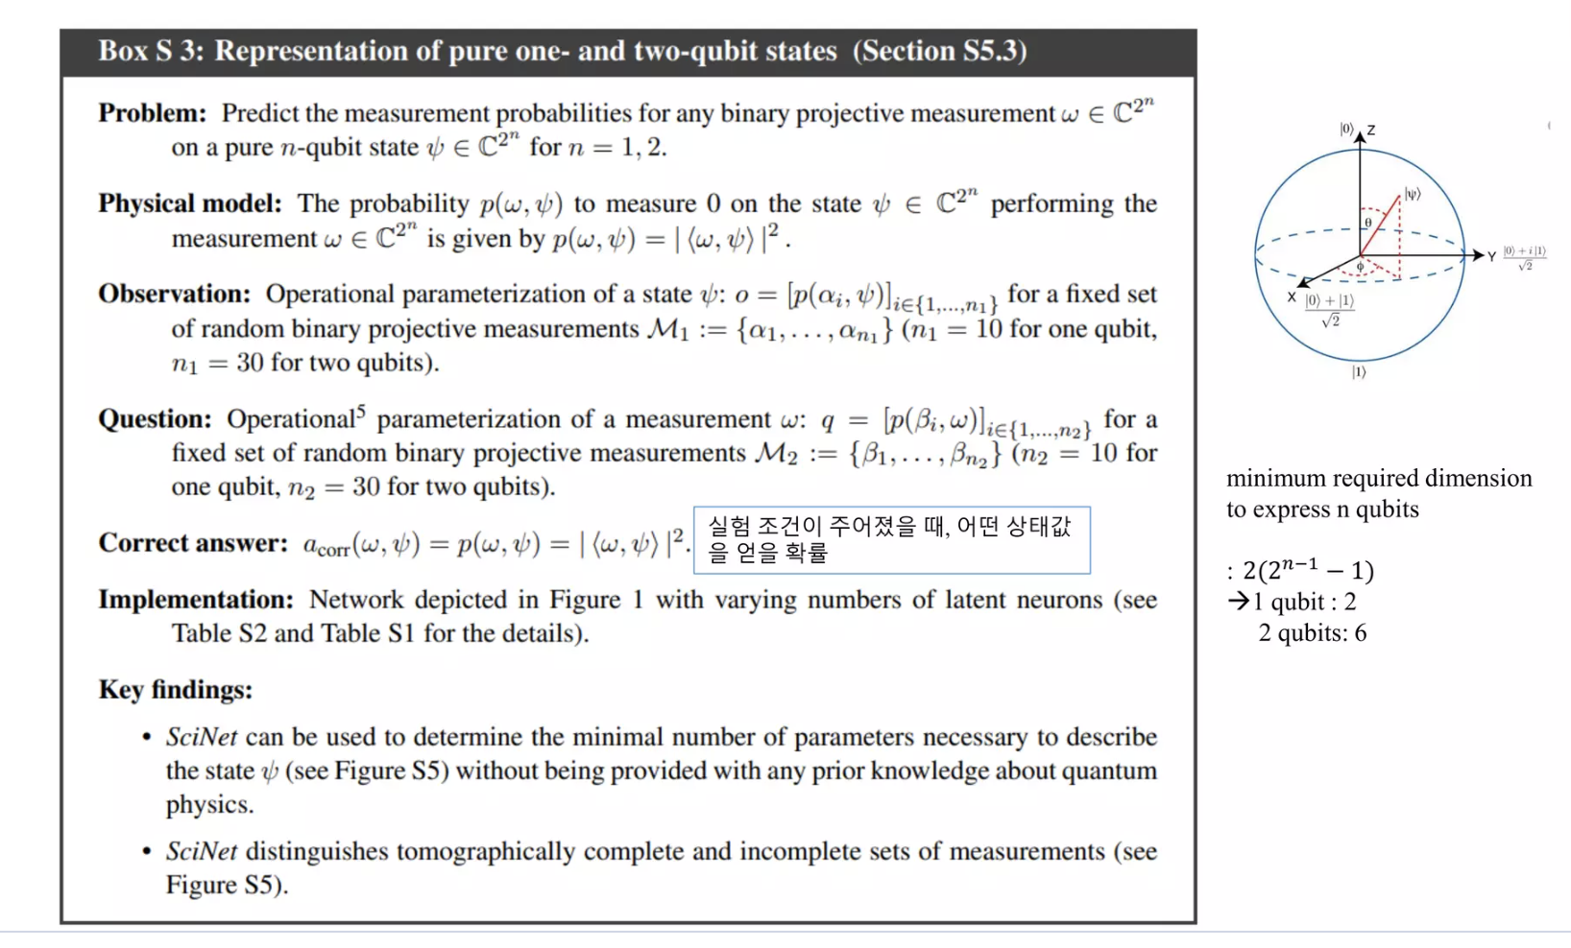
problem statement:
Predicting the measurement probabilities for any binary projective measurement w on a pure n-qubit state psi for n=1,2.

Slide 3
Definitions:
Measurement:
When a measurement is performed on a quantum system, it involves interacting with the system in a way that reveals information about one of its observable properties.
When a qubit is measured, it collapses from its superposition state into one of the two basis states (|0⟩ or |1⟩) with a probability determined by the coefficients of its superposition. The act of measurement forces the qubit to choose a definite state.

Slide 4
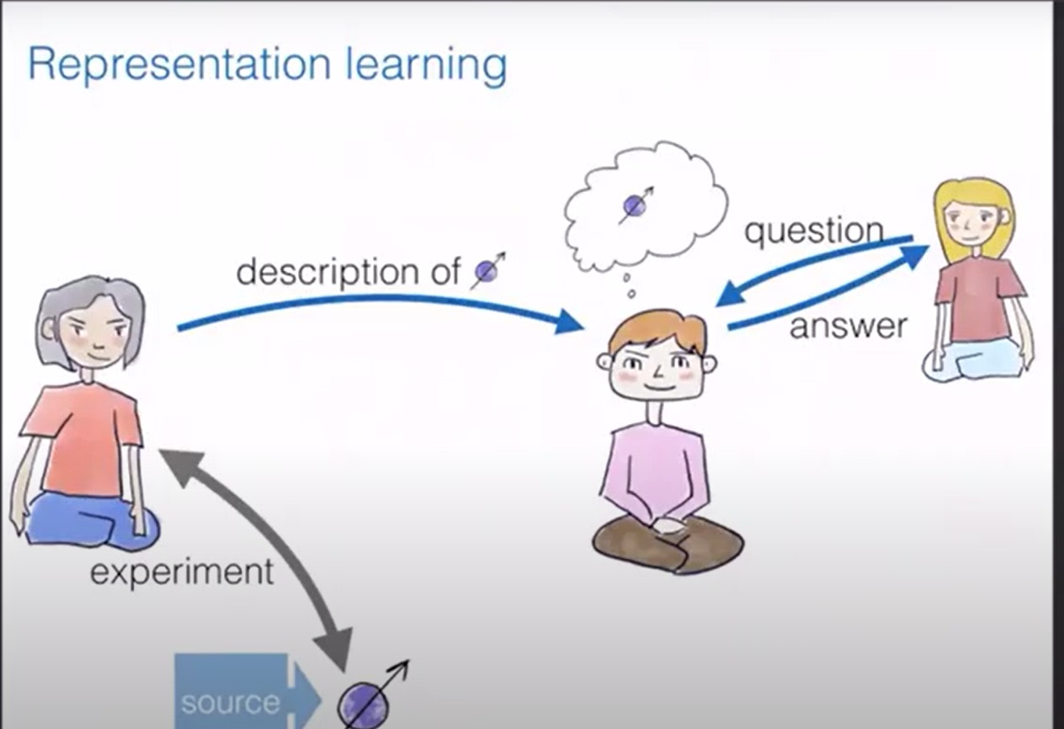
Architecture diagram

Slide 5
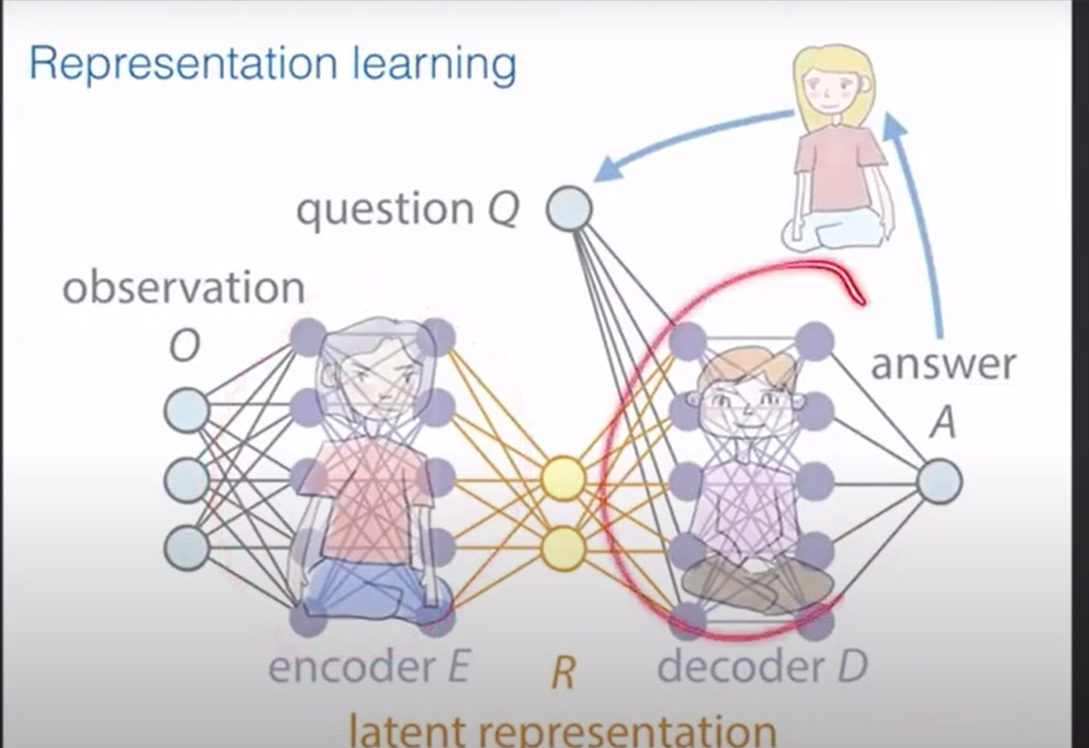
Architecture diagram in Scinet

Slide 6
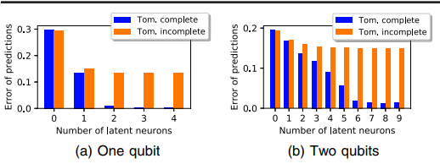
Predicting the latent variables :
We can predict latent variables(minimum information about the qubit) used by calculating the error.
The plots show the root mean square error of SciNet’s measurement predictions for test data as a function of the number of latent neurons.
For One qubit: we clearly see that the error is minimum at 2.
For Two qubit: the error is minimum at 6.

Slide 7
Code:
dataloder.py:it basically splits the data into training and validation.
ed_quantum.py:- it creates the data,it takes input as Qubit number,measurement,sample number and file name.
Data format:result = ([meas_res1, meas_res2, output], [states_in1, states_in2], [fixed_states_in1, fixed_states_in2])
training data: 95000 samples
validation data: 5000 samples
io.py:-contains the data paths and file paths formats which can be used used commonly for all other files.
model.py:-it contains functions to train,test and run the data.

Slide 8
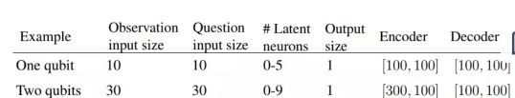
Constraints used:
1.epoch_num: 250, batch_size: 512, learning_rate: 1e-3, beta: 1e-4 2. epoch_num: 50, batch_size: 512, learning_rate: 1e-4, beta: 1e-4

Slide 9
In this research paper, they also mention two types of data:
Tomography complete:observations that provide enough information to fully characterize the quantum state of a system.
Tomography incomplete:observations performed on a quantum system does not provide enough information to fully characterize its quantum state.

Slide 10
Thank you

