Slide 1
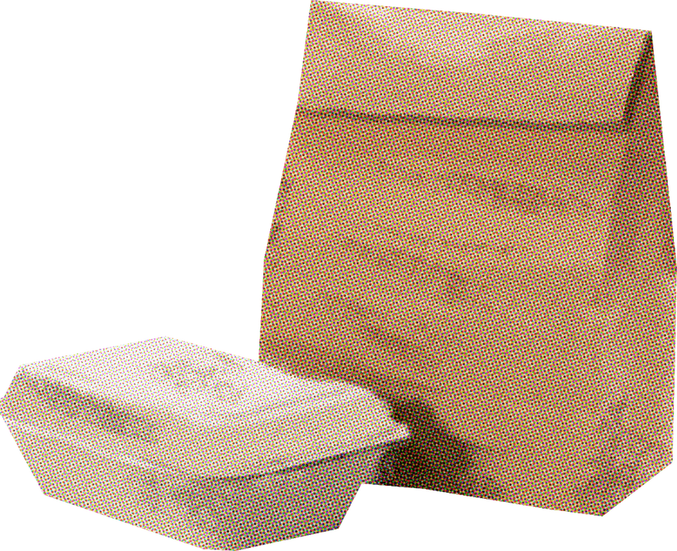

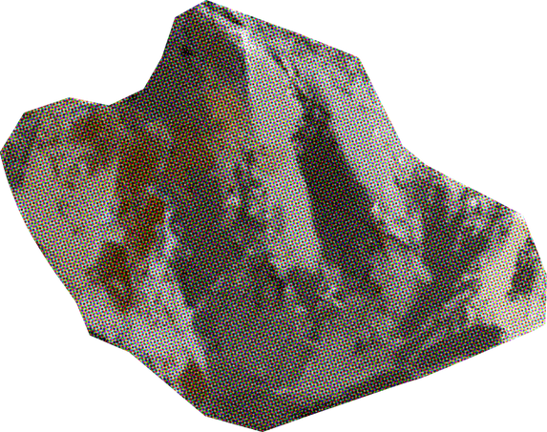


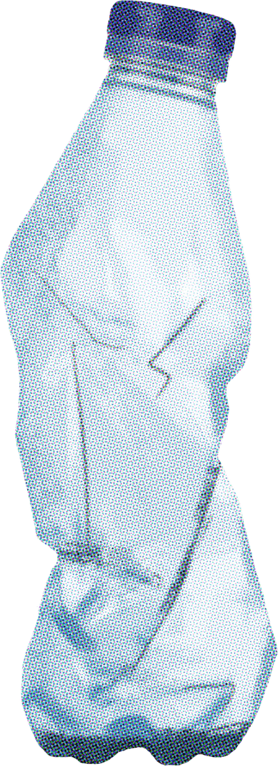
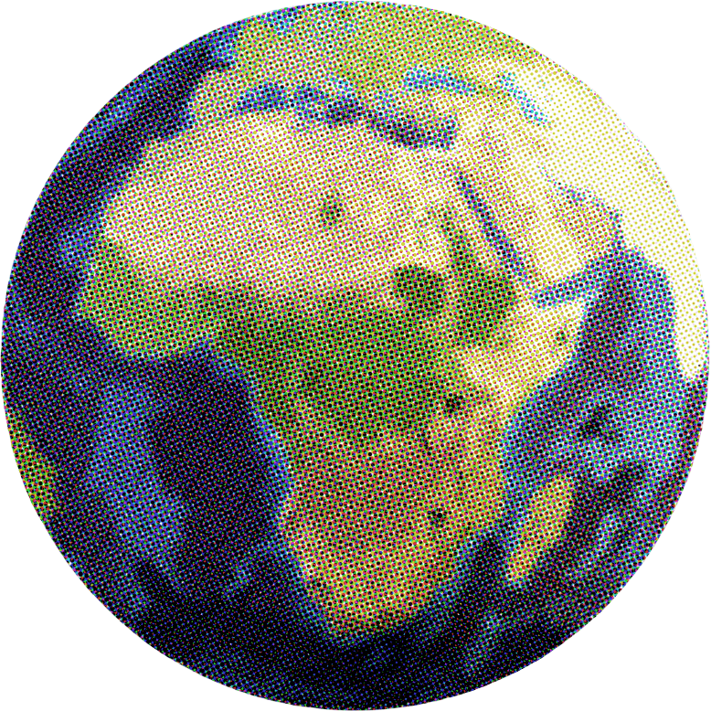
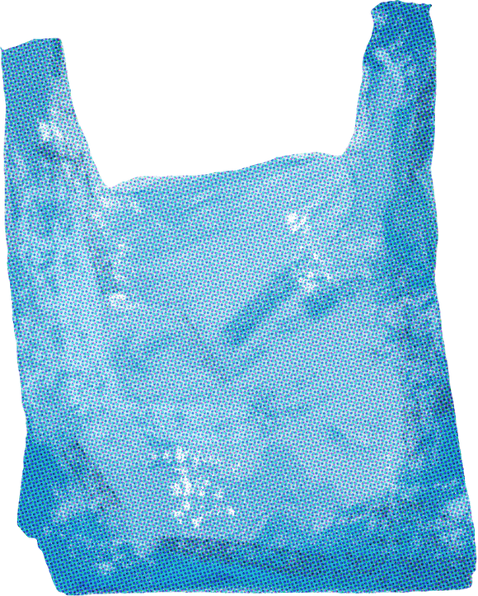

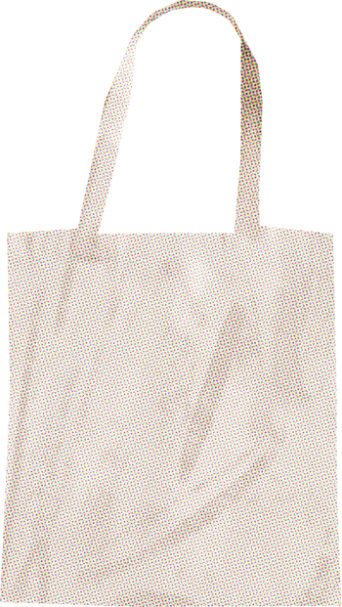
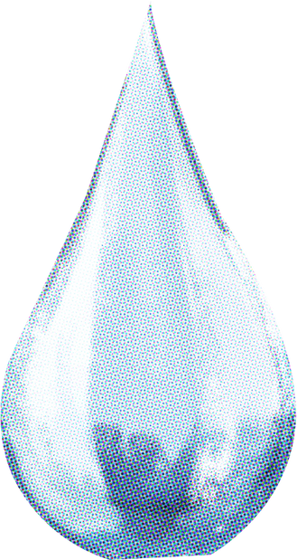
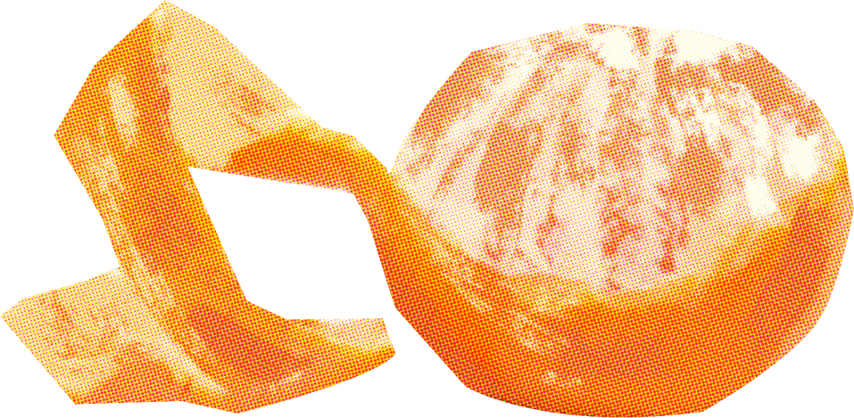
CASE STUDY
tRASH
taLKS
Why are they so important?

Slide 2

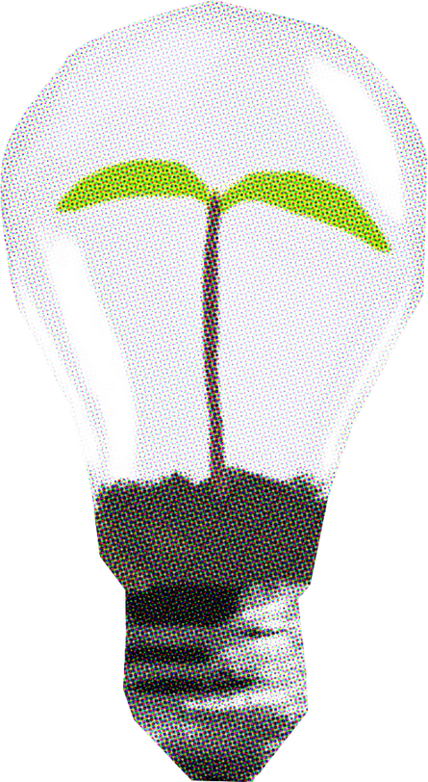
Global Crisis
Every year, over 2 billion tons of solid waste are produced globally.
Less than 20% is recycled — the rest ends up in landfills and oceans.
Manual segregation is slow, unsafe, and inefficient.
Plastics and e-waste threaten ecosystems and human health.

Slide 3

Why Recycling Fails Today
Waste arrives mixed — plastic, metal, glass, organic.
Sorting manually exposes workers to hazardous materials.
Recycling plants face bottlenecks due to low sorting accuracy.
Lack of automation leads to delays, contamination, and higher costs.

Slide 4
Enter AI — Vision for the Planet
Artificial Intelligence, particularly Computer Vision, can mimic human sight.
CNNs (Convolutional Neural Networks) learn to identify waste visually.
When integrated with IoT & robotics, AI can power automated recycling plants.

Slide 5

Problem Statement
Develop a CNN-based system capable of classifying different types of waste from images captured by cameras installed on conveyor belts in recycling plants and aligned them with SDG goals .

Slide 6
♻️ RecycLens ♻️ Smart Waste Classifier

Slide 7
Dataset - Info
TrashNet
Preprocessing Steps:
Resized to 128×128 pixels
Normalized pixel values (0–1 scale)
Data augmentation: rotation, zoom, flip, brightness shift
Source: Stanford TrashNet Dataset
Total Images: 2,527 labeled samples
Categories: Paper, Glass, Plastic, Metal, Cardboard, Trash
Image Conditions: Varied backgrounds, lighting, and orientations

Slide 8
Model Architecture
Custom Convolutional Neural Network
Layers:
3 × Conv2D layers (ReLU + MaxPooling)
Flatten layer
2 × Dense layers (with Dropout for regularization)
Output: Softmax (6 categories)
Training Parameters:
Optimizer: Adam
Loss: Categorical Cross-Entropy
Epochs: 20
Batch Size: 32

Slide 9
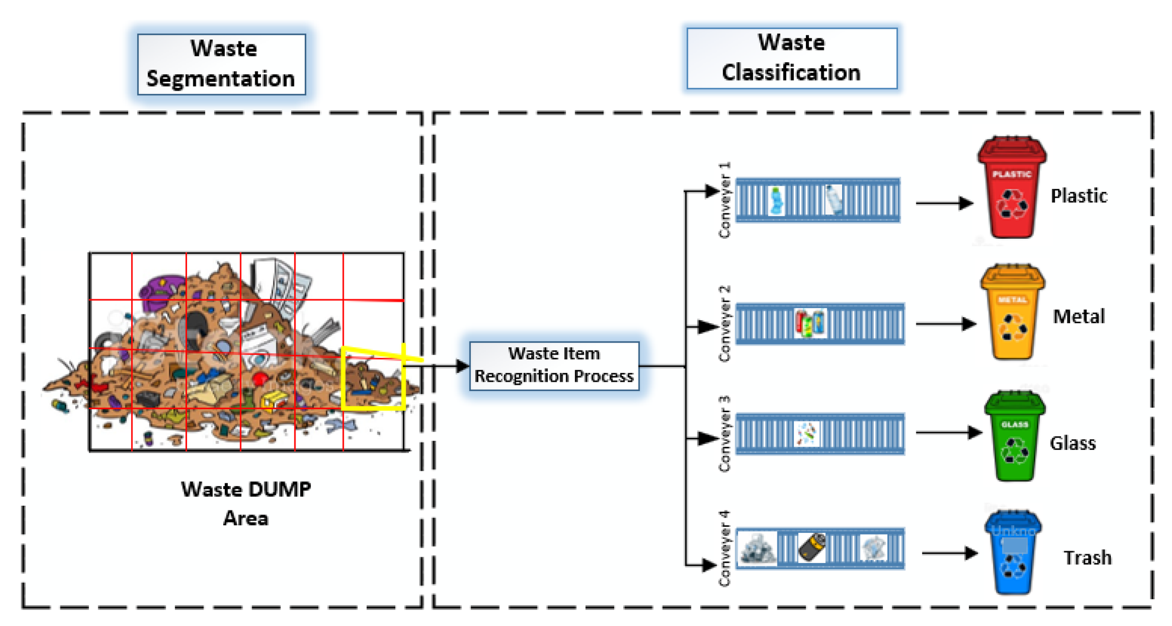
Model Architecture

Slide 10
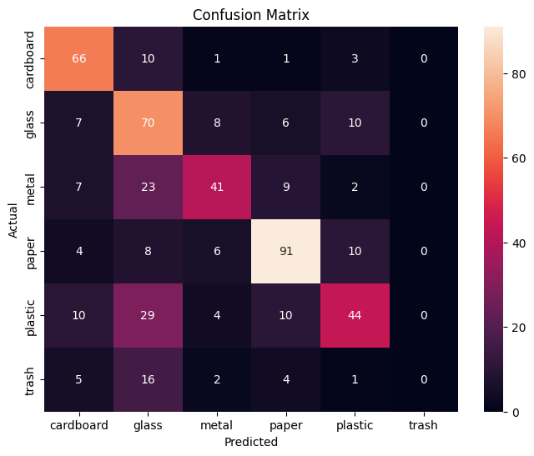

Results
Test Accuracy: 61.4% (on unseen real-world samples)
TrainLoss: 1.0878 TrainAcc: 58.02%
ValLoss: 0.8747 ValAcc: 67.57%

Slide 11

Live Demonstration — RecycLens
http://10.2.97.48:8501

Slide 12
System Design — Smart Waste Sorting
Proposed Integration:
Camera: Captures image on conveyor
CNN Model: Classifies waste in real-time
IoT Sensor: Detects object weight or material density
Robotic Arm / Actuator: Directs item to correct bin
Camera → CNN → Decision → Sorting Mechanism

Slide 13
Societal & Environmental Impact
Reduces human exposure to harmful waste
Promotes recycling and cleaner cities
Reduces landfill accumulation
Supports UN Sustainable Development Goals:
SDG 11: Sustainable Cities & Communities
SDG 12: Responsible Consumption & Production
SDG 13: Climate Action
Vision: AI as a force for environmental sustainability 🌱

Slide 14
Conclusion
RecycLens proves CNNs can intelligently classify waste for recycling.
Prototype demonstrates potential for industrial automation.
AI-driven systems like this can revolutionize waste management, reduce pollution, and promote a circular economy.
“From Trash to Tech — Empowering the Planet with AI.”

Slide 15
Thank you

Slide 16
teacher resources
Create your own slides with these elements
Fonts
Elements
Titles
Body

