Slide 1


Fed-GPT: Translating FED-speak

Slide 2
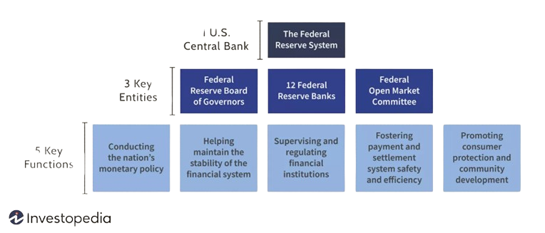
FED

Slide 3
Phases of economic Cycle
Rising production levels, a decrease in unemployment rates, stable or moderate inflation, and an uptick in corporate earnings.
Mid Cycle Recovery
Indicators of economic stability re-emerge, including bottoming-out in unemployment rates, improvements in stock prices, and increased business confidence
Trough and Early recovery
Unemployment rises as businesses lay off workers or close down operations to cut costs. Asset prices, especially in stock markets and real estate, decline as the economy contracts.
Recession
Economic Cycles
Inflation starts rising as prices for goods, labor, and resources increase due to high demand. The stock market may continue to rise, but at a slower pace, or it might begin to show volatility.
Peak and Late Expansion
Employment levels rise, and inventory starts to accumulate to meet increasing demand. Stock markets often perform well as corporate earnings improve.
Expansion (Early Cycle)

Slide 4
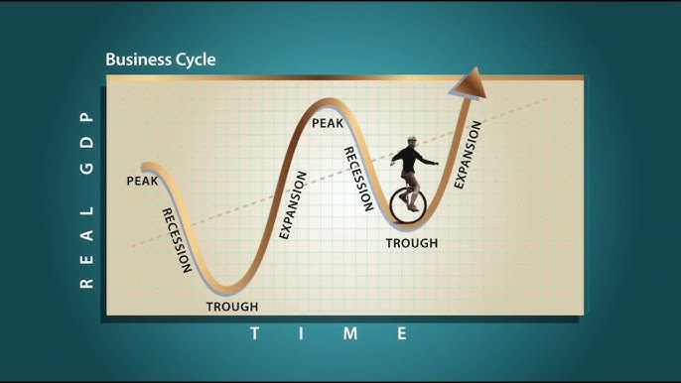
Phases of Economic Cycle
|
GDP
Time →

Slide 5
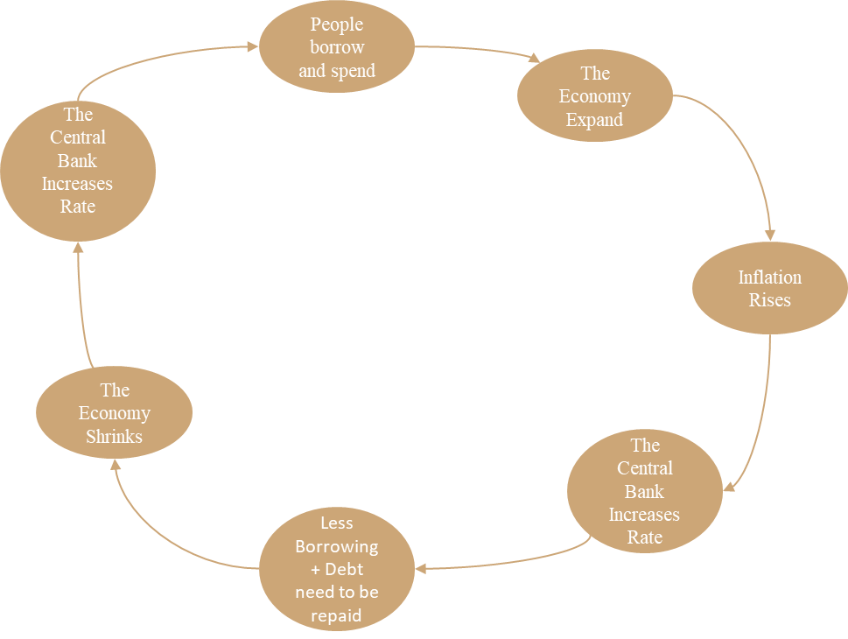
Ray Dalio
Model

Slide 6
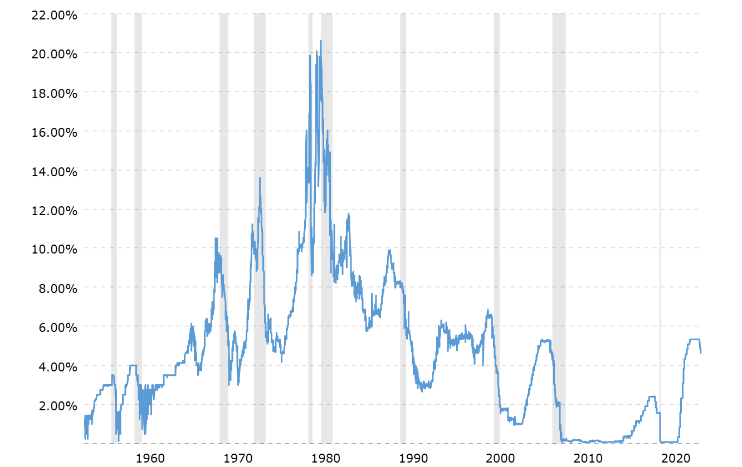
Treasury Curve

Slide 7
SENTIMENT SCORES
Collected and divided Fed releases into batches.
Sent these batches to the OpenAI API to obtain sentiment scores.
Obtained the sentiment scores for the following factors:
Short rate sentiment
Long rate sentiment
Surprise
Phase
Credit Conditions
Consumer Demand
Economic Growth
Employment
Inflation
Fed Action

Slide 8
Advanced Prompting Techniques in Large Language Models
Chain-of-Thought (CoT) Self-Consistency Decoding
If results vary significantly, human input may be required to determine the correct reasoning path.
Retrieval-Augmented Generation (RAG)
Combines document retrieval and LLM-based answer generation in two steps:
Document Retrieval: Uses dense embeddings to find relevant information.
Answer Formulation: Generates context-aware responses.
Complexity-Based Prompting
Prioritizes depth and complexity of reasoning.
In-Context Learning
Adapting to user-specific preferences in dialogue or task-specific instructions dynamically.

Slide 9
Process (Scraping -> Batch API -> Results)
Prompt Development
Developed with sponsor
(anecdotal checks)
Includes Ray Dalio’s 6 Phases Economic Model
Intuitive Scoring (1 to 5):
lower score = less
higher score = more
Percentage
Outlook and Condition
Factor Sentiments
Credit conditions
Consumer demand
Economic growth
Employment
Fed Action
Inflatio n
Other Sentiments
Short rate
Long rate
Surprise
Phase (Ray Dalio’s Economic Model)

Slide 10
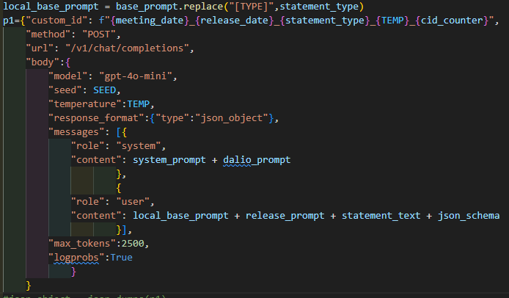
Process (Scraping -> Batch API -> Results)
The Prompt
noteworthy other:
metadata
settings

Slide 11

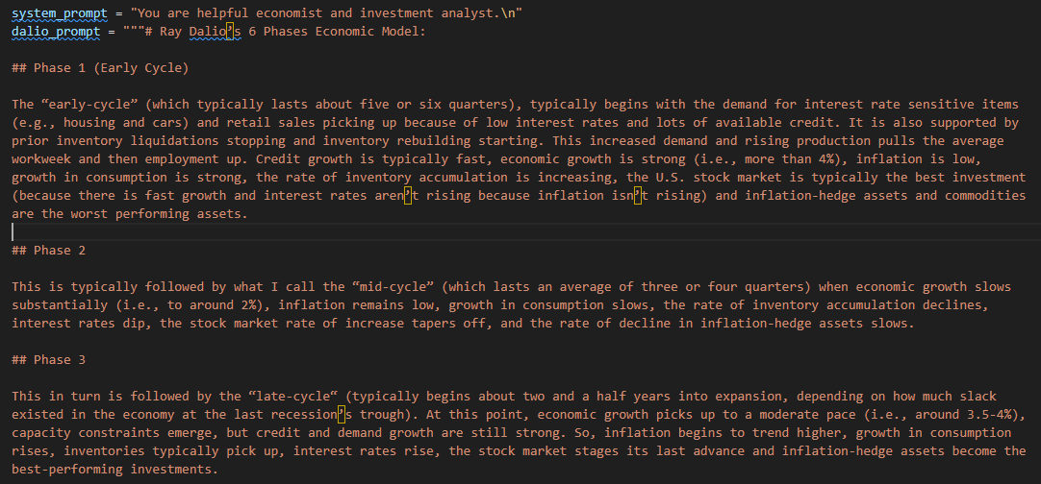
Process (Scraping -> Batch API -> Results)
The Prompt: System Role

Slide 12
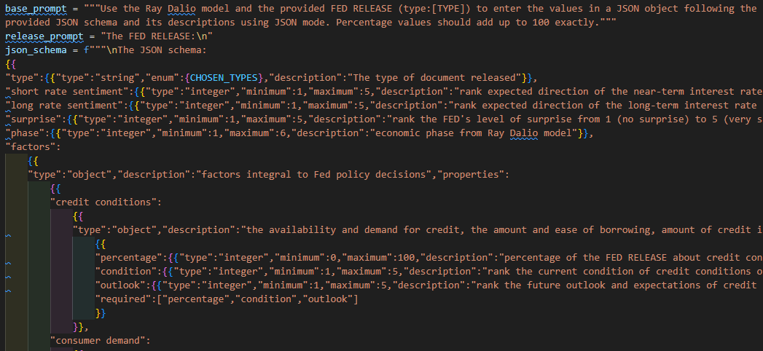
Process (Scraping -> Batch API -> Results)
The Prompt: User Role

Slide 13
Process (Scraping -> Batch API -> Results)
Web Scraping
Batch + Submit
Extract Scores
Report
Source: Fed Website
www.federalreserve.gov/
1933 - 2024
20+ Release types…
But settled on using:
Statements
Report of Policy Actions (RPAs)
Python w/ various libraries
OpenAI’s Batch API
Significant improvement
Model: gpt-4o-mini
Prompt Template
Settings
Temp = 0
JSON mode
Batch by Year (.jsonl)
Submit 10x
Extract tokens and logprob scores from batch results (.jsonl)
Calculate probability weighted averages
Report the results in an Excel spreadsheet
Update Website [Future]
Notes:
Why is editing the speaker notes such a pain?
1. Tech stack
Number of Docs, kind? Statements, ROPA,
A COROLLARY OF ACCOUNTABILITY: A History of FOMC Policy Communication Tim Todd Federal Reserve Bank of Kansas City August 2016
2. Prompt gives instructions for scoring features, Dalio model overview, instructs model to use json format
3. Why 10 X? greedy sampling, temperature set to 0, top_p and top_k
4. Perfect json format (AMAZING!), example provided
5. Combine results into single report

Slide 14
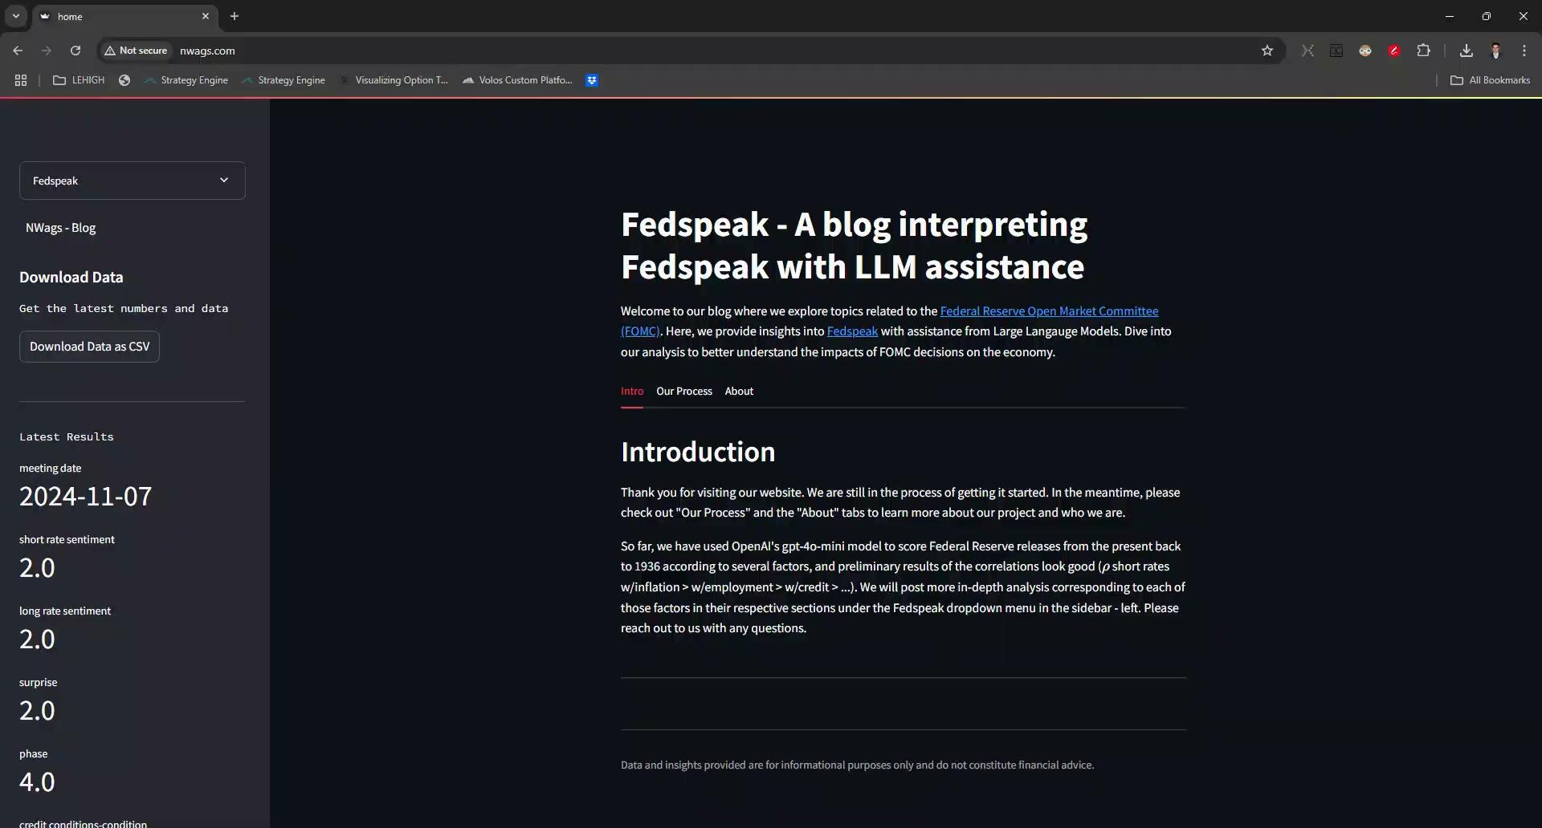
Fedspeak Website Overview
Blog Posts With Analysis
Automated Data Updates
Will be hosted on a Lehigh domain, like the PA100 Index

Slide 15
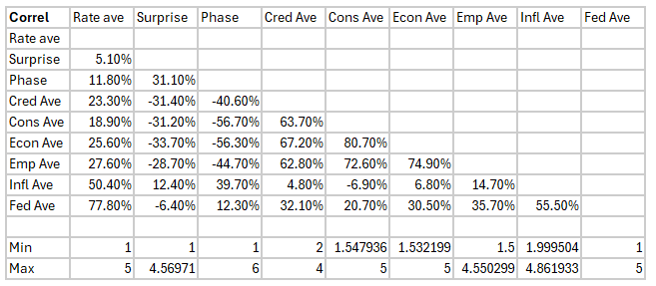
Correlation among the Sentiments
Fed Action most correlated with Inflation, followed by Employment
Then followed by Credit (unspoken mandate?)
Then followed by Economic Growth and Consumer Demand

Slide 16
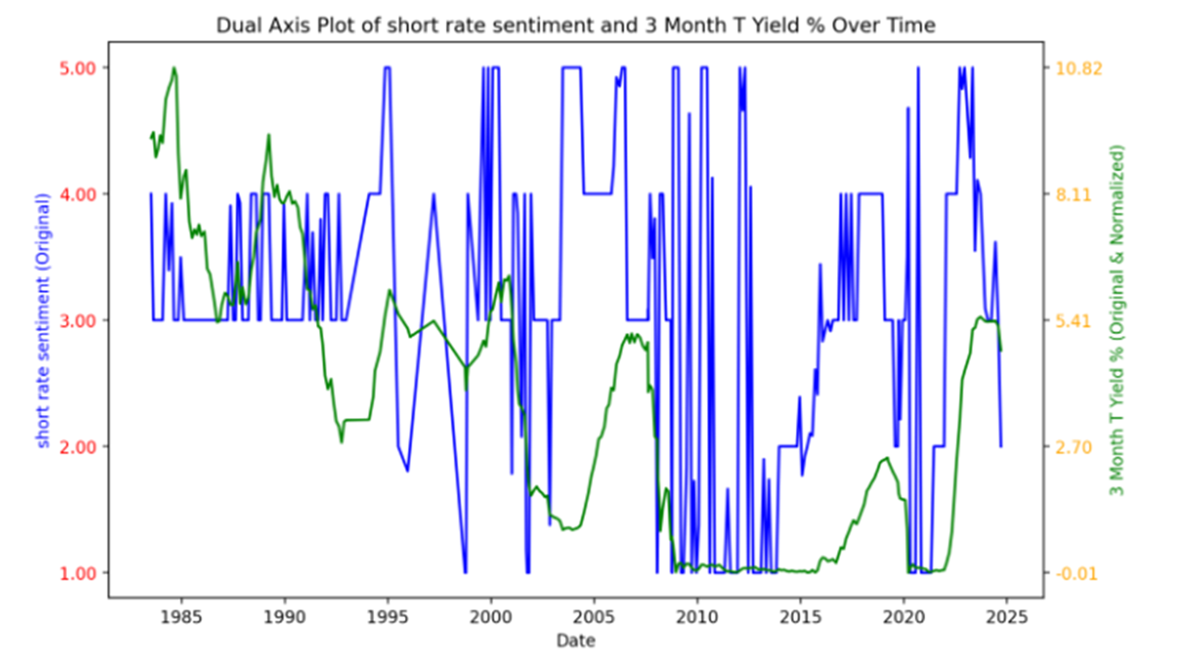
Pearson Coefficient: .27
P-Value 4.27e^-6
Spearman Coefficient: .29
P-Value 5.42e^-7
Short Rate Sentiment
Initial Plot and Testing

Slide 17
Pair sentiment signal with appropriate financial instrument/indicator.
1b. Collect time series data of match (Bloomberg, FRED).
Initial time series plot of relationship between sentiment and instrument.
2b. Check if correlations are statistically significant.
Data interpretation through plot analysis.
Data Analysis: Methodology

Slide 18
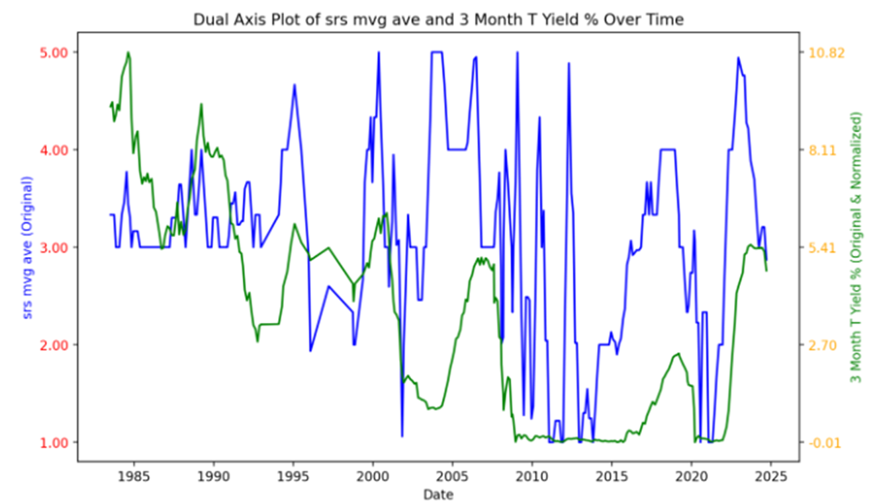
Data Interpretation Part I: Capturing the nature of the Fed

Slide 19
Data Interpretatoin Part II: Stationarity
Augmented Dickey–Fuller
Short Rate Sentiment 3-Month Treasury Yield
Test Statistic: -4.80 Test Statistic: -1.47
P-Value: 5.38e-5 P-Value: 0.55
Critical Values: Critical Values:
1%: -3.45 1%: -3.45
5%: -2.87 5%: -2.87
10%: -2.57 10%: -2.57

Slide 20
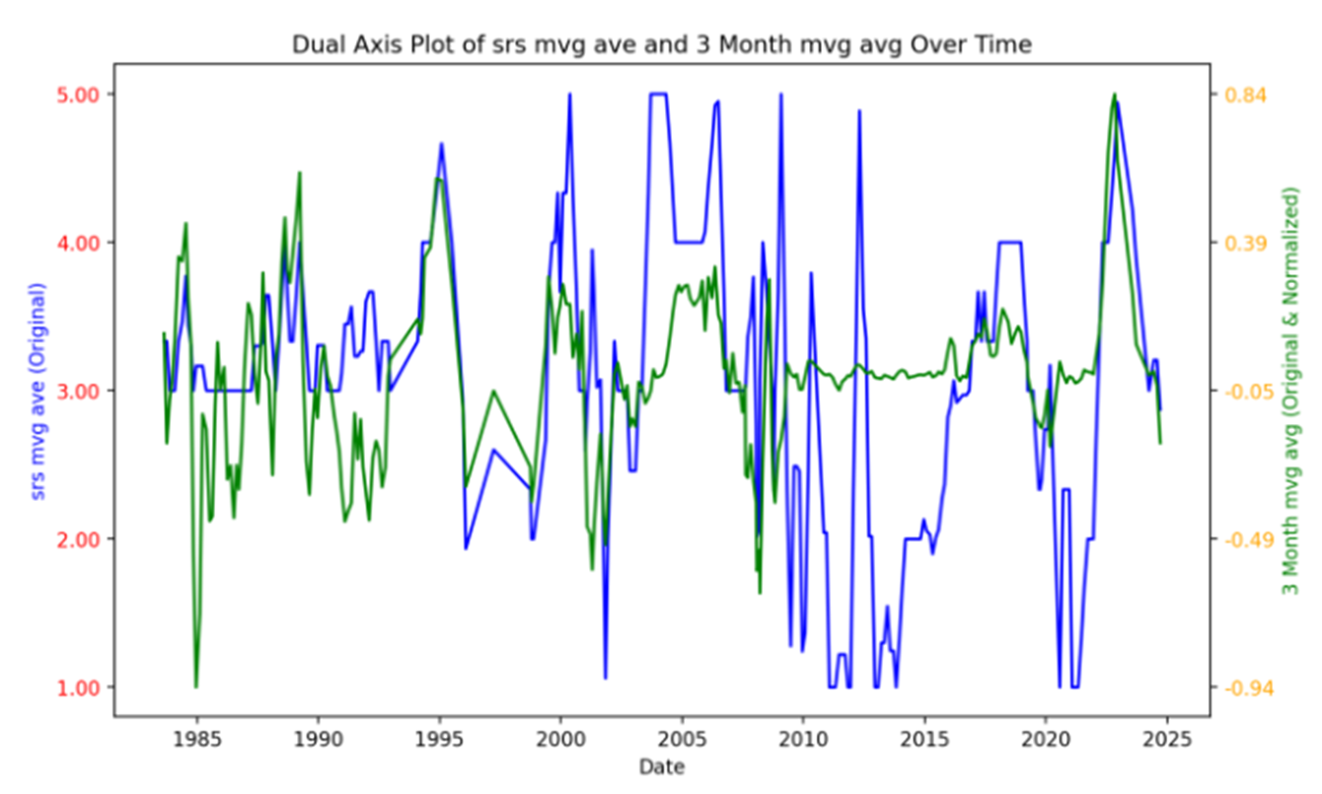
Data Manipulation Part II: Stationarity
Augmented Dickey–Fuller
3-Month Yield Change
Test Statistic: -4.99
P-Value: 2.35e-5
Critical Values:
1%: -3.45
5%: -2.87
10%: -2.57

Slide 21
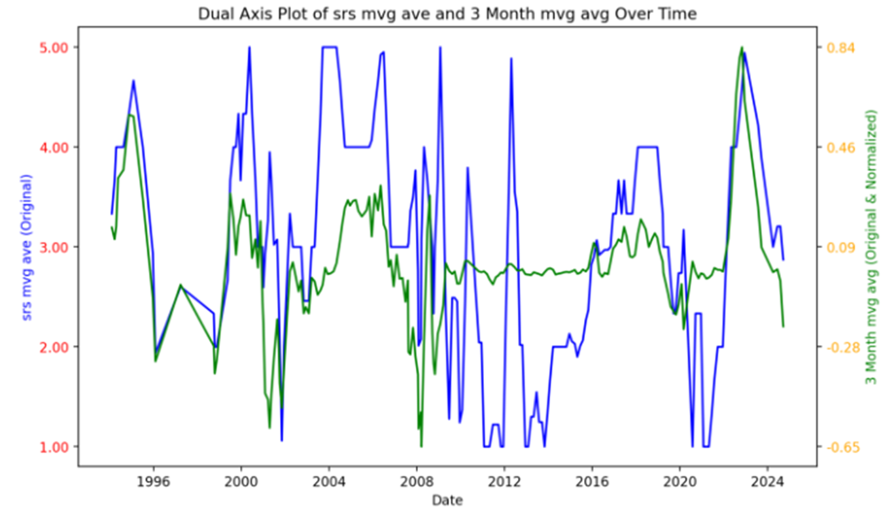
Data Manipulation Part III:
Data Sources

Slide 22
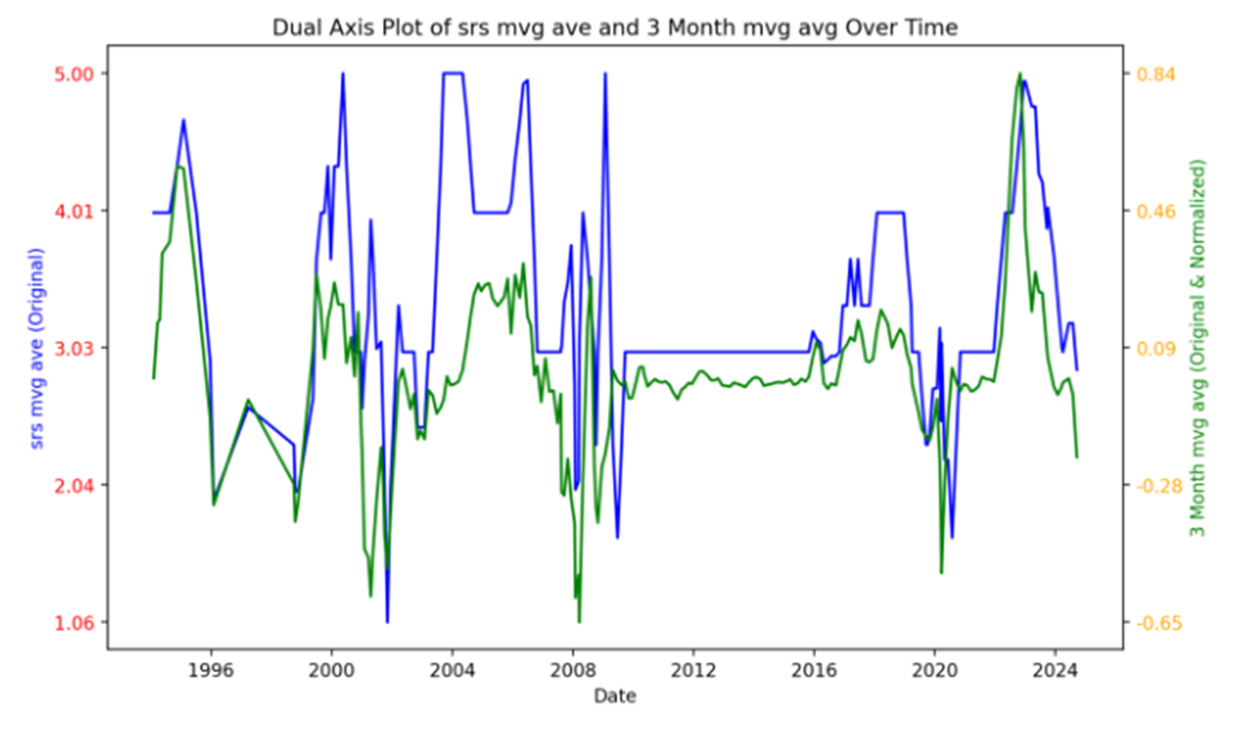
Data Manipulation Part IV:
Nature of Financial Instruments

Slide 23
Data Manipulation Conclusion
Nature of the Fed captured
Stationarity established
Eliminated poor data quality source
Accounted for zero interest rate periods
Established statistical significance
Pearson
Before: 0.27
After: 0.58
Spearman
Before: 0.29
After: 0.63

Slide 24
Our early analysis is giving positive results.
We have a full matrix of sentiment signals to investigate.
Research using the data analysis process to find strongest relationships
Experiment with predictive models to find actionable insights.
Backtest potential strategies and interpret results for feasibility.
Next steps

Slide 25
Fed-GPT: Translating Fedspeak
Thank you
Questions?

Slide 26
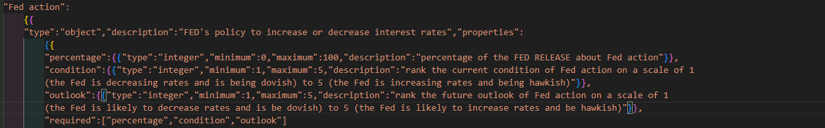
Appendix

Slide 27
Using the short and long rate sentiments to make a sentiment slope to investigate against the yield curve slope.
10 cases of sentiment interpretation
What other sentiment signals could be combined for research against market data?
List of sentiments: Short Rate, Long Rate, Economic Phase, Surprise,
Credit Conditions, Consumer Demand, Economic Growth, Employment,
Inflation, Fed Action
Interesting Inquiries

