Slide 1
Project Structure

Slide 2
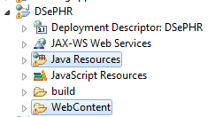
Back end business logic
Front end presentation logic

Slide 3
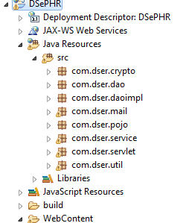
Implementation of RSA algorithm
DAO Interface
DAO Implementation
Mail sending utility
POJO classes
HDFS and HBase service provider
Servlet layer
Commonly used utilities

Slide 4
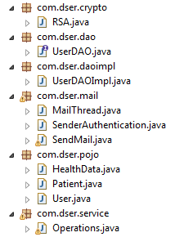

Slide 5
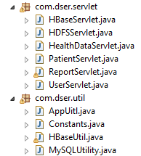

Slide 6
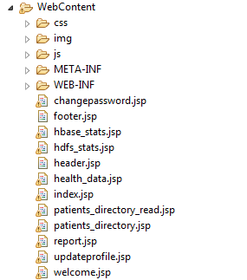

Slide 7
