Slide 1
PP, BP and MAP Prediction based on PPG Signals
Submitted By: Bhavya Alok 201000010
Kushal Jain 201000025
Date: 13th June 2022
Guided By:
Dr. Anurag Singh
Assistant Professor
Department of Electronics
International Institute of Information Technology, Naya Raipur

Slide 2
Objectives
Dataset is provided with a single PPG waveform and extracted features.
Build a decision tree from scratch, (improve upon it).
Analyze and compare with inbuilt SKlearn libraries.
Extract new features by applying PCA
Make Spectrograms of various Data Points.
*
International Institute of Information Technology, Naya Raipur
‹#›

Slide 3
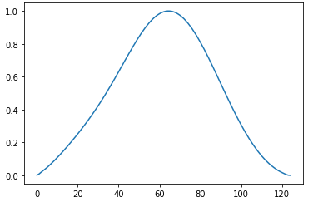
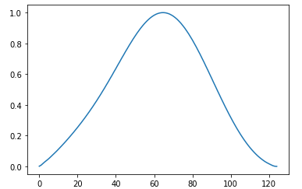
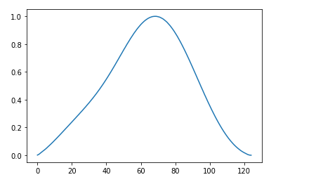
Analyzing the data
Plotting Waveforms for first few thousands of signals showed no significant difference.
*
International Institute of Information Technology, Naya Raipur
‹#›

Slide 4
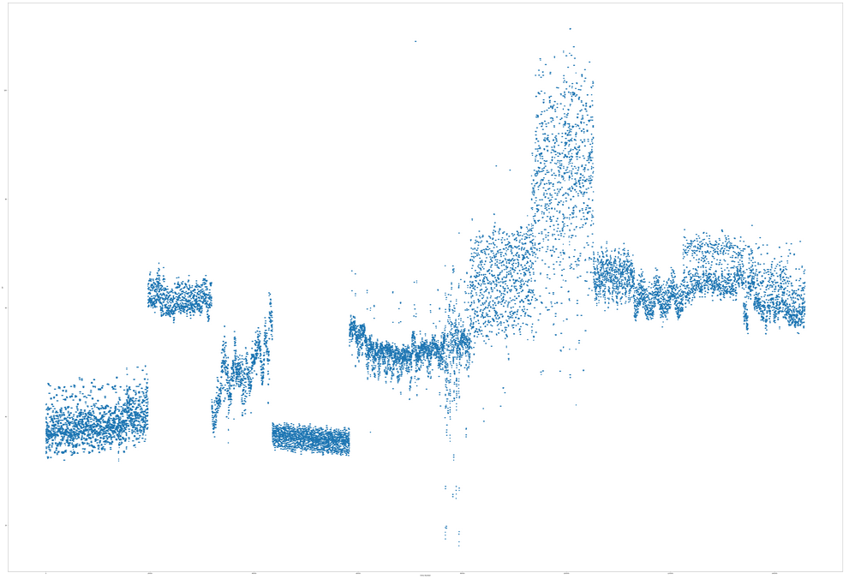
Plot of [PP vs Entry Number] showed existence of difference classes

Slide 5
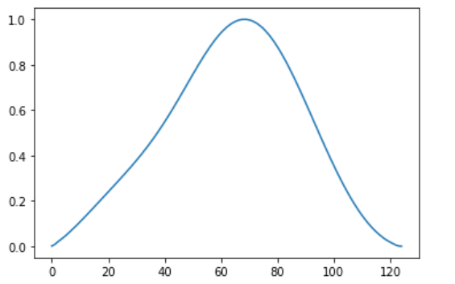
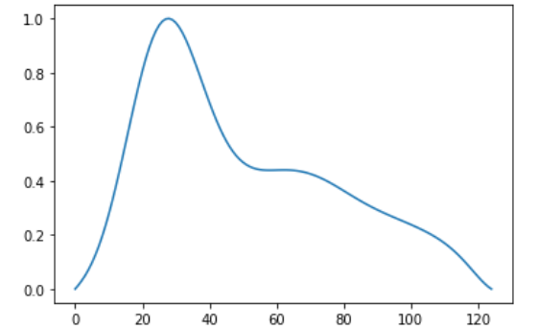
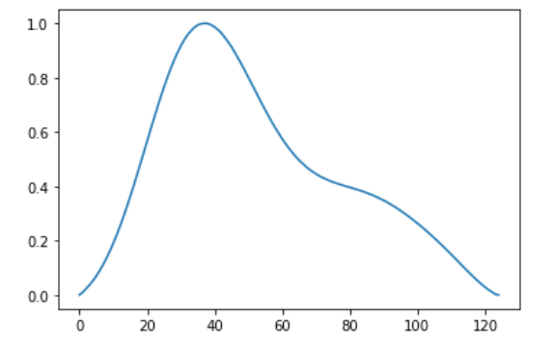
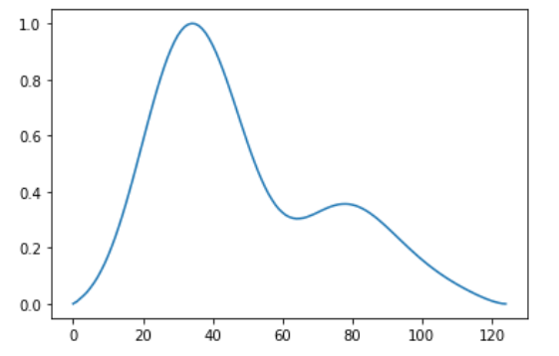
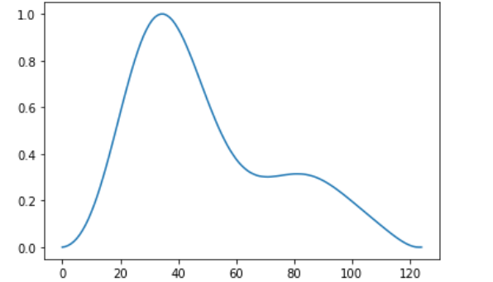
The waveforms of different classes were plotted individually, and as expected the waveforms of all different classes showed significant differences among each other.
*
International Institute of Information Technology, Naya Raipur
‹#›

Slide 6
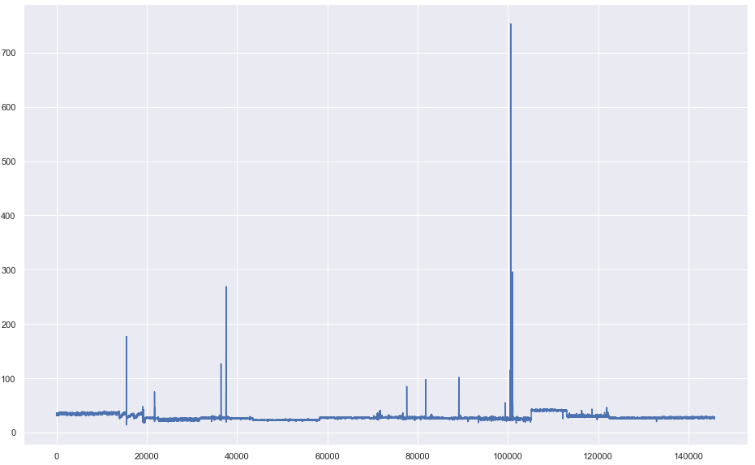
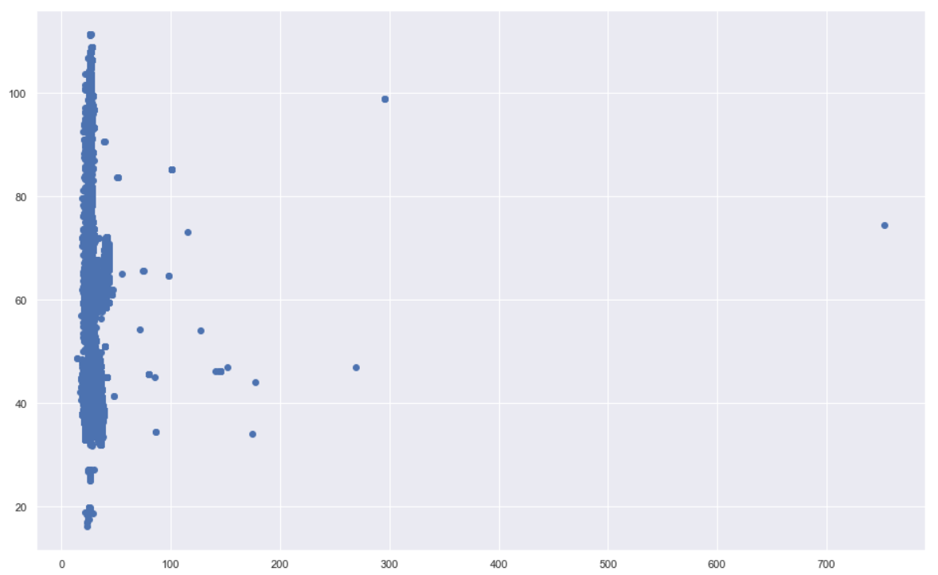
Analyzing the Data
To check the trend of features with respect to data, Features vs Entries plots were plotted.
Example of a feature likely having no impact on the target-
Plot1: Crest vs Entry Number
Plot2: Crest vs PP
*
International Institute of Information Technology, Naya Raipur
‹#›

Slide 7
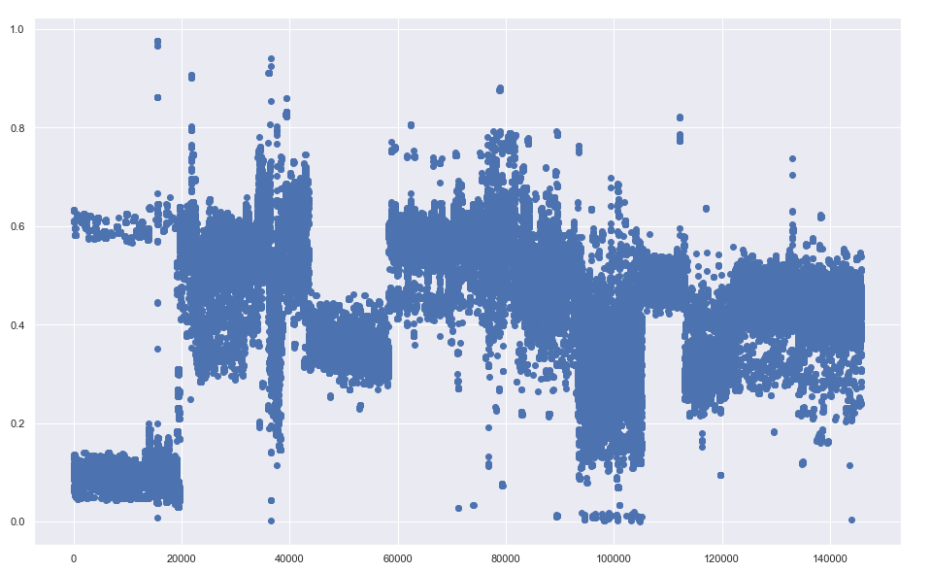
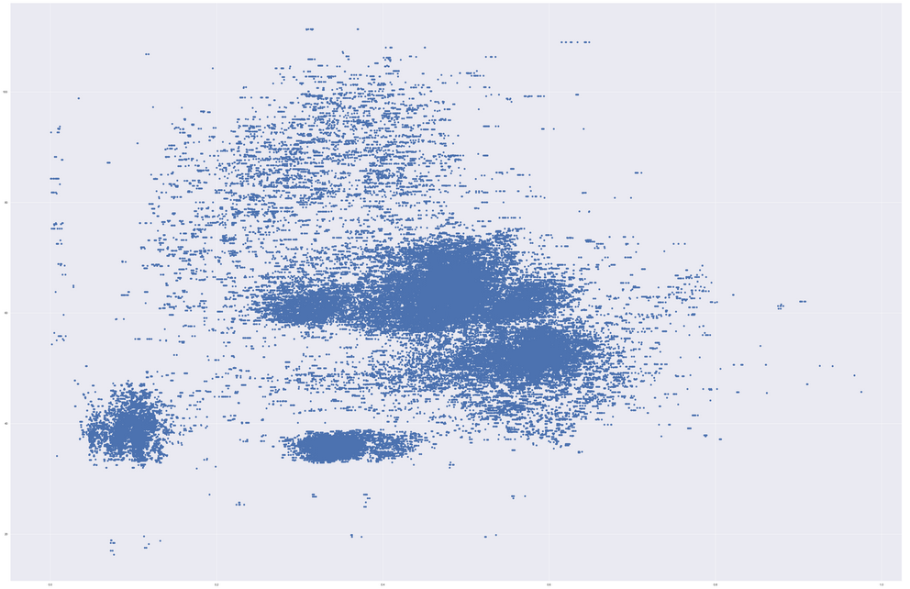
Example of a feature likely having significant impact on the target-
Plot1: Augmentation Index vs Entry Number
Plot2: Augmentation Index vs PP
*
International Institute of Information Technology, Naya Raipur
‹#›

Slide 8
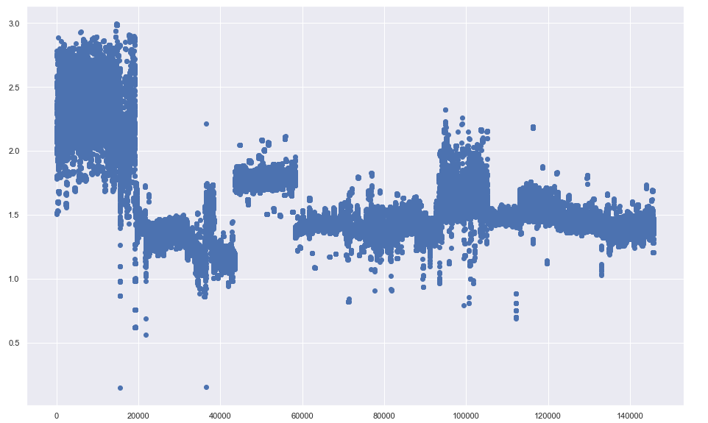
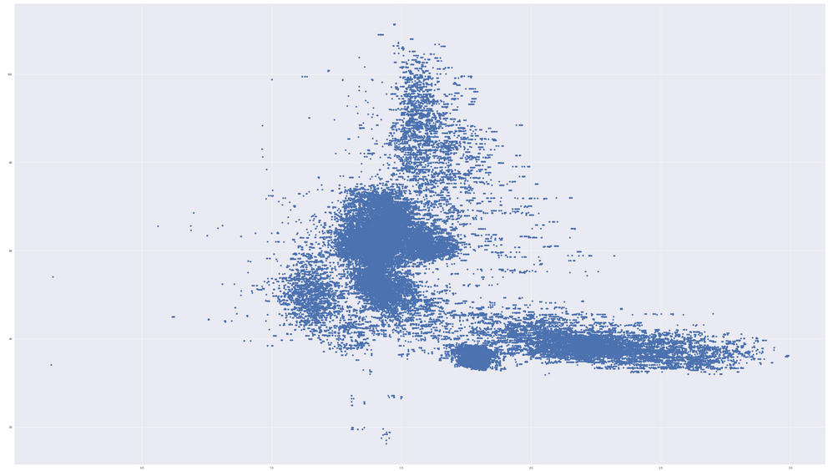
Example of a feature likely having significant impact on the target-
Plot1: RATIO_E_A vs Entry Number
Plot2: RATIO_E_A vs PP
*
International Institute of Information Technology, Naya Raipur
‹#›

Slide 9
Feature Selection
On seeing previous plots, some features need to be removed as they have no significant contribution to the predicted value. To find those features, Correlation Matrix is calculated between all features as well as the target value.
To confirm results from Correlation Matrix, one more technique of feature selection F-test statistic is used. F-test statistic confirmed the results from Correlation Matrix.
*
International Institute of Information Technology, Naya Raipur
‹#›

Slide 10
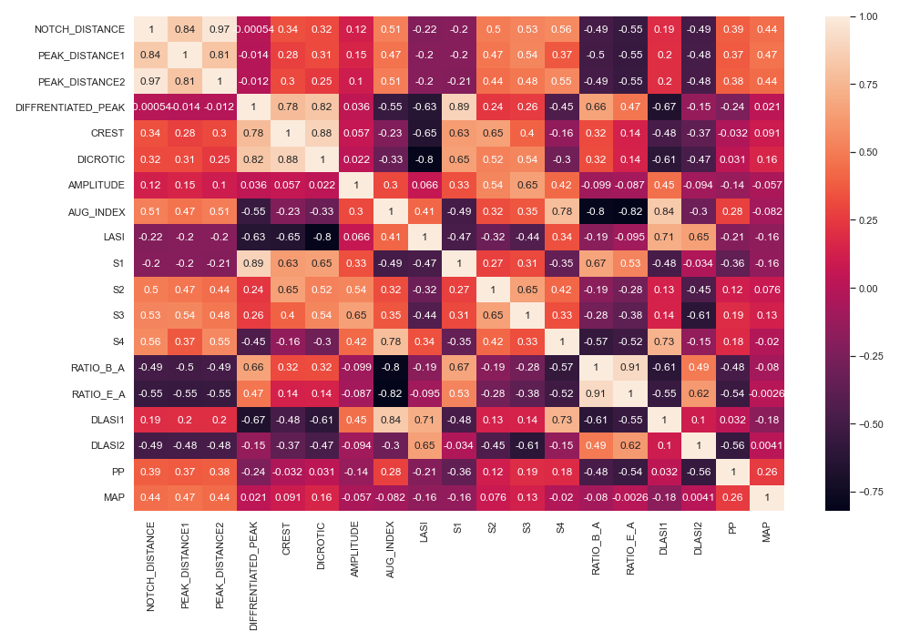
Correlation Matrix for Dependent Variables and independent variables

Slide 11
Final Extracted Features
Selected Features for PP :
['PEAK_DISTANCE1', 'PEAK_DISTANCE2', 'DICROTIC', 'AUG_INDEX', 'S4', 'RATIO_E_A', 'DLASI1', 'DLASI2']
Selected Features for MAP :
['PEAK_DISTANCE2', 'AUG_INDEX', 'S3', 'S4', 'RATIO_E_A', 'DLASI2']

Slide 12
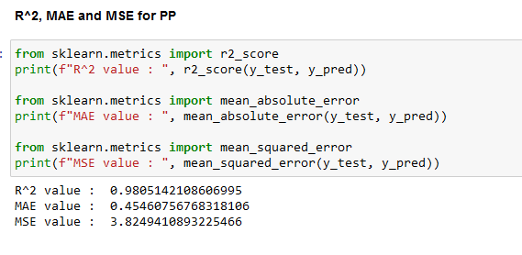
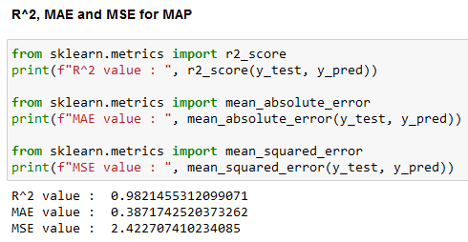
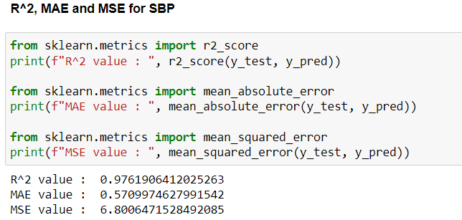
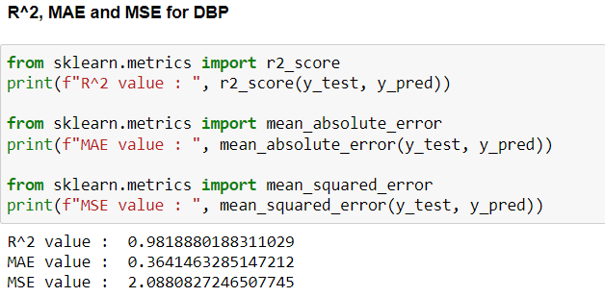
Performing Predictions using Decision Tree
Train Vs Test Split: 70 : 30

Slide 13
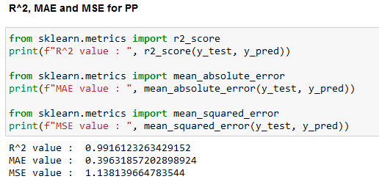
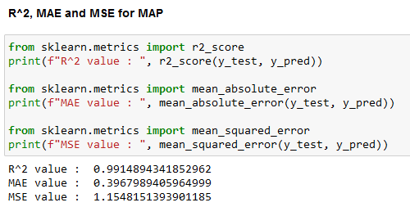
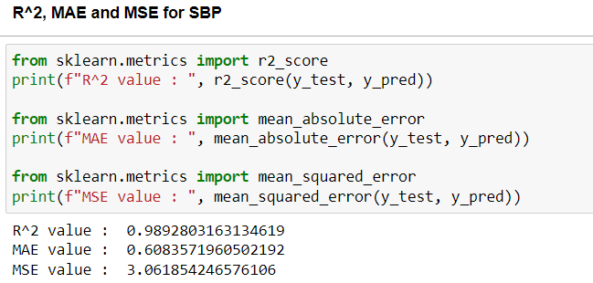
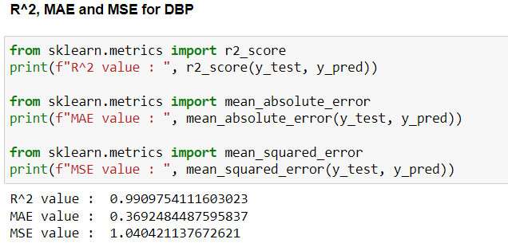
Performing Prediction using Random Forest Regressor

Slide 14
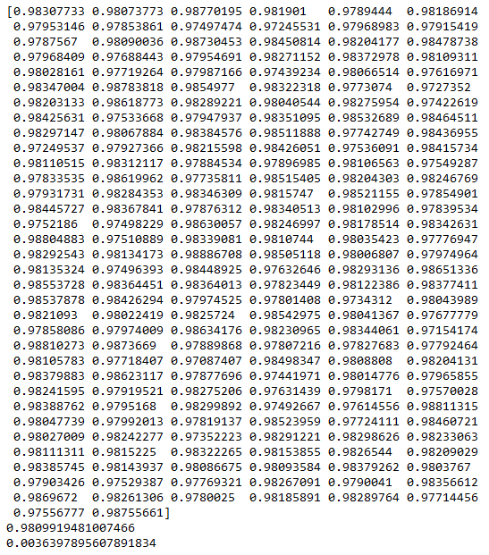
K-Fold Cross Validation

Slide 15
Regression Model
Decision Tree-
Decision tree builds regression or classification models in the form of a tree structure.
Breaks down a dataset into smaller and smaller subsets while at the same time an associated decision tree is incrementally developed with topmost node being the best predictor among all features.
A decision node has two or more branches, each representing values for the attribute tested and leaf node represents a decision on the numerical target.
Works on Standard Deviation(Variance) reduction. We use standard deviation to calculate the homogeneity of a numerical sample. If the numerical sample is completely homogeneous its standard deviation is zero.

Slide 16
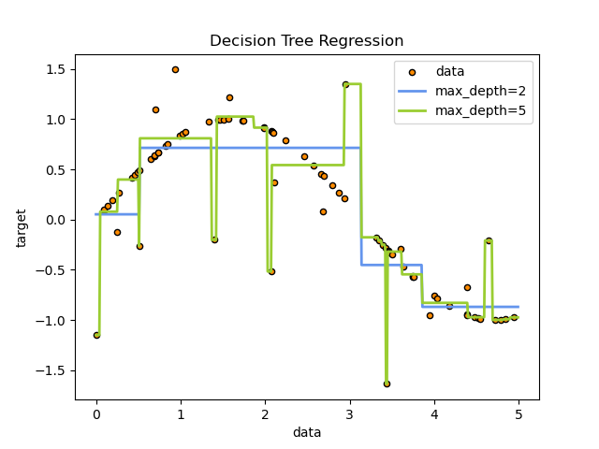
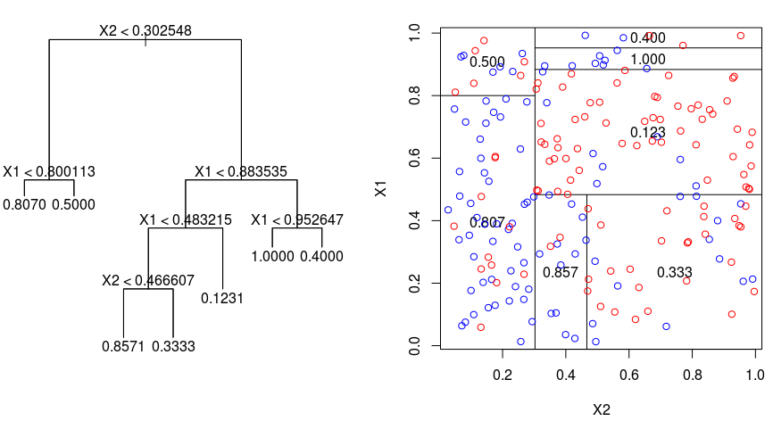
Examples of Decision Tree

Slide 17
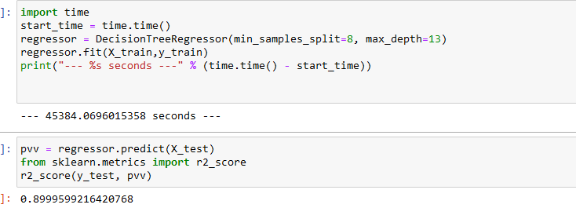
Results from Implementation:
Comparison: Model → Accuracy
SKLearn Random Forest Regressor → 99.15
SKLearn Decision Tree Regressor → 98.04
Custom Built Decision Tree → 89.99

Slide 18
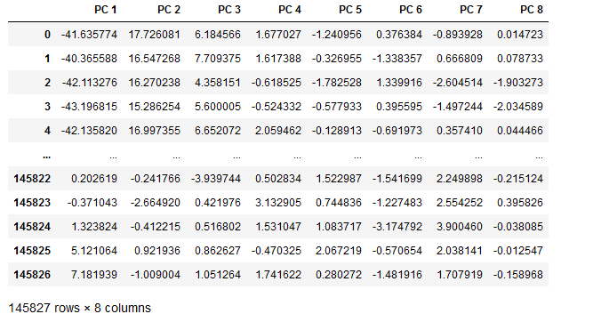
Feature Extraction using PCA

Slide 19
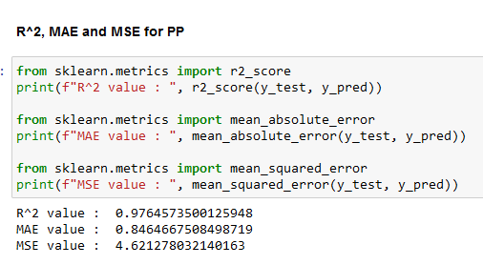
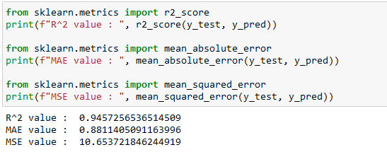
Some Predictions after PCA
Decision Tree SKLearn
Random Forest SKLearn
ACCURACY DECREASED AFTER FEATURE EXTRACTION!
IMPLYING INFORMATION WAS NOT FULLY PRESERVED

Slide 20
References
[1] Chowdhury, Moajjem Hossain et al. “Estimating Blood Pressure from the Photoplethysmogram Signal and Demographic Features Using Machine Learning Techniques.” Sensors (Basel, Switzerland) vol. 20,11 3127. 1 Jun. 2020, doi:10.3390/s20113127
[2] Kim, Seon-Chil & Cho, Sung-Hyoun. (2020). Blood Pressure Estimation Algorithm Based on Photoplethysmography Pulse Analyses. Applied Sciences. 10. 4068. 10.3390/app10124068.
[3] Zuhair, Aws. “A NOVEL WAVEFORM MIRRORING TECHNIQUE FOR SYSTOLIC BLOOD PRESSURE ESTIMATION FROM ANACROTIC PHOTOPLETHYSMOGRAM.” Journal of Engineering Science and Technology (2018): n. pag. Print. K. Elissa, “Title of paper if known,” unpublished.
[4] Bagha, Sangeeta & Shaw, Laxmi. (2011). A Real Time Analysis of PPG Signal for Measurement of SpO2 and Pulse Rate. INTERNATIONAL JOURNAL OF COMPUTER APPLICATIONS.
[5] G. Joseph, A. Joseph, G. Titus, R. M. Thomas and D. Jose, "Photoplethysmogram (PPG) signal analysis and wavelet de-noising," 2014 Annual International Conference on Emerging Research Areas: Magnetics, Machines and Drives (AICERA/iCMMD), 2014, pp. 1-5, doi: 10.1109/AICERA.2014.6908199.
[6] Elgendi, Mohamed. “On the analysis of fingertip photoplethysmogram signals.” Current cardiology reviews vol. 8,1 (2012): 14-25. doi:10.2174/157340312801215782.

Slide 21

THANK YOU
..
Dr. Shyama Prasad Mukherjee International Institute of Information Technology, Naya Raipur
*
International Institute of Information Technology, Naya Raipur
‹#›

