Slide 1
DeepNLPDocument Analyser
Presented By
Kushal Kulkarni

Slide 2

Introduction
What comes under Document?
Blog, News article, Books, Customer Review, Research Papers
Need for Document/Text Classification
Natural language cannot be easily understood by computers
Categorization of vast amount of textual data
Applications
Spam Detection
Sentiment Analysis
Customer Query classification in chatbots
Fake news detection

Slide 3
Steps for Document classification using Machine Learning
Data Preprocessing
Feature Engineering
Model Selection and Training
Performance Tuning
Testing

Slide 4
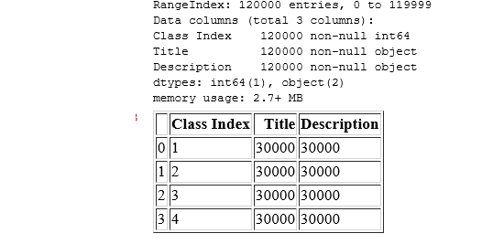
Dataset
AG corpus of News Article (http://groups.di.unipi.it/~gulli/AG_corpus_of_news_articles.html)
Collected from 2000 news sources.
120000 training samples in csv format
7600 testing samples in csv format
4 Categories - World, Sports, Business, Sci/Tech.
Library used - pandas

Slide 5
Preprocessing
Remove HTML tags
Remove extra whitespaces
Convert accented characters to ASCII characters
Remove special characters
Lowercase all texts
Convert number words to numeric form
Remove numbers
Remove stopwords (NLTK)
Lemmatization (NLTK)
Input = SPACE.com - TORONTO, Canada -- A second\team of rocketeers competing for the #36;10 million Ansari X Prize, a contest for\privately funded suborbital space flight, has officially announced the first\launch date for its manned rocket.
After preprocessing = spacecom toronto canada a second team rocketeers compete million ansari x prize contest for privately fund suborbital space flight officially announce first launch date man rocket

Slide 6
Feature Engineering
Count Vectors- generates vocabulary for all unique words of sentence. This in turn creates feature vector of the count of the words (Bag of Words BOW model)
TF-IDF - given a score to the words based on its Term Frequency (#words/ #Total words) and its Inverse Frequency
TF-IDF N-grams – TF-IDF also including bi-grams, tri-grams
TF-IDF N-grams character level
Word Embedding - It preserves contextually similar words. Useful for deep learning. Creates an embedding matrix using pre-trained vectors on large corpus

Slide 7
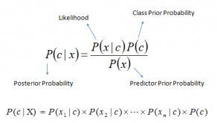
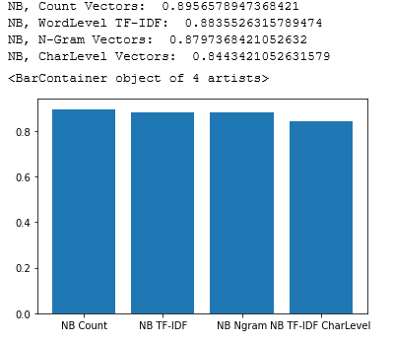
Model Selection – Baseline Models
Naïve Bayes Classifier
This classification technique is based on Bayes’ Theorem and assumes independence among the predictors.

Slide 8
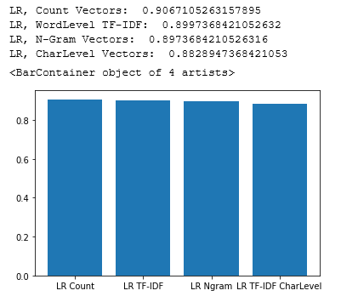
Baseline Models – Logistic Regression
This model uses a logistic/sigmoid function to calculate the probabilities of different values of the categorical dependent variable in presence of one or more predictors. Logit function is an estimation of log of odds in the favor of event and outputs a s-shaped curve with probability estimates.

Slide 9
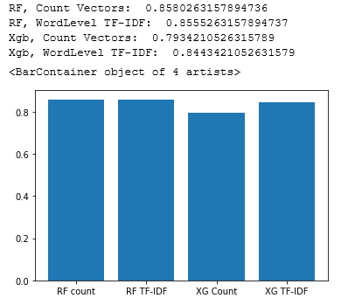
Baseline Models – Random Forest and XG boost
Bagging Model (Random Forest) - Random Forest models are a type of ensemble models, particularly bagging models. They are part of the tree-based model family.
XG Boost - Boosting models are another type of ensemble models and are part of tree based models. This model is meta-algorithm for reducing bias and variance in supervised learning. One of its strong points is that it converts weak learner i.e. classifiers slightly correlated to the true classification into stronger ones.

Slide 10
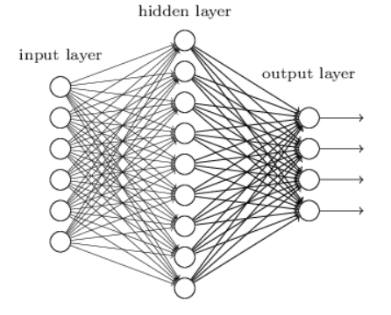
Neural Networks
Neural networks or feedforward neural networks. These have multiple layers of neurons arranged in fashion similar to that of human brain.
Activation function : transforming the summed weighted input from the node into the output for that input. I have used rectified linear activation (Relu) function since it overcomes the vanishing gradient problem, allowing models to learn faster and perform better.
Loss function : a function which needs to be minimized for correctioness of model
I have used softmax or normalized exponential function as there is multi class classification

Slide 11
Terms
Epoch : Since the training in neural networks is an iterative process, the training won’t just stop after it is done. You have to specify the number of iterations you want the model to be training. Those completed iterations are commonly called epochs. I have chosen 10
Batch size: The batch size is responsible for how many samples we want to use in one epoch, which means how many samples are used in one forward/backward pass. I have chosen 50
Validation split : this is a spit of training data to calculate loss function and should be kept apart from testing set in order to not let testing set to influence the model. Validation spit of 10 % is used

Slide 12
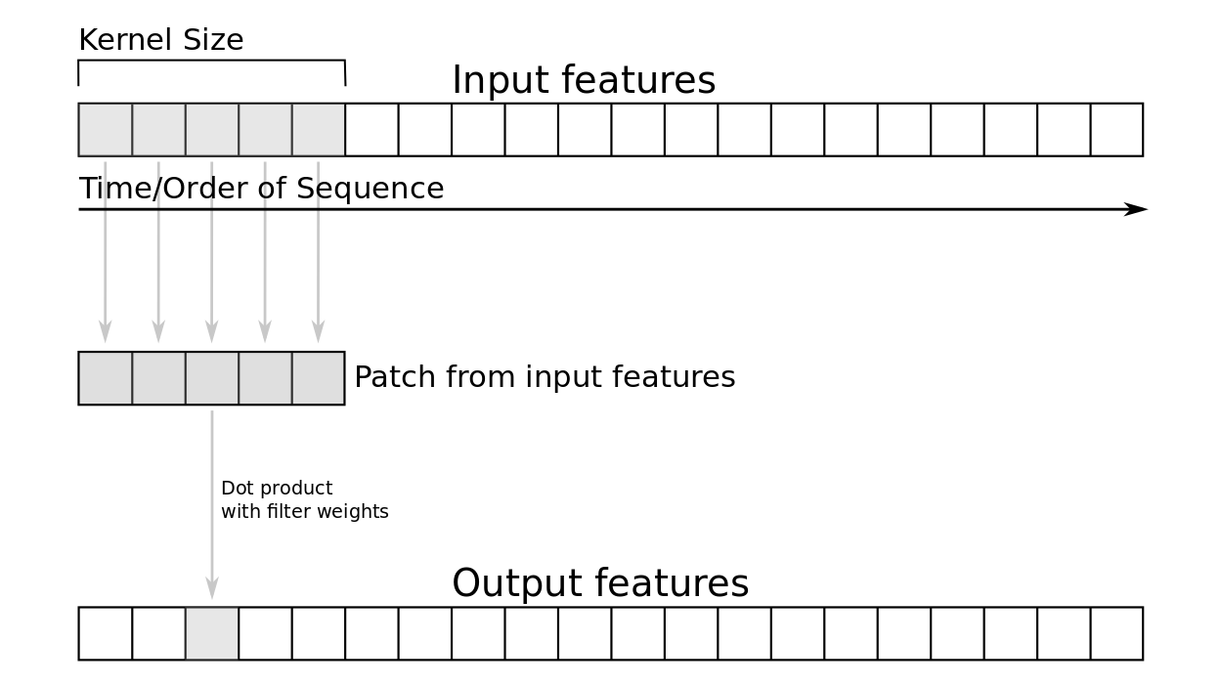
Deep Neural Networks CNN
A neural network with more than one hidden layer is considered a deep neural network.
Keras is the model-level library used . To handle low-level operations such as tensor manipulation and differentiation tensorflow is the backend engine of Keras.
CNN : It is a specialized neural network that can detect specific patterns which is used to discern the most important information in a sentence. The hidden layers called convolutional layer. I have used one dimensional CNN which is unaffected by translations The patch of filters slide filter slide over embedding matrix and extracts a specific pattern of n-gram.

Slide 13
CNN Layers Description
Embedding Layer of Keras which takes the previously calculated integers and maps them to a dense vector of the embedding using the embedding matrix from pre-trained word vectors.
Convulational layer
GlobalMaxPooling1D layer after the embedding layer to downsample (the maximum value of all features in the pool for each feature dimension)
Dense layer with Renu activation function
Dense layer with softmax activation function

Slide 14
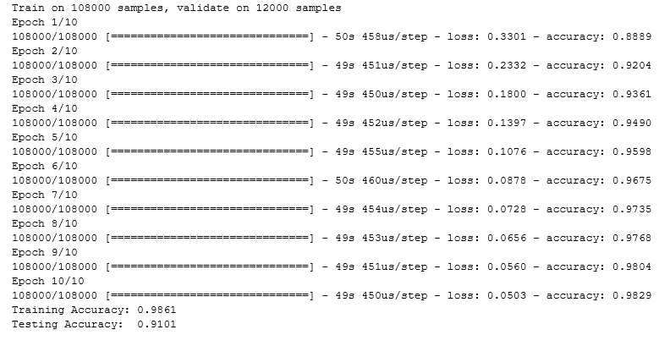
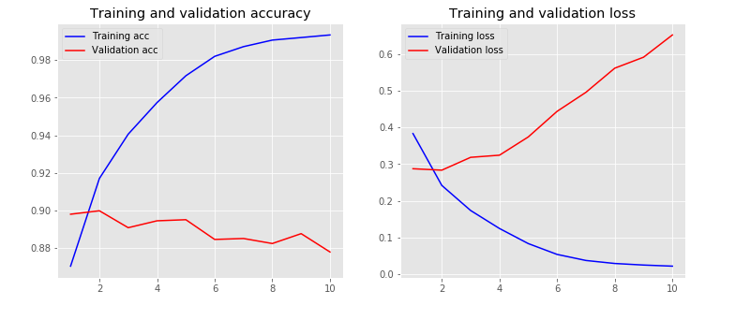
CNN Training

Slide 15
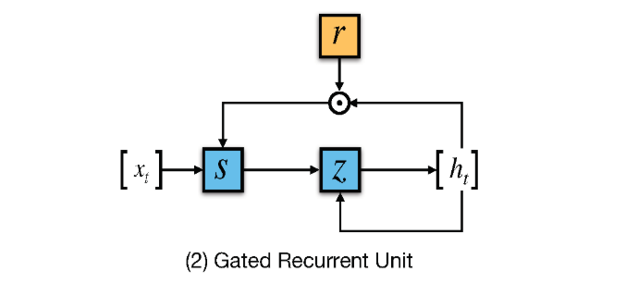
RNN
In RNN the activation outputs are propagated in both directions. It results in looping which provides a state to neurons giving it ability to remember the learnings.
The CNN layer is replaced by bidirectional GRU layer

Slide 16
Conclusion
While the classical models provided a good accuracy the neural network models improved it further. The highest accuracy achieved using CNN as 91%. With more data the deep learning models will outmatch classical models. Using word embedding provided an additional 2-3% improvement in accuracy and faster training time. CNN provided the best performance in neural networks but RNN still had good results. More training data could make RNN perform better than CNN.

