Slide 1
Trainee Data Analyst
Final Phase Presentation on Internship AY: 2024-25
Presented By
Hamsapriya N 1NT21EC052
Internship Guide
Dr. Viswanatha V
Associate Professor
Dept. of Electronics and Communication Engineering
Nitte Meenakshi Institute of Technology
Yelahanka, Bangalore-560064
Internship Supervisor ( External)
Name: Seema Syed
Designation: Project Manager
Department: IT
Address: Koramangala,Bengaluru
Dept. of Electronics and Communication Engineering, NMIT, Bengaluru

Slide 2
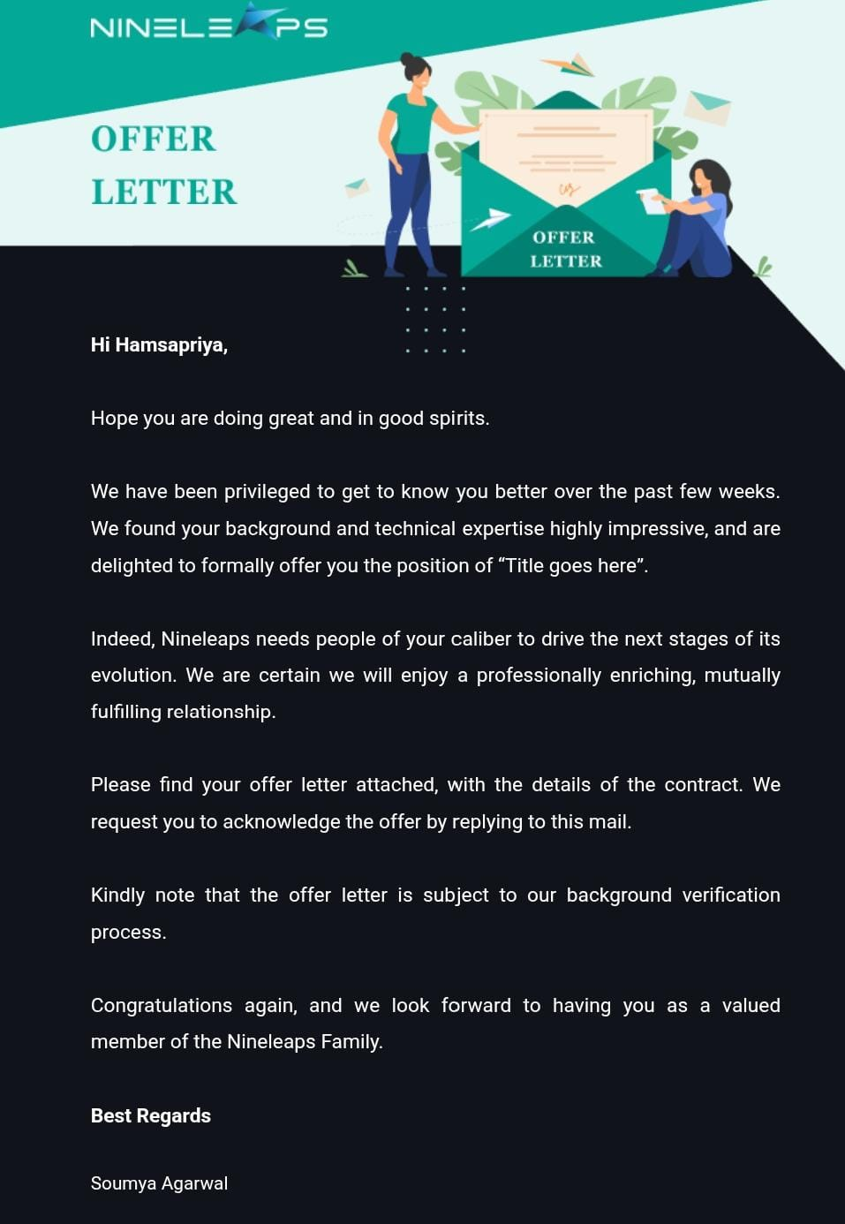
Permission Letter
Dept. of Electronics and Communication Engineering, NMIT, Bengaluru

Slide 3
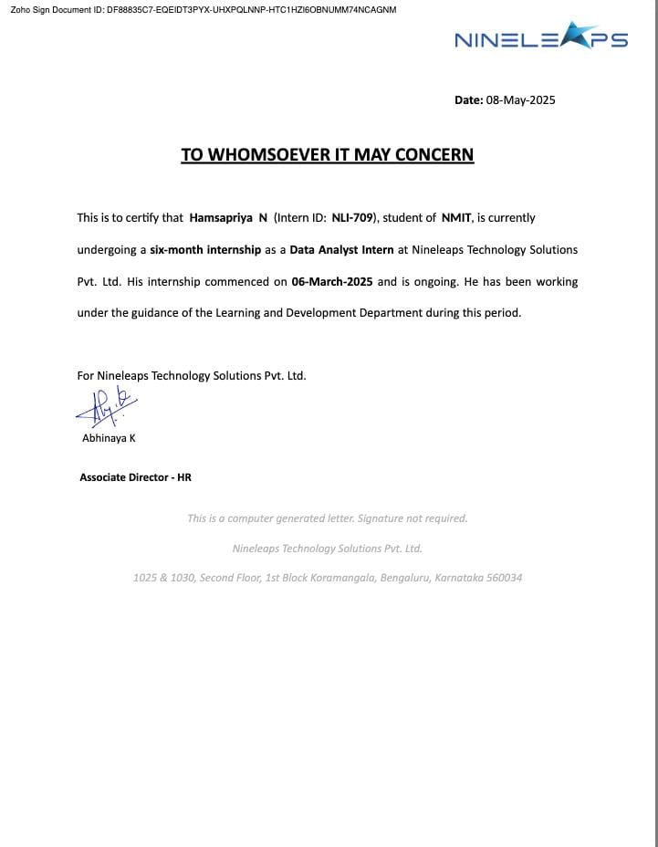
Internship Completion Certificate
Dept. of Electronics and Communication Engineering, NMIT, Bengaluru

Slide 4
Company Details
Organization Name: Nineleaps
Industry: IT
Department: Data analytics
Supervisor/Mentor: Seema Syed
Location of Internship : Koramangala, Bengaluru
Duration of Internship : 6 months
Starting Date of Internship: 6-Mar-2025
End Date of Internship: 6-Aug-2025
Dept. of Electronics and Communication Engineering, NMIT, Bengaluru

Slide 5
Presentation Outline
Introduction
Completed Work Overview
Tools & Technologies
Add Visuals
Detailed Project Outcomes
Challenges and Solutions
Future Goals
Conclusion
Dept. of Electronics and Communication Engineering, NMIT, Bengaluru 1

Slide 6
Introduction
Objective of the Internship
The primary objective of this internship was to gain hands-on experience in the IT sector and apply theoretical knowledge in a real-world professional setting. The internship provided exposure to real world data , helping to develop technical and professional skills.
Key Responsibilities
During the internship, I am assigned to the data analytics where my main tasks included:
Data Collection and Cleaning – Gather data from various sources like databases , Excel .Clean and preprocess the data by handling missing values, duplicates and formatting issues.
Data Analysis and Visualisation – Analyse data using tools like Excel,SQL ,Python to uncover trends , patterns and insights
Reporting and Communication – Prepare reports and dashboards to communicate insights to stakeholders
Dept. of Electronics and Communication Engineering, NMIT, Bengaluru 2

Slide 7
Completed Work Overview
Project: SQL Query Analysis for Uber (Internship Task)
Objective: Analyzed SQL queries and answered technical questions to support model training and/or evaluation.
Responsibilities:
Interpreted real-world SQL queries related to Uber’s business data.
Provided accurate, logical responses to query-based technical questions.
Contributed to the improvement of AI systems by validating SQL logic and intent.
Dept. of Electronics and Communication Engineering, NMIT, Bengaluru 3

Slide 8
Tools & Technologies
Google BigQuery – For executing and analyzing large-scale SQL queries on Uber datasets.
SQL – Core language for query logic and data analysis.
Google Sheets – Used to document responses and collaborate on tasks.
Basic Excel Functions – For supplementary data review and formatting.
Dept. of Electronics and Communication Engineering, NMIT, Bengaluru 4

Slide 9
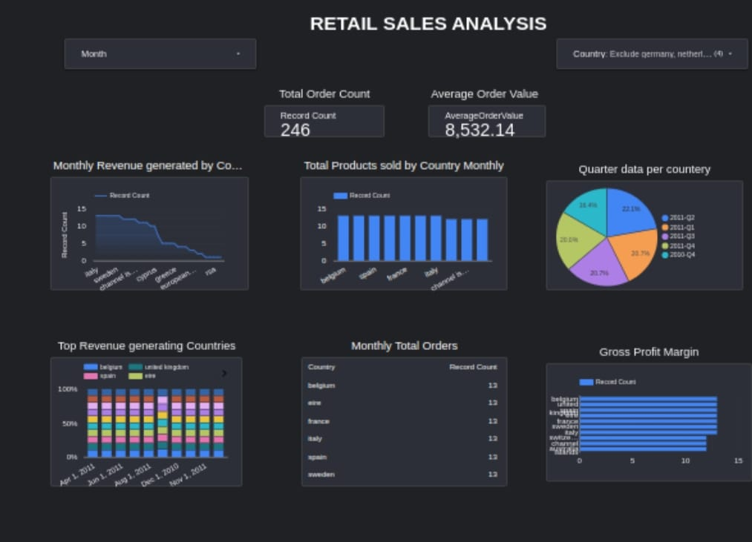
Add Visuals
Dept. of Electronics and Communication Engineering, NMIT, Bengaluru 4

Slide 10
Detailed Work Outcomes
Analyzed 150+ SQL Queries
Interpreted and evaluated complex SQL queries with joins, aggregations, subqueries, and window functions.
Real-world Data Interpretation
Worked with ride-sharing data to derive insights, mimicking Uber’s actual business scenarios.
Contributed to AI Model Training
Provided logical explanations and labels to help train and refine AI systems.
Efficient & Timely Delivery
Completed all assigned tasks before deadlines with effective time management.
Tools Used:
Google BigQuery, SQL, Google Sheets, Excel
Dept. of Electronics and Communication Engineering, NMIT, Bengaluru 4

Slide 11
Challenges and Solutions
Challenge 1: Interpreting complex SQL queries
Solution: Broke queries into smaller blocks to understand logic clearly.
Challenge 2: Understanding Uber's real-world dataset
Solution: Referred to schema documentation and analyzed similar patterns.
Challenge 3: Maintaining high accuracy under deadlines
Solution: Used checklists and peer-review approach before submission.
Challenge 4: Ambiguity in task instructions
Solution: Proactively asked for clarification and documented assumptions.
Challenge 5: First-time working with BigQuery
Solution: Took quick tutorials and practiced in sandbox before actual work.
Dept. of Electronics and Communication Engineering, NMIT, Bengaluru 4

Slide 12
Future Goals
Deepen Expertise in Data Analysis
Continue improving skills in SQL, Python, Pandas, and data visualization tools like looker studio.
Learn Advanced Analytics & AI Integration
Explore how data analysis supports AI/ML model development and decision systems.
Transition to Data Engineering Role
Gain knowledge in data pipelines, ETL processes, and tools like Apache Airflow, Spark, and BigQuery.
Contribute to Impactful Projects
Work on real-world data problems that enhance product decisions and user experience.
Dept. of Electronics and Communication Engineering, NMIT, Bengaluru 5

Slide 13
Conclusion
Gained practical experience in data analysis and visualization
Improved skills in SQL, Python, and data tools
Contributed to meaningful projects and problem-solving
Developed strong analytical and teamwork abilities
Ready to apply these skills in future data roles and continue learning
Dept. of Electronics and Communication Engineering, NMIT, Bengaluru 6

Slide 14
Thanks
I sincerely thank Nineleaps for providing this valuable internship opportunity.
Special thanks to my supervisor,Seema Syed, for continuous guidance and support.
I’m also grateful to my academic guide, Dr.Karunakara Rai B, for their mentorship throughout this journey.
Dept. of Electronics and Communication Engineering, NMIT, Bengaluru 6

