Slide 1
Banking Modelling Data
Prabhu Satya Kushal Mamillapally (G01285313)
Sai Sushanth Chandra Tanneru (G01247738)
Jyoti Mote (G01287487)
Sree Hari Vasudev Relangi (G01238644)

Slide 2
Why Banking Model?
In recent years, the number of people applying for loans has risen for a variety of reasons. Bank employees are unable to assess or foresee whether a borrower will be able to repay the loan (good or poor customer) at the specified interest rate. The classification aim is to forecast the probability of a liability consumer purchasing personal loans, we developed a model that will be used to determine which customers are most likely to approve a personal loan deal based on their relationship with the bank as well as other features in the dataset. We used two methods to predict which model, out of Logistic Regression and Random Forest is best suitable.

Slide 3
About Dataset
The dataset contains data on 5000 customers and 14 attributes. Customers' demographic details (age, income, Family ,Education ,Experience ,Income ,.), their arrangement with the bank (mortgage, securities accounts, pending on credit cards,CD Account, Online banking, Credit Card ), and their reaction to the previous personal loan initiative are all included in the results (Personal Loan).

Slide 4
Learning Outcomes
Exploratory Data Analysis
Data Cleaning
Data Visualization
Preparing the data to train a model
Training and making predictions using a classification model
Model evaluation

Slide 5
Data Preprocessing
The dataset is clean dataset. It has no null values and no missing values. There few negative number in experience which are very few. We replaced it by checking it with experience of similar characteristics like age and education. Which will help it in the precision of the dataset in further analysis.

Slide 6
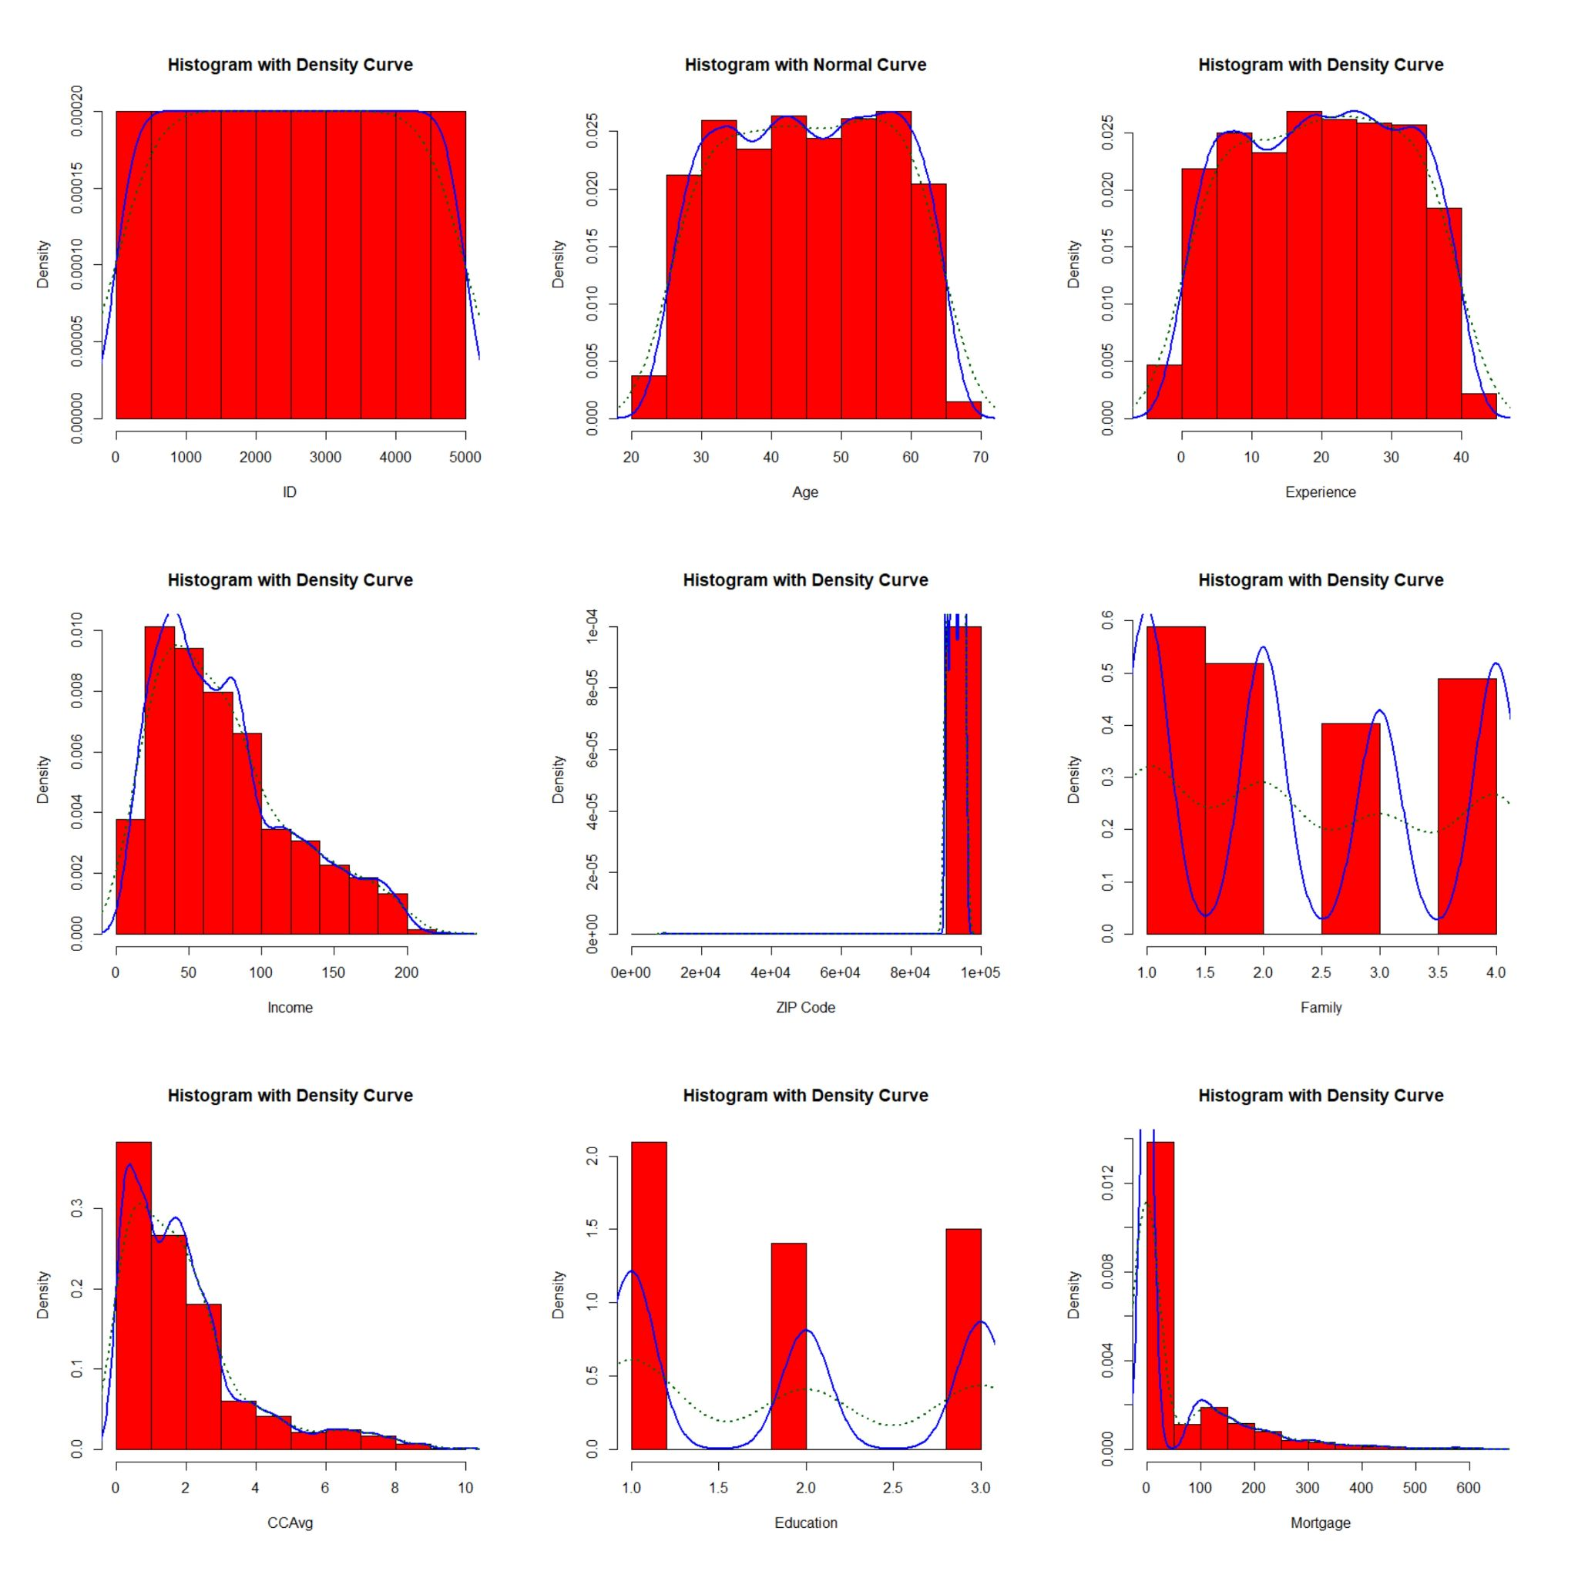
Data Visualization
As we can see from the data that ID is uniformly distributed. Age, Experience is normally distributed. Income distribution is is right skewed distribution because the tail goes to the right. Zip is uniformly distributed as datapoint are more with family size 1 and 2. CCAvg is right skewed distribution. In education UG level customers are more than the graduate and advance/professional customers. Also the mortgage is right skewed distribution.

Slide 7
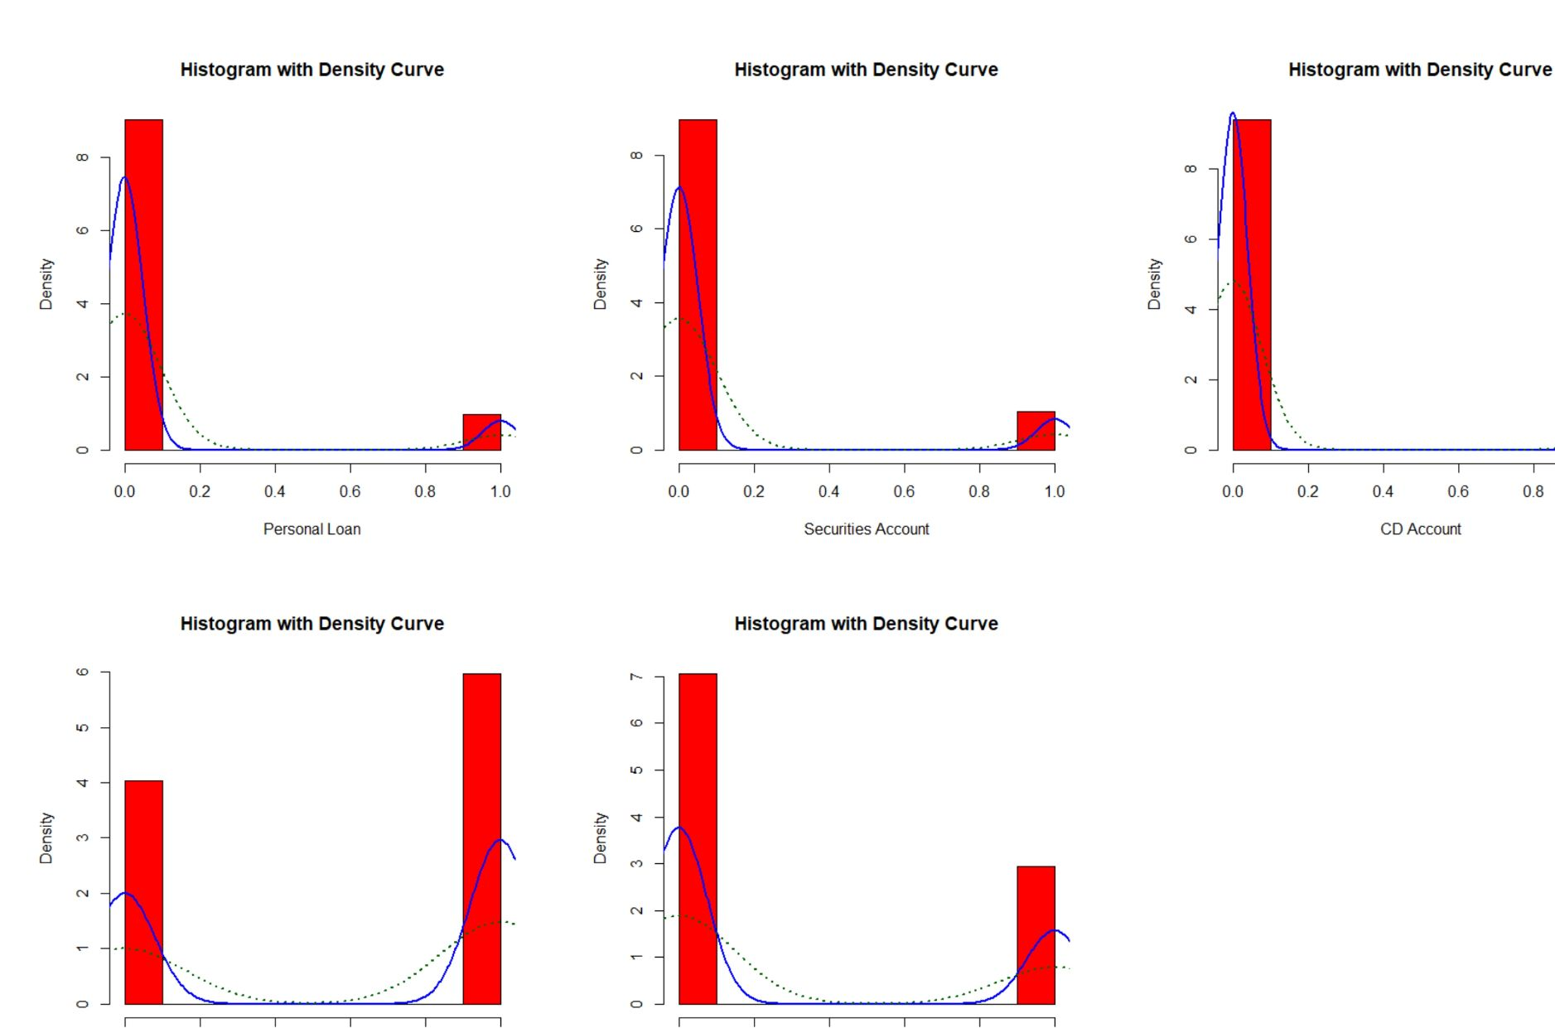
Mortgage is distribution is a right skewed distribution because the tail goes to the right. The online, credit card is Bernoulli Distribution as the number of customer who use these > the number who do not have use them.

Slide 8
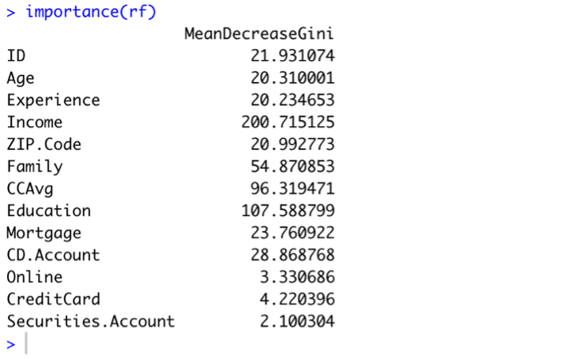
Why for Random Forest
Reason why we choose random forest are:
• The missing values will be handled by the random forest classifier, which will ensure the precision of a significant portion of the data.
• There will be no over-fitting trees in the model if there are more trees, it can accommodate a broad data set with a higher dimensionality.
• The most important reason for us to choose the model is it provides higher accuracy through cross validation.

Slide 9
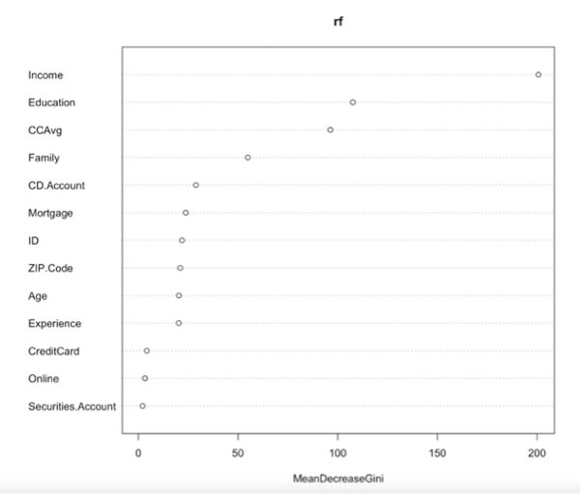
Why for Random Forest
Random forest is machine learning method which are made up of multiple decision trees using random subset feature and it make decision after comparing to multiple trees and picks the one with the best accuracy.
Reason why we choose random forest are:
•There will be no overfitting trees in the model if there are more trees, it can accommodate a broad data set with a higher dimensionality.
•The most important reason for us to choose the model is it provides higher accuracy through cross validation.

Slide 10
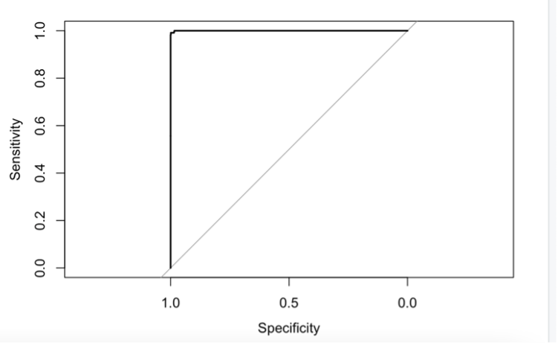
Outcomes
• The model has highest accuracy of 98%.
• Income is the most important variable that is influencing the model.

Slide 11
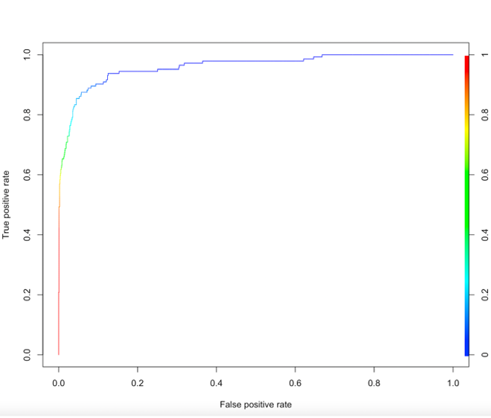
Why Logistic Regression?
• When the dependent variable is binary, logistic regression is the best regression analysis to use.
• To characterize data and illustrate the relationship between one dependent binary variable and one or more nominal, ordinal, interval, or ratio-level independent variables, logistic regression is used.
• . Logistic regression model is easier to implement, interpret, and efficient to train.

Slide 12
Outcomes
• one unit increase in the value of Income, the dependent variable increases by a factor of 1.066 times, when other independent variables are constant.
• The accuracy of the training set and test set was found out to be 95.84%.

Slide 13
Conclusion
• The accuracy of the Logistic regression was found out to be 95.48%
• The accuracy of the Random Forest was found out to be 98.81%
• The most important variable for predicting if the customer accepts the loan are the same in both the models which are Income, Education, CCAvg, Family and CD.Account with an exception of Credit Card in the Logistic Regression.

Slide 14

Thank You !!

