Slide 1
AWS Solution architect associate
By Kushal Kumar Naidu

Slide 2
What is aws
Amazon web services is the world’s most broadly adopted cloud platform.
It has around 200 services spread across its data centers globally.
Millions of customers ranging from startups to multinational companies are using the AWS to lower costs, become more agile and innovate faster.

Slide 3
History of aws
2002 – internally launches in Amazon.
2003 – Amazon infrastructure is one of their core strength, started idea to market.
2004 – launched publicly with SQS (Simple Queue Service).
2006 – relaunched publicly with SQS, S3, EC2.
2007 – Launched in Europe.
2010 – became global.

Slide 4
Aws cloud use cases
Aws enables you to build sophisticated, scalable applications.
Applicable to a diverse set of industries like Netflix, McDonalds, 21st Century Fox etc.
Use cases include:
Enterprise IT
Creating back up & storage for apps
Big data analytics
Hosting web & mobile applications
Gaming.

Slide 5
Aws is a global infrastructure
Aws is currently spread across the globe hence it has a global infrastructure.
It manages its infrastructure through different domains called as:
Regions
Availability zones
Data centers
Edge locations / point of presence

Slide 6
Aws regions
Aws region is cluster of data centers.
Most aws services are region scoped.
Aws regions are all around the world with names like
Us-east-1
Eu-west-2
There are several factors to be considered before choosing an aws region.

Slide 7
How to choose an aws region
Compliance – with the data governance and legal requirements.
Proximity to customers – reduced latency.
Availability of services in the region – new services are not available in every region.
Pricing – pricing varies region to region.

Slide 8
aws Availability zones
Each aws region has many availability zones. (usually 3, min 2 and max 6)
Each AZ is one or more discrete data centers with redundant power, networking and connectivity.
They are separate from each other, so that they are isolate from disaster.
They are connected with high bandwidth and low latency networking.

Slide 9
Aws point of presence / edge locations
Amazon has 216 point of presence (205 edge locations and 11 regional caches) in 84 cities across 42 countries.
The main purpose of edge locations is that Content is delivered to end users with lower latency.

Slide 10
Iam (identity access management)
IAM is a global service.
We create users and assign groups for the users.
Groups only contain users not groups.
Users don’t have to belong to a group & users can also belong to multiple groups.

Slide 11
Iam permissions
Users or groups can be assigned JSON documents called policies that describe what are the users and groups allowed & not allowed.
These policies define the permissions of the users.
In AWS you apply least privileges principle, making sure the user doesn’t have permissions more than required.

Slide 12
Iam policy inheritance
We can assign a policy to a group all users in the group will have the policies.
If the user is not in any group then we can assign an inline policy only to the user.
If the user is in two different groups then the user will have policies of both the groups.

Slide 13
Aws ec2 basics
What is EC2?
EC2 stands for Elastic Compute Cloud, it is an infrastructure as a service. It is a virtual server or machine.
It is one of the most popular AWS services.
It mainly consists of capability to:
Renting virtual machines (EC2)
Storing data on VM (EBS)
Distributing load across machines (ELB)
Scaling the services using auto scaling group (ASG)

Slide 14
Ec2 sizing and configuration options
It allows us to choose out virtual machine based on the needs.
Operation system – Linux, windows or mac os.
How much power & core is required (CPU).
How much random-access memory is required (RAM).
How much storage space is required
Network card: speed of the card, public IP address.
Firewall rules: security groups.

Slide 15
Ec2 user data
It is possible to bootstrap our instances using an EC2 user data script.
What is bootstrapping?
It means launching commands when a machine starts.
That script is only run once at the first instance.
EC2 user data is used to automate boot tasks such as:
Installing updates
Installing software, downloading common files from internet
Anything else you thing of.

Slide 16
Ec2 instance types: examples
INSTANCE | VCPU | MEM(GB) | STORAGE | N/W PERF | EBS BANDWIDTH
T2.micro | 1 | 1 | EBS-only | Low to moderate
T2.xlarge | 4 | 16 | EBS-only | Moderate
C5d.4xlarge | 16 | 32 | 1x400 nvme ssd | Upto 10gbps | 4750
R5.16xlarge | 64 | 512 | EBS-only | 20gbps | 13600
M5.8xlarge | 32 | 128 | EBS-only | 10gbps | 6800
There are 100’s of instance types the above table is just a basic representation of few of them.

Slide 17
Launching an ec2 instance running on linux
Step 1: Choose an Amazon Machine Image (AMI)
Step 2: Choose an instance type
Step 3: Configure instance details
Step 4: Add storage
Step 5: Add tags
Step 6: Configure security group
Step 7: Review instance launch

Slide 18
Ec2 instance types
AWS keeps on upgrading the no of instances, but they are categorized in to the below types:
General purpose instance types
Compute optimized instance types
Memory optimized instance types
Storage optimized instance types

Slide 19
General purpose instance types
This instance type is great for diversity of workloads such as web servers or code repositories.
It has proper balance between:
Compute
Memory
Network

Slide 20
Compute optimized instance types
This type of instances are great for intensive tasks that require high performance processors.
Use cases:
Batch processing workloads
Media transcoding
High performance web servers
High performance computing (HPC)
Machine learning
Gaming servers

Slide 21
Memory optimized instance types
Fast performance for workloads that process large data sets in memory.
Use cases:
High performance databases
Distributed web scale cache stores
Business intelligence
Applications performing real time processing of big real time deals

Slide 22
Storage optimized instance types
This instance type is great for storage intensive tasks that require high, sequential read and write access to large data sets on local storage.
Use cases:
High frequency online transaction processing system
Relational and NoSQL databases
Cache for in-memory databases
Data warehousing applications
Distributed file systems

Slide 23
Security groups in ec2
Security group are fundamental of networking in AWS
They control how traffic is allowed into or out of our ec2 instances.
Security group only contains allow rules.
Security group can reference by IP or by other security group
Security group acts as firewall on EC2 instances.
They regulate:
Access to ports
Authorized IP ranges- IPV4 & IPV6
Control of inbound & outbound network.

Slide 24
Security groups in ec2 contd..
They can be attached to multiple instances, similarly an EC2 instance can have multiple security groups.
Security groups are locked down to a region/VPC combination. (meaning if we change the region or VPC then the security group will not be present)
Its good to maintain one separate security group for SSH access.
If your application is not accessible(time out) then it’s a security group issue.

Slide 25
Security groups in ec2 contd.,
If your application gives a connection refused error, then its an application error or its not launched.
All inbound traffic is blocked by default.
All outbound traffic is authorized by default.
Referencing other security group:
if the EC2 instance is attached with a security group 1 and has inbound rules with authorized to security group 1 and security group 2, then another EC2 instances with security group 1 & 2 can access the EC2 instance, whereas the EC2 instance with security group 3 cannot access it.

Slide 26
Classic ports to know
22 – SSH (secure shell) – log in to a Linux instance.
21 – FTP (file transfer protocol) – upload files using file share.
22 – SFTP (secure file transfer protocol) – upload file using SSH.
80 – HTTP – access unsecured website.
443 – HTTPS – access secured website.
3389 – RDP – (remote desktop protocol) – log into a remote windows instance.

Slide 27
Ssh (secure shell)
SSH us a command line utility that we can use in mac, Linux & windows>10.
For windows<=10 we can use putty.
In AWS we can also use WC2 instance connect which works on all OS types.
SSH is one of the most important function it allows you to control a remote machine by using the command line.

Slide 28
How to ssh using linux / Mac os
Open the terminal.
Copy the .pem file of the EC2 instance to any directory. (change mode of the file to 0400)
Copy the IPV4 public IP from the EC2 instance (Make sure that the security group inbound rule is set for SSH).
Then type the command ssh ec2-user @IP (here the IP is the copied IP address).
Now you will be into EC2 machine.
To exit just type exit.

Slide 29
Ec2 instance connect
This option is currently working for only the ubuntu and amazon linux 2 AMI’S.
This type of the connection also depends on the SSH so if the SSH rule is not included in the security group then this wont work though it is browser based.
To connect:
Select your instance.
Click on connect.
Select EC2 instance connect.
Give a username.
Click on connect.

Slide 30
ec2 purchasing options
On demand instances – they are good for short workload, predictable pricing, pay by second.
Reversed instances (1 & 3 years) – they are good for long work loads.
Convertible reversed instances (1 & 3 years) - long work loads with flexible instances.
Savings plan (1 & 3 years) – commitment to an amount of usage(instead of committing to instances), long workloads.
Spot instances – short workloads, very cheap, can lose instances (less reliable).
Dedicated hosts – book an entire physical server, control instance placement.
Dedicated instances – no other customers will share your hardware.
Capacity reservations – reserve capacity in a specific AZ for any duration.

Slide 31
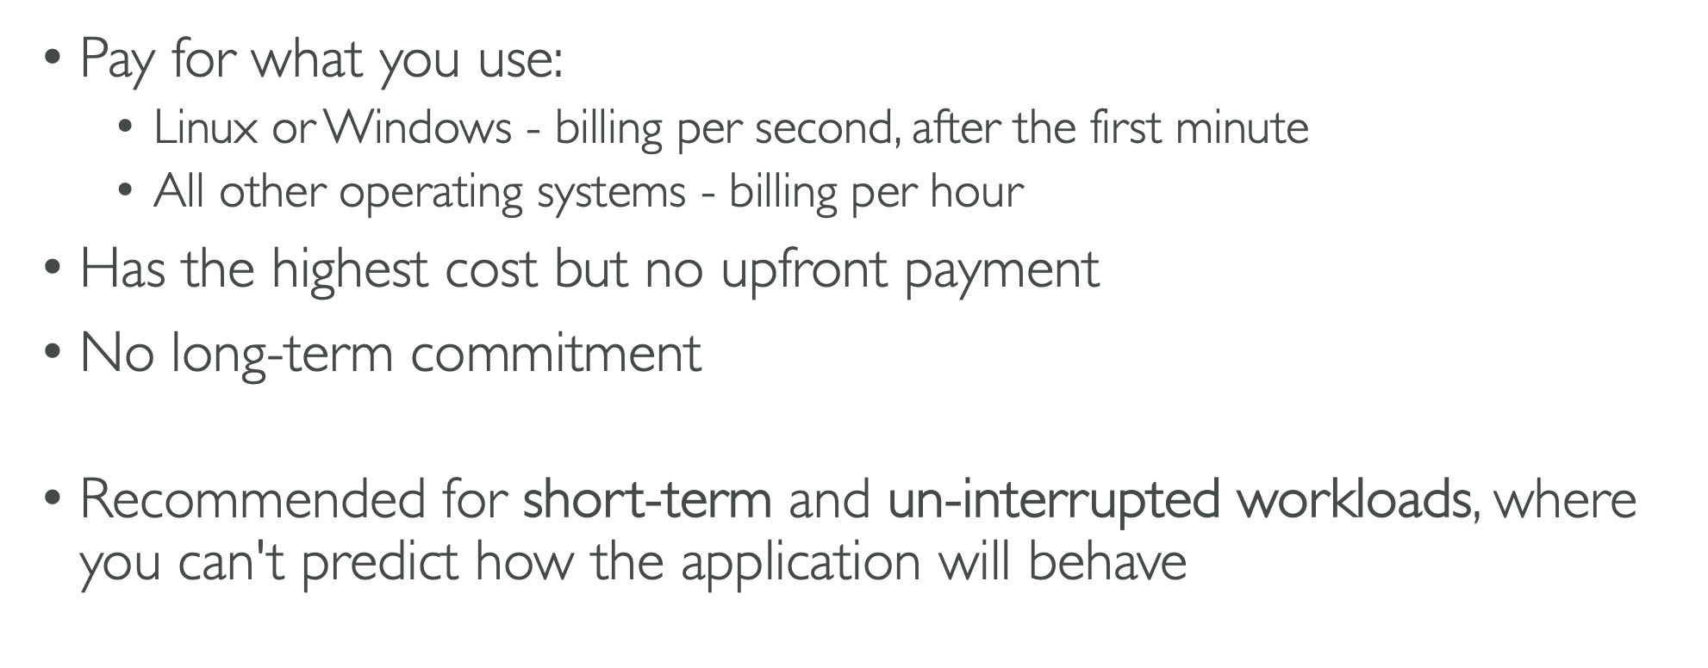
Pay on demand

Slide 32
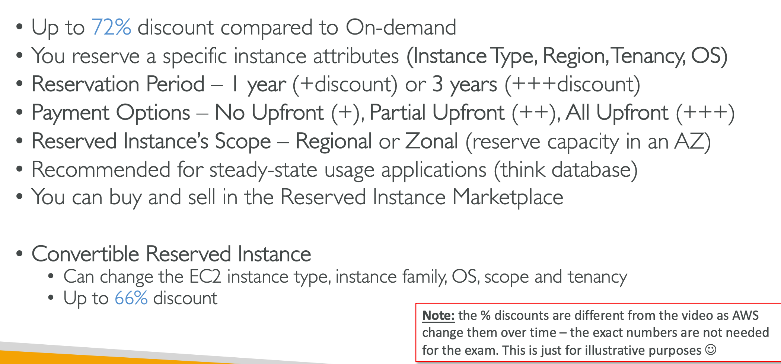
Ec2 reserved instances

Slide 33
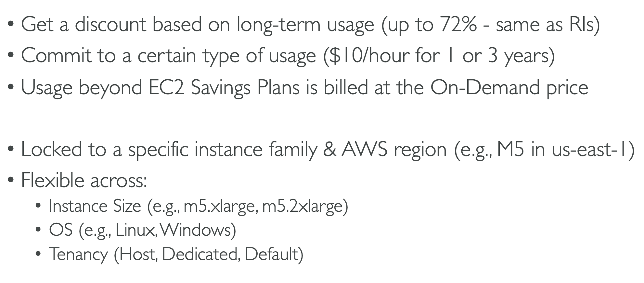
Ec2 savings plan

Slide 34
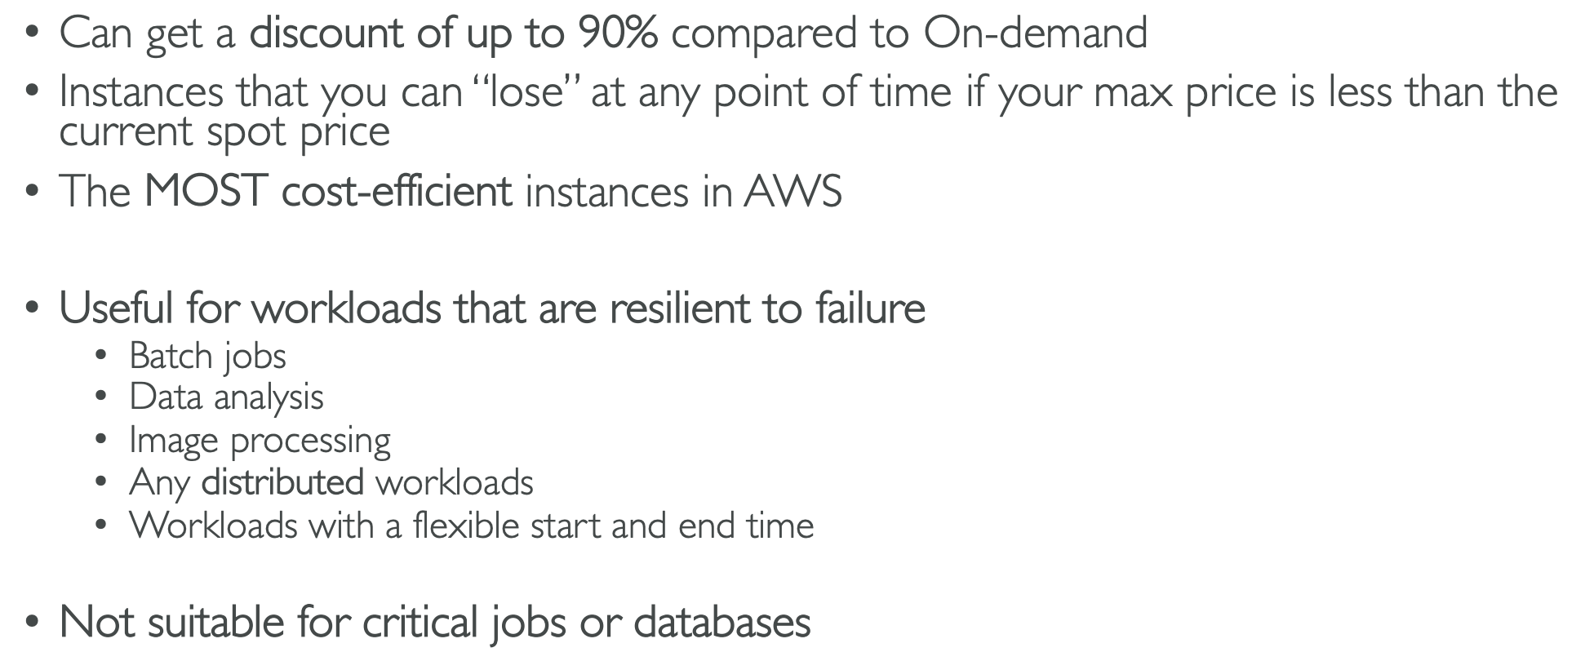
Ec2 spot instances

Slide 35
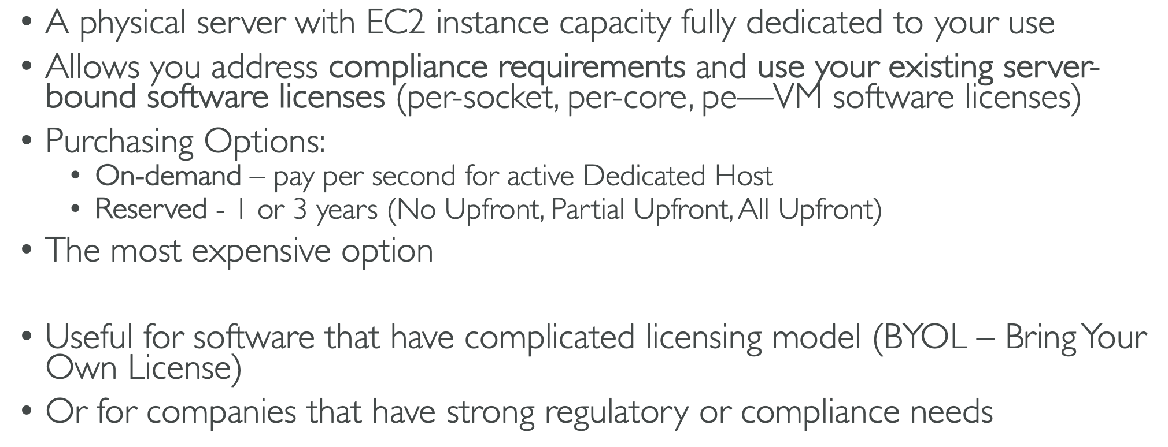
Ec2 dedicated hosts

Slide 36
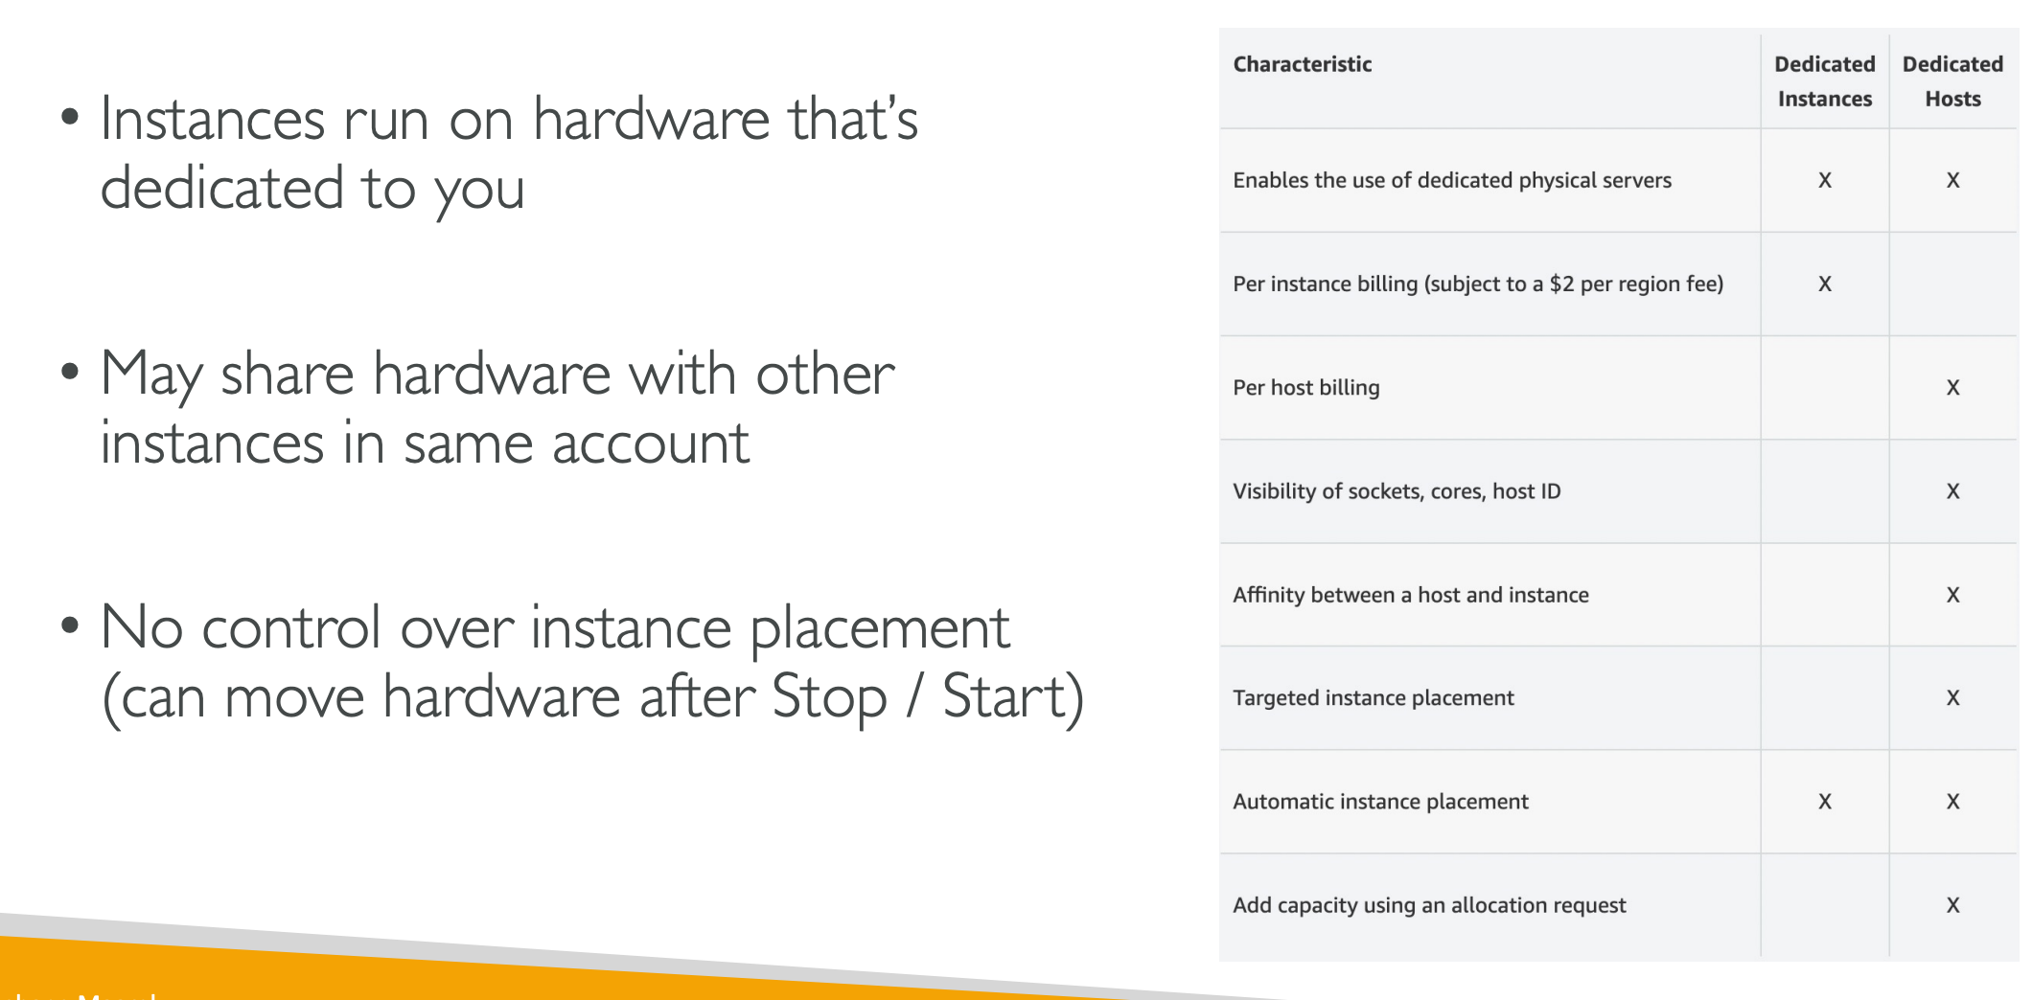
Ec2 dedicated instances

Slide 37
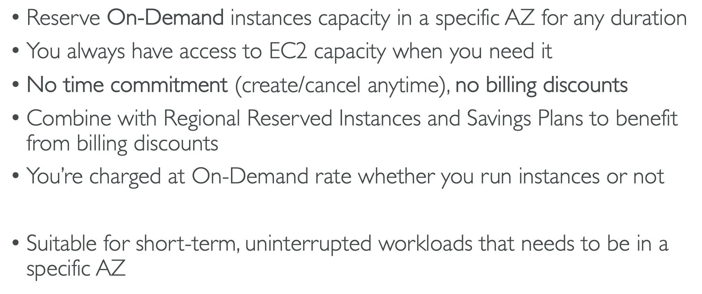
Ec2 capacity reservations

Slide 38
Which purchasing option is right for me?
Example – resort
On demand – coming and staying in resort whenever we like, we pay the full price.
Reserved – like planning ahead and if we plan to stay for too long time, we may get a good discount.
Savings plans – pay a certain amount per hour for certain period and stay in any room type.
Spot instances – the hotel allows people to bid for the empty rooms and the highest bidder keeps the rooms. You can get kicked out at any time.
Dedicated hosts – we book an entire building of the resort.
Capacity reservations – you book a room for a period with full price even you don’t stay in it.

