Slide 1
AWS Solution architect associate
By Kushal Kumar Naidu

Slide 2
What is cloud computing
Cloud computing is the on-demand delivery of IT resources over the internet with pay as you go pricing.
Instead of buying and maintaining the physical resources like data centers, server, computing power and databases, we can just use the resources virtually from the cloud provider.
Who is using cloud computing?
It is been by organizations of every type, size and industry. It can be a start up to a multi-national company or it can also be an individual who is using the cloud services.

Slide 3
Top cloud providers in the world
Amazon Web Services
Microsoft Azure
Google Cloud Platform
Alibaba Cloud
IBM

Slide 4
What is aws
Amazon web services is the world’s most broadly adopted cloud platform.
It has around 200 services spread across its data centers globally.
Millions of customers ranging from startups to multinational companies are using the AWS to lower costs, become more agile and innovate faster.

Slide 5
History of aws
2002 – internally launches in Amazon.
2003 – Amazon infrastructure is one of their core strength, started idea to market.
2004 – launched publicly with SQS (Simple Queue Service).
2006 – relaunched publicly with SQS, S3, EC2.
2007 – Launched in Europe.
2010 – became global.

Slide 6
Aws cloud use cases
Aws enables you to build sophisticated, scalable applications.
Applicable to a diverse set of industries like Netflix, McDonalds, 21st Century Fox etc.
Use cases include:
Enterprise IT
Creating back up & storage for apps
Big data analytics
Hosting web & mobile applications
Gaming.

Slide 7
Aws is a global infrastructure
Aws is currently spread across the globe hence it has a global infrastructure.
It manages its infrastructure through different domains called as:
Regions
Availability zones
Data centers
Edge locations / point of presence

Slide 8
Aws regions
Aws region is cluster of data centers.
Most aws services are region scoped.
Aws regions are all around the world with names like
Us-east-1
Eu-west-2
There are several factors to be considered before choosing an aws region.

Slide 9
How to choose an aws region
Compliance – with the data governance and legal requirements.
Proximity to customers – reduced latency.
Availability of services in the region – new services are not available in every region.
Pricing – pricing varies region to region.

Slide 10
aws Availability zones
Each aws region has many availability zones. (usually 3, min 2 and max 6)
Each AZ is one or more discrete data centers with redundant power, networking and connectivity.
They are separate from each other, so that they are isolate from disaster.
They are connected with high bandwidth and low latency networking.

Slide 11
Aws point of presence / edge locations
Amazon has 216 point of presence (205 edge locations and 11 regional caches) in 84 cities across 42 countries.
The main purpose of edge locations is that Content is delivered to end users with lower latency.

Slide 12
Iam (identity access management)
IAM is a global service.
We create users and assign groups for the users.
Groups only contain users not groups.
Users don’t have to belong to a group & users can also belong to multiple groups.

Slide 13
Iam permissions
Users or groups can be assigned JSON documents called policies that describe what are the users and groups allowed & not allowed.
These policies define the permissions of the users.
In AWS you apply least privileges principle, making sure the user doesn’t have permissions more than required.

Slide 14
Iam policy inheritance
We can assign a policy to a group all users in the group will have the policies.
If the user is not in any group then we can assign an inline policy only to the user.
If the user is in two different groups then the user will have policies of both the groups.

Slide 15
Aws ec2 basics
What is EC2?
EC2 stands for Elastic Compute Cloud, it is an infrastructure as a service. It is a virtual server or machine.
It is one of the most popular AWS services.
It mainly consists of capability to:
Renting virtual machines (EC2)
Storing data on VM (EBS)
Distributing load across machines (ELB)
Scaling the services using auto scaling group (ASG)

Slide 16
Ec2 sizing and configuration options
It allows us to choose out virtual machine based on the needs.
Operation system – Linux, windows or mac os.
How much power & core is required (CPU).
How much random-access memory is required (RAM).
How much storage space is required
Network card: speed of the card, public IP address.
Firewall rules: security groups.

Slide 17
Ec2 user data
It is possible to bootstrap our instances using an EC2 user data script.
What is bootstrapping?
It means launching commands when a machine starts.
That script is only run once at the first instance.
EC2 user data is used to automate boot tasks such as:
Installing updates
Installing software, downloading common files from internet
Anything else you thing of.

Slide 18
Ec2 instance types: examples
INSTANCE | VCPU | MEM(GB) | STORAGE | N/W PERF | EBS BANDWIDTH
T2.micro | 1 | 1 | EBS-only | Low to moderate
T2.xlarge | 4 | 16 | EBS-only | Moderate
C5d.4xlarge | 16 | 32 | 1x400 nvme ssd | Upto 10gbps | 4750
R5.16xlarge | 64 | 512 | EBS-only | 20gbps | 13600
M5.8xlarge | 32 | 128 | EBS-only | 10gbps | 6800
There are 100’s of instance types the above table is just a basic representation of few of them.

Slide 19
Launching an ec2 instance running on linux
Step 1: Choose an Amazon Machine Image (AMI)
Step 2: Choose an instance type
Step 3: Configure instance details
Step 4: Add storage
Step 5: Add tags
Step 6: Configure security group
Step 7: Review instance launch

Slide 20
Ec2 instance types
AWS keeps on upgrading the no of instances, but they are categorized in to the below types:
General purpose instance types
Compute optimized instance types
Memory optimized instance types
Storage optimized instance types

Slide 21
General purpose instance types
This instance type is great for diversity of workloads such as web servers or code repositories.
It has proper balance between:
Compute
Memory
Network

Slide 22
Compute optimized instance types
This type of instances are great for intensive tasks that require high performance processors.
Use cases:
Batch processing workloads
Media transcoding
High performance web servers
High performance computing (HPC)
Machine learning
Gaming servers

Slide 23
Memory optimized instance types
Fast performance for workloads that process large data sets in memory.
Use cases:
High performance databases
Distributed web scale cache stores
Business intelligence
Applications performing real time processing of big real time deals

Slide 24
Storage optimized instance types
This instance type is great for storage intensive tasks that require high, sequential read and write access to large data sets on local storage.
Use cases:
High frequency online transaction processing system
Relational and NoSQL databases
Cache for in-memory databases
Data warehousing applications
Distributed file systems

Slide 25
Security groups in ec2
Security group are fundamental of networking in AWS
They control how traffic is allowed into or out of our ec2 instances.
Security group only contains allow rules.
Security group can reference by IP or by other security group
Security group acts as firewall on EC2 instances.
They regulate:
Access to ports
Authorized IP ranges- IPV4 & IPV6
Control of inbound & outbound network.

Slide 26
Security groups in ec2 contd..
They can be attached to multiple instances, similarly an EC2 instance can have multiple security groups.
Security groups are locked down to a region/VPC combination. (meaning if we change the region or VPC then the security group will not be present)
Its good to maintain one separate security group for SSH access.
If your application is not accessible(time out) then it’s a security group issue.

Slide 27
Security groups in ec2 contd.,
If your application gives a connection refused error, then its an application error or its not launched.
All inbound traffic is blocked by default.
All outbound traffic is authorized by default.
Referencing other security group:
if the EC2 instance is attached with a security group 1 and has inbound rules with authorized to security group 1 and security group 2, then another EC2 instances with security group 1 & 2 can access the EC2 instance, whereas the EC2 instance with security group 3 cannot access it.

Slide 28
Classic ports to know
22 – SSH (secure shell) – log in to a Linux instance.
21 – FTP (file transfer protocol) – upload files using file share.
22 – SFTP (secure file transfer protocol) – upload file using SSH.
80 – HTTP – access unsecured website.
443 – HTTPS – access secured website.
3389 – RDP – (remote desktop protocol) – log into a remote windows instance.

Slide 29
Ssh (secure shell)
SSH us a command line utility that we can use in mac, Linux & windows>10.
For windows<=10 we can use putty.
In AWS we can also use WC2 instance connect which works on all OS types.
SSH is one of the most important function it allows you to control a remote machine by using the command line.

Slide 30
How to ssh using linux / Mac os
Open the terminal.
Copy the .pem file of the EC2 instance to any directory. (change mode of the file to 0400)
Copy the IPV4 public IP from the EC2 instance (Make sure that the security group inbound rule is set for SSH).
Then type the command ssh ec2-user @IP (here the IP is the copied IP address).
Now you will be into EC2 machine.
To exit just type exit.

Slide 31
Ec2 instance connect
This option is currently working for only the ubuntu and amazon linux 2 AMI’S.
This type of the connection also depends on the SSH so if the SSH rule is not included in the security group then this wont work though it is browser based.
To connect:
Select your instance.
Click on connect.
Select EC2 instance connect.
Give a username.
Click on connect.

Slide 32
ec2 purchasing options
On demand instances – they are good for short workload, predictable pricing, pay by second.
Reversed instances (1 & 3 years) – they are good for long work loads.
Convertible reversed instances (1 & 3 years) - long work loads with flexible instances.
Savings plan (1 & 3 years) – commitment to an amount of usage(instead of committing to instances), long workloads.
Spot instances – short workloads, very cheap, can lose instances (less reliable).
Dedicated hosts – book an entire physical server, control instance placement.
Dedicated instances – no other customers will share your hardware.
Capacity reservations – reserve capacity in a specific AZ for any duration.

Slide 33
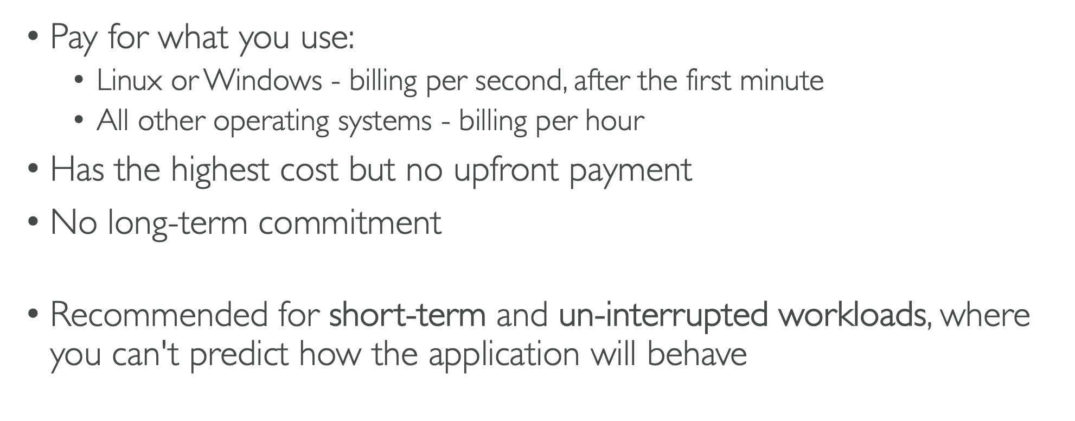
Pay on demand

Slide 34
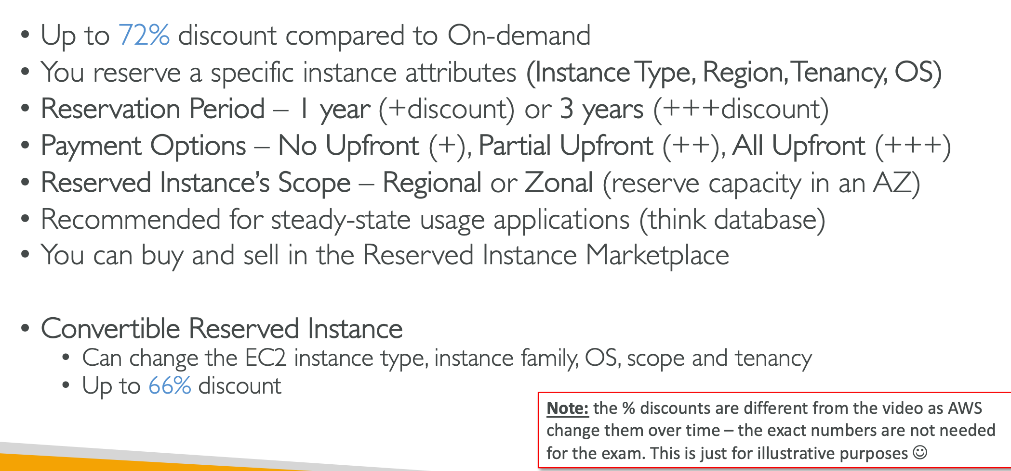
Ec2 reserved instances

Slide 35
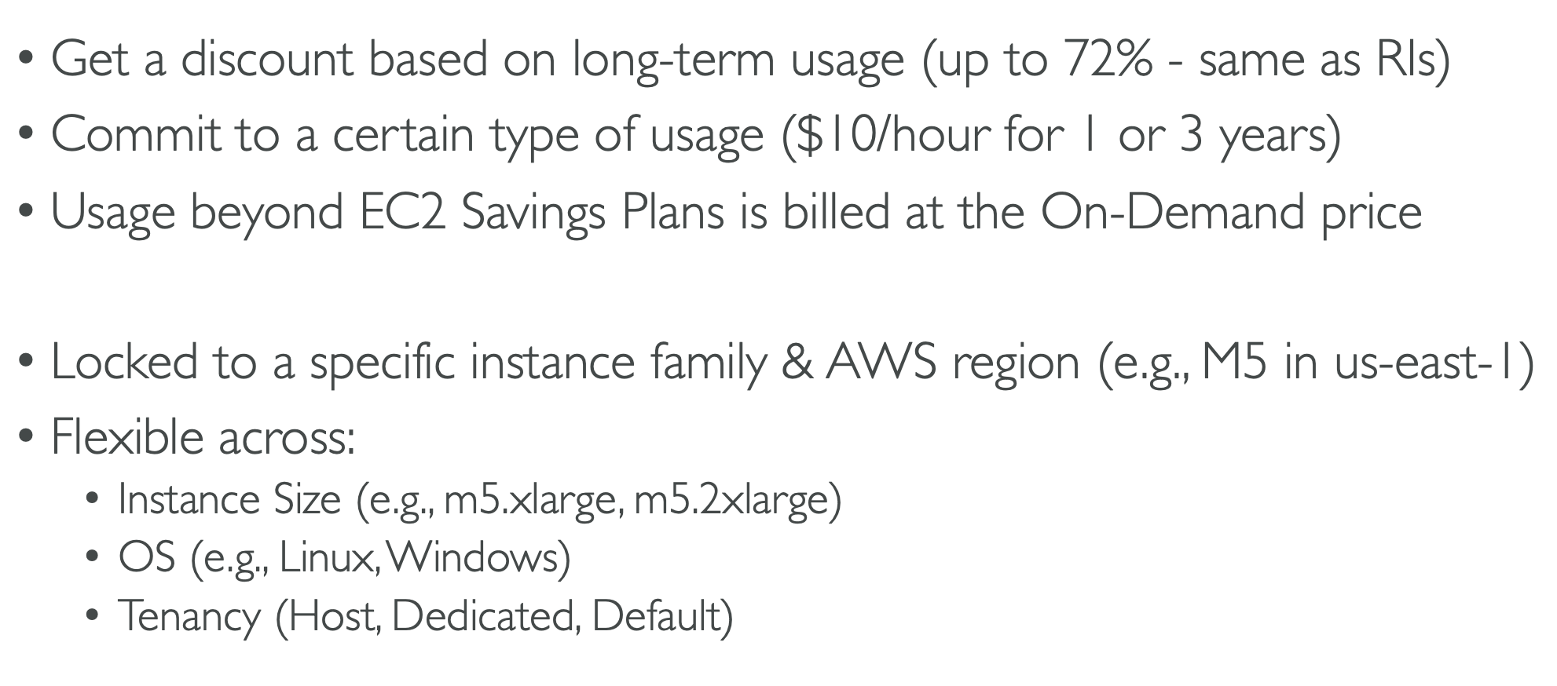
Ec2 savings plan

Slide 36
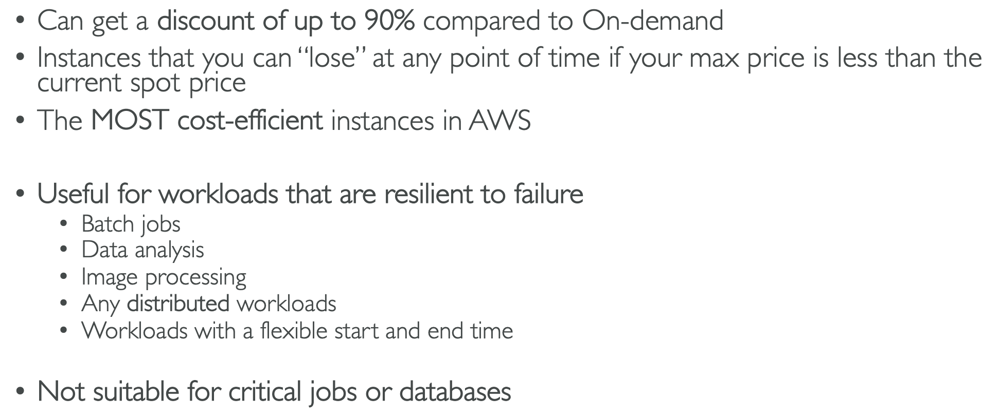
Ec2 spot instances

Slide 37
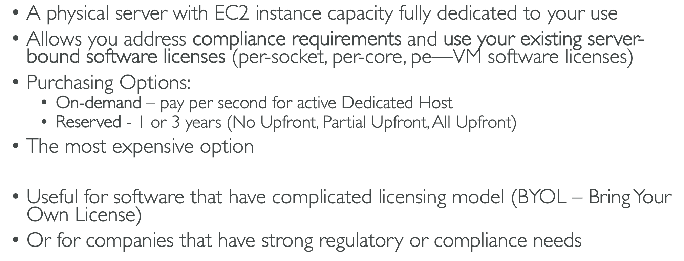
Ec2 dedicated hosts

Slide 38
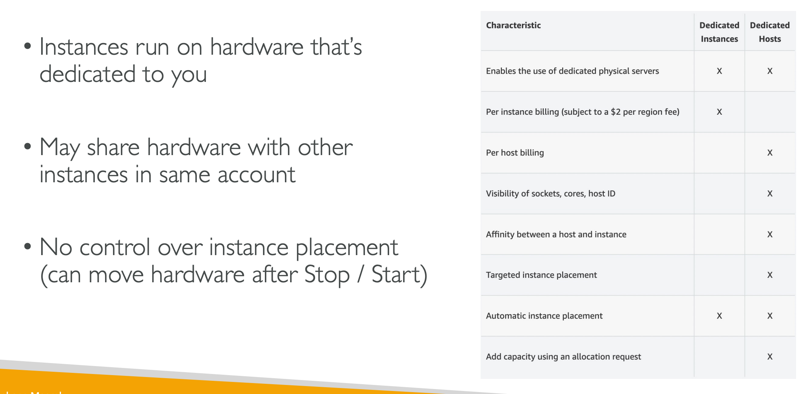
Ec2 dedicated instances

Slide 39
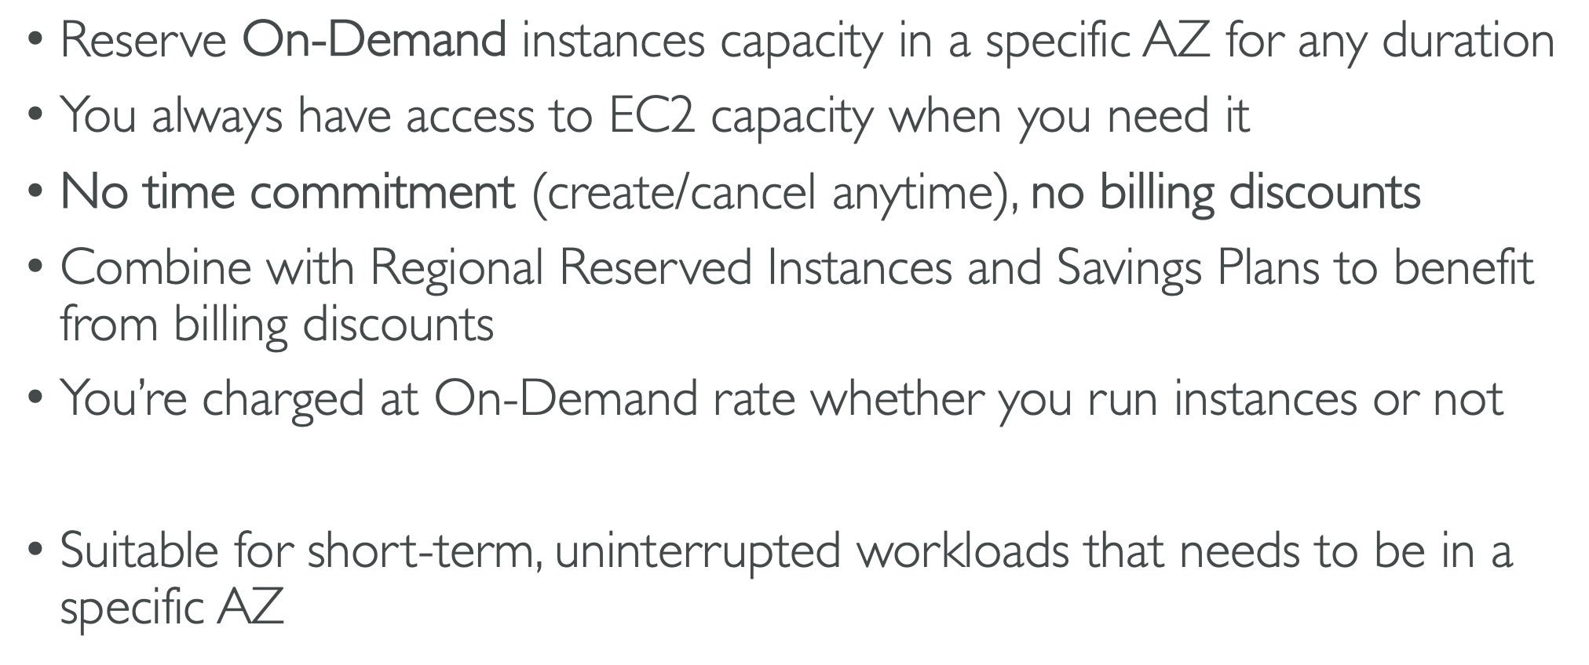
Ec2 capacity reservations

Slide 40
Which purchasing option is right for me?
Example – resort
On demand – coming and staying in resort whenever we like, we pay the full price.
Reserved – like planning ahead and if we plan to stay for too long time, we may get a good discount.
Savings plans – pay a certain amount per hour for certain period and stay in any room type.
Spot instances – the hotel allows people to bid for the empty rooms and the highest bidder keeps the rooms. You can get kicked out at any time.
Dedicated hosts – we book an entire building of the resort.
Capacity reservations – you book a room for a period with full price even you don’t stay in it.

Slide 41
Public vs private vs elastic ips
There are two sorts of IPs, IPV4 and IPV6
IPV4 is the most commonly used IP, it basically looks like 19.2.23.33
It is a 4 numbers separated by a dot and each number ranges from [0-255]
IPV6 is bit different from the IPV4, it is mostly used for internet of things operations.
The structure of IPV6 is a string of hexadecimal numbers with letters.
AWS supports both IPV4 and IPV6, but we will be using the IPV4 the most.
IPV4 allows 3.7 billion different addresses in the public space.

Slide 42
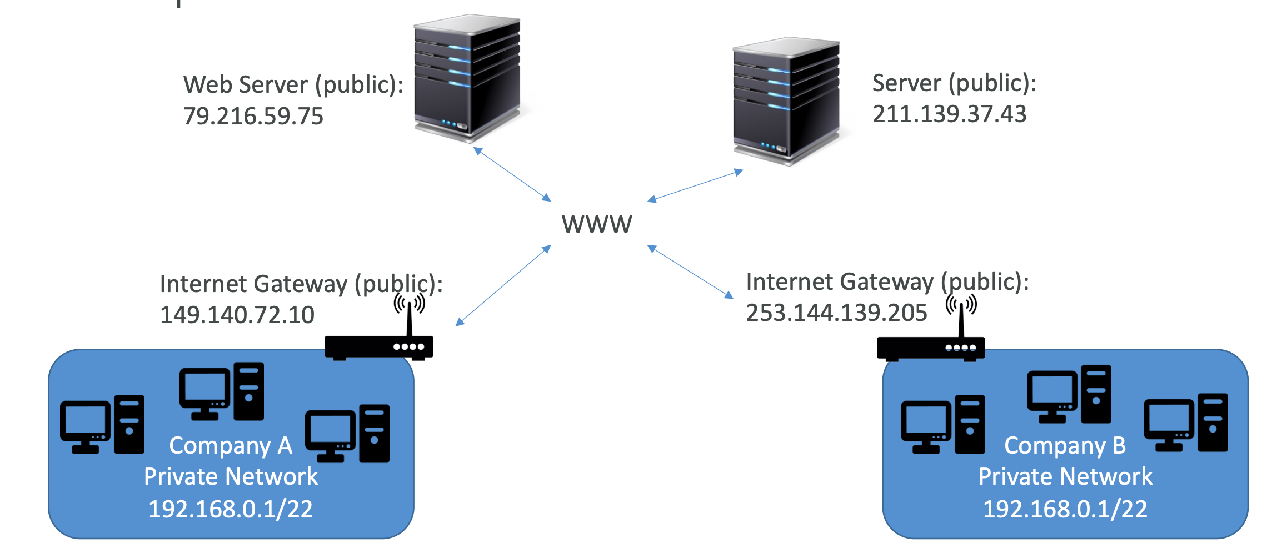
Public vs private ipv4
Two EC2 instances or web servers can communicate to each other by using their public IPs.
But in companies they use a private IP, the computers that are connected within this private network can communicate within each other using the private IP.
If the company has a public internet gateway attached to it, then all the web servers on the internet can communicate with the computers in the private network.

Slide 43
Public vs private ipV4
public
private
Public IP means that the machine can be identified by the internet.
Every public IP must be unique across the whole web.
It can be geo-located easily by googling.
It means that the machine can be identified only on a private network.
The IP must be unique across the private network.
But two different private networks can have the same IP
Machines can connect to each other using internet gateway.
Notes:
No two public IP’s can be same.
For Private, only a specified range of IPs can be used as private.

Slide 44
Elastic IP
If you need a fixed public IP for the EC2 instance, then we can use the Elastic IP.
An elastic IP is a public IPV4, we own it as long as we don’t delete it.
We can attach an elastic IP to only one EC2 instance at a given time.
AWS allows a maximum of 5 elastic IP’s per account (However the number can be increased by requesting the AWS)
Try to avoid using elastic IP
They often reflect poor infrastructural design
Instead use a random public IP and register a DNS to it.
Use a load balancer and don’t use a public IP.
Notes:
Whenever we stop or restart the EC2 instance the public IPV4 address will be changed, to avoid this we can the elastic IP

Slide 45
placement groups
We can control how an EC2 instance is placed in the AWS infrastructure. This can be done by using the placement groups.
The placement group is basically a strategy to group the EC2 instances, there are three types of placement group strategies:
Cluster
Spread
Partition
Notes:
We won’t be directly seeing the hardware or interacting with the AWS hardware but we will let the hardware know where to place the EC2 instance based on the placement group.

Slide 46
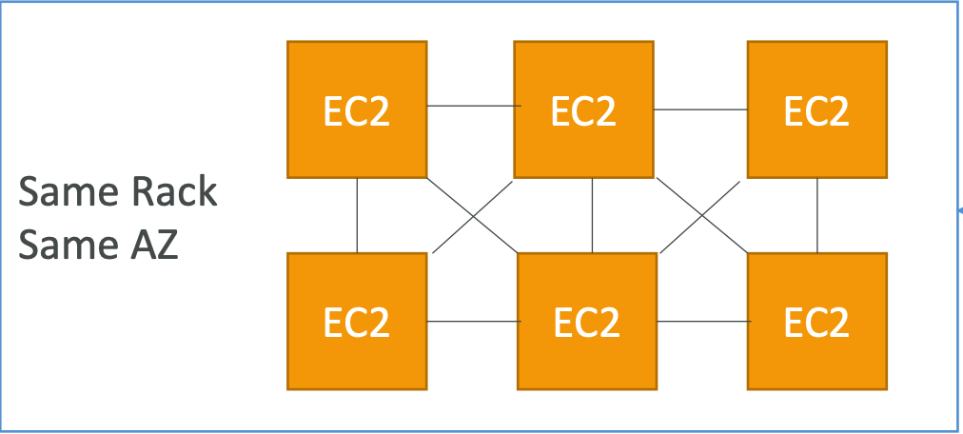
Placement group – cluster
If the cluster placement group is specified, then all the EC2 instances will be in the same rack in the same AZ.
This allows the cluster to have low latency and great network
The con is that if the rack fails then the entire cluster of EC2 instances will fail.
Use cases:
Big data jobs that needs to complete fast
Application that needs extremely low latency and high network throughput.
Notes:
Here the rack is nothing but the hardware of the AWS.

Slide 47
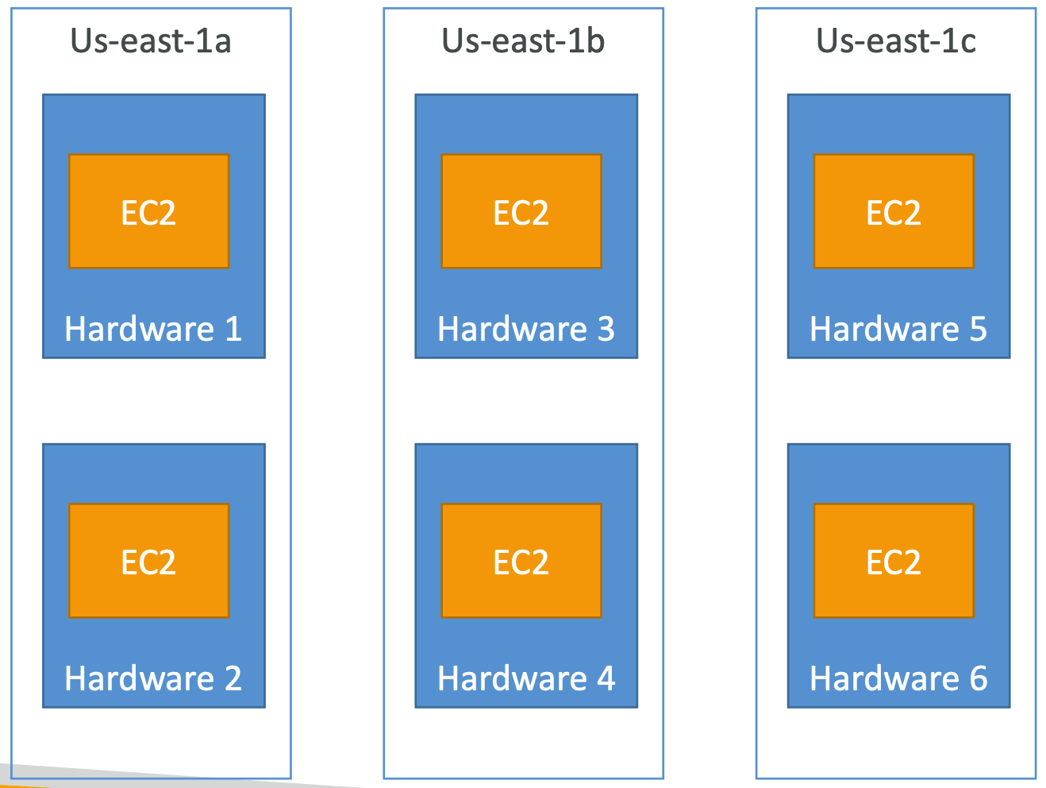
Placement group - spread
Spread is quite opposite to the cluster, here the EC2 instances will be spread across different AZ’s
Each EC2 instance will be placed in a separate rack of the AZ, thus minimizing the risk of failure.
Each AZ is limited to maximum of 7 EC2 instances.
Use cases:
Application that needs high availability and reduced risk.
Critical applications where each instances must be isolated from the failure of other instance.

Slide 48
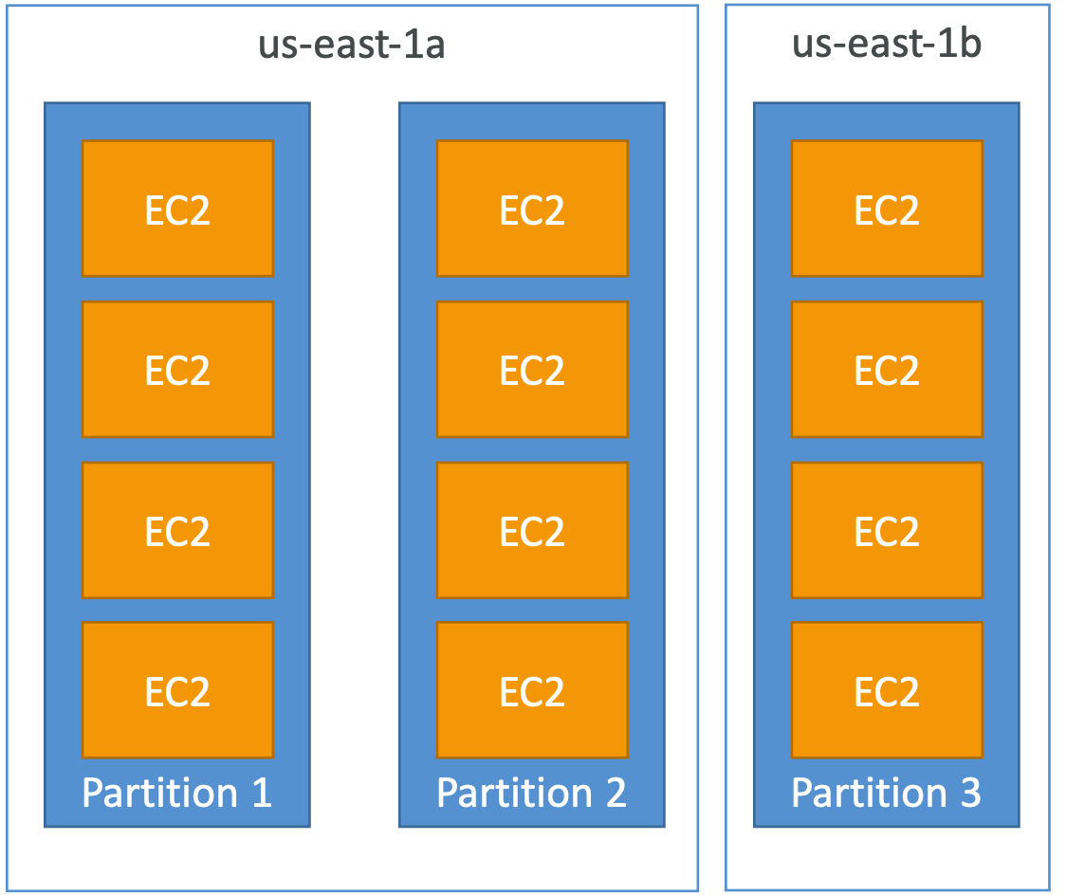
Placement group - partition
It is like spread as it can be spread across the AZ’s
Each AZ can have a maximum of 7 partitions, and each partition can have 100’s of EC2 instances.
Failure of a partition will be affected to all the EC2 instances inside the partition but not to other partition.
Use cases:
HDFS, HBase, Cassandra, kafka.

Slide 49
Ebs overview
What is an EBS volume?
An EBS(Elastic Block Store) Volume is a network drive that can be attached to your EC2 instances while they run.
It allows you to persist data of the EC2 instance even after it is terminated.
We can also mount the restored EBS volume to a different EC2 instance.
They can be only attached to one EC2 instance at a time.
They are bound to a specific AZ.

Slide 50
EBS Volume ( a network drive)
Analogy: Think of them as a network USB stick.
It is a network drive ( not a physical drive).
It uses network to communicate to the instances, which means there might be a bit of latency.
Since they are a network drive, they can be detached from an EC2 instance and attached to another instance quickly.
Have a provisioned capacity. (size in GBs & IOPS)
You will be billed for the provisioned capacity.
You can increase the capacity overtime.

Slide 51
Ebs snapshots
Make a backup(snapshot) of your EBS volume at a point in time.
Not necessary to detach the volume to capture a snapshot but it is recommended.
Can copy snapshot across region or AZ.

Slide 52
Ebs snapshot features
EBS snapshot archive:
Move a snapshot to an archive tier that is 75% cheaper.
Takes within 24 to 72 hours for restoring the archive.
Recycle bin for EBS snapshot:
Setup rules to retain deleted snapshots, so you can recover them after an accidental deletion.
Specify retention rule can be from 1 day to 1 year.

Slide 53
Ami overview
It stands for Amazon Machine Image.
AMI are customization of an EC2 instance.
You add your own software, config, operating system, monitoring etc.
Faster boot/configuration time because all your software is pre-packaged.
AMI are built for a specific region can be copied across regions.
You can launch EC2 instances from:
A public AMI: AWS provided.
Your own AMI: You create and maintain yourself.
An AWS marketplace AMI: An AMI someone else made.
Notes:
You can use AMI created by AWS or your own.

Slide 54
AMI process (from an ec2 instance)
Start an EC2 instance.
Stop the instance (for data integrity).
Build an AMI (This will also create EBS snapshots).
Launch instances from other AMIs.

Slide 55
Ec2 instance store
The EBS volume (network drive) attached to the EC2 instance is good but with limited performance.
If you need high performance hardware disk, then we need to use EC2 instance store.
Using EC2 instance store gives us better I/O performance.
EC2 instance store is ephemeral.
It loses its data storage it the instance is stopped.
EC2 instance store cannot be used for long term storage of data.
Its good for buffer/cache/scratch data/ temporary content.
Risk of data loss is high if hardware fails.
Backup and replication is your responsibility.
Notes:
We have seen how to attach ab EBS volume that is a n/w drive to EC2 instance
EC2 instances are nothing but virtual machine in the AWS DC, few of these ec2 come with a hard disk attached to it. These are called as instance stores.

Slide 56
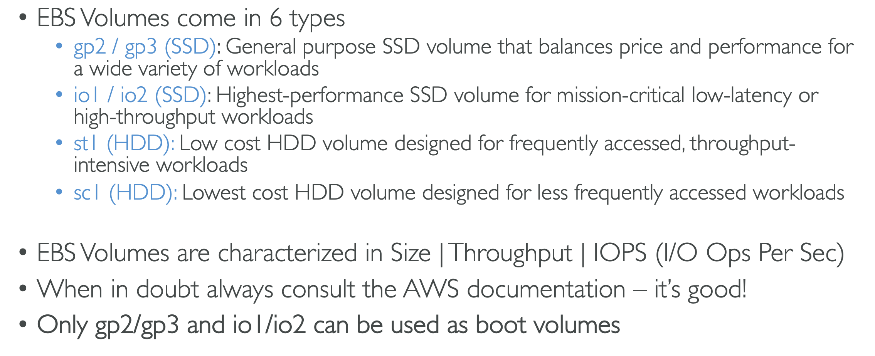
Ebs volume types

Slide 57
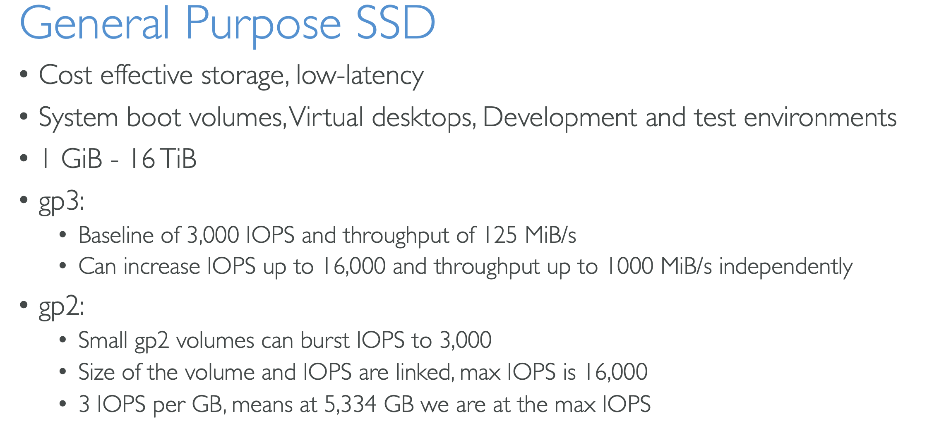
Ebs volume types use cases

Slide 58
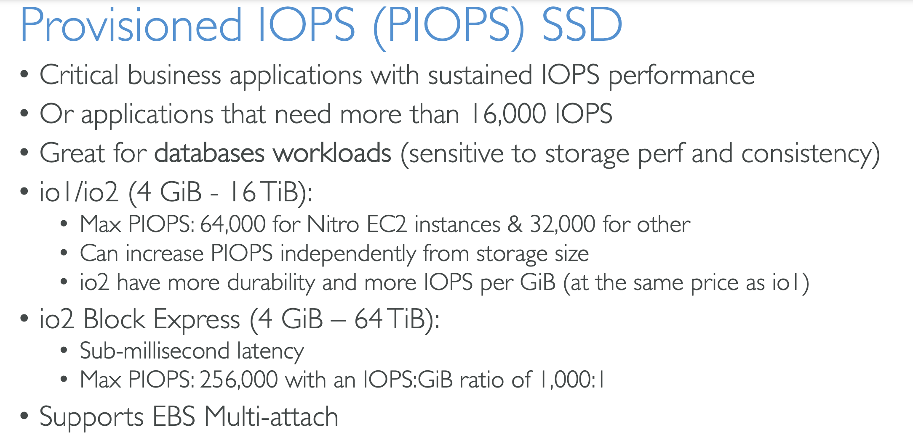
Ebs volume types use cases

Slide 59
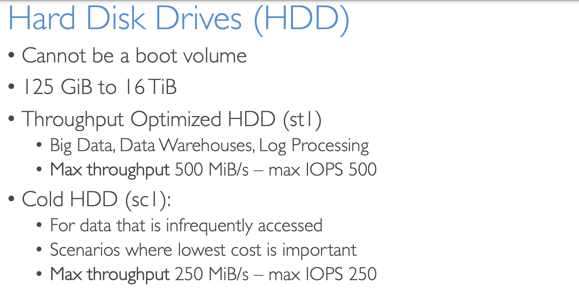
Ebs volume types use cases

Slide 60
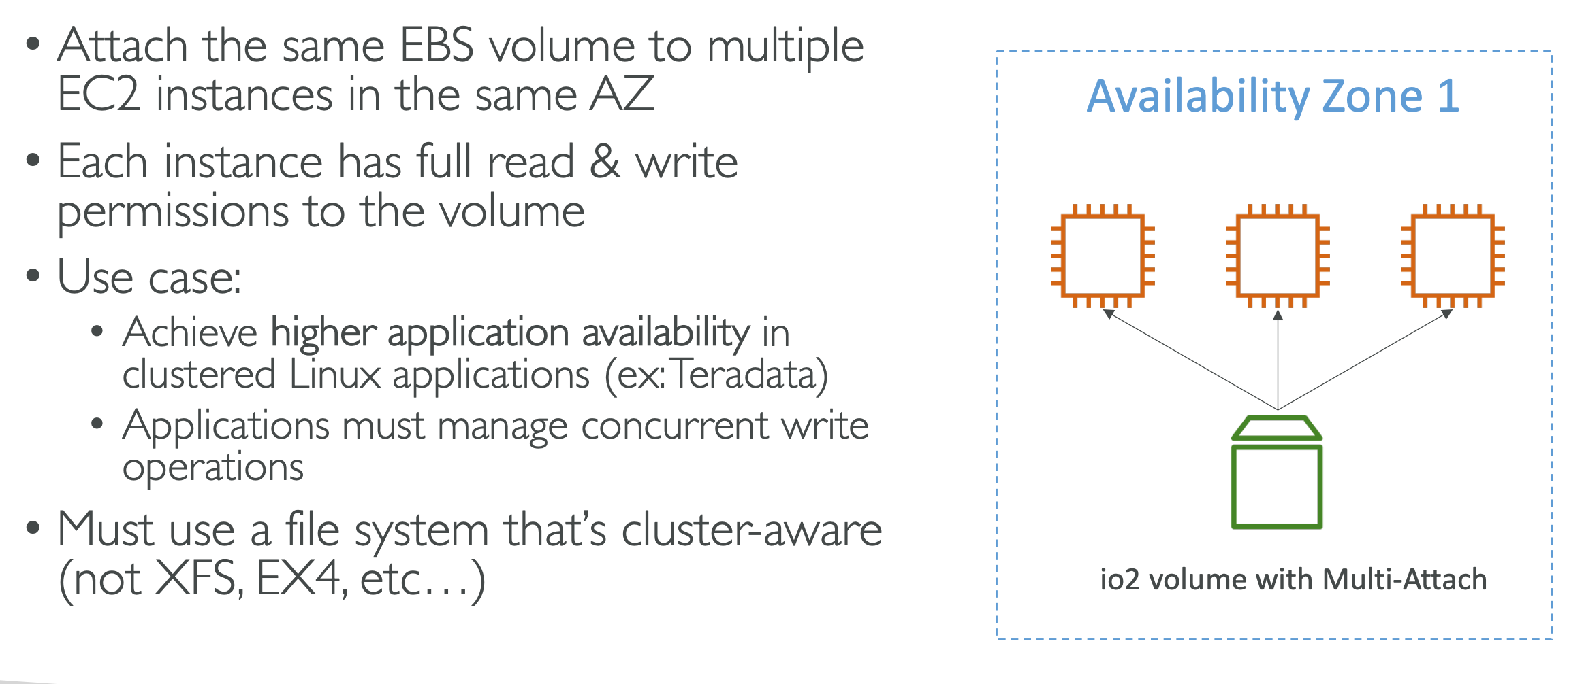
Ebs multi-attach- io1/io2 family

Slide 61
Ebs encryption
When you create an encrypted EBS volume you achieve the following:
Data at rest is encrypted inside the volume.
All the data in flight moving between the instance and the volume in encrypted.
All the snapshots are encrypted.
All the volumes created from the snapshot will also be encrypted.
Encryption and decryption are handled transparently.
Encryption has minimal impact on latency.
EBS encryption leverages keys from KMS (AES-256)

Slide 62
Encryption: encrypt an unencrypted ebs volume
Create an EBS snapshot of the volume.
Encrypt the EBS snapshot (using copy).
Create new EBS volume from the snapshot.
Now you can attach the encrypted volume to the original instance.

Slide 63
Amazon efs- elastic file system
Managed NFS (Network file system) that can be mounted on many EC2 instances.
EFS works with EC2 instances in multi A-Z.
Highly available, scalable, expensive(3xgp2), pay per use.
Use cases:
Content management, web servers, data sharing.
Uses NFSv4.1 protocol.
Uses security group to control access to EFS.
It is only compatible with Linux based AMI.

Slide 64
Efs performance and storage classes
Scale:
1000’s of concurrent NFS clients, 10GB+/second throughput.
Grow to petabyte-scale network file system automatically.
Performance mode:
General purpose – latency sensitive mode, use cases(web servers, CMS, etc).
Max I/O mode- higher latency, throughput, highly available.
Throughput mode:
Bursting mode: 1TB = 50MiB/s + bursts of upto 100 MiB/s.
Provisioned mode: set your throughput regardless of storage.

Slide 65
Efs – storage classes
Storage tiers(to move a file for different tier after N days)
Standard: for frequently accessed files.
Infrequent access (EFS-IA): cost to retrieve files, lower price to store, enable EFS-IA with a life cycle policy.
Availability and durability:
Regional: multi AZ, great for production.
One zone: one AZ, great for dev, back up enabled by default, compatible with IA (EFS one zone IA)

Slide 66
Ebs vs efs
EBS Volumes..
Can be attached to only one instance at a time.
They are locked at the AZ level.
To migrate an EBS volume across AZ
Take a snapshot.
Restore the snapshot to another AZ.
Root EBS volumes instances get terminated by default if the EC2 instance gets terminated. (you can disable it)

Slide 67
EBS VS efs
Mounting 100s of instances across AZ.
EFS share website files (WordPress).
Only for Linux instances (POSIX).
EFS has higher price point than EBS.
Can leverage EFS-IA for cost savings.
Notes:
EBS is charged for entire provisioned capacity no matter it uses it or no, whereas EFS is charged only for the amount of storage it uses.

Slide 68
Scalability & high availability
Scalability means that an application / system can handle greater loads by adapting.
There are two kinds of scalability:
Vertical scalability.
Horizontal scalability (Elasticity).
Scalability is linked but different to high availability.
Let us consider a call center as example to understand the difference.

Slide 69
Vertical scalability.
Vertical scalability means increasing the size of the instance.
In a call center we have a junior operator who can take up to 5 calls and hour, but the requirement has changed, and we need more calls to be handled.
Solution: We replace the junior operator with a senior operator who can handle more calls in a faster way.
In terms of instances, assume our application runs on a t2.micro, scaling that application vertically means running it on a t2.Large
Vertical scalability is very common for non distributed systems such as database.
RDS, ElastiCache are services that can scale vertically.
Notes:
There’s usually a limit to how much you can vertically scale (hardware limit)

Slide 70
Horizontal scalability
Horizontal scalability means increasing the number of instances / systems for your application.
In a call center, if we have only one junior operator and the workload is too much then I will hire couple of more junior operators or many more.
Horizontal scaling implies distributed systems.
This is very common for web applications / modern applications.
Its very easy to horizontally scale thanks to the cloud offering such as Amazon EC2.

Slide 71
High availability
High availability is like horizontal scaling.
Hight availability means running your application / system in at least 2 AZ’s.
The goal of high availability is to survive AZ / data center loss.
The high availability can be passive (for RDS multi-AZ for example).
The high availability can be active (for horizontal scaling).
For a call center example: if we have an office at New York and an office at San Francisco then, if there is failure in the New York office the San Francisco office will supplement it.

Slide 72
High availability & scalability for ec2
Vertical scaling: increase instance size (scale up/down).
From t2.nan – 0.5G RAM, 1 vCPU
To u-12tb1.metal – 12.3TB of RAM, 448 vCPUs
Horizontal Scaling: Increase number of instances (scale out/in).
For Auto Scaling Group.
Load Balancer.
High Availability: Run instances for the same application across multi-AZ.
Auto Scaling Group multi-AZ.
Load Balancer multi-AZ.

Slide 73
Elastic load balancing
What is load balancing?
Load balances are servers that forward traffic to multiple servers (ex: EC2 instances) downstream.

Slide 74
Why use a load balancer?
Spread load across multiple downstream instances.
Expose a single point of access (DNS) to your application.
Seamlessly handle failures of downstream instances.
Do regular health checks to your instances.
Provide SSL termination (HTTPS) for your websites.
Enforce stickiness with cookies.
High availability across zones.
Separate public traffic from private traffic.

Slide 75
Why use an elastic load balancer?
An elastic load balancer is a managed load balancer.
AWS guarantees that it will be working.
AWS takes care of upgrades, maintenance, high availability.
AWS provide a few configuration knobs.
It costs less to setup your own load balancer, but it will be a lot more effort of your end.
It is integrated with many AWS offering / services.
EC2, EC2 Auto Scaling Group, Amazon ECS.
AWS Certificate Manager (ACM), CloudWatch.
Route 53, AWS WAF, AWS Global Accelerator.

Slide 76
Health checks
Health checks are crucial for load balancers.
They enable the load balancer to know if the instances it forwards traffic to are available to reply to requests.
The health check is done on a port and a route (/health is common).
If the response is not 200(OK), then the instance is unhealthy.

Slide 77
Types of load balancer on AWs
AWS has 4 kinds of manages load balancers.
Classic Load Balancer (V1 – old generation) – 2009 – CLB
HTTP, HTTPS, TCP, SSp (Secure TCP).
Application Load Balancer (V2 – new generation) – 2016 – ALB
HTTP, HTTPS, WebSocket.
Network Load Balancer (V2 – new generation) – 2017 – NLB
TCP, TLS (Secure TCP), UDP.
Gateway Load Balancer – 2020 – GWLB
Operates at the network layer (Layer 3) – IP Protocol.
It is recommended to use newer generation load balancers as they provide more features.
Some load balancers can be setup as interna (private) or external (public) ELBs

Slide 78
Load balancers and security groups

Slide 79
Classic load balancer (V1)
It supports TCP (Layer 4), HTTP & HTTPS (Layer 7).
Health checks are TCP or HTTP based.
Fixed hostname → XXX.region.elb.amazonaws.com
Notes:
So, we will setup a client talking to our CLB from a HTTP listener and internally that CLB will be redirecting the traffic to EC2 instances.

