Slide 1

Parameter Setting and Reliability Test of a Sensor System for Baby Detection in a baby seat in a car
Autonomous Intelligence System
&
Machine Learning
Dr. Andreas Pech & Dr. Peter Nauth
M.Engg in Information Technology
By
Kushal Prakash - 1429800
Madhushree Manjunatha Lakshmidevi - 1445185

Slide 2
Contents
Introduction
Methodology
Implementation
Results

Slide 3
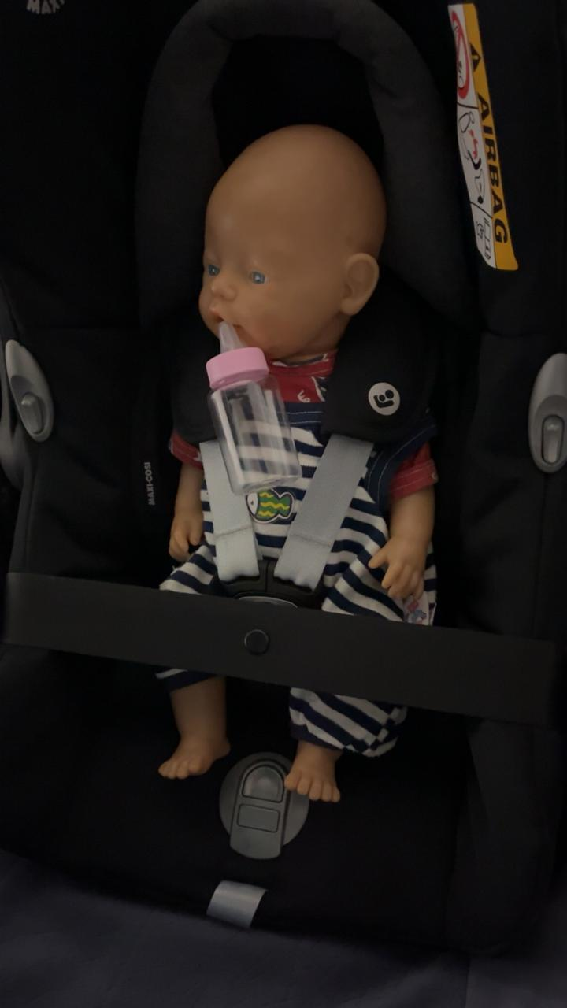
Introduction
Ultrasonic sensors emit waves towards a car seat, detecting presence by measuring wave reflection time. Integrated into automotive safety systems, they alert caregivers when the threshold distance indicates a baby's presence, enhancing safety.

Slide 4
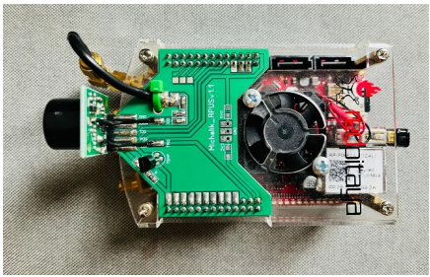
Methodology
Red Pitaya board
Measuring methods using the sensor
Fig.1: Ultrasonic sensor and Red Pitaya device

Slide 5
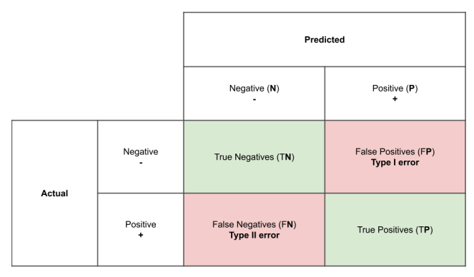
Methodology
Fast Fourier Transform
Confusion matrix
Fig.2: Confusion Matrix

Slide 6
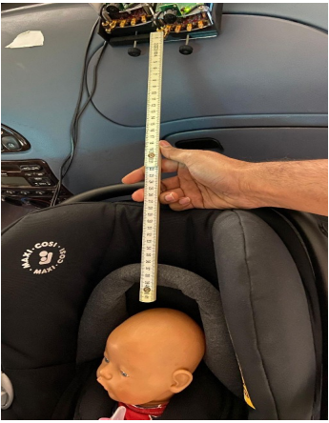
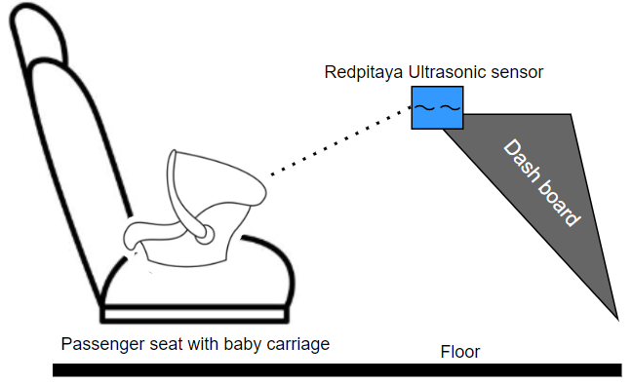
IMPLEMENTATION
Setup and sensor placement
Measurements
Fig.3: Passenger-seat with baby carriage diagram view (side view)
Fig.4 Measuring the baby’s height

Slide 7
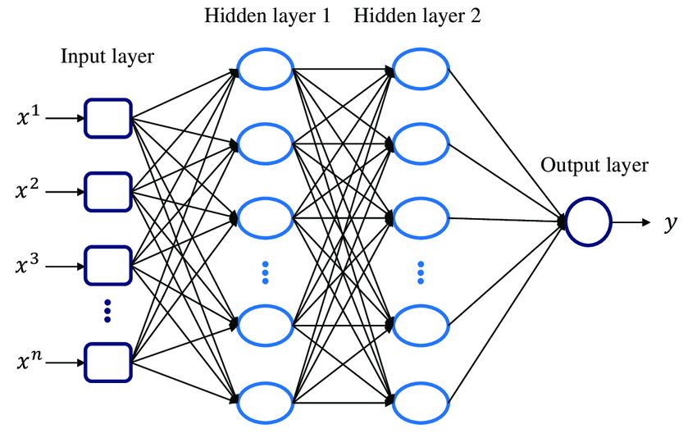
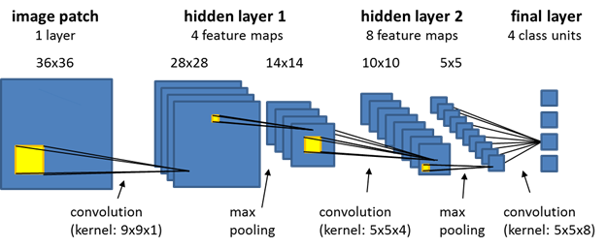
IMPLEMENTATION
Multi-Layer Perceptron
MLP
Convolutional Neural Network
CNN
Fig.6: Convolutional Neural Network architecture [2]
Fig.5: Multi Layer Perceptron architecture [1]

Slide 8
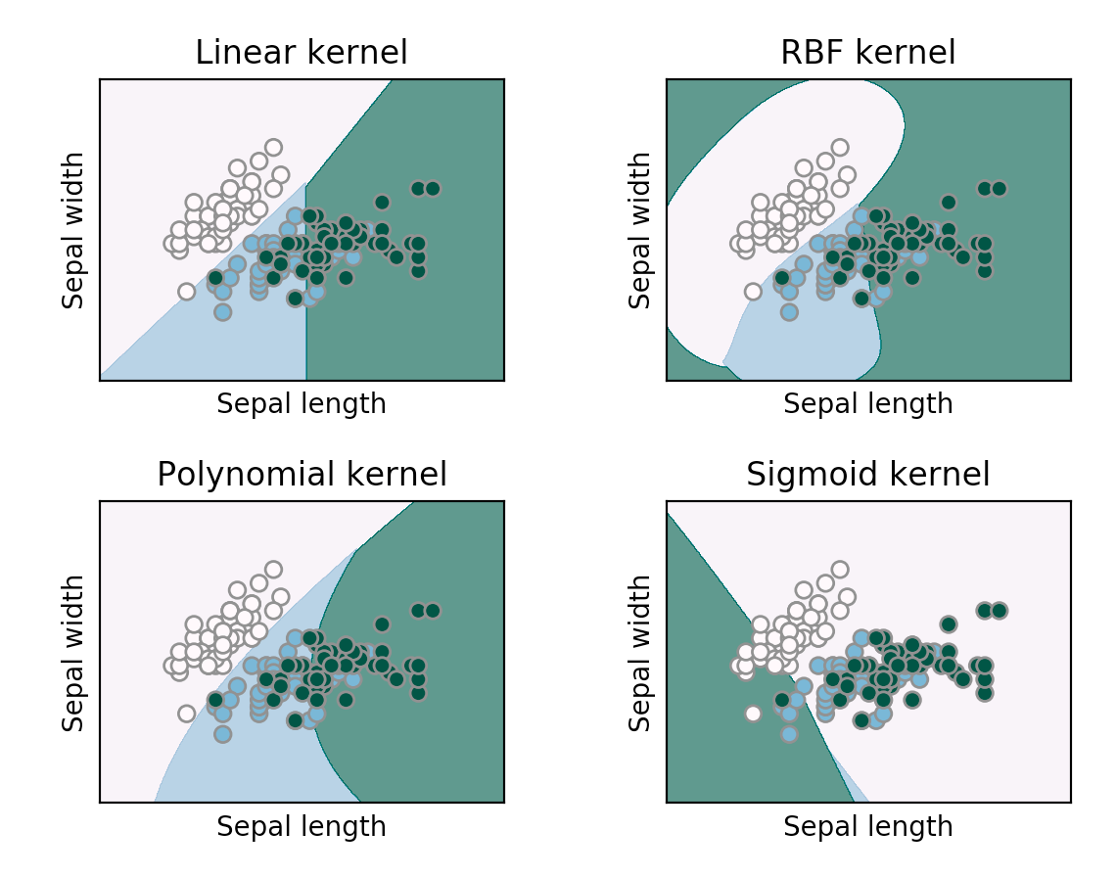
IMPLEMENTATION
Support Vector Machine
SVM
Fig 7: SVM with linear and nonlinear kernel [3]

Slide 9
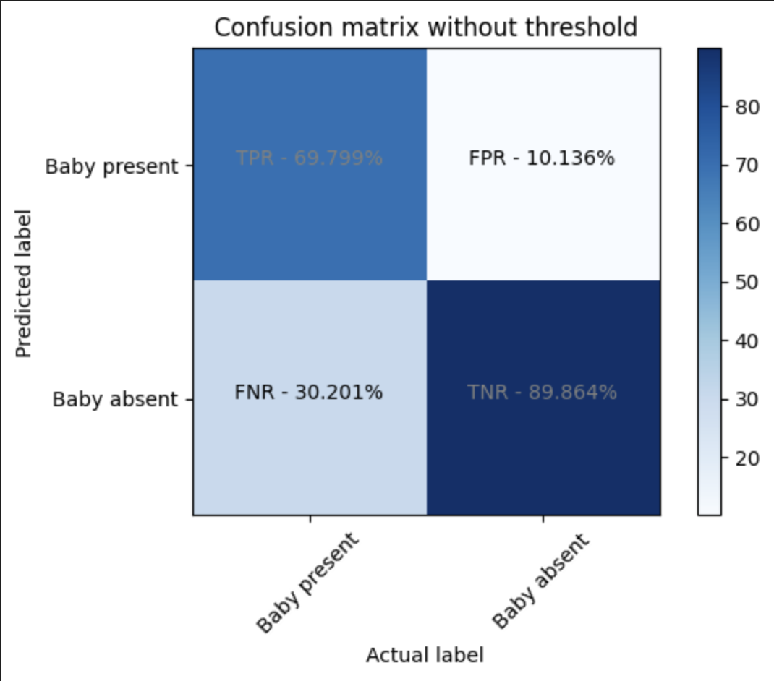
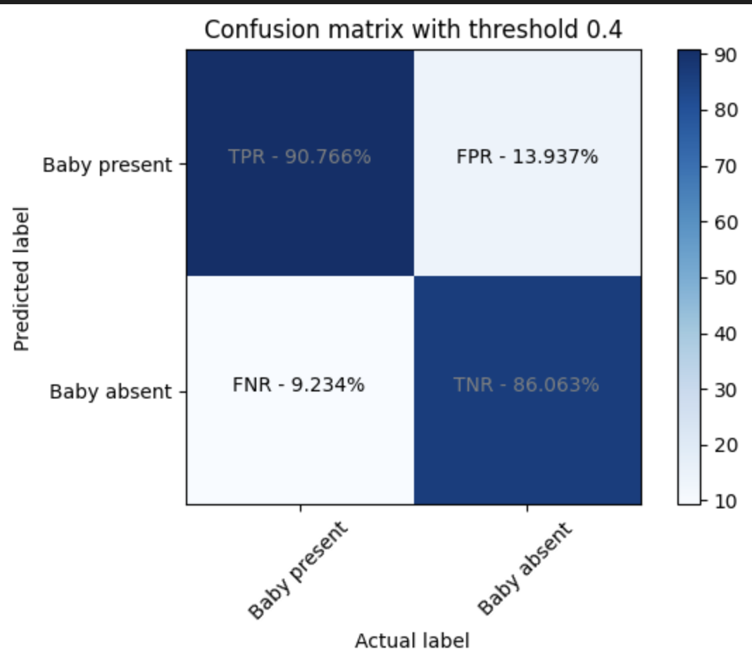
RESULTS
Multi-Layer Perceptron
Fig.8: Confusion Matrix with threshold for MLP model
Fig.9: Confusion Matrix without threshold for MLP model

Slide 10
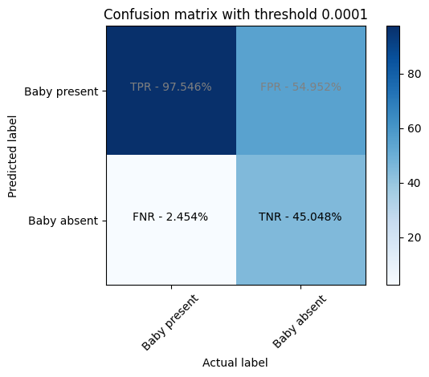
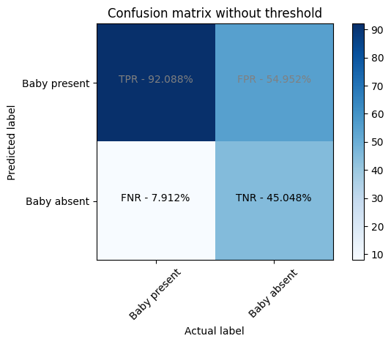
RESULTS
Convolutional Neural Network
Fig.10: Confusion matrix with threshold of CNN model
Fig.11: Confusion matrix without threshold
of CNN model

Slide 11
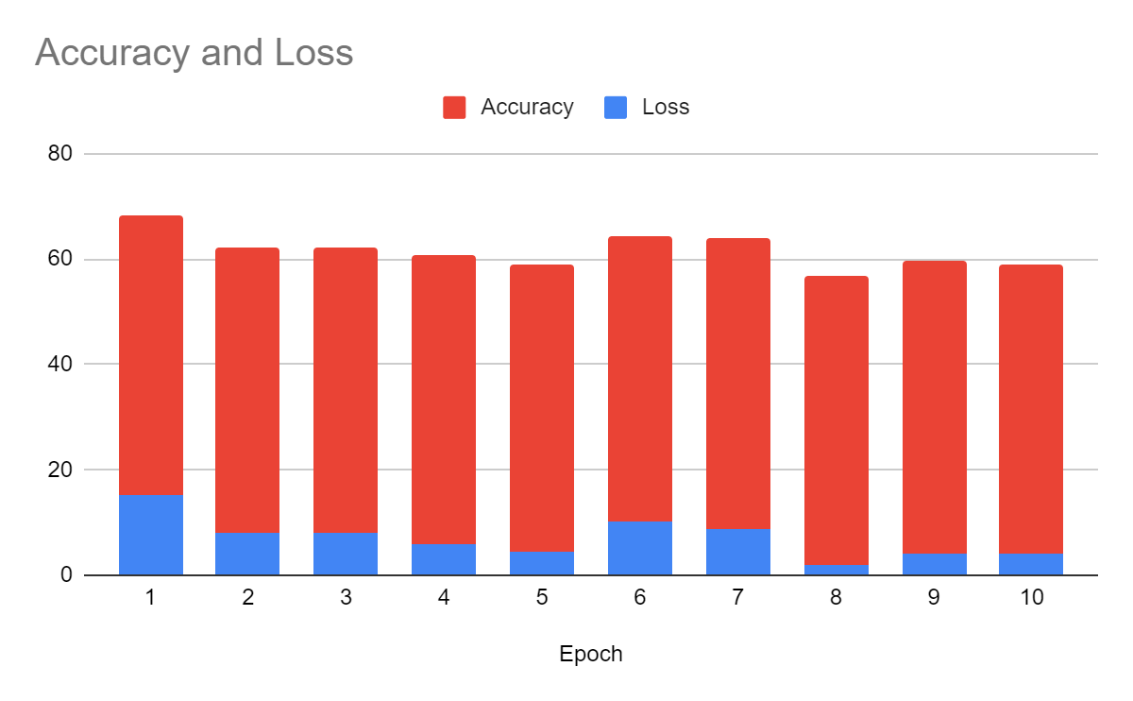
RESULTS
Accuracy and Loss over Epochs of CNN
Fig.12: Analysis of Accuracy and Loss over Epochs of CNN

Slide 12
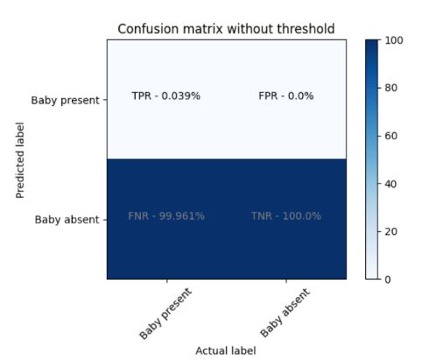
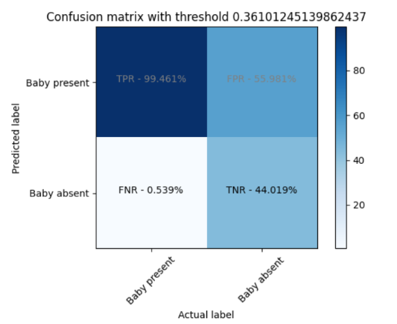
RESULTS
Support Vector Machine
Fig.13: Confusion matrix with threshold of SVM model
Fig.14: Confusion matrix without threshold of SVM model

Slide 13
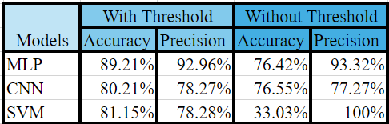
RESULTS
Comparison Table
Fig.15: Comparison of 3 models

Slide 14
REFERENCE
[1] https://www.researchgate.net/figure/Multilayer-perceptron-MLP-architecture-with-two-hidden-layers-and-one-prediction-output_fig1_349630467
[2] https://docs.ecognition.com/eCognition_documentation/Reference%20Book/02%20Algorithms%20and%20Processes/9%20Deep%20Learning%20(CNN)%20Algorithms/Deep%20Learning%20(CNN)%20Algorithms.htm
[3] https://www.google.com/url?sa=i&url=https%3A%2F%2Fwww.analyticsvidhya.com%2Fblog%2F2021%2F06%2Fsupport-vector-machine-better-understanding%2F&psig=AOvVaw3gSAZqHGxOuHc5RTskmDCd&ust=1711903444098000&source=images&cd=vfe&opi=89978449&ved=0CBQQjhxqFwoTCKig7aK3nIUDFQAAAAAdAAAAABAE

Slide 15

QUESTIONS ?

Slide 16


