Slide 1

Object Detection and Tracking in Computer Vision using Deep Learning
Individual Project
Dr. Peter nauth
M.Engg. in Information Technology
By
Kushal Prakash 1429800

Slide 2
Agenda
Introduction
Methodology
Implementation
Results
Limitations
Demo

Slide 3
Introduction
Autonomous systems need robust object detection and tracking algorithms
YOLO algorithm is an excellent object detection algorithm
Intel RealSense can be used to combine RGB and 3-D depth image to accurately map the surrounding

Slide 4
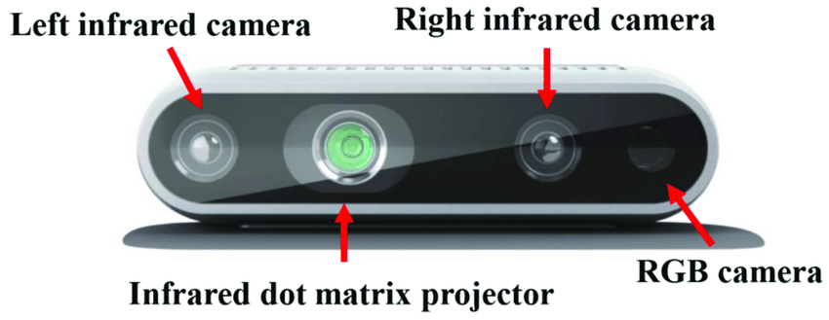
Methodology
Intel RealSense sensor
Measurement methods
Confusion matrix
Model training
Figure 1: Intel RealSense depth camera D435

Slide 5
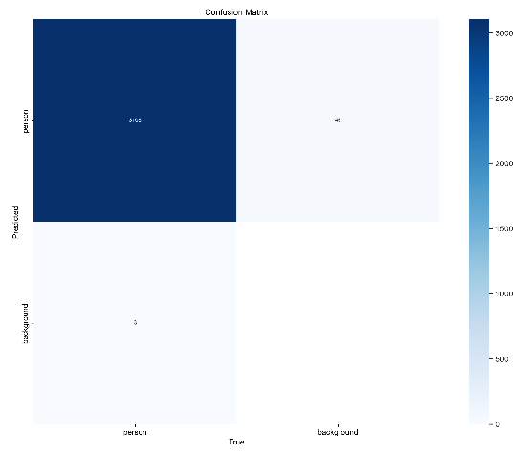
Confusion Matrix
A confusion matrix was generated for the testing data
Figure 2: Confusion Matrix for depth images dataset

Slide 6
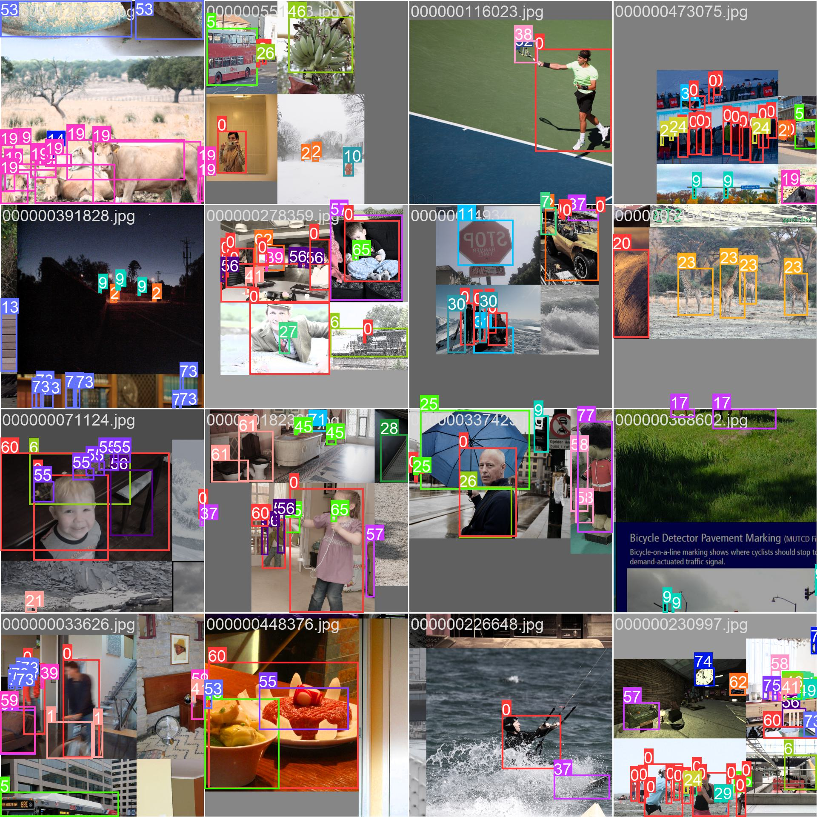
Model Training
Model was trained for 100 epochs with object detection as the primary focus.
Figure 3: Annotations for COCO dataset images

Slide 7
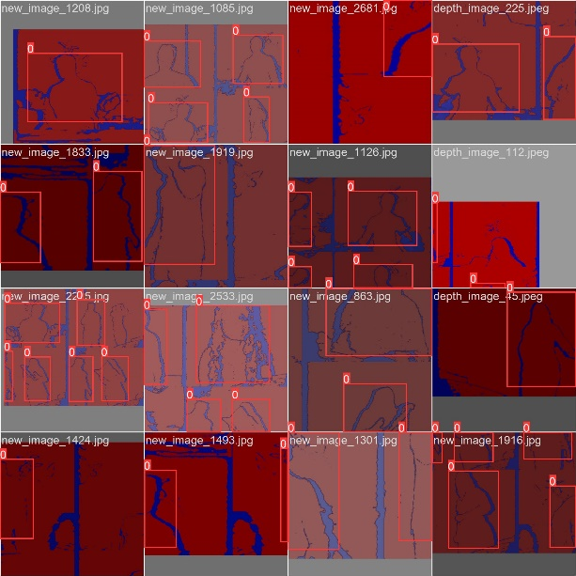
Implementation
Experimental setup and sensor placement
Z.16 data format used for data collection
Figure 4: Annotations for depth sensor dataset

Slide 8
Yolo algorithm
Used Yolov8 for detection algorithm
Threshold
Boundary box
Figure 5: Yolov8 against previous versions

Slide 9
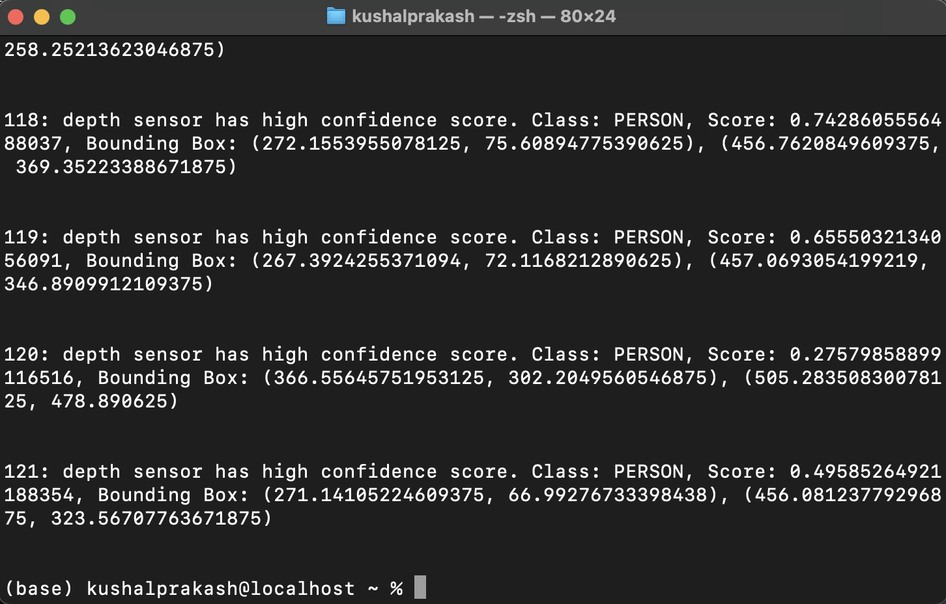
Combining Sensors to obtain best of both results
Based on confidence score, our algorithm choses the best sensor data for the situation or combines to get a consolidated result
Figure 6: Results of our code to choose the best sensor for the given frame

Slide 10
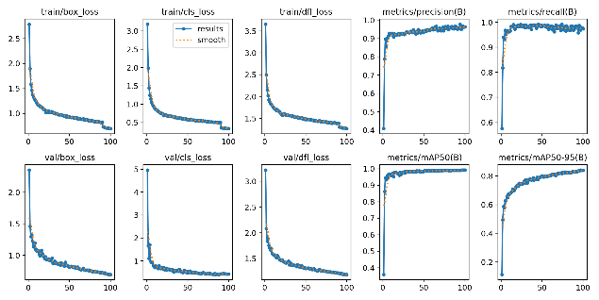
Results
RGB sensor provides more reliable data under normal lighting conditions
Depth sensor proves to be more useful during poor lighting conditions.
Combining both the sensors provides coverage of more scenarios and broader applications
Figure 7: Metrics graph of the Yolo training

Slide 11
Limitations
Sensor is currently outdated and not actively maintained by the manufacturer
Latest platforms do not support both the sensors

Slide 12
GitHub repo link:
https://github.com/kushalprakash6/ObjectDetectionAndTracking

Slide 13
Demo

Slide 14
Question??

Slide 15
Thank you!!!

