Slide 1


Intelligent National Health Management Platform
Revolutionizing Healthcare Access Through Digital Innovation
Connecting Care, Saving Lives, Powering the Future of Medicine
Team DOT_ZIP
Kushal Prasad Joshi | Bibek Ghimire | Shasanka Acharya | Kamal Rokaya

Slide 2








AGENDA
The Problem
Our solution
Traction and Validation
Solution Architecture
Platform Workflow
Social Impact
Sustainable Business Model
National Rollout Strategy
Infrastructure and Operational Cost
Intelligence & Analytics Layer

Slide 3
AGENDA
The Problem
Our solution
Traction and Validation
Solution Architecture
Platform Workflow
Social Impact
Sustainable Business Model
National Rollout Strategy
Infrastructure and Operational Cost
Intelligence & Analytics Layer

Slide 4
AGENDA
The Problem
Our solution
Traction and Validation
Solution Architecture
Platform Workflow
Social Impact
Sustainable Business Model
National Rollout Strategy
Infrastructure and Operational Cost
Intelligence & Analytics Layer

Slide 5
AGENDA
The Problem
Our solution
Traction and Validation
Solution Architecture
Platform Workflow
Social Impact
Sustainable Business Model
National Rollout Strategy
Infrastructure and Operational Cost
Intelligence & Analytics Layer

Slide 6
AGENDA
The Problem
Our solution
Traction and Validation
Solution Architecture
Platform Workflow
Social Impact
Sustainable Business Model
National Rollout Strategy
Infrastructure and Operational Cost
Intelligence & Analytics Layer

Slide 7
AGENDA
The Problem
Our solution
Traction and Validation
Solution Architecture
Platform Workflow
Social Impact
Sustainable Business Model
National Rollout Strategy
Infrastructure and Operational Cost
Intelligence & Analytics Layer

Slide 8
AGENDA
The Problem
Our solution
Traction and Validation
Solution Architecture
Platform Workflow
Social Impact
Sustainable Business Model
National Rollout Strategy
Infrastructure and Operational Cost
Intelligence & Analytics Layer

Slide 9
AGENDA
The Problem
Our solution
Traction and Validation
Solution Architecture
Platform Workflow
Social Impact
Sustainable Business Model
National Rollout Strategy
Infrastructure and Operational Cost
Intelligence & Analytics Layer

Slide 10
AGENDA
The Problem
Our solution
Traction and Validation
Solution Architecture
Platform Workflow
Social Impact
Sustainable Business Model
National Rollout Strategy
Infrastructure and Operational Cost
Intelligence & Analytics Layer

Slide 11
AGENDA
The Problem
Our solution
Traction and Validation
Solution Architecture
Platform Workflow
Social Impact
Sustainable Business Model
National Rollout Strategy
Infrastructure and Operational Cost
Intelligence & Analytics Layer

Slide 12
AGENDA
The Problem
Our solution
Traction and Validation
Solution Architecture
Platform Workflow
Social Impact
Sustainable Business Model
National Rollout Strategy
Infrastructure and Operational Cost
Intelligence & Analytics Layer

Slide 13
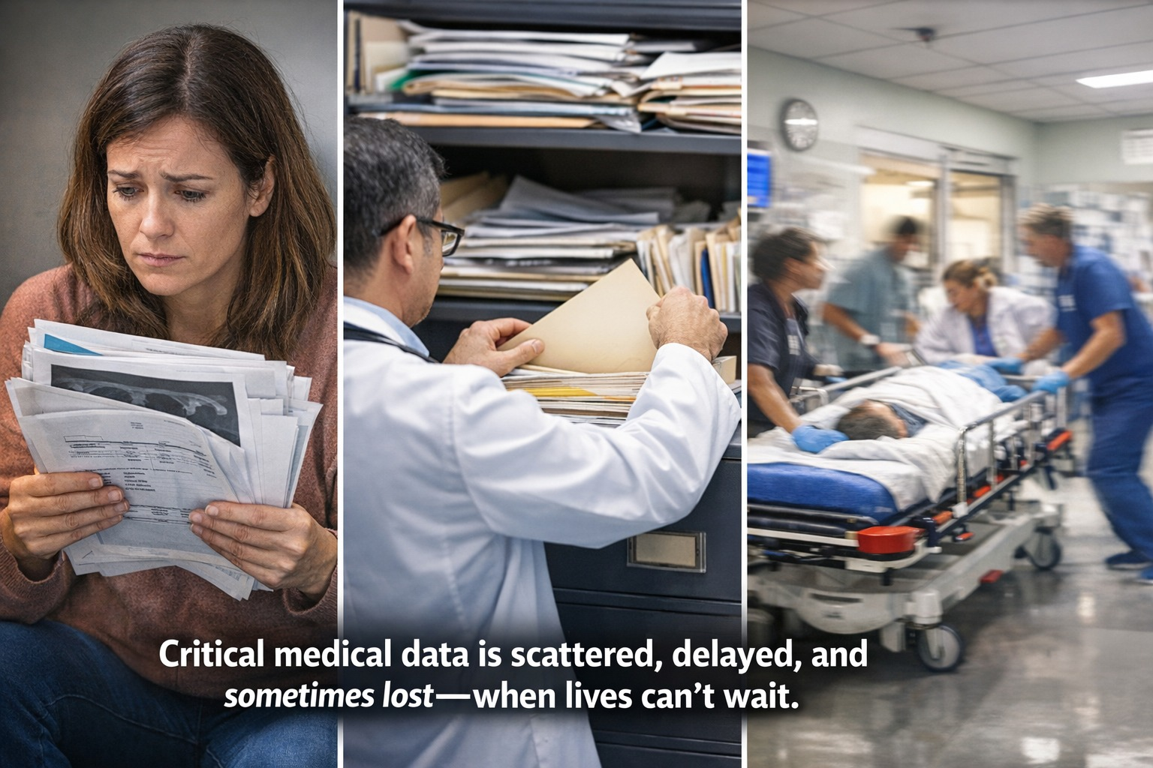
THE PROBLEM
Fragmented Medical Records
Every hospital, every lab, every clinic is an island.
Your medical history stays where it was created.
Patients Suffer
Repeat tests – waste of time & money
Lost prescriptions – delayed treatment
Emergency visits – doctors work blind
System Suffers
No centralized health intelligence
Outbreaks detected too late
Billions lost in redundant diagnostics
💰 NPR 50M+ estimated annual loss in Nepal alone from repeated tests.

Slide 14
THE PROBLEM
Fragmented Medical Records
Every hospital, every lab, every clinic is an island.
Your medical history stays where it was created.
Patients Suffer
Repeat tests – waste of time & money
Lost prescriptions – delayed treatment
Emergency visits – doctors work blind
System Suffers
No centralized health intelligence
Outbreaks detected too late
Billions lost in redundant diagnostics
💰 NPR 50M+ estimated annual loss in Nepal alone from repeated tests.

Slide 15
THE PROBLEM
Fragmented Medical Records
Every hospital, every lab, every clinic is an island.
Your medical history stays where it was created.
Patients Suffer
Repeat tests – waste of time & money
Lost prescriptions – delayed treatment
Emergency visits – doctors work blind
System Suffers
No centralized health intelligence
Outbreaks detected too late
Billions lost in redundant diagnostics
💰 NPR 50M+ estimated annual loss in Nepal alone from repeated tests.

Slide 16
THE PROBLEM
Fragmented Medical Records
Every hospital, every lab, every clinic is an island.
Your medical history stays where it was created.
Patients Suffer
Repeat tests – waste of time & money
Lost prescriptions – delayed treatment
Emergency visits – doctors work blind
System Suffers
No centralized health intelligence
Outbreaks detected too late
Billions lost in redundant diagnostics
💰 NPR 50M+ estimated annual loss in Nepal alone from repeated tests.

Slide 17

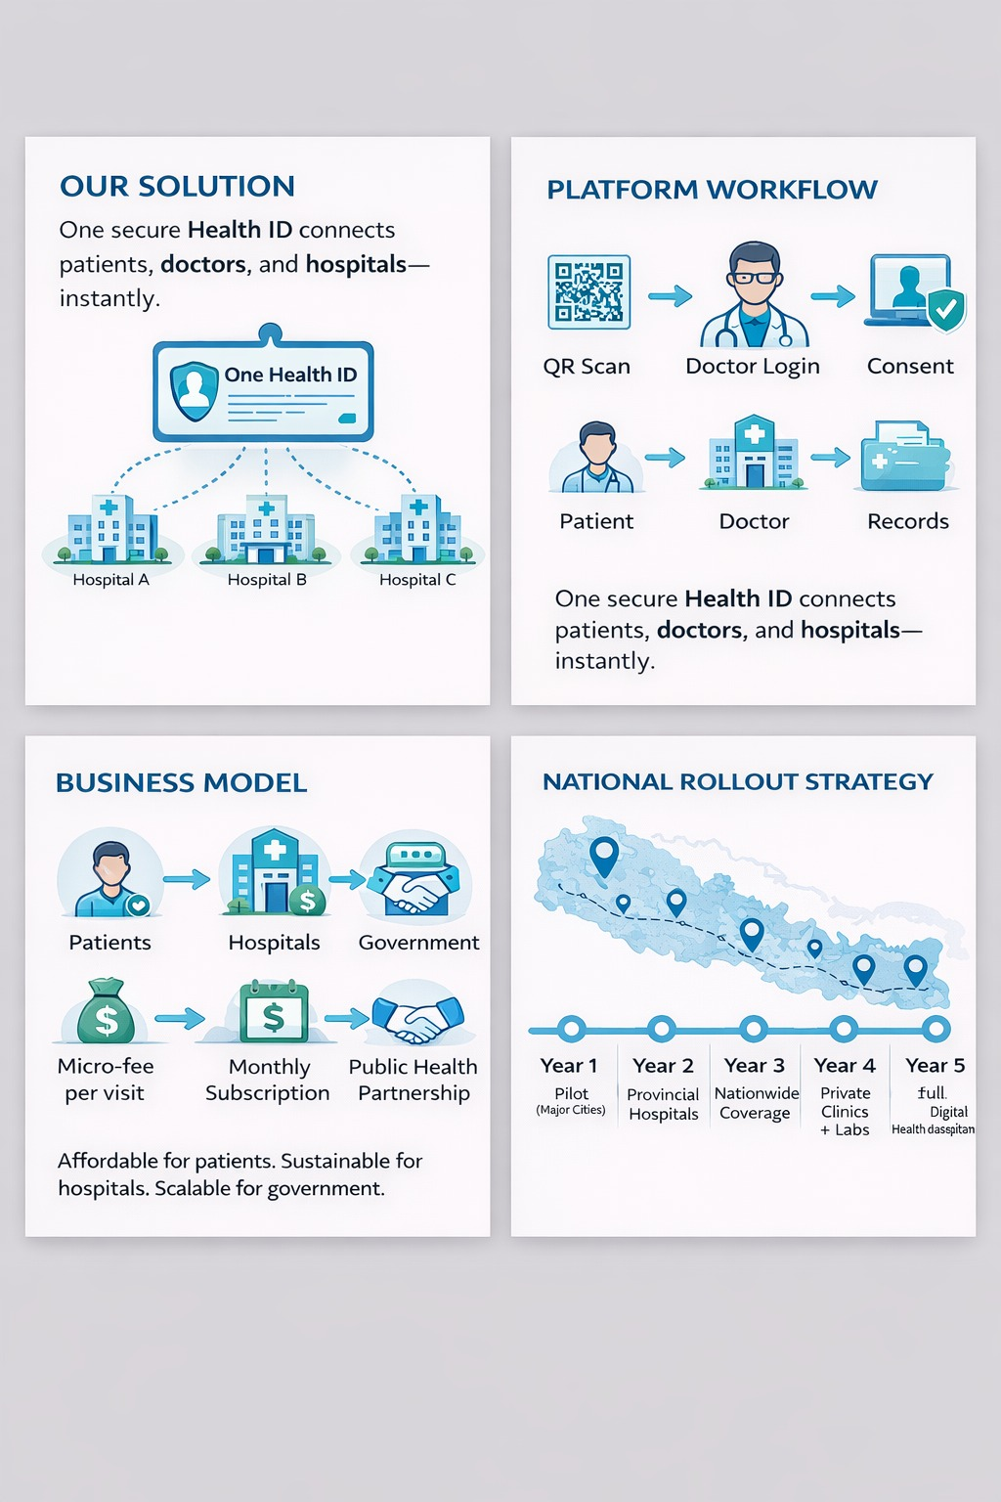
OUR SOLUTION
Unified lifetime health record: from birth to golden years
Global UUID: every patient, hospital, doctor uniquely identified
Consent-first architecture: patient controls who sees what
Break‑glass emergency override: seconds matter, audit trails protect
Break‑glass emergency override: seconds matter, audit trails protect
"Centralized. Intelligent. Connected Healthcare.”
✨ Our Platform
🌐 One platform. One lifetime record. Everywhere.
📶 User device first design & encrypted cloud storage.
🚨 Emergency-ready architecture with instant override protocols

Slide 18
OUR SOLUTION
Unified lifetime health record: from birth to golden years
Global UUID: every patient, hospital, doctor uniquely identified
Consent-first architecture: patient controls who sees what
Break‑glass emergency override: seconds matter, audit trails protect
Break‑glass emergency override: seconds matter, audit trails protect
✨ Our Platform
🌐 One platform. One lifetime record. Everywhere.
📶 User device first design & encrypted cloud storage.
🚨 Emergency-ready architecture with instant override protocols
"Centralized. Intelligent. Connected Healthcare.”

Slide 19
OUR SOLUTION
Unified lifetime health record: from birth to golden years
Global UUID: every patient, hospital, doctor uniquely identified
Consent-first architecture: patient controls who sees what
Break‑glass emergency override: seconds matter, audit trails protect
Break‑glass emergency override: seconds matter, audit trails protect
✨ Our Platform
🌐 One platform. One lifetime record. Everywhere.
📶 User device first design & encrypted cloud storage.
🚨 Emergency-ready architecture with instant override protocols
"Centralized. Intelligent. Connected Healthcare.”

Slide 20
TRACTION & VALIDATION
Problem Validation
Solution Validation
Conducted a Google form survey
Survey responses indicate strong demand for:
✓ Centralized digital medical records
✓ Easy access to medical history across hospitals
✓ Majority have lost prescriptions or medical report at least once
✓ 90% + face difficulty accessing medical history when visiting new
hospital
✓ Overall satisfaction with current medical record keeping system
is low to very low
Informal discussions with peers and healthcare worker confirm:
✓ Repeated diagnostics are common due to missing
records
✓ Digital access would save time, money, and effort

Slide 21
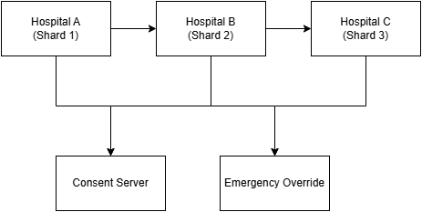


SOLUTION ARCHITECTURE
Core Components
Patient are global
• One UUID, One record
Doctors, Nurses, Labs are local
• Must belong to a verified hospital/organization
System Admin
• Approves every non-patient user (zero trust onboarding)
All Access Audited
• Who? What? When? Why? Immutable logs.
Security Foundation
End-to-end encryption
Role-based access control
Patient-controlled permissions

Slide 22
SOLUTION ARCHITECTURE
Core Components
Patient are global
• One UUID, One record
Doctors, Nurses, Labs are local
• Must belong to a verified hospital/organization
System Admin
• Approves every non-patient user (zero trust onboarding)
All Access Audited
• Who? What? When? Why? Immutable logs.
Security Foundation
End-to-end encryption
Role-based access control
Patient-controlled permissions

Slide 23
SOLUTION ARCHITECTURE
Core Components
Patient are global
• One UUID, One record
Doctors, Nurses, Labs are local
• Must belong to a verified hospital/organization
System Admin
• Approves every non-patient user (zero trust onboarding)
All Access Audited
• Who? What? When? Why? Immutable logs.
Security Foundation
End-to-end encryption
Role-based access control
Patient-controlled permissions

Slide 24
SOLUTION ARCHITECTURE
Core Components
Patient are global
• One UUID, One record
Doctors, Nurses, Labs are local
• Must belong to a verified hospital/organization
System Admin
• Approves every non-patient user (zero trust onboarding)
All Access Audited
• Who? What? When? Why? Immutable logs.
Security Foundation
End-to-end encryption
Role-based access control
Patient-controlled permissions

Slide 25
SOLUTION ARCHITECTURE
Core Components
Patient are global
• One UUID, One record
Doctors, Nurses, Labs are local
• Must belong to a verified hospital/organization
System Admin
• Approves every non-patient user (zero trust onboarding)
All Access Audited
• Who? What? When? Why? Immutable logs.
Security Foundation
End-to-end encryption
Role-based access control
Patient-controlled permissions

Slide 26
SOLUTION ARCHITECTURE
Core Components
Patient are global
• One UUID, One record
Doctors, Nurses, Labs are local
• Must belong to a verified hospital/organization
System Admin
• Approves every non-patient user (zero trust onboarding)
All Access Audited
• Who? What? When? Why? Immutable logs.
Security Foundation
End-to-end encryption
Role-based access control
Patient-controlled permissions

Slide 27
PLATFORM WORKFLOW
1
Patient Registration Once
Gets QR ready UUID
7
System Admin
See full audit trail
2
Doctor logs in
Searches patient by ID/QR
3
Consequent Requested
OTP sent to patient (mock SMS)
4
Patient shares OTP
Access granted to view records
5
Medical Record Update
Doctor uploads diagnosis & prescription; labs upload verified reports
6
Emergency?
Break-glass with justification by authorized users

Slide 28
PLATFORM WORKFLOW
1
Patient Registration Once
Gets QR ready UUID
7
System Admin
See full audit trail
2
Doctor logs in
Searches patient by ID/QR
3
Consequent Requested
OTP sent to patient (mock SMS)
4
Patient shares OTP
Access granted to view records
5
Medical Record Update
Doctor uploads diagnosis & prescription; labs upload verified reports
6
Emergency?
Break-glass with justification by authorized users

Slide 29
PLATFORM WORKFLOW
1
Patient Registration Once
Gets QR ready UUID
7
System Admin
See full audit trail
2
Doctor logs in
Searches patient by ID/QR
3
Consequent Requested
OTP sent to patient (mock SMS)
4
Patient shares OTP
Access granted to view records
5
Medical Record Update
Doctor uploads diagnosis & prescription; labs upload verified reports
6
Emergency?
Break-glass with justification by authorized users

Slide 30
PLATFORM WORKFLOW
1
Patient Registration Once
Gets QR ready UUID
7
System Admin
See full audit trail
2
Doctor logs in
Searches patient by ID/QR
3
Consequent Requested
OTP sent to patient (mock SMS)
4
Patient shares OTP
Access granted to view records
5
Medical Record Update
Doctor uploads diagnosis & prescription; labs upload verified reports
6
Emergency?
Break-glass with justification by authorized users

Slide 31
PLATFORM WORKFLOW
1
Patient Registration Once
Gets QR ready UUID
7
System Admin
See full audit trail
2
Doctor logs in
Searches patient by ID/QR
3
Consequent Requested
OTP sent to patient (mock SMS)
4
Patient shares OTP
Access granted to view records
5
Medical Record Update
Doctor uploads diagnosis & prescription; labs upload verified reports
6
Emergency?
Break-glass with justification by authorized users

Slide 32
PLATFORM WORKFLOW
1
Patient Registration Once
Gets QR ready UUID
7
System Admin
See full audit trail
2
Doctor logs in
Searches patient by ID/QR
3
Consequent Requested
OTP sent to patient (mock SMS)
4
Patient shares OTP
Access granted to view records
5
Medical Record Update
Doctor uploads diagnosis & prescription; labs upload verified reports
6
Emergency?
Break-glass with justification by authorized users

Slide 33
PLATFORM WORKFLOW
1
Patient Registration Once
Gets QR ready UUID
7
System Admin
See full audit trail
2
Doctor logs in
Searches patient by ID/QR
3
Consequent Requested
OTP sent to patient (mock SMS)
4
Patient shares OTP
Access granted to view records
5
Medical Record Update
Doctor uploads diagnosis & prescription; labs upload verified reports
6
Emergency?
Break-glass with justification by authorized users

Slide 34
PLATFORM WORKFLOW
1
Patient Registration Once
Gets QR ready UUID
7
System Admin
See full audit trail
2
Doctor logs in
Searches patient by ID/QR
3
Consequent Requested
OTP sent to patient (mock SMS)
4
Patient shares OTP
Access granted to view records
5
Medical Record Update
Doctor uploads diagnosis & prescription; labs upload verified reports
6
Emergency?
Break-glass with justification by authorized users

Slide 35
SECURITY & CONSENT – BUILT FOR TRUST
Patient‑controlled consent
OTP‑based one‑time access
Time‑bound (limited time access)
Revocable anytime
Emergency override (break‑glass)
One‑click access with mandatory justification
Permanent audit record, no deletion ever
Defense in depth
JWT with role‑based access control (RBAC)
Column‑level encryption for PII (national ID, phone)
Bcrypt password hashing (production ready)
Full audit logging for all sensitive reads/writes
Projected Impact: 10% reduction in repeated tests = NPR 50M+ saved annually | Emergency delays reduced by 35%

Slide 36
SECURITY & CONSENT – BUILT FOR TRUST
Patient‑controlled consent
OTP‑based one‑time access
Time‑bound (limited time access)
Revocable anytime
Emergency override (break‑glass)
One‑click access with mandatory justification
Permanent audit record, no deletion ever
Defense in depth
JWT with role‑based access control (RBAC)
Column‑level encryption for PII (national ID, phone)
Bcrypt password hashing (production ready)
Full audit logging for all sensitive reads/writes
Projected Impact: 10% reduction in repeated tests = NPR 50M+ saved annually | Emergency delays reduced by 35%

Slide 37
SECURITY & CONSENT – BUILT FOR TRUST
Patient‑controlled consent
OTP‑based one‑time access
Time‑bound (limited time access)
Revocable anytime
Emergency override (break‑glass)
One‑click access with mandatory justification
Permanent audit record, no deletion ever
Defense in depth
JWT with role‑based access control (RBAC)
Column‑level encryption for PII (national ID, phone)
Bcrypt password hashing (production ready)
Full audit logging for all sensitive reads/writes
Projected Impact: 10% reduction in repeated tests = NPR 50M+ saved annually | Emergency delays reduced by 35%

Slide 38
SECURITY & CONSENT – BUILT FOR TRUST
Patient‑controlled consent
OTP‑based one‑time access
Time‑bound (limited time access)
Revocable anytime
Emergency override (break‑glass)
One‑click access with mandatory justification
Permanent audit record, no deletion ever
Defense in depth
JWT with role‑based access control (RBAC)
Column‑level encryption for PII (national ID, phone)
Bcrypt password hashing (production ready)
Full audit logging for all sensitive reads/writes
Projected Impact: 10% reduction in repeated tests = NPR 50M+ saved annually | Emergency delays reduced by 35%

Slide 39
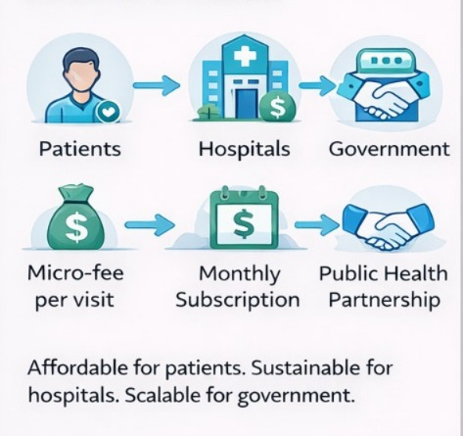
Scalability
Phase 1 – Hackathon
Single MySQL instance, modular monolith
All features working, end‑to‑end
Phase 2 – Regional Pilot
Shard by patient_id (UUID range)
Read replicas for analytics
Hospital‑level isolation via hospital_id
Phase 3 – National Scale
Regional sharding + global master patient index
Async consent propagation
Separate analytics warehouse for ML training
We designed for scale from day zero.

Slide 40
Scalability
Phase 1 – Hackathon
Single MySQL instance, modular monolith
All features working, end‑to‑end
Phase 2 – Regional Pilot
Shard by patient_id (UUID range)
Read replicas for analytics
Hospital‑level isolation via hospital_id
Phase 3 – National Scale
Regional sharding + global master patient index
Async consent propagation
Separate analytics warehouse for ML training
We designed for scale from day zero.

Slide 41
Scalability
Phase 1 – Hackathon
Single MySQL instance, modular monolith
All features working, end‑to‑end
Phase 2 – Regional Pilot
Shard by patient_id (UUID range)
Read replicas for analytics
Hospital‑level isolation via hospital_id
Phase 3 – National Scale
Regional sharding + global master patient index
Async consent propagation
Separate analytics warehouse for ML training
We designed for scale from day zero.

Slide 42
Scalability
Phase 1 – Hackathon
Single MySQL instance, modular monolith
All features working, end‑to‑end
Phase 2 – Regional Pilot
Shard by patient_id (UUID range)
Read replicas for analytics
Hospital‑level isolation via hospital_id
Phase 3 – National Scale
Regional sharding + global master patient index
Async consent propagation
Separate analytics warehouse for ML training
We designed for scale from day zero.

Slide 43
Scalability
Phase 1 – Hackathon
Single MySQL instance, modular monolith
All features working, end‑to‑end
Phase 2 – Regional Pilot
Shard by patient_id (UUID range)
Read replicas for analytics
Hospital‑level isolation via hospital_id
Phase 3 – National Scale
Regional sharding + global master patient index
Async consent propagation
Separate analytics warehouse for ML training
We designed for scale from day zero.

Slide 44
THE GOLD MINE: DATA FOR AI & HUMANITY
From fragmented visits to longitudinal story
20 years of BP, sugar, cholesterol, medications
Lifestyle patterns, hereditary markers, environmental factors
AI/ML opportunities
Diabetes risk predictor: trained on real PIMA dataset
Heart disease classifier: Cleveland dataset
Outbreak detection: anomaly detection on visit counts
Future potential
Early warning for slow‑onset diseases (Parkinson’s, Alzheimer’s, CKD)
Personalised treatment recommendations
National epidemic forecasting
Every patient’s lifetime health journey → the richest dataset on earth.

Slide 45
THE GOLD MINE: DATA FOR AI & HUMANITY
From fragmented visits to longitudinal story
20 years of BP, sugar, cholesterol, medications
Lifestyle patterns, hereditary markers, environmental factors
AI/ML opportunities
Diabetes risk predictor: trained on real PIMA dataset
Heart disease classifier: Cleveland dataset
Outbreak detection: anomaly detection on visit counts
Future potential
Early warning for slow‑onset diseases (Parkinson’s, Alzheimer’s, CKD)
Personalised treatment recommendations
National epidemic forecasting
Every patient’s lifetime health journey → the richest dataset on earth.

Slide 46
THE GOLD MINE: DATA FOR AI & HUMANITY
From fragmented visits to longitudinal story
20 years of BP, sugar, cholesterol, medications
Lifestyle patterns, hereditary markers, environmental factors
AI/ML opportunities
Diabetes risk predictor: trained on real PIMA dataset
Heart disease classifier: Cleveland dataset
Outbreak detection: anomaly detection on visit counts
Future potential
Early warning for slow‑onset diseases (Parkinson’s, Alzheimer’s, CKD)
Personalised treatment recommendations
National epidemic forecasting
Every patient’s lifetime health journey → the richest dataset on earth.

Slide 47
THE GOLD MINE: DATA FOR AI & HUMANITY
From fragmented visits to longitudinal story
20 years of BP, sugar, cholesterol, medications
Lifestyle patterns, hereditary markers, environmental factors
AI/ML opportunities
Diabetes risk predictor: trained on real PIMA dataset
Heart disease classifier: Cleveland dataset
Outbreak detection: anomaly detection on visit counts
Future potential
Early warning for slow‑onset diseases (Parkinson’s, Alzheimer’s, CKD)
Personalised treatment recommendations
National epidemic forecasting
Every patient’s lifetime health journey → the richest dataset on earth.

Slide 48
THE GOLD MINE: DATA FOR AI & HUMANITY
From fragmented visits to longitudinal story
20 years of BP, sugar, cholesterol, medications
Lifestyle patterns, hereditary markers, environmental factors
AI/ML opportunities
Diabetes risk predictor: trained on real PIMA dataset
Heart disease classifier: Cleveland dataset
Outbreak detection: anomaly detection on visit counts
Future potential
Early warning for slow‑onset diseases (Parkinson’s, Alzheimer’s, CKD)
Personalised treatment recommendations
National epidemic forecasting
Every patient’s lifetime health journey → the richest dataset on earth.

Slide 49
SOCIAL IMPACT BEYOND TECHNOLOGY
Metric | Impact
Repeated diagnostics | ↓ 40% – saves NPR 50M+ annually
Emergency handoff time | ↓ 35% – from 15 min to under 1 min
Patient history availability | ↑ 95% – currently <30%
Rural coverage | Offline‑first, sync when online encrypted
SDG alignment | SDG 3 – Good Health & Well‑Being
Future potential
Empowers patients: they own their data, not hospitals.
Empowers doctors: complete history, better decisions.
Empowers the nation: data‑driven health policy.

Slide 50
SOCIAL IMPACT BEYOND TECHNOLOGY
Metric | Impact
Repeated diagnostics | ↓ 40% – saves NPR 50M+ annually
Emergency handoff time | ↓ 35% – from 15 min to under 1 min
Patient history availability | ↑ 95% – currently <30%
Rural coverage | Offline‑first, sync when online encrypted
SDG alignment | SDG 3 – Good Health & Well‑Being
Future potential
Empowers patients: they own their data, not hospitals.
Empowers doctors: complete history, better decisions.
Empowers the nation: data‑driven health policy.

Slide 51
SOCIAL IMPACT BEYOND TECHNOLOGY
Metric | Impact
Repeated diagnostics | ↓ 40% – saves NPR 50M+ annually
Emergency handoff time | ↓ 35% – from 15 min to under 1 min
Patient history availability | ↑ 95% – currently <30%
Rural coverage | Offline‑first, sync when online encrypted
SDG alignment | SDG 3 – Good Health & Well‑Being
Future potential
Empowers patients: they own their data, not hospitals.
Empowers doctors: complete history, better decisions.
Empowers the nation: data‑driven health policy.

Slide 52
SOCIAL IMPACT BEYOND TECHNOLOGY
Metric | Impact
Repeated diagnostics | ↓ 40% – saves NPR 50M+ annually
Emergency handoff time | ↓ 35% – from 15 min to under 1 min
Patient history availability | ↑ 95% – currently <30%
Rural coverage | Offline‑first, sync when online encrypted
SDG alignment | SDG 3 – Good Health & Well‑Being
Future potential
Empowers patients: they own their data, not hospitals.
Empowers doctors: complete history, better decisions.
Empowers the nation: data‑driven health policy.

Slide 53
SOCIAL IMPACT BEYOND TECHNOLOGY
Metric | Impact
Repeated diagnostics | ↓ 40% – saves NPR 50M+ annually
Emergency handoff time | ↓ 35% – from 15 min to under 1 min
Patient history availability | ↑ 95% – currently <30%
Rural coverage | Offline‑first, sync when online encrypted
SDG alignment | SDG 3 – Good Health & Well‑Being
Future potential
Empowers patients: they own their data, not hospitals.
Empowers doctors: complete history, better decisions.
Empowers the nation: data‑driven health policy.

Slide 54
BUSINESS MODEL & SUSTAINABILITY
Phase | Revenue Stream | Payer
1. Pilot | Implementation + training fee | Government / Insurance
2. Scale | Per‑hospital subscription | Private & public hospitals
3. Analytics | Anonymized insights dashboard | Ministry of Health, NGOs
4. AI‑aaS | Predictive API access | Research institutions
Freemium for patients: always free
Hospitals pay: value > cost (saves repeated tests)
Government pays: for national intelligence & outbreak control

Slide 55
BUSINESS MODEL & SUSTAINABILITY
Phase | Revenue Stream | Payer
1. Pilot | Implementation + training fee | Government / Insurance
2. Scale | Per‑hospital subscription | Private & public hospitals
3. Analytics | Anonymized insights dashboard | Ministry of Health, NGOs
4. AI‑aaS | Predictive API access | Research institutions
Freemium for patients: always free
Hospitals pay: value > cost (saves repeated tests)
Government pays: for national intelligence & outbreak control

Slide 56
BUSINESS MODEL & SUSTAINABILITY
Phase | Revenue Stream | Payer
1. Pilot | Implementation + training fee | Government / Insurance
2. Scale | Per‑hospital subscription | Private & public hospitals
3. Analytics | Anonymized insights dashboard | Ministry of Health, NGOs
4. AI‑aaS | Predictive API access | Research institutions
Future potential
Freemium for patients: always free
Hospitals pay: value > cost (saves repeated tests)
Government pays: for national intelligence & outbreak control

Slide 57
BUSINESS MODEL & SUSTAINABILITY
Phase | Revenue Stream | Payer
1. Pilot | Implementation + training fee | Government / Insurance
2. Scale | Per‑hospital subscription | Private & public hospitals
3. Analytics | Anonymized insights dashboard | Ministry of Health, NGOs
4. AI‑aaS | Predictive API access | Research institutions
Future potential
Freemium for patients: always free
Hospitals pay: value > cost (saves repeated tests)
Government pays: for national intelligence & outbreak control

Slide 58
BUSINESS MODEL & SUSTAINABILITY
Phase | Revenue Stream | Payer
1. Pilot | Implementation + training fee | Government / Insurance
2. Scale | Per‑hospital subscription | Private & public hospitals
3. Analytics | Anonymized insights dashboard | Ministry of Health, NGOs
4. AI‑aaS | Predictive API access | Research institutions
Future potential
Freemium for patients: always free
Hospitals pay: value > cost (saves repeated tests)
Government pays: for national intelligence & outbreak control

Slide 59
THANK YOU
Together, we can transform healthcare for every citizen.

