Slide 1


K. L. E. SOCIETY’S
K. L. E. INSTITUTE OF TECHNOLOGY
Gokul, Hubballi - 580 027
Department of Computer Science and Engineering
A Seminar presentation on
Rule-based Classification
Presented by:
Kushal Raga 2KE19CS048
Under the Guidance of
Prof. Pradeep S
Date:09/12/2022

Slide 2
Contents
Rule-based classification
Characteristics of Rule Based Classifiers
Rule Assessment
Algorithms to Generate Rules from Given Data
1R Algorithm
Sequential Covering Algorithm
Applications of Rule based classification
Case Study
Conclusion
References

Slide 3
Rule-based Classification
a well-known technique used in data mining
classifiers make use of a set of IF-THEN rules for classification
We can express a rule in the following form −
IF condition THEN conclusion
Let us consider a rule R1,
R1: IF age = youth AND student = yes
THEN buy_computer = yes

Slide 4
Rule-based Classification
The IF part of the rule is called rule antecedent or precondition.
The antecedent part the condition consist of one or more attribute tests and these tests are logically ANDed.
Syntax: IF condition1 AND condition2 THEN conclusion
The THEN part of the rule is called rule consequent.
The consequent part consists of class prediction.

Slide 5
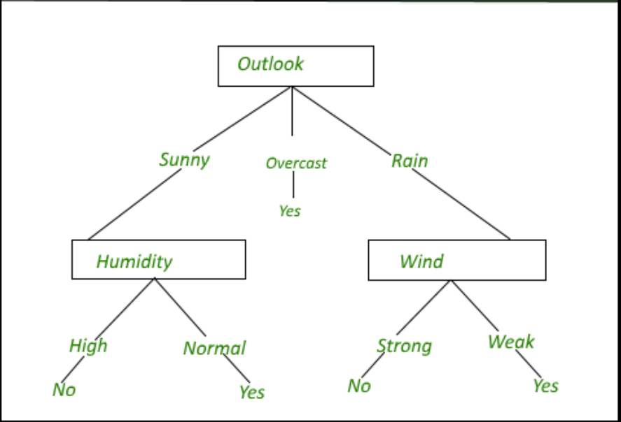

Slide 6
Characteristics of Rule Based Classifiers
1) Rules may not be mutually exclusive
Different rules are generated for data, so it is possible that many rules can cover the same record. A solution to make rules mutually exclusive is using ordered rule set.
2) Rules may not be exhaustive
It is possible that some of the data entries may not be covered by any of the rules. The solution to making rules exhaustive is using default classes.

Slide 7
Rule Assessment
Rule can be accessed based on two factors. Let’s define a few parameters first.
na = number of records covered by the rule(R).
nc = number of records correctly classified by rule(R).
n = Total number of records
Coverage of a rule: Percentage of records that satisfy the rule’s antecedent
Coverage (R) = na / |n|
Accuracy of a rule: Percentage of records that satisfy the antecedent and consequent value
Accuracy (R) = nc / na

Slide 8
Algorithms to Generate Rules from Given Data
1) OneR Algorithm (1R)
1R is based on a simple classification rule, where rules are created to test each attribute/feature. A problem with 1R algorithm is that overfitting is likely to occur.
2) Sequential Covering Algorithm
In this kind of algorithm, rules are learned sequentially, one at a time.

Slide 9
1R Algorithm
Pseudocode of 1R Algorithm
For each attribute/feature -
For each categorical value of that attribute, make a rule as follows;
Count how often each value of class appears to
Find the most frequent class
Calculate the error rate of the rules of each attribute
Choose the attribute with the lowest error rate

Slide 10
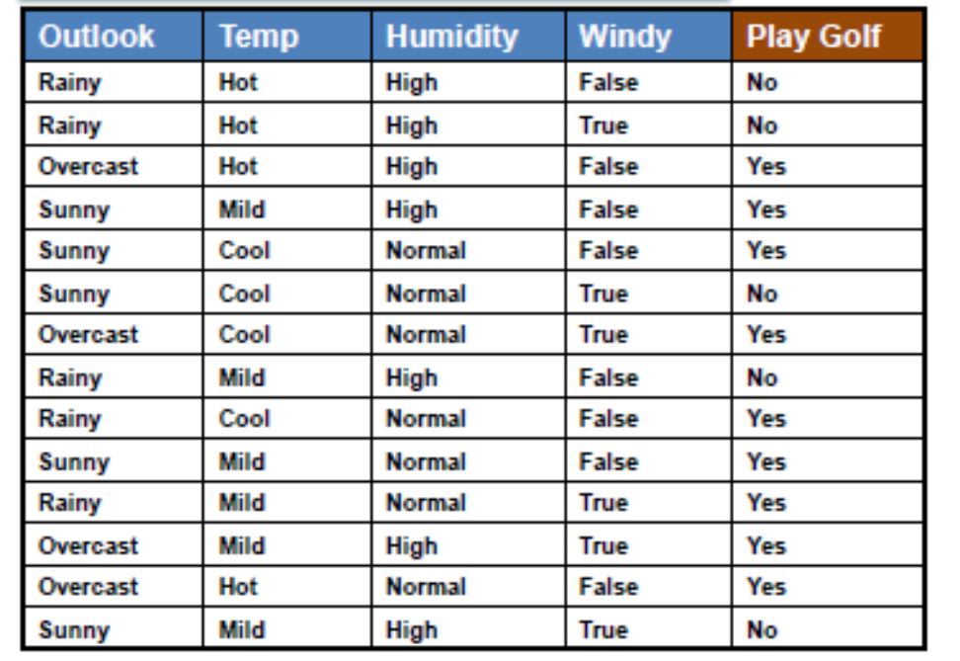

Slide 11
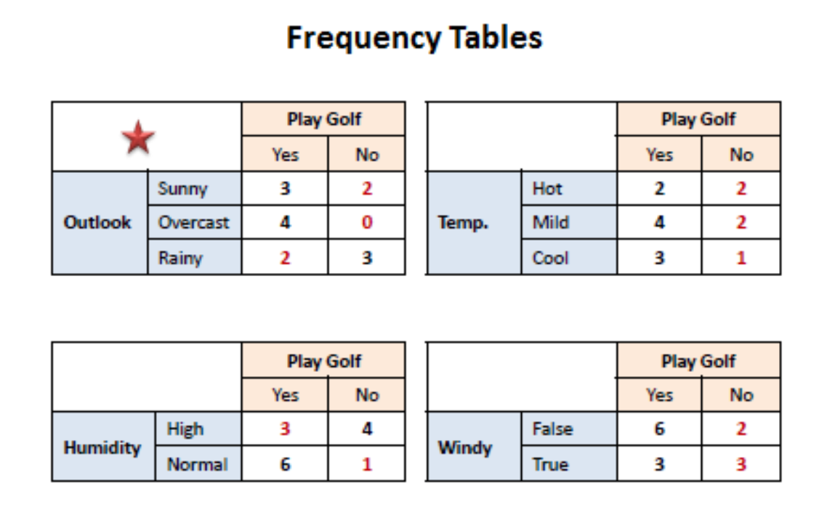

Slide 12
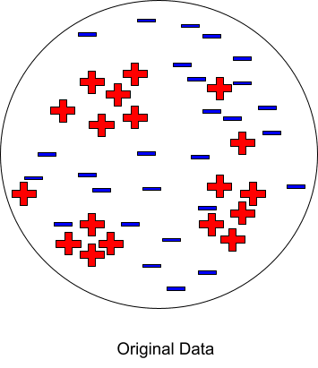
Sequential Covering Algorithm
It consists of 5 steps.
The idea is to learn one rule, remove the data it covers, then repeat.
CN2, RIPPER

Slide 13
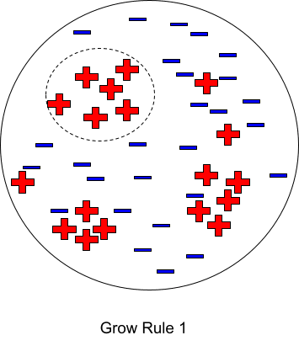
Step 1: Rule Growing
Start from an empty rule. Grow a rule using the 1R algorithm such that the rule covers the majority of records of the class.

Slide 14
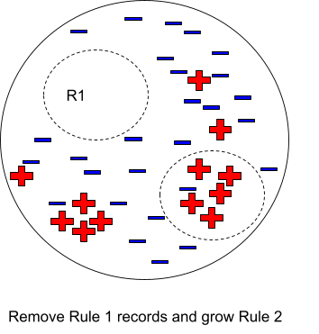
Step 2: Instance Elimination
Remove the records covered by the previous rule. This step ensures that the following rule will differ from the previous one. It improves the accuracy of the rule as well.

Slide 15
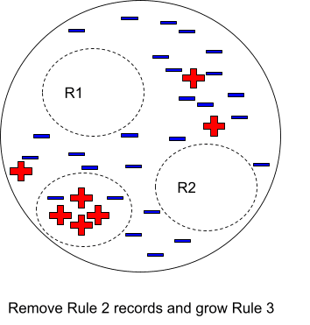
Step 3: Rule Evaluation
Evaluate each rule’s accuracy. Repeat the above two steps until a stopping criterion is met.

Slide 16
Sequential Covering Algorithm
Step 4: Stopping Criteria
If the accuracy of the rule is not up to mark, then discard that rule.
Step 5: Rule Pruning
Calculate the error rate at every step similar to the 1R algorithm.

Slide 17
Applications of Rule Based Classification
Machine Learning
Databases
Medical fields
Geographic Information System
Quality and reliability engineering
Autonomous driving
Artificial Intelligence

Slide 18

Medical Databases - A Case
Reference: Datta, R.P. and Saha, S. (2016) ‘Applying rule-based classification techniques to medical databases: an empirical study’, Int. J. Business Intelligence and Systems Engineering, Vol. 1, No. 1, pp.32–48.

Slide 19
Objectives
The objective of this study is:
1) How does one choose the algorithm that is best suited to the particular dataset under consideration?
2) How does one compare the effectiveness of a particular algorithm with that of another?
five rule-based classification techniques

Slide 20
Methodology
Medical datasets source: UCI Machine Learning Repository in attribute relation file format.
Steps:
Break the data into ten sets of size n/10.
Train on nine datasets and test on the remaining one dataset.
Repeat ten times and take a mean accuracy.
Parameters:
• search method = greedy stepwise
• seed value = 1 (seed is used for randomising the data)

Slide 21
Methodology
Methods studied in this paper:
NNGE
PART
RIDOR
Decision Tree (DT)
JRIP

Slide 22
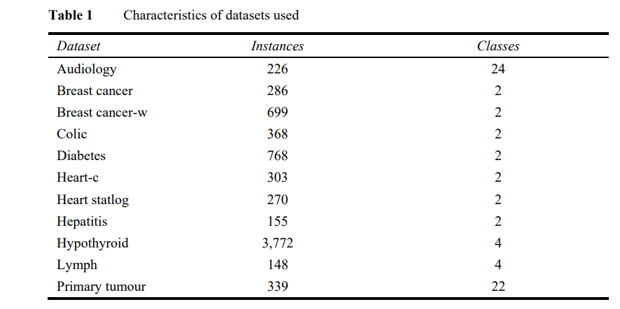

Slide 23
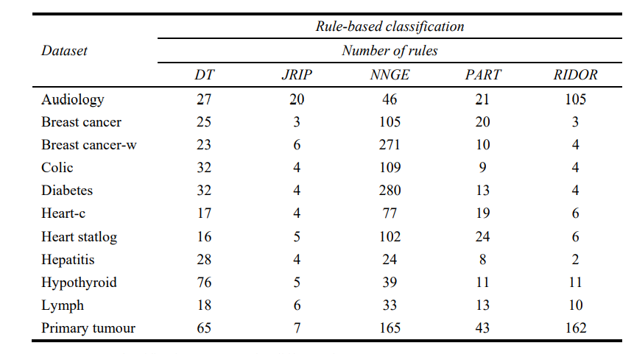

Slide 24
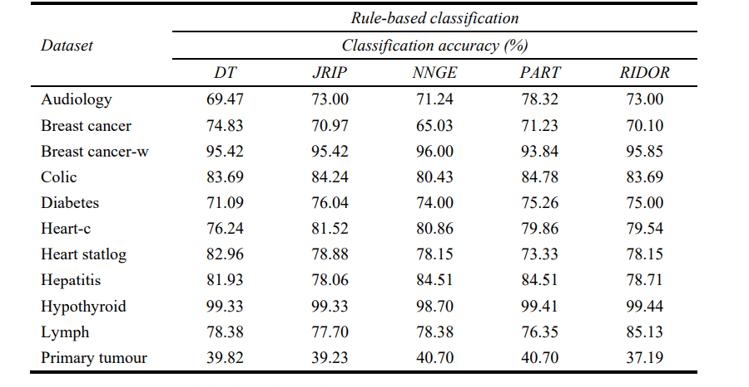

Slide 25
Observations
The PART algorithm seems to be outperforming the other algorithms in classification accuracy. The PART algorithm and the RIDOR algorithm are comparable in the Hypothyroid dataset.
The NNGE and DT algorithms seem to be outperforming the other algorithms in classification accuracy in the Breast cancer-w and Primary tumour dataset.
The DT algorithm alone outperforms the other algorithms in the Breast cancer and Heart statlog dataset.
The JRIP algorithm works better in the Diabetes and Heart-c databases.
Summary of Medical Databases - A Case

Slide 26
Conclusion
Rule Based Data Mining Classifier is a spervised approach for data mining,machine learning.
This classifier is simple and more easily interpretable than regular data mining algorithms.
These are learning sets of rules which are implemented using the IF-THEN clause.
It works very well with both numerical as well as categorical data. It has great applications in machine learning as well as databases.
The case study showed how there can be implementation of rule based classification methods in medical databases.

Slide 27
References
[1] Datta, R.P. and Saha, S. (2016) ‘Applying rule-based classification techniques to medical databases: an empirical study’, Int. J. Business Intelligence and Systems Engineering, Vol. 1, No. 1, pp.32–48.
[2] J. Christopher, "The Science of Rule-based Classifiers," 2019 9th International Conference on Cloud Computing, Data Science & Engineering (Confluence), 2019, pp. 299-303, doi: 10.1109/CONFLUENCE.2019.8776954.
[3] Rule Based Systems for Classification in Machine Learning Context by Han Liu, 2015.
[4] M. M. Mazid, A. B. M. S. Ali and K. S. Tickle, "A Comparison Between Rule Based and Association Rule Mining Algorithms," 2009 Third International Conference on Network and System Security, 2009, pp. 452-455, doi: 10.1109/NSS.2009.81.
[5] Data Mining: Concepts and Techniques, 3rd Edition by Jiawei Han, Jian Pei, Micheline Kamber

